Slide 1


SEO Report of April 2026
keystonerealestateadvisory
Keystone Real Estate Advisory
Keystonerealestateadvisory.com

Slide 2
April Task
Technical + On Page Issue | Status
404 Page Issue | Ongoing
Fix Thin Page | Ongoing
Core Web Vitals Issue | Ongoing
Location Content | Ongoing
Image Optimisation | Ongoing
UI UX Pages | Ongoing
Soft 404 | Ongoing
Home Page New Design | Ongoing
Developer Content | Ongoing
Auto Create Duplicate Link | Done
Redirect Duplicate Link | Done
Canonical Issue Pagination Page | Done
Not Mobile Friendly | Ongoing
Keystonerealestateadvisory.com

Slide 3
Domain Overview
March 26
April 26
9
DA
22
PA
1
Spam Score
2810
Backlink
9
DA
23
PA
1
Spam Score
2880
Backlink
Keystonerealestateadvisory.com

Slide 4
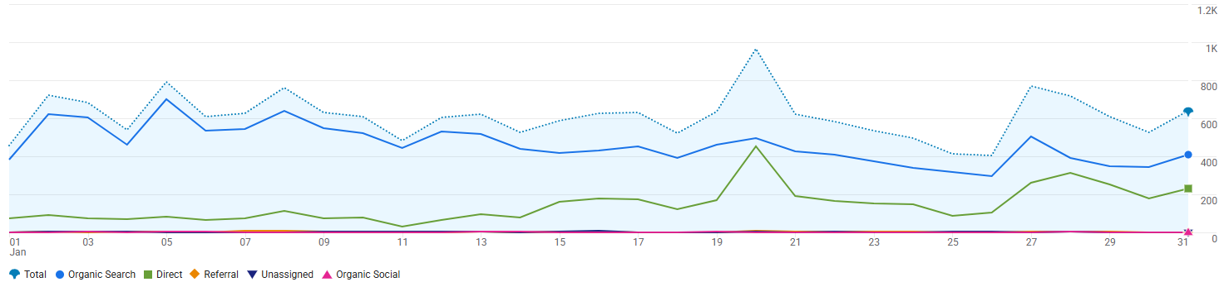
Overall Traffic
Total Traffic ( March )
18,995
Total Traffic ( April )
15,004
Keystonerealestateadvisory.com

Slide 5
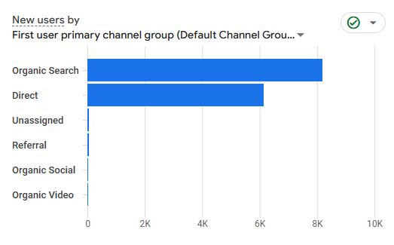
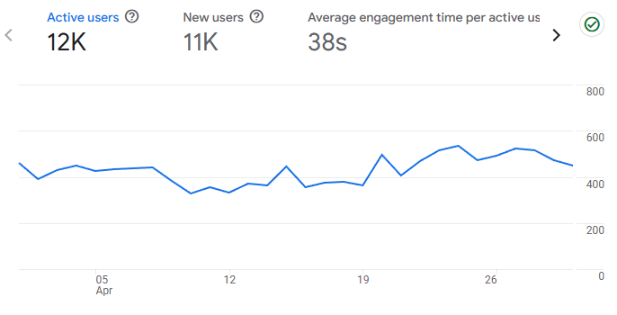
TRAFFIC OVERVIEW
Month | Organic | Referral | Social | Direct
Feb 26 | 12,613 | 95 | 64 | 7,348
March 26 | 12,154 | 143 | 49 | 6,507
April 26 | 11,616 | 119 | 44 | 3,230
AI
83
89
81
Organic Traffic Drop by 4.2%
Bounce Rate – 49.29
Keystonerealestateadvisory.com

Slide 6

Event
Month | Page View
Feb | 80,619
March | 75,712
April | 67,934
Month | Landing Page
Feb | 19,249
March | 18,995
April | 15,004
Keystonerealestateadvisory.com

Slide 7

Leads
Source | Total Leads | Total No of Booking | Total Site Visit
Keystone | 407 | 1 | 16
Microsite | 194 | 0 | 10
Total | 601 | 1 | 26
Devices | Lead %
Mobile | 60.38%
PC | 39.52 %
County | Lead%
India | 93.05%
Other | 6.95%
Keystonerealestateadvisory.com

Slide 8
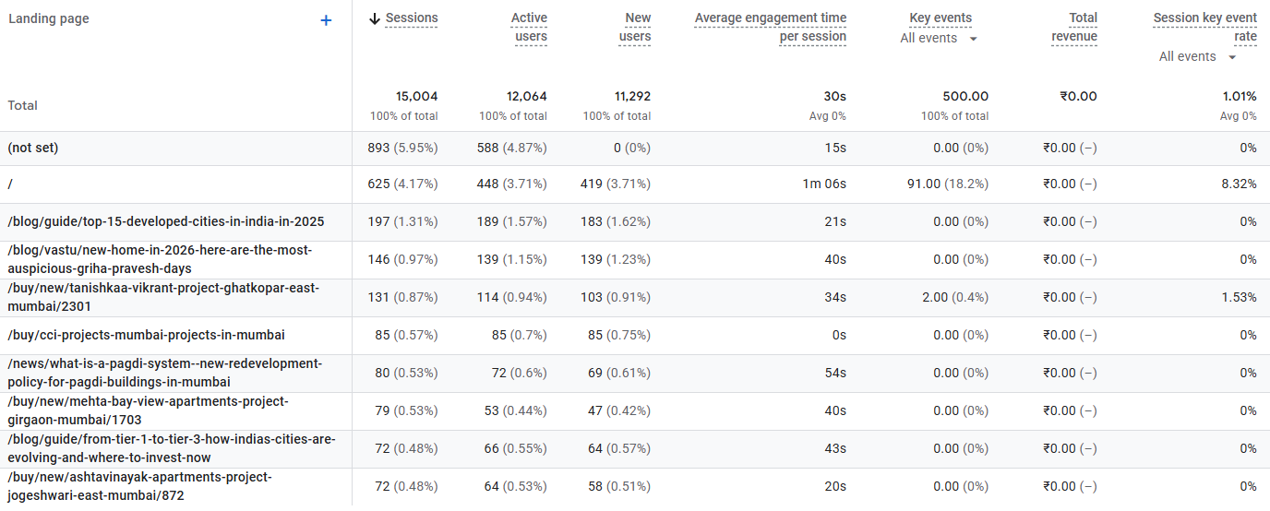
Landing Page
Keystonerealestateadvisory.com

Slide 9
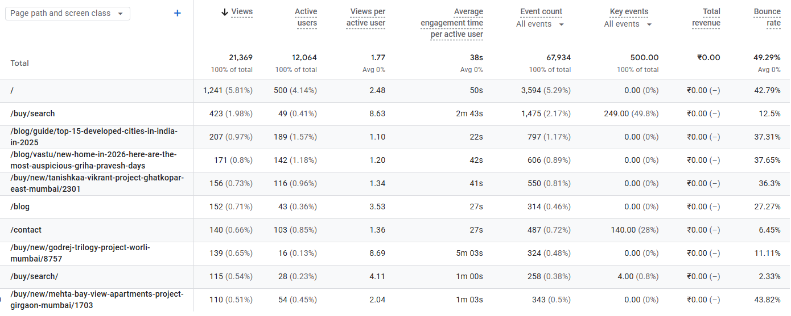
Page View
Keystonerealestateadvisory.com

Slide 10
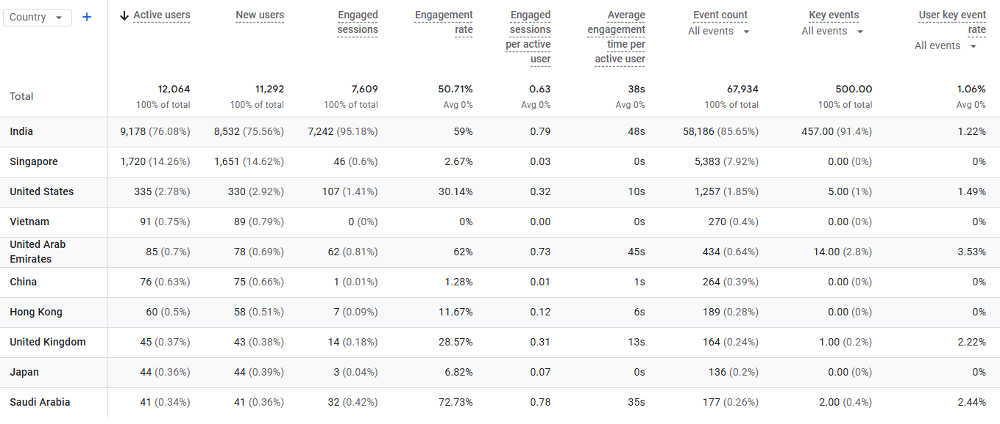
Demographic : Country
Keystonerealestateadvisory.com

Slide 11
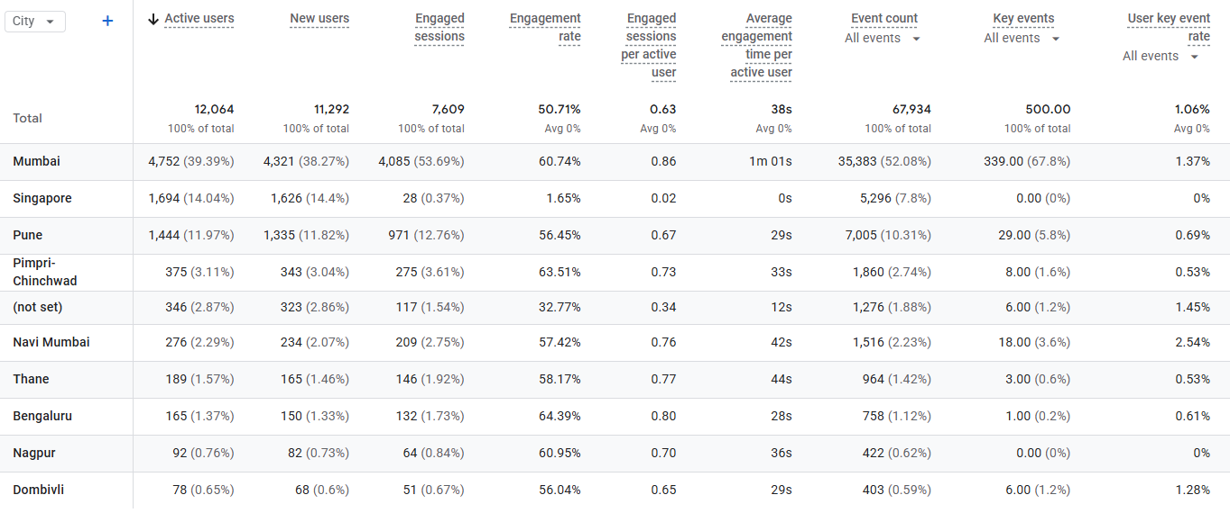
Demographic : City
Keystonerealestateadvisory.com

Slide 12
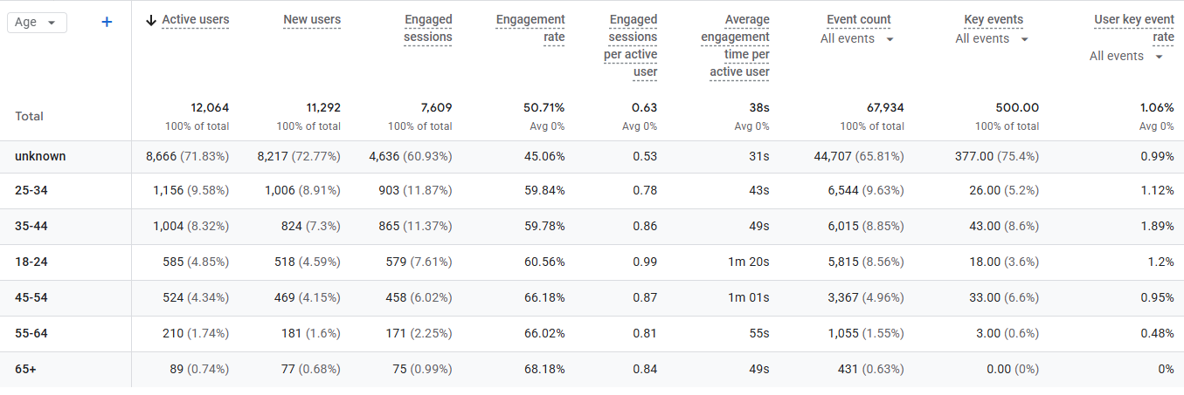
Demographic : Age
Keystonerealestateadvisory.com

Slide 13
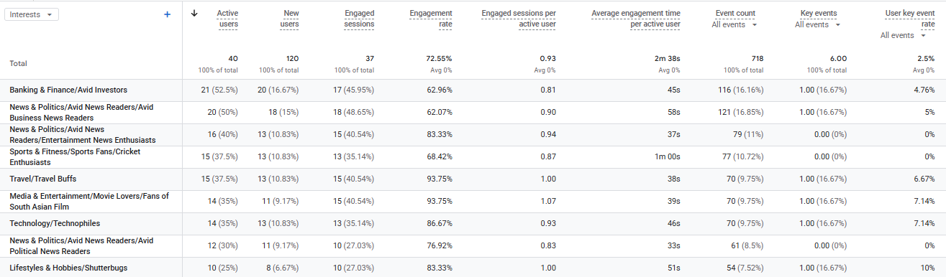
Demographic: Interests
Keystonerealestateadvisory.com

Slide 14
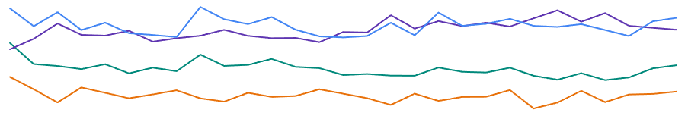
Performance Overview
Month | Total Click | Total Impression | Avg CTR | Avg Position
Feb | 9,693 | 840K | 1.1% | 9 (PG 1)
March | 10,285 | 882K | 1.2% | 8.9 (PG 1)
April | 10,280 | 879K | 1.2% | 8.9 (PG 1)
Click | Impression | CTR | Position
Keystonerealestateadvisory.com

Slide 15
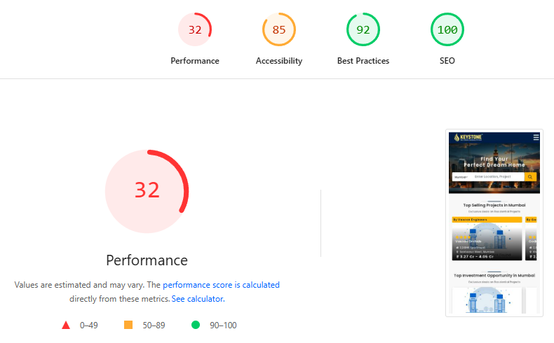
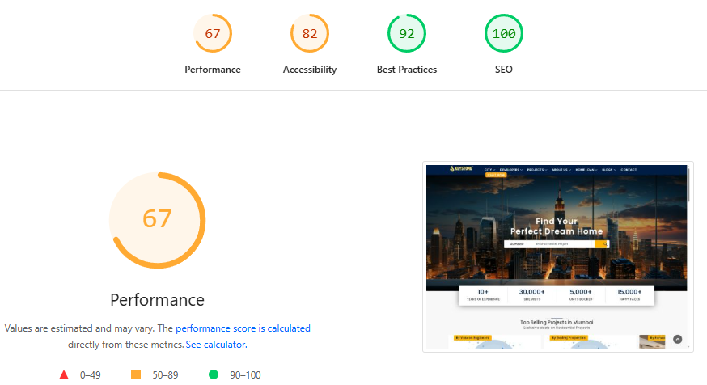
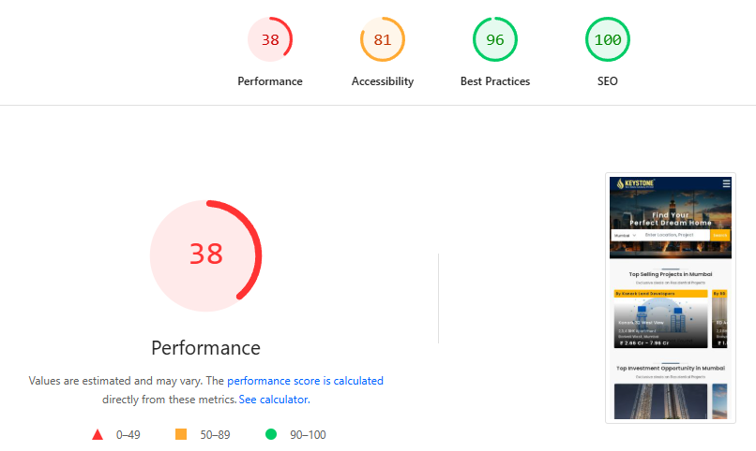
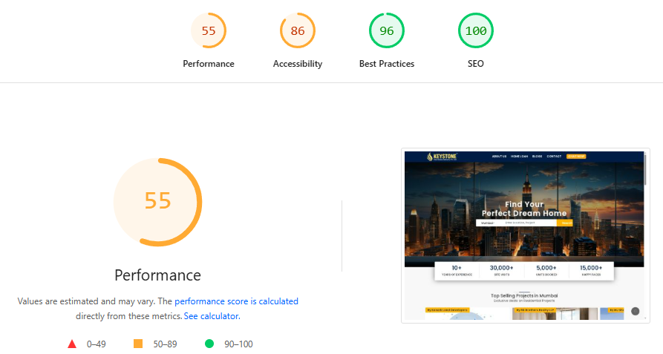
Page Speed Insight
Mobile
Desktop
March
April
Keystonerealestateadvisory.com

Slide 16
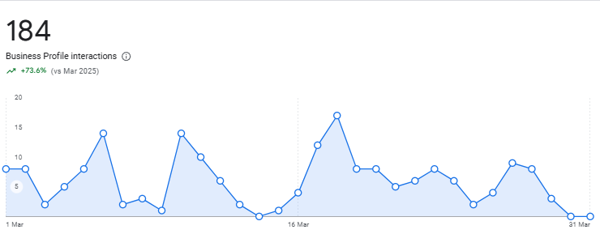
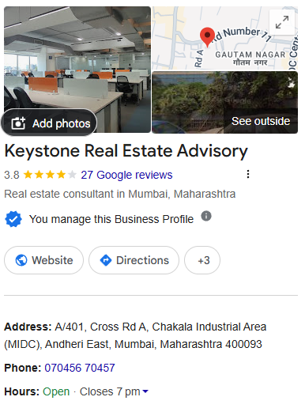
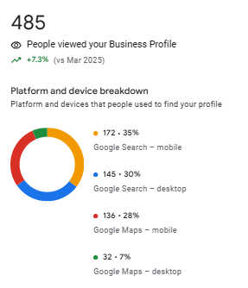
GMB Performance
Profile Interaction
Keystonerealestateadvisory.com

Slide 17
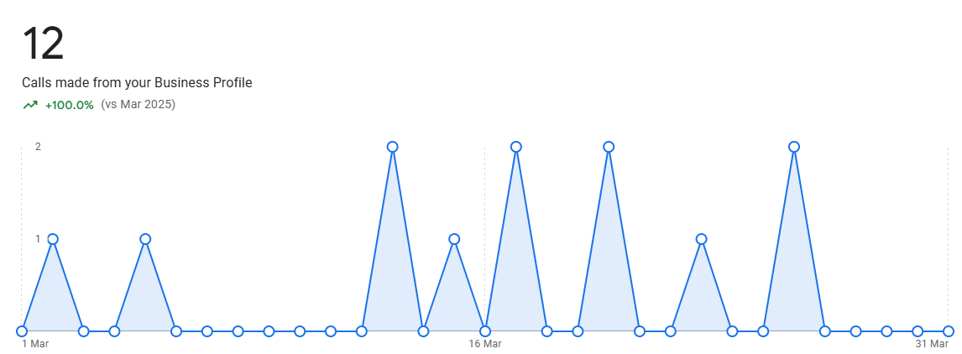
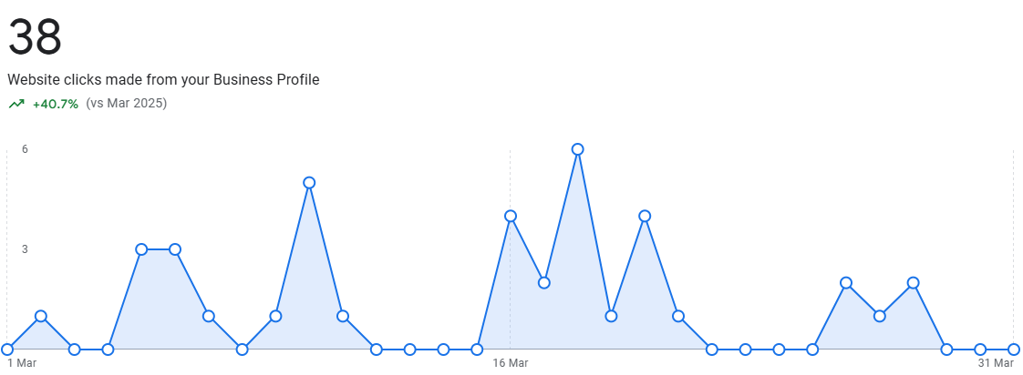
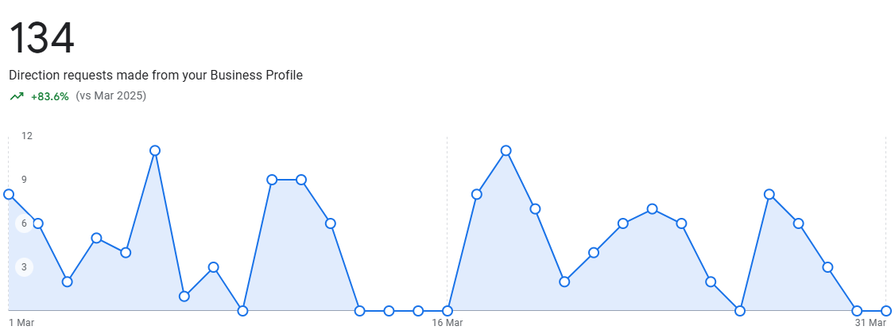
GMB Performance
Call
Website Traffic
Direction
Keystonerealestateadvisory.com

Slide 18


FF-Page SEO
Keystonerealestateadvisory.com

Slide 19

Social Bookmarking
No of Bookmarking | 50
NO | Link
1 | https://justpep.com/story/business/godrej-urban-park-in-powai-mumbai-price-floor-plan-brochure
 | https://www.diigo.com/user/homeconsulting62
2 | https://www.freewebmarks.com/story/godrej-urban-park-in-powai-mumbai-price-floor-plan-brochure
3 | https://www.socialbookmarkiseasy.info/preview-story/
4 | https://www.bookmarktheme.info/preview-listing/
5 | https://www.productbookmarks.com/preview-post/
6 | https://www.bookmarkbuzz.com/preview-bookmark/
7 | https://www.indusdirectory.com/preview-directory/
8 | https://www.usbookmarks.com/preview-story/
9 | https://www.nativebookmarks.com/preview-article/
10 | https://justpep.com/story/business/godrej-urban-park-in-powai-mumbai-price-floor-plan-brochure
Keystonerealestateadvisory.com

Slide 20

Business Listings
No of Listing | 70
NO | Link
1 | https://www.businessfinder.in/?post_type=listing&p=97351
2 | https://in.enrollbusiness.com/BusinessProfile/6471747/Keystone%20-%20Best%20Real%20Estate%20Property%20Dealers,%20Agents%20in%20India
3 | https://www.poweredindia.com/users/
4 | https://mumbai.locanto.me/ID_6625745626/Keystone-Best-Real-Estate-Property-Dealers-Agents-in-India.html&myads
5 | https://global.showmelocal.com/dashboard/blocked.aspx?bid=36801391
6 | https://keystonerealty.2fl.co/
7 | https://service.opendi.in/verify?sid=39549&key=6560797547d40
8 | https://www.cybo.com/IN-biz/keystone-real-estate-advisory_10
9 | https://www.indiacom.com/thankyou?from=addyourlist
10 | https://www.freelistingindia.in/listings/keystone-best-real-estate-property-dealers-agents-in-india

Slide 21

Business Directory
No of Directory | 110
NO | Link
1 | https://www.seooptimizationdirectory.com/submit.php?c=132
2 | https://www.familydir.com/submit.php?c=80
3 | https://target-directory.com/submit?c=80
4 | https://www.craigslistdir.org/submit.php?c=110
5 | https://www.freeseolink.org/submit.php?c=50
6 | https://www.gowwwlist.com/submit.php?c=540
7 | https://directory4.org/submit?c=80
8 | https://worldweb-directory.com/add.php?c=42
9 | https://www.blahoo.net/Business_Economy/
10 | https://www.ecobluedirectory.com/submit.php?c=80

Slide 22

Keyword Position
Keystonerealestateadvisory.com

Slide 23
Keyword Ranking

Slide 24
Keyword Ranking
Generic Keywords | Rank
most developed city in india | 3
fastest growing city in india 2025 | 6
most developed cities in india | 12
developed city in india | 12
developed cities in india | 10
most modern city in india | 4
best city to live in india 2025 | 19
most developed city of india | 4
best developed city in india | 3
most expensive neighborhoods in india | 5
flats in wagholi | 10
most expensive area in india | 8
most developing city in india | 6
flat for sale in goregaon west | 9
fastest growing cities in india 2025 | 3
fastest developing cities in india | 8
most developed cities of india | 7
most developed city in india 2025 | 3
dlf project in andheri west | 6
most developed area in india | 4
most developing cities in india | 6
most expensive residential area in india | 10
top cities in india 2025 | 6
best developed cities in india | 7
most developed city in north india | 4
most developed city in india | 4
fastest growing city in india 2025 | 6
most developed cities in india | 6
developed city in india | 4
Generic Keywords | Rank
navi mumbai flats for sale | 15
flats in thane for sale | 29
flats in south mumbai | 25
3 bhk flat for sale in mumbai | 33
flats for sale in kandivali east | 13
commercial property in mumbai | 16
4 bhk flat in mumbai | 80
flats for sale in andheri east | 14
apartments for sale in north bangalore | 13
3 bhk apartment in mumbai | 45
developed state in india 2025 | 7
india top 10 city name | 2
real estate developers in mumbai | 41
2 bhk flat in mumbai | 14
2 bhk flats in mumbai | 14
flats in malad west | 11
flats for sale in goregaon west | 8
2bhk flat price in mumbai | 16
flats for sale in wagholi | 6
developed state in india 2025 | 7
india top 10 city name | 2
real estate developers in mumbai | 41
2 bhk flat in mumbai | 14
2 bhk flats in mumbai | 14
flats in malad west | 11
flats for sale in goregaon west | 8
2bhk flat price in mumbai | 16
flats for sale in wagholi | 6
developed state in india 2025 | 7
Keystonerealestateadvisory.com

Slide 25
Keyword Ranking
Generic Keywords | Rank
flat for sale in wagholi pune | 7
flat for sale in wagholi | 6
developing cities in india | 7
2 bhk ready to move flats in goregaon west | 9
fastest developing city in india | 11
most developed place in india | 4
flats for sale in mahalaxmi mumbai | 9
develop city in india | 3
most growing city in india | 7
most developed city in india infrastructure | 3
developed cities of india | 5
india top 10 developed city | 4
most expensive areas in india | 8
buy 1bhk in mumbai | 14
developed city of india | 3
most developed city in india top 10 | 6
most developed places in india | 7
most modern city india | 3
best sea facing apartments in mumbai | 9
most developed cities in india ranking | 7
most expensive neighborhood in india | 6
most expensive residential areas in india | 10
most developed cities in india 2025 | 3
most expensive society in india | 3
most developed cities in maharashtra | 7
1bhk for sale mumbai | 10
flat for sale in wagholi pune | 7
flat for sale in wagholi | 6
developing cities in india | 7
Generic Keywords | Rank
flats for sale in powai mumbai | 13
best cities to live in india | 3
best cities in india | 32
india top 10 richest city | 2
best states in india | 3
dlf projects in mumbai | 10
most developed cities in uttar pradesh | 18
flats for sale in powai mumbai | 13
flats for sale in goregaon west | 27
3 bhk flats for sale in mumbai | 33
flat in navi mumbai for sale | 42
flat for sale in south mumbai | 34
2 bhk flat mumbai | 32
thane flat for sale | 36
flat for sale in north bangalore | 44
2 bhk flat in mumbai for sale | 31
flat for sale in worli | 33
flat in andheri east | 44
buy commercial property in bangalore | 35
new mumbai flats for sale | 40
3 bhk mumbai | 44
3 bhk apartments for sale in mumbai | 29
flat for sale in malad west | 31
1bhk flat for sale in mumbai | 30
flats in south mumbai for sale | 37
3bhk in mumbai | 46
1 bhk for sale in mumbai | 36
3bhk flat in mumbai | 45
godrej properties pimpri | 66
Keystonerealestateadvisory.com

Slide 26



Keystonerealestateadvisory.com

