Slide 1
📚 Book Recommendation .
By ,
Divyarani kalyane.

Slide 2
Objective
Generate the features from the dataset and use them to recommend the books accordingly to the users.
Goal: Build a system that recommends books based on user preferences.

Slide 3
DATA
COLLECTION
EDA
MODEL BUILDING
DEPLOYMENT

Slide 4
Dataset Overview
• Dataset contains information about books and user interactions.
• Features include:
- User ID
- Book Title
- Ratings
• Data cleaning and preprocessing applied.

Slide 5
Methodology
Steps followed:
1. Data preprocessing & cleaning.
2. Handling missing values.
3. Creating a utility matrix.
4. Applying similarity measures (Cosine similarity).
5. Generating top-N recommendations.

Slide 6
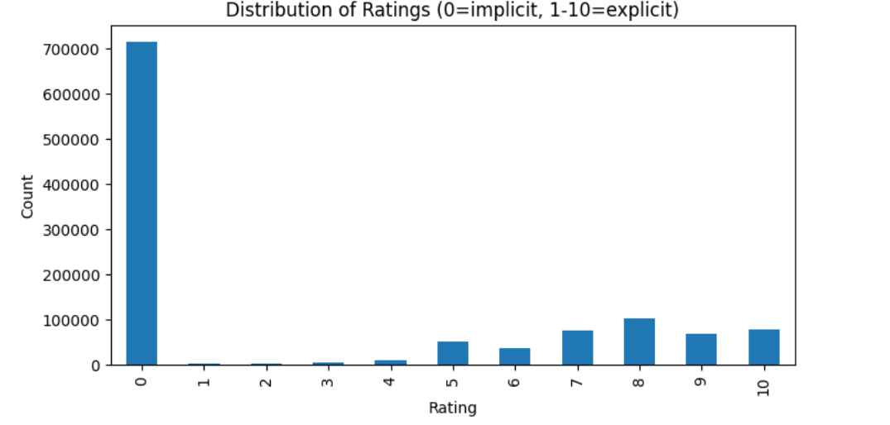
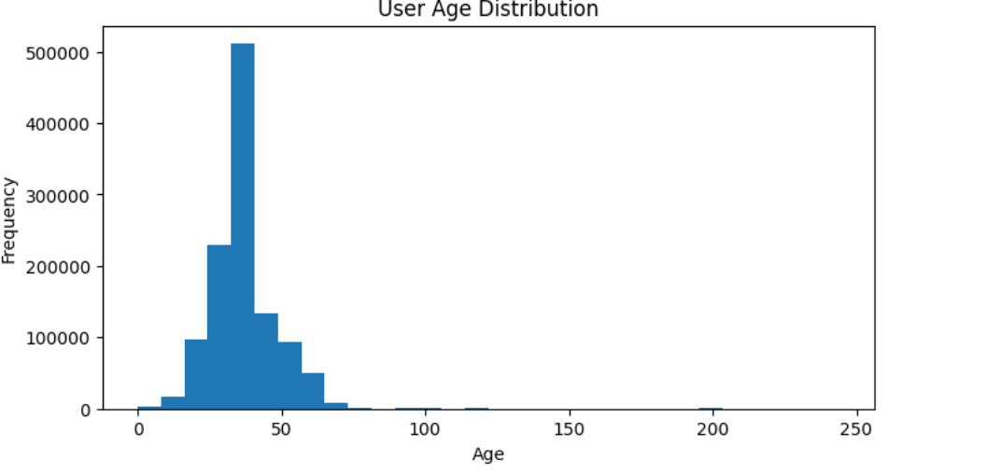
EDA

Slide 7
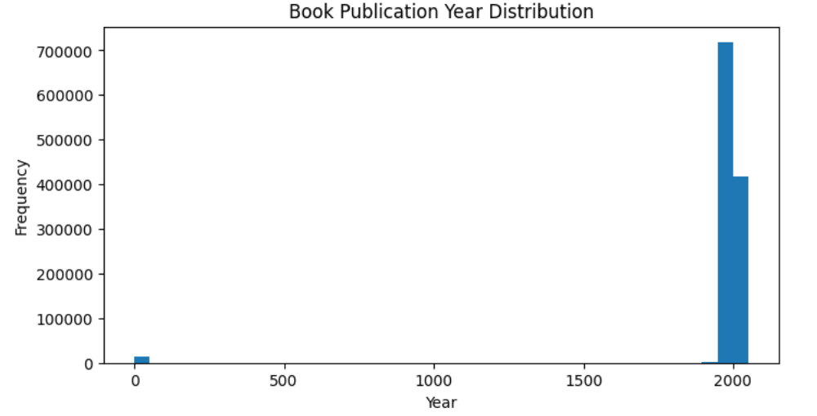
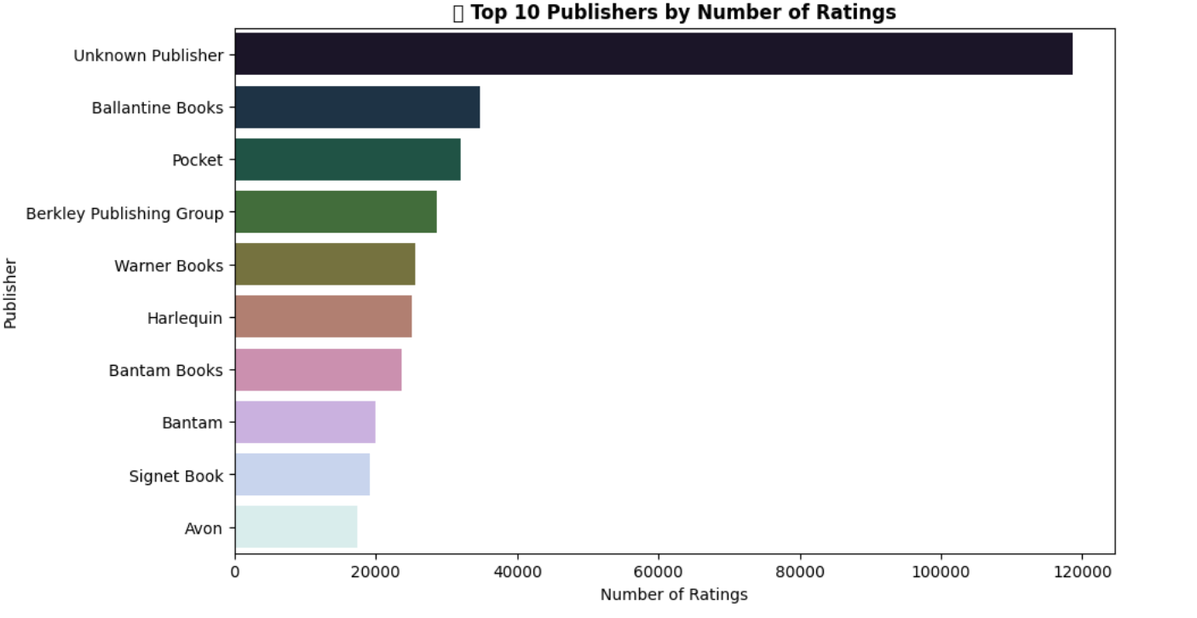

Slide 8
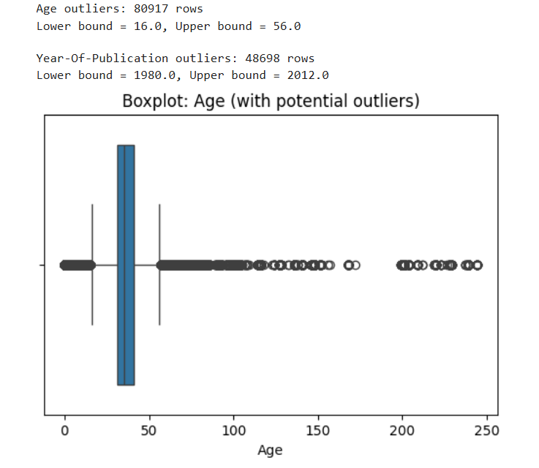
OUTLIERS DETECTION

Slide 9
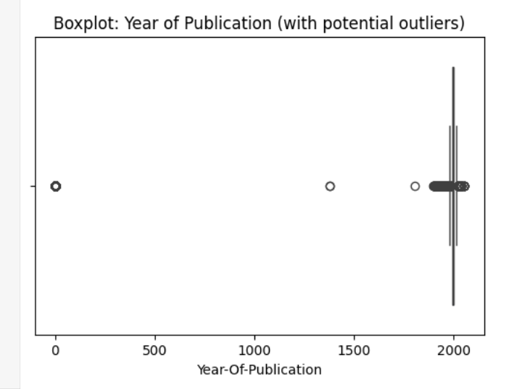

Slide 10
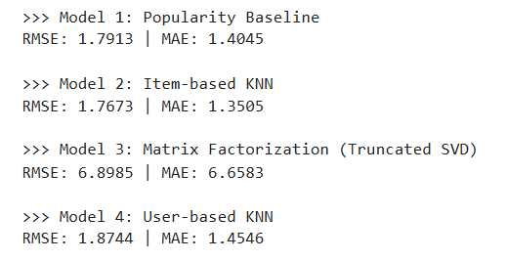
MODEL BUILDING

Slide 11
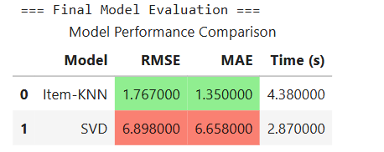
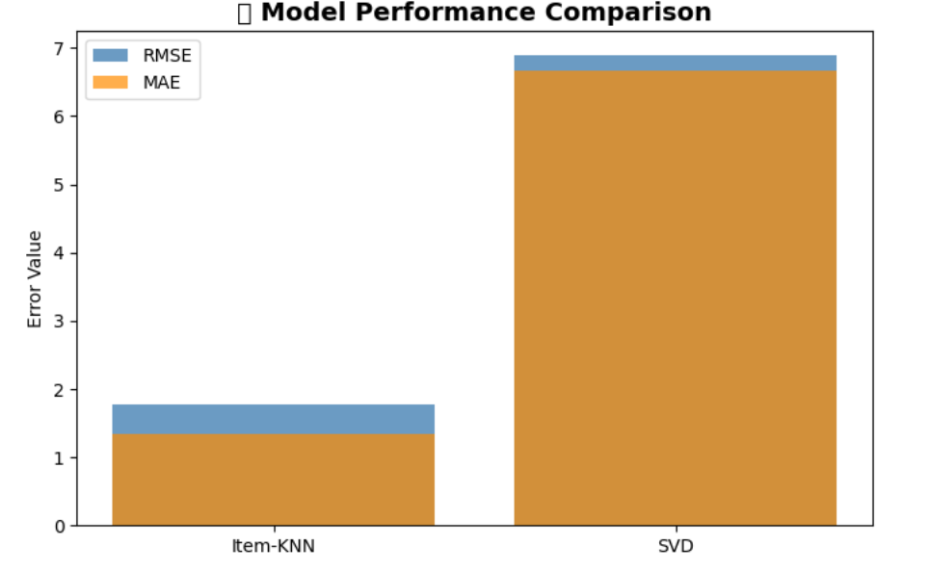
BEST MODEL

Slide 12
Model Implementation
• Techniques used:
- Collaborative Filtering
- Content-based Filtering
• Algorithms:
- Cosine Similarity
- Nearest Neighbors

Slide 13
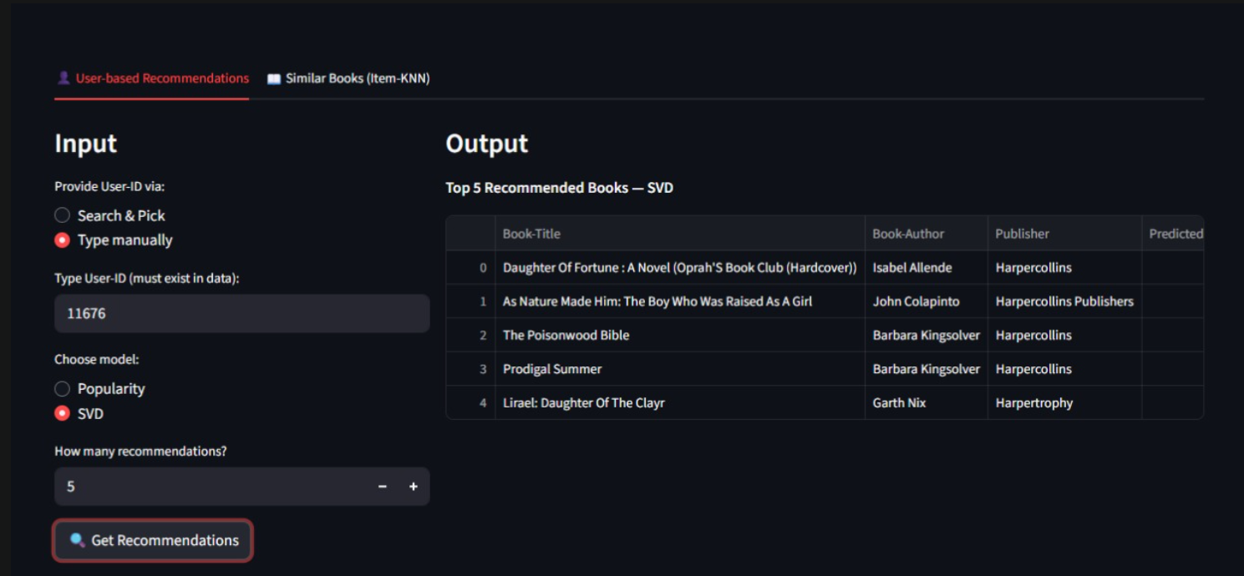
OUTPUT

Slide 14
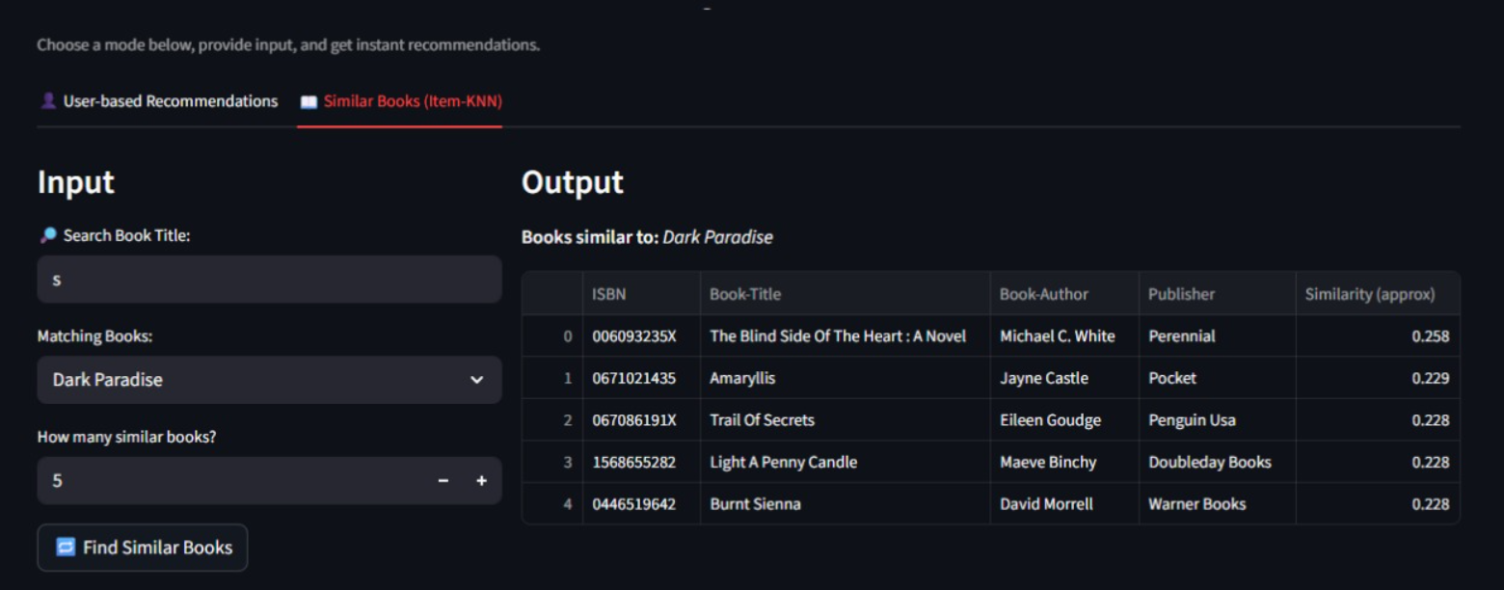

Slide 15
System Architecture
1. User inputs book name.
2. Model calculates similarity scores.
3. Top N similar books are recommended.
4. Display recommendations to user.

Slide 16
CHALLENGES FACED
Handling missing and inconsistent data
High sparsity in the user–book rating matrix
Computational complexity of similarity calculations
Cold start problem for new users and books
Difficulty in balancing accuracy vs. diversity of recommendations

Slide 17
IMPORTANCE OF THE PROJECT
Helps readers discover books that match their interests
Saves time by reducing the effort of searching through thousands of books
Enhances user satisfaction with personalized recommendations
Increases engagement for book platforms (users spend more time reading)
Provides a foundation for building smarter recommendation engines in other domains

Slide 18
Conclusion
Successfully built a functional book recommendation system
Generated personalized book suggestions based on user preferences
Improved the reading experience by making book discovery easier
Demonstrated the use of data preprocessing, similarity measures, and recommendation algorithms
Laid the groundwork for future improvements with advanced techniques

Slide 19
Thank You!

