Slide 1




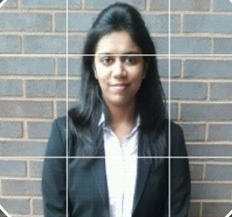
Predicting Facebook Check-ins
Nitasha Sharma Divya Rathore Shruti Tripathi Sanya Relan

Slide 2
Introduction
Our goal is to predict which place a person would likely check-in.
We have considered the artificial data consisting of more than 100,000 places located in a 10 km by 10 km square.
So,we considered just a portion of the 10X10 grid.
For a given set of coordinates, our goal is to find out the most likely checked in places.

Slide 3
Data
row_id: id of the check-in event
x y: coordinates
accuracy: location accuracy
time: timestamp
place_id: id of the business, this is the target we are predicting.

Slide 4
Data Normalization
The data consists of approximately 29 million observations where the location (x, y), accuracy, and timestamp is given along with the target variable ie. the checked in location.
We considered the six most visited places from all the places given in the dataset.
We normalize the data in order to scale the data in the same range.

Slide 5
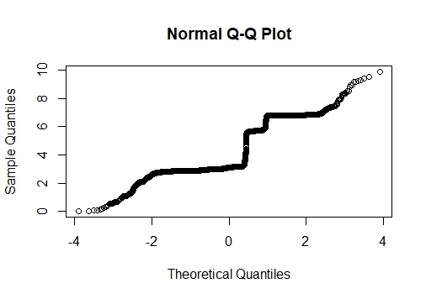
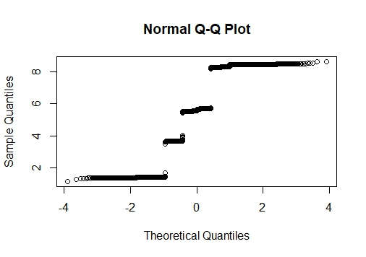
Data Without Normalization
x variable without y variable without
normalization normalization

Slide 6
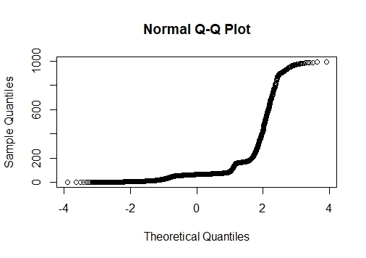
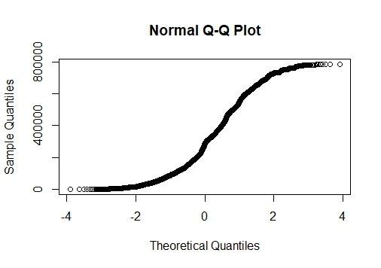
Accuracy without Time without
normalization Normalization

Slide 7
Exploratory Data Analysis
29 million rows
X&Y are bounded between the range from 0 to 10
Timestamp of check-in’s in minutes
Place Id are identifiers for approx 10,000 uniques places

Slide 8
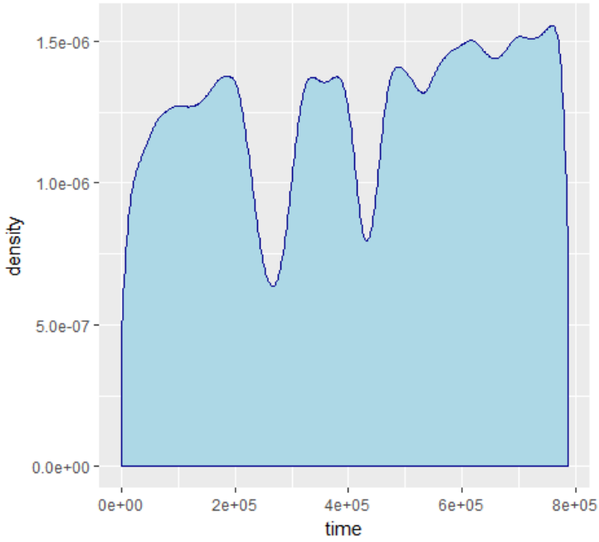
Time-Density plot
Interestingly time variable is evenly dispersed.
There are two big dips in the plot.

Slide 9
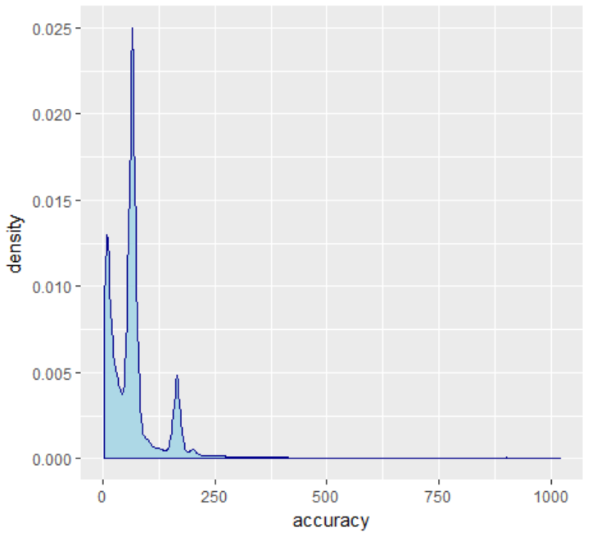
Accuracy Density Plot
Most check-ins have accuracy between the rage from 0 to 150.
We might infer that we have different accuracy at different locations.

Slide 10
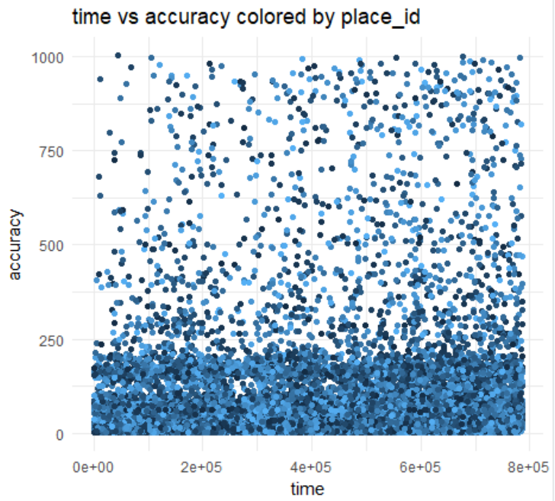
Time vs Accuracy
No visible relation between time and accuracy.
Distribution of accuracy is uniform throughout time range

Slide 11
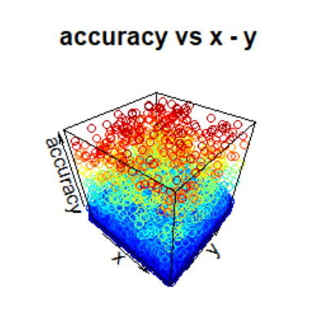
3D Plot
Accuracy is different for different places.
Most of the Place IDs have low accuracy, only a selected few have higher accuracies.

Slide 12
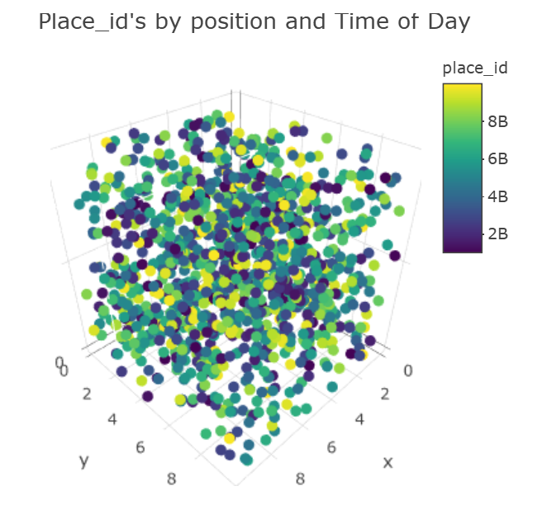
3D Plot
X-Y with Hour
The Check-ins appears to be evenly dispersed when we are considering a small chunk of time.

Slide 13
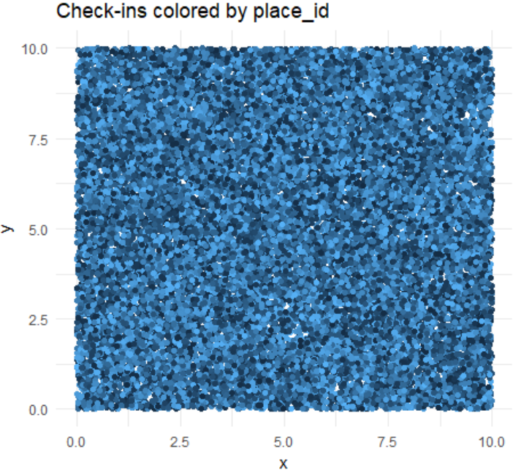
X-Y by PlaceID
PlaceId homogeneously distributed across coordinates.

Slide 14
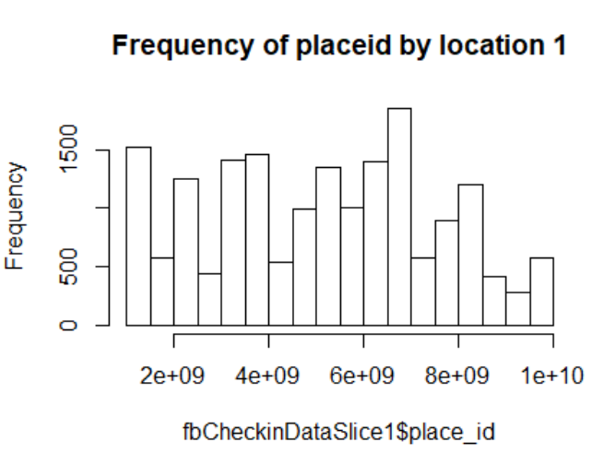
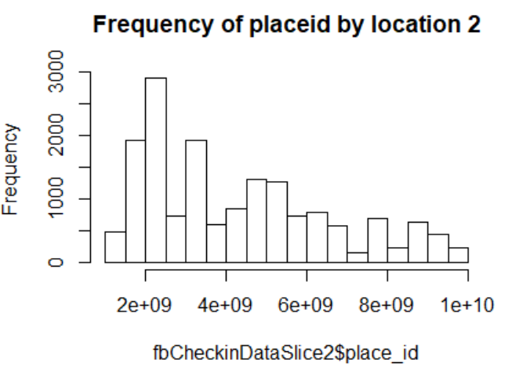
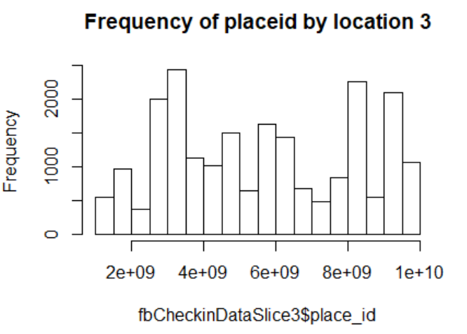
Histogram of Place IDs

Slide 15
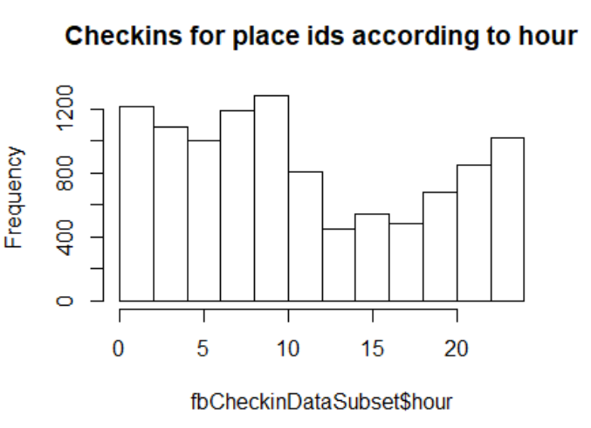
Check-Ins with Hour

Slide 16
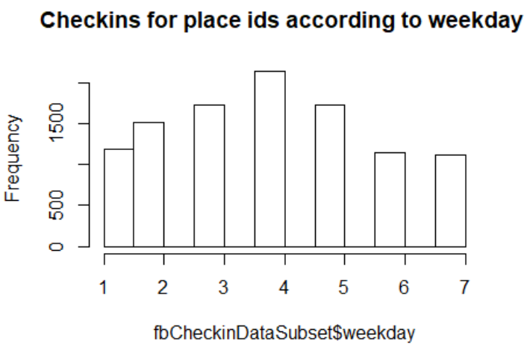
Check-Ins with Weekdays

Slide 17
Classification Models
k nearest Neighbor
Naive Bayes
Random Forest

Slide 18
k-Nearest Neighbor
K nearest neighbors is a simple algorithm that stores all available cases and classifies new cases based on a similarity measure (e.g., distance functions).
Error rate with this model taking k=40 is 2.7.

Slide 19
Naive Bayes
The probability of a place given its features can be expressed in the form
p(place | x, y, time, accuracy) ∝ p(x, y, time, accuracy | place)p(place)
We reason that the time, location and accuracy features are independent given the place.
We validate this assumption by observing data grouped by place ids
Error rate with this model: 1.2

Slide 20
Random Forest
Random forest is a supervised learning algorithm which builds multiple decision trees and merges them together to get a more accurate and stable prediction.]
Error rate with random forest : 0.14

Slide 21
Conclusion

Slide 22
Thank You!

