Slide 1
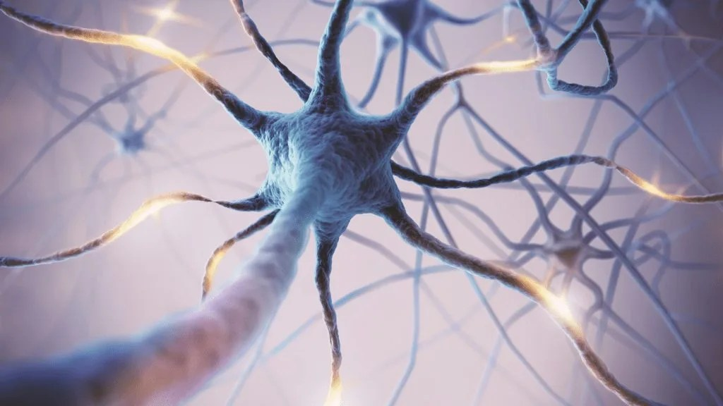
SIMPLE AUTOENCODER FOR MNIST - Unsupervised Deep Learning for Data Representation
PRESENTED BY,
DIVYA J
DEPARTMENT OF MCA
SJB INSTITUTE OF TECHNOLOGY

Slide 2
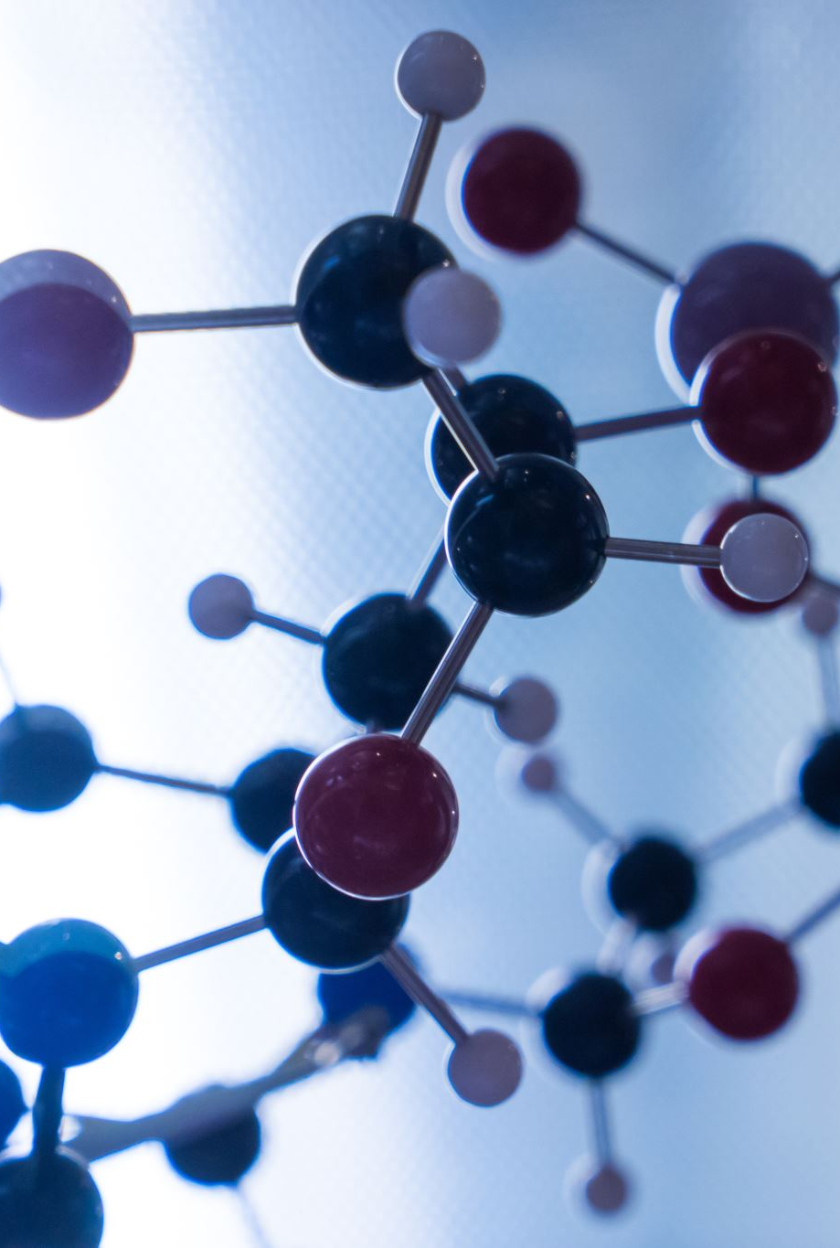
What is an Autoencoder?
An autoencoder is a type of artificial neural network that learns to represent data in a compressed form and then reconstructs it as closely as possible to the original input.
Autoencoders originated from early research in neural networks and unsupervised learning.
Inspired by principal component analysis (PCA) and Hopfield networks in the 1980s.
First introduced by Rumelhart, Hinton, and Williams (1986) in their work on backpropagation for feature learning.
Initially used for dimensionality reduction, later evolved into deep architectures for image processing, anomaly detection, and generative models.
Modern autoencoders are widely used in deep learning, denoising, and generative AI.

Slide 3
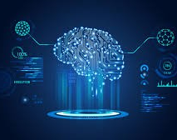
Why Use Autoencoders?
Dimensionality Reduction – Compresses data like PCA but captures complex patterns.
Denoising – Removes noise from images and signals (e.g., cleaning blurry images).
Anomaly Detection – Finds unusual patterns (e.g., fraud detection, medical diagnosis).
Feature Extraction – Learns key features for better image and text analysis.
Generative Models – Creates new data (used in AI art, deepfakes).

Slide 4
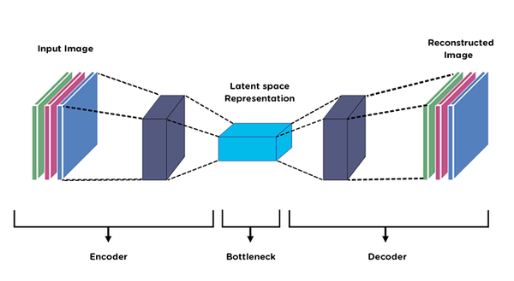
Architecture of Autoencoder in Deep Learning
The architecture of an autoencoder consists of three main components: the Encoder, the Bottleneck (Latent Space) and the Decoder. Let’s deep dive into each part to understand how they work together.

Slide 5
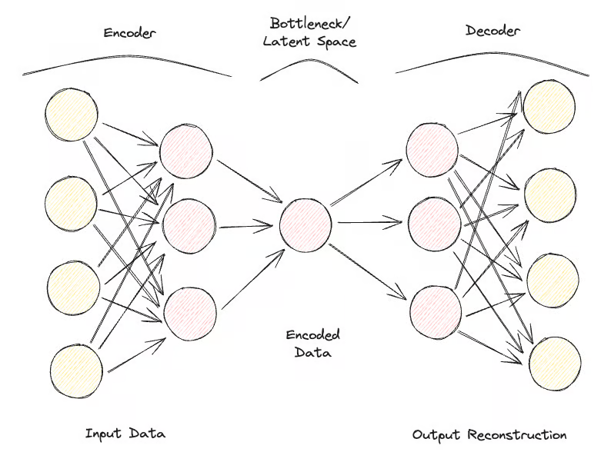
1. ENCODER
The encoder is the part of the network that takes the input data and compresses it into a smaller lower-dimensional representation.
Input Layer: This is where the original data enters the network e.g., an image or a set of features.
Hidden Layers: These layers apply transformations to the input data. The encoder’s goal is to extract essential features and reduce the data’s dimensionality.
Output of Encoder (Latent Space): The encoder outputs a compressed version of the data often called the latent representation or encoding. This is a condensed version of the input retaining only the important features.

Slide 6
2. Bottleneck (Latent Space)
The bottleneck is the smallest layer of the network where the data is represented in its most compressed form. It’s often referred to as the latent space or code.
This layer contains a reduced set of features representing the most important information from the input.
The idea is that through this compression the network learns the key patterns and structures of the input data.

Slide 7
3. Decoder
The decoder is responsible for taking the compressed representation from the latent space and reconstructing it back into the original data form.
Hidden Layers: The decoder uses a series of layers to gradually expand the compressed data back to the original input’s dimensions.
Output Layer: This layer produces the reconstructed data and aim to closely resemble the input data.

Slide 8
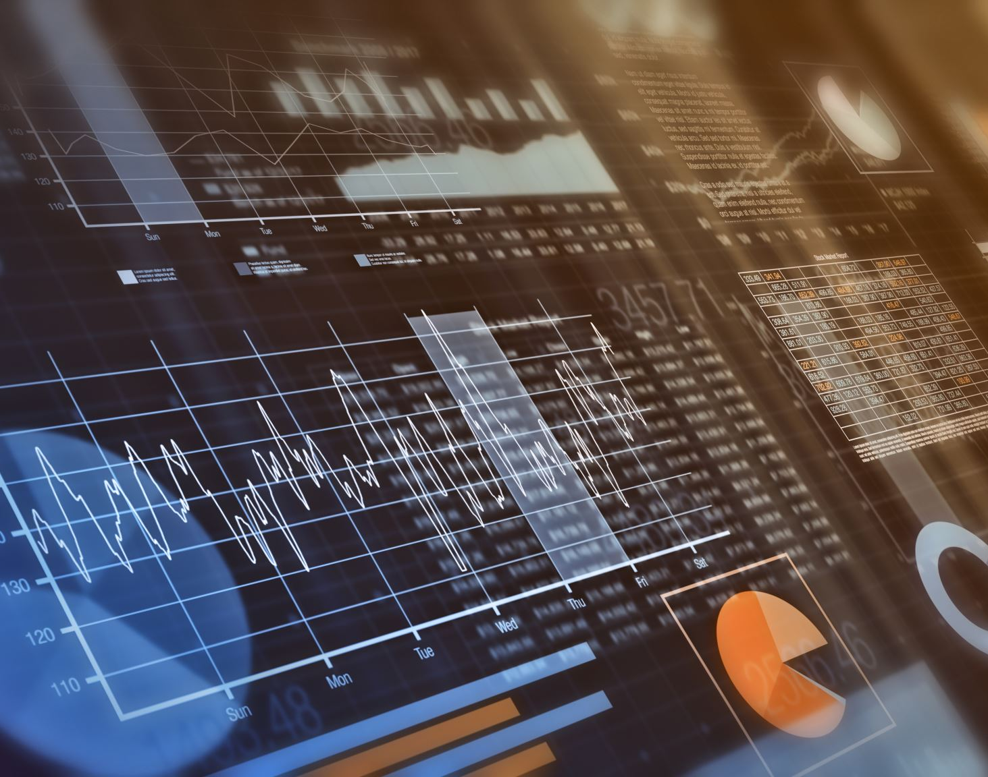
Loss Function in Autoencoder Training
During training an autoencoder aims to minimize the reconstruction loss which measures the difference between the original input and the reconstructed output. The choice of loss function depends on the type of data:
Mean Squared Error (MSE): This is commonly used for continuous data. It measures the average squared differences between the input and the reconstructed data.
Binary Cross-Entropy: Used for binary data (0 or 1 values). It calculates the difference in probability between the original and reconstructed output.
The network adjusts its weights to minimize this reconstruction loss learning to extract and retain only the most important features of the input data which are then stored in the latent space (bottleneck layer).

Slide 9

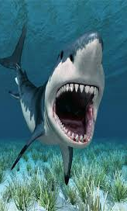

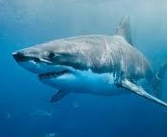
For example, imagine training our autoencoder with hundreds of thousands of shark images.

Slide 10
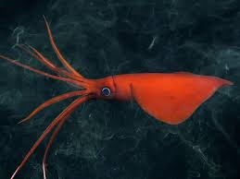
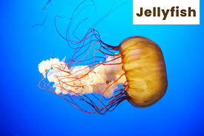
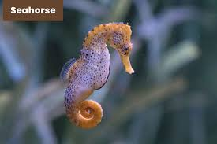
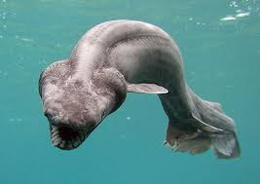
along with pictures of other objects and creatures that are not sharks in our dataset.

Slide 11
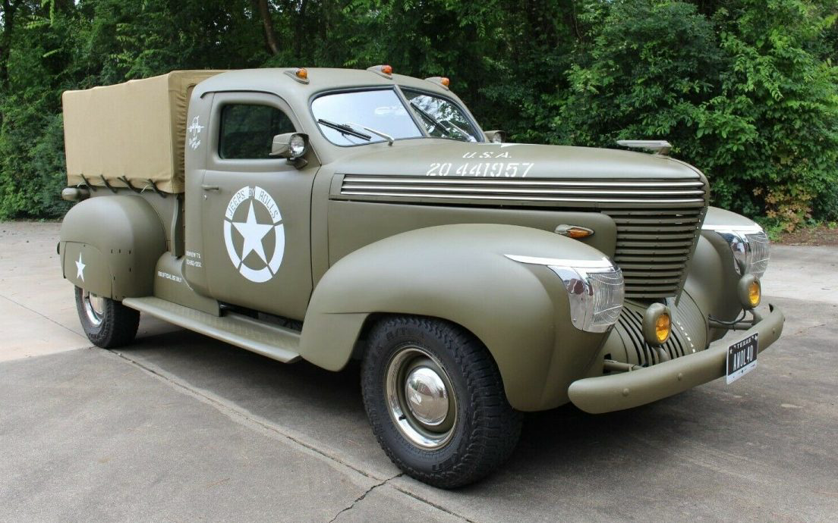

Now, when we pass an image of a truck, the autoencoder will attempt to reconstruct it using the learned shark features, resulting in a higher reconstruction error between the input image and the reconstructed image.
INPUT PICTURE
RECONSTRUCTED PICTURE

Slide 12
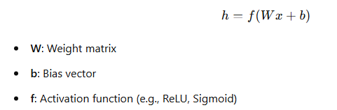
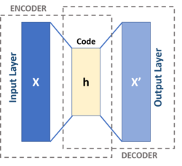
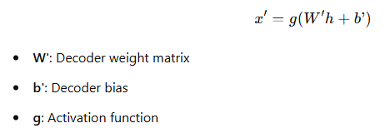
Mathematical Understanding of Autoencoders
1. Encoder Transformation
The encoder compresses input x into a lower-dimensional representation h:
2. Decoder Reconstruction
The decoder reconstructs x' from the latent representation h:

Slide 13

Mathematical Understanding of Autoencoders
3. Training Objective: Minimizing Reconstruction Error
We optimize weights and biases to minimize the reconstruction loss:
(Commonly used Mean Squared Error (MSE) loss function)
4. Optimization & Learning
Backpropagation is used to compute gradients.
Optimization algorithms: Stochastic Gradient Descent (SGD) or Adam adjust weights iteratively.

Slide 14
Types of Autoencoders
Vanilla Autoencoder – A basic encoder-decoder network trained to reconstruct input.
Sparse Autoencoder – Introduces a sparsity constraint on hidden units to enforce feature selection.
Denoising Autoencoder – Trained with noisy inputs to learn robust feature representations.
Variational Autoencoder (VAE) – Uses probabilistic latent space sampling for generative modeling.

Slide 15
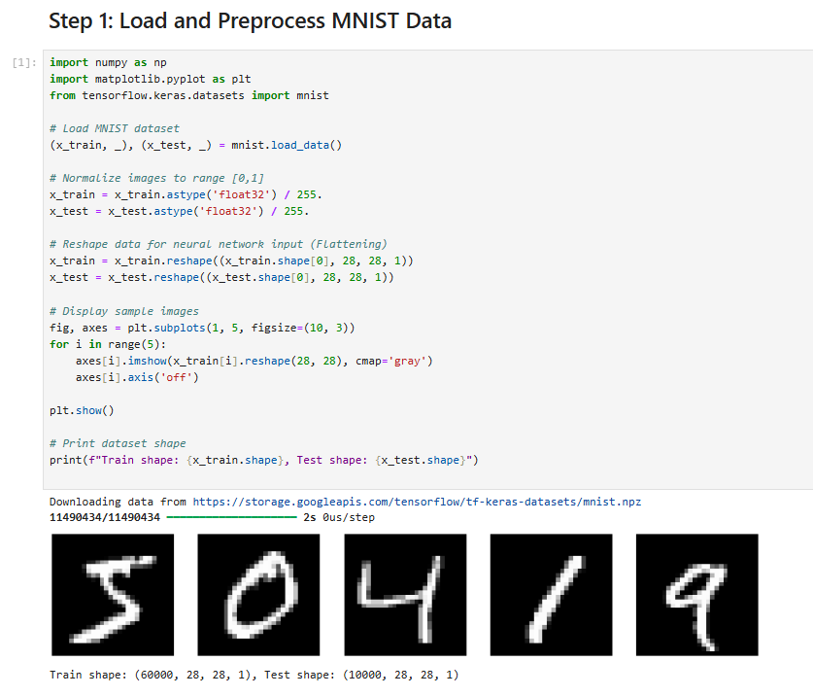
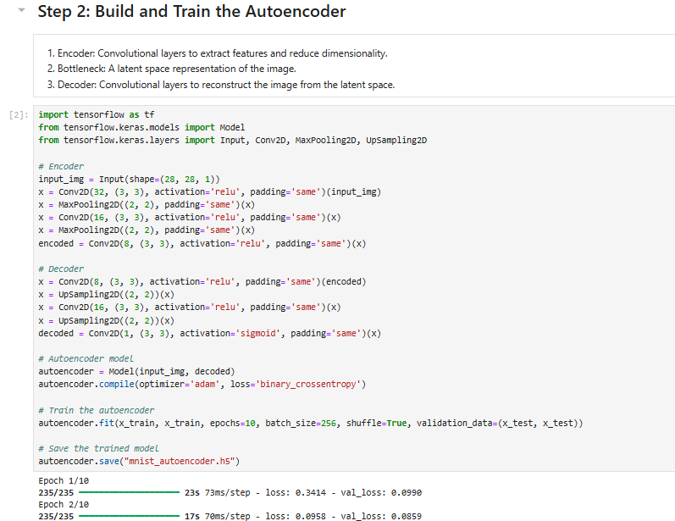
Implementation of Autoencoders on MNIST DATASET

Slide 16
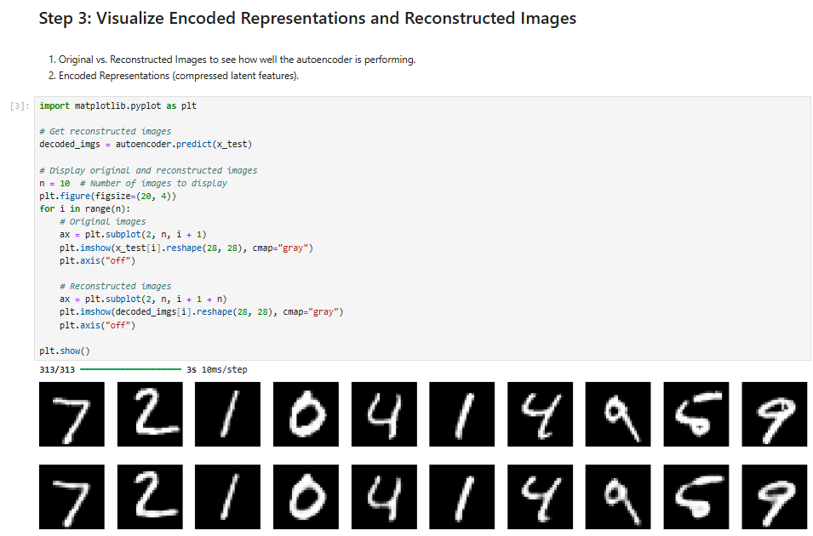
Implementation of Autoencoders on MNIST DATASET

Slide 17
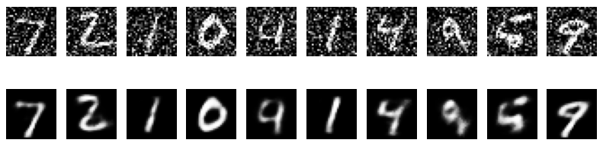
Reconstructed images after training the autoencoder with noisy input data.

Slide 18
Limitations & Challenges
Training requires large datasets.
Prone to overfitting if not regularized properly.
Latent space interpretability is challenging.
High computational cost for deep architectures.

Slide 19
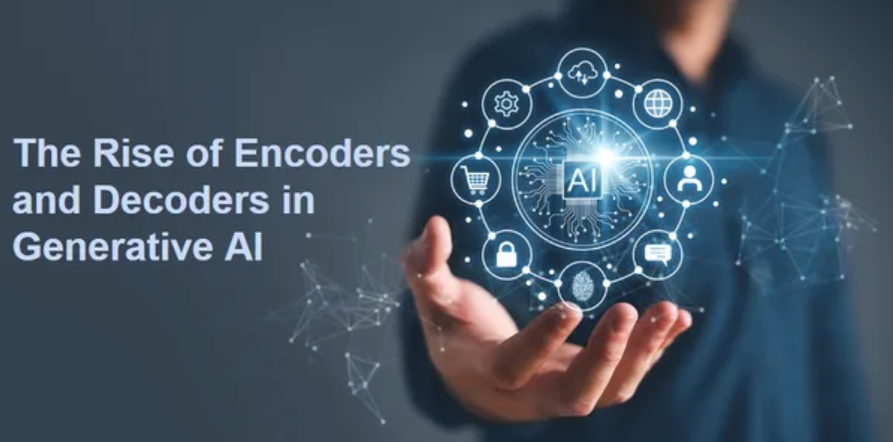
Future Trends in Autoencoders
Use in self-supervised learning – Autoencoders help in learning useful representations without labeled data.
Advancements in generative models – Enhancing VAEs and GANs for higher-quality image and text generation.
Expanding applications – Used in medical imaging, NLP, and reinforcement learning for better feature extraction and decision-making.

Slide 20
Summary & Key Takeaways
Autoencoders are powerful unsupervised learning models.
Used for dimensionality reduction, denoising, anomaly detection, and generation.
Different types include vanilla, sparse, denoising, and variational autoencoders.
Future research aims to enhance interpretability and efficiency.

Slide 21

THANK YOU ANY QUESTIONS?

