Slide 1
TITLE :AI Legal-Language Plain-English Explainer
Student name: K. Sai Divya Roll number: 23QM1A0585
Department : CSE
Course: Generative AI (KG23ACD303) | Assessment: Sem
Faculty / Guest Lecturer: Mr. Yashwanth Date: [DD Month YYYY]

Slide 2

Project Snapshot
Use case: The use case is to convert complicated legal clauses into simple English so that ordinary people can easily understand legal documents.
Target users: Students, Tenants, Employees, Small business owners, Non-Legal Professionals.
Input:Legal clauses, rental agreements, employment contracts, bank agreements, terms and conditions, and other legal text.
Output:Simplified explanation, glossary, ambiguity detection, and disclaimer.
Syllabus alignment:Advanced Transformer Techniques, Natural Language Processing (NLP), Text Generation Applications, Text Summarization, and Attention Mechanisms.
Status: Prototype run in Google Collab with two open-source models, Flan-T5 and GPT-2.

Slide 3
Problem Statement
Legal documents often contain complex words, technical terms, and lengthy sentences that are difficult for ordinary people to understand. People may struggle to identify the actual meaning of legal clauses, important terms, and unclear statements, which can lead to confusion or misunderstanding. Reading and interpreting these documents may also require professional legal assistance. Therefore, this project aims to develop an AI-based Legal Language Explainer that uses transformer models such as FLAN-T5 and GPT-2 to convert complex legal language into simple, easy-to-understand English. The system also identifies important legal terms, highlights potentially ambiguous phrases, and evaluates the generated explanations based on readability, clarity, and meaning preservation. The main goal is to make legal information easier to understand while ensuring that the output is used for educational purposes and not as a replacement for professional legal advice.

Slide 4
Proposed Solution & System Architecture
The system converts complex legal language into simple English explanations with key terms and ambiguity identification.
User enters a legal clause, agreement, or contract text.
Input is checked for missing or unclear information.
The text is preprocessed and converted into a suitable prompt.
Two AI models, FLAN-T5 and GPT-2, process the legal text.
Simple explanations and key-term glossaries are generated.
Ambiguous clauses, uncertainties, and limitations are identified.
Final outputs are displayed with a disclaimer stating that the content is not legal advice.
Architecture: User Input → Text Preprocessing → Prompt Builder → FLAN-T5 & GPT-2 Processing → Plain-English Explanation → Glossary & Ambiguity Detection → Final Output + Legal Disclaimer.

Slide 5
Dataset / Inputs & Pre-processing
Input source: User-provided legal clauses, rental agreements, employment contracts, and other legal documents. A fixed external dataset is not required for the basic workflow.
Required fields: Legal text, document type, applicable jurisdiction (if known), and preferred explanation level.
Pre-processing: Correct spelling, clean text, remove unnecessary spaces, split long clauses, and identify important legal terms.
Protected details: Preserve important legal facts, obligations, rights, conditions, dates, amounts, and penalties without changing their original meaning.
Privacy and safety: Avoid collecting unnecessary personal or confidential information. Do not store sensitive legal documents without appropriate safeguards. Clearly state that AI output is not legal advice.
Language scope for the sample: English legal clause, simplified into plain English, with a key-term glossary, ambiguity analysis, and uncertainty section.

Slide 6
Methodology
1. Data Collection
Collect legal clauses from user-provided or publicly available sample documents.
2. Text Preprocessing
Clean the input, correct spelling, remove unnecessary spaces, and tokenize the text..
3. AI Model Processing:
Use FLAN-T5 and GPT-2 transformer models to process and generate explanations.
4. Text Simplification
Convert complex legal sentences into easy-to-understand language..
5. Key-Term Extraction
Identify important legal terms and generate simple definitions.
6. Ambiguity Detection
Highlight unclear statements, missing conditions, and uncertain information..
7. Output Generation
Display the plain-English explanation, glossary, uncertainty, limitations, and legal disclaimer..
8. Evaluation
Review the generated output for readability, accuracy, completeness, and preservation of the original meaning.

Slide 7
Tool Selection
S.No | Tool / Model | Purpose
1 | Python | Main programming language
2 | Google Colab | Code execution and Prototype development
3 | Flan-T5-base (Hugging Face) | Generate simple-English explanations
4 | GPT-2 (Hugging Face) | Generate and compare text outputs
5 | NLTK | Text preprocessing and tokenization
6 | PyTorch | Run transformer models

Slide 8
Implementation & Code Structure
• Suggested environment: Python in Google Colab or a local Python environment.
• Possible modules: input_handler.py, preprocessing.py, prompt_builder.py, generator.py, glossary.py, ambiguity.py, evaluator.py, output.py
• Main implementation decision: Send the same legal text and equivalent instructions to both models so their outputs can be compared fairly.
• Validation checks: Readability, sentence length, preservation of legal meaning, key-term accuracy, ambiguity identification, and disclaimer presence.
• Libraries and models: Python, Hugging Face Transformers, FLAN-T5, GPT-2, NLTK, and Gradio. Add tested model versions and repository links after implementation.

Slide 9
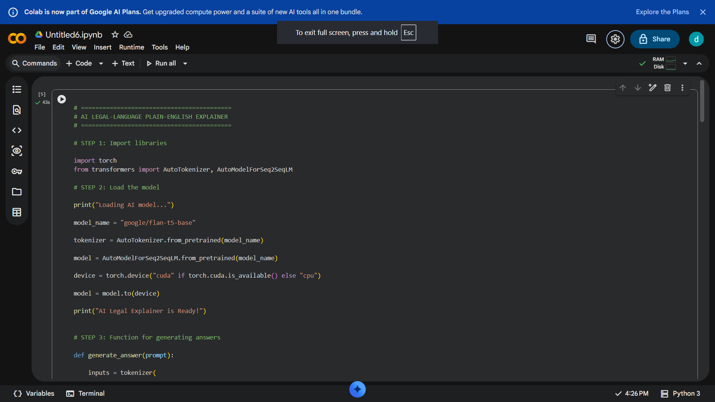
Code Execution Evidence
The notebook installs the required libraries, detects GPU or CPU availability, and loads FLAN-T5-base (Tool A) and GPT-2 (Tool B). The same legal clause and simplification task are given to both models. The generated outputs are compared using TextStat to measure readability and sentence complexity. The system generates a plain-English explanation, key-term glossary, ambiguity identification, and uncertainty and limitations section, along with a disclaimer stating that the output is not legal advice.

Slide 10
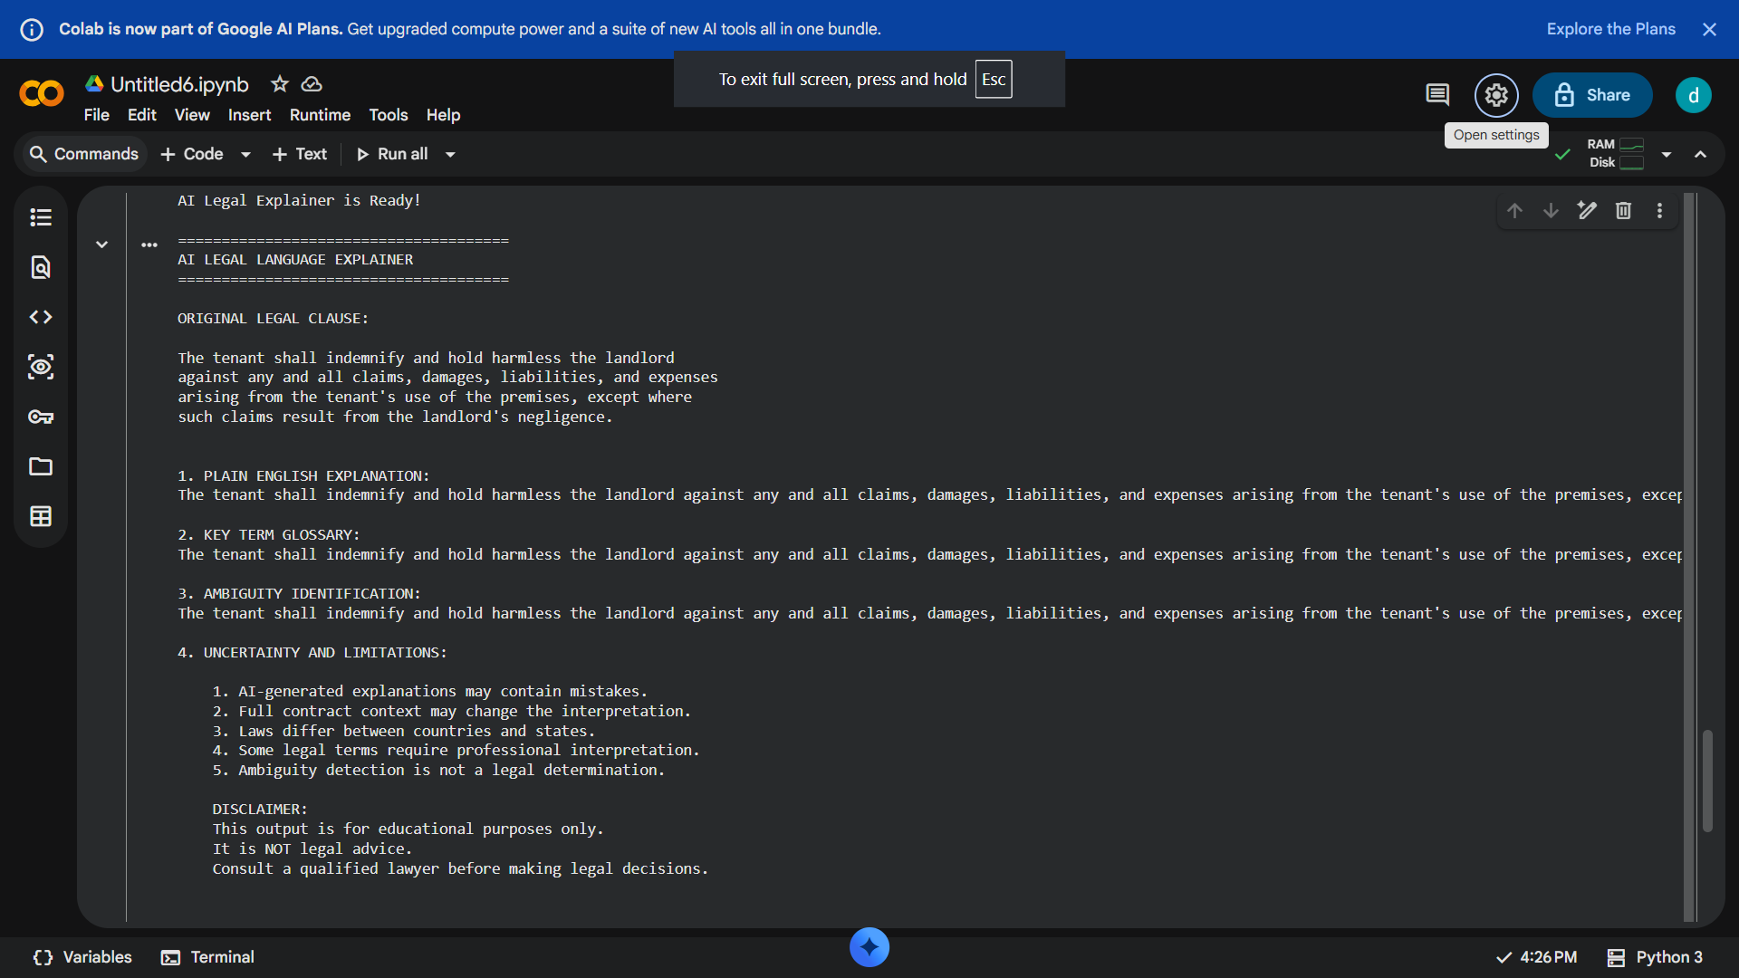
Results & Output Showcase

Slide 11
Testing, Evaluation & Comparison
Metric | Tool A (Flan-T5) | Tool B (GPT-2)
Inference latency | 5.13 sec | 15.13 sec
Word count | 50 words | 108 words
Flesch-Kincaid grade | 9.08 | 6.51
Reading ease score | 59.63 / 100 | 80.47 / 100
Ambiguity Identification | Good | Moderate

Slide 12
Ethics, Limitations & Future Work
• Risk:AI may generate incorrect legal explanations or misinterpret important legal terms and clauses.
• Bias and inclusion: Use clear, neutral and unbiased language; avoid misleading interpretations and ensure explanations are understandable to everyone.
• Safeguard: A qualified lawyer should review important explanations before users rely on them. Clearly state that the output is not legal advice.• Limitations: AI may miss legal context, misunderstand complex clauses or fail to identify certain ambiguities; readability scores are only indicators.• Future work:Add more languages, PDF document uploads, voice explanations, advanced legal AI models and interactive chatbot support.

Slide 13
Conclusion&References
Key-Term Identification: Provides simple meanings of important legal terms.
Ambiguity Detection: Highlights potentially unclear words and phrases in legal clauses.
Evaluation: Compares AI-generated explanations based on readability, clarity, response time and meaning preservation.
References
1.Hugging Face. FLAN-T5 Model Documentation. Official documentation.
2. Radford, A. et al. (2019). Language Models are Unsupervised Multitask Learners. OpenAI. Research paper.
3. Hugging Face. Transformers Library Documentation. Official website.
4. Google Colab. Python Notebook Environment. Official website.
5. Python Software Foundation. Python Documentation. Official documentation.

Slide 14
Thank You

