Slide 1

School of
Electronics and Communication Engineering
Minor Project Report on
Real-Time Traffic Signal and Arrow Recognition for Autonomous Vehicles
By:
1. | Chandan.Raikar | USN:01FE21BEC038
2. | Sanjana.A | USN:01FE21BEC363
3. | Divya.R.Salmani | USN:01FE21BEC013
4. | Sanjana | USN:01FE21BEC261
Semester: VI, 2023-2024
Under the Guidance of
Rajeshwari.K

Slide 2

K.L.E SOCIETY’S
KLE Technological University,
HUBBALLI-580031
2022-2023
SCHOOL OF ELECTRONICS AND COMMUNICATION ENGINEERING
CERTIFICATE
This is to certify that project entitled "Real-Time Traffic Signal and Arrow Recognition for Autonomous Vehicles" is a bonafide work carried out by the student team of "Chandan.Raikar(01FE21BEC038), Sanjana.A (01FE21BEC363), Divya.R.Salmani(01FE21BEC013),Sanjana(01FE21BEC261)”.The project report has been approved as it satisfies the requirements with respect to the mini project work prescribed by the university curriculum for BE (VI Semester) in School of Electronics and Communication Engineering of KLE Technological University for the academic year 2023- 2024.
Rajeshwari.K | Suneeta.V.Budihal | B.S. Anami
Guide | Head of School | Registrar
External Viva:
Name of Examiners
Signature with date
1.
2.

Slide 3
ACKNOWLEDGMENT
We extend our gratitude to Dr. Ashok Shettar, Vice-Chancellor of KLE Technological University,Hubballi, and Dr. P. G. Tewari, Dean Academics of KLE Technological University, for providing us with the opportunity to conduct our research and for their unwavering support throughout the CIM Minor Project. Special thanks to Dr. Suneeta V.B., our head of school, for her leadership and support. We are also thankful to Prof. Rajeshwari K. for her invaluable help and guidance during our work. Additionally, we acknowledge the contributions of all teaching and non-teaching staff for their assistance and encouragement.
-The project team

Slide 4
ABSTRACT
This study explores real-time traffic signal and arrow recognition, crucial for safe and efficient autonomous vehicles in smart transportation systems. We analyze the evolution of detection techniques, from traditional computer vision to deep learning. Strengths, limitations, and future directions of these methods are investigated. Utilizing datasets like ROBOFLOW UNIVERSE fuels our innovative approach. Accurate and real-time recognition is essential for the progress of self-driving cars and the future of intelligent transportation.

Slide 5
Contents
1.Introduction
1.1 Motivation . . . . . . . . . . . . . . . . . . . . . . . . . . . . . . . . . . . . . . . 6
1.2 Objectives . . . . . . . . . . . . . . . . . . . . . . . . . . . . . . . . . . . . . . . 6
1.3 Literature survey . . . . . . . . . . . . . . . . . . . . . . . . . . . . . . . . . . 7
1.4 Problem statement . . . . . . . . . . . . . . . . . . . . . . . . . . . . . . . . 8
1.5 Organization of the report . . . . . . . . . . . . . . . . . . . . . . . . . . 8
2.System design 10
2.1 Functional Block Diagram. . . . . . . . . . . . . . . . . . . . . . . . . . 10
2.1.1 Functional Block Diagram Explanation . . . . . .. . . . . . . . 10
2.2 YOLO-NAS Architectural Diagram . . . . . . . . . . . . . .. . . . . . 11
2.2.1 YOLO-NAS Architectural Diagram Explanation . . . . . . . 12
3.Implementation details 13
3.1 Environment Setup. . . . . . . . . . . . . . . . . . . . . . . . . . . . . . . . 13
3.2 Setting Up YoloV8,Dataset,Training YoloV8s Model And Getting the Results
3.2.1 SettingupYoloV8,TrainingYoloV8smodel . . . . . . .. . . . . . 14
3.2.2 Visualizing Results In The Environment . . . . . . . . . . . . . 15
4.Results 16
4.1 Visualizing Results . . . . . . . . . . . . . . . . . . . . . . . . . . . . . . . .16
4.1.1 Result Analysis . . . . . . . . . . . . . . . . . . . . . . . . . . . . . . . . . 17
5.Conclusion and future scope 18
5.1 Conclusion . . . . . . . . . . . . . . . . . . . . . . . . . . . . . . . . . . . . . . 18
5.2 Future Scope . . . . . . . . . . . . . . . . . . . . . . . . . . . . . . . . . . . . 19
References
16

Slide 6
Chapter 1
Introduction
Self-driving cars hold immense potential for revolutionizing transportation, but their safe navigation hinges on accurately interpreting traffic signals. This is where real-time traffic signal and arrow recognition comes in as the eyes on the road for autonomous vehicles. By recognizing traffic light colors (red, yellow, green) and any directional arrows in real-time, self-driving cars can make informed decisions, ensuring safe and efficient traffic flow. This research delves into the critical technologies that enable this recognition. We'll explore how computer vision and deep learning algorithms are used to process camera images and extract crucial information from traffic signals. We'll also discuss the challenges associated with real-time recognition, such as varying lighting conditions, weather, and occlusions.
  1.1 Motivation
  The quest for "Real-Time Traffic Signal and Arrow Recognition for Self-Driving Cars" is driven by a dual desire: enhancing safety and optimizing traffic flow. Precise and immediate understanding of traffic signals (red, yellow, green) and directional arrows is paramount for safe navigation. By interpreting these cues correctly, autonomous vehicles can make informed decisions, preventing accidents and adhering to traffic laws. Furthermore, real-time recognition fosters smoother traffic flow. Self-driving cars can anticipate upcoming stops, adjust speeds, and navigate intersections efficiently based on arrow signals, ultimately reducing congestion and improving travel times for everyone.
  1.2 Objectives
• Develop a robust system that accurately detects and interprets traffic signals (red, yellow, green) in real-time. This involves overcoming challenges like varying lighting, weather, and occlusions.

Slide 7
• Enable self-driving cars to recognize directional arrows on traffic signals. This allows the vehicles to understand lane-specific instructions and navigate intersections safely and efficiently.
• Improve the overall safety of autonomous vehicles. By accurately interpreting traffic signals, self-driving cars can avoid collisions and adhere to traffic laws, reducing accidents and promoting safer roads.
• Enhance traffic flow efficiency. Real-time recognition allows self-driving cars to anticipate upcoming stops and adjust speed accordingly, leading to smoother traffic flow and reduced congestion.
• Contribute to the advancement of autonomous vehicle technology. Accurate and reliable traffic signal and arrow recognition is a critical piece of the puzzle for self-driving cars to become a reality.
1.3 Literature survey
The authors of the paper are Xiyun Wang and Chao Wang from Shandong University of Science and Technology. The literature survey includes references to studies on foggy weather, vehicle detection, defogging algorithms, and target detection methods. Some referenced studies are "Research progress of image Telecommunications," "End-to-end image defogging based on deep learning," and "Adaptive feature fusion for complex road scene target detection algorithm.“

Slide 8
The authors of the paper are Miand Mostafa and Milad Ghantous from the Department of Media Engineering Technology at the German University in Cairo, Egypt.The document discusses the training of a deep neural network using the YOLOv4 algorithm to detect and classify traffic lights for Advanced Driver Assistance Systems (ADAS) in self-driving cars. It also incorporates an algorithm to alert the driver in real-time based on the detection results. The research utilized transfer learning and the LISA dataset for training, achieving a mean Average Precision (mAP) score of 92.16%.

Slide 9
  1.4 Problem statement
  Real-Time Traffic Signal and Arrow Recognition for Autonomous Vehicles.
  1.5 Organization of the report
Chapter 1: Introduction- Initiating with an introduction, the project provides an initial overview, setting the stage for the systematic exploration of various facets.
Chapter 2: System Design- The project extensively examines the complexities of system design, offering an in-depth overview of its structure and components.
Chapter 3: Planning and Execution- In this thoroughly covers the planning and execution aspects of the design, shedding light on strategic decisions made during the development phase.
Chapter 4: Results Analysis- Progressing further shifts focus to presenting and analyzing results, featuring detailed discussions to clarify findings and highlight significant outcomes.
Chapter 5: Conclusion- Finally concluding the report with a summary, providing insights into project outcomes, implications, and paving the way for future exploration and development in the identified scope.

Slide 10
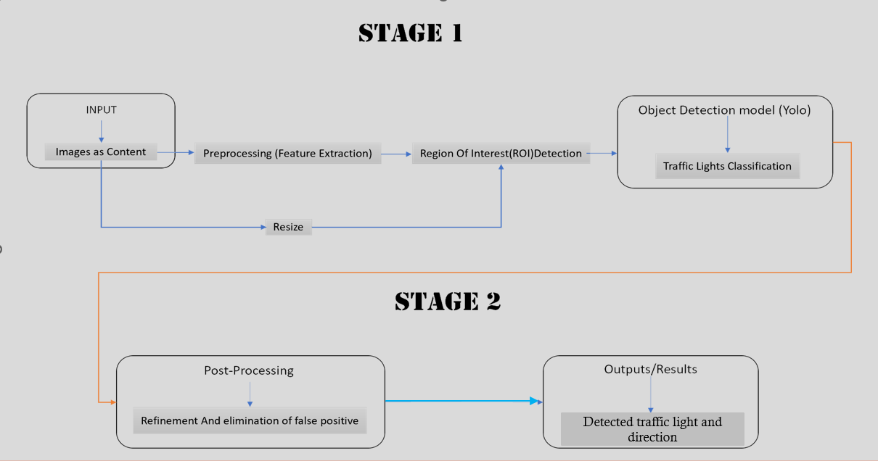
Chapter 2
System design
In this Chapter, We will analyze YOLO-NAS cutting-edge advancements and intricate design principles as we look into the system’s inner workings. The block diagram for our project will show how YOLO-NAS cutting-edge features were incorporated and how well our solution integrated them.
  2.1 Functional Block Diagram
Fig 2.1: Shows Functional Block Diagram

Slide 11
  2.1.1 Functional Block Diagram Explanation
Input: Video frames or still images, maybe in different resolutions and formats (such as RGB or GRAYSCALE), are received.
Preprocessing: Applies data normalization, and filtering (e.g., Gaussian blur) to miti gate noise and enhance relevant features. May involve color space conversion (e.g., RGB to HSV) for robust traffic light representation.
Region of Interest (ROI) Detection: Employs object detection algorithms (e.g., YOLOV8,YOLO-NAS) to localize traffic light bounding boxes within the frame. Can incorporate anchor boxes of varying sizes and aspect ratios to handle diverse traffic light positions and appearances.
Traffic Light Classification: Leverages deep convolutional neural networks (CNNs) trained on labeled datasets of traffic light images. CNN architecture likely features convolutional layers for feature extraction, followed by pooling layers for spatial down-sampling and fully-connected layers for classification into red, yellow, or green states.

Slide 12
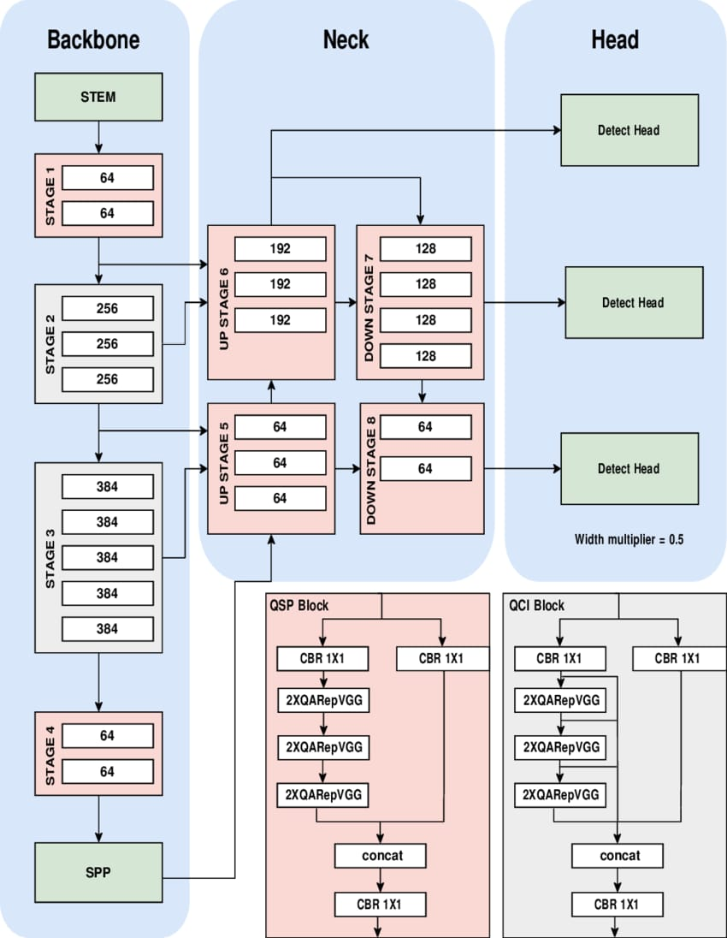
  2.2 YOLO-NAS Architectural Diagram

Slide 13
  2.2.1 YOLO-NAS Architectural Diagram Explanation
Backbone: This is the initial stage of the network responsible for extracting features from the input image. The image goes through a series of convolutional layers that progressively reduce its size while increasing the number of channels. In the YOLONAS architecture, the specific convolutional layers used in the backbone are not specified.
Neck: The neck stage refines the features extracted from the backbone. It typically consists of several convolutional layers that further process the feature maps. In the YOLONAS architecture, the neck consists of a Spatial Pyramid Pooling (SPP) layer and several Convolutional layers with a kernel size of 1x1 [1].
Head: The final stage of the network, the head is responsible for generating the final detections. It takes the processed features from the neck and uses them to predict bounding boxes and class probabilities for the objects in the image. In the YOLONAS architecture, the head uses several convolutional layers and detection heads to output the final results.

Slide 14
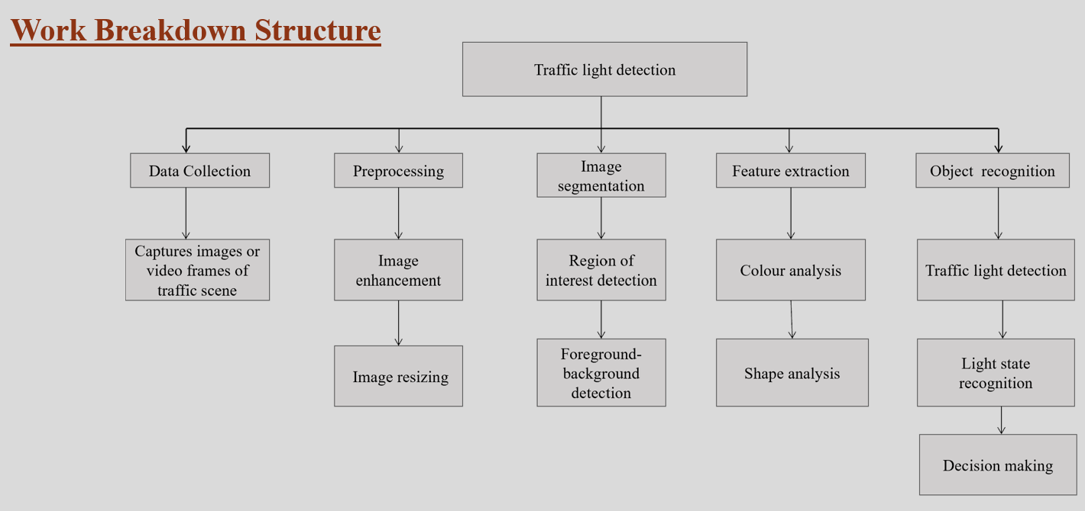
  2.2.2 Work Breakdown Structure
Fig 2.2.2: Work Breakdown Structure

Slide 15
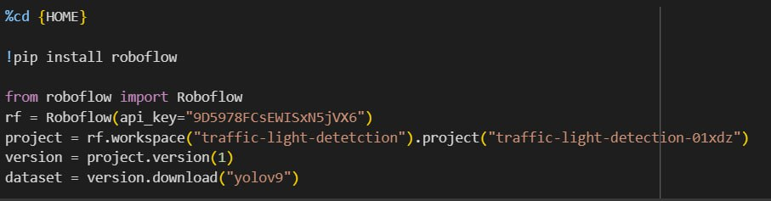
Chapter 3
Implementation details
In this chapter, We will dive into the technical intricacies of establishing a robust environment tailored for training a YOLO-NAS model. This involves configuring essential dependencies, preparing the dataset meticulously, and executing the training and testing process for the model.
3.1 Environment Setup

Slide 16
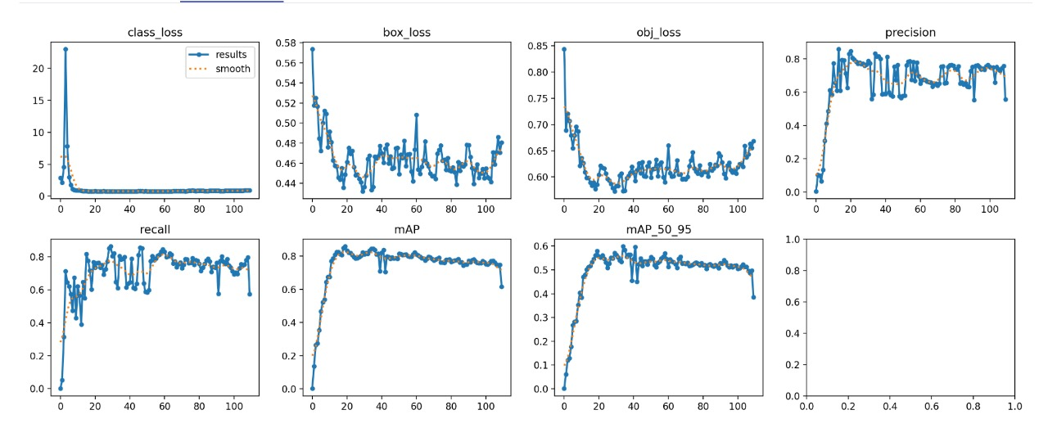
3.2.1 Setting up YoloV8, Training YoloV8s model

Slide 17
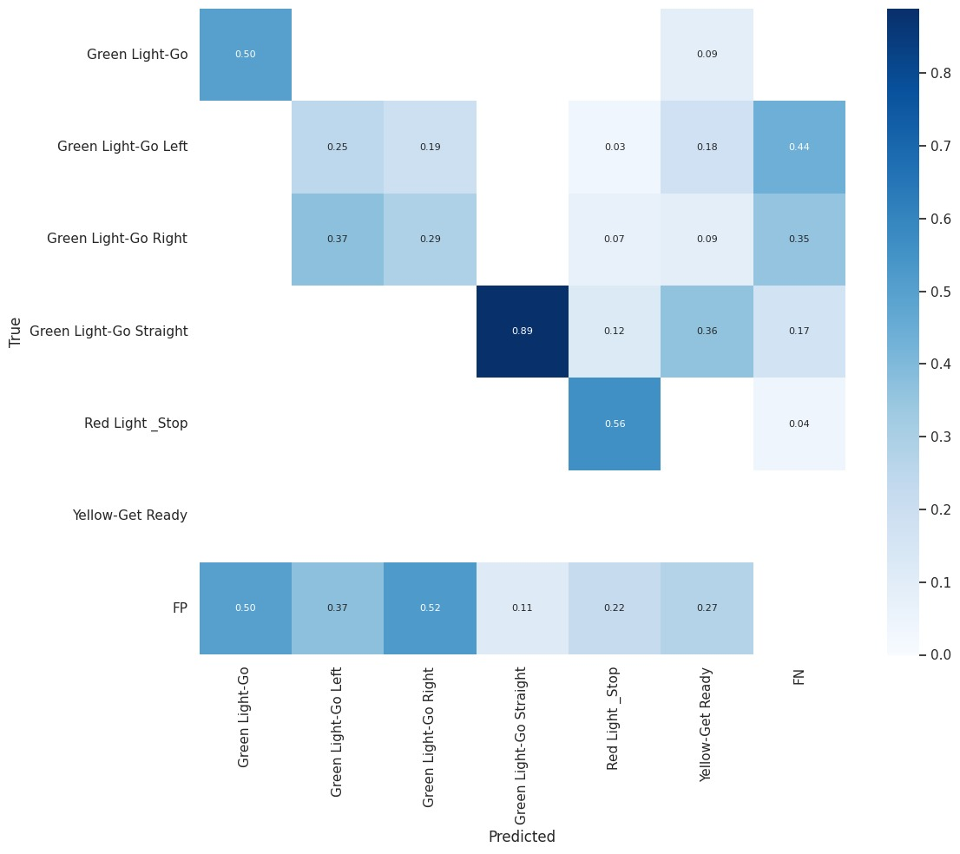

Slide 18
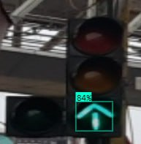
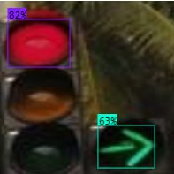
Chapter 4
Results
In this chapter, we will delve into a comprehensive exploration of the results and project out comes achieved through the implementation of YOLO-NAS. This entails an in-depth analysis of the results obtained.
4.1 Visualizing Results

Slide 19
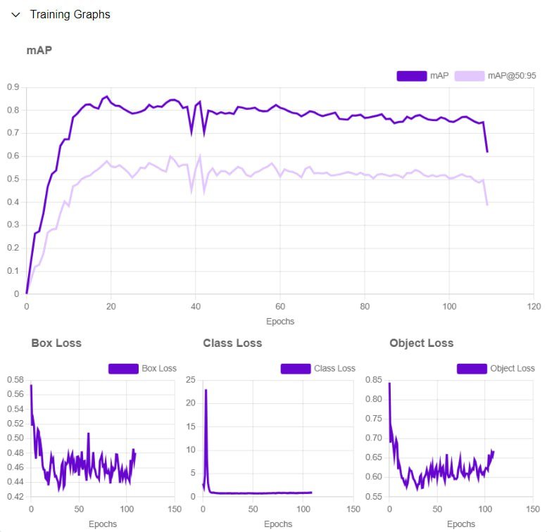
4.1.1 Result Analysis
Chapter 5
Conclusions and future scope
5.1 Conclusion
YOLO-NAS can achieve higher accuracy and precision compared to manually designed models like YOLOv8, particularly on specialized or custom datasets.
YOLO-NAS emerges as a superior choice due to its advanced Neural Architecture Search (NAS) capabilities.
This technology allows for the development of highly optimized models that deliver better performance in specialized applications.

Slide 20
5.2 Future scope
• Improved Accuracy and Robustness: Future research will focus on developing even more accurate and robust detection algorithms. This includes tackling challenges like extreme weather conditions, complex lighting scenarios (e.g., glare, shadows), and occlusions from other vehicles or objects. Advancements in deep learning architectures and sensor fusion (combining camera data with LiDAR or radar) are promising avenues.
• Integration with V2X Communication: Future systems could leverage Vehicle-to-Everything (V2X) communication to receive real-time traffic signal information directly from infrastructure. This would complement camera-based recognition and enhance reliability, especially at intersections with malfunctioning or obscured signals.
• Multi-Sensor Fusion and Contextual Awareness: The future may see the integration of additional sensors like LiDAR and radar to provide richer data for recognition. Additionally, incorporating contextual information, such as traffic flow patterns and historical data, could further improve decision-making for self-driving cars.
• Standardization and Regulations: As self-driving cars become closer to reality, standardization of traffic signal formats and regulations around real-time recognition systems will be crucial. This ensures consistent communication and reduces risks associated with variations across regions.

Slide 21
References:
Mark Philip Philipsen, ”Traffic Light Detection: A Learning Algorithm and Evaluations on Challenging Dataset”, 2015 IEEE 18th International Conference on Intelligent Transportation Systems. [1]
Trung-Hieu Nguyen, ”A Lightweight Model For Real-time Traffic Sign Recognition”, 2020 5th International Conference on Green Technology and Sustainable Development (GTSD). [2]
Noor Hussain Sarhan, ”Traffic light Detection using OpenCV and YOLO”, 2022 Interna tional Conference on Innovation and Intelligence for Informatics, Computing, and Technologies (3ICT). [3]
Amara Dinesh Kumar, ”Novel Deep Learning Model for Traffic Sign Detection Using Cap sule Networks,” CoRR, vol. abs/1805.04424, 2018. [4]
Fatma Nur Ortata¸ s, ”Performance Evaluation of YOLOv5, YOLOv7, and YOLOv8 Models in Traffic Sign Detection”, 2023 8th International Conference on Computer Science and Engi neering (UBMK). [5]
Abdellah Nabou, ”Road Signs Recognition by Using YOLOv8 Model”, 2023 14th Interna tional Conference on Intelligent Systems: Theories and Applications (SITA). [6]

