Slide 1

School of
Electronics and Communication Engineering
Minor Project Report on
SOLAR CHARGING SYSTEM
By:
1. | Chandan.R | USN:01FE21BEC038
2. | Divya.R.Salmani | USN:01FE21BEC013
3. | Sanjana.A | USN:01FE21BEC363
4. | Sanjana | USN:01FE21BEC261
Semester: VI, 2023-2024
Under the Guidance of
Rajeshwari.k

Slide 2

K.L.E SOCIETY’S
KLE Technological University,
HUBBALLI-580031
2022-2023
SCHOOL OF ELECTRONICS AND COMMUNICATION ENGINEERING
CERTIFICATE
This is to certify that project entitled “ Solar Charging System ” is a bonafide work carried out by the student team of ”Chandan.R(01FE21BEC038),Divya.R.Salmani(01FE21BEC013),
Sanjana.A(01FE21BEC363),Sanjana(01FE21BEC261)”. The project report has been approved as it satisfies the requirements with respect to the minor project work prescribed by the university curriculum for BE (VI Semester) in School of Electronics and Communication Engineering of KLE Technological University for the academic year 2023- 2024.
Rajeshwari.K | Suneeta .V.Budihal | B.S.Anami
Guide | Head of School | Registrar
External Viva:
Name of Examiners
Signature with date
1.
2.

Slide 3
ACKNOWLEDGMENT
We would like to express our gratitude to Dr. P. G. Tewari, Dean of Academics at KLE Technological University, and Dr. Ashok Shettar, Vice-Chancellor of KLE Technological University, Hubballi, for giving us the chance to conduct our research and for their unwavering support during the CIM Minor Project. Our school's head of school, Dr. Suneeta V.B., deserves special recognition for her guidance and assistance. We also acknowledge Prof. Rajeshwari K. for her great assistance and direction throughout our effort. Furthermore, we thank all of the teaching and non-teaching personnel for their support and encouragement.
-The project team

Slide 4
Contents
1.Introduction
1.1 Motivation . . . . . . . . . . . . . . . . . . . . . . . . . . . . . . . . . . . . . . . 5
1.2 Objectives . . . . . . . . . . . . . . . . . . . . . . . . . . . . . . . . . . . . . . . 6
1.3 SDGs Goal ……….. . . . . . . . . . . . . . . . . . . . . . . . . . . . . . . . . . . 7
1.4 Literature Survey … . . . . . . . . . . . . . . . . . . . . . . . . . . . . . . . . 8
1.5 Problem Statement ……….. . . . . . . . . . . . . . . . . . . . . . . . . . . 10
1.6 Bill Of Materials . . . . . . . . . . . . . . . . . . . . . . . . . . .. . . .. . . .10
1.7 Organization Of Report . . . . . . . . . . . . . . . . . . . . . . . . . . . .11
2.System design 12
2.1 Functional Block Diagram. . . . . . . . . . . . . . . . . . . . . . . . . . 12
2.1.1 Functional Block Diagram Explanation . . . . . .. . . . . . . . 13
2.2 ESP32 Architectural Diagram . . . . . . . . . . . . . . . . .. . . . . . 14
2.2.1 Features Of ESP32 . . . . . . . . . . . . . . . . . . . . . . . . . . . . . 15
3.Implementation details 16
3.1 Environment Setup. . . . . . . . . . . . . . . . . . . . . . . . . . . . . . . . 16
4.Results 16
4.1 Results . . . . . . . . . . . . . . . . . . . . . . . . . . . . . . . . . .. . . . . . . 19
4.1.1 Result Analysis . . . . . . . . . . . . . . . . . . . . . . . . . . . . . . . . . 19
5.Conclusion and future scope 20
5.1 Conclusion . . . . . . . . . . . . . . . . . . . . . . . . . . . . . . . . . . . . . . 20
5.2 Future Scope . . . . . . . . . . . . . . . . . . . . . . . . . . . . . . . . . . . . 20
References

Slide 5
Chapter 1
Introduction
  The popularity of electric vehicles is growing due to rising pollution and depletion of fossil fuels (EVs). But to really have an influence on the environment, EVs need clean electricity. In order to overcome this, solar charging systems use photovoltaic (PV) panels to capture solar energy. After then, EV batteries are charged either directly or indirectly using this solar energy. The carbon footprint of EVs is greatly decreased by these systems by using clean, renewable solar electricity. Furthermore, flexible power management is made possible by the grid connection and battery storage, which guarantees dependable charging in low sunlight. An autonomous, safe, and sustainable route to cleaner mobility in the future is provided by solar-powered EV charging stations.
  1.1 Motivation
  The necessity to solve two pressing issues—environmental pollution and the depletion of fossil fuels—is what spurred the development of solar charging systems for electric cars (EVs). Even if EVs are a great first step in the fight against urban air pollution, their environmental benefits are undermined if they run on non-renewable electricity. We are able to power EVs in a way that genuinely reduces their carbon footprint by employing solar energy, a clean and sustainable resource. Solar charging systems also lessen dependency on fossil fuels and the grid, promoting energy security and independence. Long-term economic gains are also possible from them since they provide a sustainable energy source and reduce the cost of power. Incorporating solar energy into EV charging infrastructure contributes to the worldwide movement towards sustainable development and combating climate change, while also facilitating the shift to environmentally friendly transportation.

Slide 6
1.2 Objective
Reduce Carbon Emissions: By using clean, renewable solar energy for EV charging, we can lessen the carbon footprint connected with EVs and promote environmental sustainability.
Boost Energy Independence: By giving EVs a dependable and sustainable energy source, we can lessen our reliance on the grid and non-renewable energy sources.
Enhance Cost Efficiency: By using free solar energy, we can reduce the long-term operating expenses of EV charging and lessen our need on purchased electricity.
Provide dependability: To incorporate battery storage technologies that provide a steady and dependable power source for electric vehicle charging, even at times of low sunshine or increased demand.
Promote Sustainable Infrastructure: To create and put into place infrastructure that facilitates the use of renewable energy, which will lead to a greater acceptance of sustainable mobility habits.
Encourage Grid Stability: To make it possible for solar charging stations that are connected to the grid to import and export electricity, balancing supply and demand and improving overall grid stability.

Slide 7
1.3 SDGs Goal
Sustainable, Reliable, and inexpensive Energy (SDG 7): Solar charging systems offer EV owners an economical, renewable energy option, facilitating the availability of inexpensive, dependable, and sustainable energy.
Climate Action (SDG 13): Solar charging systems considerably reduce greenhouse gas emissions by lowering reliance on fossil fuels, which helps to combat climate change and promote international climate action initiatives.
Industry, Innovation, and Infrastructure (SDG 9): Using solar energy to power EV charging stations highlights cutting-edge technological advancements and improves the sustainability of industrial and urban infrastructure.
Sustainable Cities and Communities (SDG 11): By reducing pollution and encouraging cleaner transportation options, the installation of solar-powered EV charging stations aids in the growth of sustainable urban environments.
Partnerships for the Goals (SDG 17): In order to progress renewable energy technology and meet common sustainable development goals, governments, corporations, and communities must work together to successfully implement solar charging infrastructure for EVs.
Responsible Consumption and generation (SDG 12): By lowering reliance on non-renewable energy sources and minimising environmental effect through cleaner energy generation, using solar energy for EV charging promotes responsible consumption.

Slide 8
1.4 Literature survey
Zarren Firdouse, Syed Majed Ashraf, Khaliqur Rahman, and Haroon Rehman from the Electrical Engineering Department at Aligarh Muslim University in Aligarh, India, are the authors of the work. The reports, technical papers, and web sites pertaining to solar energy, electric vehicles, power quality, and environmental impact are among the sources listed in the paper's literature. The International Energy Agency's reports, research on air pollution and transportation-related emissions, and technical articles on solar energy, electric car technology, and power quality evaluation are a few examples of the cited literature.
An EV charger and solar panel hybrid system: a stochastic simulationIn order to control the growing demand for electric vehicles while maximising the financial gain of the charging station operator (CPO), the paper presents a stochastic simulation for a hybrid system of solar panels and EV chargers. It highlights that, given the growing strain on the electrical infrastructure, a smart charging methodology is essential to guarantee stability and security. Based on reasonable assumptions, the simulation produces large amounts of data, taking into account variables like the number of vehicles, arrival hours, charging state, and solar energy installation. The study is broken down into sections that address energy-related computations, a case study in a university parking lot, the hybrid system, and the suggested charging simulation platform.

Slide 9
Commercial office buildings with rooftop solar PV systems for electric vehicle charging loadThe Indian Institute of Technology, Roorkee, India's Department of Electrical Engineering is home to the paper's author. The integration of rooftop solar PV systems, infrastructure for electric vehicle (EV) charging, and their effects on commercial buildings and the energy grid are probably the main topics of the literature review in the paper. It might talk about the difficulties, chances, and developments in these fields, especially in relation to smart measurement, instrumentation, and sustainable urban development. Professionals, academics, and stakeholders working in the sectors of energy, sustainability, smart infrastructure, and urban development are likely to find value in the findings given in this paper.
The paper's authors are Vijith K. and Rahul Hossain. The paper's literature review refers to a number of articles and conference papers, including "Model predictive current controller for grid connected PV inverter" by Arya Gopakumar and A Vijayakumari, "Development of fast large lead-acid battery charging system using multi-state strategy" by Cheng Siong Lee, Hsiung Cheng Lin, and Sin-You Lai, "Design of an electric vehicle fast-charging station with integration of renewable energy and storage" by JA Dom ́ınguez-Navarro, R Dufo-L ́opez, JM Yusta-Loyo, JS Artal-Sevil, and JL Bernal-Agust ˁın, "Grid connected multilevel inverter for renewable energy applications" by R Mahalakshmi and KC Sindhu Thampatty, and others. These sources address a variety of subjects pertaining to power, electric vehicle charging, and renewable energy.

Slide 10
1.5 Problem statement
Develop a solar panel charging system for a vehicle, ensuring efficient utilization of solar energy and real-time charging process.
1.6 Bill of materials
Name of the component | Quantity | Cost
ESP32 | 1 | 450
LCD display | 1 | 160
Solar Panel | 1 | -
Li-ion Battery | 8 | 70
PCB | 1 | 50
Battery holder | 2 | 200
Jumper wires | - | 50

Slide 11
1.7 Organization of the report
Chapter 1: Introduction- Initiating with an introduction, the project provides an initial overview, setting the stage for the systematic exploration of various facets.
Chapter 2: System Design- The project extensively examines the complexities of system design, offering an in-depth overview of its structure and components.
Chapter 3: Planning and Execution- In this thoroughly covers the planning and execution aspects of the design, shedding light on strategic decisions made during the development phase.
Chapter 4: Results Analysis- Progressing further shifts focus to presenting and analyzing results, featuring detailed discussions to clarify findings and highlight significant outcomes.
Chapter 5: Conclusion- Finally concluding the report with a summary, providing insights into project outcomes, implications, and paving the way for future exploration and development in the identified scope.

Slide 12
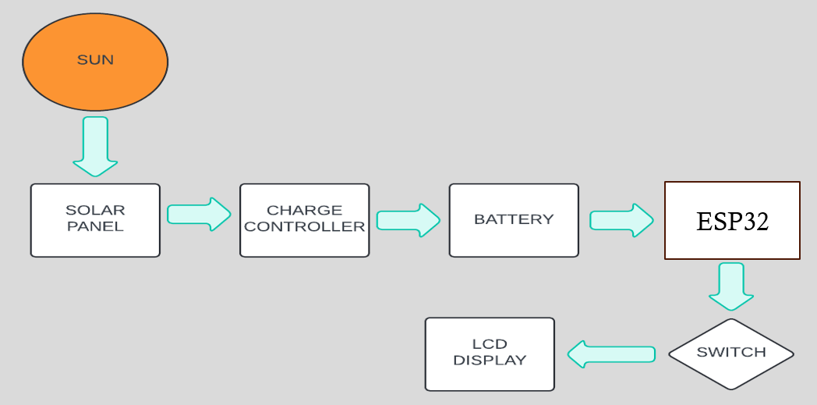
Chapter 2
System design
In this chapter, we will analyze the advancements and intricate design principles of the solar charging system for electric vehicles (EVs). We will delve into the system’s inner workings, exploring how its innovative features are incorporated. The block diagram for our project will illustrate the integration of these advanced features and demonstrate how effectively our solution utilizes them.
2.1 Functional block diagram
Figure 2.1: Functional Block Diagram

Slide 13
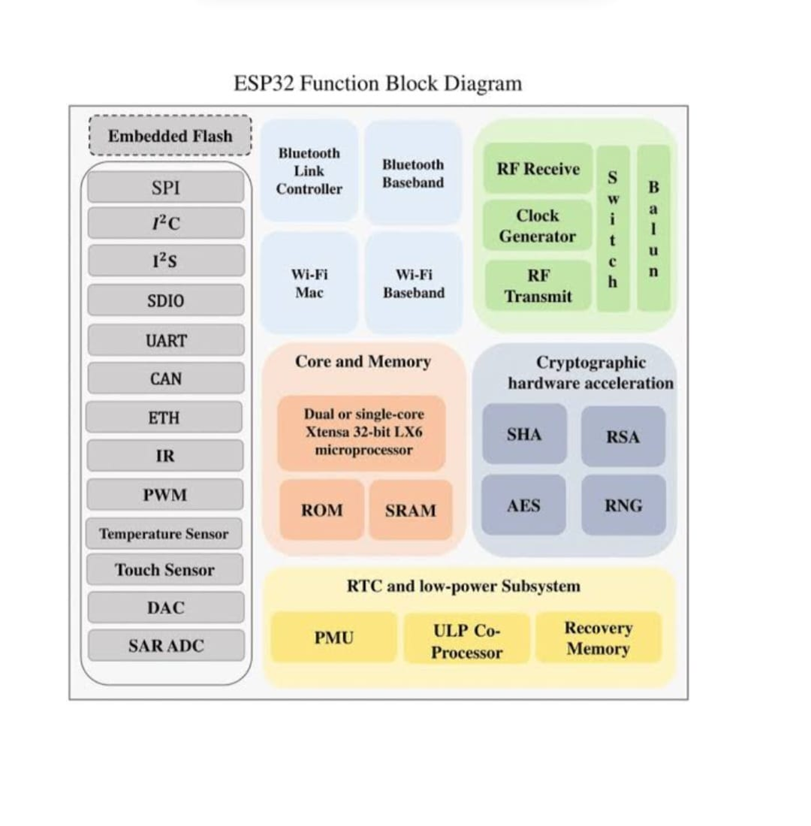
2.1.1 Functional block diagram explanation
Solar Panel: It produces direct current (DC) electricity by harnessing sunshine.
Charge Controller: It controls solar panel voltage and current to securely charge the battery without overcharging it.
Battery: The solar panel's electrical energy is stored in a battery.
ESP32 microcontroller: The gadget that the solar charging system is powering.
LCD display :The LCD display is utilised to show system information, including battery voltage and charging status.
Switch: The switch is utilised for manually turning on and off the system.
2.2 ESP32 Architecture Diagram
Figure 2.2: ESP32 Architecture Diagram

Slide 14
2.2.1 Features of ESP32
Dual-core Processor: The ESP32 has two Xtensa LX6 CPUs that provide excellent processing power and efficiency. These CPUs may be individually controlled and utilised for a variety of activities.
Wi-Fi and Bluetooth Connectivity: It has integrated Bluetooth (v4.2 and BLE) and Wi-Fi (802.11 b/g/n) features, making it simple to connect to the internet and other devices.
Low Power Consumption: Because of its power-efficient design, the ESP32 is appropriate for low-power and battery-powered applications. Several power-saving settings are available to maximise energy efficiency.
Rich Peripheral Interface: It has many peripherals, including SPI, I2C, UART, ADC, DAC, PWM, and more, which makes it possible to interface with sensors, actuators, and other external devices in a flexible way.
Secure Connectivity: To guarantee secure connection and data integrity, the ESP32 has strong security features such support for WPA3 encryption, secure boot, flash encryption, and cryptographic accelerators.

Slide 15
Chapter 3
Implementation details
3.1 Environment Setup
Components and tools needed :-
Solar panel
ESP32
LCD display
Lithium-ion battery
PCB
Battery holder
Jumper wires
3.2 Working
The solar panel is fixed to the car and uses sunshine to continuously produce electricity. The lithium-ion battery stores this energy and uses it to power the car when needed. In this setup, the ESP32 microcontroller is essential. their voltage proportions. Two batteries, referred to as the master and slave, will have their voltage levels monitored by Arduino code through the use of an ESP32 microcontroller. The LiquidCrystal_I2C library is utilised to exhibit voltage readings on a 16x2 LCD panel. The code initialises the LCD, the relay pin, and serial communication during the setup phase.

Slide 16
It also displays a welcome message and sets the relay to HIGH to connect the load to the master battery for the first time. The code reads the analogue voltage values from the master (MBat) and slave (SBat) battery pins, translates them to real voltages, and shows the results on the LCD during the main loop. Next, it determines if the voltage of the master battery falls below 10V. If so, the code investigates whether the voltage of the slave battery is more than 10V. If so, it updates the display and shifts the load to the slave battery. It displays a low battery alert if both batteries are low. The load is maintained on the master battery if the voltage stays over 10V. By adjusting the load between the two batteries dynamically in response to their respective voltage levels, this configuration guarantees a consistent power source.

Slide 17
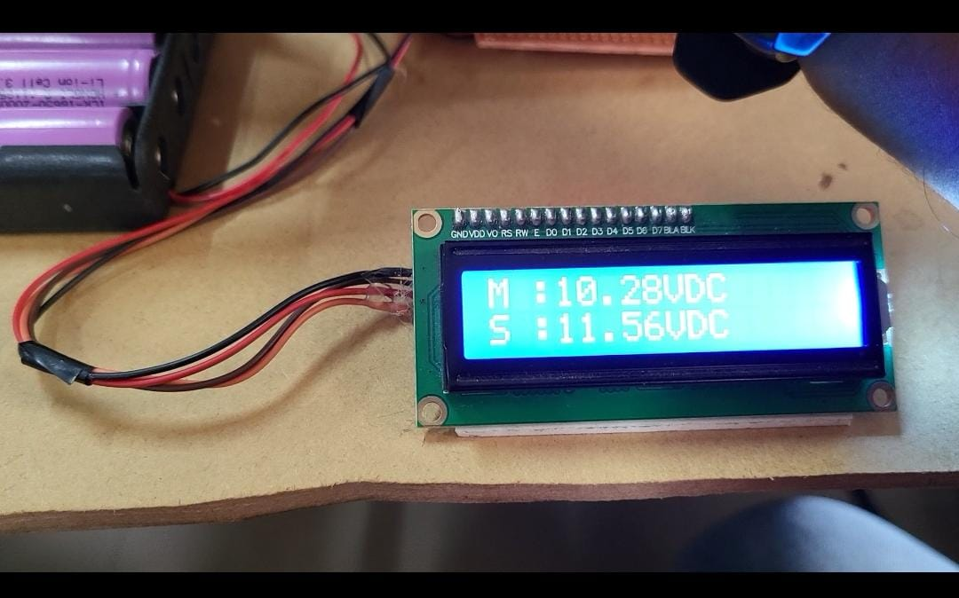

Chapter 4
Results and discussions
4.1 Results
This chapter presents the results of the solar charging system for EV vehicles and evaluates its effectiveness.

Slide 18
Chapter 5
Conclusions and future scope
  5.1 Conclusion
  In conclusion, a lithium-ion battery is effectively charged by a solar-charging system for cars, guaranteeing a steady supply of electricity while the vehicle is moving and stopped. The system, which is controlled by an ESP32 microcontroller, senses the condition of a switch to identify the proper charging mode. The car charges while driving when the switch is turned ON. On the other hand, the car charges when it is stopped while the switch is off. Real-time status information on the system, including charging activity, battery level, and vehicle movement condition, is provided by an LCD display that is connected to the ESP32. This creative configuration helps to conserve the environment by encouraging the use of sustainable energy sources and increasing the vehicle's energy efficiency. It also lessens the vehicle's need on fossil fuels.
  5.2 Future scope
  Enhanced Efficiency: To optimise the amount of energy captured from sunshine and its application for EV charging, future research can concentrate on enhancing the efficiency of solar panels and energy storage devices.
  Smart Grid Integration: As more sophisticated grid integration technologies are developed, solar charging systems will be able to better control energy flow, plan charging times, and return energy to the grid during times of high demand.

Slide 19
3. Advanced Materials: Research into novel materials and technologies for solar panels and batteries may result in solar charging systems that are more robust, economical, and efficient.
4. Wider Adoption: By lowering dependency on fossil fuels and encouraging sustainable mobility, a wider adoption of EVs can be facilitated by increasing the deployment of solar charging stations in both urban and rural locations.
5. Autonomous Systems: Adding intelligent and autonomous systems to the management and upkeep of solar charging stations can improve performance and dependability and guarantee continuous functioning with less need for human intervention.
6. Hybrid Systems: By fusing solar energy with additional renewable energy sources, including wind or hydropower, hybrid systems can provide EV charging with more dependable and constant electricity.

Slide 20
Reference
Hans Manoj Raghubir;Sayyad Azmat Suleman;Satya Prakash,” Design and development of Wind Solar Energy Charging System for Electric Vehicle”, 2019 2nd International Conference on Power and Embedded Drive Control (ICPEDC).[1]
Rahul Hossain; Vijith K;” Solar Energy based EV Charging Station With Added Battery Storage System”, 2021 IEEE International Power and Renewable Energy Conference (IPRECON) .[2]
Zarren Firdouse; Syed Majed Ashraf; Khaliqur Rahman;” Hybrid Solar PV System for Electric Vehicles Battery Charging “,2023 International Conference on Power, Instrumentation, Energy and Control (PIECON).[3]
Abhijith Pangil Sidharthan; Salma Al Aref; “Optimization of Charging in a Multi-Port EV Charging Station for Emergency Vehicle Priority Fast Charging”, 2021 IEEE International Women in Engineering (WIE) Conference on Electrical and Computer Engineering (WIECON-ECE).[4]

