Slide 1
Software Architectural Styles
Team Members:
Sai Tejini Varma Sangaraju(z1948240)
Divya Sangaraju(z1948236)

Slide 2
Introduction
The architectural styles are those which tell us how the entire code of the business is being organized on a high level.
While designing a business process first we need to understand the architectural styles that are there, and we need to choose a suitable style that will suite our project.
This gives us an overview of how a project works in general and what are the relations between each layer.
There are several architectural styles like the Layered, client server and Event driven that were used as attributes in our dataset.

Slide 3
Dataset
Our dataset includes information about the developers, including details about each developer's most recent degree, work history, and knowledge of specific architectural styles.
It has information about how many architectural styles a developer has used for a particular project.

Slide 4
Attributes
Timestamp
Your Good Name?: It tells us the name of the developer.
Organization?: This column provides the developer's educational institution information.
Last Degree?: This column tells us the information about the developer’s degree.
Job Experience ?: In which industry is the developer working
How Many Repository Architectural Styles have you used for a particular project?: There are 18 such columns in this dataset that discusses various architectural styles and indicate how many times the developer employed each one while working on the project.

Slide 5
Research Question?
Based on the architectural styles used in a project can we predict the pattern in the educational qualifications of the developer?
Predicting Last Degree? and Job Experience ?
Dependent Variables: Last Degree? and Job Experience ?
Independent Variables: All the 18 attributes regarding the architectural styles.

Slide 6
Methods
Step 1: Pre-processing the dataset:
  Checked for missing values in the data
  Verified if there are any duplicate rows. There were 2 duplicate rows so, we dropped them.
Step 2: Data Reduction:
  We have dropped the columns “Timestamp” and “Your Good Name” that were not important for our analysis.
Step 3: Exploratory Data analysis:
  We are analyzed the attributes in the dataset.
Step 4: Label Encoding to find correlation between the attributes and plotted heatmap
Step 5: Performed standardization to ensure that all the attributes contribute equally to avoid biased outcome.

Slide 7
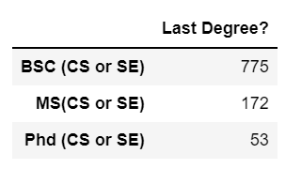
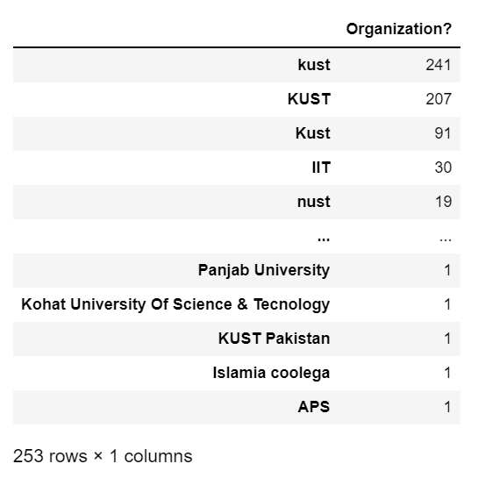
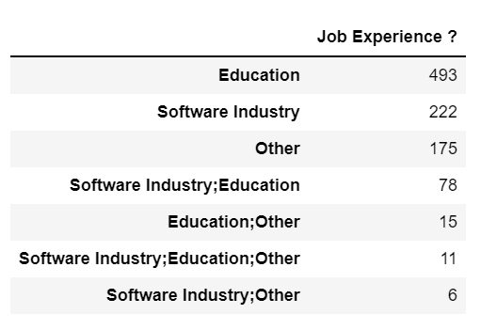

Slide 8
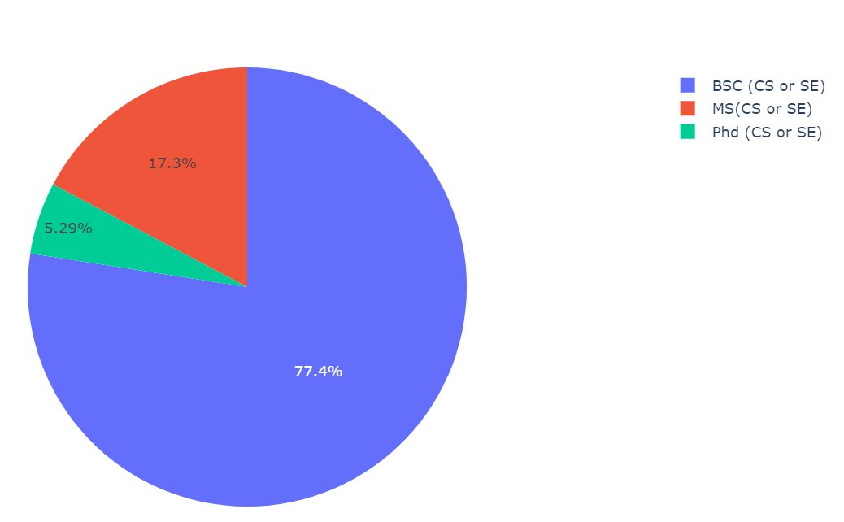
Last Degree?

Slide 9
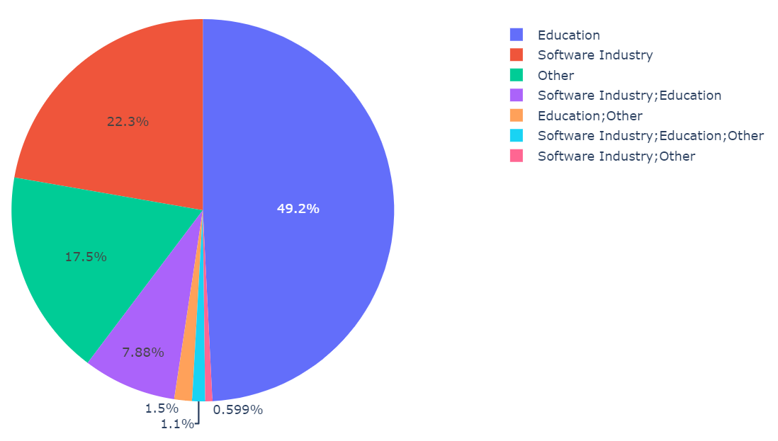
Job Experience ?

Slide 10
Last Degree vs Architectural Styles

Slide 11
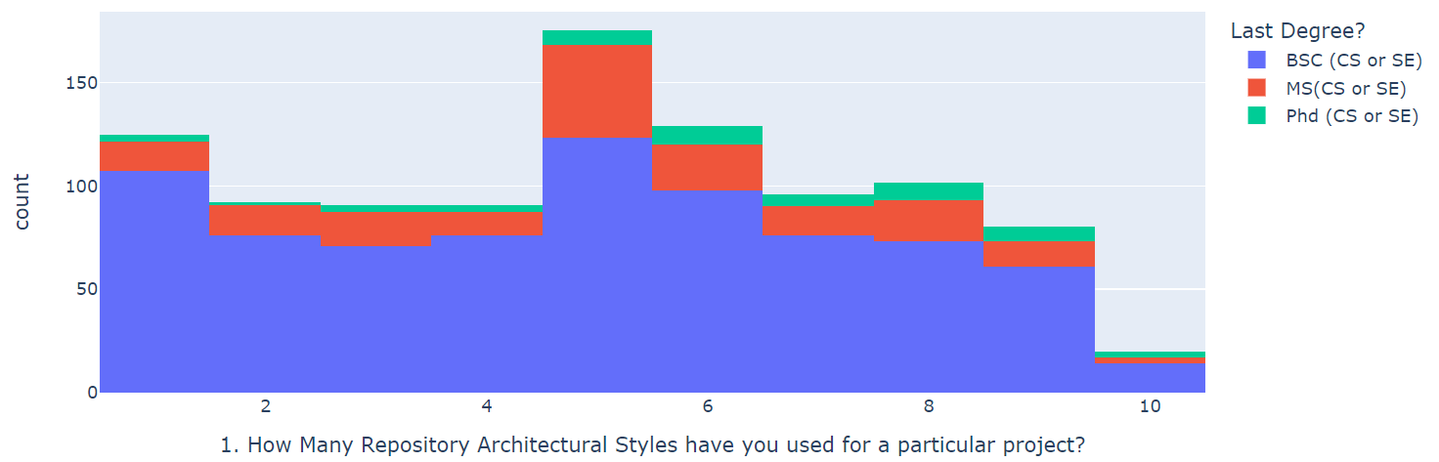
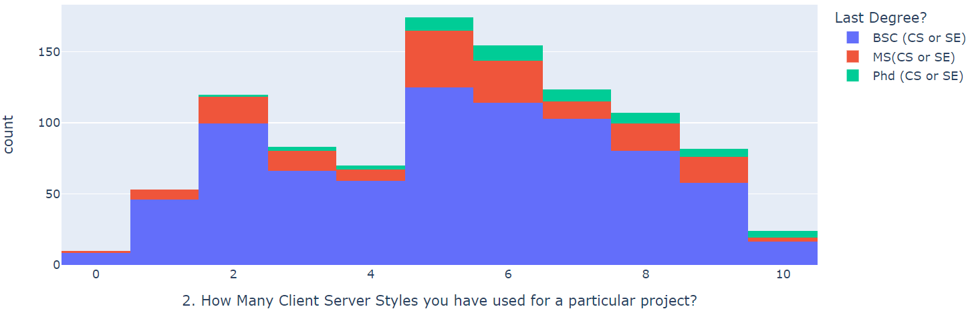
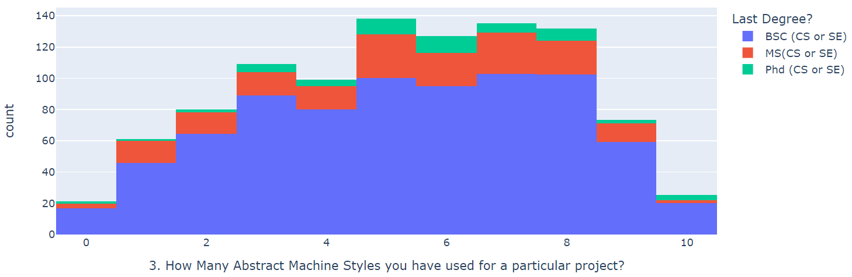
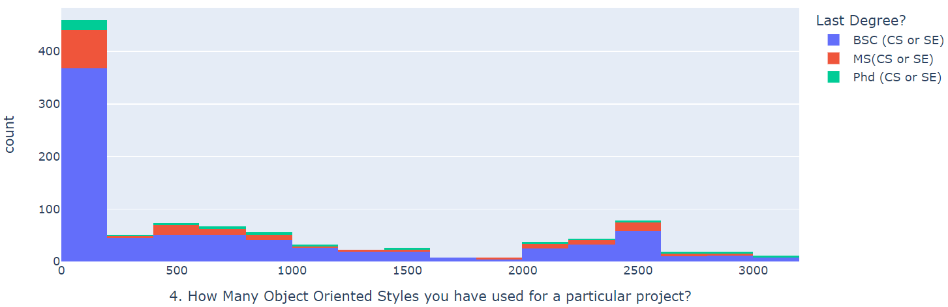

Slide 12
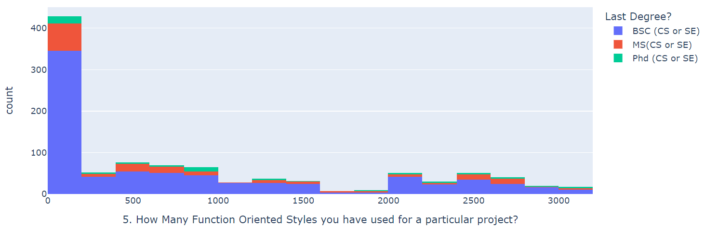
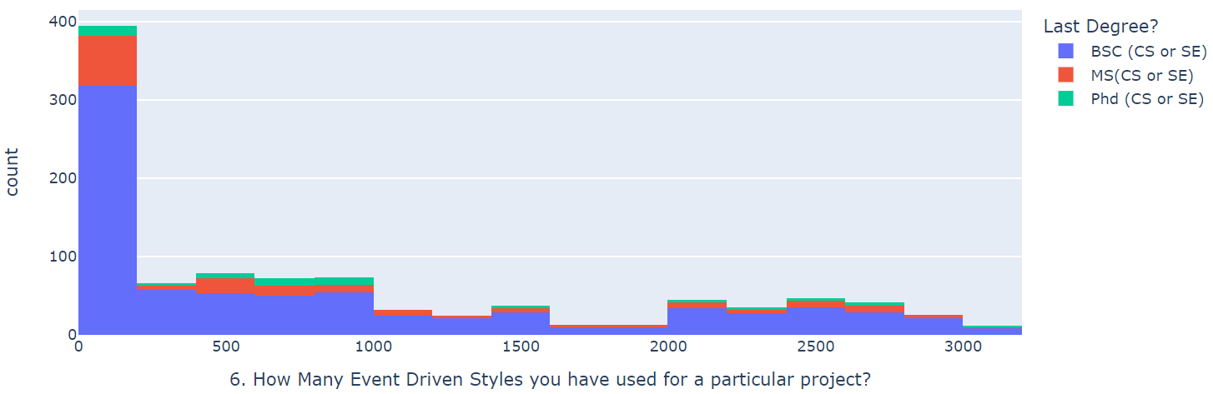
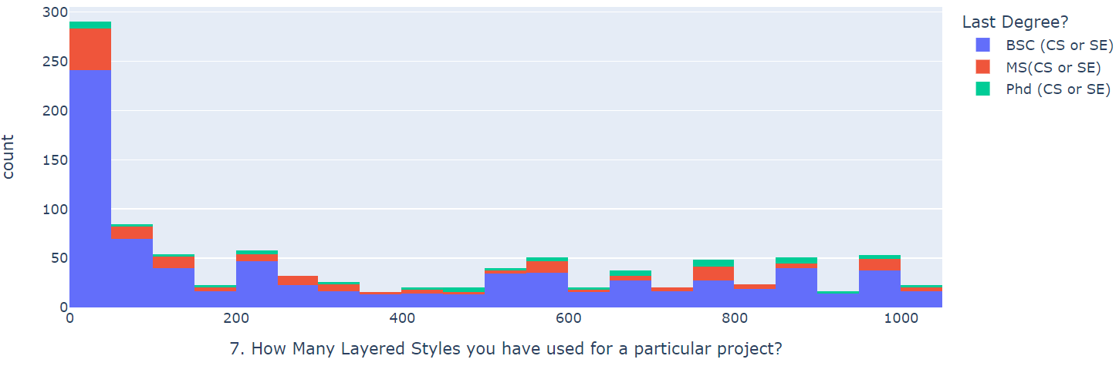
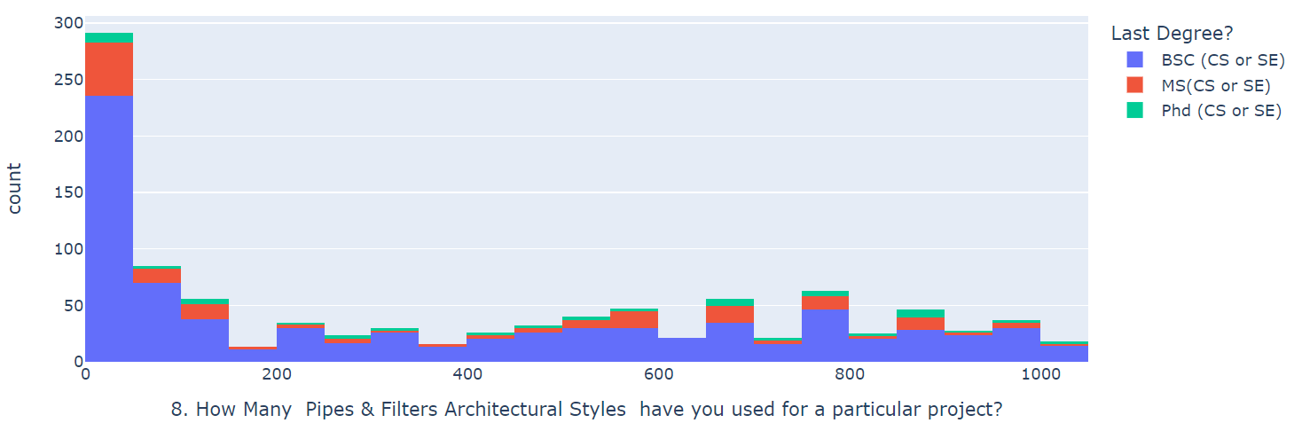

Slide 13
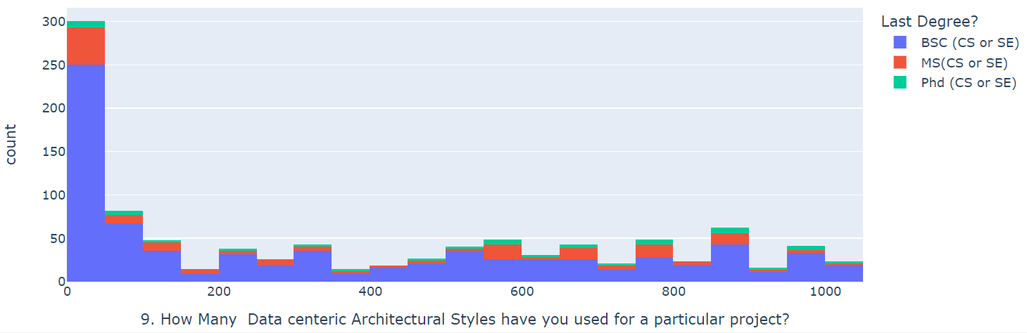
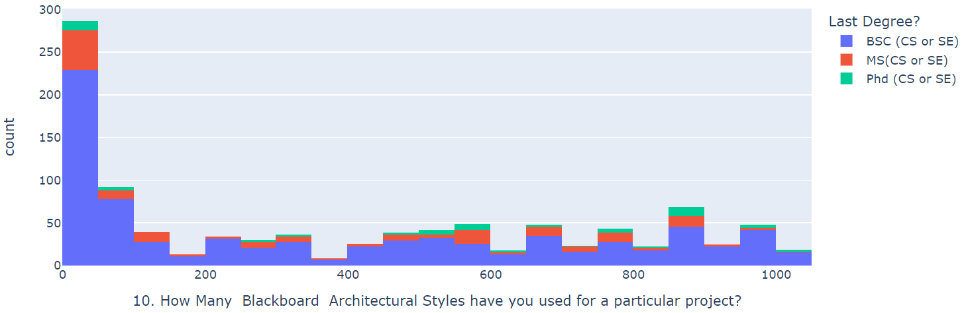
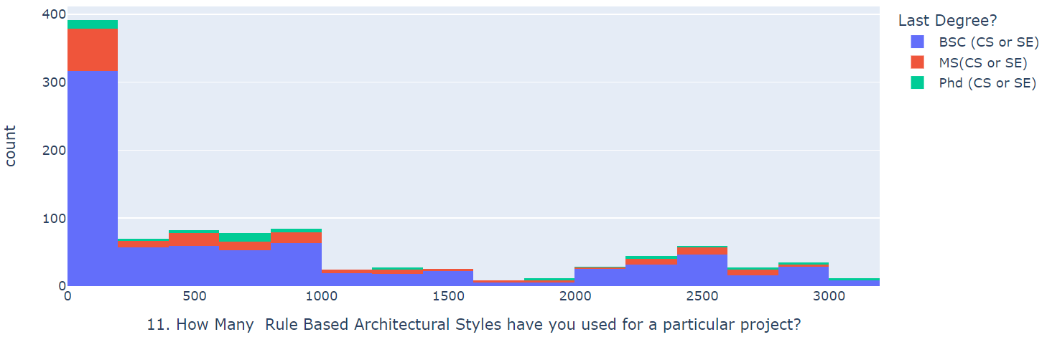
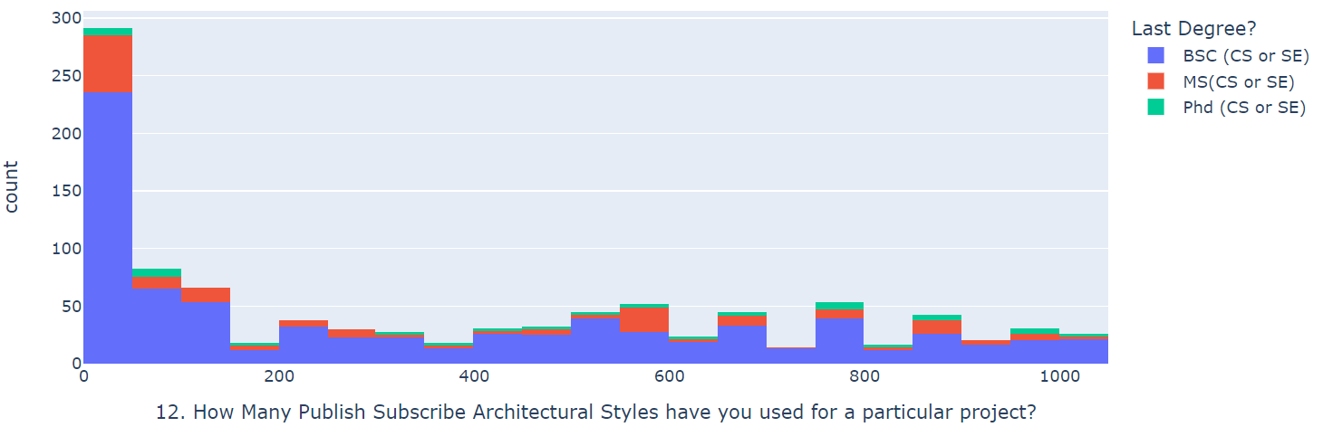

Slide 14
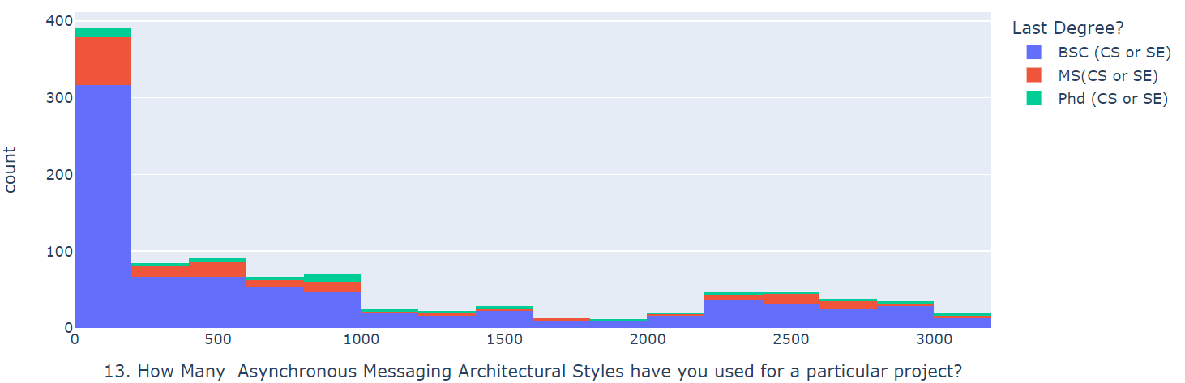
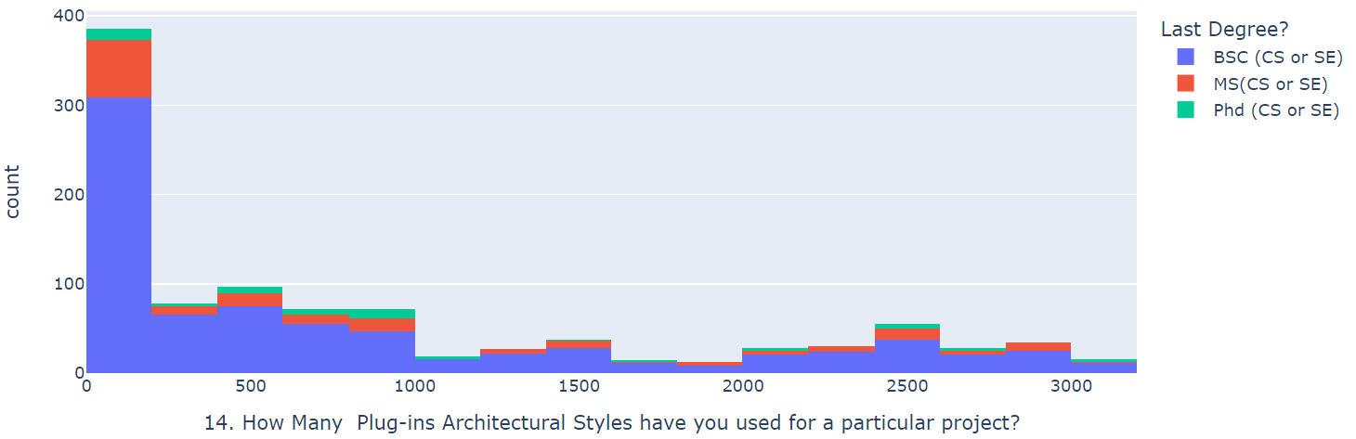
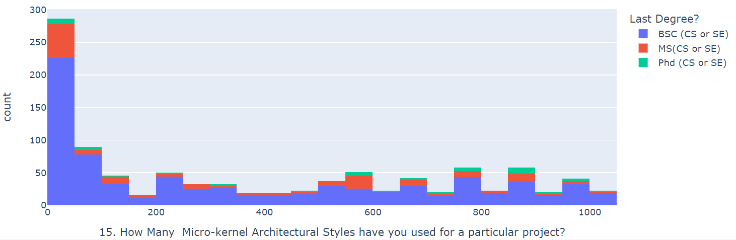
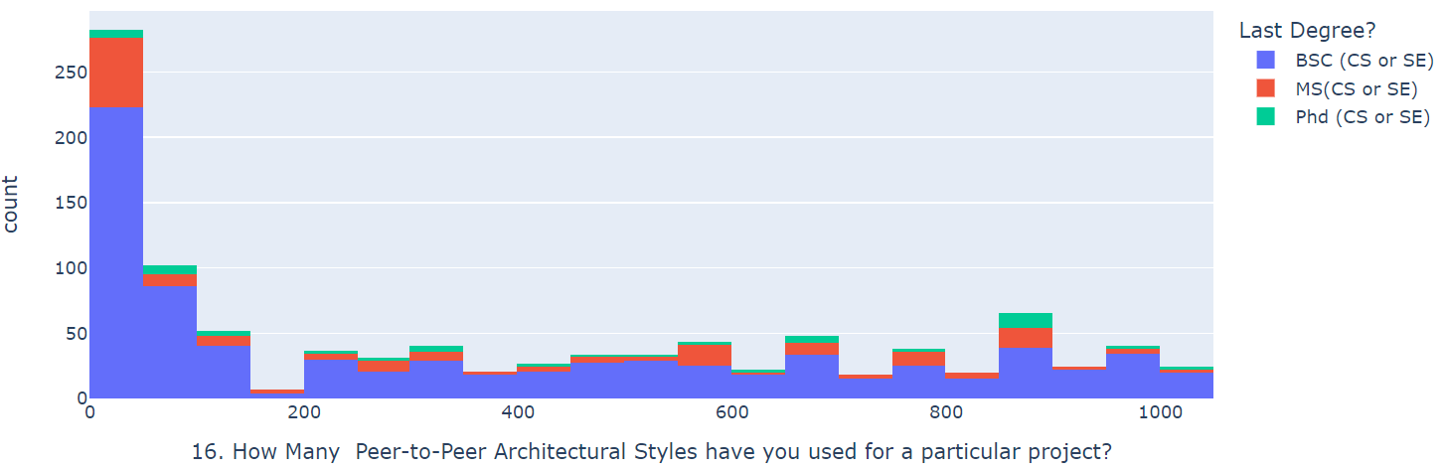

Slide 15
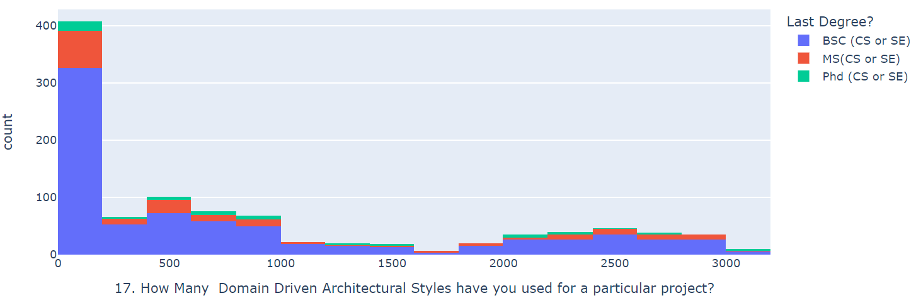


Slide 16
Job Experience vs Architectural Styles

Slide 17
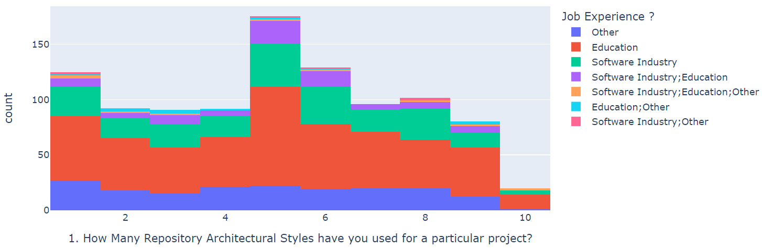
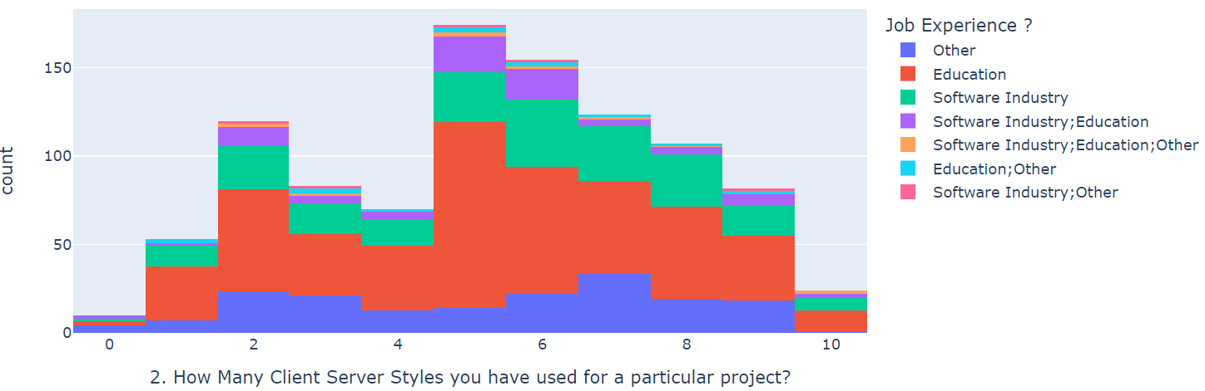
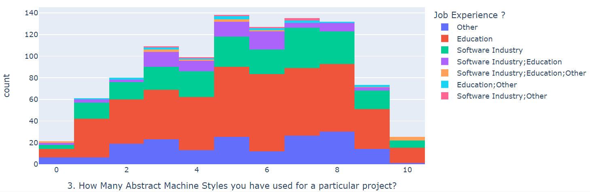
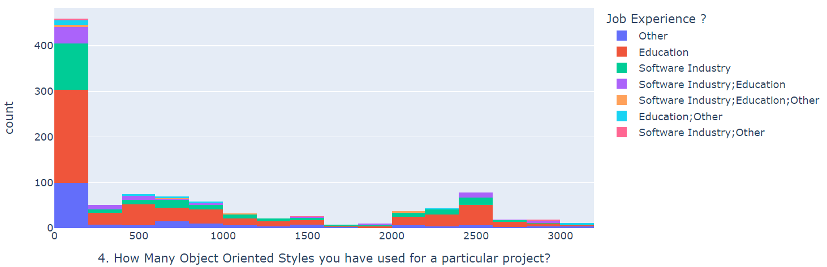

Slide 18
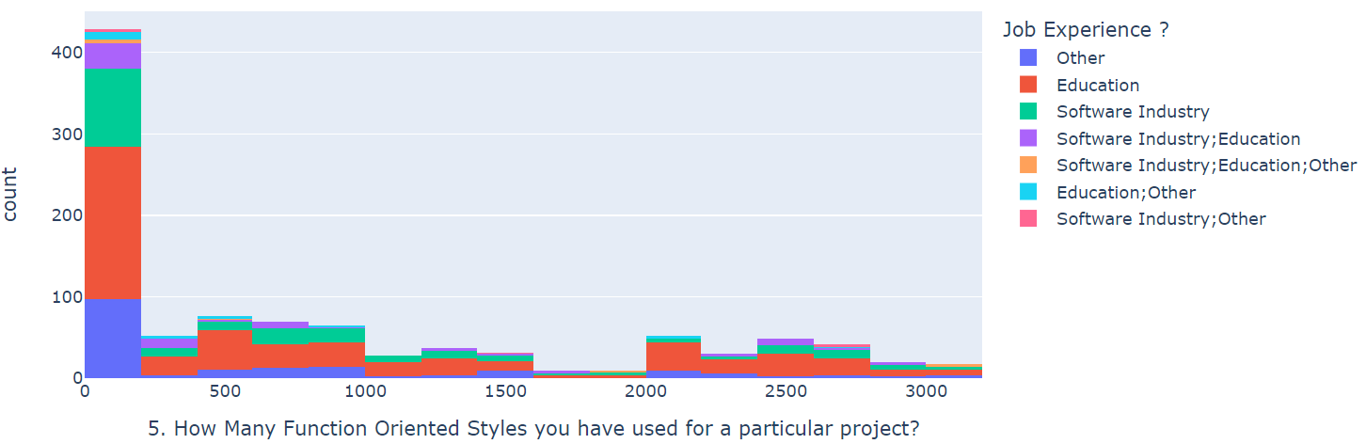
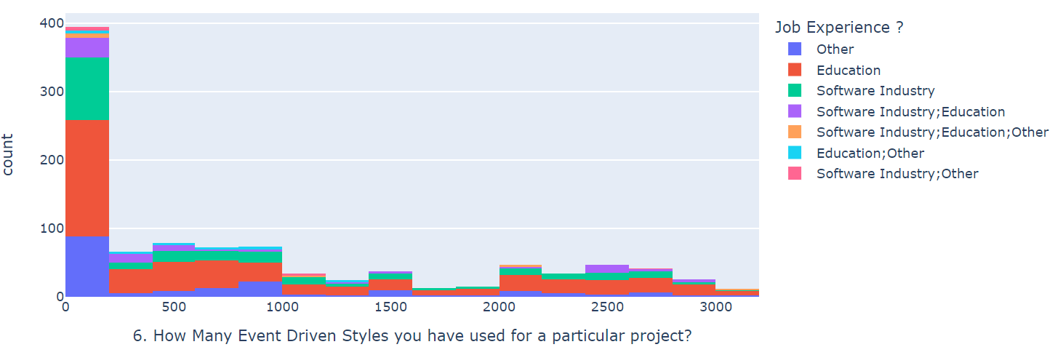
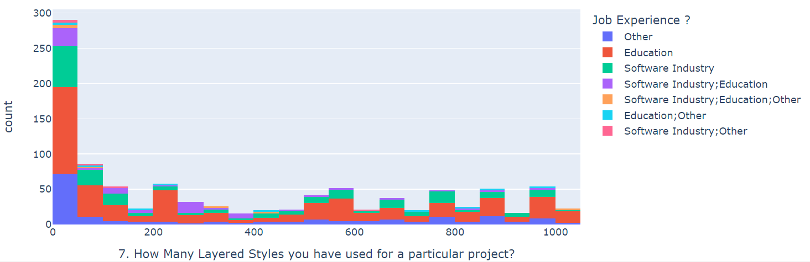
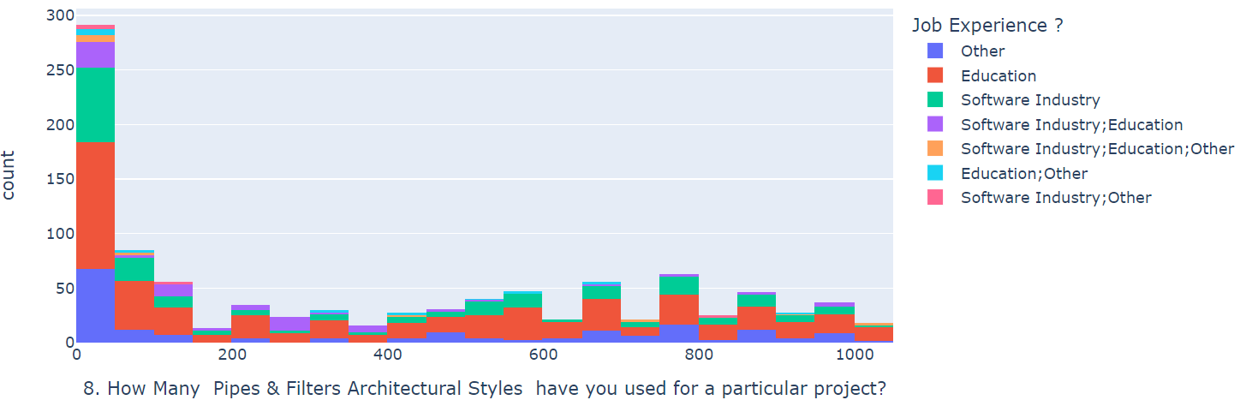

Slide 19
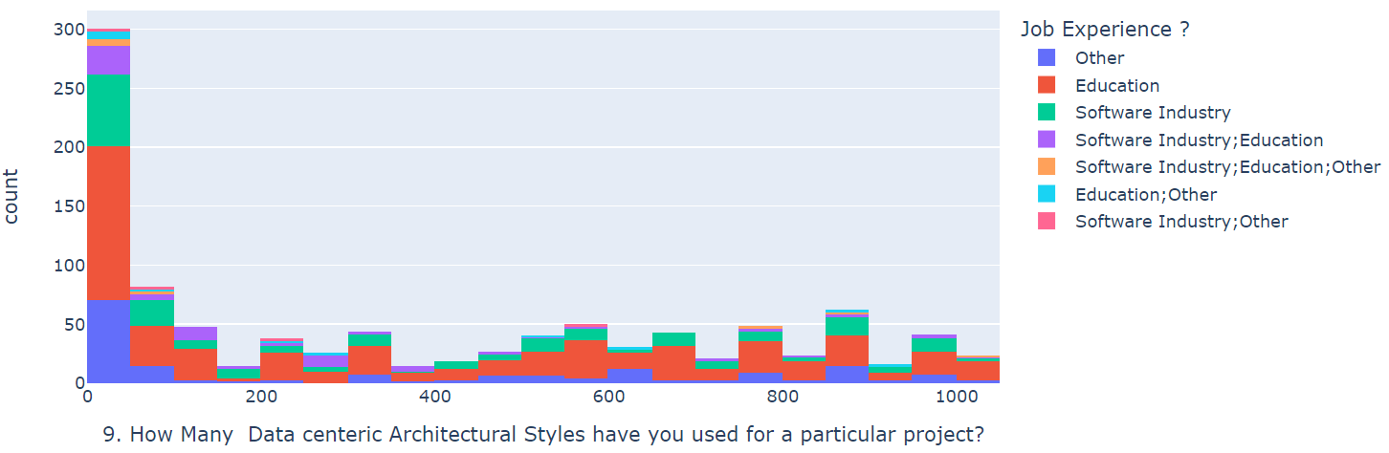
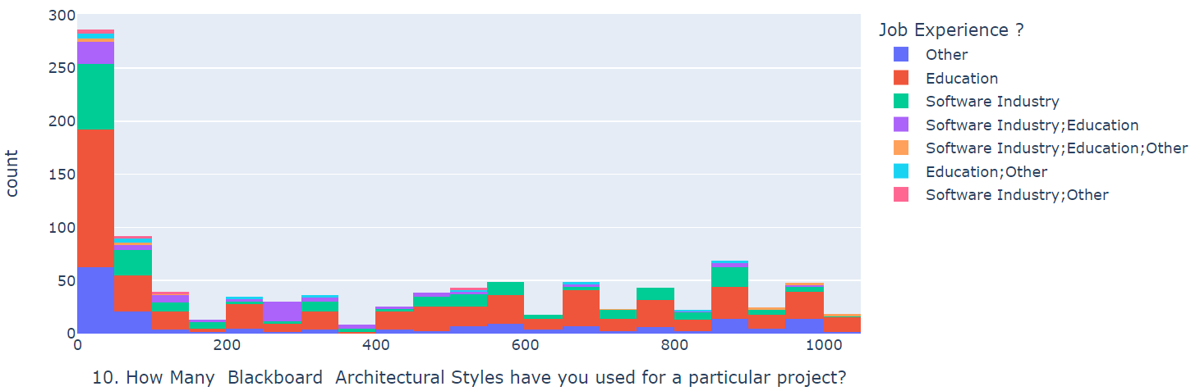
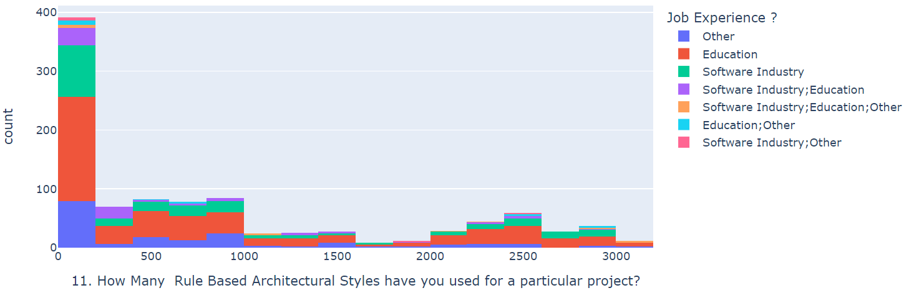
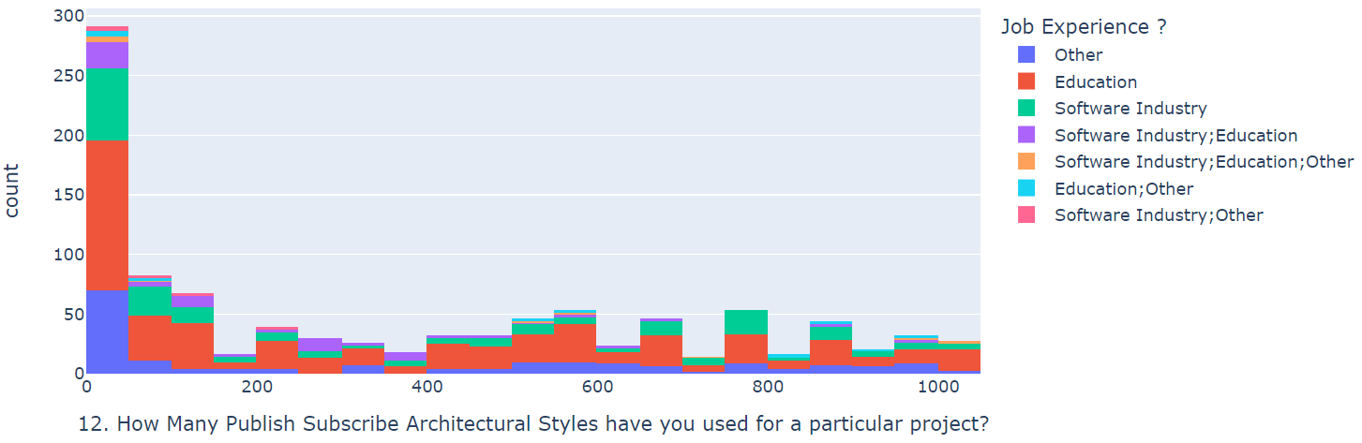

Slide 20
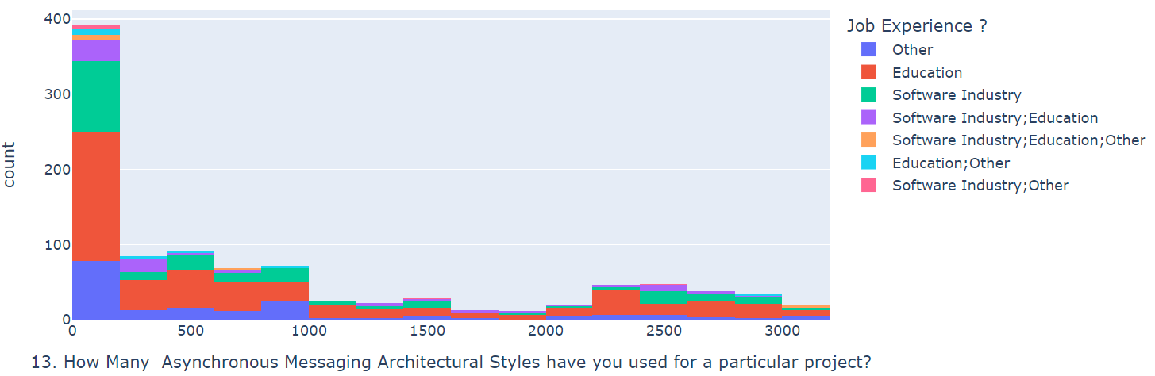
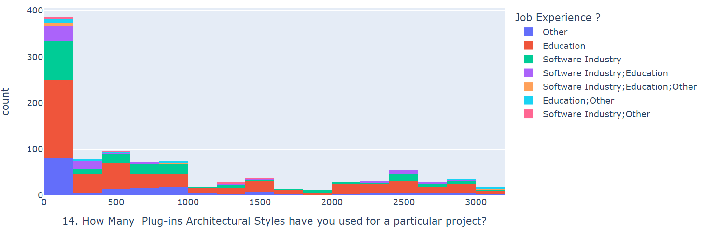
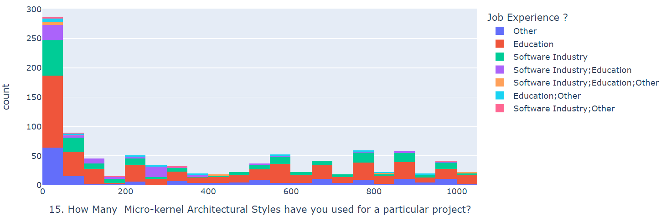
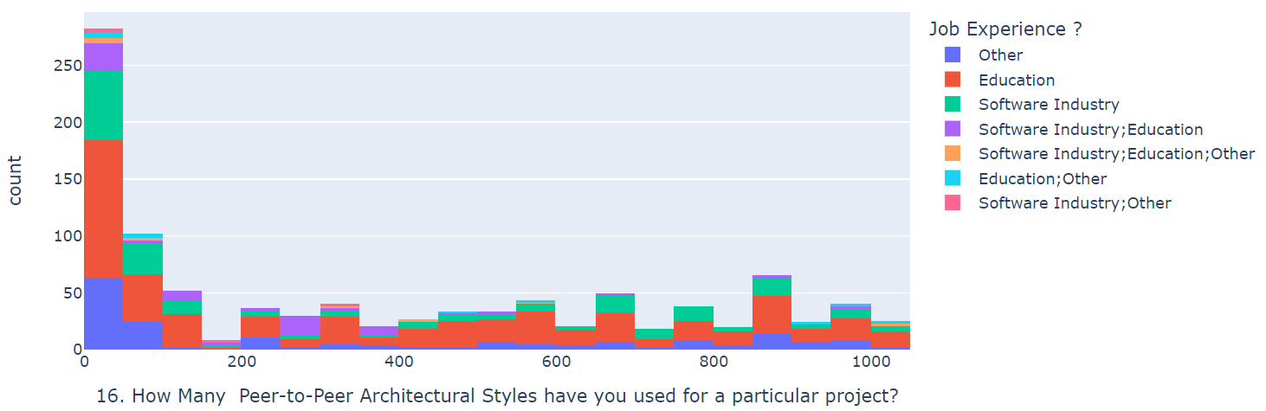

Slide 21
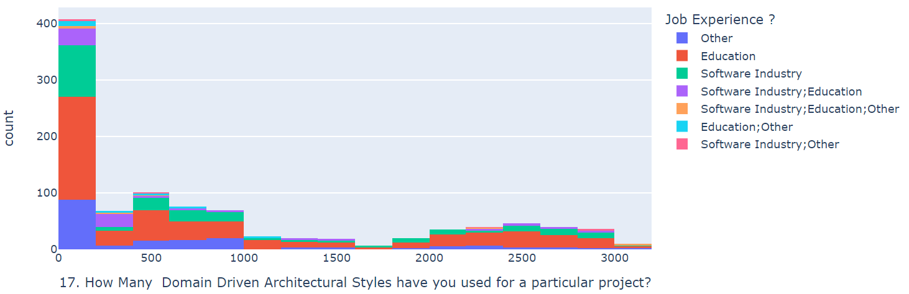
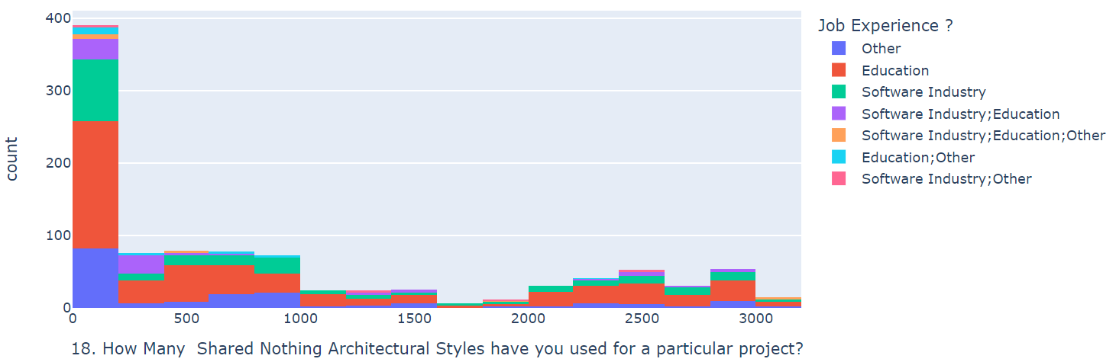

Slide 22
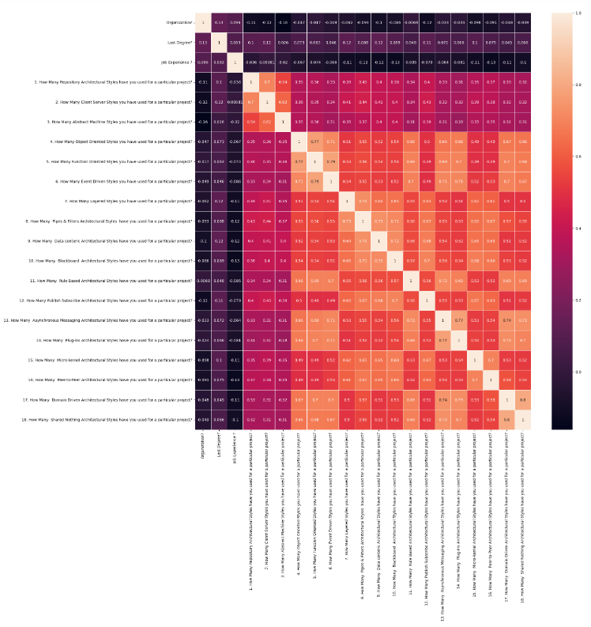
Heatmap

Slide 23
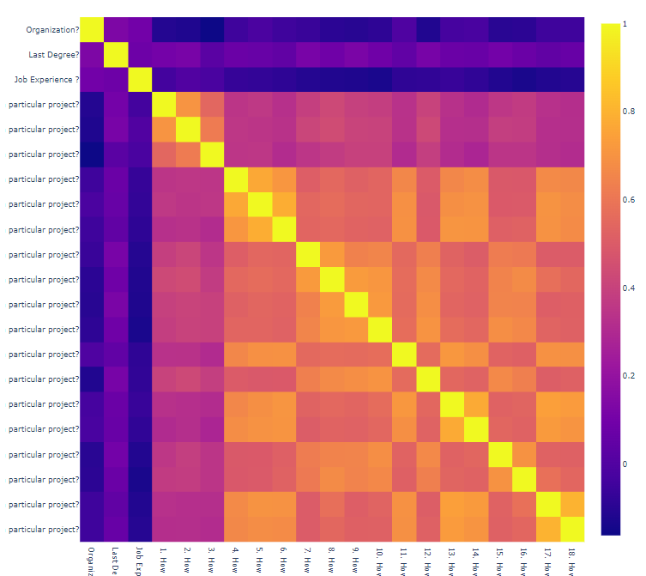

Slide 24
Machine Learning Algorithms
We have employed the following machine learning algorithms:
  Logistic Regression
  Decision Tree Classifier
  KNN Classifier

Slide 25
Logistic Regression
Logistic regression is a classification model used to predict the relation between dependent and independent features. In binary logistic regression the target or dependent variable should be a single feature whereas the independent variables could be multiples features. This model is mostly employed when the target variable is in binary format i.e., if the data to be predicted is either yes or no and true or false. When the dependent or target attribute has more than two possible unordered options then multinomial logistic regression can be used. If the target variable has more than two possible ordered options, then ordinal logistic regression can be used for predicting the relation between the target and independent features.

Slide 26
Decision Tree Classifier
Decision tree classifier can be used for performing classification tasks. This algorithm consists of a tree like structure and has root node, intermediate nodes, branches, and leaf nodes. The target or the dependent variable forms the leaf nodes and the test to be performed on independent variables forms the root and intermediate nodes. The results of these tests are represented by the branches in the tree. Decision tree classifier can be used when we are dealing with multidimensional data i.e., when we have a greater number of features. Based on the results of the tests performed on independent features the algorithm will generate subsets and this process is continued until the lead nodes are reached.

Slide 27
KNN Classifier
K-Nearest Neighbor algorithm makes prediction based on the proximity between the data points. This classifier can be used for both classification and regression tasks. However, it is mostly employed for performing classification tasks. This classifier assigns a label to the new data point based on label that is more commonly reported near that new data point.

Slide 28
Target Variable: Last Degree?

Slide 29
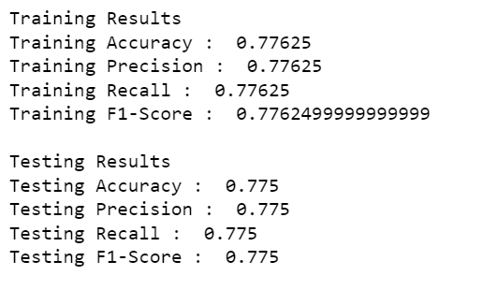
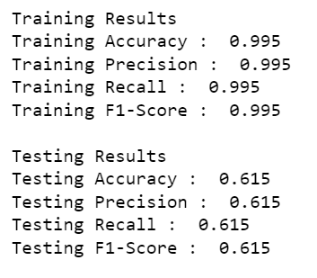
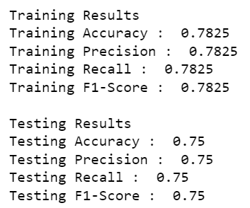
Logistic Decision KNN
Regression Tree Classifier Classifier

Slide 30
Overfitting
Overfitting case is observed when the machine learning model fits closely to the training data but not the testing data.
We have observed the overfitting condition when training the model with decision tree classifier. This condition might have raised due to the large amount of irrelevant data present in the dataset.

Slide 31
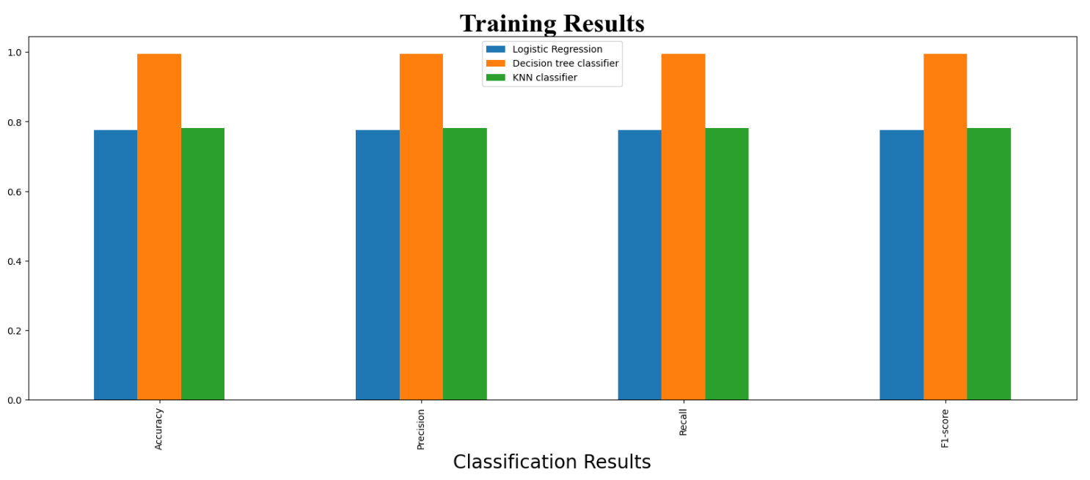
Plots of Classification Results

Slide 32
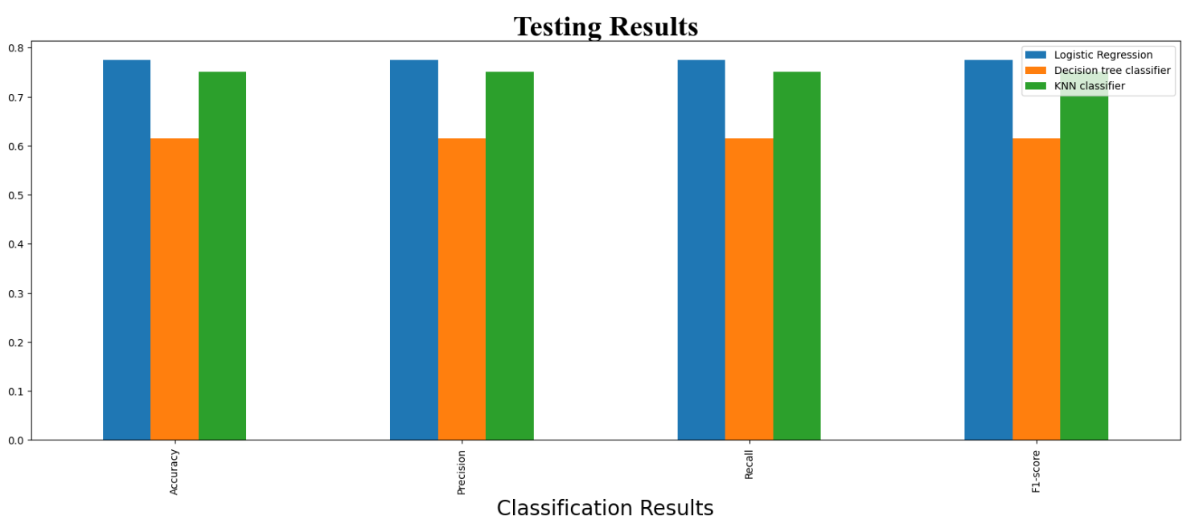

Slide 33
Target Variable: Job Experience ?

Slide 34
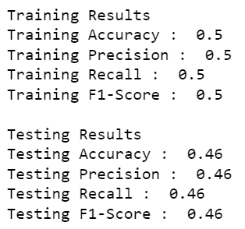
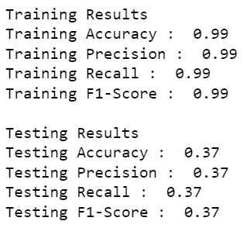
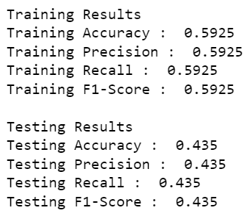
Logistic Decision KNN
Regression Tree Classifier Classifier

Slide 35
Overfitting
Even when we were predicting the Job Experience feature, we have observed overfitting condition when the model is trained with decision tree classifier. It might be because of the same reason as mentioned i.e., large amounts of irrelevant information being present in the dataset.

Slide 36

Plots of Classification Results

Slide 37


Slide 38
Conclusion
Software architectural styles are really very useful as they provide us information regarding how the entire code of the business is being organized on a high level. So, we have worked on a dataset that contains information regarding the educational qualifications of the developers and the different software architectural styles they have used in projects. We built models to predict the educational qualifications of the developer such last degree and job experience based on the software architectural styles they have used.

Slide 39
Thank
You

