Slide 1
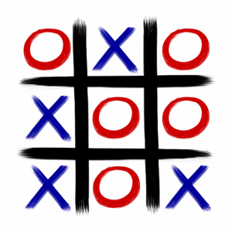
Tic Tac Toe
Reinforcement Learning Game In Python
Presenter:
Divya Saxena (1001773376)
1

Slide 2
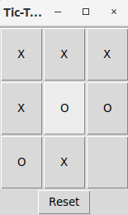
Introduction
To play Tic Tac Toe against a computer player trained by playing 20,000 games against itself. This will bring up a simple GUI in which clicking on any of the buttons causes the mark "X" to appear and the computer to immediately respond with a countermove.
CSE-6369-002-Reinforcement Learning
1

Slide 3
Introduction contd..
Two Tic-Tac-Toe games have been implemented . One is Fair and other is Unfair.
In Unfair, one party randomly starts and there is a 10% chance that at any point, one of the players has to give up a turn (or in other terms where a move fails to deposit a token)
In Fair,it has been designed such that it is not possible to beat Qplayer.
It can also be played against “T-hand” player by Human_vs_Tplayer. The “T-hand” player makes winning moves if they are available and blocks those of opponents otherwise choosing moves at random. Unlike the Q player, it can be beaten with the right strategy.
CSE-6369-002-Reinforcement Learning
1

Slide 4
Technical Requirements
Language: Python 3.5
Libraries: numpy, tkinter, copy, pickle, matplotlib
OS: Linux
Integrated Development Environment: PyCharm
CSE-6369-002-Reinforcement Learning
1

Slide 5
Process
In the game of Tic Tac Toe, at each discrete time step t, the state of the system is defined by which player’s turn it is, and the available actions by the empty squares on the board.
A policy tells which action to take in which state to maximize our chance of winning.
Given a policy , at any given time each state has a certain value , which is the expected discounted reward from following that policy for all future time:
where is the reward at time step and represents the discount factor.
CSE-6369-002-Reinforcement Learning
1

Slide 6

Process contd..
In this implementation of Tic Tac Toe, ‘sign convention’ is adopted that reward is positive for player “X” – specifically, a reinforcement of is awarded when player “X” wins, when player “O” wins, and in the case of a tie. Hence, player “X” seeks to maximize value, whereas player “O” seeks to minimize it. The discount factor is given a value of .
(Its value is not so important in Tic Tac Toe as the game is deterministic with a finite time horizon).
In the attempt to find the optimum policy such that the value achieves a unique optimum value . To this end the evaluation function is defined as the maximum discounted cumulative reward that can be obtained by starting from state applying the he implementation of Q-learning follows the pseudo-code given by Meeden.
In the game of Tic Tac Toe, at each discrete time step t, the state and applying as first action:
where is the state that results from applying action in state .
1.0
-1.0
0.5
0.9
s
a
a
s
CSE-6369-002-Reinforcement Learning
1

Slide 7




Process contd..
To optimize the total future discounted reward, the action must be the one which maximizes Q:
which, upon inserting into the above equation, leads to Bellman’s equation:
This recursive definition of Q provides the basis for Q-learning. Lets start initial estimate
of and choose an action , thereby obtaining an immediate reward
and arriving at a new state . If the estimate is correct, the expected difference
would be zero. If it is not zero, but slightly positive (negative), then the action and resulting reward can be viewed as ‘evidence’ that the estimate is too low (high).
a
a
CSE-6369-002-Reinforcement Learning
1

Slide 8

Process contd..
The way this ‘discrepancy’ is handled is by simply adding this difference, weighted by learning factor , to the previous estimate to obtain a revised estimate :
In this implementation of Q-learning for Tic Tac Toe, has the form of a dictionary, the keys of which are the states of the game (represented by the game’s and the mark of player whose turn it is) and the values are again dictionaries containing the current estimate of the for each available move (i.e., empty square). Bellman’s equation is implemented in the method of the class, which is called on every move.
The game’s is shared with any instances of playing the game, which uses it to make its move decisions. Following the implementation by Heisler, the follows an “ -greedy” policy, meaning that with probability it chooses a random move, and otherwise it follows the policy dictated by – that is, if the player has mark “X” (“O”), choose the move with the highest (lowest) Q-value, in accordance with our ‘sign convention’. During training, is set to a high value to encourage exploration, whereas for the actual match against a human, it is set to zero for optimal performance.
Q
Board
Q
learn_Q
Game
Q
QPlayer
QPlayer
Q
epsilon
CSE-6369-002-Reinforcement Learning
1

Slide 9
Implementation
Programming Language - Python 3.5
Policy File - /Code/policy.p
Libraries – pickle, numpy, tkinter, copy, matplotlib
Python Files -
Code/TTT_Human_vs_TPlayer.py
Code/TTT_Human_vs_Qplayer.py
Code/TTT_Human_vs_QPlayer_fair.py
Code/TTT_Qplayer_training.py
Code/TTT_Qlearning.py
Code/TTT_Qplayer_training_fair.py
Code/TTT_QLearning_fair.py
Code/graphplt.py
Code/Player.py
Code/Board.py
CSE-6369-002-Reinforcement Learning
1

Slide 10
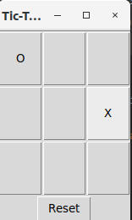
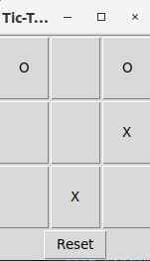
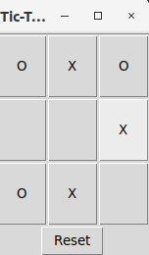
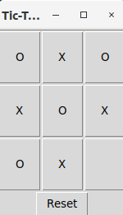
Game Steps
Sample steps for Tic Tac Toe
CSE-6369-002-Reinforcement Learning
1

Slide 11
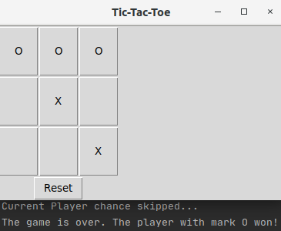
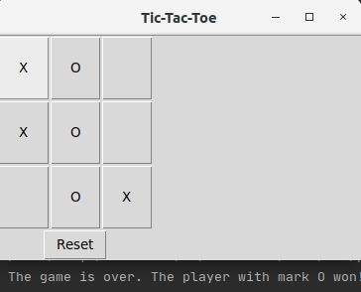
Game Steps contd..
Unfair Tic Tac Toe: When player’s turn get skipped
Fair Tic Tac Toe
CSE-6369-002-Reinforcement Learning
1

Slide 12
Rewards
Rewards earned by the agent as follows:
Player X won -> positive reward (+1)
Player O won -> negative reward ( -1)
A smaller positive reward for cat's game(Draw) (+0.5)
No reward if the game is not yet finished (0.0)
CSE-6369-002-Reinforcement Learning
1

Slide 13
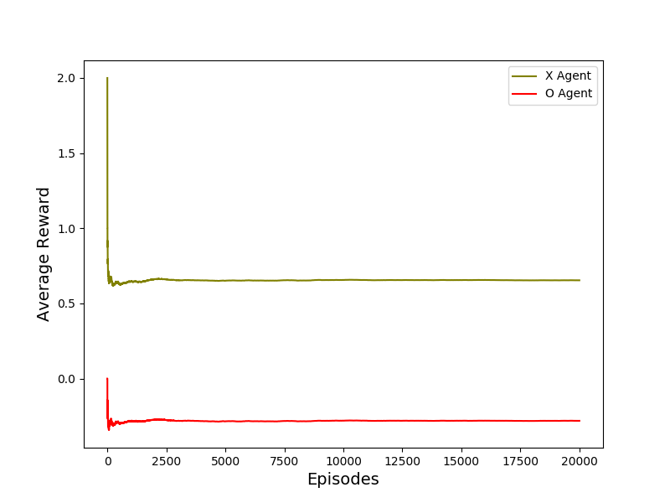
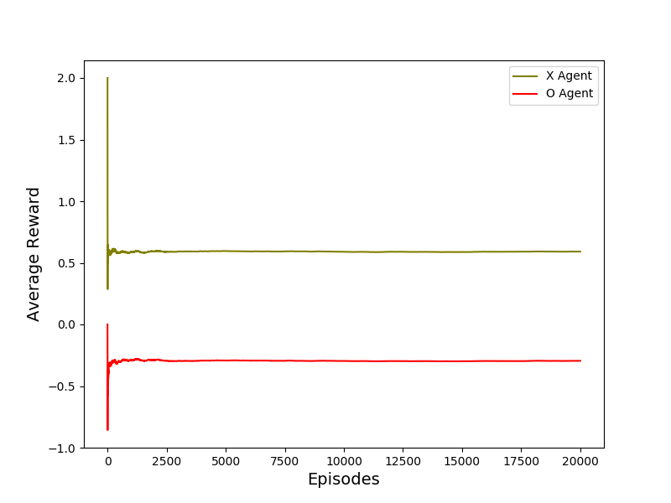
Graphs
Fair TicTacToe game: It shows the average reward earned by “X” and “O”player in 20000 episodes using Q learning
Unfair TicTacToe game(10% chance of skipping current’s player turn): It shows the average reward earned by “X” and “O”player in 20000 episodes using Q learning
CSE-6369-002-Reinforcement Learning
<number>

Slide 14
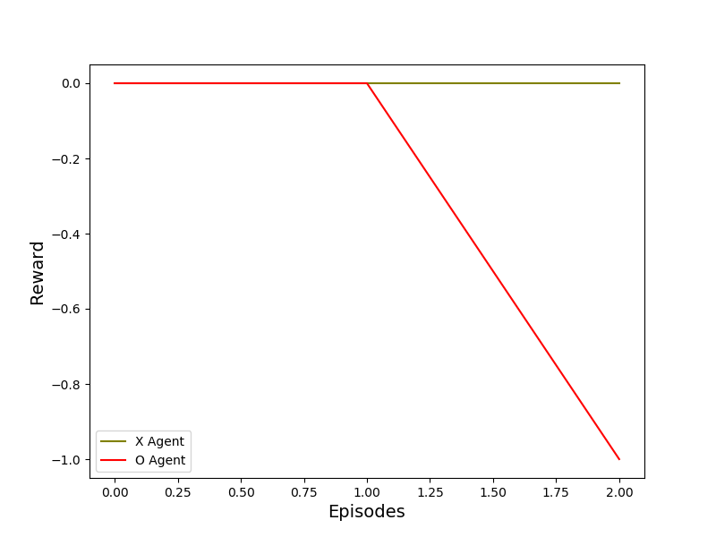
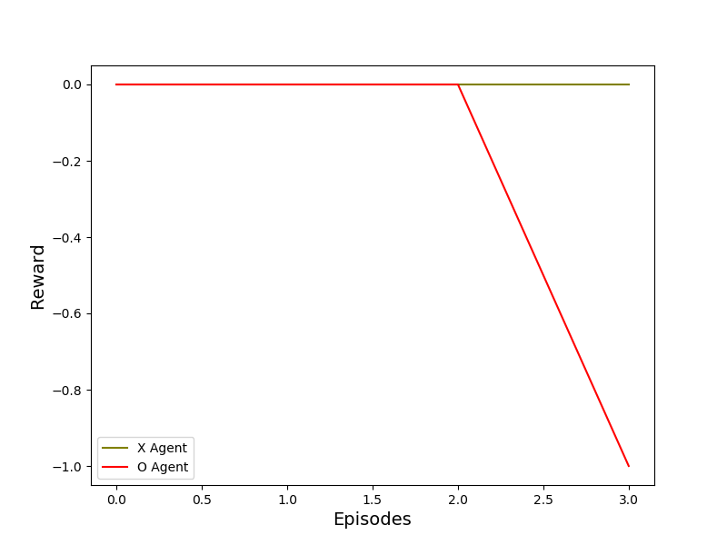
Graphs contd..
Fair TicTacToe game: It shows the reward earned by “X” and “O”player game played between Human vs Q player after getting trained
Unfair TicTacToe game :It shows the reward earned by “X” and “O”player game played between Human vs Q player after getting trained
CSE-6369-002-Reinforcement Learning
<number>

Slide 15
Pseudo Code
Implement Tic-Tac-Toe where one party randomly starts and there is a 10% chance that at any point one of the players has to give up a turn (or in other terms where a move fails to deposit a token):
TTT_QPlayer_training.py
self.chance = round(np.random.random_sample(), 1)
if self.chance != 0.1:
if self.curr_player == self.player1:
self.curr_player = self.player2
self.other_player = self.player1
else:
self.curr_player = self.player1
self.other_player = self.player2
else:
print("Current Player chance skipped...")
if self.curr_player == self.player1:
self.curr_player = self.player1
self.other_player = self.player2
else:
self.curr_player = self.player2
self.other_player = self.player1
CSE-6369-002-Reinforcement Learning
<number>

Slide 16
Code Description
graphplt.py
Plot the graphs using matplotlib.
Player.py
Contains a class which is used to check the marks “X” or “O” for each player.
Board.py
Contains a class which is used for setting the board to play the game like setting of reward earned by each player, available moves, etc.
TTT_Qlearning.py
Q learning algorithm on which the model gets trained on in 20000 episodes. This file also contains the logic for unfair game i.e. one party randomly starts and there is a 10% chance that at any point one of the players has to give up a turn.
TTT_Qlearning_fair.py
Q learning algorithm on which the model gets trained on in 20000 episodes. This file contains the logic for fair game.
TTT_Qplayer_training.py
Triggers Q learning implemented in TTT_Qlearning.py and plot the graph average reward earned by each player in 20000 episodes. This is for unfair Tic Tac Toe. Policy file policy.p will be created and saved in /Code location.
CSE-6369-002-Reinforcement Learning
<number>

Slide 17
Code Description contd..
TTT_Qplayer_training_fair.py
Triggers Q learning implemented in TTT_Qlearning.py and plot the graph average reward earned by each player in 20000 episodes. This is for fair Tic Tac Toe. Policy file policy.p will be created and saved in /Code location.
TTT_Human_vs_Qplayer.py
Allow Human to play against Q player using Policy policy.p. If the model has been trained for fair Tic Tac Toe(TTT_Qplayer_training_fair.py), Human will play against it. If model has been trained for unfair(10 % chance of skipping current players chance) Tic Tac Toe(TTT_Qplayer_training.py), Human will play against it.
TTT_Human_vs_Qplayer_fair.py
Allow Human to play against Q player using Policy policy.p. If the model has been trained for fair Tic Tac Toe(TTT_Qplayer_training_fair.py), Human will play against it. If model has been trained for fair Tic Tac Toe(TTT_Qplayer_training.py), Human will play against it.
TTT_Human_vs_Tplayer.py
Allow Human to play against T player. The "T-hand" player makes winning moves if they are available and blocks those of opponents, otherwise choosing moves at random. Unlike the QPlayer, it can frequently be beaten with the right strategy.
CSE-6369-002-Reinforcement Learning
<number>

Slide 18
Conclusion
For Fair Tic Tac Toe, after 20,000 training games against itself with epsilon=0.9, the Q Player seems practically unbeatable by a human player.
It would be instructive, however, to check this by putting it against a player following the minimax algorithm for many games.
It would also be interesting to check the finding that a Q-learned player is able to beat the "T-hand" player maximum of the time and draw in remaining games.
For UnFair Tic Tac Toe, after 200,000 training games against itself with epsilon=0.9, the outcome becomes unpredictable.
Most probable chance for wining the game is the player who plays first in the game when the game falls in 10% chance scenario
CSE-6369-002-Reinforcement Learning
<number>

Slide 19
(For more details, please refer ProjectReport.doc)
Thank you !
CSE-6369-002-Reinforcement Learning
<number>

