Slide 1

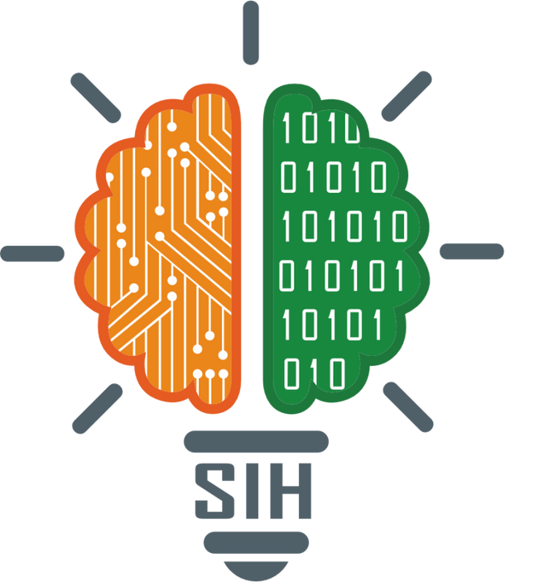
SMART INDIA HACKATHON 2025
TITLE PAGE
Problem Statement ID – SIH25203
Problem Statement Title- AI-Powered Multilingual Content
Localization Engine for Skill Courses
Theme- Miscellaneous
PS Category- Software
Team ID- 76257
Team Name (Registered on portal) – Tech Wizards
AICTE Code- C-19837

Slide 2
IDEA TITLE
Tech
Wizards
PROBLEM STATEMENT
Skill development courses are available only in English or a few major Indian languages.
Learners from rural and regional backgrounds face difficulty in understanding and retaining course content.
Lack of localized study materials and videos creates a digital divide.
SOLUTION
Pravaha is an AI-powered multilingual content localization engine designed to make skill courses accessible in 22+ Indian languages.
It provides a multilingual website interface, localized skill videos (subtitles), and translated study materials, speech-to-text support.
Cultural adaptation, that is, converting American or other language units to Indian friendly units.
Text-to-speech support in a desirable language for differently abled people.
Providing a glossary to refer to words.

Slide 3
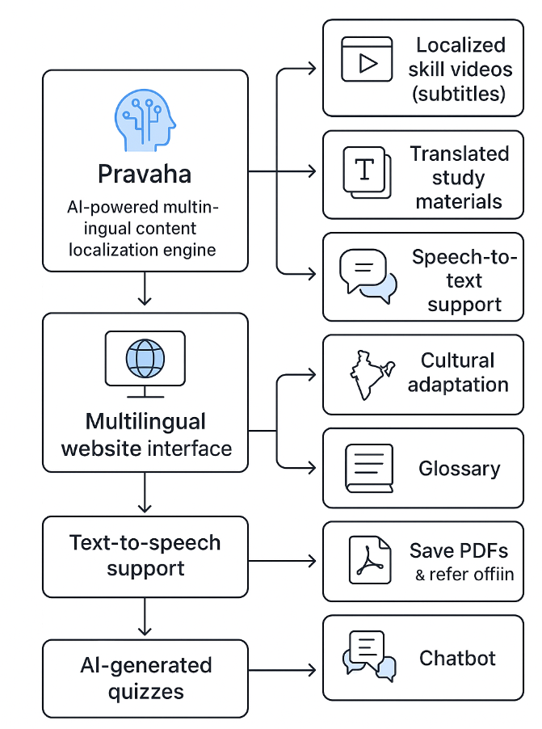
TECHNICAL APPROACH
Tech
Wizards
TECH STACK
Frontend- HTML, CSS, JavaScript
AI Integration- Google Translate (NMT), OpenAI, Wiktionary, OpenCV, spaCy
Video & Course Integration- YouTube API
Personalisation- Chatbase API
Data Storage- MySQL, Google Cloud or MongoDB

Slide 4
FEASIBILITY AND VIABILITY
Tech
Wizards
Feasibility:
Automatic multilingual website interface, skill video localization, and study material translation.
Scalable as more languages and courses are added.
Challenges
Personalized career guidance requires continuous content updates.
Cultural adaptation
Strategies
Include human review for critical translations and key study materials.
Offer downloadable PDFs and offline access for study material.
Use lightweight video streaming.

Slide 5
IMPACT AND BENEFITS
Tech
Wizards
Promotes inclusive education and equal learning opportunities.
Reduces language-based barriers, empowering underserved communities.
Learners from diverse regions can access skill courses in their mother tongue (22+ languages).
Improves learning comprehension and retention by providing content in native languages.
Supports career development through personalized guidance, motivational content, and skill-building videos. Encourages digital inclusion for rural, first-generation, and low-bandwidth users.

Slide 6
RESEARCH AND REFERENCES
Tech
Wizards
Digital India Report 2023-
Language inclusion and digital literacy.
Skill India Mission-
Vocational and skill development frameworks.
Google Translate & NMT documentation-
Neural Machine Translation research.
You Tube API and Chat Base API documentation-
Video integration and personalized content.

