Slide 1

MSPM’S Deogiri Institute of Engineering and Management
Studies,Aurangabad
Academic Year 2019-2020
Department of Computer Science and Engineering Subject:Theory of computation
Topic: Conversion Of Regular Expression to NFA
Git-hub link;
Submitted by Priyanka Dolse(36163)
Divya shah(36164) Under the Guidance of Prof. Sarika Chavan
Asst.Prof.Department of CSE
(Deogiri Institute Engineering and Management Studies)

Slide 2
Non-Deterministic Finite Automaton (NDFA)
Nondeterministic means choice of moves for automata. In non-deterministic finite automata we are allowed a set of possible moves. The definition of nondeterministic automata is similar to that of deterministic finite automata but with one difference, the transition function. A nondeterministic finite automata is s 5-tuple ( Q, Σ, δ, F q₀), where
Formal Definition of a NDFA
A NDFA can be represented by a 5-tuple (Q, ∑, δ, q₀, F) where − Q is a finite set of states. ∑ is a finite set of symbols called the alphabet. δ is the transition function where δ: Q × ∑ → Q q₀ is the initial state from where any input is processed (q₀ ∈ Q). F is a set of final state/states of Q (F ⊆ Q).

Slide 3
Graphical Representation of a NDFA
A DFA is represented by digraphs called state diagram. The vertices represent the states. The arcs labelled with an input alphabet show the transitions. The initial state is denoted by an empty single incoming arc. The final state is indicated by double circles.

Slide 4
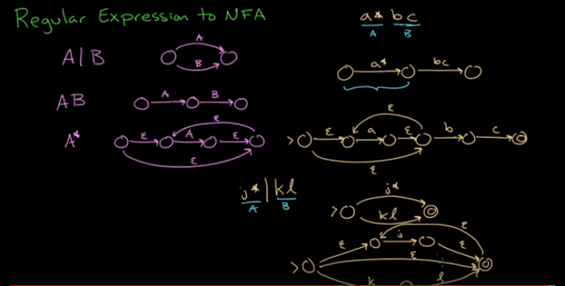

Slide 5
Regular Expressions
Regular Expressions are used to denote regular languages. An expression is regular if:
ɸ is a regular expression for regular language ɸ.
ɛ is a regular expression for regular language {ɛ}.
If a ∈ Σ (Σ represents the input alphabet), a is regular expression with language {a}.
If a and b are regular expression, a + b is also a regular expression with language {a,b}.
If a and b are regular expression, ab (concatenation of a and b) is also regular.
If a is regular expression, a* (0 or more times a) is also regular.

Slide 6
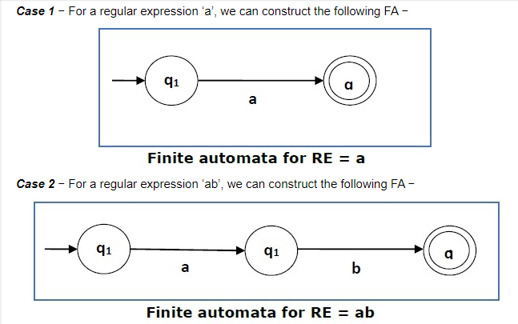

Slide 7
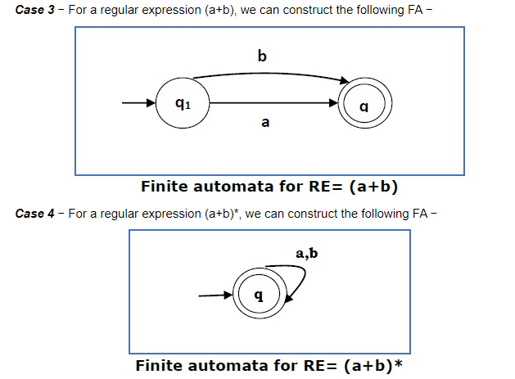

Slide 8
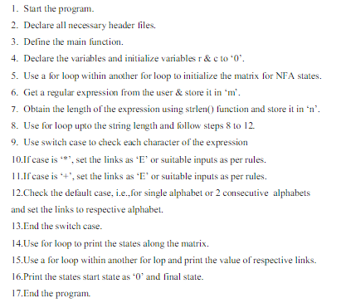
Algorithm

Slide 9
Application
NFAs and DFAs are equivalent in that if a language is recognized by an NFA, it is also recognized by a DFA and vice versa. The establishment of such equivalence is important and useful. It is useful because constructing an NFA to recognize a given language is sometimes much easier than constructing a DFA for that language. It is important because NFAs can be used to reduce the complexity of the mathematical work required to establish many important properties in the theory of computation. For example, it is much easier to prove closure properties of regular languages using NFAs than DFAs.

Slide 10
Conclusion
In this project we learn NFA and how to implemeant the conversion of
regular expression to NFA in c language.

Slide 11
THANK YOU !!

