Slide 1
CS584: Machine Learning Implementation of Result Prediction by Analyzing Data in DotA2
Presenter: Xin Su, Shiyang Li
Instructor: Gady Agam
Department of Computer Science
Illinois Institute of Technology

Slide 2
Outlines
Introduction
Data Collection
Algorithm
Decision Tree
Random Forest (Majority voting / AdaBoost voting)
Performance
Result and Discussion
Conclusion

Slide 3
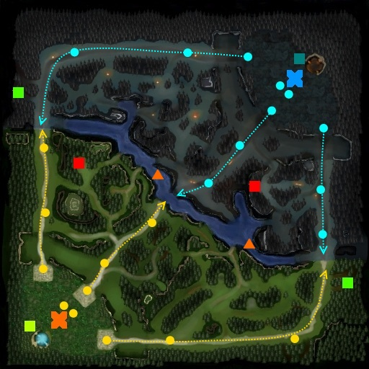
Introduction
DotA2
Multi-player online battle game: 5 vs 5

Slide 4
Data Collection
Filtered WebAPI
Game Duration > 18 min
Features
Each player owns 7 features:
'kills', 'deaths', 'assists’
'last_hits', 'denies’
'gold_per_min', 'xp_per_min’
Total 70 features for one game
Total 1908 lines of data

Slide 5
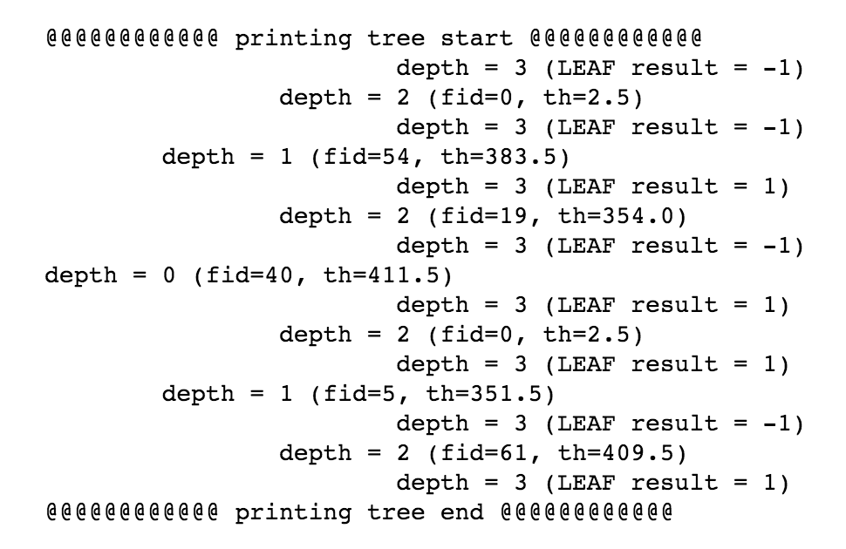
Algorithm - Greedy Decision Tree
Feature split selection
Least classification error
Stopping condition
Data completed separated
No features
Minimum data amount
Maximum tree depth

Slide 6
Algorithm - Random Forest
Data & Feature Split
Bootstrap sampling data
Random m features << total M features
Voting Machine
Majority voting
AdaBoost voting

Slide 7
Algorithm - AdaBoost
T weak models f₁(X)..f_{T}(X), m datasets, n features
Start same weight for all data: α_{i} = 1/m, i = 1..m
for (t in 1 .. T) :
Learn f_{t}(X) with data weights α_{i}
Compute model weight w_{i}
w_{t} = ½ ln((1- weight_error(f_{t})) / weight_error(f_{t}))
Recompute data weights α_{i}
α_{i} = α_{i} exp(-w_{t}), if f_{t}(x_{i}) = y_{i}
α_{i} = α_{i} exp(w_{i}), if f_{t}(x_{i}) != y_{i}
Final model predict by
ÿ = sign(sum_{t=1..T}(w_{t}f_{t}(X)))

Slide 8
Performance
Model | Parameters | Accuracy | Duration
Decision Tree | max_depth=8 min_amt=5 | 0.99 | <= 1s
Random Forest (Majority voting) | min_amt = 5 max_depth = 3 tree_amt = 20 feature_size = 0.1 | 0.984 | <= 16s
Random Forest (AdaBoost voting) | min_amt = 5 max_depth = 3 tree_amt = 20 feature_size = 0.1 | 0.982 | <= 16s
DT | sklearn | 0.79 | <= 0.5s
RF | sklearn | 0.985 | <= 0.5s
SVM | sklearn | 0.99 | <= 0.1s
Naive Bayes | sklearn | 0.99 | <= 0.1s

Slide 9
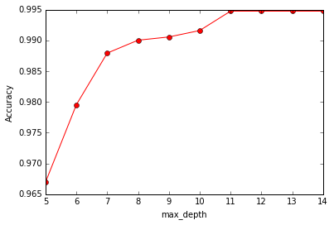
Parameter Exploration
Decision Tree
max_depth

Slide 10
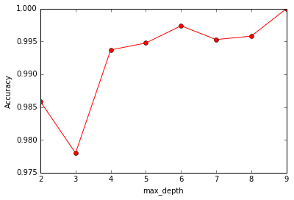
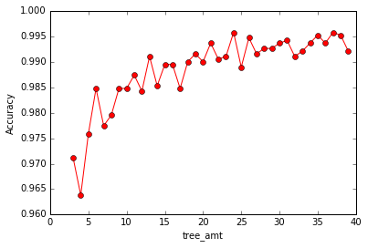
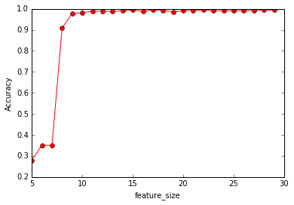
Parameter Exploration
Random Forest
max_depth
tree_amt
feature_size

Slide 11
Algorithm Comparison
Decision Tree
High Accuracy
Fast
Random Forest
High Accuracy
Fast (a little bit slower)
Random Forest (AdaBoost):
High Accuracy
Fast (a little bit slower)
Not contribute too much in this case

Slide 12
Conclusion
Future Work
Predict based on real game timeline
Classification of player’s role

Slide 13
Reference
[1] F. Johansson and J. Wikstr ̈om, “Result prediction by mining replays in dota 2,” Master’s thesis, Blekinge Institute of Technology, SE-371 79 Karlskrona, Sweden, 2015.
[2] “The WebAPI Website,” 2012. http://dev.dota2.com/showthread. php?t=58317 [Online; accessed 10-Mar-2016].
[3] D. P. Kevin Conley, “A Recommendation Engine for Picking Heroes in Dota2,” 2013.
[4] C. G. Emily Fox, “Classification: A machine learning perspective,” University of Washington, Coursera, 2016.
[5] M. P. Atish Agarwala, “Learning Dota 2 Team Compositions,” 2014.
[6] C. M. Kuangyan Song, Tianyi Zhang, “Predicting the winning side of DotA2,” 2015.

