Slide 1

Notes:
Welcome. Over the next minutes I show how we analysed fifteen years of stock movements, how we decided which articles belong on stock, and how we set reorder points from demand. Each part first shows how it was done technically, then what it means for the client. The headline: about 1.27 million less capital tied up, with 95 percent fill. All code, notebooks and the full report are in the repository on the slide.
The talk follows this structure: (1) the challenge and the data, (2) Part 1, where the capital sits, (3) Part 2, which articles belong on stock, (4) Part 3, reorder points, simulation and stress test, (5) the recommendation and next steps. Keep the intro short; the summary slide that follows gives the three headline numbers.

Slide 2
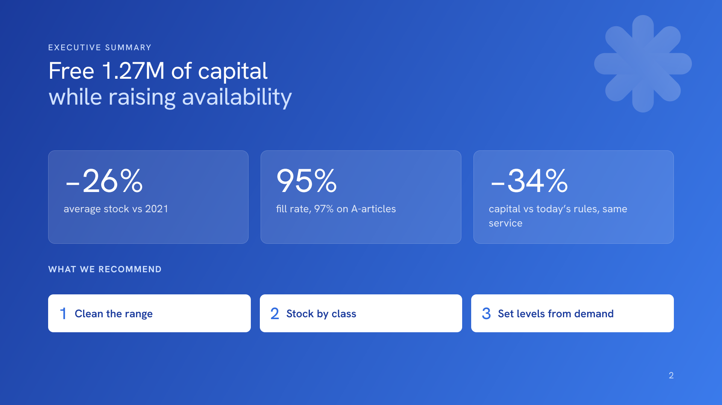
Notes:
Three numbers to remember. Average stock falls by 26 percent compared with 2021: 3.65 million instead of 4.92 million. Availability rises to 95 percent value-weighted fill, 97 percent on the A-articles. And compared with today’s reorder points, the same service needs about a third less capital. The recommendation in three steps: clean the range by de-listing 427 articles and running down idle stock; stock by class, so only Runners and selected Repeaters are held; and set every reorder point from demand, recalculated monthly. All results come from a simulation of test year 2021 on the 1,751 inventory articles; values are in the dataset’s anonymised currency units.

Slide 3
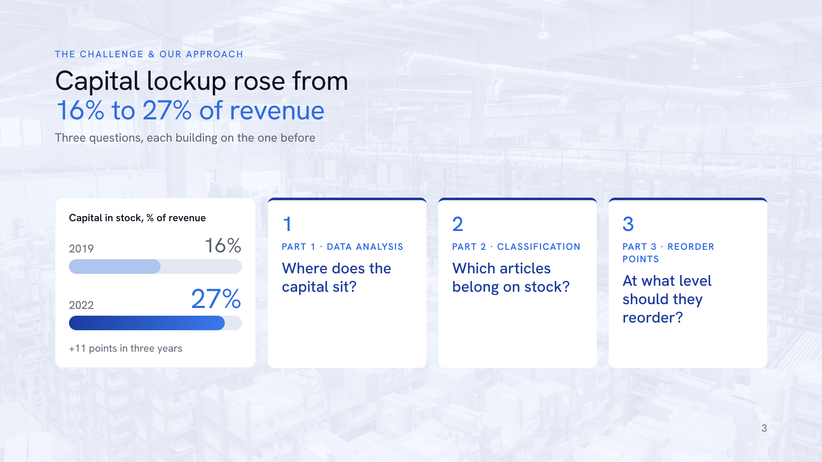
Notes:
The client’s problem: capital tied up in stock grew from 16 to 27 percent of revenue in three years. We answer three questions that build on each other. Part 1: where does the capital sit and how healthy is it? Part 2: which articles should be on stock at all? Part 3: at what level should those articles reorder? Part 1 findings define the Part 2 features, and the Part 2 classes decide which articles get a Part 3 reorder point. Every result comes from the 2.69 million stock movements, 2007 to 2022, covering 58,764 articles.

Slide 4

Notes:
Before any modelling, this is what the raw data looks like. Top left, a heatmap of movements per month: activity grew about five-fold, from 108 thousand movements in 2008 to 274 thousand in 2021, so rules set years ago are unlikely to fit today. Top right: the range has a very long tail; half of all 58,764 articles moved only twice in fifteen years, typically one receipt and one use. Bottom left, a Lorenz curve: value is highly concentrated; 7 percent of the active articles carry 80 percent of usage value and 33 percent carry 95 percent. That concentration is why we later segment by value for service levels. Bottom right: articles with a reorder point are cheap, high-volume parts, median price 4.7, against 150 for other articles, which are mostly bought for a specific need.

Slide 5
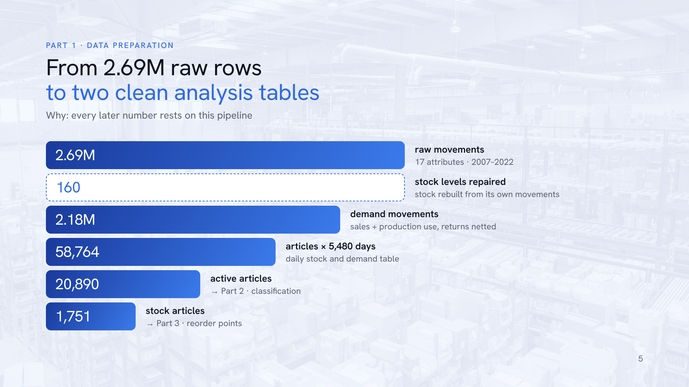
Notes:
This is the preparation pipeline every later result rests on. We start from 2.69 million raw movements with 17 attributes, 2007 to 2022, no missing values. A consistency check showed that the inventory level field is the stock before a movement, not after as documented: 99.99 percent of rows satisfy next level equals level plus quantity. So we rebuilt each article’s stock as opening level plus cumulative movements, which repaired 160 inconsistent levels, including one at 1.1 billion units. Demand is defined as sales, entry type 1, plus usage for production, type 5, net of returns: 2.18 million movements. Transfers and adjustments are not demand. From that we build a daily table of stock and demand per article over 5,480 days, and two analysis populations: the 20,890 articles with demand in the last three years for the classification, and the 1,751 articles with a reorder point today for Part 3. Two caveats: all quantities are multiples of 1.1107 because of anonymisation, which keeps ratios valid, and master data such as lead time, MOQ and price is a 2022 snapshot.

Slide 6
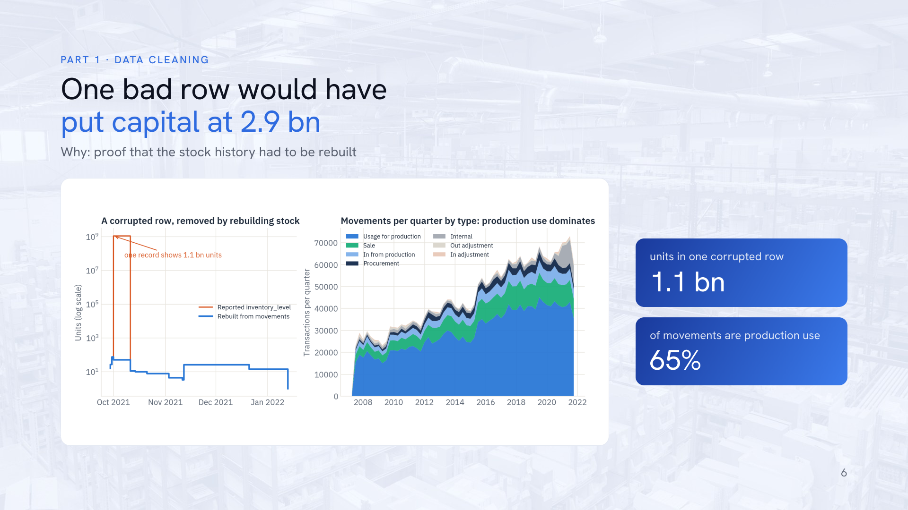
Notes:
Left: one cheap article whose reported stock jumps to 1.1 billion units in a single corrupted row. Taken at face value, it would inflate 2021 capital from about 8 million to almost 2.9 billion. The rebuilt stock, in blue, stays in a normal range. Right: what the business is. 65 percent of all movements are usage for production, so most stock feeds the company’s own production rather than retail sales. That matters for strategy: a stockout often stops production, not just a sale.
This matters for everything that follows: the stock field in the raw data cannot be trusted row by row, so we rebuilt each article's stock level from its own movements (cumulative receipts minus issues). That rebuilt stock is what all capital figures, idle-stock figures and the simulation start from.

Slide 7
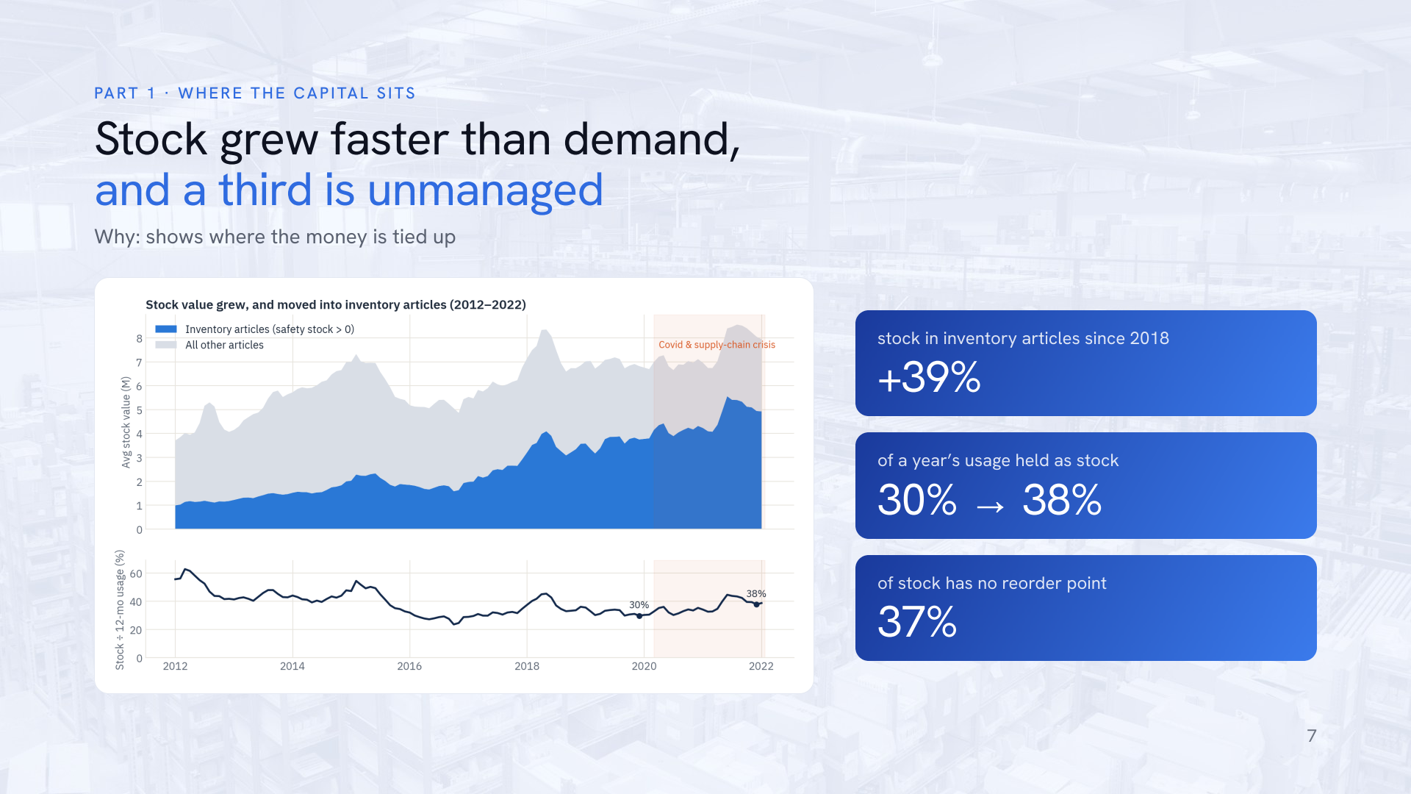
Notes:
Capital moved into the inventory articles: their stock value rose from 3.5 million in 2018 to 4.9 million in 2021, plus 39 percent, and their share of all stock went from 48 to 62 percent. Stock also grew faster than usage: from 30 to 38 percent of a year’s usage. And 37 percent of all stock value, 2.9 of 7.9 million, sits in articles without any reorder point: stock that no rule controls. That is exactly what the classification has to address.
For the client, the takeaway is that the growth in capital is not explained by growing demand, and more than a third of it is not governed by any rule at all. Those two facts are why we need both a classification (what should be on stock) and demand-driven reorder points (how much).

Slide 8
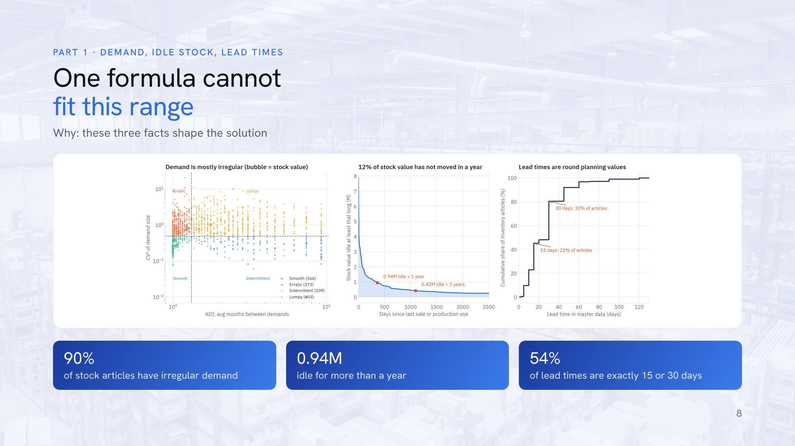
Notes:
Three findings shape the solution. Left: demand is mostly irregular. Only 166 inventory articles, about 10 percent, have smooth demand; the rest are erratic, lumpy, intermittent or sporadic. On 5 percent of demand days, rare large orders carry 29 percent of volume. So one textbook safety-stock formula cannot fit all articles. Middle: 12 percent of stock value, 0.94 million, has not moved for a year, 0.42 million of it for three years or more; 318 articles keep a reorder point despite no demand for over a year. Right: lead times are planning values. 54 percent sit on exactly 15 or 30 days, and there are no order dates, so their real variability cannot be measured. We therefore stress-test lead times in Part 3.

Slide 9
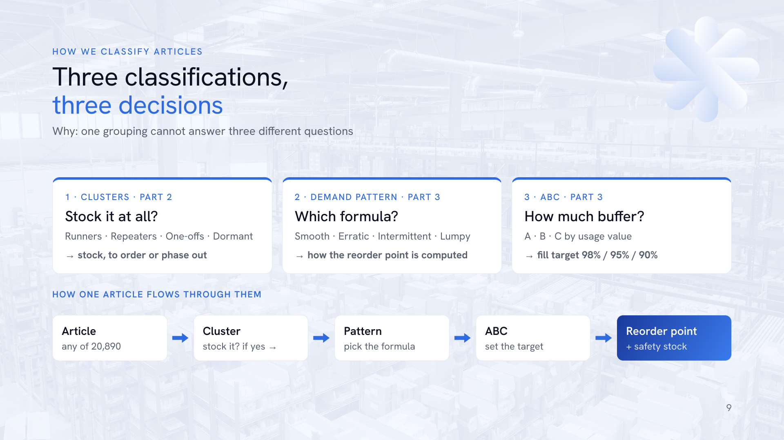
Notes:
We use three classifications, and each answers a different question, so they complement rather than compete. First, the four clusters from Part 2, built on demand behaviour with K-means, decide whether an article belongs on stock at all: stock, stock selectively, buy to order, or phase out. Second, the demand pattern, the Syntetos–Boylan scheme based on how often demand arrives, ADI, and how much its size varies, CV squared, decides which reorder-point formula is valid: the normal formula only works for smooth and erratic demand, so intermittent and lumpy articles use the distribution of their own past lead-time demand. Among the 1,751 inventory articles: Lumpy 603, Erratic 373, Intermittent 209, Smooth 166, Sporadic 148, no demand 252. Third, ABC by 12-month usage value, cut at 80 and 95 percent, sets the service target: 98, 95 or 90 percent fill.

Slide 10
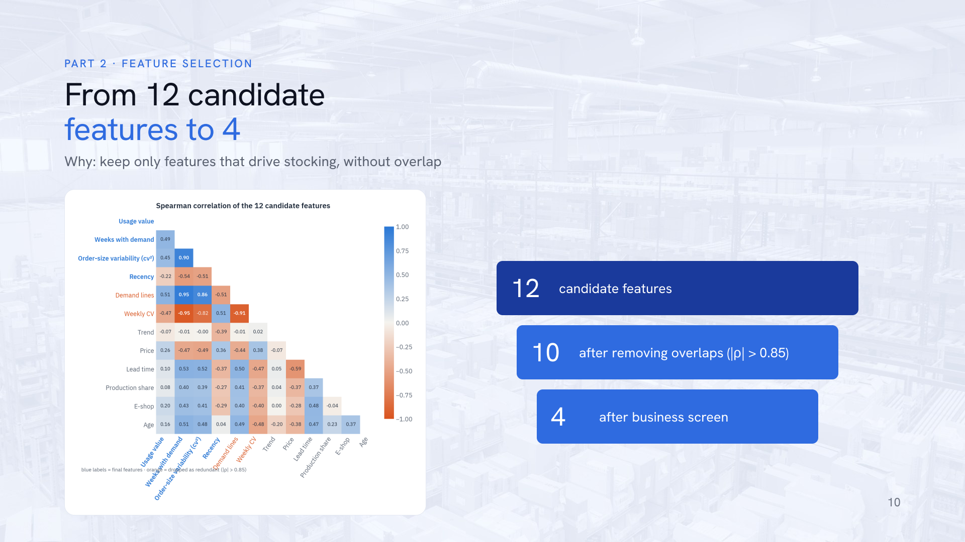
Notes:
We started with twelve candidate features describing value, frequency, variability, recency, price, lead time, trend, product type, e-shop and age. The correlation matrix on the left shows which ones overlap. A redundancy filter removes one of every pair with Spearman rho above 0.85: number of demand lines and weekly CV go. We deliberately kept order-size variability: its correlation of 0.90 with frequency is an artefact of one-time demand, where CV squared is zero by definition, and drops to 0.49 for articles with three or more demand weeks. A business screen then removes lead time, which would leak today’s stocking decision, price, which is already inside usage value, product type, e-shop and age, which only describe the classes, and trend, which is noisy for low-volume articles. Four features remain: usage value, weeks with demand, order-size variability and days since last demand.

Slide 11
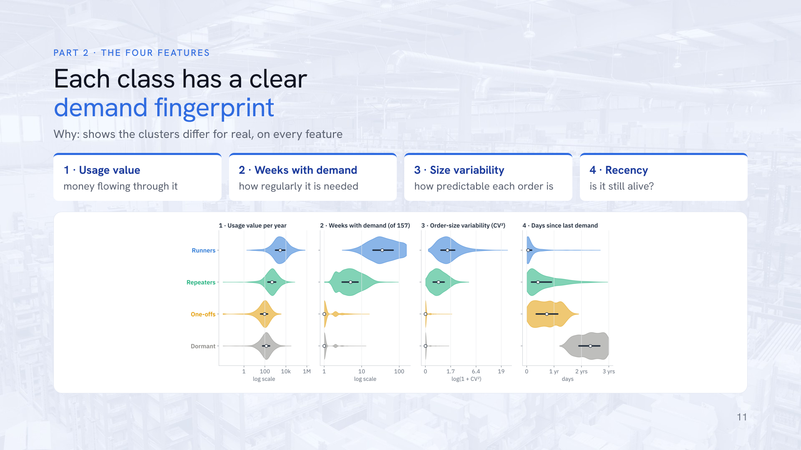
Notes:
The four clustering features, defined. Usage value: units used per year times purchase price, how much money flows through the article. Weeks with demand: number of weeks out of 157 with any demand, how regularly it is needed. Order-size variability: the squared coefficient of variation of non-zero order sizes, how predictable each order is. Recency: days since last demand up to 21 January 2022, whether the article is still alive. Each violin shows the full distribution per class; the white dot is the median and the dark bar the middle half of articles. Two features separate almost perfectly: weeks with demand splits Runners and Repeaters from the rest, and recency splits One-offs from Dormant. All four are log-scaled where skewed and standardised before K-means so that no feature dominates.

Slide 12
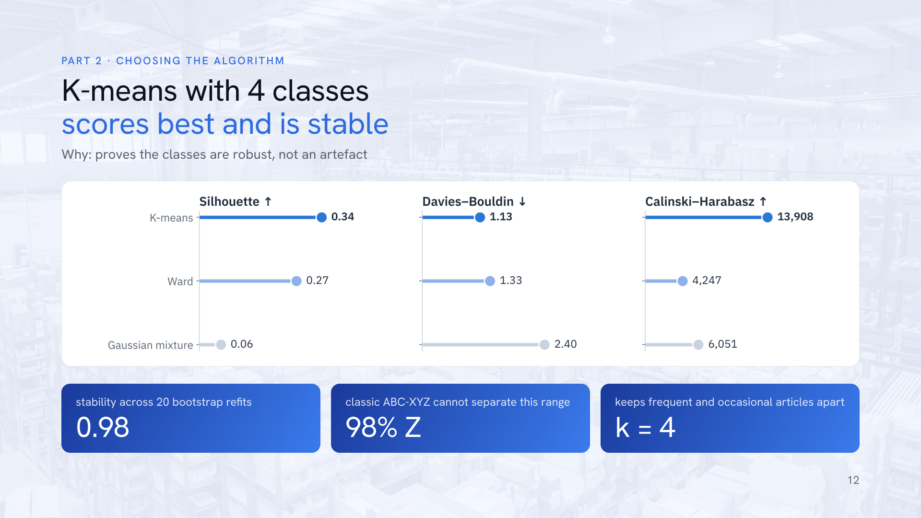
Notes:
We compared three clustering algorithms with four classes on three quality metrics, and K-means wins on all of them: silhouette 0.34 against 0.27 for Ward and 0.06 for a Gaussian mixture; Davies–Bouldin 1.13, lower is better; Calinski–Harabasz 13,908. Ward was run on an 8,000-article sample. Three classes score marginally higher on silhouette, 0.35, but merge frequent and occasional articles that need different strategies, so we keep four. We also tested pure silhouette maximisation: it kept the binary e-shop flag and dropped usage value, statistically tidy but useless for stocking. The classes are stable: refitting on 20 bootstrap samples gives an adjusted Rand index of 0.98, minimum 0.96. The classic XYZ benchmark puts 98 percent of articles in Z, so ABC-XYZ cannot separate this range. A random forest shows what separates our classes: recency, then variability, then usage value, then frequency.

Slide 13
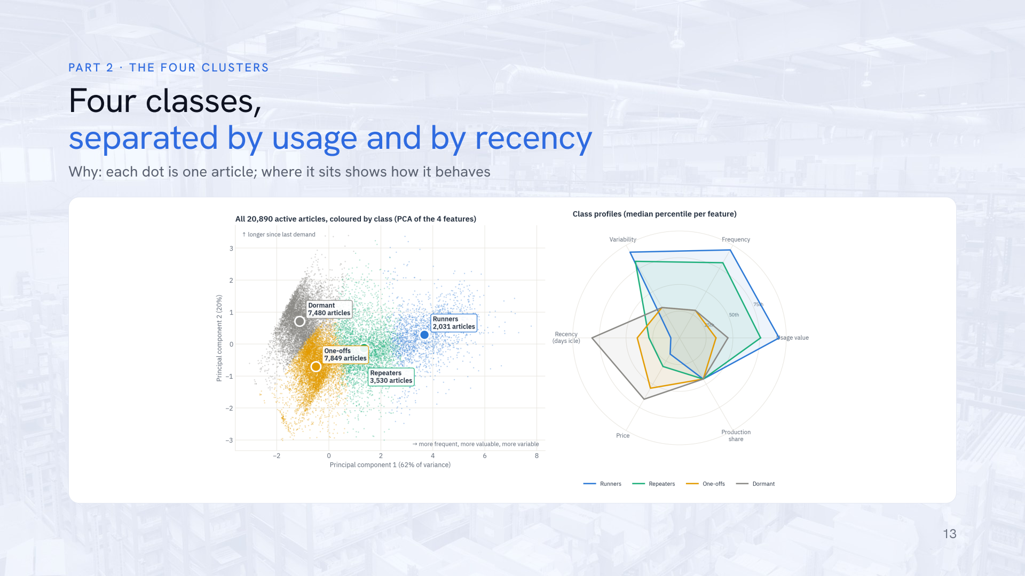
Notes:
Each dot is one of the 20,890 active articles, placed by a principal component analysis of the four features. The horizontal axis, 62 percent of the variance, runs from rarely used, low-value articles on the left to frequent, high-value ones on the right. The vertical axis, 20 percent, is recency. Runners sit far right, Dormant articles top left, One-offs bottom left, Repeaters in between. The radar on the right shows each class’s median percentile on six features; the classes also differ on features the model never saw: One-offs and Dormant articles are the most expensive per unit, while Runners are cheap and often used in production.

Slide 14
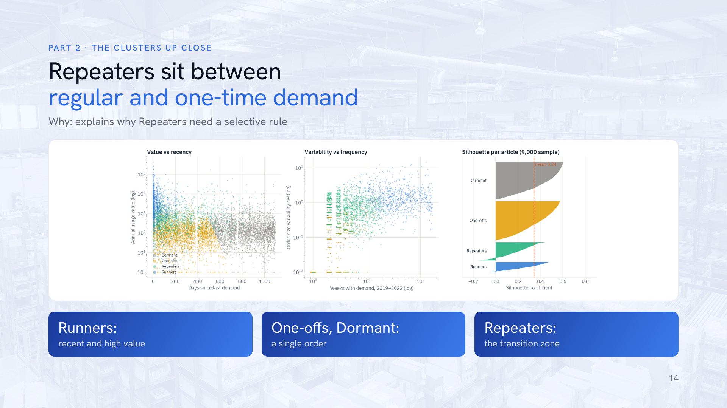
Notes:
Three views of the same classes. Left, value against recency: Runners cluster in the recent, high-value corner; Dormant articles start where demand stopped about 14 months ago. Middle, variability against frequency: One-offs and Dormant articles have one or two orders and therefore zero variability; Repeaters order a few times a year with variable sizes; Runners order weekly. Right, the silhouette of each article: the mean is 0.34; Dormant, 0.41, and One-offs, 0.37, are the cleanest classes; Repeaters, 0.19, are the transition zone between occasional and regular demand, which is why their strategy is selective rather than all-or-nothing.

Slide 15
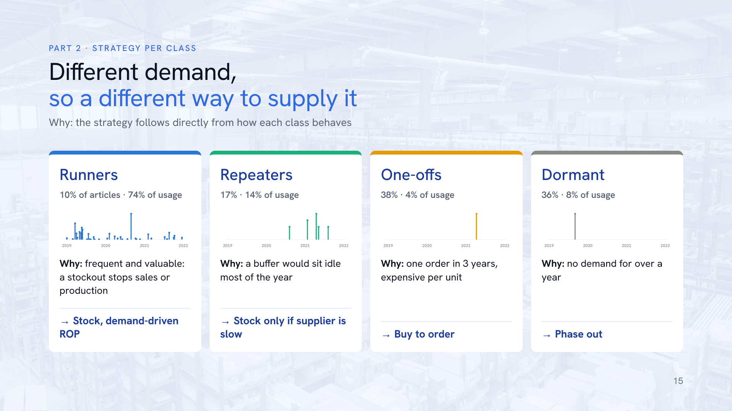
Notes:
Each class, and why its strategy follows from its demand. Runners: 2,031 articles, 10 percent of the active range but 74 percent of usage value; around 17 orders a year, last used about three weeks ago, cheap per unit, 37 percent mainly used in production. A stockout hurts and a buffer turns over quickly, so they are stocked with a demand-driven reorder point and a service target by value. Repeaters: 3,530 articles, about 2 orders a year in lumpy sizes, last used about five months ago. A permanent buffer would sit idle most of the year, so we stock them only where the supplier’s lead time is longer than the customer is willing to wait, with a lower target of about 90 percent. One-offs: 7,849 articles, one order in three years, expensive per unit, last used about nine months ago. Holding them is paying to wait for a repeat that may never come, so they are bought or produced to order without safety stock. Dormant: 7,480 articles with no demand for over 14 months, median 2.3 years. The remaining stock is at risk of obsolescence, so we stop replenishing and sell off or write it down.

Slide 16
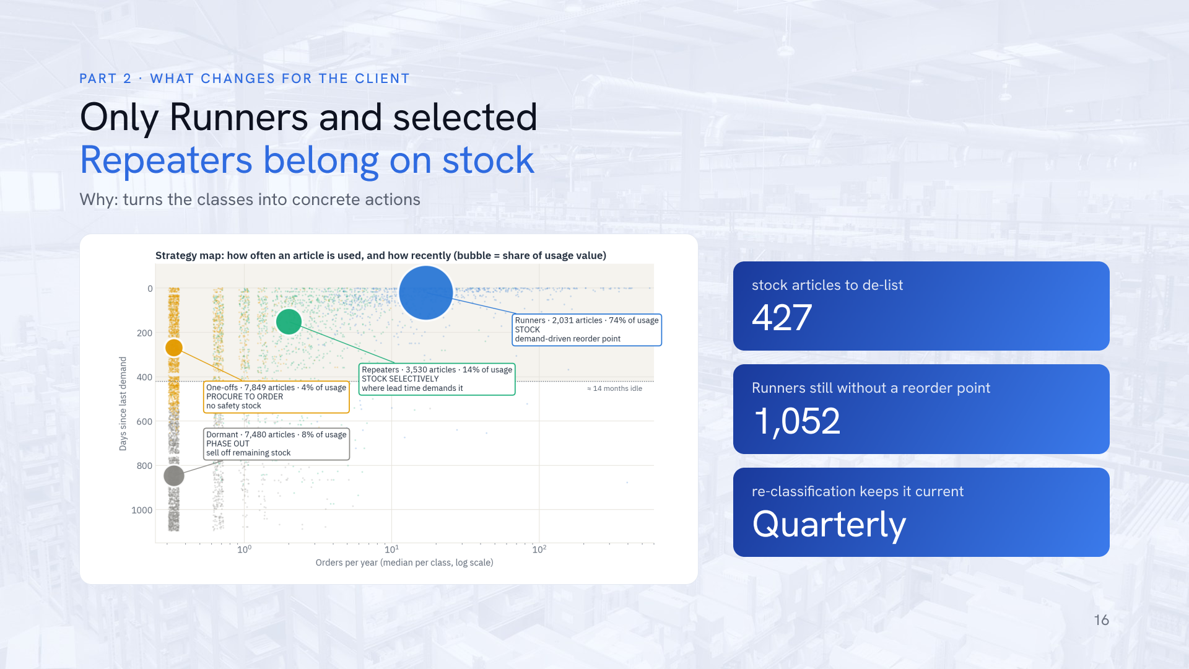
Notes:
The strategy map places each class by how often it is ordered and how long ago it was last used; bubble size is its share of usage value. What changes for the client: de-list 427 stock articles, that is 175 stocked One-offs and Dormant articles plus 252 stocked articles without any demand in three years. Review the 1,052 Runners that have no reorder point today; only 18 percent of them are mainly used in production, so most are candidates for proper stock management rather than ad-hoc buying. Repeaters need a rule, not a default. And the class becomes master data, recomputed every quarter, so articles that slow down move from Runners to Repeaters to Dormant automatically.

Slide 17
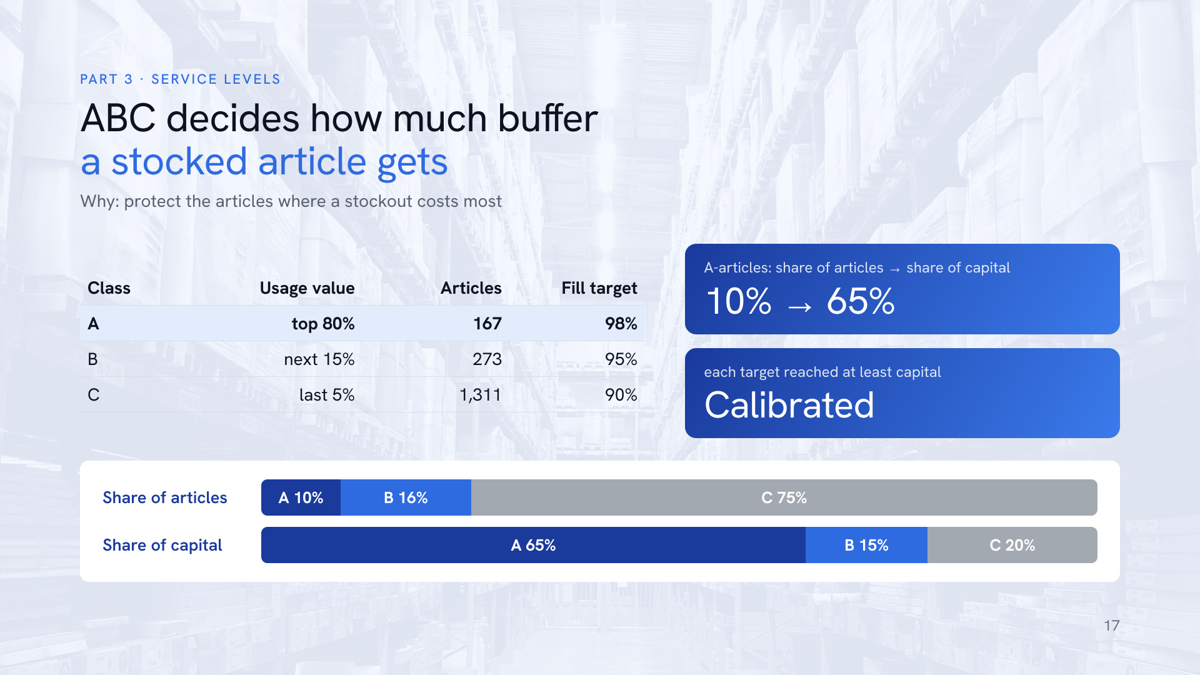
Notes:
ABC is the classic Pareto cut: rank the 1,751 inventory articles by twelve-month usage value, that is usage times purchase price, add up their shares and cut at 80 and 95 percent. The top 80 percent of value is A, 167 articles; the next 15 percent B, 273 articles; the rest C, 1,311 articles including those without usage. A-articles are about 10 percent of the articles but hold about 65 percent of stock capital, and a stockout there costs most, so they get the highest target, 98 percent, and the pilot. C-articles are many but cheap, so a 90 percent target saves capital at little risk. In the simulation we calibrated the safety parameter per class on 2020 data as the smallest value that reaches each target. Remember the difference to Part 2: the cluster decides if we stock an article, ABC decides how safely.

Slide 18
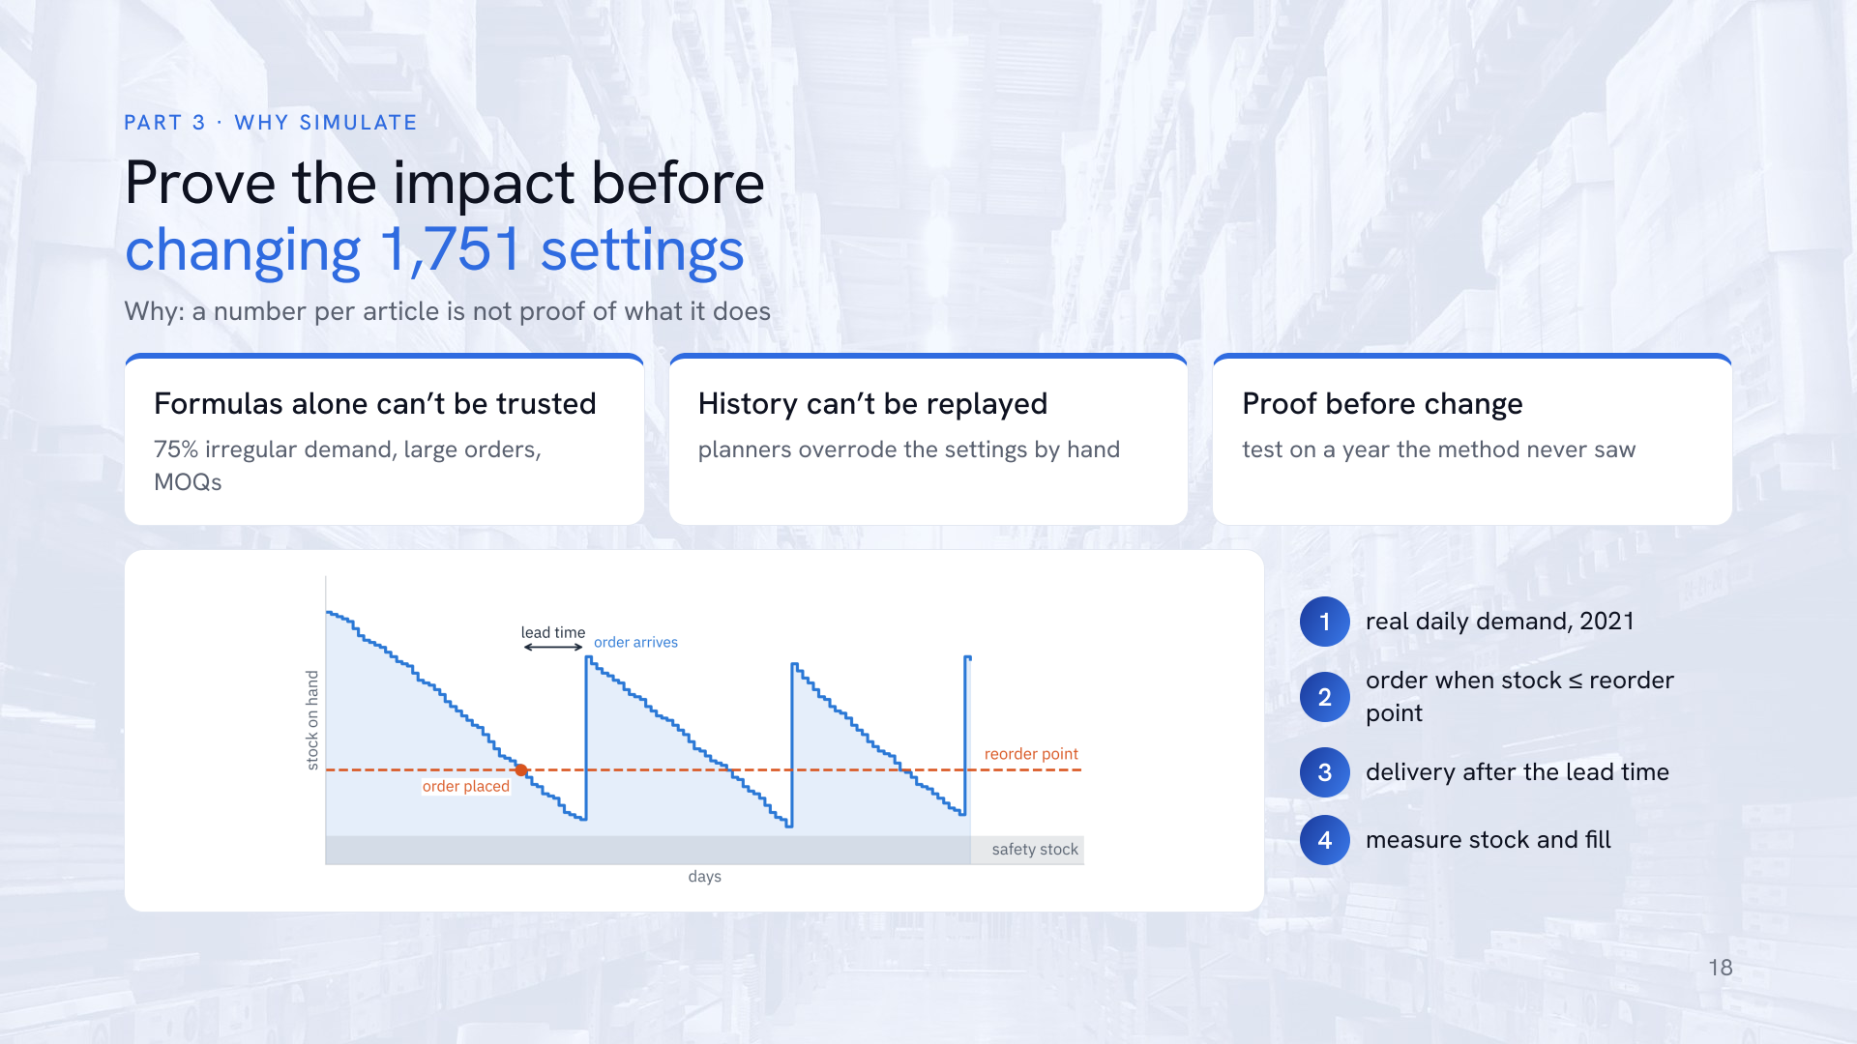
Notes:
Why simulate at all? Three reasons. First, a formula alone cannot be trusted here: 75 percent of inventory articles have irregular demand, orders are large and the minimum order quantity binds, so textbook formulas give levels whose real effect on stock and service is unknown. Second, history cannot simply be replayed: planners overrode the reorder points by hand, and recorded service is censored, because usage is only booked when stock exists, so the recorded 99.6 percent fill says little. Third, the client needs proof before changing 1,751 settings. How it works: every day, for all 1,751 articles in parallel, the real 2021 base demand is taken from stock and unmet demand is back-ordered. When stock plus open orders falls to the reorder point, an order of today’s typical size, at least the MOQ, is placed and arrives after the article’s lead time. Rare large orders, daily demand above Q3 plus 3 IQR, are procured to order. The demand-driven policy recalculates each reorder point monthly on the last 365 days: mu times LT plus z sigma root of LT over 7 for steady demand, the p-quantile of past lead-time demand for irregular demand. Safety stock is the reorder point minus mu times LT. Timeline without look-ahead: parameters from 2019 to 2020, service levels calibrated on 2020, results measured on 2021.

Slide 19
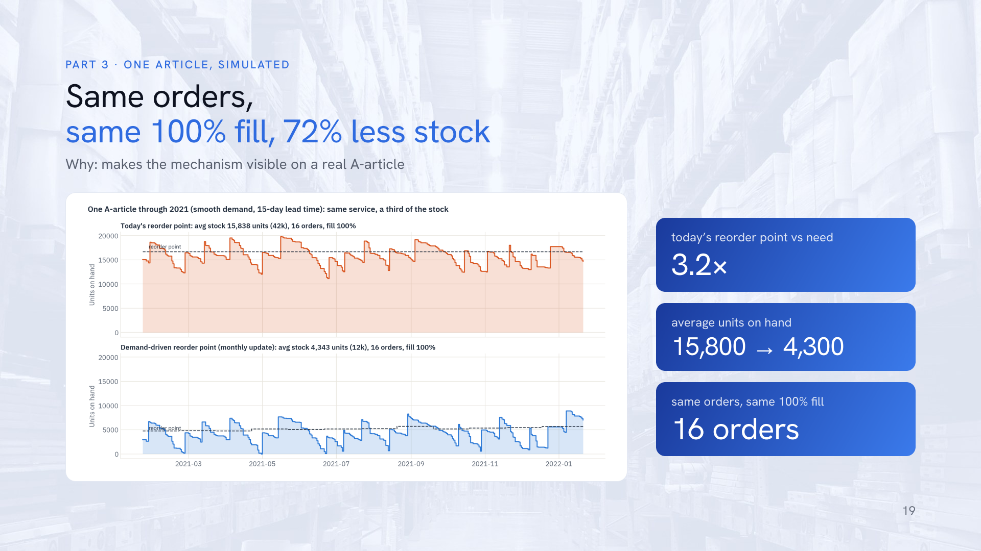
Notes:
One real A-article through 2021. Top: today’s reorder point of 16,661 units is 3.2 times what this article needs, so the warehouse carries about 15,800 units on average. Bottom: the demand-driven reorder point follows demand month by month and carries about 4,300 units. Same number of orders, 16, same full availability, but 72 percent less capital on this one article.
To read the simulation: we replay 2021 day by day. Each day the real demand is taken from stock; when the stock position falls to the reorder point, an order is placed and arrives after the article's lead time. We then measure average stock and the share of demand served directly from stock. This example shows the mechanism on one article; the next slides show the same for all 1,751 stock articles.

Slide 20
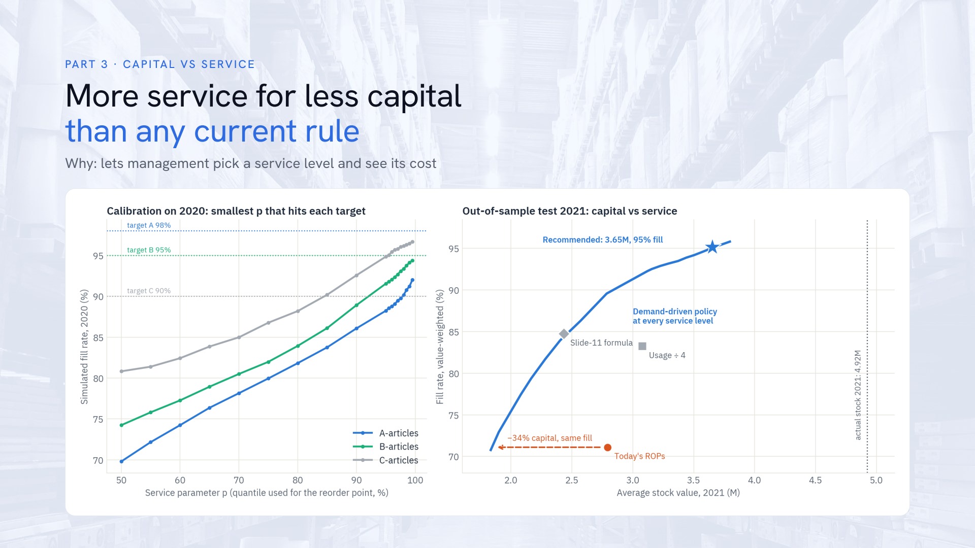
Notes:
Left, the calibration on 2020: for each ABC class, the simulated fill rate as the service parameter increases. We picked the smallest parameter that reaches each target: C reaches 90 percent at p equals 85 percent; A and B reach the best attainable level, 92 and 94 percent in 2020, at 99.5 percent; the gap comes from new, fast-growing articles that no history can anticipate. Right, the test year 2021: every point on the blue curve is the demand-driven policy at a different service level. It lies above all current rules: today’s reorder points, the usage divided by four rule and the case’s slide-11 formula. At the same 71 percent fill as today’s reorder points, it needs 34 percent less capital. The recommended point is 95 percent fill at 3.65 million, against 4.92 million actually held.

Slide 21
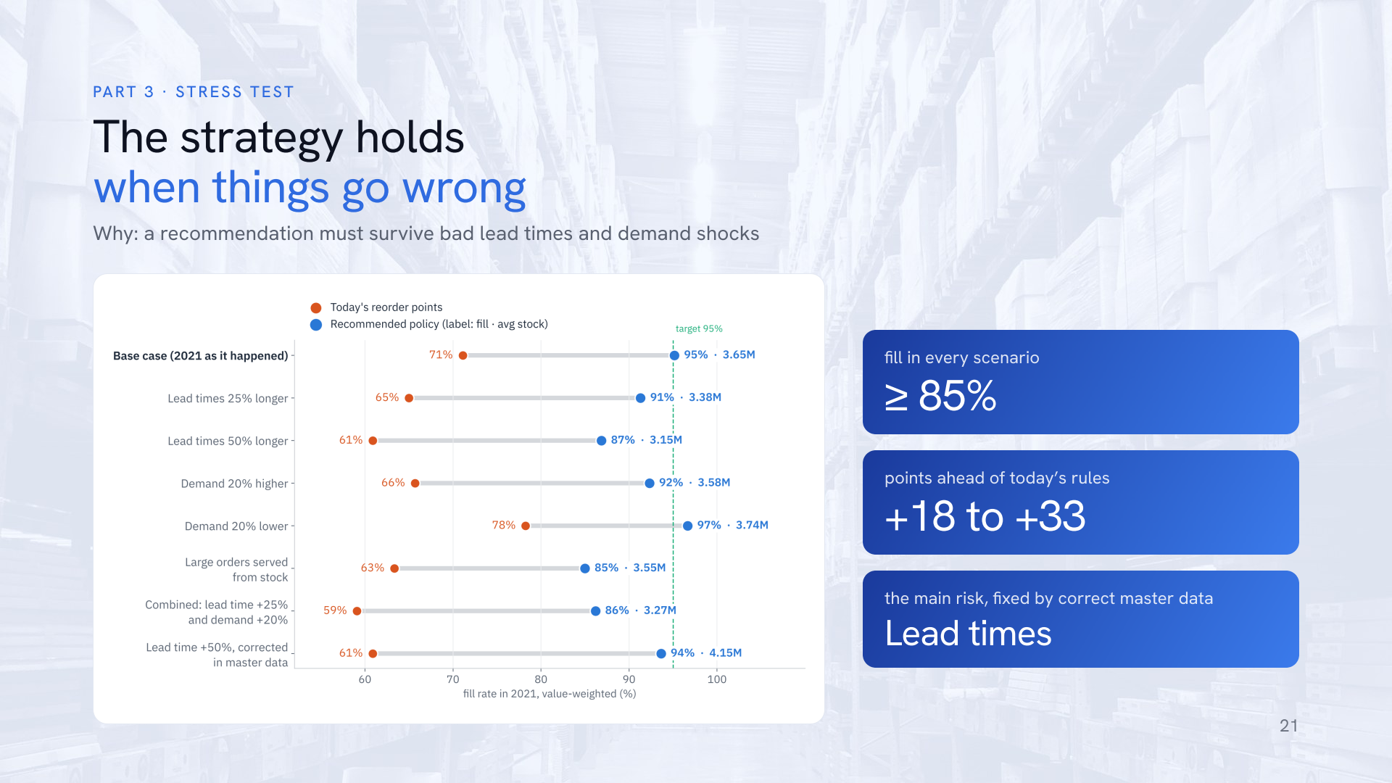
Notes:
Why stress-test? A strategy that only works when everything goes to plan is not a recommendation. We re-ran the 2021 simulation under eight scenarios: lead times 25 and 50 percent longer than the master data says; demand 20 percent higher or lower than history; rare large orders served from stock instead of to order; a combined case with lead times 25 percent longer and demand 20 percent higher; and lead times 50 percent longer but corrected in the master data. Orange is today’s reorder points, blue the recommended policy, labelled with fill rate and average stock. The recommended policy never drops below 85 percent fill and stays 18 to 33 points ahead of today’s rules in every scenario, because it recalculates monthly and adapts to new demand. Today’s rules never reach 80 percent. The main vulnerability is lead time: if real lead times are 50 percent longer and nobody notices, fill drops to 87 percent; once the lead time is corrected in the master data, the policy recovers to 94 percent at 4.15 million, still below the 4.92 million actually held. So the stress test tells the client exactly which data to fix first.

Slide 22
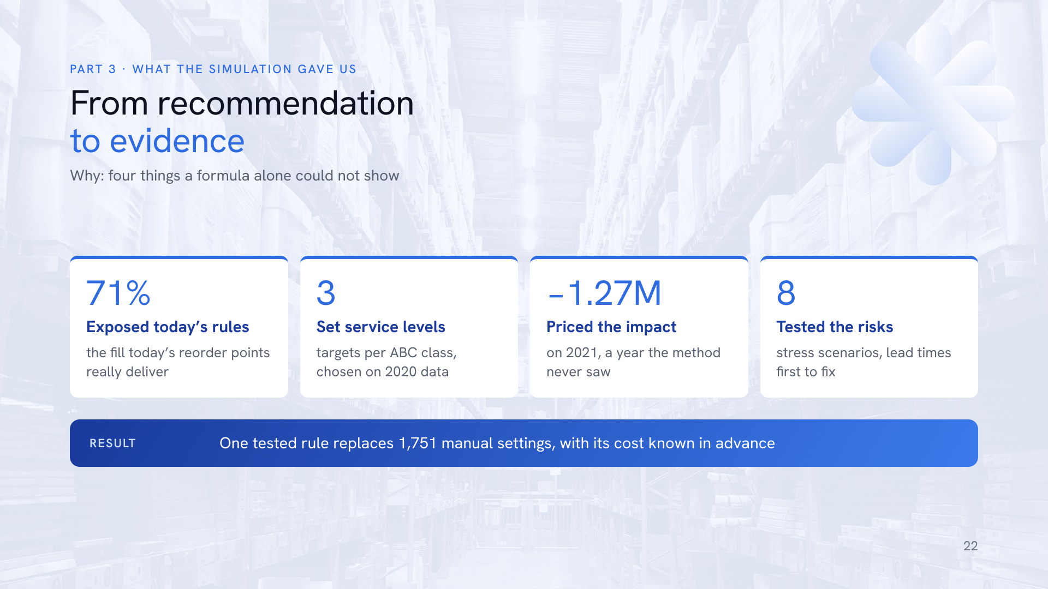
Notes:
To close Part 3, why the simulation was worth building. It did four things a formula alone cannot. One: it exposed today’s rules. Followed strictly, today’s reorder points give only 71 percent fill, which explains why planners top up by hand and why stock ended at 4.92 million. Two: it set the service levels. The safety parameter per ABC class was chosen on 2020 data as the smallest value reaching each target, so the least capital, no guessing. Three: it priced the impact on 2021, a year the method never saw: 95 percent fill at 3.65 million, so 1.27 million or 26 percent released and about 0.25 million a year saved in holding cost. Four: it tested the risks, with eight stress scenarios that show the policy holds and point to lead times as the data to fix first. Without a simulation, a formula gives a number per article but not what it does to stock and service when demand is lumpy, orders are large and MOQs bind. With it, management can pick any point on the capital–service curve and know its cost before changing 1,751 settings.

Slide 23
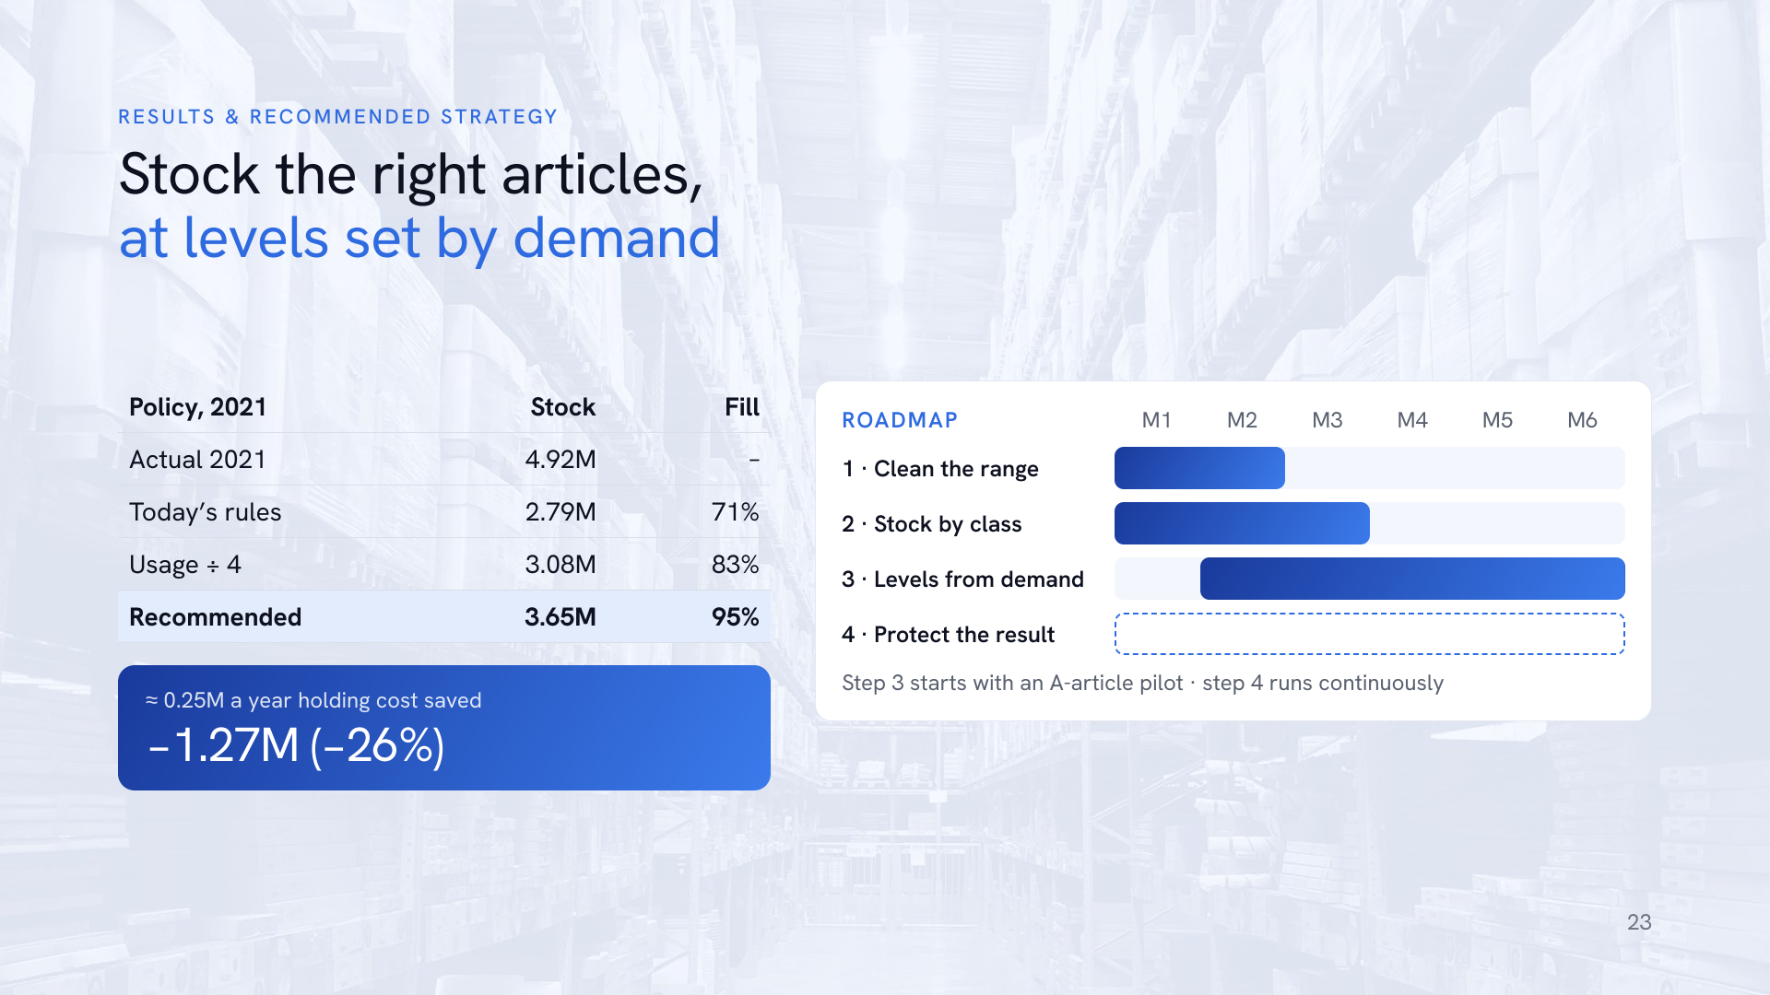
Notes:
Putting it together. In the test year, the recommended demand-driven policy holds 3.65 million on average against 4.92 million actually held, and reaches 95 percent fill, 97 percent on A-articles. For comparison, today’s reorder points followed strictly would give only 71 percent fill, the usage divided by four rule 83 percent, and the case’s slide-11 formula 85 percent at 2.43 million. That frees 1.27 million, 26 percent, and saves about 0.25 million a year in holding cost at an assumed 20 percent rate, 0.19 to 0.32 million at 15 to 25 percent. The roadmap: one, clean the range in months one to two by de-listing 427 articles and selling off or writing down 0.94 million of idle stock. Two, stock by class in months one to three. Three, replace manual reorder points with the demand-driven rule, recalculated monthly with targets A 98, B 95, C 90 percent, starting with the A-articles that hold about 65 percent of capital as a pilot. Four, protect the result: record order dates to measure real lead times, plan rare large orders through customer and production orders, and set order size together with the reorder point. 1,751 manual settings become one rule. Every article’s recommended level is in the Excel file in the repository.

Slide 24

Notes:
Our results hold up against the main data gaps, but they have limits. Master data is a 2022 snapshot, so history is valued at today’s purchase price and compared with today’s settings. There are no order dates, so lead-time variability cannot be measured; the stress test bounds the risk, with 50 percent longer lead times giving 87 percent fill. The holding cost rate of 20 percent is an assumption; it only affects the yearly saving, not the capital figures. And recorded service is censored, because usage is only booked when stock exists, so service is compared inside the simulation, not against history. Values are anonymised: quantities carry a constant factor of 1.1107 and money is in dataset units; ratios and percentages are unaffected. Next steps with the client: agree service targets per class, validate lead times for the A-articles, run a one-quarter pilot on the A-articles compared against the simulation, and quantify the capital released by phasing out One-offs and Dormant articles. Everything is reproducible from the raw file in the repository. Thank you, I am happy to take questions.

