Slide 1
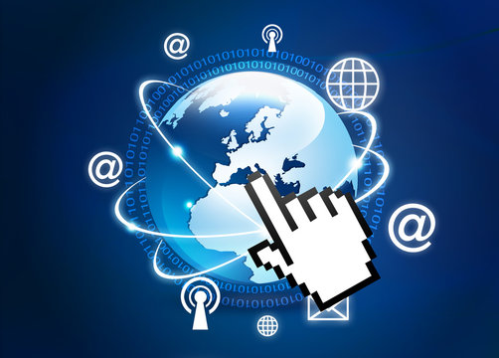
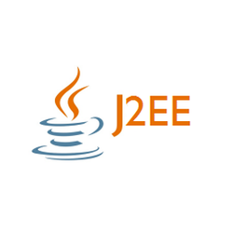

Slide 2
J2SE (Java 2 Platform, Standard Edition)
Also known as Core Java, this is the most basic and standard version of Java. It’s the purest form of Java, a basic foundation for all other editions.
It consists of a wide variety of general purpose API’s (like java.lang, java.util) as well as many special purpose APIs.
J2SE is mainly used to create applications for Desktop environment.

Slide 3
Introduction to J2EE
Using the Java 2 Platform, Standard Edition (J2SE) as a basis, Java 2 Platform, Enterprise Edition (J2EE) builds on top of this.
J2EE is used to provide the types of services that are necessary to build large scale, distributed, component based, multi-tier applications.
J2EE is a collection of APIs that can be used to build such systems.
J2EE is also a standard for building and deploying enterprise applications, held together by the specifications of the APIs that it defines and the services that J2EE provides.

Slide 4
J2EE (Java 2 Platform, Enterprise Edition)
The Enterprise version of Java has a much larger usage of Java, like development of web services, networking, server side scripting and other various web based applications.
J2EE is a community driven edition, i.e. there is a lot of continuous contributions from industry experts, Java developers and other open source organizations.

Slide 5
Architectures for Application Development
Monoliths
N-tier architecture (tightly coupled)
Micro services (decoupled)
Event-driven architecture
Service-oriented architecture (loosely coupled).

Slide 6
Monoliths
It is a single application stack that contains all functionality within that 1 application.
It is tightly coupled.
A single change to the application code requires the whole application to be re-released.

Slide 7
Microservices architecture
Microservices are both an architecture and an approach to writing software.
With microservices, apps are broken down into their smallest components, independent from each other. Each of these components, or processes, is a microservice.
Microservices are distributed and loosely coupled, so they don’t impact one another.

Slide 8
Microservices architecture
The goal of using a microservices architecture is to deliver quality software faster.
This leads to more developers working on their individual services at the same time, instead of updating the whole application, resulting in less time spent in development and the ability to release new features more often.

Slide 9
Event-driven architecture
An event is any significant occurrence or change in state for system hardware or software. The source of an event can be from internal or external inputs.
Event-driven architecture enables minimal coupling, which makes it a good option for modern, distributed application architectures.
Many programs spend most of their time waiting for something to happen. This is especially true for computers that work directly with humans, but it’s also common in areas like networks. Sometimes there’s data that needs processing, and other times there isn’t.

Slide 10
Event-driven architecture
Programming a web page with JavaScript involves writing the small modules that react to events like mouse clicks or keystrokes.
The browser itself orchestrates all of the input and makes sure that only the right code sees the right events.
Many different types of events are common in the browser, but the modules interact only with the events that concern them.

Slide 11
Layered or N-tier architecture
A layered or N-tier architecture is a traditional architecture often used to build on-premise and enterprise apps, and is frequently associated with legacy apps.
In a layered architecture, there are several layers or tiers, often 3, but there can be more, that make up the application, each with their own responsibility.

Slide 12
Layered or N-tier architecture
Layers help to manage dependencies and perform logical functions.
In a layered architecture, the layers are arranged horizontally, so they are only able to call into a layer below.
The code is arranged so the data enters the top layer and works its way down each layer until it reaches the bottom, which is usually a database.
Along the way, each layer has a specific task, like checking the data for consistency or reformatting the values to keep them consistent. It’s common for different programmers to work independently on different layers.

Slide 13
Multi-Tier Architecture
Many IT departments used two-tier, client/server architecture model.
This two-tier architecture depends heavily on keeping client software updated, which is both difficult to maintain and costly to deploy in a large corporation that has several intranets and workforce that consist of field representatives and other remote users
The two-tier, client/server architecture had to be abandoned and a new , multi-tier architecture had to be built in its place.

Slide 14
Distributed System
Distributed systems divide the work amongst several independent modules.
A distributed system consists of multiple autonomous computers that communicate through a computer network. The computers interact with each other in order to achieve a common goal. A computer program that runs in a distributed system is called a distributed program.

Slide 15
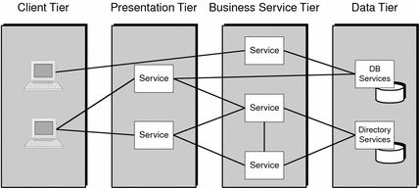
Multi-tiered Architecture Design
Java Enterprise System is well-suited for multi-tiered architecture design, where services are placed in tiers according to the functionality they provide.
Each service is logically independent and can be accessed by services in either the same tier or a different tier.

Slide 16
Multi-tiered Architecture Design
Client tier
Contains client applications that present information to end users. For Java Enterprise System, these applications are typically mail clients, web browsers, or mobile access clients.
Presentation tier
Provides services that display data to end users, allowing users to process and manipulate the presentation. For example, a web mail client or Portal Server component allows users to modify the presentation of information they receive.

Slide 17
Multi-tiered Architecture Design
Business service tier
Provides back-end services that typically retrieve data from the data tier to provide to other services within the presentation or business service tiers or directly to clients in the client tier. For example, Access Manager provides identity services to other Java Enterprise System components.
Data tier
Provides database services accessed by services within the presentation tier or business service tier. For example, Directory Server provides LDAP directory access to other services.

Slide 18
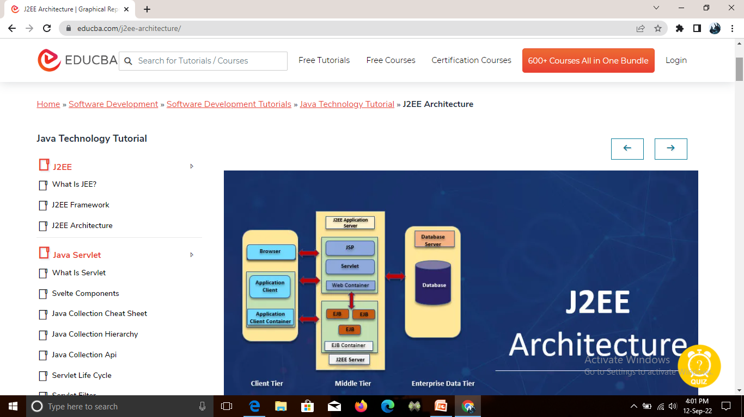
J2EE Architecture

Slide 19
Client Tier
The client tier consists of programs or applications interact with the user.
Client tier prompts the user inputs into user requests then forwarded to the J2EE server then processed result returned back to the client.
Clients can be classified as a
Web Client.
Application Client.

Slide 20
Web Client
Web client consists of dynamic web pages of various mark-up languages that are generated by web components running in web tier.
Web clients are also called as thin clients that usually do not perform things like query database, execute business rules.
Applets: Web pages received from web tier embedded an Applet these run on a web browser.
Web components are APIs for creating a web client program.

Slide 21
Application Clients
The application client runs on the client machine and handles the tasks that give richer user interfaces.
The application client runs on the client machine and handles the tasks that give richer user interfaces.
Application clients can directly access EJBs running in the business tier using an HTTP connection.

Slide 22
Middle Tier (Web tier & EJB Tier)
Web Tier /Web Component
Web components can be servlets or JSP pages.
Servlets can dynamically process the request and generate the responses.
servlets are dynamic pages to some extent but JSP pages are static in nature.
Web tier might include EJB components for processing user inputs and sends the input to Enterprise bean running in the business tier.

Slide 23
EJB Tier /EJB Component
Enterprise components handle usually business code that is logic to solve particular business domains such as banking or finance are handled by enterprise bean running in the business tier.
Enterprise Container receives data from client processes if necessary, sends it to the enterprise information system for storage.
Enterprise bean also retrieves data from storage, processes it and sends it back to the client.

Slide 24
Three kinds of beans:
Session Bean: Session bean is used for a conversation with the client. Once the client finishes the execution session bean destroys.
Entity Bean: Holds the particular data stored in a database. Once the server shutdowns or client finishes its execution entity bean data is preserved.
Message Driven Bean: Message bean combines the properties of Session Bean and JMS. Which benefits the business component to receive messages asynchronously.

Slide 25
Enterprise Information System
This tier consists of database servers, enterprise resource planning systems and other data sources.
Resources are typically located on a separate machine than the J2EE Server and accessed by components on the business tier.

Slide 26
Containers in J2EE Architecture
Application Client Container
The container includes a set of classes, libraries, other files that are required to execute client programs in their own JVM.
Manages the execution of client components.
It also provides services that enable java client program to execute.
This container is specific to the EJB container.

Slide 27
Web Container
Web Container is a component of the web server that interacts with Java servlets.
A web container is responsible for managing the servlets lifecycle and mapping URLs.
Web container handles a request from Servlets and JSP files and other files that includes server-side code.
This provides a runtime environment for additional web components security, transaction, deployment, etc.

Slide 28
EJB Container
Enterprise Java bean container consists of server components that contain business logic.
Provides local and remote access to enterprise beans.
EJB container is responsible for creating enterprise bean, binding enterprise bean to the naming services.

Slide 29
Applet Container
The container where the client’s Applet programs will run may be in a web browser or other application programs that support applet programming.
These are normal web pages downloaded from the web servers and executes on the client browser.

Slide 30
J2EE Components & Services
Primary technologies
Servlets
JavaServer Pages (JSP)
Enterprise JavaBeans (EJB)
Standard services & supporting technologies
Java database connectivity(JDBC) data access API
Remote Method Invocations (RMI)
Extensible Markup Languages(XML)
JavaIDL
JavaMail

Slide 31
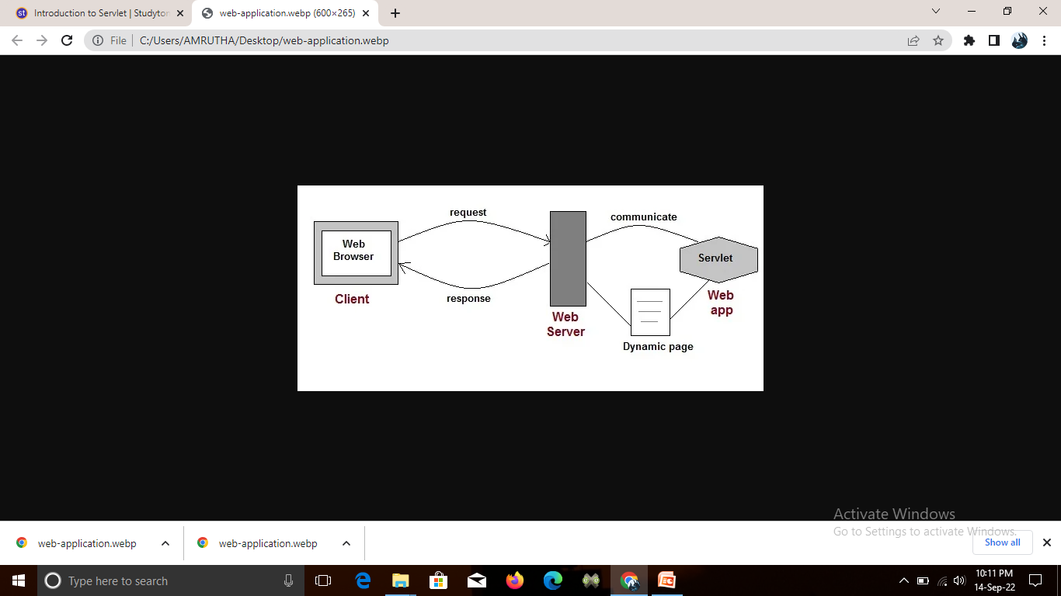
Servlets
Servlet Technology is used to create web applications.
Servlet technology uses Java language to create web applications.

Slide 32
Servlets
Web applications are helper applications that resides at web server and build dynamic web pages.
A dynamic page could be anything like a page that randomly chooses picture to display or even a page that displays the current time.
As Servlet Technology uses Java, web applications made using Servlet are Secured, Scalable and Robust.

Slide 33
Java Server Page(JSP)
JSP technology is used to create dynamic web applications.
JSP pages are easier to maintain then a Servlet.
JSP pages are opposite of Servlets as a servlet adds HTML code inside Java code, while JSP adds Java code inside HTML using JSP tags. Everything a Servlet can do, a JSP page can also do it.
Using JSP, one can easily separate Presentation and Business logic.

Slide 34
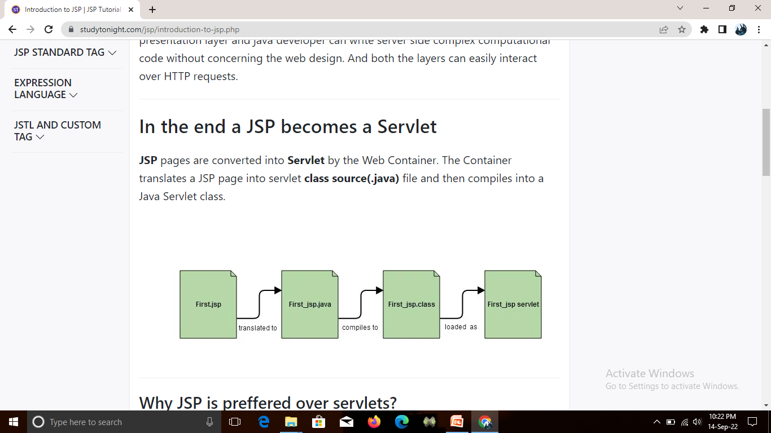
In the end a JSP becomes a Servlet
JSP pages are converted into Servlet by the Web Container. The Container translates a JSP page into servlet class source(.java) file and then compiles into a Java Servlet class.

Slide 35
JSP
JSP provides an easier way to code dynamic web pages.
JSP does not require additional files like, java class files, web.xml etc
Any change in the JSP code is handled by Web Container(Application server like tomcat), and doesn't require re-compilation.

Slide 36
Enterprise Java Beans
EJB (Enterprise Java Bean) is used to develop scalable, robust and secured enterprise applications in java.
Middleware services such as security, transaction management etc. are provided by EJB Container to all EJB applications.
To run EJB application, you need an application server (EJB Container) such as Jboss, Glassfish, Weblogic, Websphere etc.

Slide 37
Enterprise Java Beans
It performs:
1. life cycle management
2. security
3. transaction management
4. object pooling.
Note: EJB application is deployed on the server,
so it is called server side component also.

