Slide 1
Overview Of J2EE

Slide 2
Past History
Initially two tier architecture (client server applications)
Client is responsible for data access applying business logic and presentation of data
Only service provided by Server was that of database server.

Slide 3
Two Tier Application Architecture
Client Server

Slide 4
Two Tier Application Architecture
Drawbacks
Easy to deploy but difficult to enhance or upgrade.
It makes reuse of business and presentation logic difficult.
Not scalable and not suited for internet

Slide 5
Java 2 Platform Enterprise Edition(J2EE)
J2EE is an architecture for implementing enterprise class applications using Java and Internet Technology
- Solves problems of two tier architecture

Slide 6
J2EE
To develop n tier application
It supports the development of a variety of application types
  small client server systems
  Systems running on Intranets
  Systems on large scale internet e-commerce site

Slide 7
J2EE Features
Component based model
Container provided services
Highly Scalable
Simplified Architecture
Flexible security model

Slide 8
Java: Foundation for J2EE
J2EE is an application of java
Write once and deploy the code into any platform

Slide 9
J2SE(Java Platform, Standard Edition)
Also known as Core Java, this is the most basic and standard version of Java. It’s the purest form of Java, a basic foundation for all other editions.
It consists of a wide variety of general purpose API’s (like java.lang, java.util) as well as many special purpose APIs.
J2SE is mainly used to create applications for Desktop environment.

Slide 10
J2SE
Sapana Mehta (CS-6V81)
This is the standard, from which all other editions came out, according to the needs of the time.
The famous JVM of Java, the heart of Java development, was also given by this edition only. It’s because of this feature, that Java has such a wide usage.

Slide 11
J2EE(Java Platform, Enterprise Edition)
The Enterprise version of Java has a much larger usage of Java, like development of web services, networking, server side scripting and other various web based applications.
J2EE is a community driven edition, i.e. there is a lot of continuous contributions from industry experts, Java developers and other open source organizations.

Slide 12
J2EE
J2EE uses many components of J2SE, as well as, has many new features of it’s own.
J2EE uses HTML, CSS, JavaScript etc., so as to create web pages and web services.
Its more versatile and web friendly.
Portability and security was its main features.

Slide 13
Architectures for Application Development
Monoliths
N-tier architecture (tightly coupled)
Micro services (decoupled)
Event-driven architecture
Service-oriented architecture (loosely coupled).

Slide 14
Monoliths
It is a single application stack that contains all functionality within that 1 application.
It is tightly coupled.
A single change to the application code requires the whole application to be re-released.

Slide 15
Microservices architecture
Microservices are both an architecture and an approach to writing software. With microservices, apps are broken down into their smallest components, independent from each other. Each of these components, or processes, is a microservice.
Microservices are distributed and loosely coupled, so they don’t impact one another.

Slide 16
Microservices architecture
The goal of using a microservices architecture is to deliver quality software faster.
This leads to more developers working on their individual services at the same time, instead of updating the whole application, resulting in less time spent in development and the ability to release new features more often.

Slide 17
Event-driven architecture
Event-driven architecture enables minimal coupling, which makes it a good option for modern, distributed application architectures.
Event-driven architecture is made up of event producers and event consumers. An event producer detects or senses an event and represents the event as a message.

Slide 18
Event-driven architecture
It does not know the consumer of the event, or the outcome of an event.
After an event has been detected, it is transmitted from the event producer to the event consumers through event channels, where an event processing platform processes the event asynchronously.

Slide 19
Event-driven architecture
An event driven architecture may be based on either a pub/sub model or an event stream model.
The pub/sub model is based on subscriptions to an event stream. With this model, after an event occurs, or is published, it is sent to subscribers that need to be informed.

Slide 20
Event-driven architecture
This differs from an event streaming model where event consumers don’t subscribe to an event stream. Instead, they can read from any part of the stream and can join the stream at any time.

Slide 21
J2EE Components & Services
Primary technologies
  Servlets
  JavaServer Pages (JSP)
  Enterprise JavaBeans (EJB)
Standard services & supporting technologies
  Java database connectivity(JDBC) data access API
  Remote Method Invocations (RMI)
  Extensible Markup Languages(XML)
  JavaIDL
  JavaMail

Slide 22
J2EE Tiers
Client Presentation
  HTML or Java applets deployed in Browser
  XML documentations transmitted through HTTP
  Java clients running in Client Java Virtual Machine (JVM)
Presentation Logic
  Servlets or JavaServer Pages running in web server
Application Logic
  Enterprise JavaBeans running in Server

Slide 23
J2EE Application Model
Browser is able to process HTML and applets pages.
It forwards requests to the web server, which has JSPs and Servlets
Servlets and JSPs may access EJB server.
Java Standalone runs on java client, which access EJB server using RMI.

Slide 24
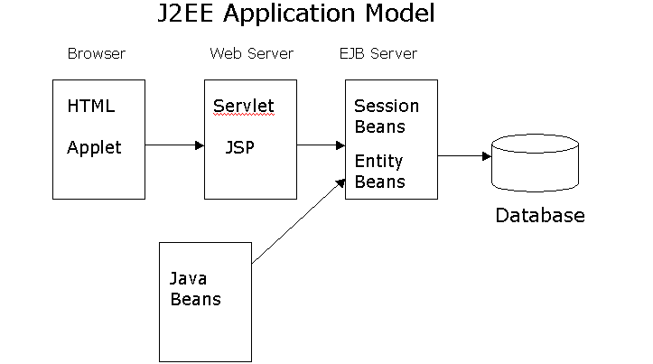
J2EE Application Model

Slide 25
Enterprise Java Beans (EJBs)
Enterprise Java beans architecture is a component model for development and deployment of distributed business application.
Entity Beans
  Represent persistent business Entity
  Persisted in storage system ( usually Database)
  Might contain Application logic intrinsic to entity
Session Beans
  Perform work for individual clients on the server
  Encapsulate complex business logic
  Can coordinate transactional work on multiple entity beans

Slide 26
States and Persistence
Session beans can be
  Stateless- belong to client for duration of a method call
  Stateful- belong to client for duration of client conversation
Entity beans can have
  Bean-managed persistence- The developer writes SQL code to retrieve,store and update database
  Container managed persistence- The developer provide database mapping information that allows the container to manage persistence

Slide 27
Example of EJB Application
It consists of number of clients accessing session beans and entity beans
Each Session bean provides specialized processing on behalf of client
e.g. Travel Agent session bean makes travel reservations while Flight Scheduler bean schedules planes to fly on various routes.
Each Entity Bean represent different type of business entity.
e.g.Passengers, seats, planes, flights are entity beans

Slide 28
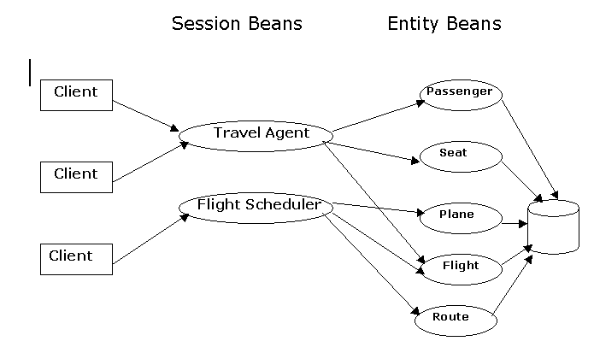
Example EJB Application

Slide 29
Overview of Servlets
Are container managed web components
Replace Common Gateway Interface(CGI) or Active Server Pages (ASP)
Generate dynamic response to requests from web based clients
Synchronize multiple concurrent client request
Serve as client proxies

Slide 30
Servlet Operation
Server is Java program that runs as separate thread inside servlet container.
Servlet container is part of web server
It interact with web client using response request paradigm

Slide 31
JavaServer Pages (JSP)
Text based documents describe how to process a request and create a response
Contains HTML or XML and other JSP elements defined by JSP specification.
Are Installed on web server
are web components that sits on top of java servlet mode.

Slide 32
JSP Advantages
Performance
  Runtime characteristics of servlets
  Automatic recompilation of modified pages
  Server side processing
Programming
  Emphasize use of reusable components
  Write Once , Run Anywhere properties
  Extensible through custom tag libraries
Provides front end access mechanism to EJBs

Slide 33
Parts of JSP Pages
Directive
<%@ pageimport=“java.util.”, MVCApp.Cart, MVCApp.CartItem” %>
Declaration
<%! Iterator it = null; CartItem ci = null; Vector cpi = null;%>
Raw HTML
<html><head><title>Shopping Cart</title></head></html>
Action
<jsp:usebean id =“Cart” scope = “session” class = “MVCApp.Cart”/>
Scriplets
%
Cpi = cart.getCartItems ( );
it = cpi.iterator();
While (it.hasNext()){ci= (Cart Item)it.next();
%>

Slide 34
Parts of JSP Pages
Expression
<td<% = ci.getTitle() %></td>
<td align =“right”><%=ci.getQuantity()%></td>
Implicit Objects
<% string action = request.getParameter(“action”) ; %>

Slide 35
What is Application Server
  Application servers enable the development of multi-tiered distributed applications. They are also called “middleware”
  An application server acts as the interface between the database(s), the web servers and the client browsers

