Slide 1
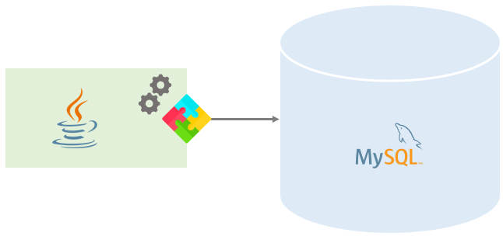
JDBC- Java Data Base Connectivity

Slide 2
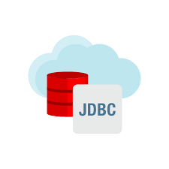
Introduction
JDBC is a java application program interface that allows the java programmers to access database management system from java code.
It was developed by Java soft , a subsidiary of Sun Microsystems.
JDBC is a Java API to connect and execute the query with the database.

Slide 3
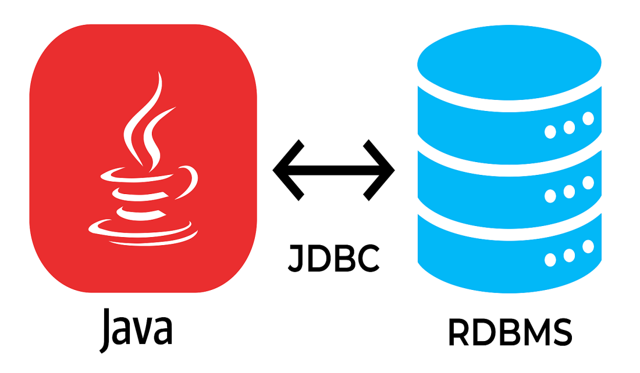
JDBC
JDBC is an interface between Java and Database
JDBC receives queries from Java Application program and communicate with Database
All the communications are in the form of SQL commands.
JDBC is responsible for:
Open a Connection
Communicate with database
Execute SQL statements
Retrieve query results

Slide 4
Purpose of JDBC
Enterprise applications created using the JAVA EE technology need to interact with databases to store application-specific information.
So, interacting with a database requires efficient database connectivity, which can be achieved by using the ODBC(Open database connectivity) driver.
This driver is used with JDBC to interact or communicate with various kinds of databases such as Oracle, MS Access, Mysql, and SQL server database.

Slide 5
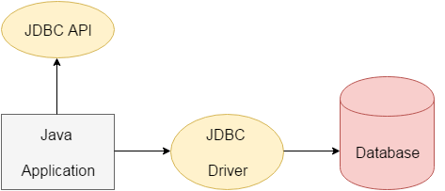
JDBC Architecture

Slide 6
JDBC Architecture
Application: It is a java applet or a servlet that communicates with a data source.
The JDBC API: The JDBC API allows Java programs to execute SQL statements and retrieve results. Some of the important classes and interfaces defined in JDBC API are as follows:
DriverManager: It plays an important role in the JDBC architecture. It uses some database-specific drivers to effectively connect enterprise applications to databases.
JDBC drivers: To communicate with a data source through JDBC, you need a JDBC driver that intelligently communicates with the respective data source.

Slide 7
Why Should We Use JDBC
Before JDBC, ODBC API was the database API to connect and execute the query with the database.
But, ODBC API uses ODBC driver which is written in C language (i.e. platform dependent and unsecured).
That is why Java has defined its own API (JDBC API) that uses JDBC drivers (written in Java language).

Slide 8
JDBC drivers
JDBC driver is responsible for making connection with different databases
It is also translating the queries received from Application and submit into database
A reverse translation is also required to perform by the Driver
JDBC Driver speaks JAVA to Application and native language to database
JDBC Drivers are exists for almost all databases
Appropriate driver will load for required database

Slide 9
JDBC drivers
Sun has defined four categories of JDBC drivers.
The categories delineate the differences in architecture for the drivers.
One difference between architectures lies in whether a given driver is implemented in native code or in Java code. Native code means whatever machine code is supported by a particular hardware configuration.
For example, a driver may be written in C and then compiled to run on a specific hardware platform.
Another difference lies in how the driver makes the actual connection to the database.

Slide 10
The four driver types are as follows:
Type 1 Driver: JDBC/ODBC Bridge
Type 2 Driver: Native API Driver
Type 3 Driver: Network Protocol, Pure Java Drive
Type 4 Driver: Native Protocol, Pure Java Driver

Slide 11
Type 1 Driver: JDBC/ODBC Bridge
This type uses bridge technology to connect a Java client to a third-party API such as Open Data Base Connectivity (ODBC).
Sun's JDBC-ODBC bridge is an example of a Type 1 driver.
These drivers are implemented using native .
This driver connects Java to a Microsoft ODBC (Open Database Connectivity) data source.

Slide 12
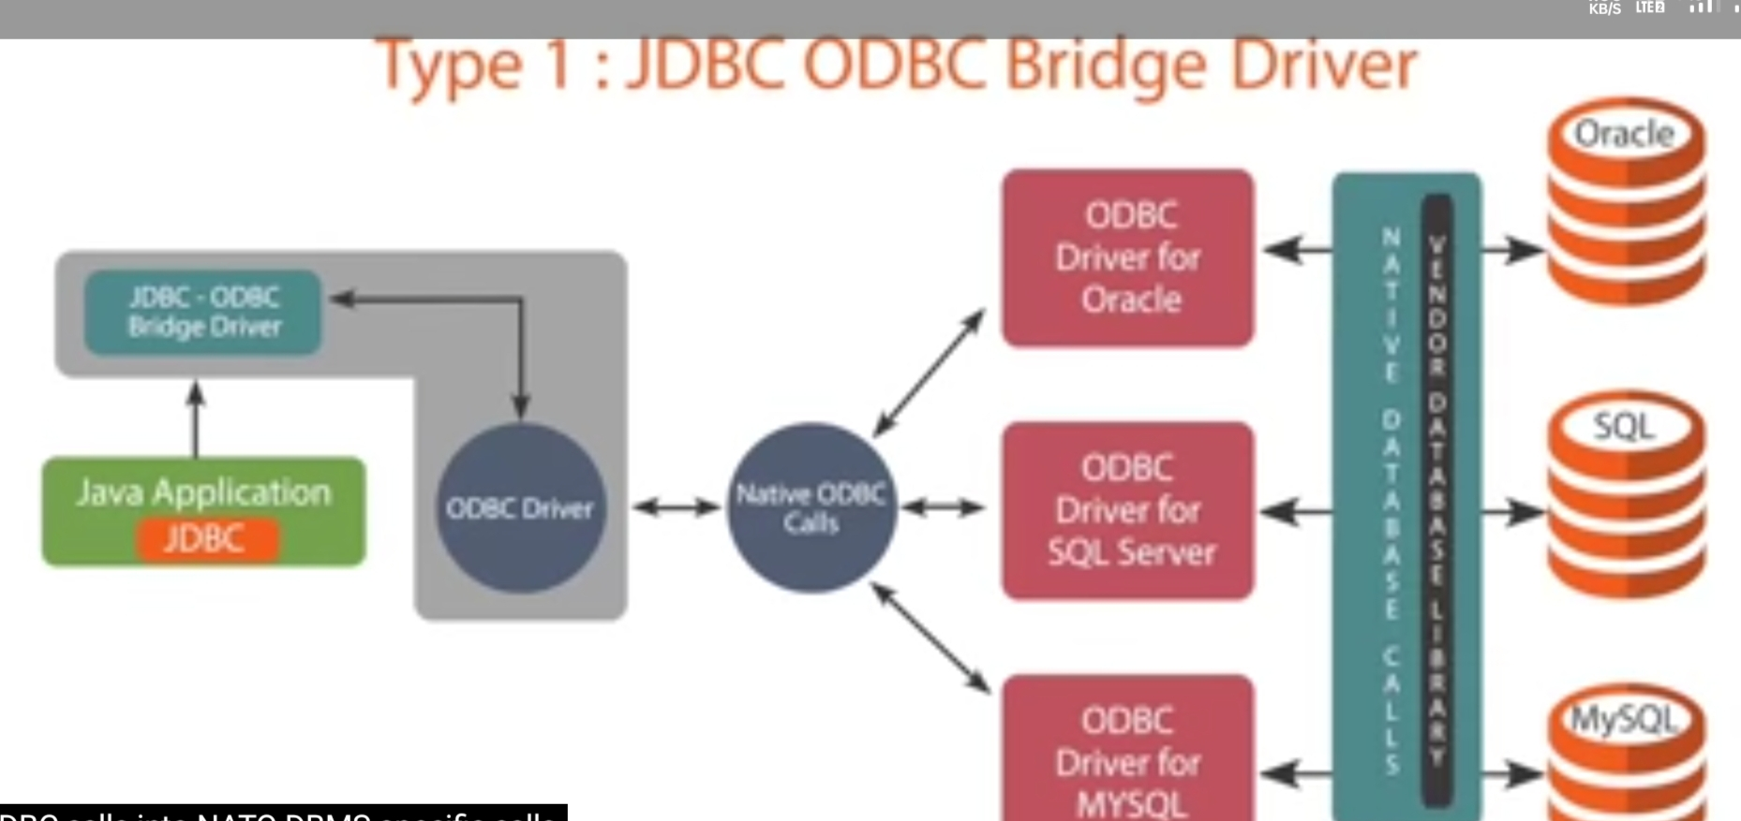

Slide 13
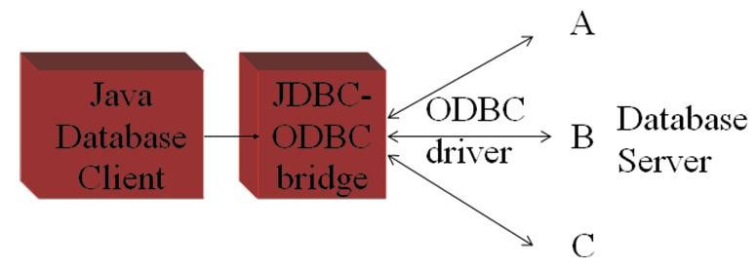
This driver typically requires the ODBC driver to be installed on the client computer and normally requires configuration of the ODBC data source. The bridge driver was introduced primarily to allow Java programmers to build data-driven Java applications before the database vendors had Type 3 and Type 4 drivers.

Slide 14
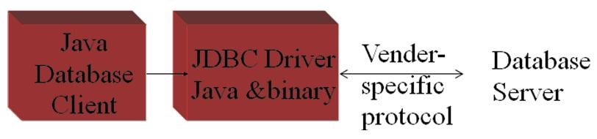
Type 2 Driver: Native API Driver
Type 2 driver is implemented using local native code, it is expected to have better performance than a pure Java driver.
These drivers enable JDBC programs to use database-specific APIs (normally written in C or C++) that allow client programs to access databases via the Java Native Interface.
This driver type translates JDBC into database-specific code. Type 2 drivers were introduced for reasons similar to the Type 1 ODBC bridge driver.

Slide 15
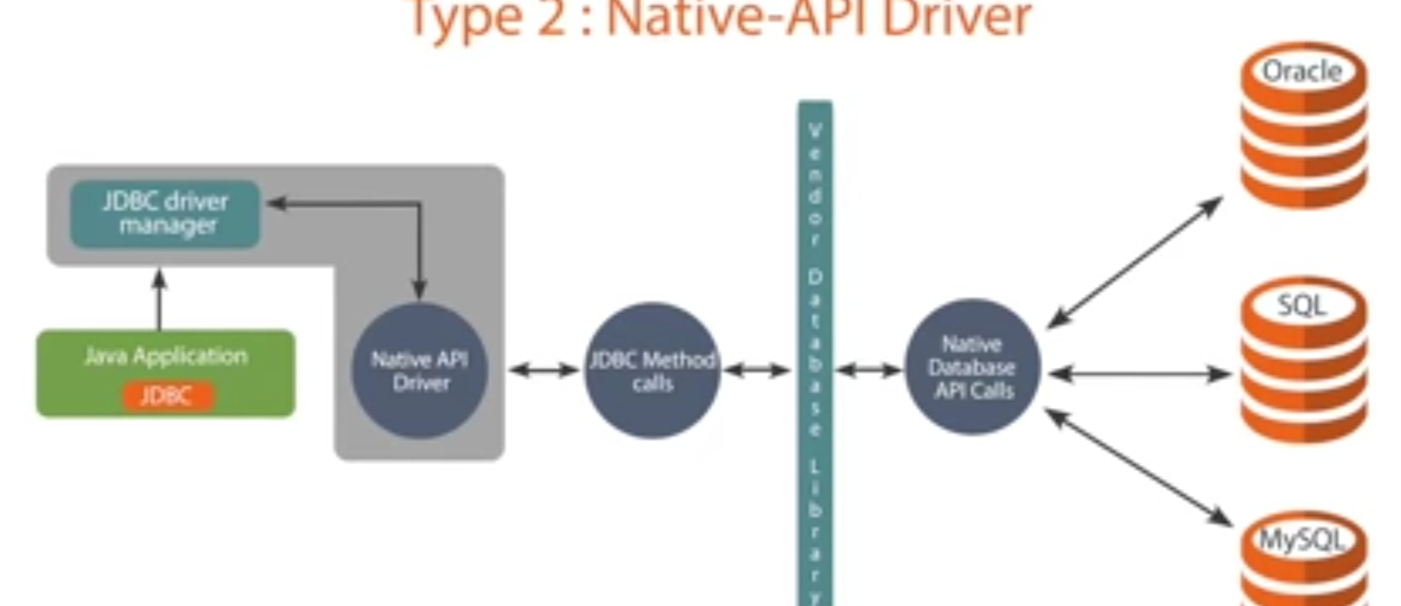

Slide 16
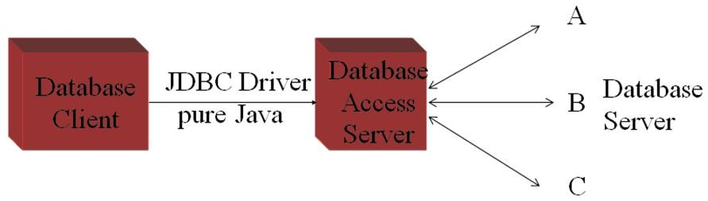
Type 3 Driver: Network Protocol, Pure Java Driver
These drivers take JDBC requests and translate them into a network protocol that is not database specific. These requests are sent to a server, which translates the database requests into a database-specific protocol.

Slide 17
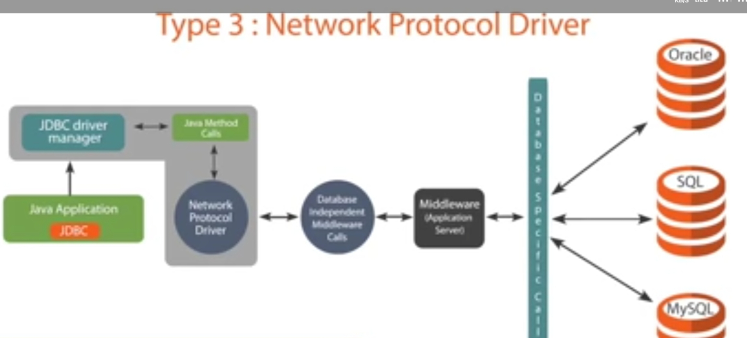

Slide 18
Network Protocol, Pure Java Driver
This type of driver communicates using a network protocol to a middle tier server.
The middle tier in turn communicates to the database.
Oracle does not provide a Type 3 driver. They do, however, have a program called Connection Manager that, when used in combination with Oracle's Type 4 driver, acts as a Type 3 driver in many respects.

Slide 19
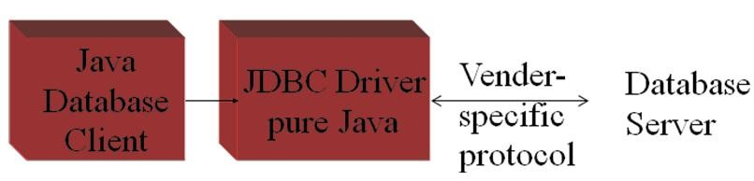
Type 4 Driver: Native Protocol, Pure Java Driver
These convert JDBC requests to database-specific network protocols, so that Java programs can connect directly to a database.
This type of driver, written entirely in Java, communicates directly with the database.
No local native code is required. Oracle's thin driver is an example of a Type 4 driver

Slide 20
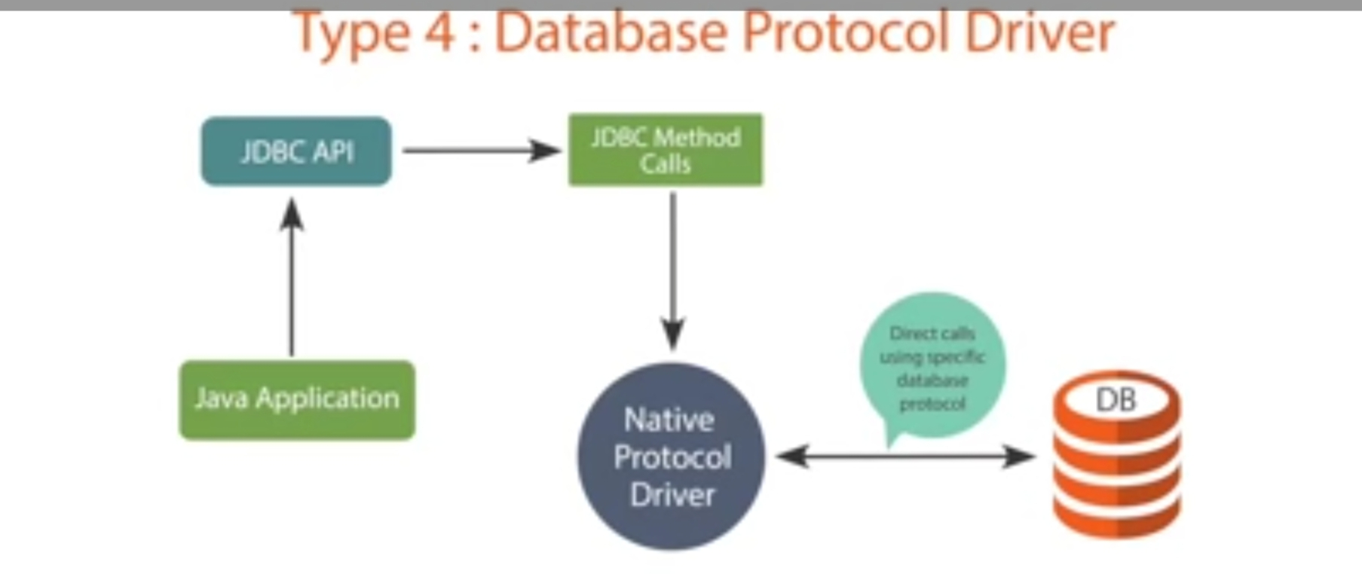

Slide 21
Steps For Connectivity Between Java Program and Database
1) Import the Packages.
2) a)Load the drivers using the forName() method.
b) Register the drivers using DriverManager.
3) Establish a connection using the Connection class object.
4) Create a statement.
5) Execute the query.
6) Process Result
7) Close the connections

Slide 22
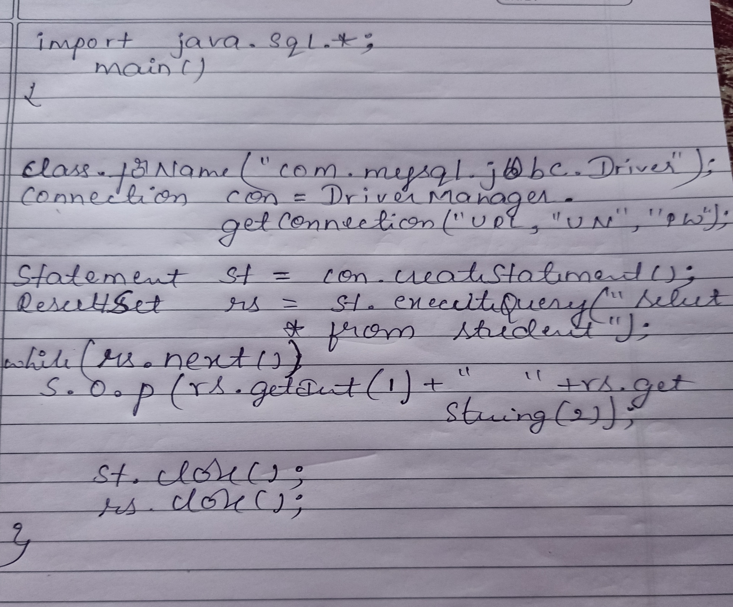

Slide 23
BATCH UPDATES
Grouping a set of INSERT or, UPDATE or, DELETE commands and execute them at once this mechanism is known as a batch update.

Slide 24
Adding statements to the batch
The statement, Prepared Statement, and Callable Statement objects hold a list to which you can add related statements using the addBatch() method.
stmt.addBatch(insert1);
stmt.addBatch(insert2);
stmt.addBatch(insert3);

Slide 25
Executing the batch
After adding the required statements, you can execute a batch using the execute Batch() method of the Statement interface.
stmt.executeBatch();
Using batch updates, we can reduce the communication overhead and increase the performance of our Java application.

Slide 26
Batch Update
Before adding statements to the batch you need to turn the auto commit off using the con.setAutoCommit(false) and, after executing the batch you need to save the changes using the con.commit() method.

Slide 27
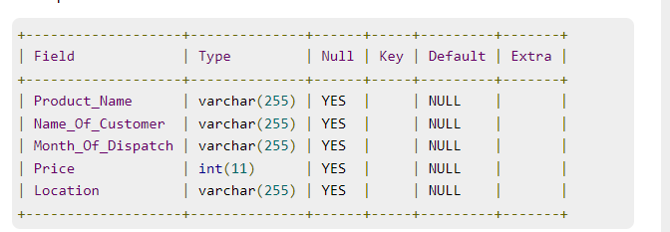
Assume we have created a table named Sales in the database with the following description:

Slide 28
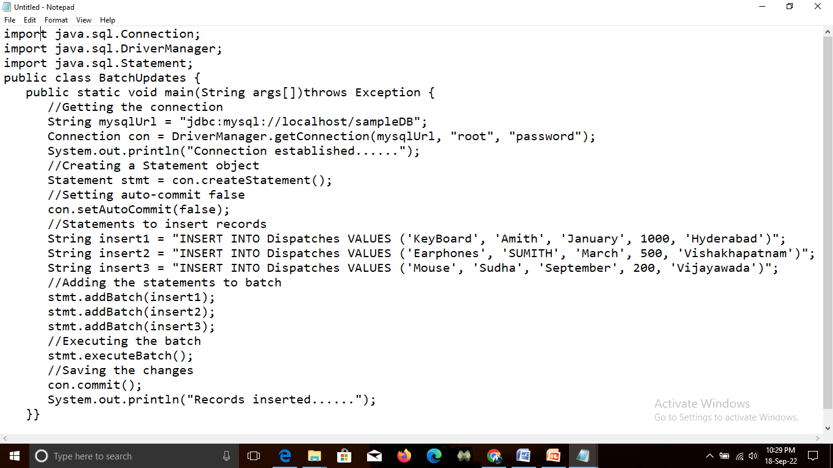

Slide 29
Output
Connection established......
Records inserted......

Slide 30
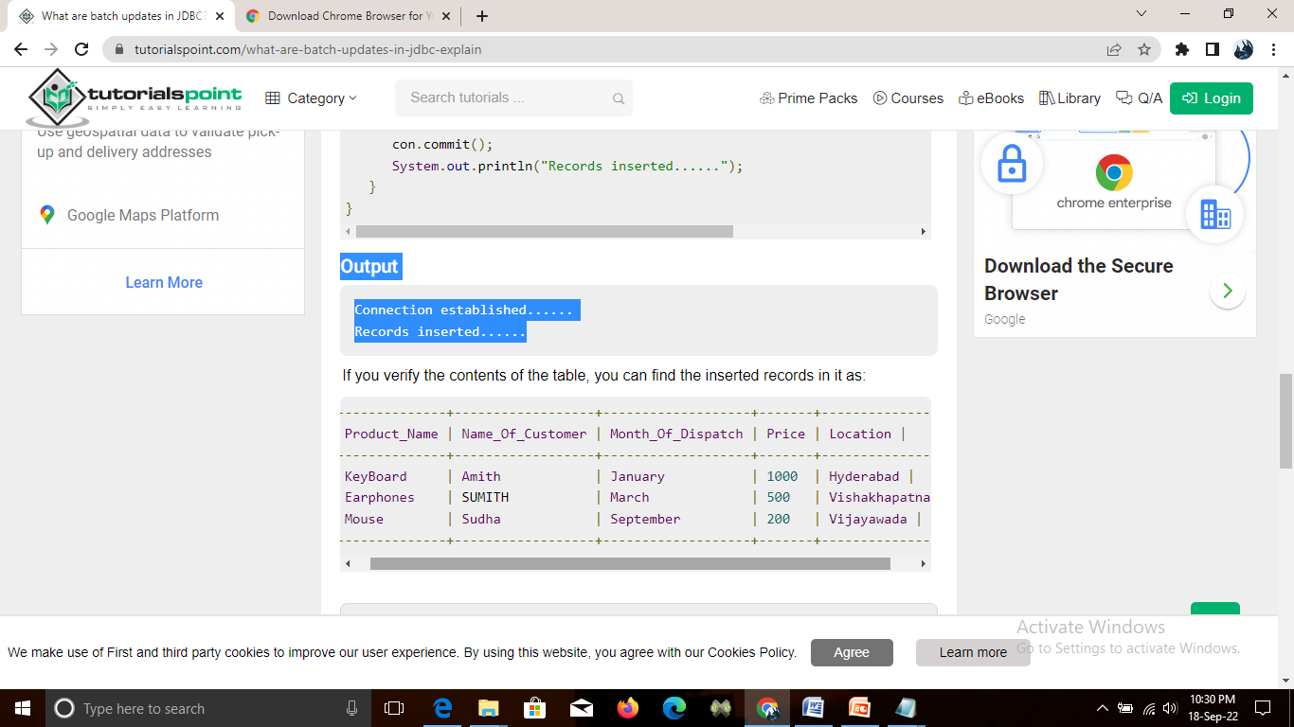
Database output

Slide 31
Mapping
Java programming language retrieves data from a database, there has to be some form of mapping and data conversion.
In most cases, programmers using the JDBC API will be programming with knowledge of their target database's schema.

Slide 32
JDBC Types Mapped to Java Types
A programmer should write code with this mapping in mind. For example, if a value in the database is a SMALLINT, a short should be the data type used in a JDBC application.
The getObject methods for both the CallableStatement and ResultSet interfaces use the mapping in "JDBC Types Mapped to Java Object Types"

Slide 33
JDBC Type Java Type
CHAR String
VARCHAR String
BIT boolean
REAL float
FLOAT double

Slide 34
Java Types Mapped to JDBC Types
The table shows the mapping a driver should use for the ResultSet.updateXXX methods and for IN parameters.
Java Type JDBC Type
String CHAR, VARCHAR, or LONGVARCHAR
java.math.BigDecimal NUMERIC
java.sql.Date DATE
java.sql.Time TIME
java.sql.Timestamp TIMESTAMP

Slide 35
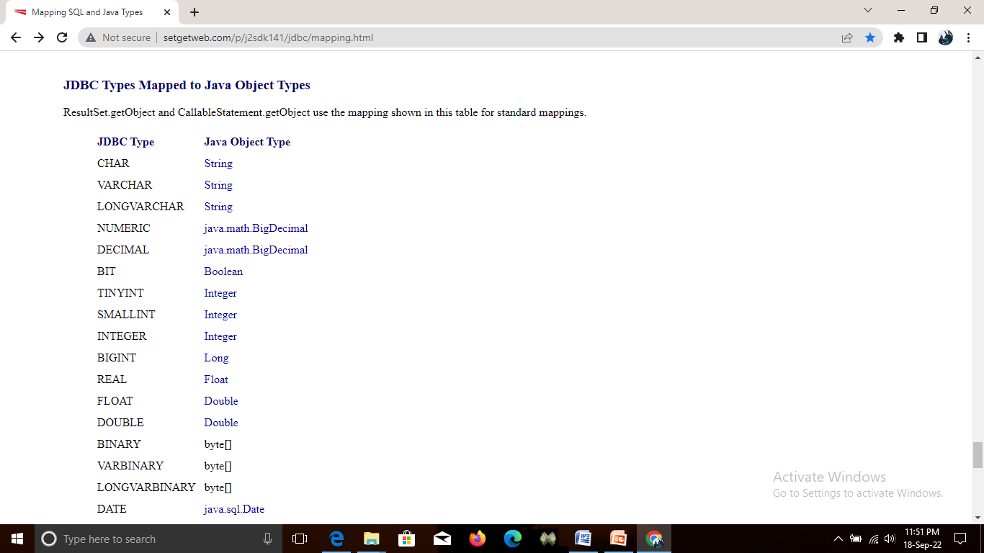
JDBC Types Mapped to Java Object Types
ResultSet.getObject and CallableStatement.getObject use the mapping shown in this table for standard mappings.

Slide 36
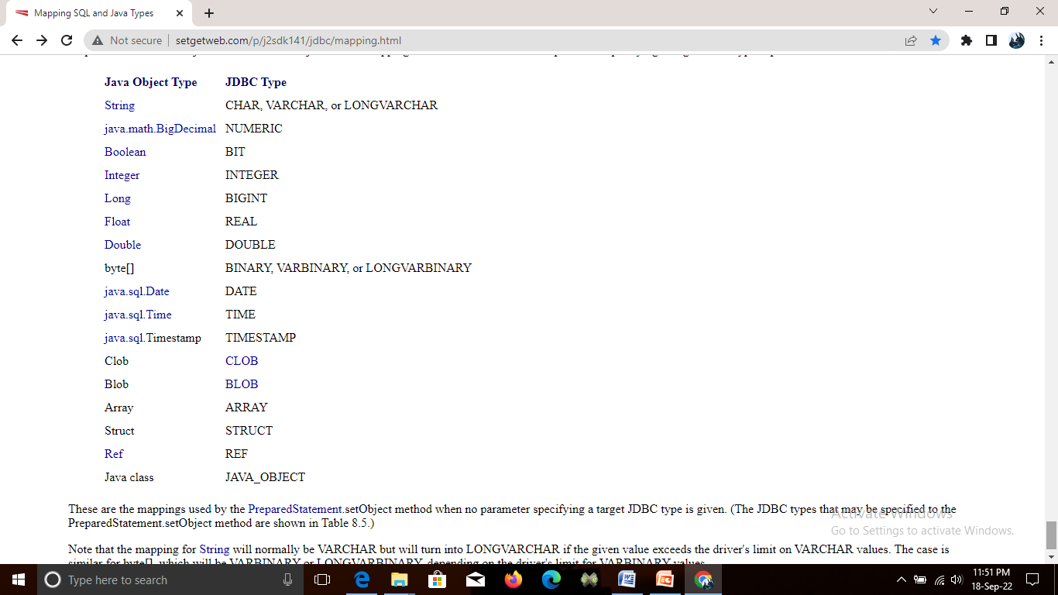
Java Object Types Mapped to JDBC Types
PreparedStatement.setObject and RowSet.setObject use the mapping shown in this table when no parameter specifying a target JDBC type is provided.

Slide 37
JDBC Data Types
The JDBC driver converts the Java data type to the appropriate JDBC type, before sending it to the database.
It uses a default mapping for most data types.
For example, a Java int is converted to an SQL INTEGER.
Default mappings were created to provide consistency between drivers.

Slide 38
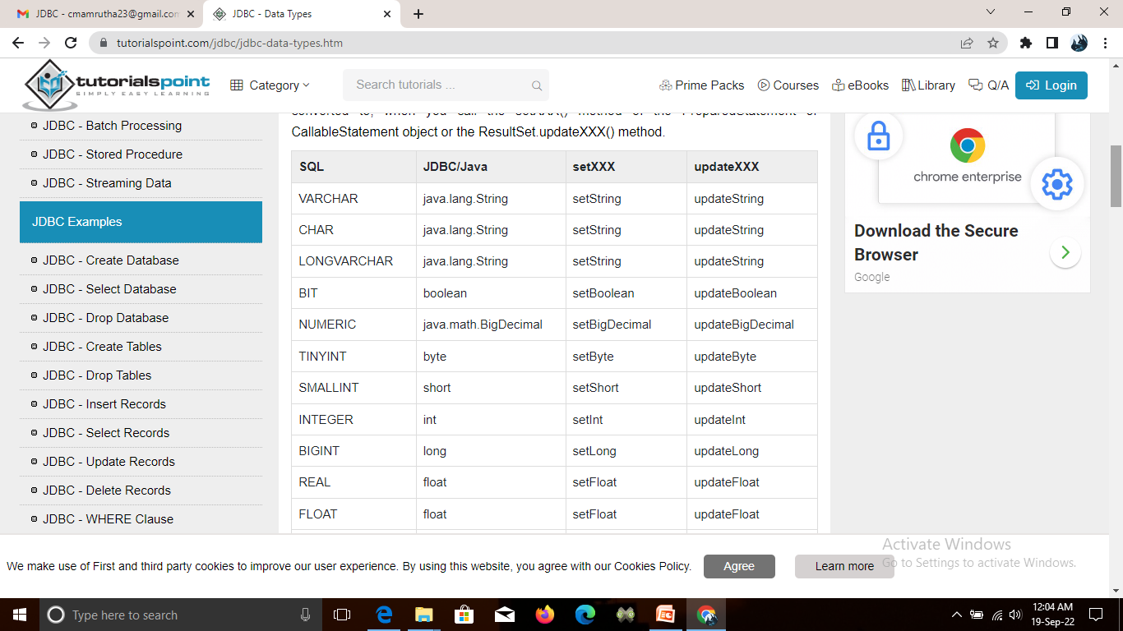
The default JDBC data type that the Java data type is converted to, when you call the setXXX() method of the PreparedStatement or CallableStatement object or the ResultSet.updateXXX() method.

Slide 39
Advanced Data Types
JDBC 3.0 has enhanced support for BLOB, CLOB, ARRAY, and REF data types.
The ResultSet object now has updateBLOB(), updateCLOB(), updateArray(), and updateRef() methods that enable you to directly manipulate the respective data on the server.
The setXXX() and updateXXX() methods enable you to convert specific Java types to specific JDBC data types.
The methods, setObject() and updateObject(), enable you to map almost any Java type to a JDBC data type.

Slide 40
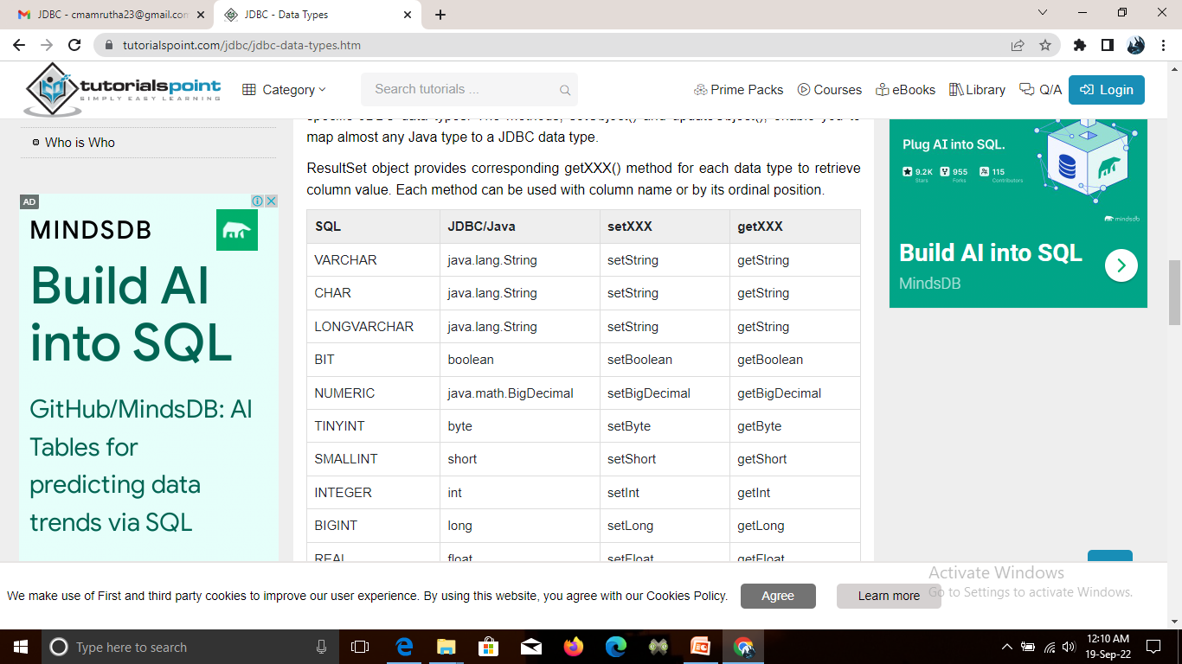
ResultSet object provides corresponding getXXX() method for each data type to retrieve column value.

