Slide 1
An Intermediate-Level Introduction to Web Mining
Kooper Young
Nikitha Vedant Madabhushi
Divya Shree Moka
Bharath Kumar Reddy Mopuru
Susmitha Muppalla
Manohar Sri Vikram Vattikuti

Slide 2
CONTENTS
Introduction
Web Mining Types
Uses and Utility
Future
Conclusion

Slide 3
INTRODUCTION
Web Mining is the application of Data Mining techniques to automatically discover and extracts patterns and information from the world wide web.
Based on the topology of the hyperlinks web structure mining will categories the web pages and generate the information such as similarity and relationship between different websites.
It helps in solving the problem of how users are using the website.

Slide 4
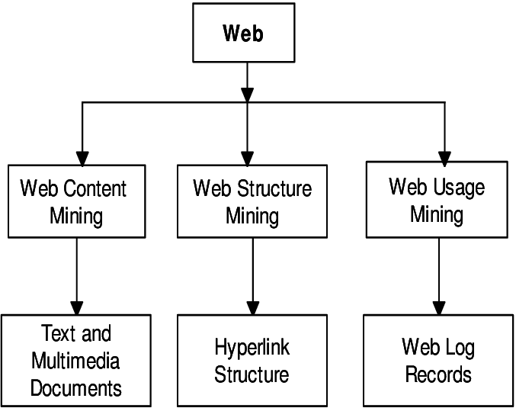
WEB MINING TYPES

Slide 5
WEB CONTENT MINING
The process of discovering useful information from the content of web page or web document.
Useful information contains text, image, audio, video.
Web content mining also known as “Web Text Mining”.
Content data is a group of facts that a web page is designed.
Techniques: 1) Natural Language Processing (NLP) 2) Information Retrieval (IR)

Slide 6
WEB STRUCTURE MINING
The structure of a typical web graph is as follows: Structure Information
Hyperlinks - as connections between two related pages(Web pages)
Web Structure Mining is a process of using the graph theory to analyze the Web pages and connection structure of a website.
It extracts patterns from hyperlinks in the Web.
A hyperlink is a structural component that connects the web page to a different location.
Techniques: 1) Page rank technique by Google. 2) CLEVER technique by giving weights to the pages.

Slide 7
WEB USAGE MINING
Web Usage Mining is the type of Web Mining activity which predicts about which pages are likely to be visited in near future based on the active users behavior.
Such pages can be pre-fetched to reduce access time.
The usage data records the users behavior when the user browses or makes transactions on the websites in order to better understand of user.
Web servers, web proxies and client application can easily capture web usage data.
Techniques to discover patterns: 1) Pattern Discovery Tools 2) Pattern Analysis Tools

Slide 8
USES AND UTILITY
Web mining can improve web surfing experience and personalize content based on user behavior patterns.
It provides valuable insights into student behavior, assignments, and participation rates.
Web mining can be used for market research to analyze customer feedback, social media reviews, and competitive analysis.
In the healthcare field, web mining is being used for tracking disease outbreaks, analyzing patient records, and medical research.
Open Information Extraction system (OIE) is a powerful web mining technique.

Slide 9
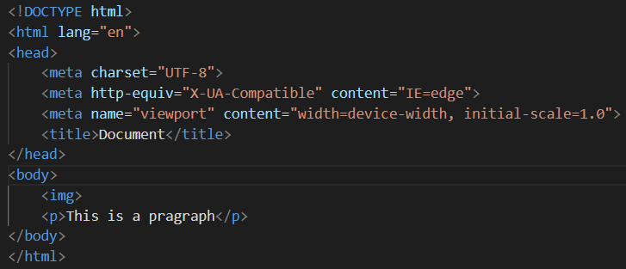
FUTURE OF WEB MINING
Natural language processing (NLP) can be integrated with web mining to understand and analyze human-generated text more effectively.
Deep learning can be used for image and video recognition in web mining, providing insights into user behavior related to visual content.
Machine learning algorithms can be used to enhance the accuracy and efficiency of web mining by analyzing vast amounts of data and identifying patterns and trends.

Slide 10
CONCLUSION
Web mining is a powerful tool for extracting insights from large datasets of web data.
It has numerous applications in e-commerce, education, healthcare, and social media.
Web mining can improve the web browsing experience, personalize content and layout, and provide valuable insights into student behavior in online learning environments.
As internet continues to grow, web mining is likely to become increasingly important for understanding and utilizing the wealth of information available to us.
Web mining has many more applications that are yet to be discovered.

Slide 11
References
1. Ai, J., Laffey, J.: Web mining as a tool for understanding online learning. MERLOT
Journal of Online Learning and Teaching 3(2), 160–169 (2007)
2. Eirinaki, M., Vazirgiannis, M.: Web mining for web personalization. ACM Trans-
actions on Internet Technology (TOIT) 3(1), 1–27 (2003)
3. Etzioni, O., Banko, M., Soderland, S., Weld, D.S.: Open information extraction
from the web. Communications of the ACM 51(12), 68–74 (2008)
4. Etzioni, O., Fader, A., Christensen, J., Soderland, S., et al.: Open information ex-
traction: The second generation. In: Twenty-Second International Joint Conference
on Artificial Intelligence. Citeseer (2011)

Slide 12
References
5. Khder, M.A.: Web scraping or web crawling: State of art, techniques, approaches
and application. International Journal of Advances in Soft Computing & Its Applications 13(3) (2021)
6. Kumar, A., Singh, R.K.: Web mining overview, techniques, tools and applications:
A survey. International Research Journal of Engineering and Technology (IRJET) 3 (12), 1543–1547 (2016)
7. Li, Y., Zhong, N.: Web mining model and its applications for information gathering.
Knowledge-Based Systems 17(5-6), 207–217 (2004)
8. Ratnakumar, A.J.: An implementation of web personalization using web mining
techniques. Journal of Theoretical and applied information technology 18(1), 67–73 (2010)

Slide 13
References
9. Srivastava, J., Desikan, P., Kumar, V.: Web mining: Accomplishments and future
directions. In: National Science Foundation Workshop on Next Generation Data Mining (NGDM’02). pp. 51–56 (2002)
10. Wang, Y.: Web mining and knowledge discovery of usage patterns. CS748T Project
(Part I) Feb (2000)

