Slide 1
An Intermediate-Level Introduction to Web Mining
Kooper Young
Nikitha Vedant Madabhushi
Divya Shree Moka
Bharath Kumar Reddy Mopuru
Susmitha Muppalla
Manohar Sri Vikram Vattikuti

Slide 2
CONTENTS
Introduction
Web Mining Types
Uses and Utility
Future
Conclusion

Slide 3
INTRODUCTION
Web Mining is the application of Data Mining techniques to automatically discover and extracts patterns and information from the world wide web.
Based on the topology of the hyperlinks web structure mining will categories the web pages and generate the information such as similarity and relationship between different websites.
It helps in solving the problem of how users are using the website.

Slide 4
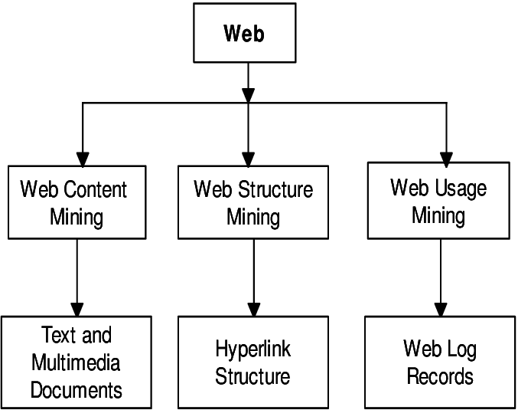
WEB MINING TYPES

Slide 5
WEB CONTENT MINING
The process of discovering useful information from the content of web page or web document.
Useful information contains text, image, audio, video.
Web content mining also known as “Web Text Mining”.
Content data is a group of facts that a web page is designed.

Slide 6
WEB CONTENT MINING - Techniques
Techniques: 1) Natural Language Processing (NLP) - NLP is a branch of artificial intelligence that enables computers to understand, interpret, and generate human language. NLP has many real-world applications, such as language translation, sentiment analysis, chatbots, speech recognition, and text classification. 2) Information Retrieval (IR) - Information Retrieval (IR) is the process of retrieving relevant information from a large collection of unstructured or semi-structured data. It involves indexing, searching, and retrieving information from various sources, including text documents, web pages, and multimedia content.

Slide 7
WEB STRUCTURE MINING
The structure of a typical web graph is as follows: Structure Information
Hyperlinks - as connections between two related pages(Web pages)
Web Structure Mining is a process of using the graph theory to analyze the Web pages and connection structure of a website.
It extracts patterns from hyperlinks in the Web.
A hyperlink is a structural component that connects the web page to a different location.

Slide 8
WEB STRUCTURE MINING
Techniques: 1) Page rank technique by Google - PageRank is a link analysis algorithm used by Google Search to rank websites in their search engine results. PageRank relies on the uniquely democratic nature of the web by using its vast link structure as an indicator of an individual page's value. 2) CLEVER technique by giving weights to the pages - CLEVER (Cross-Language Evaluation of Web Pages Retrieval) is a technique used to improve the effectiveness of search engines in retrieving web pages in multilingual environments.

Slide 9
WEB USAGE MINING
Web Usage Mining is the type of Web Mining activity which predicts about which pages are likely to be visited in near future based on the active users behavior.
Such pages can be pre-fetched to reduce access time.
The usage data records the users behavior when the user browses or makes transactions on the websites in order to better understand of user.
Web servers, web proxies and client application can easily capture web usage data.

Slide 10
WEB USAGE MINING
Techniques to discover patterns: 1) Pattern Discovery Tools - Pattern Discovery Tools are algorithms and techniques used to identify and extract meaningful patterns from data. These tools are commonly used in data mining, machine learning, and other fields to uncover hidden insights and relationships within data sets. 2) Pattern Analysis Tools - Pattern analysis tools are used to analyze data and identify patterns that can provide insights and support decision-making. These tools are often used in fields such as data mining, machine learning, and artificial intelligence.

Slide 11
USES AND UTILITY
Web mining can improve web surfing experience and personalize content based on user behavior patterns.
It provides valuable insights into student behavior, assignments, and participation rates.
Web mining can be used for market research to analyze customer feedback, social media reviews, and competitive analysis.
In the healthcare field, web mining is being used for tracking disease outbreaks, analyzing patient records, and medical research.
Open Information Extraction system (OIE) is a powerful web mining technique.

Slide 12
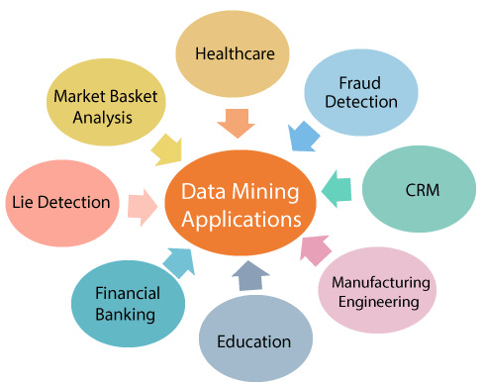
USES AND UTILITY

Slide 13
FUTURE OF WEB MINING
Natural language processing (NLP) can be integrated with web mining to understand and analyze human-generated text more effectively.
Deep learning can be used for image and video recognition in web mining, providing insights into user behavior related to visual content.
Machine learning algorithms can be used to enhance the accuracy and efficiency of web mining by analyzing vast amounts of data and identifying patterns and trends.

Slide 14
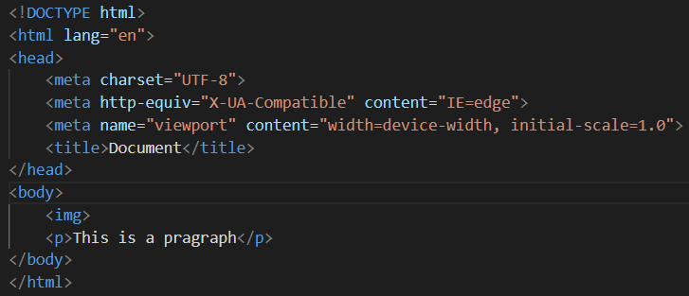
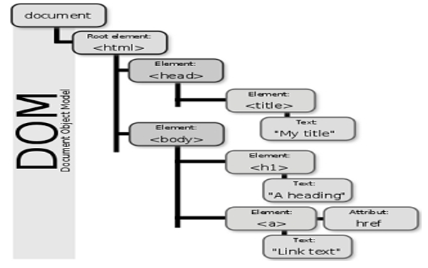
HTML PARSING
DOM PARSING

Slide 15
CONCLUSION
Web mining is a powerful tool for extracting insights from large datasets of web data.
It has numerous applications in e-commerce, education, healthcare, and social media.
Web mining can improve the web browsing experience, personalize content and layout, and provide valuable insights into student behavior in online learning environments.
As internet continues to grow, web mining is likely to become increasingly important for understanding and utilizing the wealth of information available to us.
Web mining has many more applications that are yet to be discovered.

Slide 16
REFERENCES
Ai, J., Laffey, J.: Web mining as a tool for understanding online learning. MERLOT Journal of Online Learning and Teaching 3(2), 160–169 (2007)
Eirinaki, M., Vazirgiannis, M.: Web mining for web personalization. ACM Transactions on Internet Technology (TOIT) 3(1), 1–27 (2003)
Etzioni, O., Banko, M., Soderland, S., Weld, D.S.: Open information extraction from the web. Communications of the ACM 51(12), 68–74 (2008)
Etzioni, O., Fader, A., Christensen, J., Soderland, S., et al.: Open information extraction: The second generation. In: Twenty-Second International Joint Conference on Artificial Intelligence. Citeseer (2011)
Khder, M.A.: Web scraping or web crawling: State of art, techniques, approaches and application. International Journal of Advances in Soft Computing & Its Applications 13(3) (2021)
Kumar, A., Singh, R.K.: Web mining overview, techniques, tools and applications: A survey. International Research Journal of Engineering and Technology (IRJET)3(12), 1543–1547 (2016)

Slide 17
THE END

