Slide 1

Genetic Algorithm In Partial Transmit Sequence To Reduce Peak To Average Power Ratio In Orthogonal Frequency Division Multiplexing
Project Batch No : 35
Team Members :
Y. M. Sri Harika(15B01A04H9).
M. Divya Shree (15B01A0495).
Usha Vanaja Srilakshmi.P (15B01A04G1) .
N. Bala Durga (15B01A04A5).
Under the guidance of :
Mr. P. Ravi Kumar, M. Tech (Ph. D)
Sr. Assistant Professor
DEPARTMENT OF ELECTRONICS AND COMMUNICATION ENGINEERING
SHRI VISHNU ENGINEERING COLLEGE FOR WOMEN :: BHIMAVARAM

Slide 2
Contents
Motivation
Objective
Introduction
Orthogonality
OFDM Block Diagram
PAPR
Partial transmit sequence
Genetic algorithm
Flow chart
Literature Survey
Simulation results
Conclusion

Slide 3
Motivation
OFDM is becoming the chosen modulation technique for wireless communication.
High Peak-to-Average Power Ratio(PAPR) is one of the most serious problems in OFDM Systems.
Reduction in PAPR reduces bandwidth and provides high data transmission.
High PAPR increases the complexity of Power Amplifier.

Slide 4
Objective
To reduce peak to average power ratio in OFDM systems using genetic algorithm.
To improve the Bit Error Rate (BER)

Slide 5
Introduction
OFDM is a spectrally efficient multicarrier modulation technique for high speed data transmission over multipath fading channels.
Major drawback in OFDM is high peak-to-average-power ratio(PAPR) of the transmitted signals.
Various techniques are used to reduce the PAPR out of which Partial Transmit Sequence (PTS) technique is preferred.

Slide 6
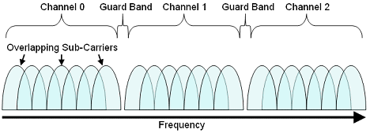
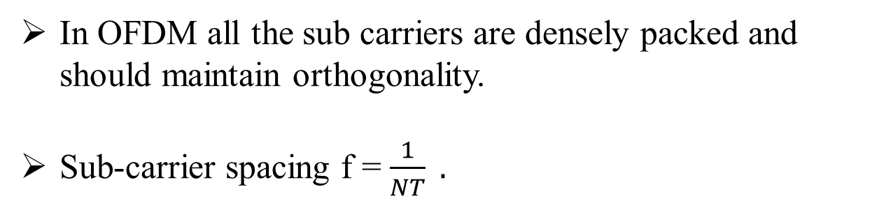
Sub Carriers
In OFDM all the sub carriers are densely packed and should maintain orthogonality.
Sub-carrier spacing f = $\frac{1}{NT} .$

Slide 7
Sub Blocks
The input data can be divided into sub-blocks using three methods:
Adjacent Partition
Interleaved Partition
Pseudo Random Partition
Of these three methods pseudo random partition gives the best performance.

Slide 8
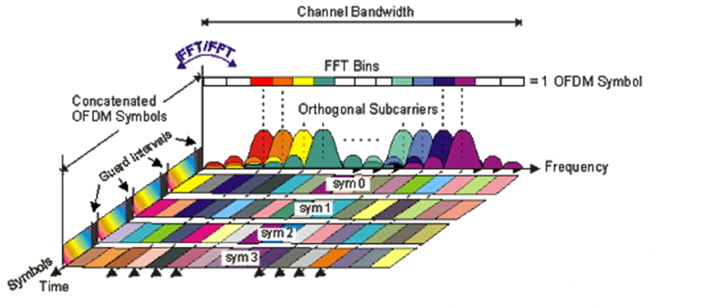
OFDM Symbol
Multiple symbols can be concatenated to create the final OFDM burst signal.

Slide 9
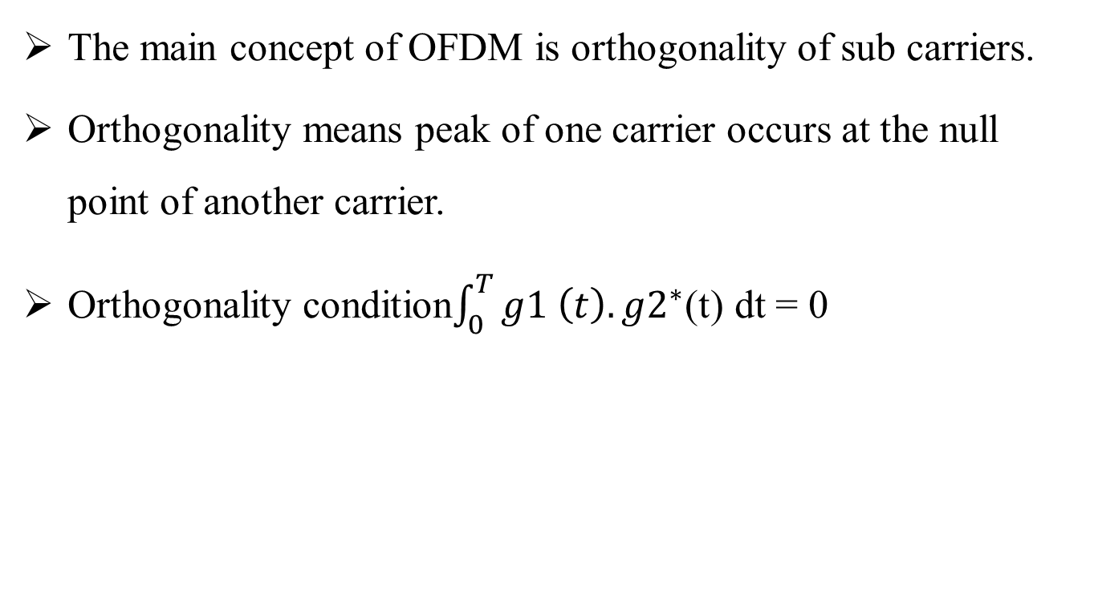
Orthogonality
The main concept of OFDM is orthogonality of sub carriers.
Orthogonality means peak of one carrier occurs at the null point of another carrier.
Orthogonality condition$\int_{0}^{T}{g1 \left(t\right).g2^{∗}}$(t) dt = 0

Slide 10
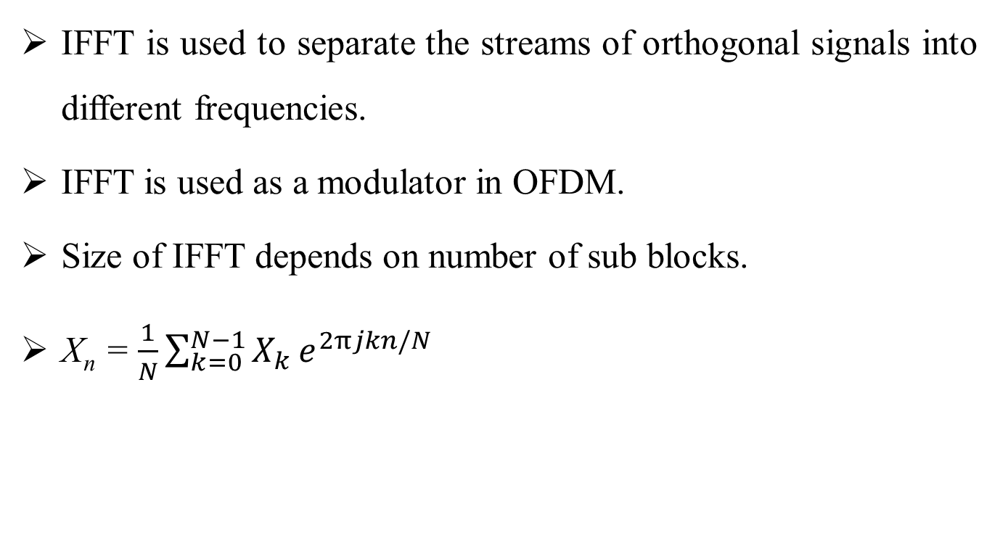
Inverse Fast Fourier Transform
IFFT is used to separate the streams of orthogonal signals into different frequencies.
IFFT is used as a modulator in OFDM.
Size of IFFT depends on number of sub blocks.
X_{n} = $\frac{1}{N}\sum_{k=0}^{N−1}{X_{k}}e^{2πjkn/N}$

Slide 11
OFDM Block Diagram
Input data
Serial to parallel
Modulation scheme
IFFT
Parallel to serial
channel
Output data
Parallel to serial
Demodulation scheme
FFT
Serial to parallel

Slide 12
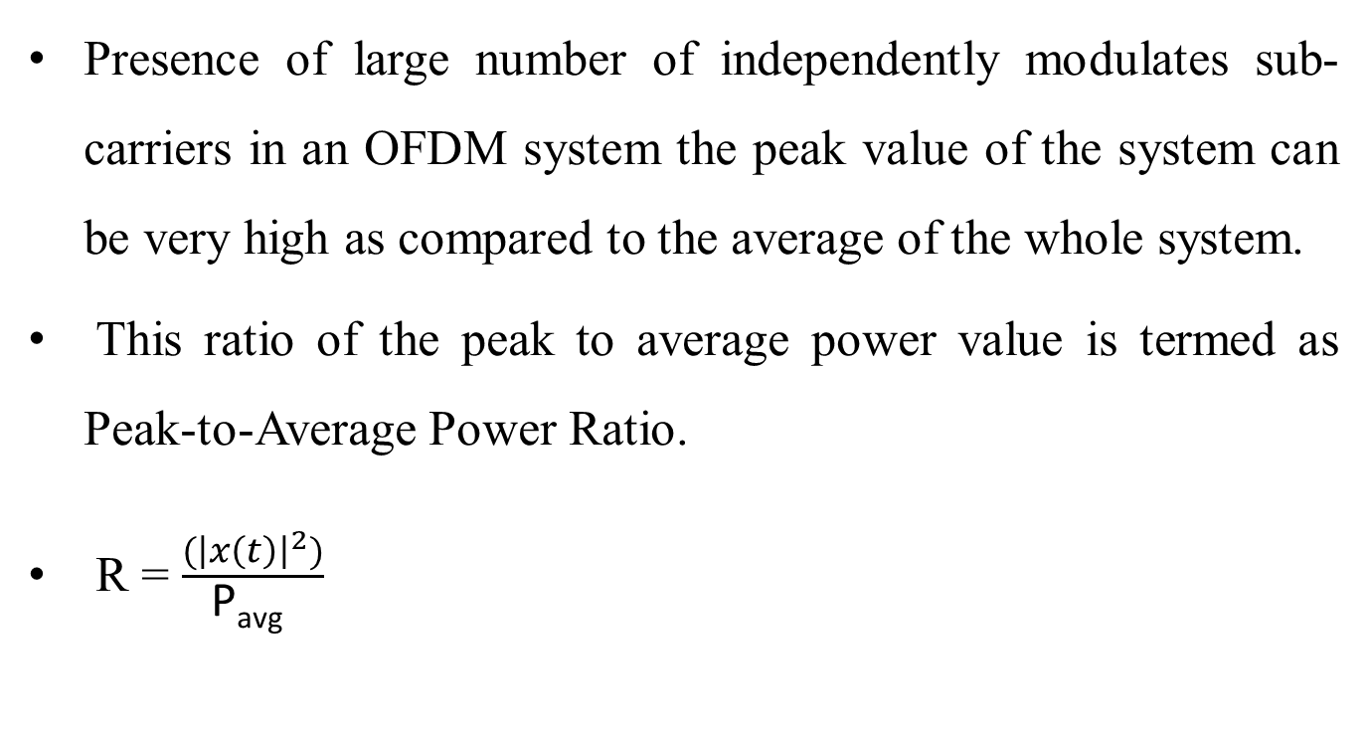
PAPR
Presence of large number of independently modulates sub-carriers in an OFDM system the peak value of the system can be very high as compared to the average of the whole system.
This ratio of the peak to average power value is termed as Peak-to-Average Power Ratio.
R = $\frac{({\left|x\left(t\right)\right|}^{2})}{\text{P}\text{avg} }$

Slide 13
CCDF
Complementary Cumulative Distributive Function is used to measure the efficiency of PAPR techniques.
The CCDF of an OFDM system to measure the PAPR can be given as
CCDF = Pr (PAPR>PAPR₀)
Where Pr is the probability and PAPR₀ is the threshold value.

Slide 14
Partial Transmit Sequence
The principle of PTS is to divide the input data block into several disjoint sub-blocks and transform these sub-blocks into PTS by inverse Fast Fourier Transform then minimum PAPR is selected.
The input data is divided to reduce the autocorrelation between the subcarriers.

Slide 15
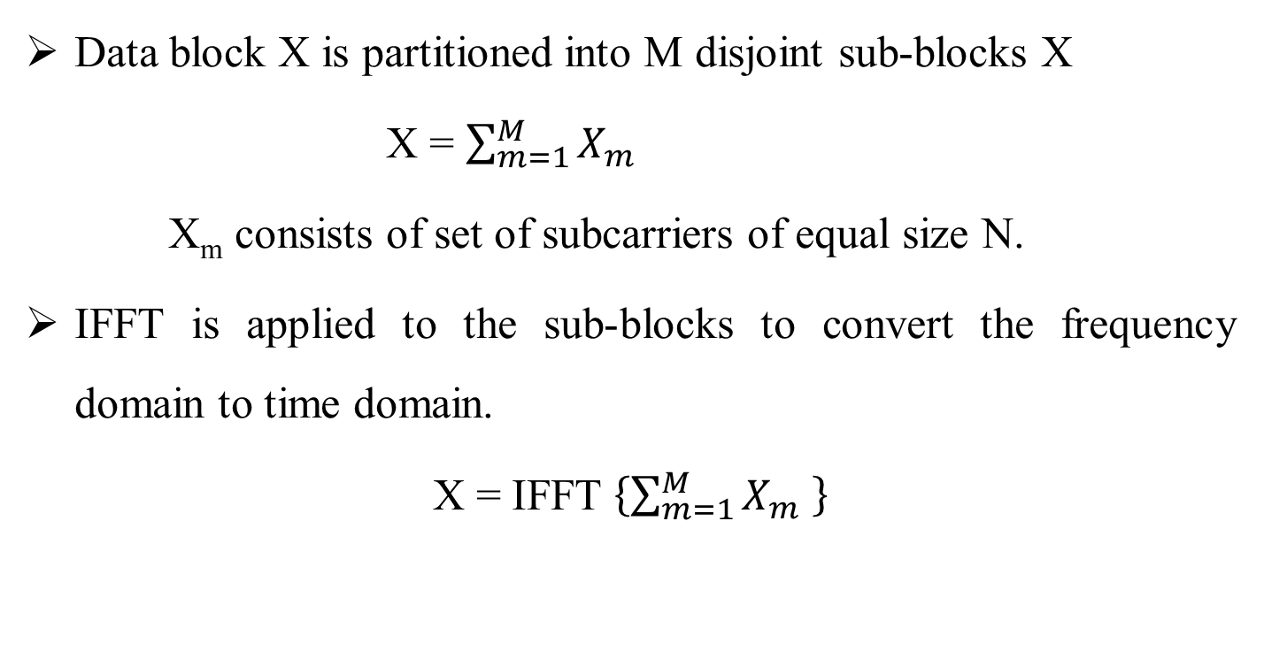
Partial Transmit Sequence(cont..)
Data block X is partitioned into M disjoint sub-blocks X
X = $\sum_{m=1}^{M}{X_{m}}$
X_{m} consists of set of subcarriers of equal size N.
IFFT is applied to the sub-blocks to convert the frequency domain to time domain.
X = IFFT $\left\{\sum_{m=1}^{M}{X_{m} }\right\}$

Slide 16
Partial Transmit Sequence(cont..)
The partial transmit sequence (PTS) technique partitions an input data block of N symbols into V disjoint sub blocks as follows:
X=[X¹,X²,X³,..........,X^{v}]^{T}
where Xi are the sub blocks that are consecutively located and also are of equal size.

Slide 17
Partial transmit sequence(cont..)
Then each partitioned sub block is multiplied by a corresponding complex phase factor
b^{v} = e^{jøv} , v =1,2,...,V
The PTS technique suffers from the complexity of searching for the optimum set of phase vector, especially when the number of sub block increases.
Search complexity can be reduced by adopting genetic algorithm.

Slide 18
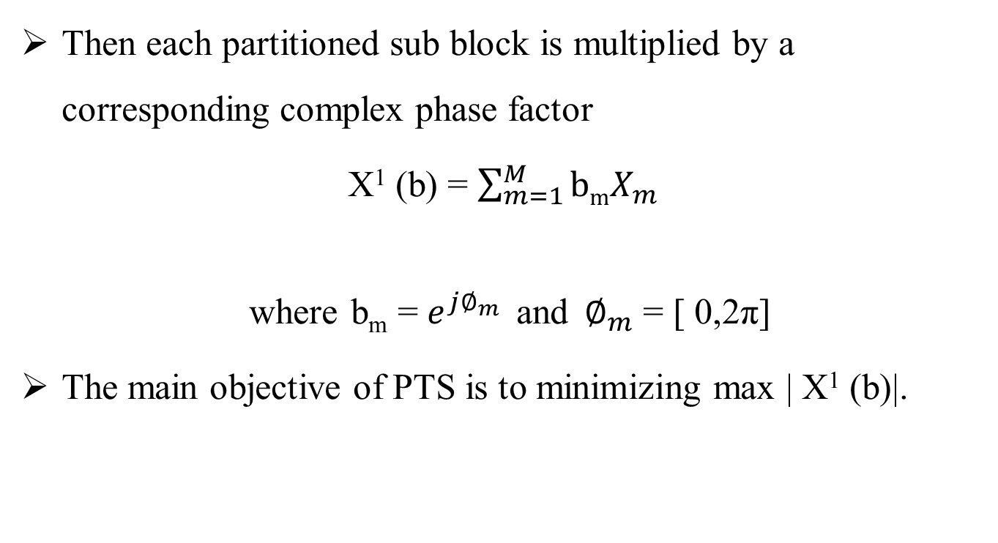
Partial Transmit Sequence(cont..)
Then each partitioned sub block is multiplied by a corresponding complex phase factor
X¹ (b) = $\sum_{m=1}^{M}{bmX_{m}}$
where b_{m} = $e^{j∅_{m}}$ and $∅_{m}$ = [ 0,2π]
The main objective of PTS is to minimizing max | X¹ (b)|.

Slide 19
PTS Block Diagram
X¹
N point IFFT
Serial to Parallel converter
b¹
X²
X
N point IFFT
x
Input data
Σ
b²
X^{V}
N point IFFT
b^{v}
Genetic Algorithm Phase optimization

Slide 20
Genetic Algorithm
Genetic algorithms are adaptive heuristic search algorithm based on the evolutionary ideas of natural selection and genetics.
It is used to solve optimization problems.

Slide 21
Genetic Algorithm(cont..)
Five phases are considered in a genetic algorithm.
1) Initial population
2) Fitness function
3) Selection
4) Crossover
5) Mutation

Slide 22
Flow Chart
no
yes
stop
Generate a set of random variables
Calculate the fitness value for each function
Apply crossover operation to a pre specified percent of selected population
Apply mutation operation to a pre specified parent of selected population
Are stopping condition satisfied?
Apply selection operation to the population together with newly generated individuals to build generated individuals to build the next generations

Slide 23
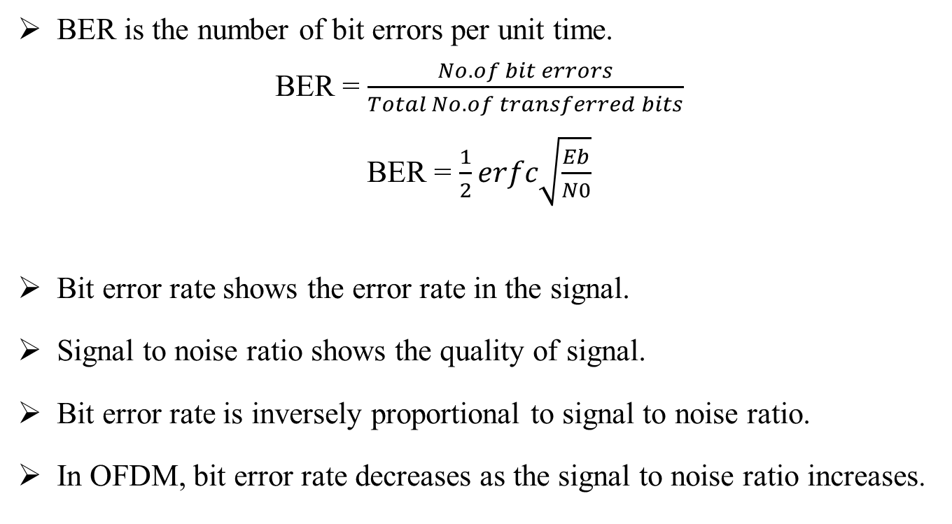
Bit Error Rate
BER is the number of bit errors per unit time.
BER = $\frac{No.of bit errors}{Total No.of transferred bits}$
BER = $\frac{1}{2}erfc\sqrt{\frac{Eb}{N0}}$
Bit error rate shows the error rate in the signal.
Signal to noise ratio shows the quality of signal.
Bit error rate is inversely proportional to signal to noise ratio.
In OFDM, bit error rate decreases as the signal to noise ratio increases.

Slide 24
Literature Survey
S. H. Han and J. H. Lee, “An overview of peak-to-average power ration reduction techniques for multicarrier transmission,” IEEE Wireless Communication, Vol. 12, pp. 56-65, April 2005.
It deals with the different PAPR reduction techniques proposed and the merits and demerits involved in every technique.

Slide 25
Literature Survey(cont..)
Hsinying Liang, Yan-Ru Chen, Yung-Fa Huang, Chia-Hsin Cheng, “A modified Genetic Algorithm PTS Technique for PAPR reduction in OFDM systems,” Proceedings of the 15th Asia-Pacific Conference on Communications (APCC), pp. 182-185, Oct. 2009.
It deals with peak to average power ratio(PAPR) reduction method for orthogonal frequency division multiplexing(OFDM) system by combining the Genetic algorithm and Partial Transmit Sequence

Slide 26
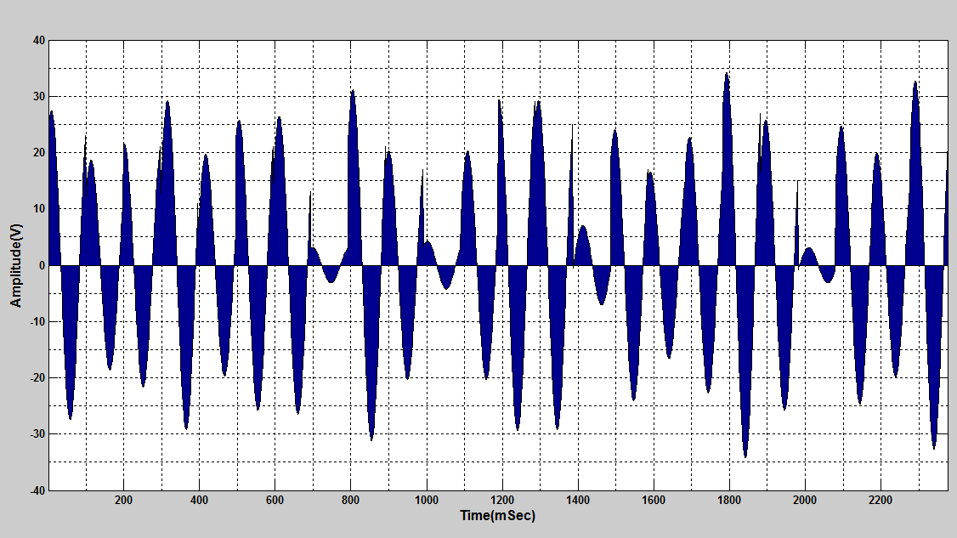
SIMULATION RESULTS OFDM Simulation

Slide 27
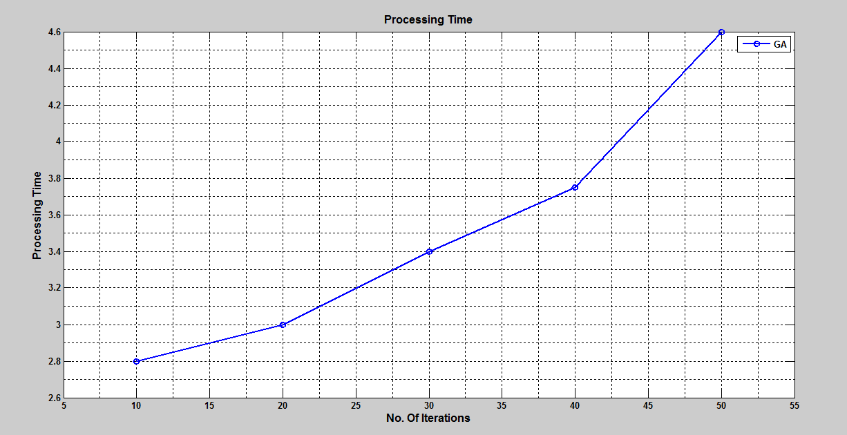
Number of Iterations in Genetic Algorithm

Slide 28
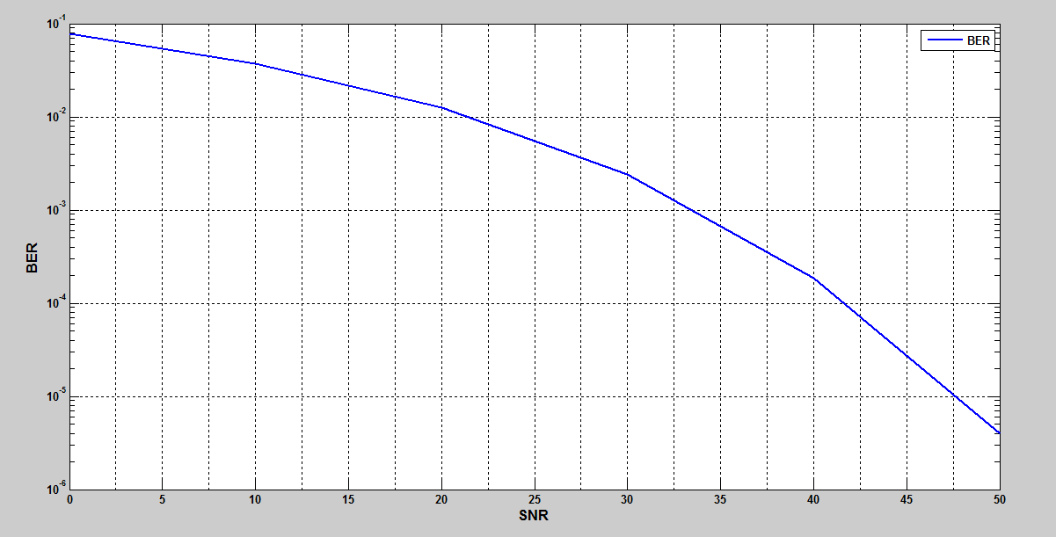
Bit Error Rate Vs Signal to Noise Ratio

Slide 29
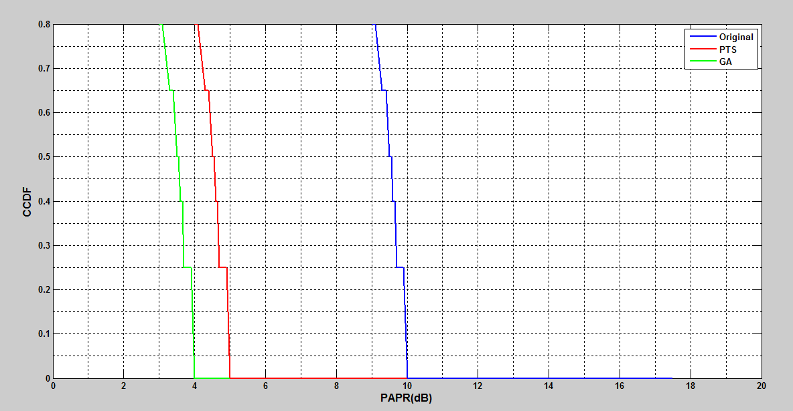
Comparison of PAPR

Slide 30
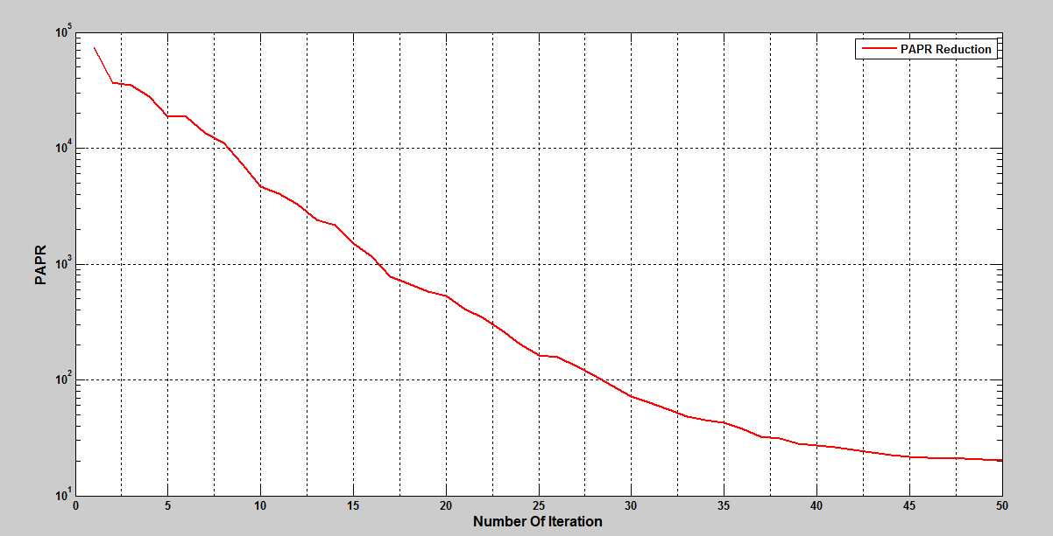
PAPR Reduction

Slide 31
Conclusion
One of the effective methods of PAPR reduction is Partial Transmit Sequence scheme. So, we can improve the performance of PAPR reduction using Genetic Algorithm (GA).

Slide 32


