Slide 1

LIFE DETECTION SYSTEM
Presented by
Divya Shree Moka
(15B01A0495)
DEPARTMENT OF ELECTRONICS & COMMUNICATION ENGINEERING
SHRI VISHNU ENGINEERING COLLEGE FOR WOMEN (AUTONOMOUS)
VISHNUPUR: BHIMAVARAM

Slide 2
CONTENTS
Introduction
Principle of Operation
Introduction to Microwaves
Major Components of the Circuit
System Diagram
Experimental Results
Advantages and Disadvantages
Future scope
Conclusion

Slide 3
INTRODUCTION
A new sensitive microwave life-detection system which can be used to locate human subjects buried under earthquake rubble or hidden behind various barriers has been constructed.
This system operating at 1150 MHz or 450 MHz can detect the breathing and heartbeat signals of human subjects through an earthquake rubble or a construction barrier of about 10-ft thickness.

Slide 4
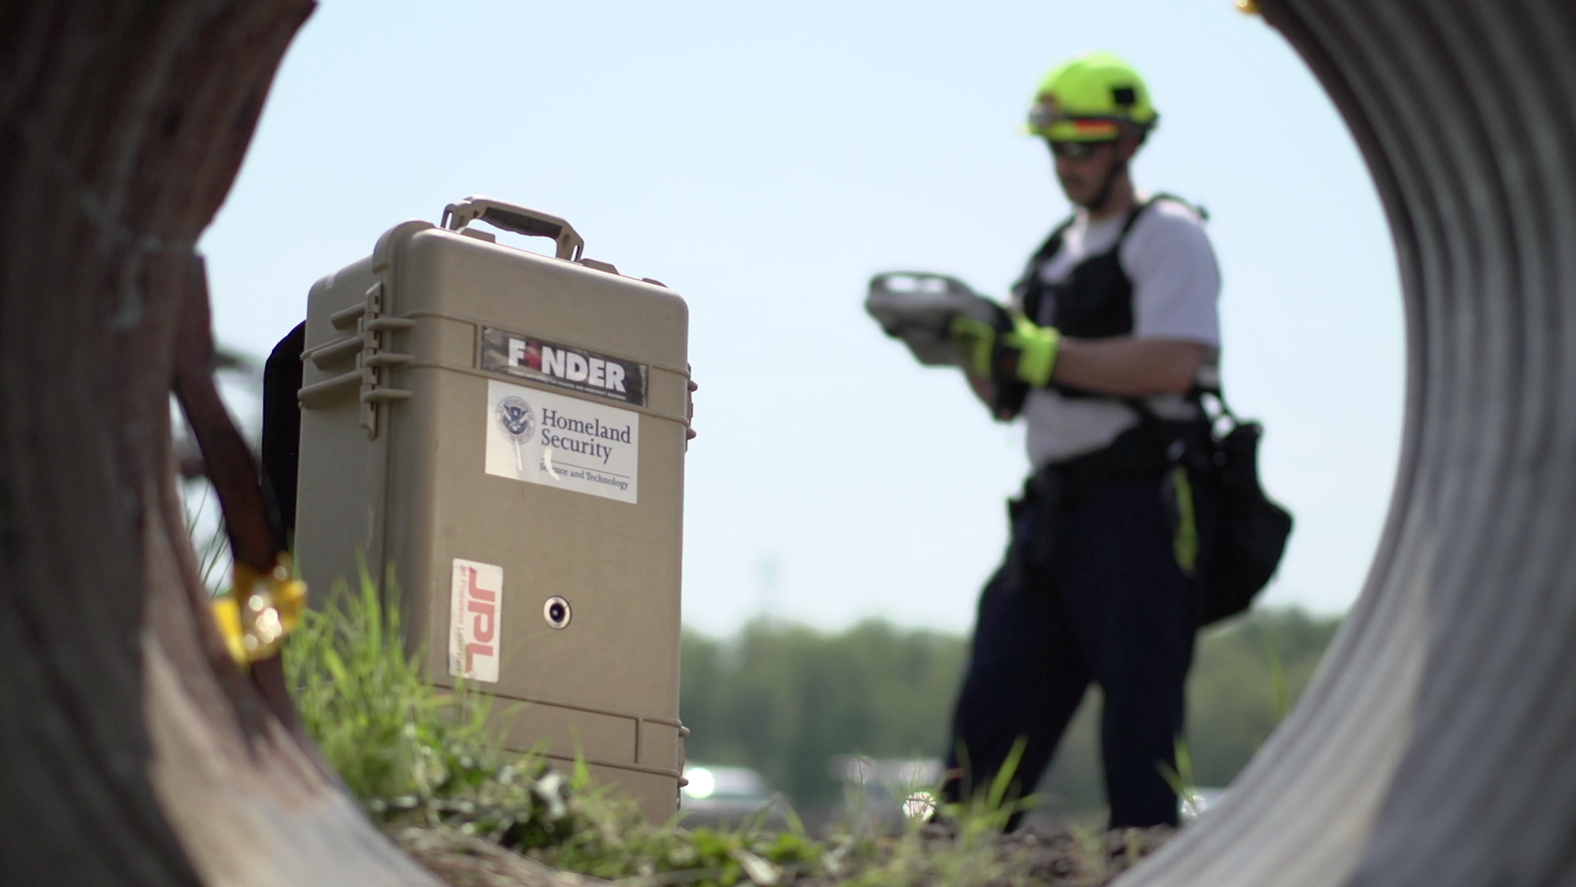
FINDER
FINDER which stands for Finding Individuals for Disaster and Emergency Response is a Life Detection System.
In the wreckage of a collapsed Textile Factory and another building in the Nepalese village of chautara, four men were rescued, two from each building, in one of the hardest-hit areas of the 7.8 magnitude earth quake on April 25.

Slide 5
PRINCIPLE OF OPERATION
When a microwave beam of appropriate frequency (L or S band) is aimed at a pile of earthquake rubble covering a human subject or illuminated through a barrier obstructing a human subject, the microwave beam can penetrate the rubble or the barrier to reach the human subject.
A human subject buried under earthquake rubble or hidden behind barriers can be located.

Slide 6
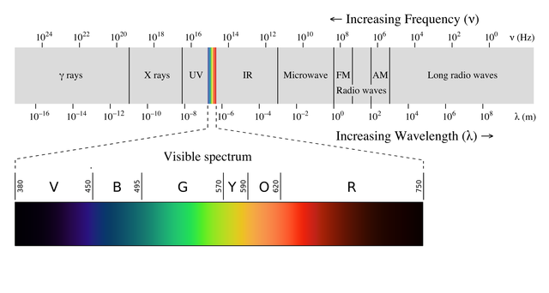
INTRODUCTION TO MICROWAVES
Microwaves are electromagnetic waves with wavelengths ranging from as long as one meter to as short as one millimetre, or equivalently, with frequencies between 300 MHz (0.3 GHz) and 300 GHz.

Slide 7
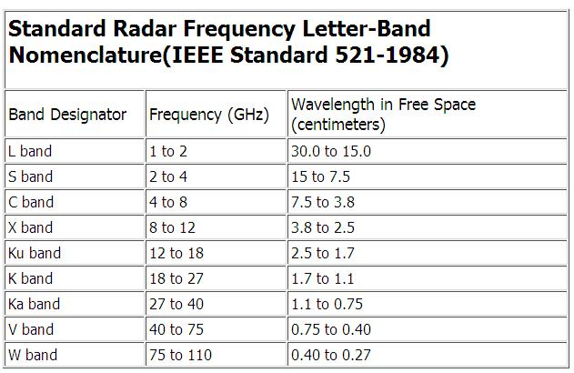
MICROWAVE BANDS

Slide 8
MAJOR COMPONENTS OF THE CIRCUIT
The microwave life detection system has four major components. They are
A Microwave Circuit
A Microwave controlled Clutter Cancellation System
Dual Antenna System
Laptop Control

Slide 9
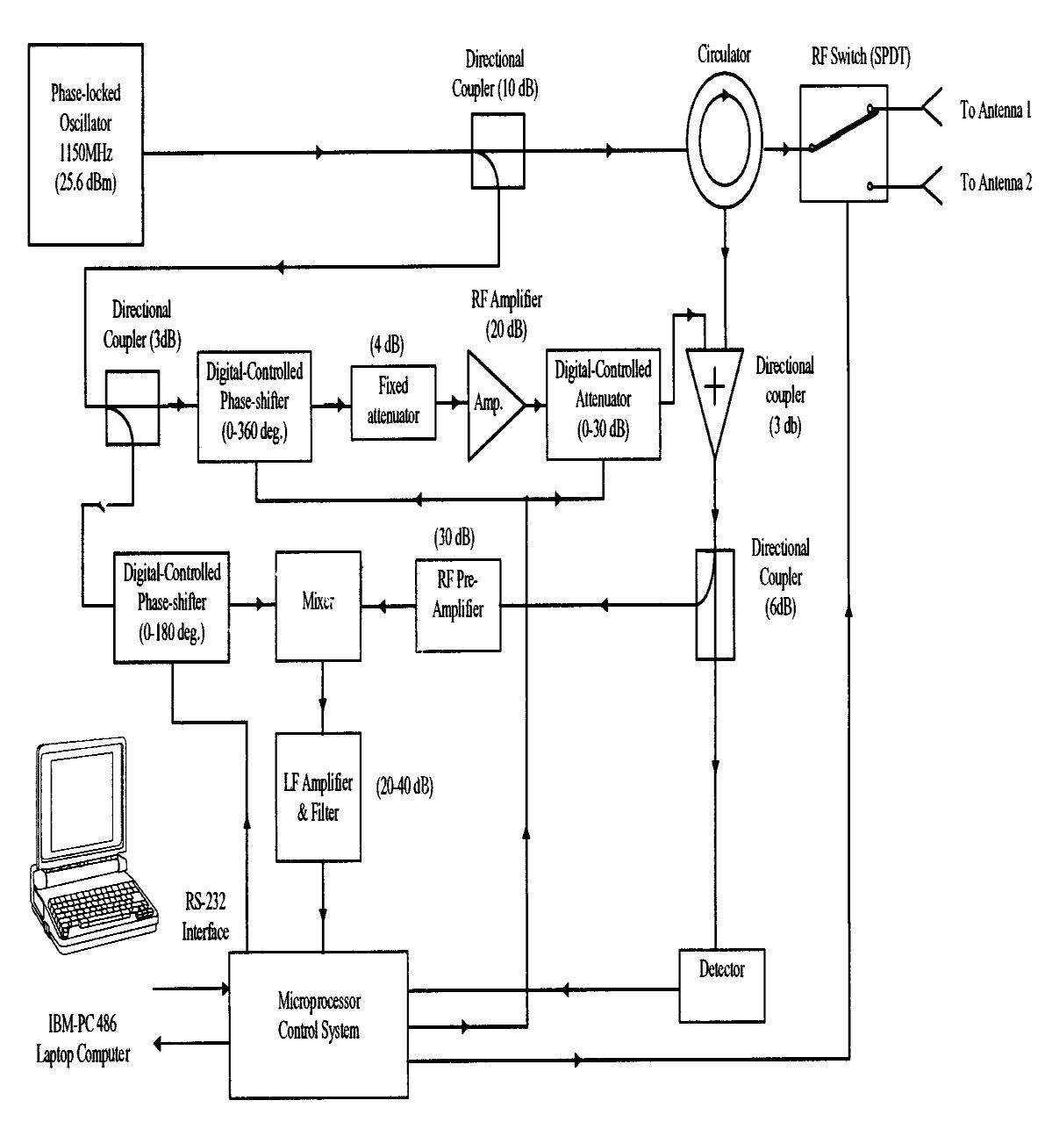
SYSTEM DIAGRAM

Slide 10
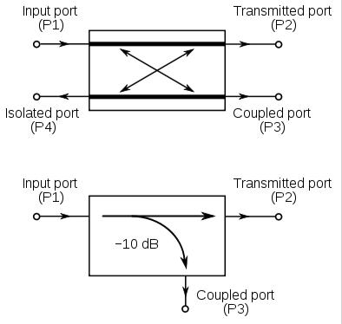
DIRECTIONAL COUPLER
A directional coupler has four ports, where one is regarded as the input, one is regarded as the "through" port (where most of the incident signal exits), one is regarded as the coupled port (where a fixed fraction of the input signal appears, usually expressed in dB), and an isolated port, which is usually terminated.

Slide 11
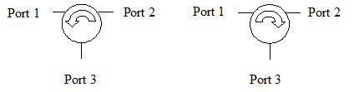
CIRCULATOR
A circulator is a ferrite device with usually three ports.
The energy into port 1 predominantly exits port 2, energy into port 2 exits port 3, and energy into port 3 exits port 1.
In a reciprocal device the same fraction of energy that flows from port 1 to port 2 would occur to energy flowing the opposite direction, from port 2 to port 1.

Slide 12
CLUTTER CANCELLATION SYSTEM
The clutter cancellation unit consists of
A digitally controlled phase shifter
A fixed attenuator
A RF amplifier
A digitally controlled attenuator.

Slide 13
MICROPROCESSOR CONTROL UNIT
ANTENNA SYSTEM:
Initially the switch is kept in position 1 (signal is transmitted through the antenna1).
Wait for some predetermined sending time, Ts.
Then the switch is thrown to position 2 (signal is received through the Antenna 2).
Wait for some predetermined receiving time, Tr.
Go to step 1.
Repeat the above procedure for some predetermined time, T.

Slide 14
MICROPROCESSOR CONTROL UNIT
CLUTTER CANCELLATION SYSTEM:
Send the signal to the rubble through antenna 1.
Receive the signal from the rubble through antenna 2.
Check the detector output. If it is within the predetermined limits go to step 5.
Otherwise send the correction signal to the digitally controlled phase shifter 1 and attenuator and go to step 1.
Check the sensitivity of the mixer. If the optimum go to step 7.
Otherwise send the correction signal to the digitally controlled phase shifter 2 to change the phase and go to step 1.
Process the signal and send it to the laptop.

Slide 15
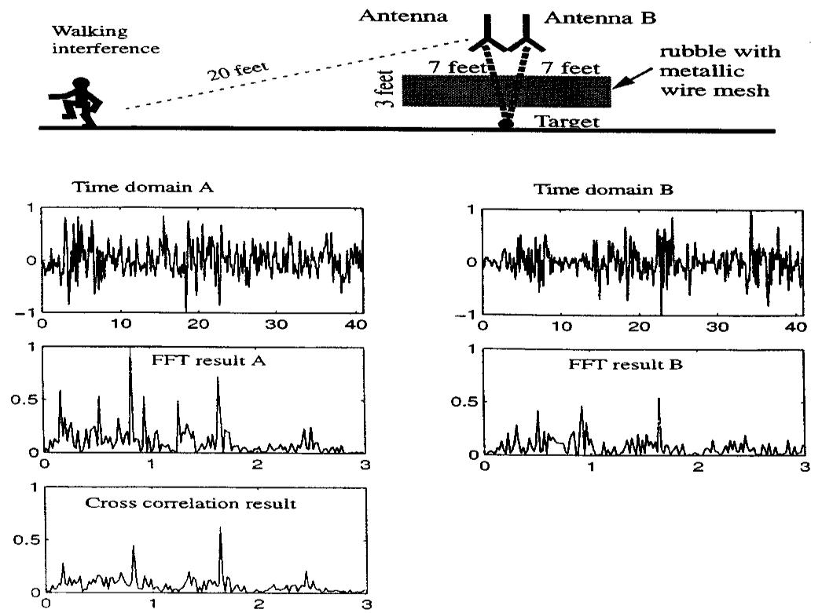
EXPERIMENTAL RESULTS

Slide 16
ADVANTAGES
Remote life sensing could be a powerful tool in applications where it is not desirable to disturb a subject’s physiological state during detection where access to the subject is limited.
The frequency 2.45 GHz i.e. L-band frequency and this is free for use by commercial applications, minimum interference with other devices is expected.
No need to use heart beat and the breathing sensor.

Slide 17
DISADVANTAGES
System is expensive but once it is implemented the expenses can be reduce lower extend.
The L- band frequency is unable to penetrate more metal like structure but it can penetrate over 10 layers of bricks.
The involvement of clutter signal may destroy the vital information of life signs. But if the proper demodulation is used one can receive the vital signs efficiently.

Slide 18
FUTURE SCOPE
In future, depending upon the developing such technology, if the system is enhanced so that it will able to detect number of victims buried under the respective rubble. Then rescuer will prefer area with more number of victims. Eventually, the system can save more lives.

Slide 19
CONCLUSION
The possible shortcoming of this system is the effects of the background noise created by the environment and operators. A sophisticated signal processing scheme may further improve the system performance.

Slide 20
THANK YOU

