Slide 1
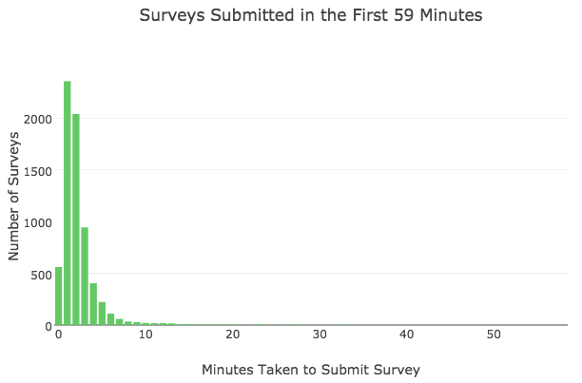
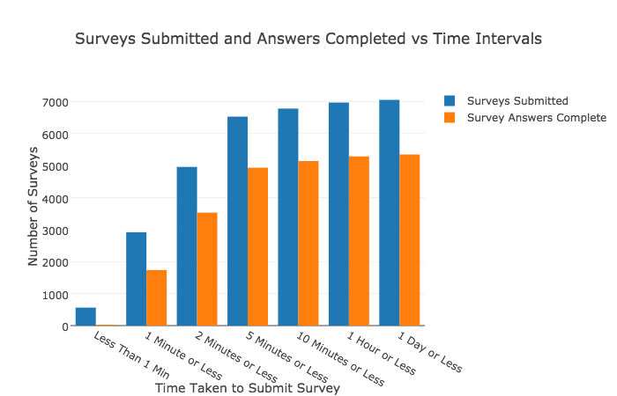
SURVEY TIME
Insights
All insights made on survey data → CTL Users Taking + Completing Survey is KEY!
Surveys only helpful if questions are answered AKA “completed”
Surveys Submitted Vs. Surveys Completed
submitted = survey turned in - Q’s can be unanswered
completed = survey turned in & Q’s are answered
QUESTION: Does survey time play a role in submission + completion?
GRAPH 1
GRAPH 2

Slide 2
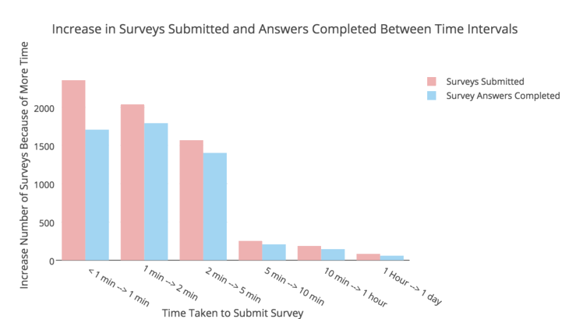
SURVEY TIME
Insights:
Increase in survey submission and completion slows after 5 minute mark
Increase in completed surveys between
1 → 2 mins > less than 1 mins → 1 min
So some extra time helps in completing surveys.
More time DOESN’T necessarily mean more completed survey
Ex: post 5 mins
Take Aways:
Most people finish in 5 mins
Set avg survey taking time: 5 mins
Goal : Get more CTL users to COMPLETE answers
→ better data
→ better analysis
→ help better

Slide 3
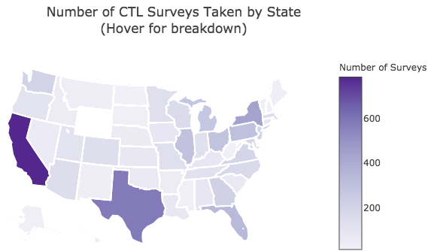
LOCATION, LOCATION, LOCATION
Insights:
CA, TX, NY are top 3 states
Question: are survey respondents concentrated in certain cities? Or spread out?
Take Aways:
Find out why/what factors of CA, TX, NY have most interaction with CTL
Can focus on better advertisements across the nation
Notes:
Working with survey data, the information is self reported allowing for bias. However there are a few things in this survey that are picked up through cell phone GPS information such as Longitude and Latitude. It's most likely that the 'Country' and 'State_Region' columns are automatically filled as well (but there's a slight chance these columns couldbe filled in my survey respondents themselves).

Slide 4
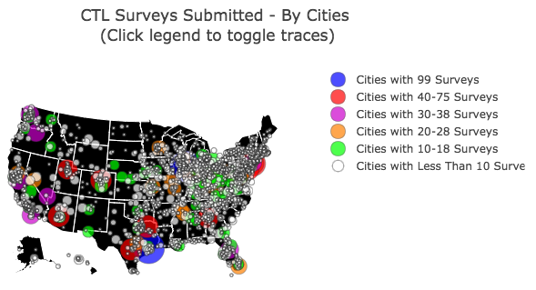
LOCATION, LOCATION, LOCATION
Insights:
Top cities are in TX, IL, and several other states
LOTS of cities with sparse respondent populations
But this means CTL is still known + accessed
How did they learn about CTL?
Take Aways:
Why are survey respondents so dense in some cities as opposed to others - common factors of popular cities?
Once we find those factors, how can we better use them
(1) better under common crises in popular cities
(2) to promote CTL - expand marketing

Slide 5
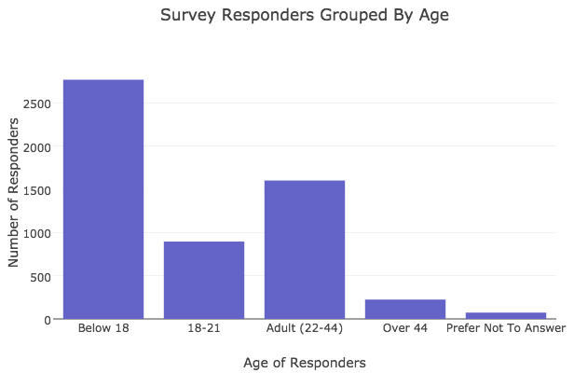
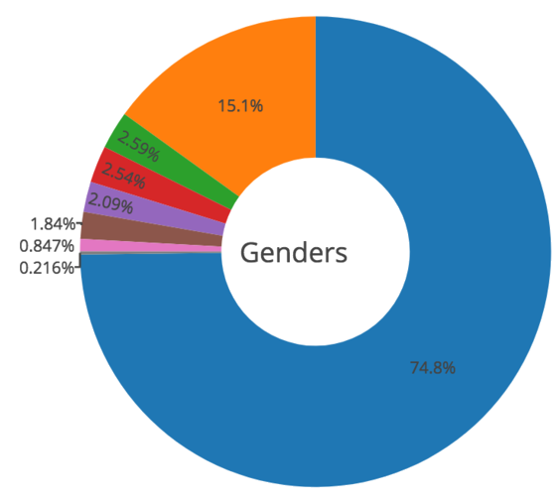
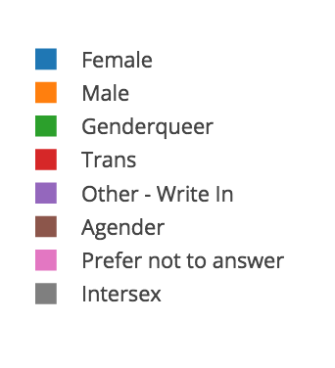
SURVEY RESPONDENTS BY AGE & GENDER
Insights:
Age below 18 > (18-21)
Why? Below 18, live at home, less access to counselors?
Why mostly females?
Stigma against men talking about
Careful to not tailor CTL practices/methods towards ‘majority’ (females)
Notes:
It's interesting that the biggest group of survey respondents is below 18. I would have assumed that the 18-21 age group would have been the highest, if not a close second to the below 18 group.
Instead however, the 2nd largest group are adults from the age of 22-44. Here are some possible explanations.
(1) Below 18 largest because it's often hard to talk about mental health with family and being under 18, you're often living at home with your parents so finding private pyschologists/counselors would require parental permission and not all high schools have anything beyond general counselors. (2) Adult (22-44) This is the general working age. For those who are not working ( post college or high school), they might not have access to mental health care. For those who do work, not all offices / workplaces offer access to mental health care and even if they do, not everyone is comfortable going to counselors in the office. (3) College Most (if not all) colleges offer access to pyschologists/counselors so it could be possible that many choose to use these resources.
When thinking about where best to reach those who could use CTL, middle schools and high schools seem like the best options to target spreading the word about CTL.
------------------
I actually think it's important that we understand the division of genders (how our survey responders identify when it comes to gender) for 2 reasons.
(1) Better reach out to genders that are underpresented. Stigma around mental health exists, but it's further nuanced by gender classification. Men, in heternormative gender binary terms, historically and culturally are not encouraged to express emotions, which is translated to not ask for help with emotional issues because it makes you vulnerable. (2) Mental Health Care Tailoring What we know of how to help people through listening, understanding situations, text counseling,etc has been tried and practiced on the population of texters. It's important that we better learn how to help people of various backgrounds, example: various genders. If we have a significantly smaller subset of those who identify as male or transgender or agender and a huge representation of those who identify as female, we might be tailoring techniques and could potentially engrain systematic changes geared more towards female than anyone else.

Slide 6
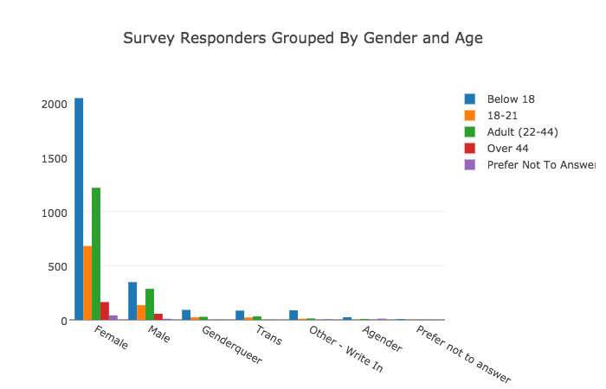
SURVEY RESPONDENTS BY AGE & GENDER
Insights:
Even divided by gender, age distribution is relatively same (below 18 > adult (22-44) > (18-21)
Men’s surveys divided by age is interesting:
Below 18 is NOT hugely different from Adult (22-24)
Women being exposed to/taking action with CTL differently based on age - where this is uniform across age for men?
Take Aways:
Why are women more involved with CTL than men, genderqueers, trans, and people who identify otherwise?
Are certain women dominated fields/places/facets of life more aware of CTL?
If so, how do we target and market to areas of other genders (and ages) that are underrepresented in CTL respondents

Slide 7

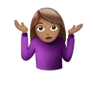
BACKGROUND + ASSUMPTIONS
DATA SET - UNKNOWNS
Data set (questions + answers) did not correspond to sample survey link
Don’t know how many actual CTL interactions occurred to calculate success rate with survey responses
Each survey doesn’t represent a unique individual
One individual could have submitted multiple surveys
Some surveys are recorded incorrectly/impartially but still logged
Age 55 was not included in any age interval options responder was given
ASSUMPTIONS TAKEN FOR ANALYSIS:
Assumed every survey represents individual (didn’t have criteria to distinguish surveys)
Insights projected/hypothesized about general populations:
Assumed survey population translated / represented general population
Assumed location data was NOT self reported (but rather based on lat/long data collected by
Did not account for self reporting bias

