Slide 1

TpT Assignment: Kaggle Bike Share Challenge
Divya Sriram
June 2017

Slide 2
MORE DATA, MORE QUESTIONS
Where is this climate data from?
Train-Test split
Train = 1st – 19th
Test = 20th – 30/31st
DC has weird seasons according to the data…
Spring = Jan - Mar
Summer = Apr - Jun
Fall = Jul - Sept
Winter = Oct – Dec
Units??
Windspeed – mph?
Humidity - ?
Useful to do some sanity checks / ball park likelihoods

Slide 3
ASSUMPTIONS + MISSING GENERAL INFO
Missing rows of data !
Some hours of certain days are missing
Dense enough data, didn’t impute these rows
First 2/3 of the month ≈ Last 1/3 of the month?
Do locals make up population for first 2/3 of month & visitors + tourists make up greater part of last 1/3 of month?
Working Population
Workinday or not – is a variable
Usefulness of the variable depends on;
What portion of the population has a steady job?
Unemployed?
Location of bike shares?
Certain locations get greater traffic for rentals?
Bike event dates?
Bike event → greater probability for higher # rentals

Slide 4
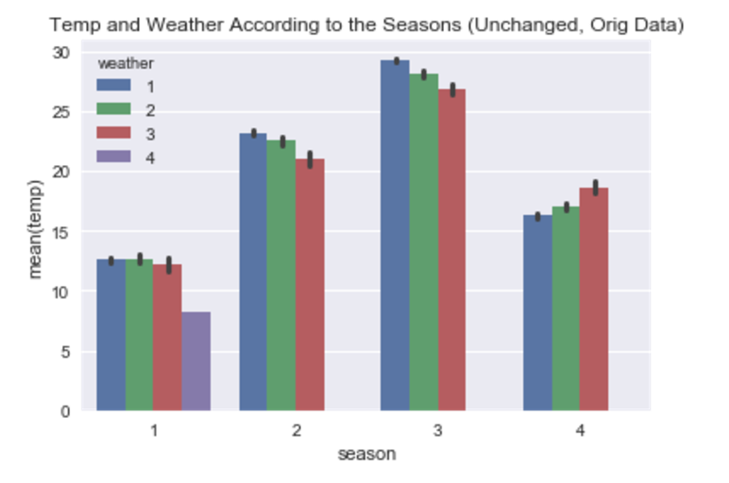
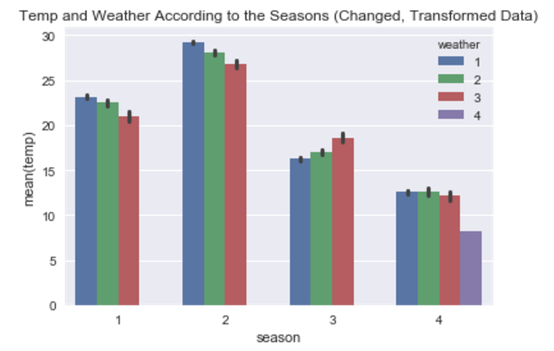
CHANGING SEASONS
UNCHANGED SEASONS
CHANGED SEASONS
Incorrect season/month grouping
Temperature Trend – weird!
coldest → warmer → hottest → cool down
(spring) (summer) (fall) (winter)
(1) (2) (3) (4)
Sensible season/month grouping
Temperature Trend – normal!
Warmer → hottest → cool down→ coldest
(spring) (summer) (fall) (winter)
(1) (2) (3) (4)
Notes:
Original Data:
Incorrect season/month grouping
Trend pattern for temperature doesn’t make sense
How likely is it that the worst weather (weather 4, purple bar) happened in Spring? Unlikely
Changed Season Data:
Changed seasons based on Northern Meteorological Seasons (season/month grouping sounds more accurate)
Temperature trend pattern makes sense (hottest in summer, coldest in winter)
Worst weather (weather 4, purple bar) occurs during winter (NOT spring like before)
Gave me a worse error in my tree model, but I’d rather stand by solid data and tweak my prediction algorithm than have a lower error on data I can’t defend to begin with.

Slide 5
SANITY CHECKS FOR DATA SET
Holidays , Weekends , Working Days
If it’s a holiday:
→ it can’t be a working day ✔
If it’s not a holiday & not the weekend → it has to be a working day ✔
Are the bike renters an anomaly?
Most people prefer nice weather to bike
Dataset shows people prefer nice weather ✔

Slide 6
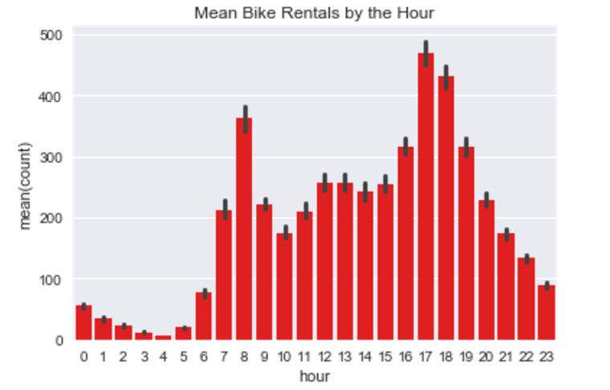
INTERESTING GLIMPSES
Max Rentals in 1 Hour = 977!
Sept 9, 2012 (6:00pm – 7:00pm)
What was happening Sept 9, 2012?
DC Bike Party (meet up time = 7:30pm)
Do people bike at odd hours?
You can rent for 24 hrs
Forgot to return?
Just keeping overnight,,
not riding
Notes:
Max rentals could have likely happened in part because of an event at that exact moment in DC:
- http://dcbikeparty.com/wp-content/uploads/2012/09/DCBP-Press-Release-September-Ride.pdf
Do people actually rent+ride bikes at odd hours?
You can rent bikes for 24 hours
So maybe people forgot to return bikes
Kept it overnight (but were not actually riding)?

Slide 7
RELATIONSHIP BETWEEN VARIABLES AND OUTCOME VARIABLE (COUNT)

Slide 8
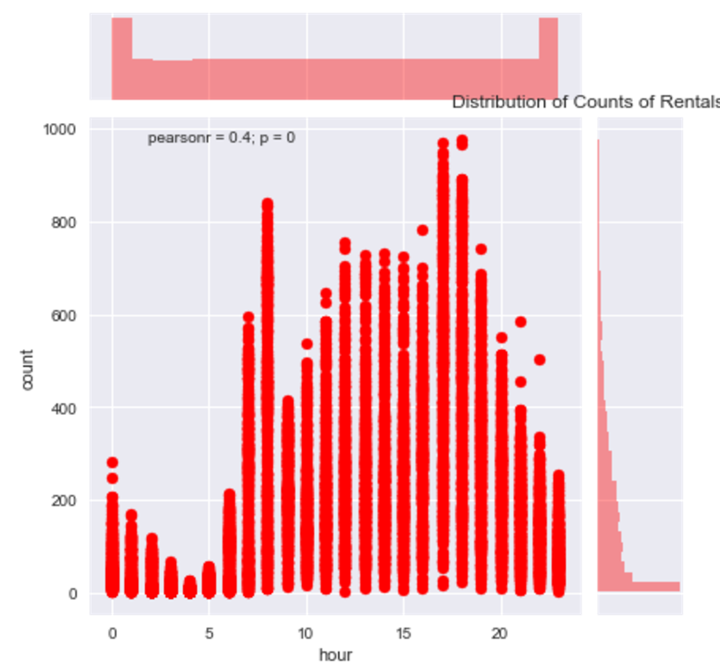
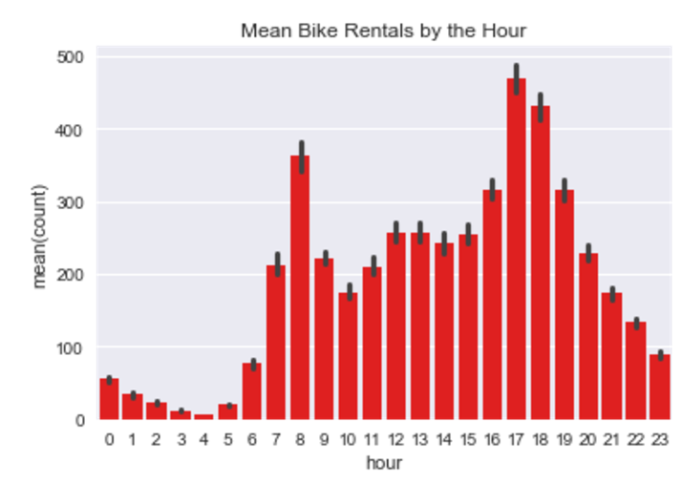
HOUR vs COUNT
Distribution of Counts of Rentals by the Hour
Mean Bike Rentals by the Hour
Notes:
The correlation matrix showed a value of 0.4 between hour and counts and these graphs seem to display that as well. As most would expect, the mean # of rentals during odd hours are fewer than that of day time hours.
It does concern me though that in the first of these plots above, there is a greater frequency of occurances (occurance of the hour being recorded itself) for the odd hours as opposed to the central day time hours.

Slide 9
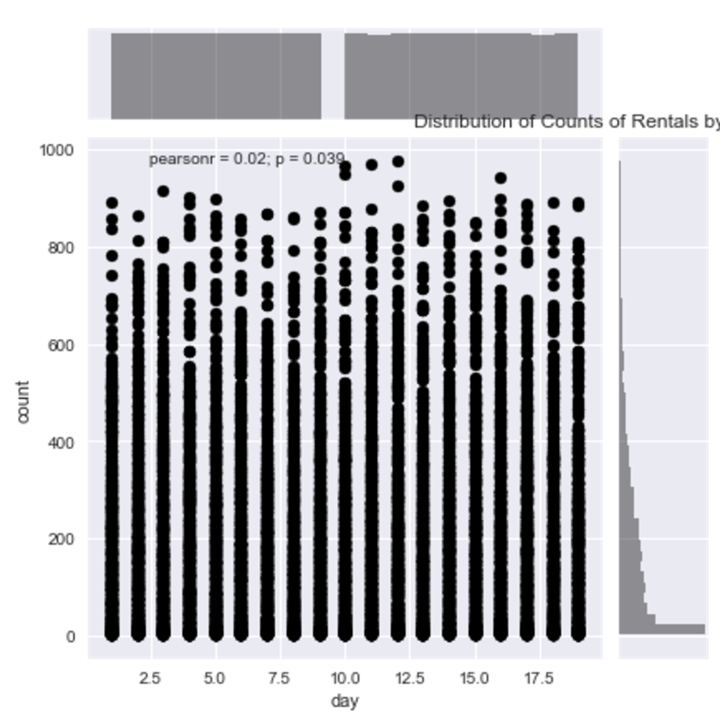
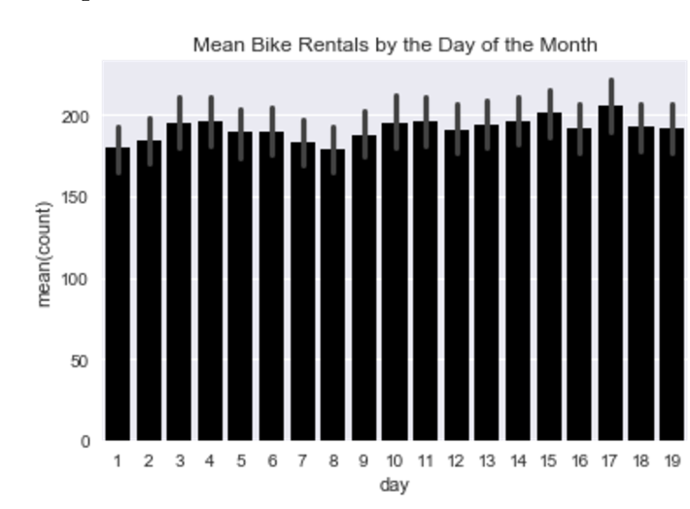
DAY OF MONTH vs COUNT
Distribution of Counts of Rentals by the Day of the Month
Mean Bike Rentals by the Day of the Month
Notes:
Like I said earlier: I was worried that the test set consists of the last 1/3 of the month which could be drastically different and influence value counts than the first 2/3 of the month (like that of the training set) but the lack of significant correlation between days of the month and counts (0.02) in the training set is in some way reassuring.

Slide 10
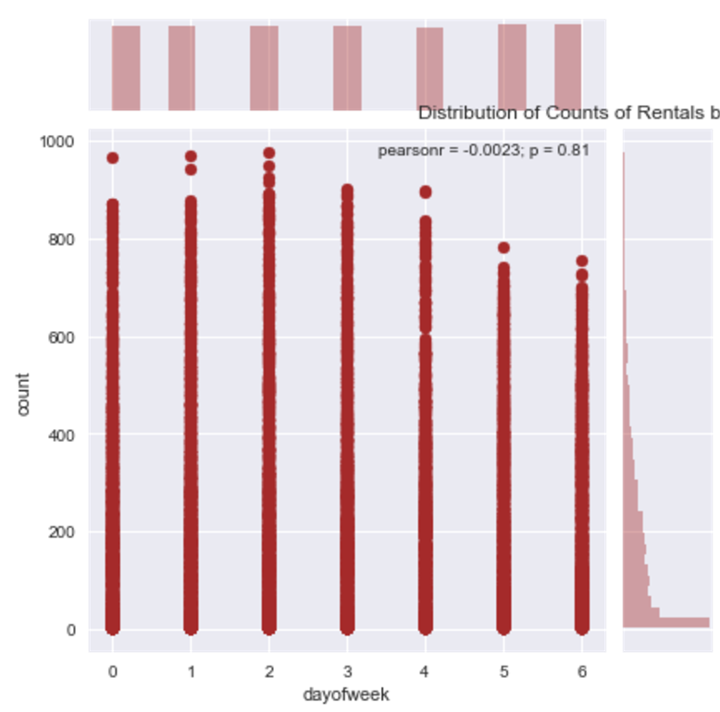
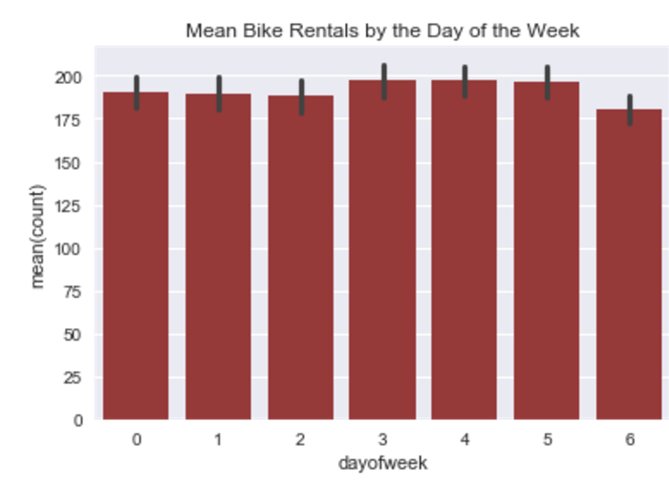
DAY OF WEEK vs COUNT
Distribution of Counts of Rentals by the Day of the Week
Mean Bike Rentals by the Day of the Week
Notes:
The actual value for correlation between day of week and count is very very small (-0.002).
But Sunday looks like the day least likely to have a large group of rentals at one hour, and in general has a slightly lower average rental count.
Note that the frequency of each day of the week is pretty even (also important, so they each have similar weights for this variable).

Slide 11
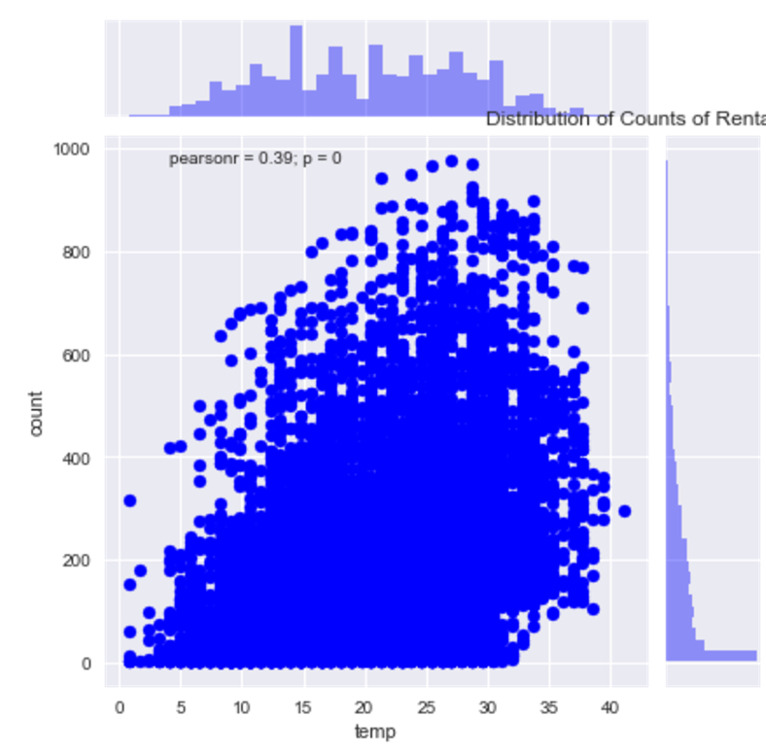
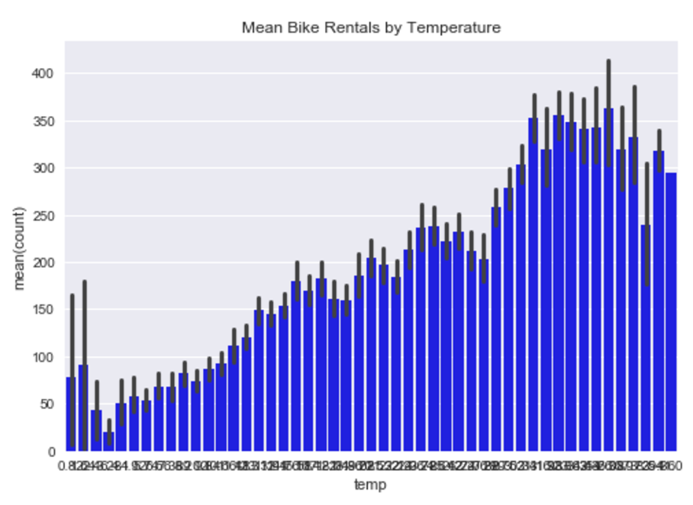
TEMPERATURE vs COUNT
Distribution of Counts of Rentals by Temperature
Mean Bike Rentals by Temperature
Notes:
Temperature is the second most correlated variable to count (0.39). The nicer (higher) the temperature, the greater the average count for bike rentals for that temperature. The highest frequency of temperatures stays in the middle (not the extremes of the dataset).

Slide 12
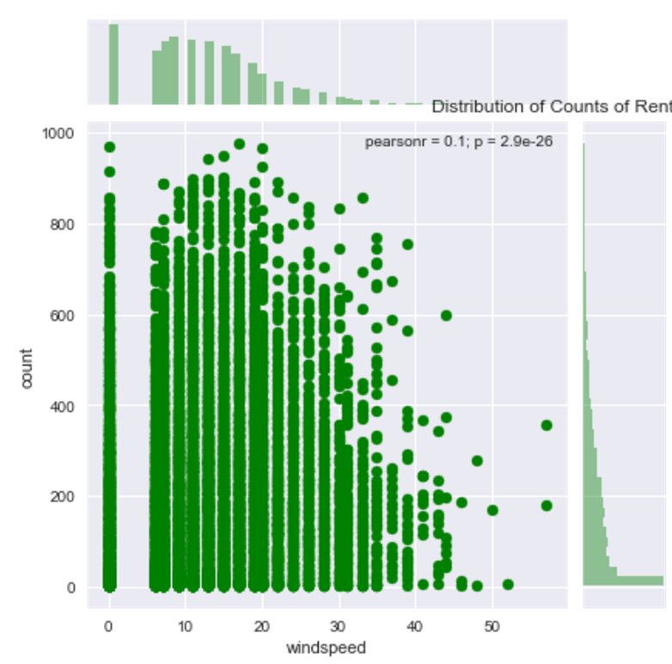
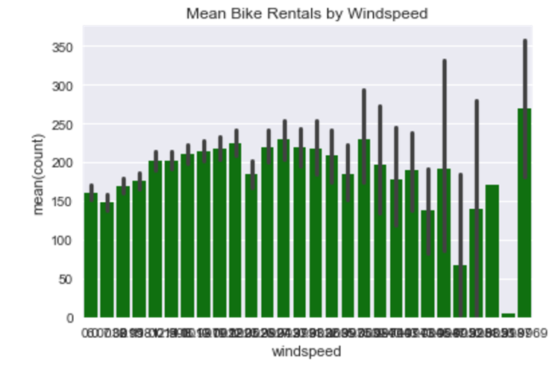
WINDSPEED vs COUNT
Distribution of Counts of Rentals by Windspeed
Mean Bike Rentals by Windspeed
Notes:
Windspeed has a correlation of (0.01) with count. It’s interesting that it does not have a negative correlation. We have over 1000 records with windspeed of 0, so I wonder if that one spike in rental counts at the upper end of the windspeed records influences the correlation, skews it positively even with greater winds.
I looked up the records with the highest windspeed and it was 2 hours in the summer, July 3rd, 2011 from 5-7pm, with weather 3 (light snow, light rain+thunderstorm+ scattered clouds). Unfortunately, because there are fewer records of rentals at higher windspeeds, those high counts play a bigger influence in average means for higher winds.

Slide 13
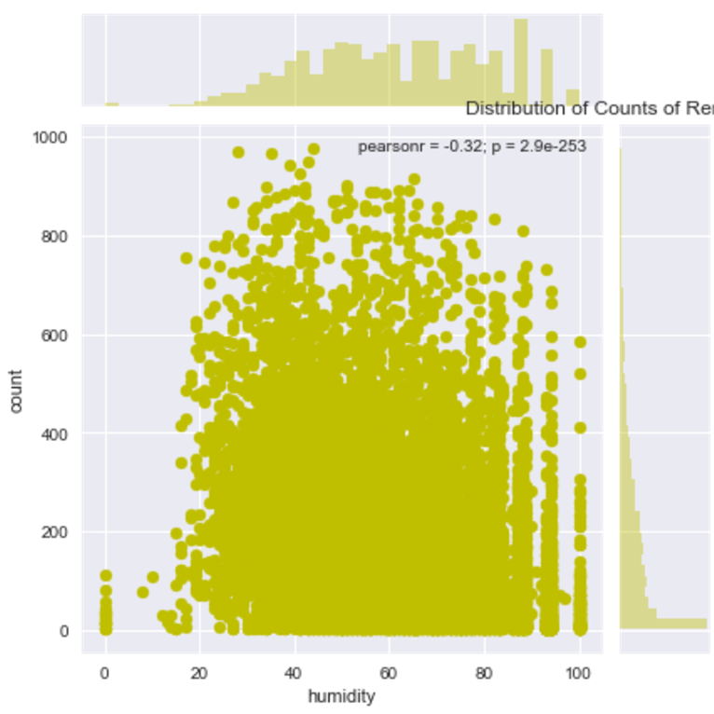
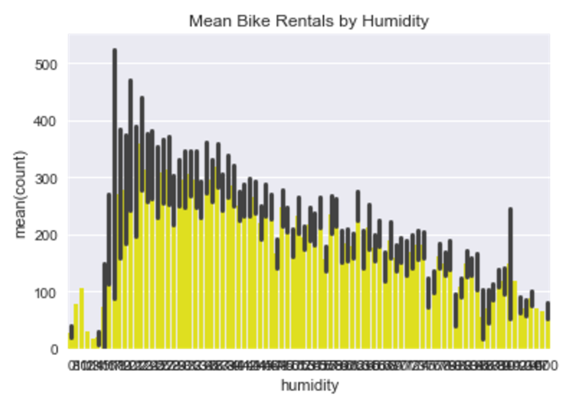
HUMIDITY vs COUNT
Distribution of Counts of Rentals by Humidity
Mean Bike Rentals by Humidity
Notes:
Humidity also has a pretty decent correlation with count (-0.32). The negative correlation makes sense to me as well. Interestingly, there is a slightly higher frequence of high humidity instances than I expected.

Slide 14
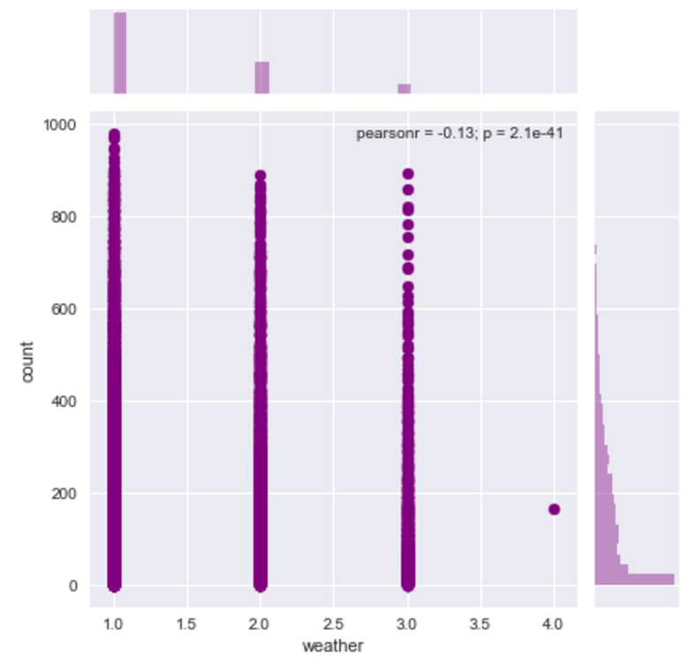
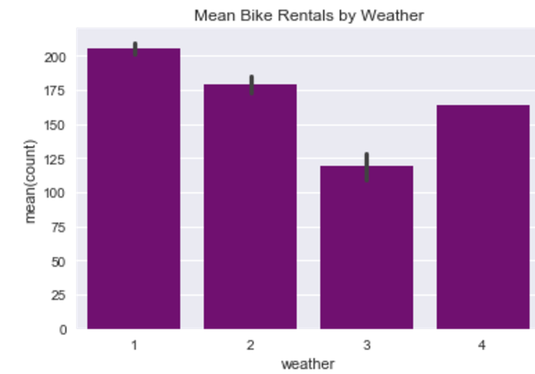
WEATHER vs COUNT
Distribution of Counts of Rentals by Weather
Mean Bike Rentals by Weather
Notes:
There is only one hour in which 164 apparent brave souls rented bikes when the weather was **4** or 'Heavy Rain + Ice Pallets + Thunderstorm + Mist, Snow + Fog' which was recorded from 6-7pm on January 9th, 2012. One guess is that maybe a group of people had decided to rent bikes that day and the weather was predicted incorrectly? I tried to see if there was an event on this day as well, but I couldn’t find anything.
Off the bat, looking at the bar plot, the average rental count for weather 4 (worst conditions) is higher than weather 3 (less severe conditions). BUT, we need to keep in mind that there is only 1 record with a weather value of 4 that happens to have a relatively high value so that will determine the whole average for weather 4.

Slide 15
OBSERVING VARIABLES TOGETHER

Slide 16
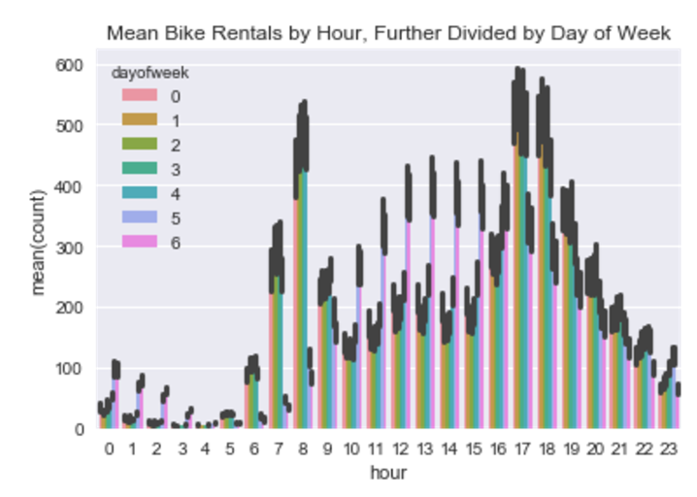
Mean Bike Rentals by Hour of Day, Further Divided by Day of Week
Notes:
Although this graph is hard to read, we can see that when you look at bike rental counts with respect to the hour that's then split up by the day of the week, there are significant differences. Both these variables together will likely be a good predictor for counts!
But this is hours in general (regardless of the day, if it’s a workingday or holiday, etc). I think that working day/weekend/holiday would affect hours. Let’s see!

Slide 17
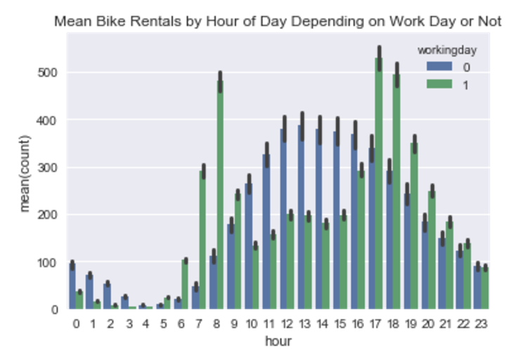
Mean Bike Rentals by Hour of Day Depending on Work Day or Not
Notes:
I was curious to see how working day fits into the hour of the day. My assumption (a big assumption in that most of these people are working, and if they are - they work 9-5ish jobs) would be that in general, on workingdays, more people would rent bikes before or after work. On a holiday or the weekend, I expected that there would more activity mid day (no work).
I think the graph tends to show something like that. Hours 10-16 (10am-5pm) have greater rental periods when it's NOT a working day (aka when it's the weekend/holiday).
I'm curious to know if the peaks for rentals during the hours of 6-8am and 5-8pm on workdays might correspond to people who bike to work?!

Slide 18
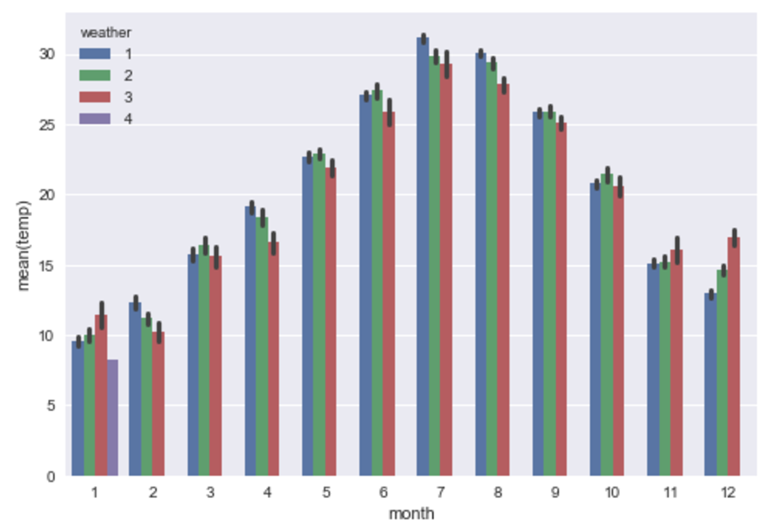
Mean Temperatures by Month, Further Divided by Weather
Notes:
From earlier graphs, I could tell that both month and weather influenced bike rental counts, but I wanted to know if people went based on average weather for that month or if the data shows nuanced peaks for rentals BASED on different weather DURING that month.
In general, it looks like in each month (with the exception of January), weather 1 (nicest weather) seems to bring the most amount of rentals - which makes sense. Also, looking at weather 3, more people biked during weather 3 during the months of 5-9 (May to September) when the temperature tends to be hotter so weather 3 is nice is my guess, let's check in the next plot.
This was a good sanity check to make sure that the people renting these bikes were in fact like most humans who prefer to ride in nice weather when possible.

Slide 19
VARIABLES I LEFT OUT FOR NOW
atemp
casual
registered
Notes:
Initially, I intended to run a linear regression model as a baseline submission
Requires the outcome variables to be independent variables (with little correlation to each other)
Atemp + temp are highly correlated, so left one variable out
Why atemp? Because I don’t know how atemp is calculated
Temp is a standard, on an absolute scale
I think I could have used casual/registered (both dependent variables) to train my model, but I wasn’t able to figure that out this time

Slide 20
PREDICTION MODEL(S)

Slide 21
WHAT CRYSTAL BALL SHOULD I USE TO PREDICT YOUR FUTURE:
RPART
Highest error (0.90215)
PARTY (ctree)
Lower error (0.67175)
RANDOM FORESTS
Lowest error (0.60693)
** changed vs unchanged seasons (random forests) :
(0.60693) (0.59960)
Notes:
RPART
PARTY
RANDOM FORESTS
Unchanged seasons actually gave me a lower error, but the data doesn’t make sense to me!)

Slide 22
BIASES IN THE DATA HOW DO THEY IMPACT WHAT WE DO WITH OUR MODEL FOR THE FUTURE?
Excluding groups of people in the data
Disabled people
People who can’t afford to pay the fee
Lack of location information
Does it truly represent ALL of DC?
Assuming other factors stay the same?
Fee to rent
Infrastructure exists

Slide 23
NEXT STEPS
Try multiple linear regression?
Try other ML model with python packages
Better feature engineering!
Build model to predict + fill in 1000 records with 0mph windspeed

Slide 24
THANK YOU KAGGLE USERNAME: “ divyasriram ”
Divya Sriram
Master of Information and Data Science (MIDS 2018)
divyasriram@berkeley.edu

