Slide 1

Attrition analysis and prediction in an It organization
Project Supervisor: MS.Sree Krishna
Name of the Student: Karumanchi.Divya Sruthi
Register Number: 39110468

Slide 2
Presentation Outline
Introduction
Objectives
System Architecture
Project design
Module Implementation
Application Snapshots
methodology
Results and Discussions
Conclusion & Future work
References

Slide 3
Introduction
Today attrition is one of the major problems faced by industry across the world.
It is the most burning issue for the industry,and high attrition rates lead to issues in the boundary of the organization
It is observed that many attributes lead to the attrition of an employee
Which includes working environment job satisfaction,employer’s behavior,job timing and most important is salary or incentives.

Slide 4
Objective
●To know the various reasons of employee attrition
● To know the Stratiges for employee attrition
● To examine the impact of three R’s on the attrition of the employee and development of the organization
●The attrition of employess is the problem faced by many organization,where valuable and experienced employes leave the organization on a daily basis

Slide 5
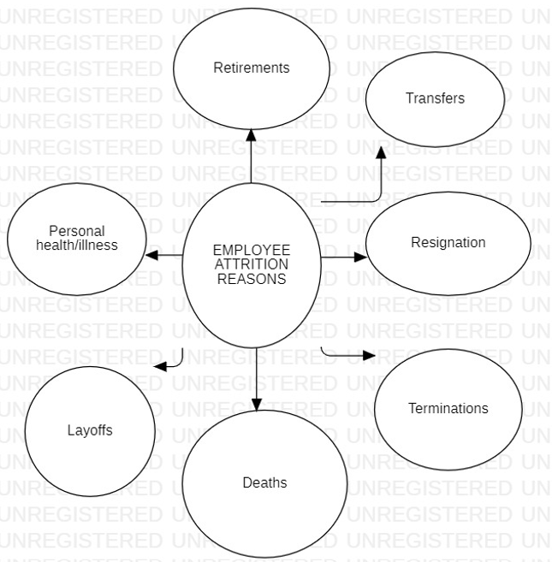
System Architecture

Slide 6
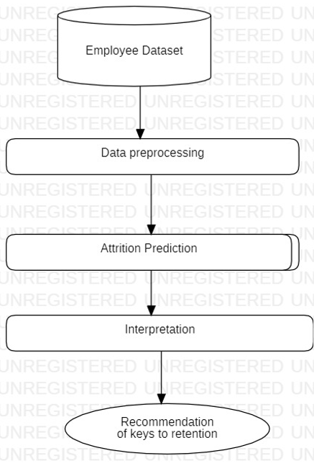
Project Design

Slide 7
Modules
Modules | Definition
numpy | It supports large, multi-dimensional arrays and matrices, along with a large collection of high-level mathematical functions to operate on these arrays.
pandas | pandas is a software library written for the Python programming language for data manipulation and analysis.
matplotlib | Matplotlib is a plotting library for the Python programming language and its numerical mathematics extension NumPy.
seaborn | Seaborn is a Python data visualization library based on matplotlib. It provides a high-level interface for drawing attractive and informative statistical graphics.
sklearn | Scikit-learn is a free software machine learning library for the Python programming language.
math | Built-in module that you can use for mathematical tasks.

Slide 8



Hardware and Software Requirements
Hardware: A laptop with a good wifi connection.
Software: Anaconda software and Jupyter python notebook.

Slide 9
Construction
Step 1. Understand the problem.
Step 2. Understand the dataset.
Step 3. Collect and prepare data.
Step 4. Determine the model's features and train it.
Step 5. Evaluate the model's performance and establish benchmarks.
Step 6. Put the model in operation and make sure it works well by testing it.
Step 7. Iterate and adjust the model for future changes.

Slide 10
Result and Performance Analysis
Accuracy:
‘logistic regression’:87%
‘KNN classifier’:58%
‘support vector machine”:86%
‘Random vector’:88%
‘Decision tree’:85%
‘Navie Bayes’:82%

Slide 11
Methodology
Research methodology:
This can be helpful to the management to improve its core weaknesses by the suggestions and recommendations prescribed in the project this can serve as a basis for measuring the organization’s overall performance in terms of employee satisfaction

Slide 12
Algorithm Contd…
Logistic Regression algorithm:
●Logistic Regression is the supervised Machine Learning model in which the model finds the best fit linear line between the independent and dependent varaible.
●We try to create a logistic regression model.It is a multiple regression model
●We can clearly observe overfitting in this model.This overfitting can be attributed to the data being non-stationary.

Slide 13
Results and Discussion
From the Logestic Regression model, the predicted accuracy score on test data is 73%.
Classiﬁcation accuracy is the number of correct predictions made as a ratio of all predictions made.
One of the most common metrics and only suitable when the data-set is balanced containing an equal number of observations in each class.

Slide 14
Conclusion
Attrition occurs especially in the groups of students,employees people from intermediate densely populated area and people in higher income deciles
These employees need their benefits package upgraded to retain them

Slide 15
References
 | attrition analysis and prediction in an it organization FLASK - From python DATASET - From github Machine learning Python - FROM Kaggle,GitHub

