Slide 1

Does Domain Generalization Provide Inherent Membership Privacy
Divyat Mahajan, Shruti Tople, Amit Sharma
Microsoft Research
PRIML/PPML'20

Slide 2
Machine Learning and Privacy Attacks
Out of Distribution Generalization (Machine Learning)
Membership Inference Attacks
(Privacy)
Model trained on some hospital is used in another hospital (Distribution Shift)
Model should not leak information about the sensitive training data of patients

Slide 3
Machine Learning and Privacy Attacks
Out of Distribution Generalization (Machine Learning)
(Yeom et al.) Overfitting increase risk from Membership Inference attacks
Membership Inference Attacks
(Privacy)
Model trained on some hospital is used in another hospital (Distribution Shift)
Model should not leak information about the sensitive training data of patients

Slide 4
Machine Learning and Privacy Attacks
Out of Distribution Generalization (Machine Learning)
(Yeom et al.) Overfitting increase risk from Membership Inference attacks
Membership Inference Attacks
(Privacy)
(Tople et al.) Causal models are more robust to membership inference attack
Model trained on some hospital is used in another hospital (Distribution Shift)
Model should not leak information about the sensitive training data of patients

Slide 5
Machine Learning and Privacy Attacks
Out of Distribution Generalization (Machine Learning)
(Yeom et al.) Overfitting increase risk from Membership Inference attacks
Membership Inference Attacks
(Privacy)
(Tople et al.) Causal models are more robust to membership inference attack
Model trained on some hospital is used in another hospital (Distribution Shift)
Model should not leak information about the sensitive training data of patients
Our Contribution
We show the connection between Domain Generalization and Membership Inference Attacks

Slide 6
Domain Generalization -> Membership Inference Attacks
Domain Generalization setup exposes ML models to domain shifts during training and expects them to generalize to unseen domains at test time

Slide 7
Domain Generalization -> Membership Inference Attacks
Domain Generalization setup exposes ML models to domain shifts during training and expects them to generalize to unseen domains at test time
Domain Generalization methods improve generalization on unseen data distributions and lead to robustness against Membership Inference Attacks

Slide 8
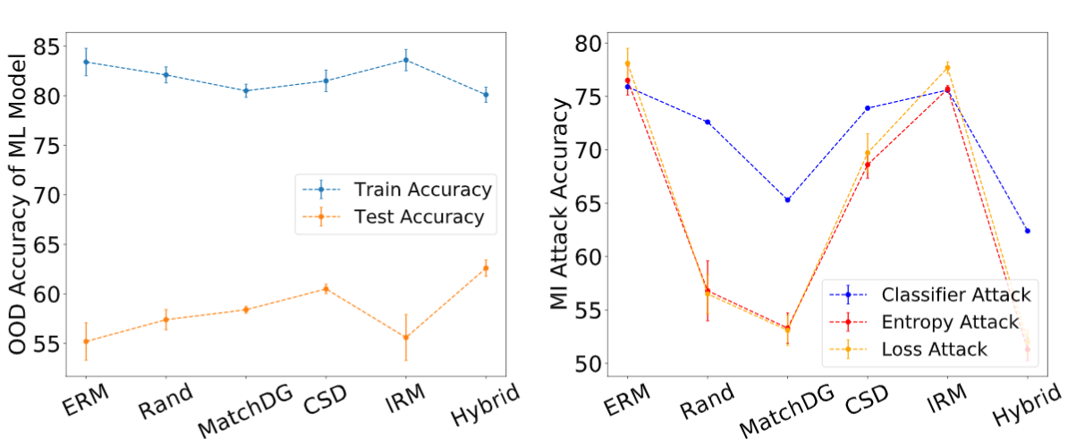
Domain Generalization -> Membership Inference Attacks
Domain Generalization setup exposes ML models to domain shifts during training and expects them to generalize to unseen domains at test time
Domain Generalization methods improve generalization on unseen data distributions and lead to robustness against Membership Inference Attacks
Chest X-Ray Dataset
Membership Inference Attack Accuracy (Lower is Better)
Out-of-Domain Accuracy

Slide 9
Membership Inference Attacks->Domain Generalization
Stable Features
Out-of-Domain Accuracy
Membership Inference Attack

Slide 10
Membership Inference Attacks->Domain Generalization
Stable Features
Out-of-Domain Accuracy
Membership Inference Attack
Better Out-of-Domain Accuracy is not a sufficient metric to evaluate Domain Generalization algorithms
Stable Features determine the true generalization performance but they are hard to determine

Slide 11
Membership Inference Attacks->Domain Generalization
Stable Features
Out-of-Domain Accuracy
Membership Inference Attack
Better Out-of-Domain Accuracy is not a sufficient metric to evaluate Domain Generalization algorithms
Stable Features determine the true generalization performance but they are hard to determine
Membership Inference Attacks can be used to evaluate Domain Generalization as they capture the extent to which stable feature were learnt

Slide 12
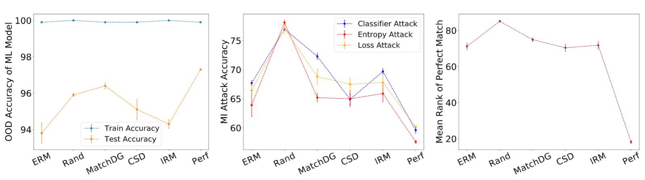
Membership Inference Attacks->Domain Generalization
High Out-of-Domain accuracy does not always imply more robustness against Membership Inference Attacks
Membership Attack Accuracy correlates with metrics to compute stable features (Mean Rank)
Rotated MNIST Dataset
Membership Inference Attack Accuracy (Lower is Better)
Mean Rank: Stable Features
(Lower is Better)
Out-of-Domain Accuracy

Slide 13
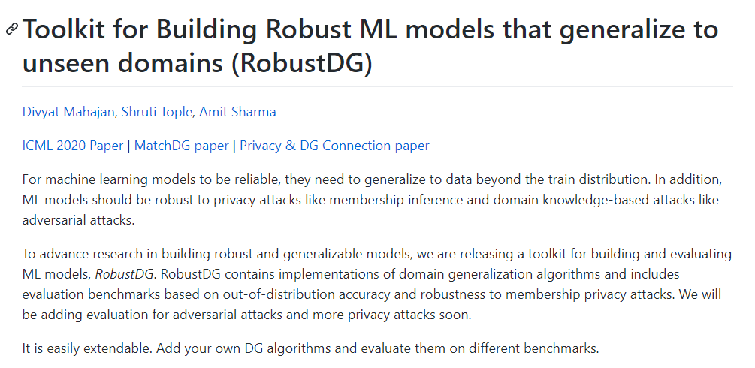
Conclusion
Please visit RobustDG (https://github.com/microsoft/robustdg) for further details

Slide 14
Thank You
Chat with us during the poster session!

