Slide 1
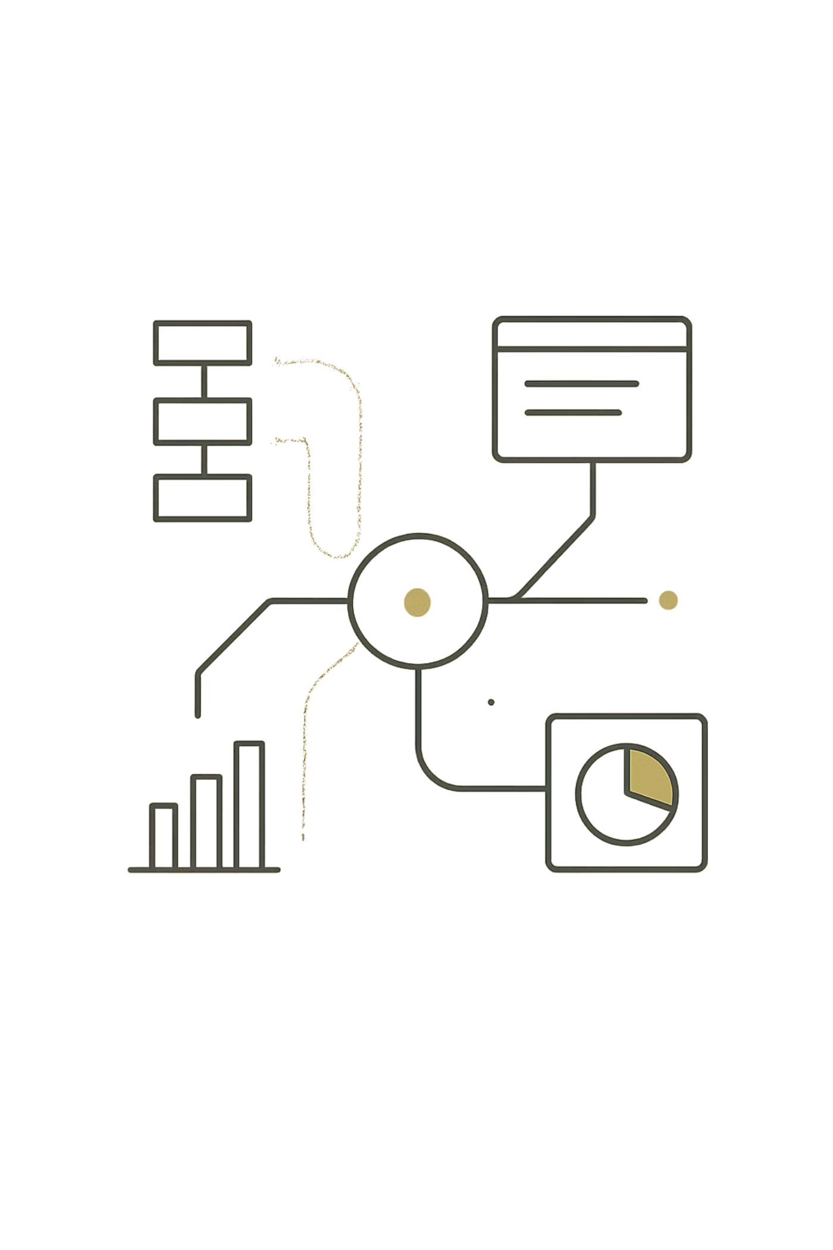
Unlocking Insights: A Journey Through Machine Learning Classification
Made by: Divya Tripathi
RA2311003030547 | BTECH CSE CORE - I

Slide 2

Chapter 1: The Foundation - What is Classification?
Supervised Learning
Discrete Categories
vs. Regression
Algorithms learn from labeled training data to predict categories for new, unseen examples.
Assigns class labels (e.g., "spam" or "not spam") based on patterns in the input data.
Classification predicts categories, while regression predicts continuous numerical values.

Slide 3
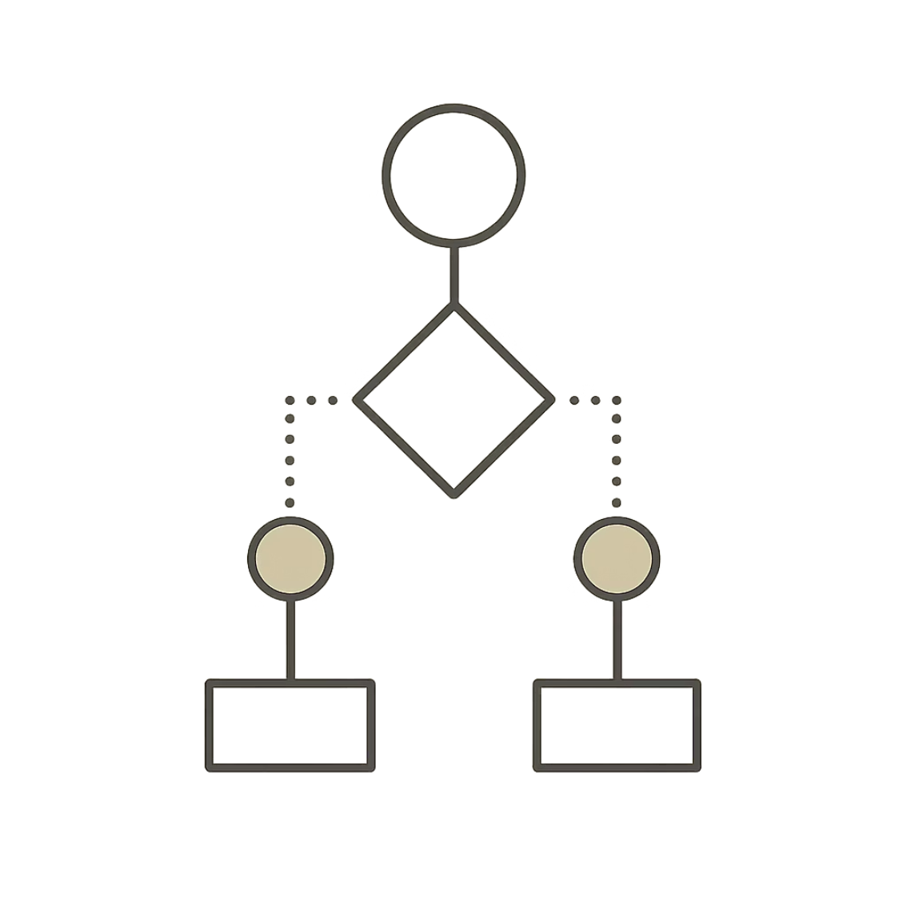
Chapter 2: Building the Tree - Decision Tree Induction
Decision Trees
Visual, flowchart-like structures where internal nodes test features, branches represent outcomes, and leaf nodes hold class labels.
Attribute Selection Measures
Information Gain: Reduces entropy (impurity) after a split.
Gini Impurity: Probability of misclassifying a randomly chosen element.
ID3 Algorithm
CART Algorithm
Uses Information Gain for attribute selection. Creates multi-way splits based on categorical features.
Uses Gini Impurity and handles both classification and regression with binary splits.

Slide 4
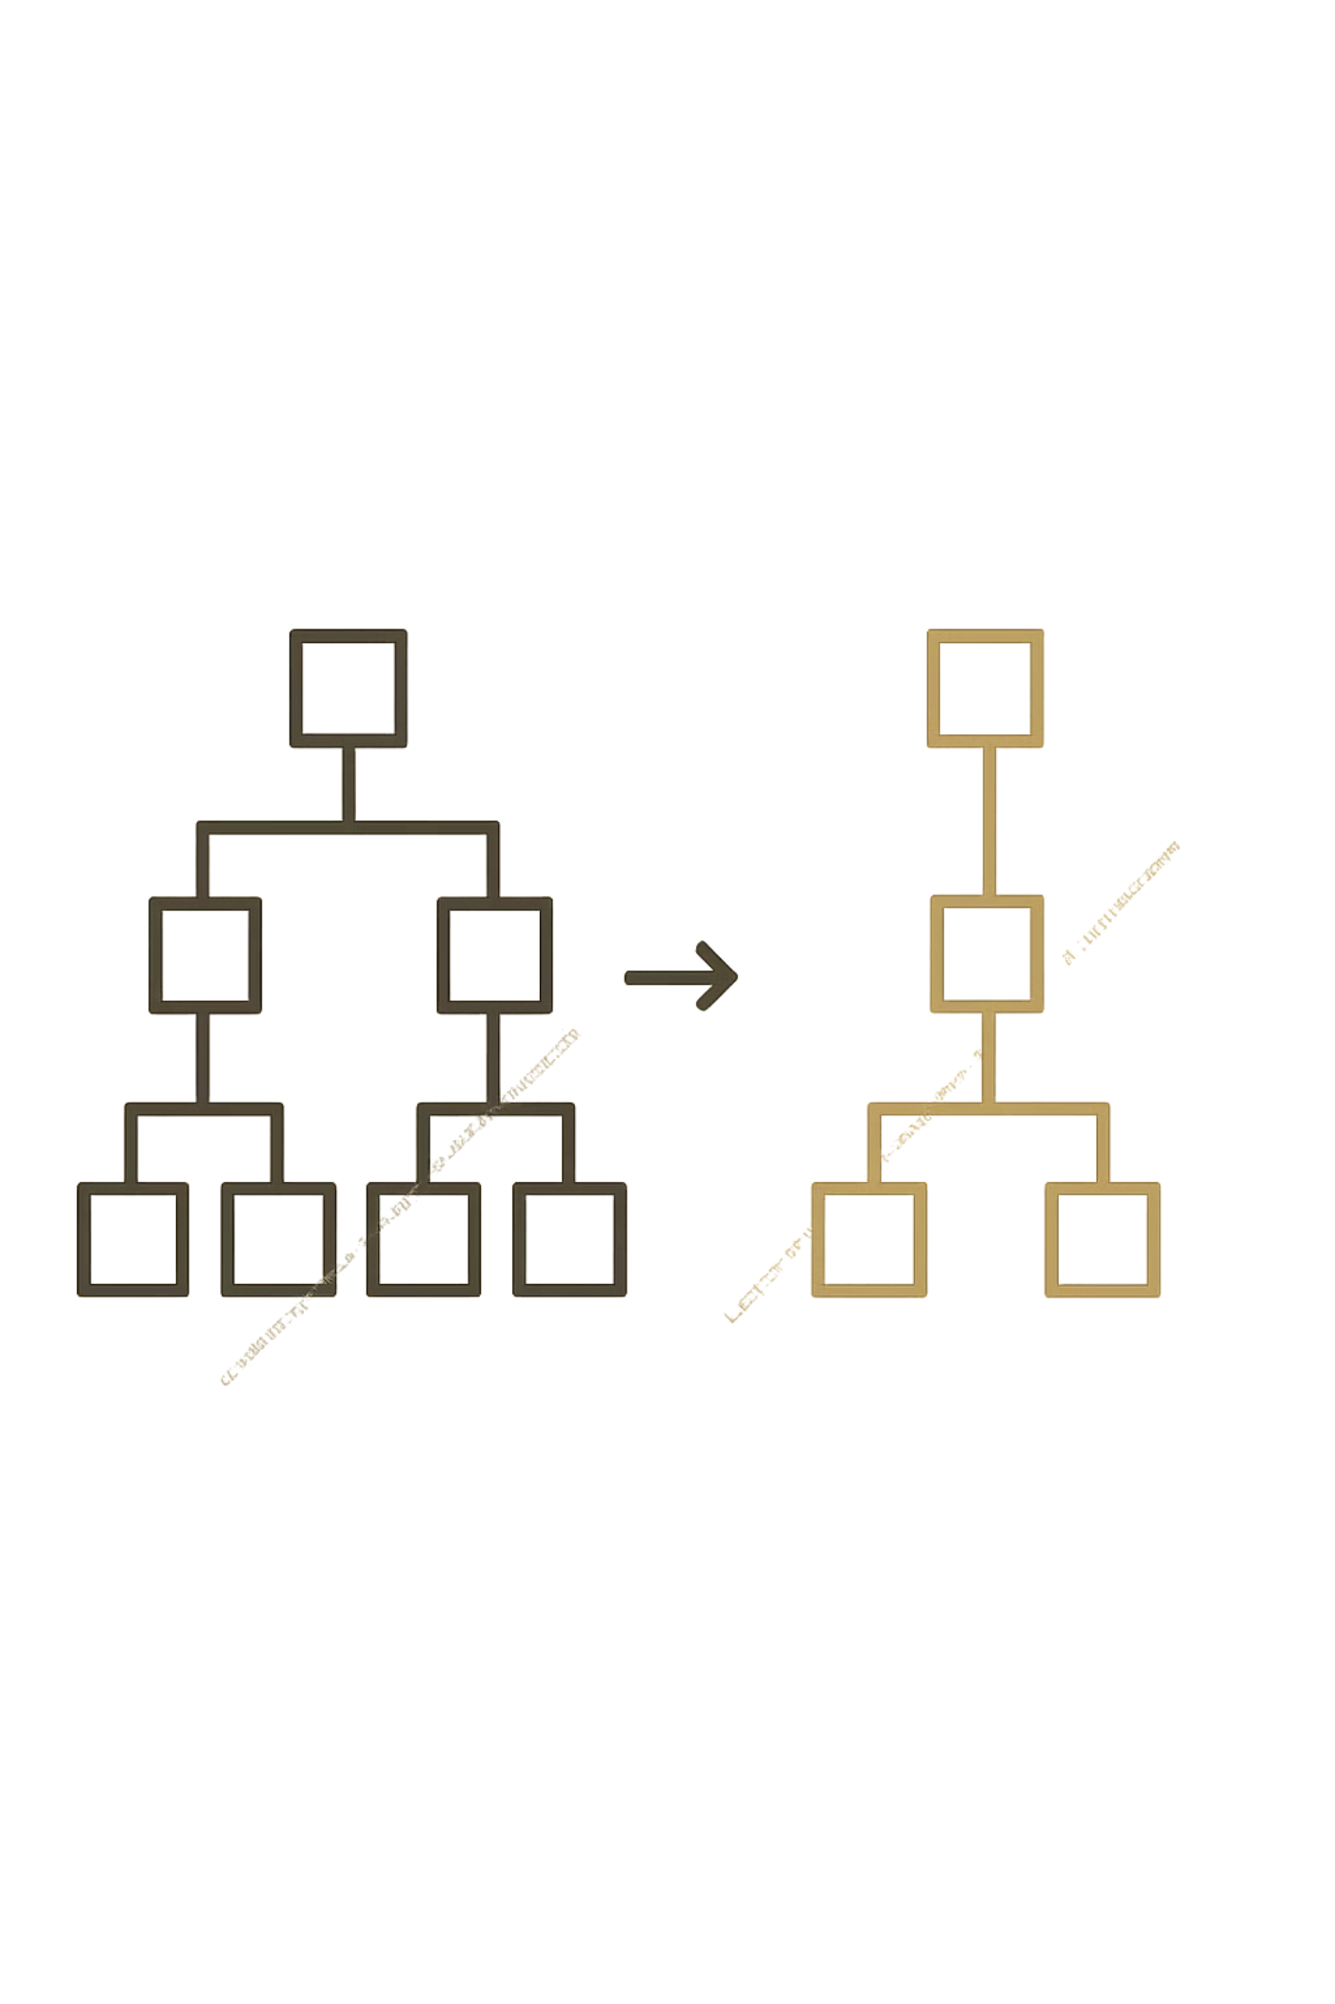


Chapter 3: Refining the Model - Tree Pruning
The Problem
Complex trees overfit training data, performing poorly on new data.
The Solution
Remove unlikely branches to simplify the tree and improve generalization.
Pre-pruning
Post-pruning
Stop tree growth early by setting maximum depth or minimum samples per leaf.
Grow full tree first, then remove branches based on validation set performance.

Slide 5
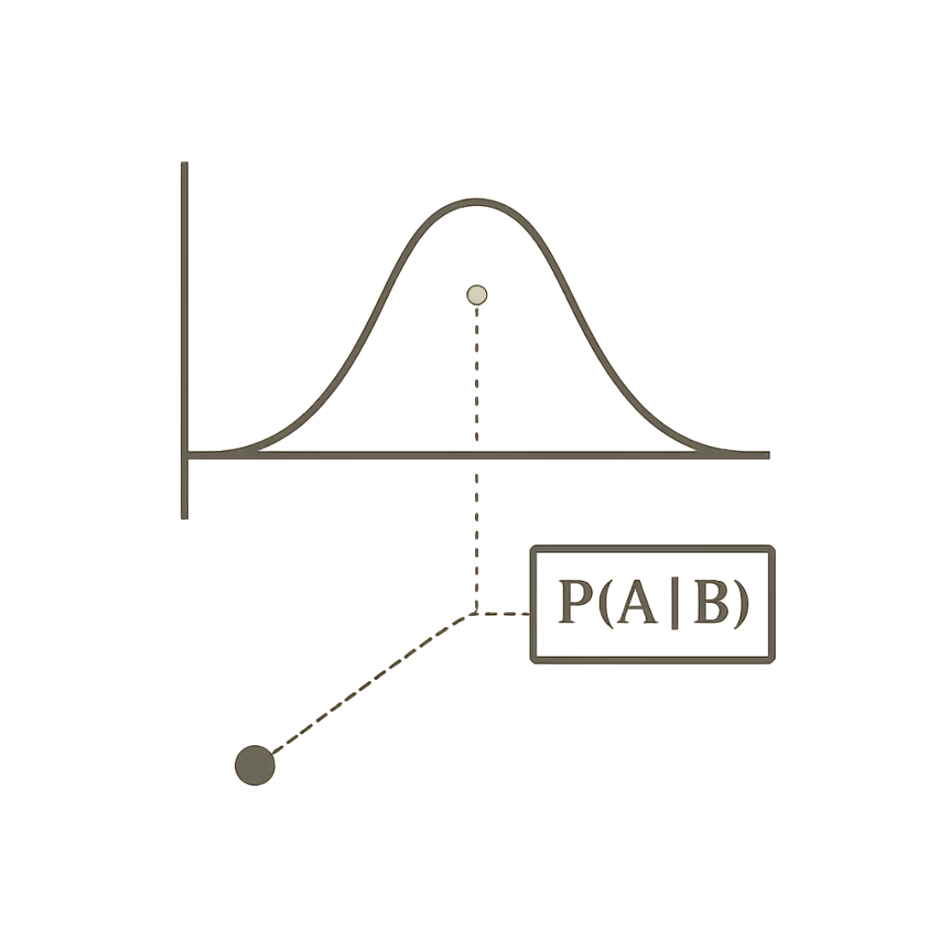
Chapter 4: Probabilistic Predictions - Bayes Classification
Bayes' Theorem
Fundamental theorem for calculating conditional probabilities. Updates beliefs about events based on new evidence.
Naive Bayesian Classification
"Naive" Assumption
Applications
Simplified version assuming features are independent given the class label.
Independence assumption simplifies calculations significantly, making it very efficient.
Widely used for text classification (spam filtering) and medical diagnosis.

Slide 6
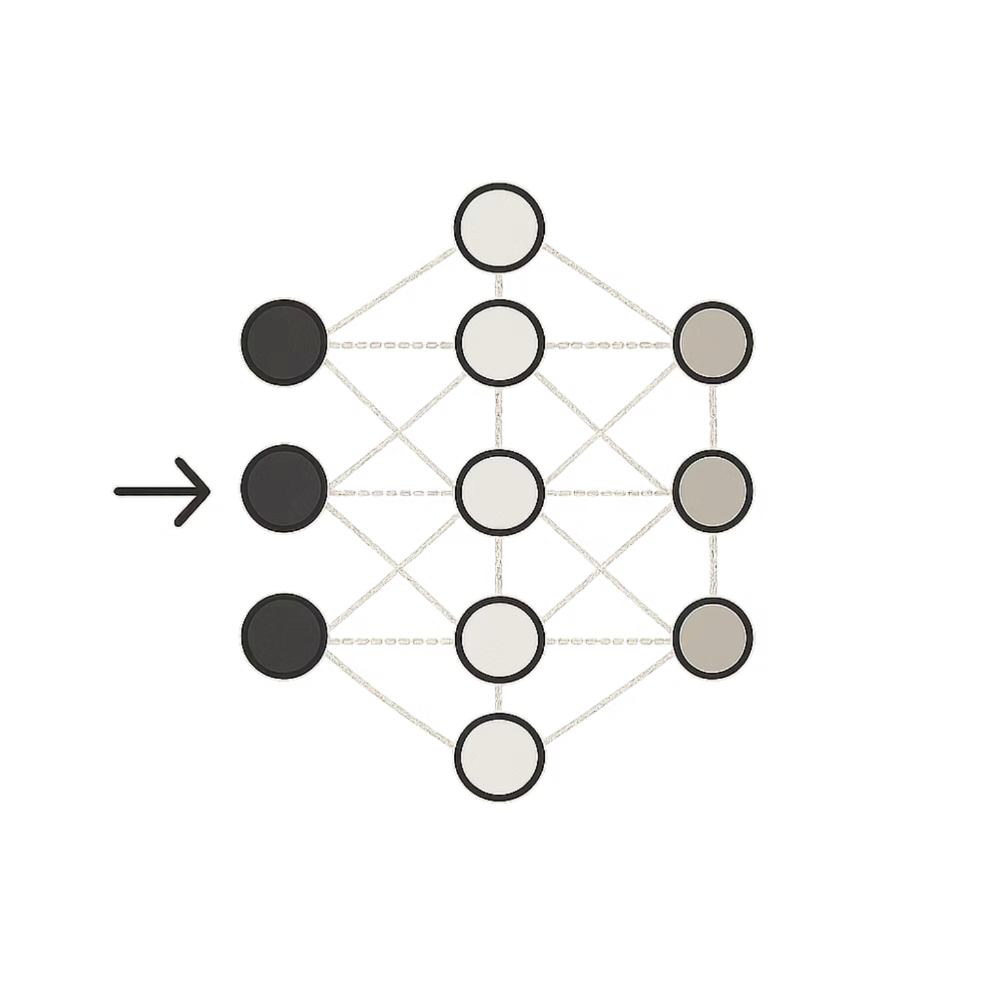
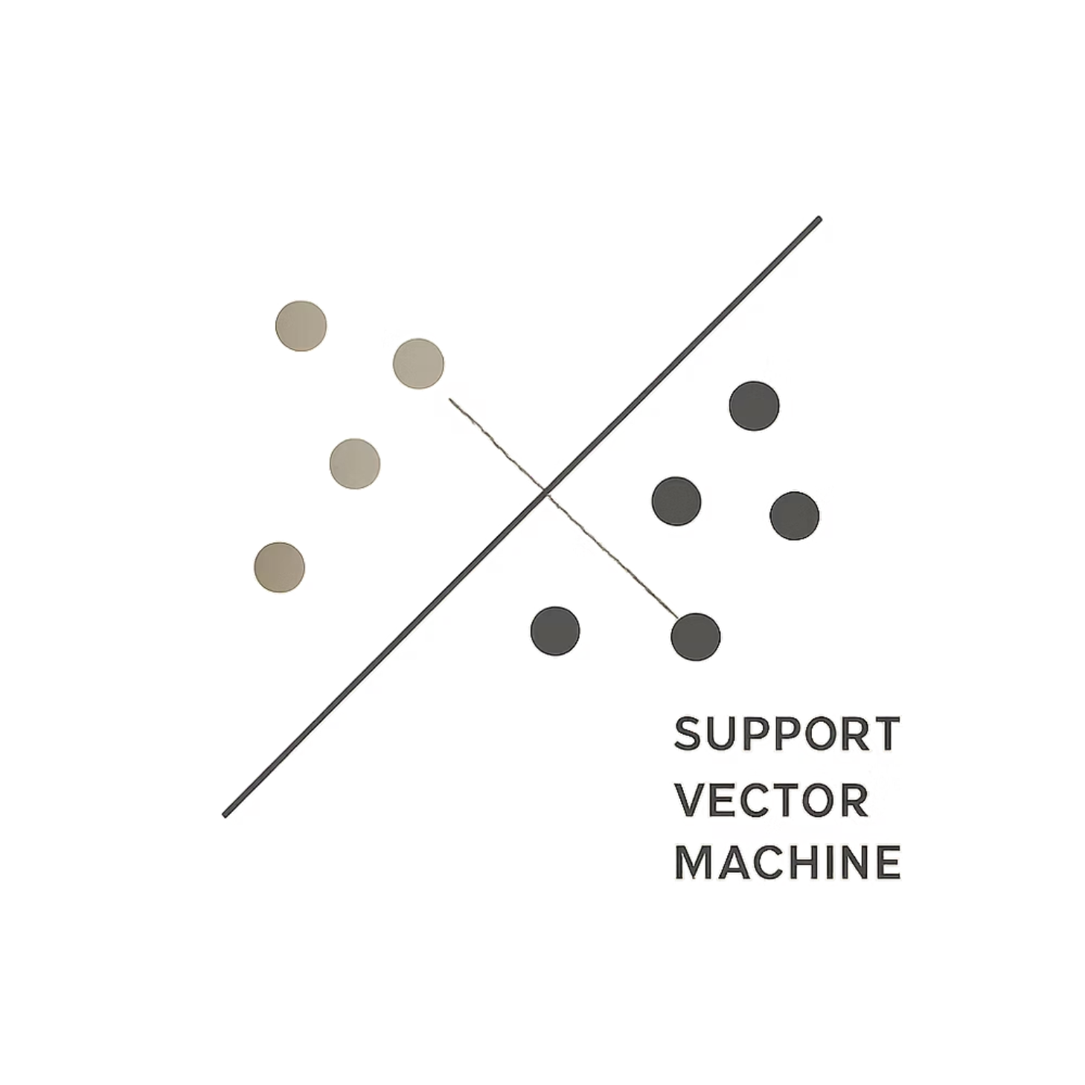
Chapter 5: Learning Complex Patterns - Advanced Classifiers
Backpropagation
Support Vector Machines
Core algorithm for training Artificial Neural Networks. Efficiently calculates gradients to update weights and minimize errors.
Finds optimal hyperplane separating different classes in high-dimensional space. Uses kernel tricks for non-linear data.

Slide 7
Chapter 6: The "Lazy" and "Eager" Learners
Lazy Learners (KNN)
Memorize training data, defer computation until prediction
Find 'k' nearest neighbors, assign majority class
Simple to implement but computationally expensive during prediction
Eager Learners (Decision Trees, SVMs, Neural Networks)
Build generalized model during training
Faster prediction using pre-built model
Require more upfront training time

Slide 8
Chapter 7: Measuring Success - Evaluating Classifier Performance
Accuracy
Precision
Recall (Sensitivity)
Overall correct predictions divided by total predictions made.
True positives / (True positives + False positives). How many predicted positives were actually positive?
True positives / (True positives + False negatives). How many actual positives were correctly identified?
F1-Score
ROC Curve & AUC
Harmonic mean of precision and recall, balancing both metrics.
Visualizes trade-off between true positive rate and false positive rate across different thresholds.

Slide 9
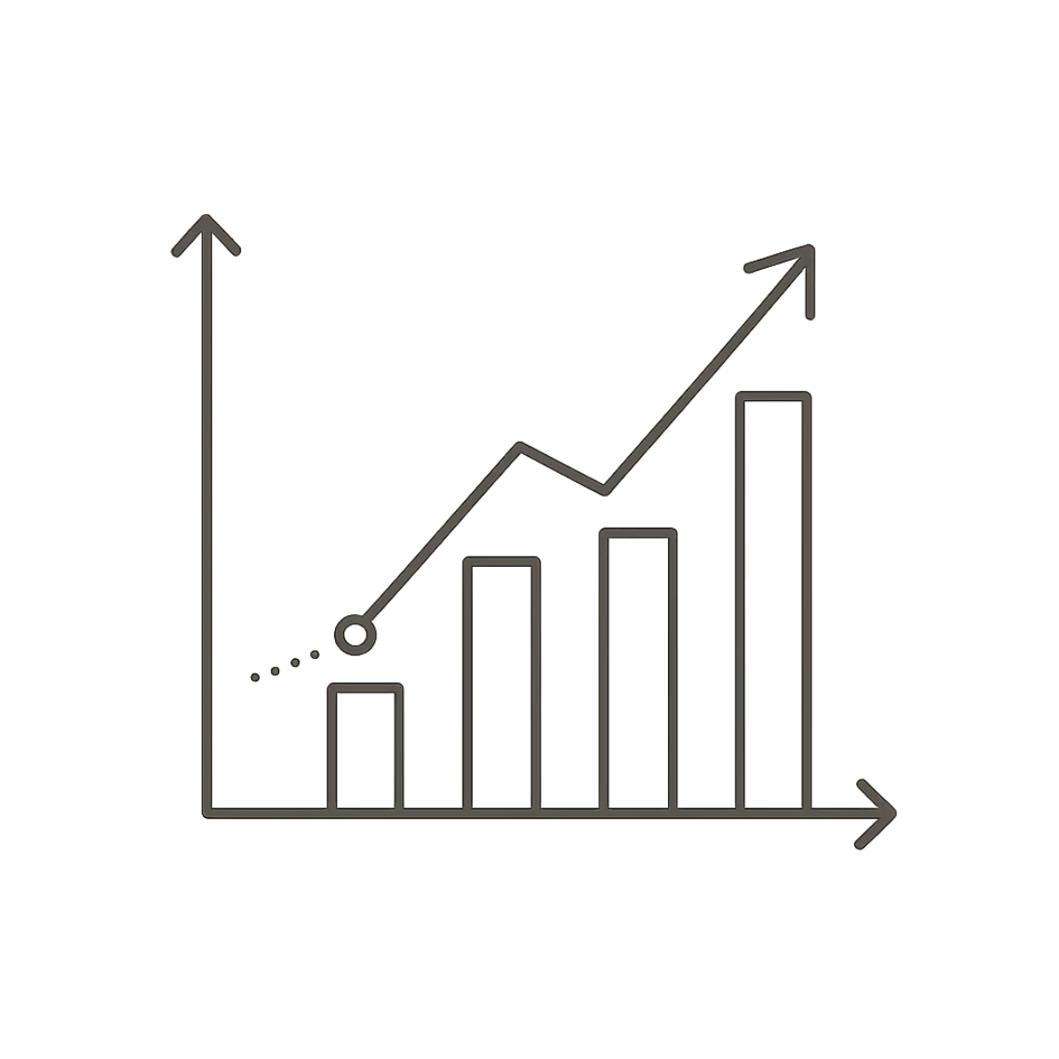
Chapter 8: Boosting Accuracy and Making Predictions
Improving Classification Accuracy
01
02
Ensemble Methods
Feature Engineering
Combine multiple models (Random Forests, Gradient Boosting) for improved robustness.
Create new, more informative features from existing data.
03
Cross-Validation
Evaluate performance using different data subsets for robust assessment.
Regression Analysis
While classification predicts categories, regression predicts continuous numerical values—a related but distinct supervised learning task.

Slide 10
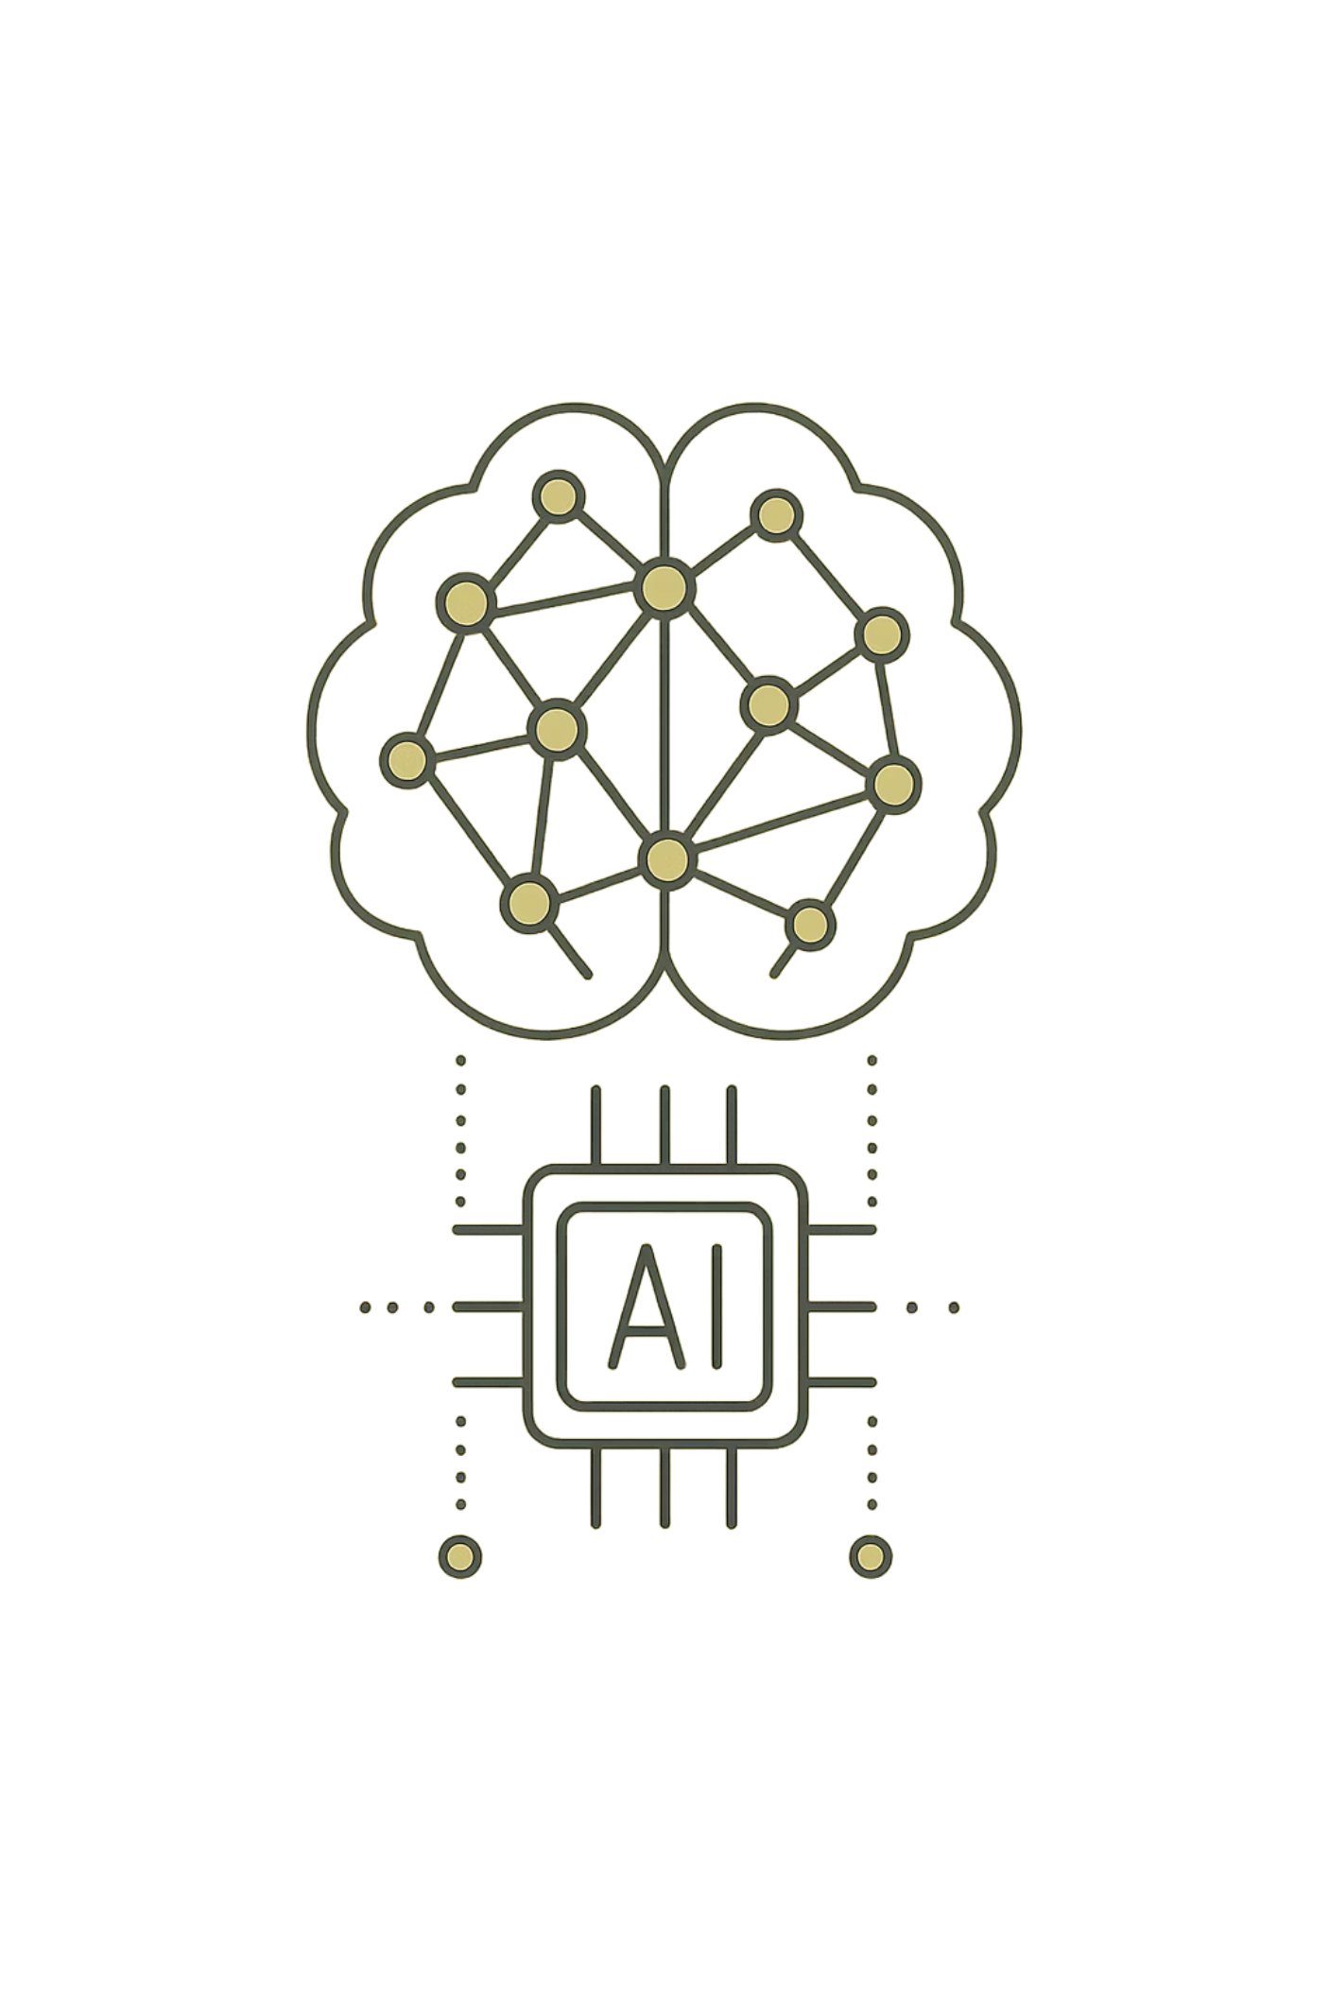
The Future of Classification: Smarter Decisions, Deeper Insights
Medical Diagnosis
Personalized Recommendations
Precision healthcare through automated analysis and pattern recognition.
Tailored experiences powered by sophisticated classification algorithms.
AI Foundation
Machine learning classification drives advancements across all AI applications.
As algorithms become more sophisticated and data more abundant, classification will continue to unlock unprecedented levels of insight and automation across every industry.

