Slide 1

DATA SCIENCE
District-Level Agricultural Data Analysis(ICRISAT Dataset)
Divya Talole
22070521066
Symbiosis Institute of Technology, Nagpur Campus

Slide 2

Overview & Data
Objective: To analyze the ICRISAT district-level dataset to understand the key factors driving agricultural productivity, model crop yields, and classify district profiles.
Dataset:
Source: ICRISAT District Level Data
Scope: 12,803 entries, 107 original columns
Key Variables: Crop production/yield, monthly climate data, fertilizer consumption, irrigation area.
Methodology:
  Preprocessing: Standardized names, imputed missing values using state-level means.
  Feature Engineering: Created key metrics like irrigation_ratio , yield_per_fertilizer , temperature_c (annual avg) , and fertiliser_per_ha.

Slide 3
Methodology - Data Pipeline
Dataset: ICRISAT District Level Data (1966-2017).
Preprocessing:
Standardized column names.
Group Mean Imputation: Filled missing values using state-level averages to preserve regional accuracy.
Removed duplicates and filtered columns with >30% missing data.
Feature Engineering:
Irrigation Ratio: (Gross Irrigated Area / Gross Cropped Area).
Efficiency: (Yield / Fertilizer Consumption).
Climate: Aggregated monthly rainfall and temperature into annual trends.

Slide 4
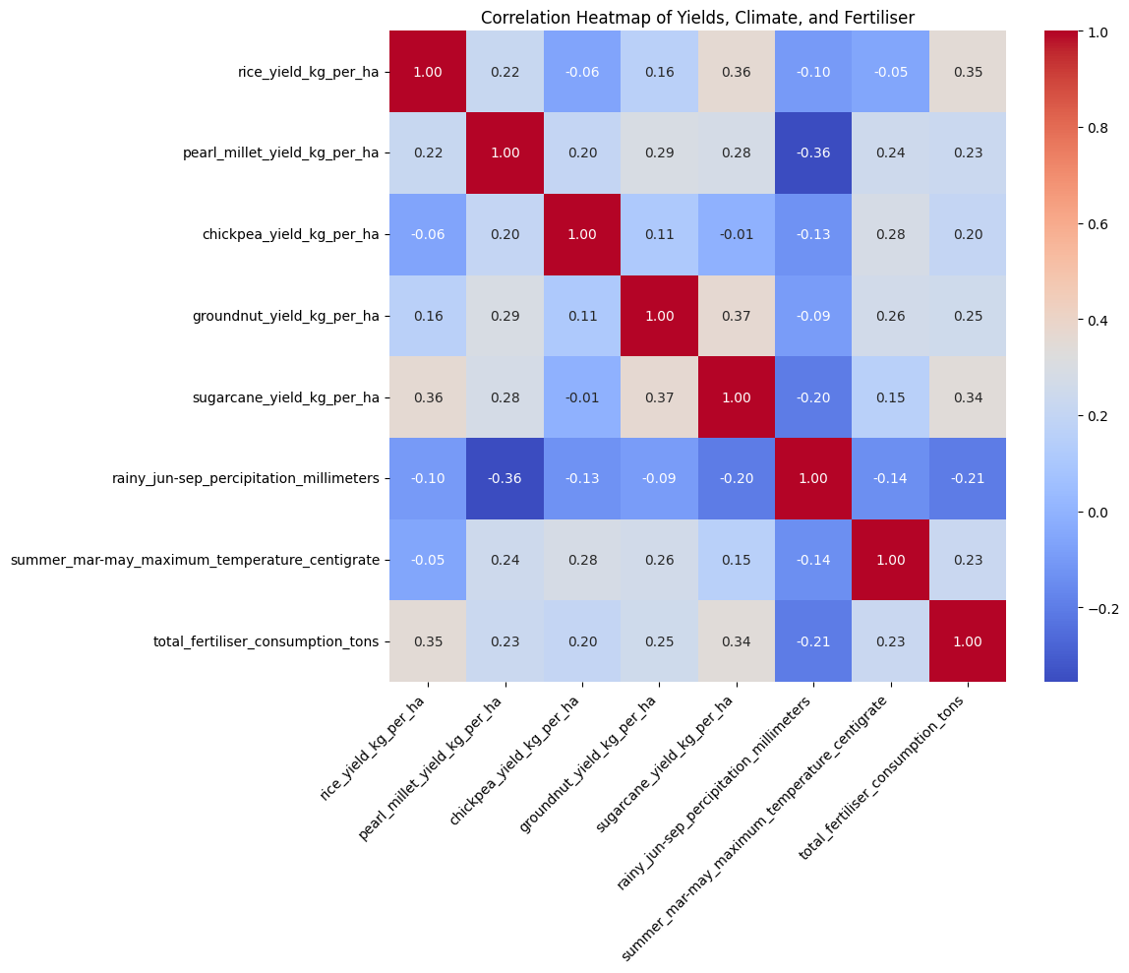
Key Factor Correlations
Correlation heatmap reveals the initial relationships between variables. Rice yield (rice_yield_kg_per_ha) shows its strongest positive correlation with total fertilizer consumption (0.35) and sugarcane yield (0.36).This suggests that factors driving sugarcane success (likely water and inputs) also drive rice success.

Slide 5
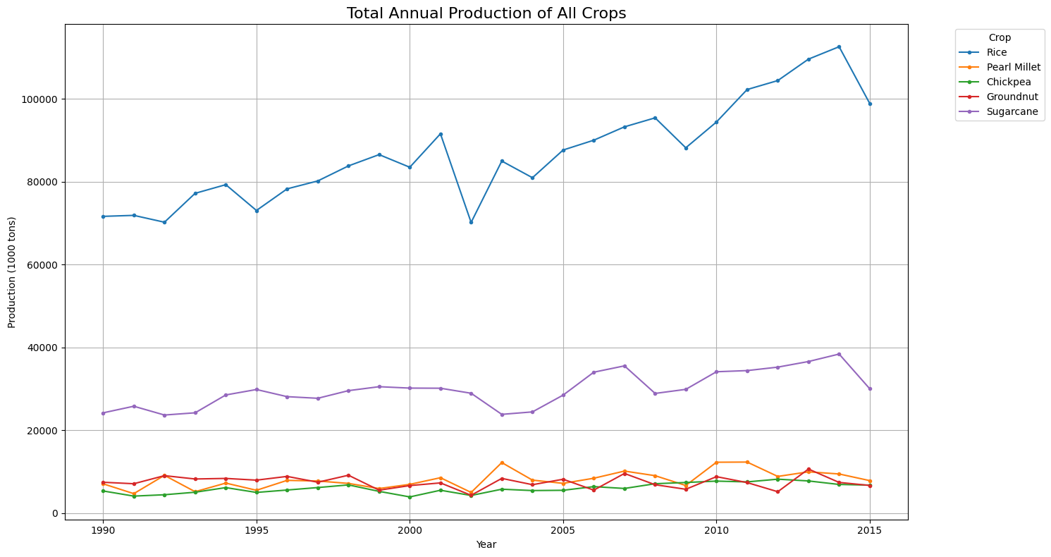
National Production Trends
National crop production has trended upward, with Rice and Sugarcane dominating total tonnage. Sugarcane production is significantly larger in volume but also shows more volatility than the steadier growth of rice .

Slide 6
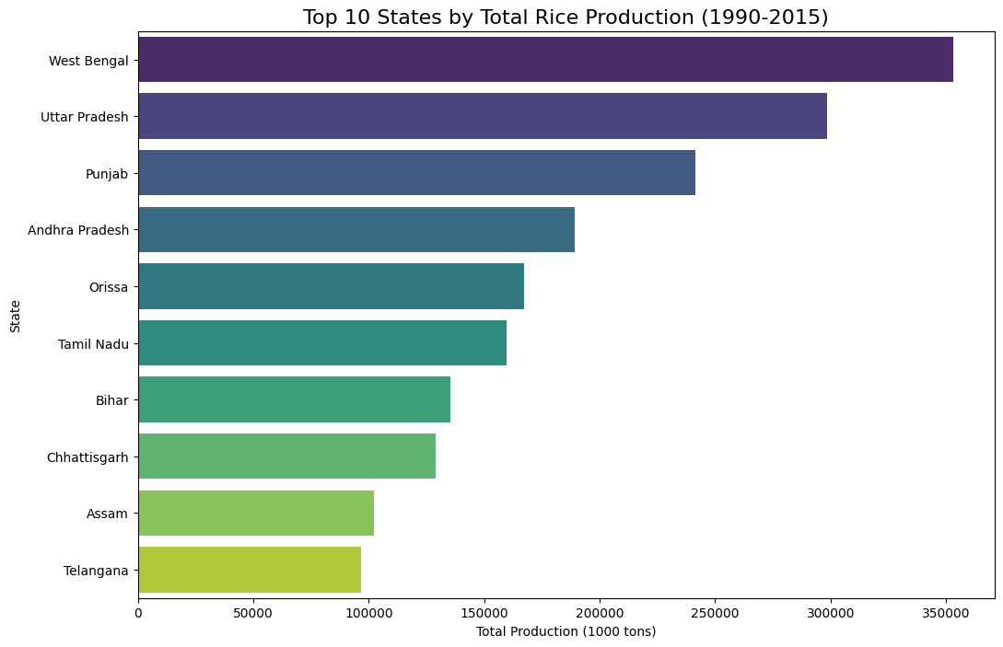
State-Level Dominance (Rice)
Production is highly concentrated. West Bengal, Uttar Pradesh, and Punjab are the top 3 states for total rice production from 1990-2015.

Slide 7
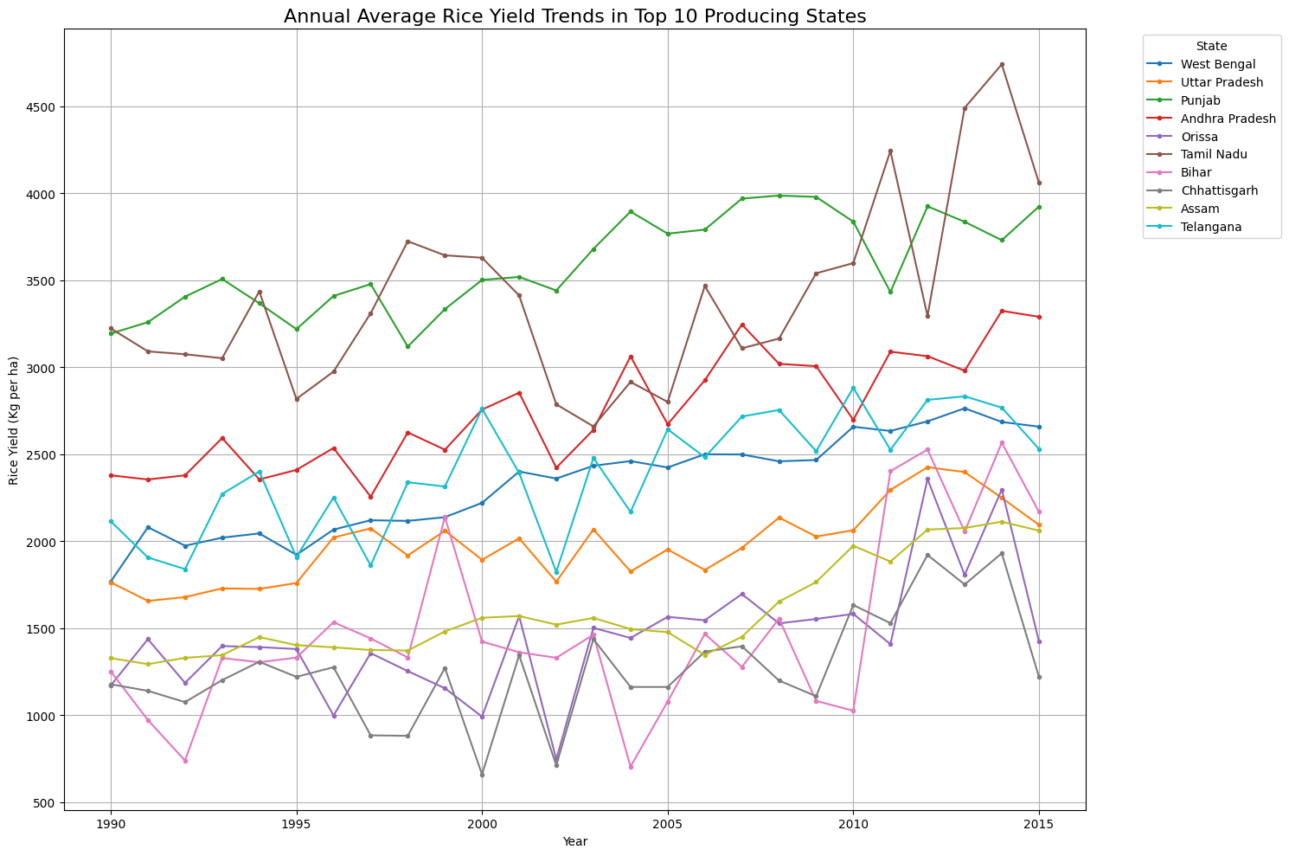
The Yield vs. Production
High production doesn't always mean high yield (efficiency). Punjab has a significantly higher and more rapidly increasing average yield (kg/ha) than other top producers like West Bengal or Orissa .

Slide 8
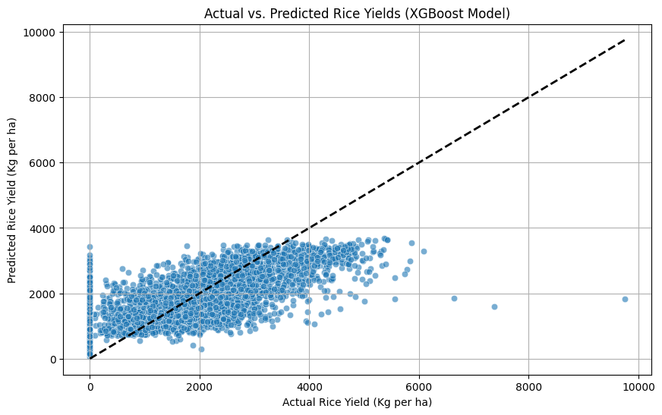
Predicting Rice Yield
A simple model fails (Negative R-squared). After robust feature engineering and a time-based split (Train < 2008, Test >= 2008), an XGBoost model could explain 45% of the variance (R-squared = 0.45) in rice yield.

Slide 9
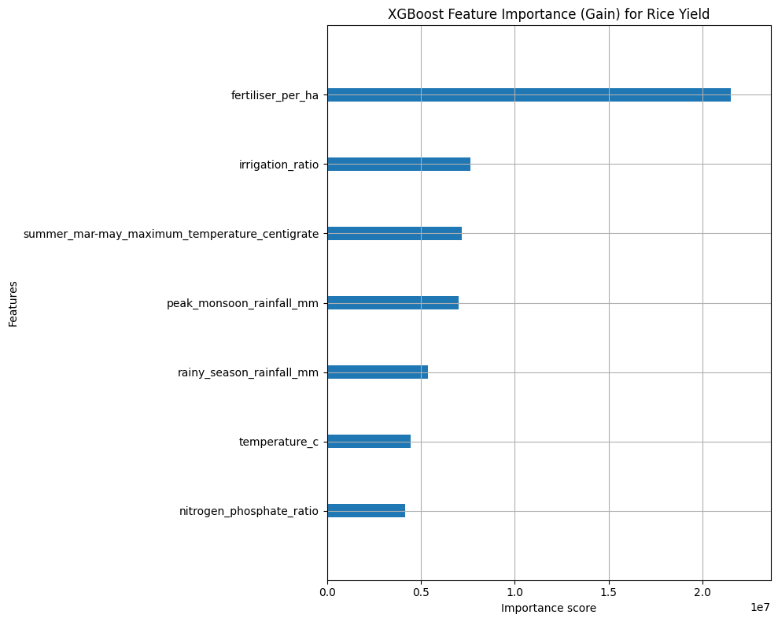
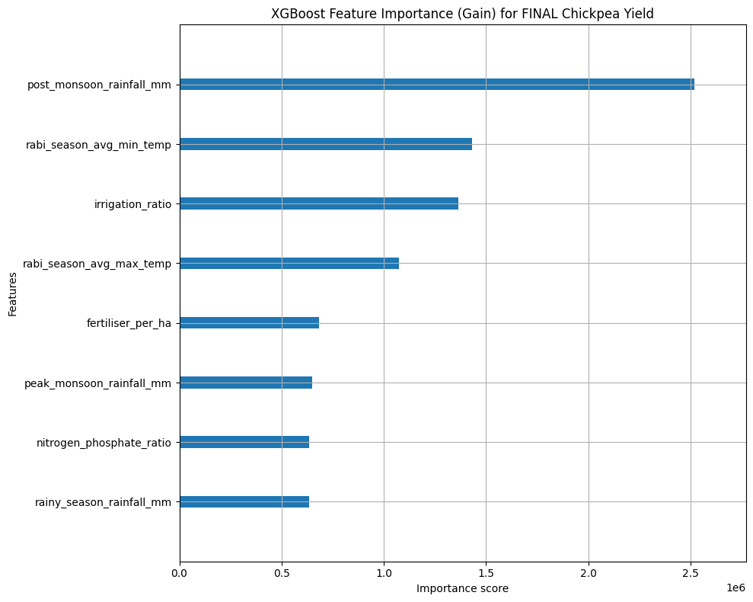
Key Predictive Factors
The most important factors for yield are different for different crops.
For Rice (Kharif Crop): 1. fertiliser_per_ha 2. irrigation_ratio 3. Summer Temperature
For Chickpea (Rabi Crop): 1. post_monsoon_rainfall_mm (Rain for planting)2. Winter Minimum Temperature 3. irrigation_ratio

Slide 10
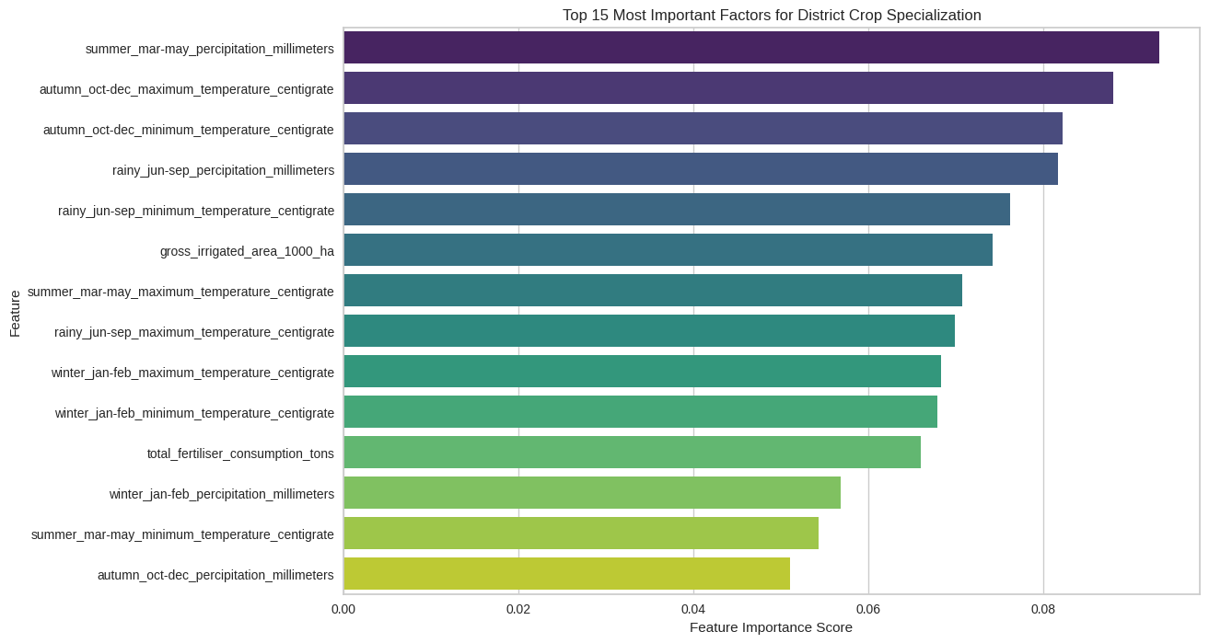
Predicting Crop Specialization
We can predict a district's dominant crop (e.g., Rice, Millet) with 88% accuracy using a Random Forest model.
Key Insight: Climate is the main driver. Seasonal rainfall and temperature were the most important predictive features.

Slide 11
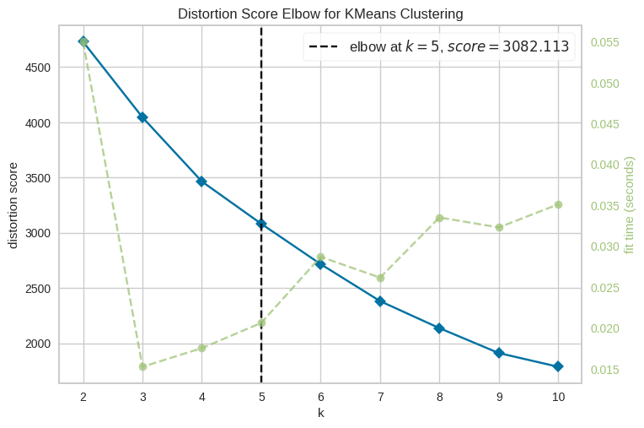
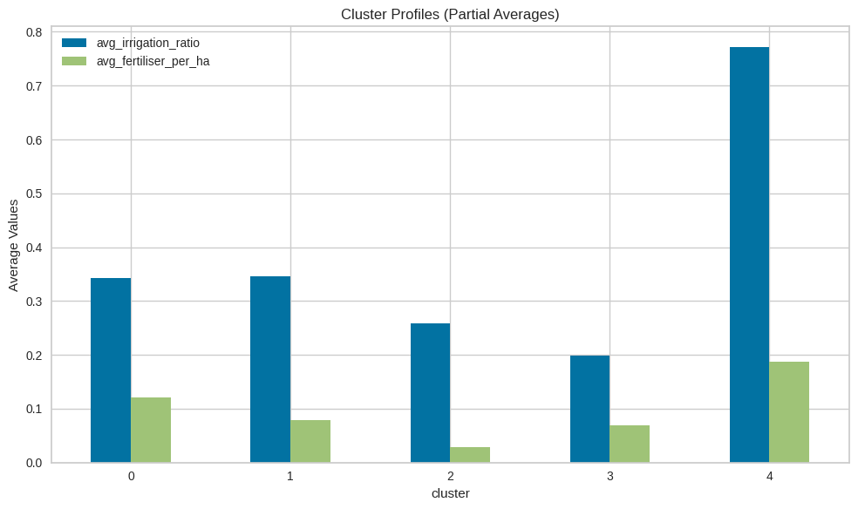
Unsupervised Learning: District Profiles
K-Means clustering identified 5 distinct agricultural profiles based on district-level averages.
Example Profile: Cluster 4 represents a "High-Input" zone, with the highest average irrigation (0.77) and fertilizer (0.19) use.

Slide 12
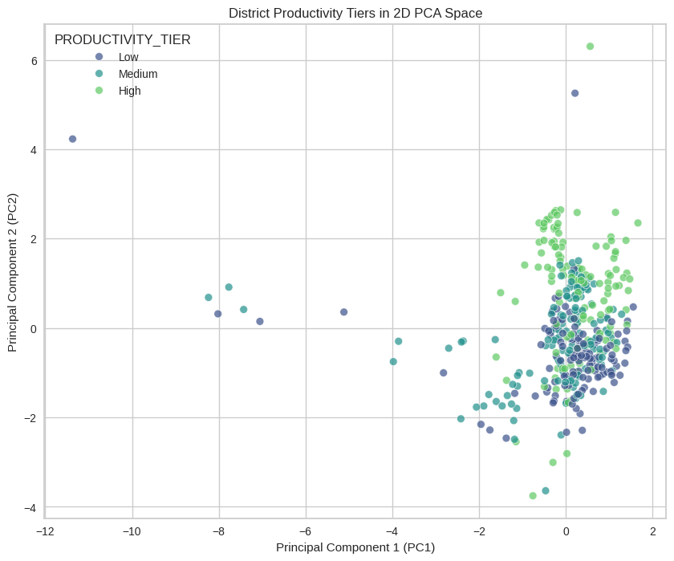
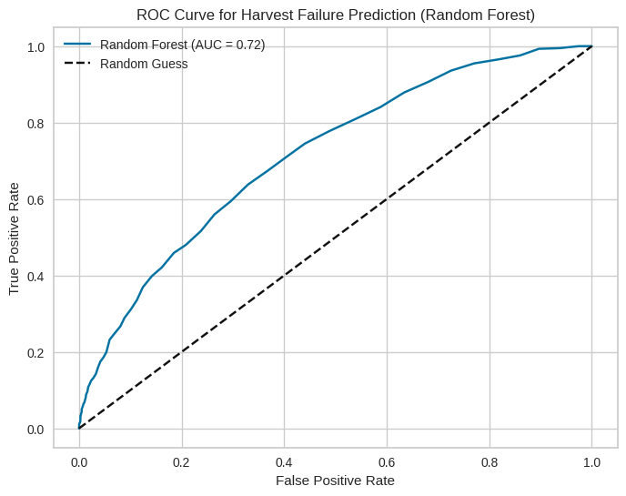
Classification Challenges
Productivity Tiers: Classifying districts as 'Low', 'Medium', or 'High' yield proved challenging (66% accuracy). A PCA plot shows the classes are heavily overlapped.
Harvest Failure: Predicting a "failure" event (yield < 20th percentile) was moderately successful (0.72 ROC AUC) but had very low recall (3%), meaning it missed most failures.

Slide 13
Key Takeaways
Inputs & Climate Drive Yield: fertiliser_per_ha and irrigation_ratio are the most consistent drivers of yield variation (how much is grown).
Climate Drives Specialization: Seasonal rainfall and temperature are the main drivers of crop specialization (what is grown).
Feature Engineering is Essential: Models only became effective after creating domain-specific features (e.g., fertiliser_per_ha, post_monsoon_rainfall_mm) and using a time-based split.
District Profiles are Identifiable: Clustering successfully segmented India into 5 distinct agricultural zones, which can be used to inform targeted policy.

