Slide 1
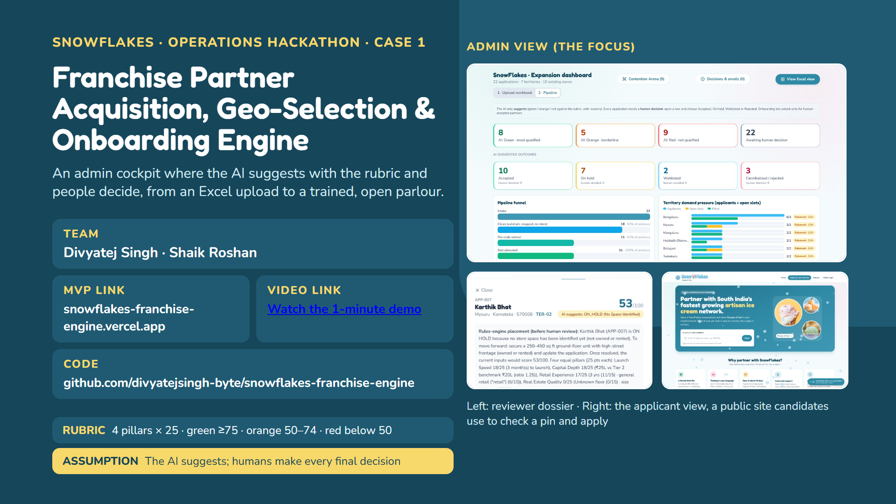
Notes:
Introduce the team and the case. Stress the admin side: an expansion reviewer uploads one Excel file and gets a rubric-based suggestion for every candidate, with exact reasons, then records the real decision. The applicant side exists (small screenshot, bottom right) so candidates can check a pin and apply, but the demo spends most time on the admin cockpit. Replace the bracketed video link with the demo video URL.

Slide 2
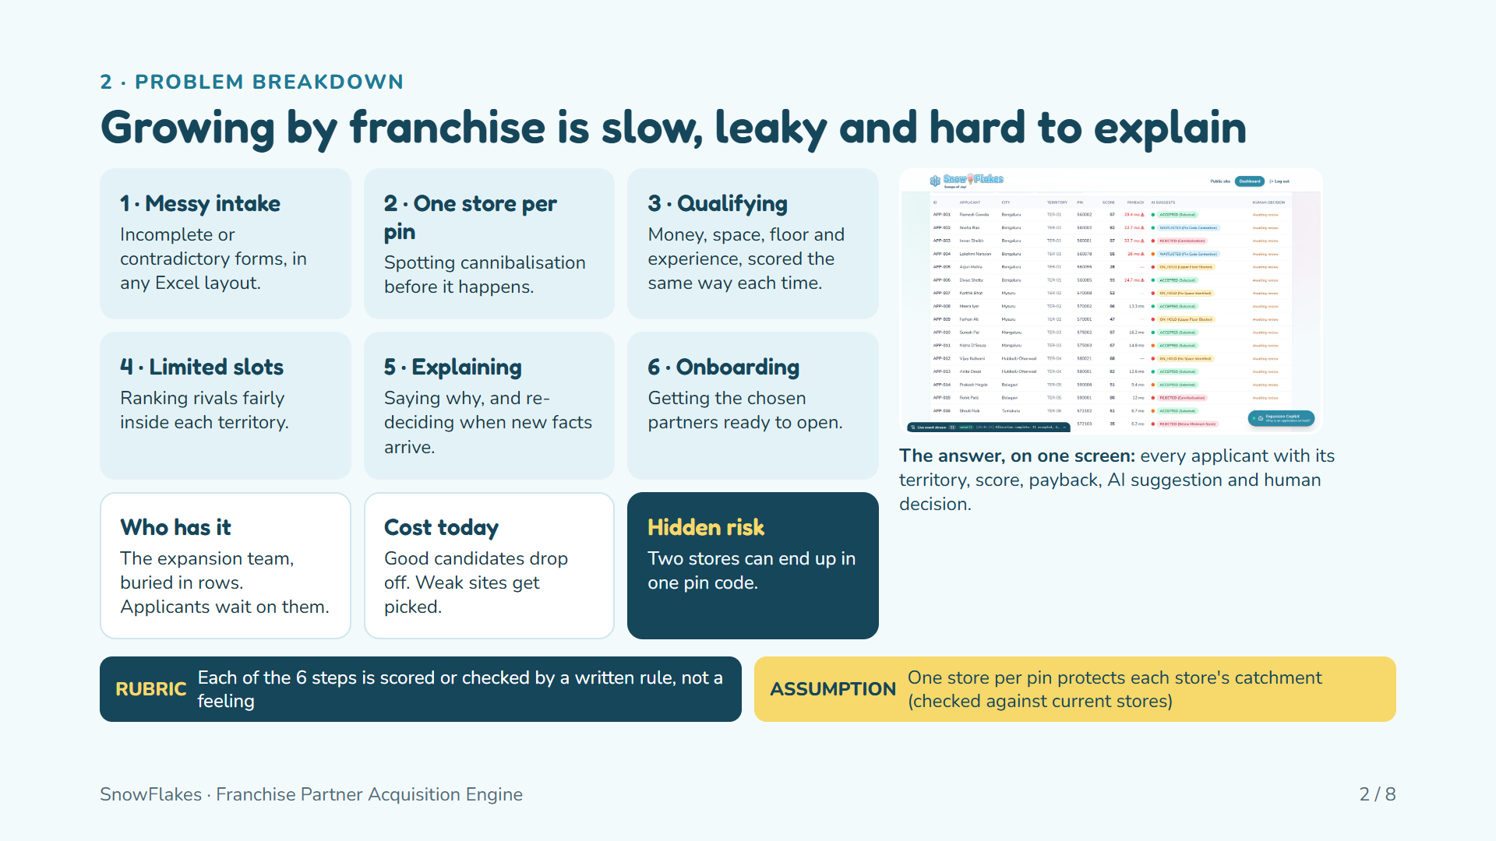
Notes:
Who has the problem: the expansion team, plus applicants who wait on them. Cost: good candidates drop off and weak locations get picked. The six sub-problems are shown as cards. The screenshot on the right is the admin pipeline table, our answer in one view. The strip at the bottom names the rubric idea (rules, not feelings) and the first assumption (one store per pin).

Slide 3
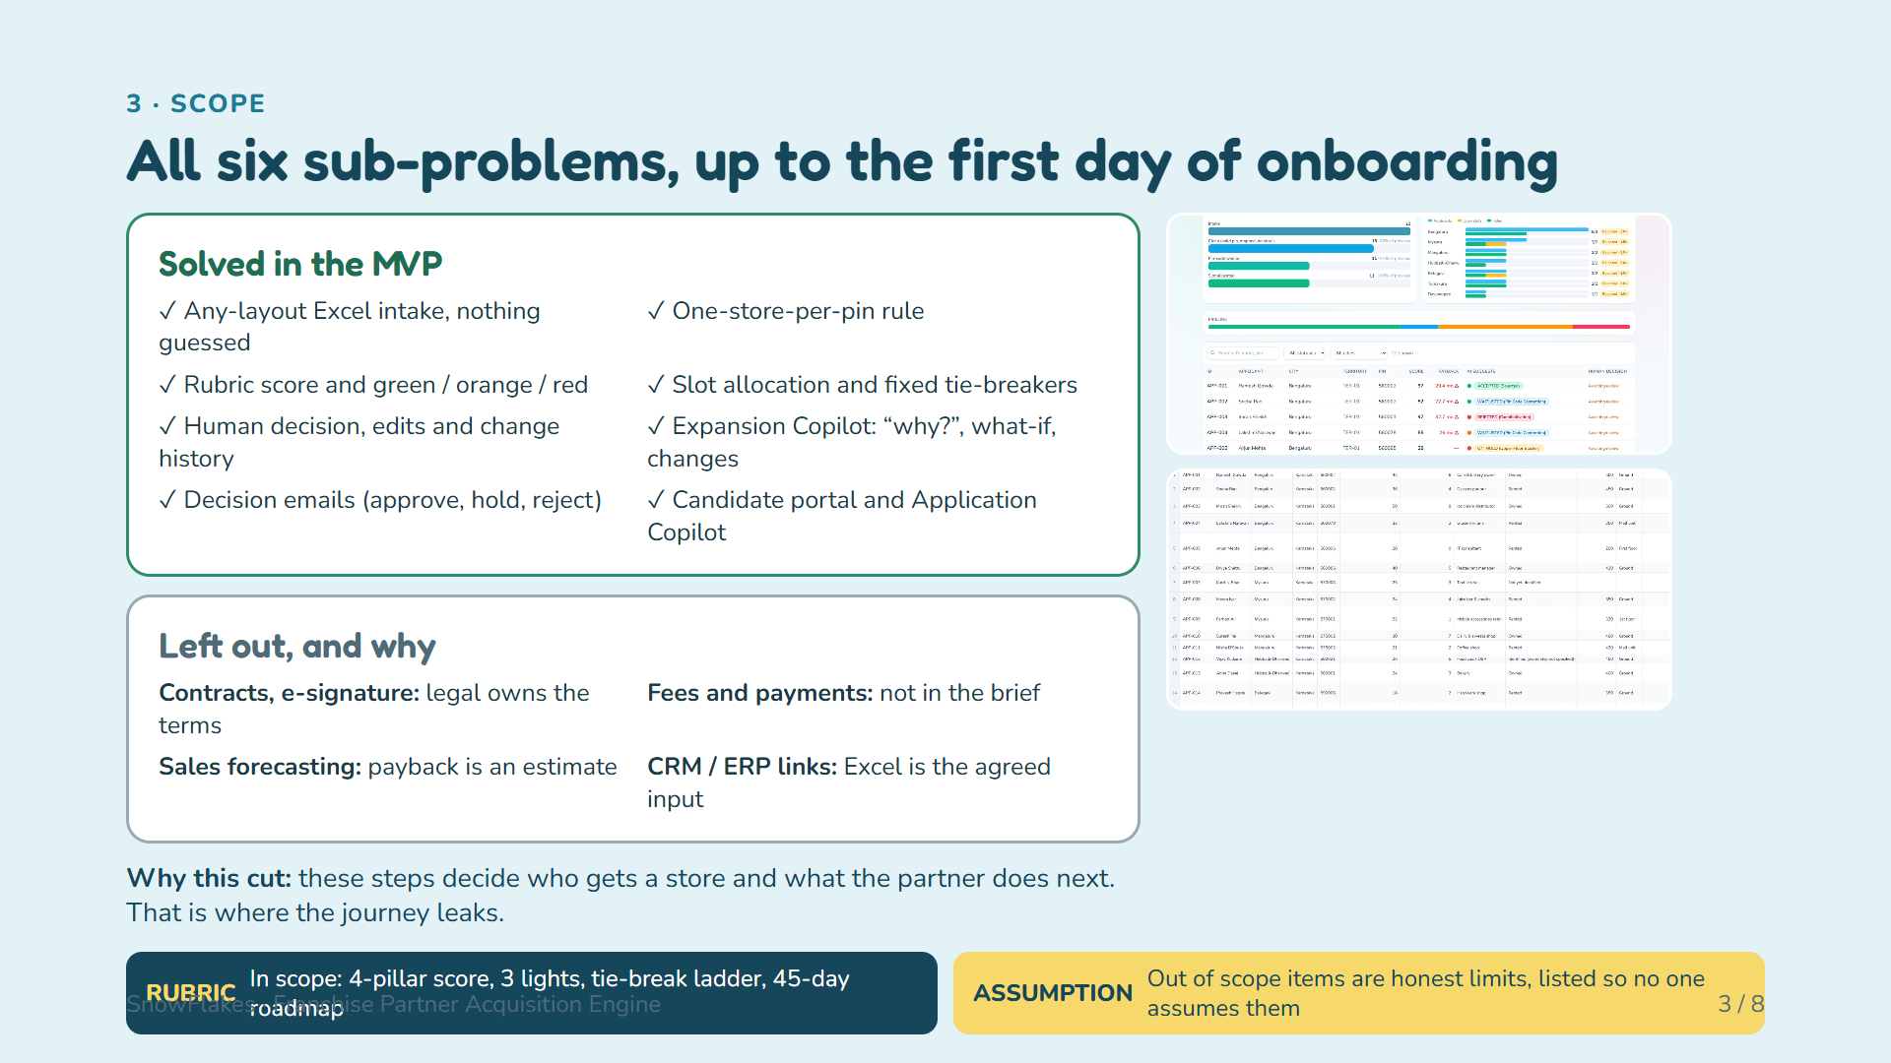
Notes:
We solved all six sub-problems because they form one chain. The right column shows two admin screens: territory demand pressure, and the Excel view that exports the Sheet 1 columns plus score, status, territory, payback, AI rating and the human decision. Left out: contracts, fees, forecasting and CRM links, each for a stated reason.

Slide 4
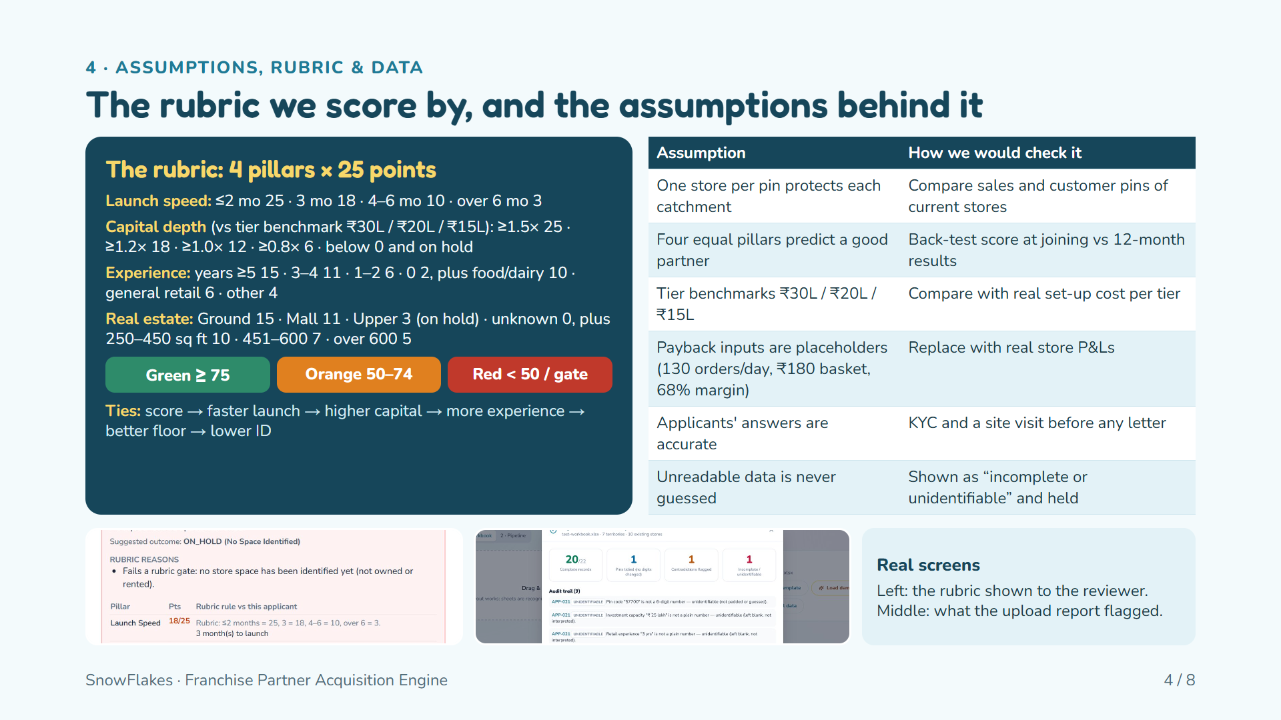
Notes:
The left card is the full rubric exactly as coded. Capital is compared with the tier benchmark. Colours: green means every gate passed and the score is at least 75; orange is borderline (50 to 74) or cannot be rated yet; red fails a gate or scores under 50. The table gives each assumption and a real-world check. Two assumptions matter most: the payback inputs are our placeholders, and unreadable data is never guessed but marked incomplete.

Slide 5
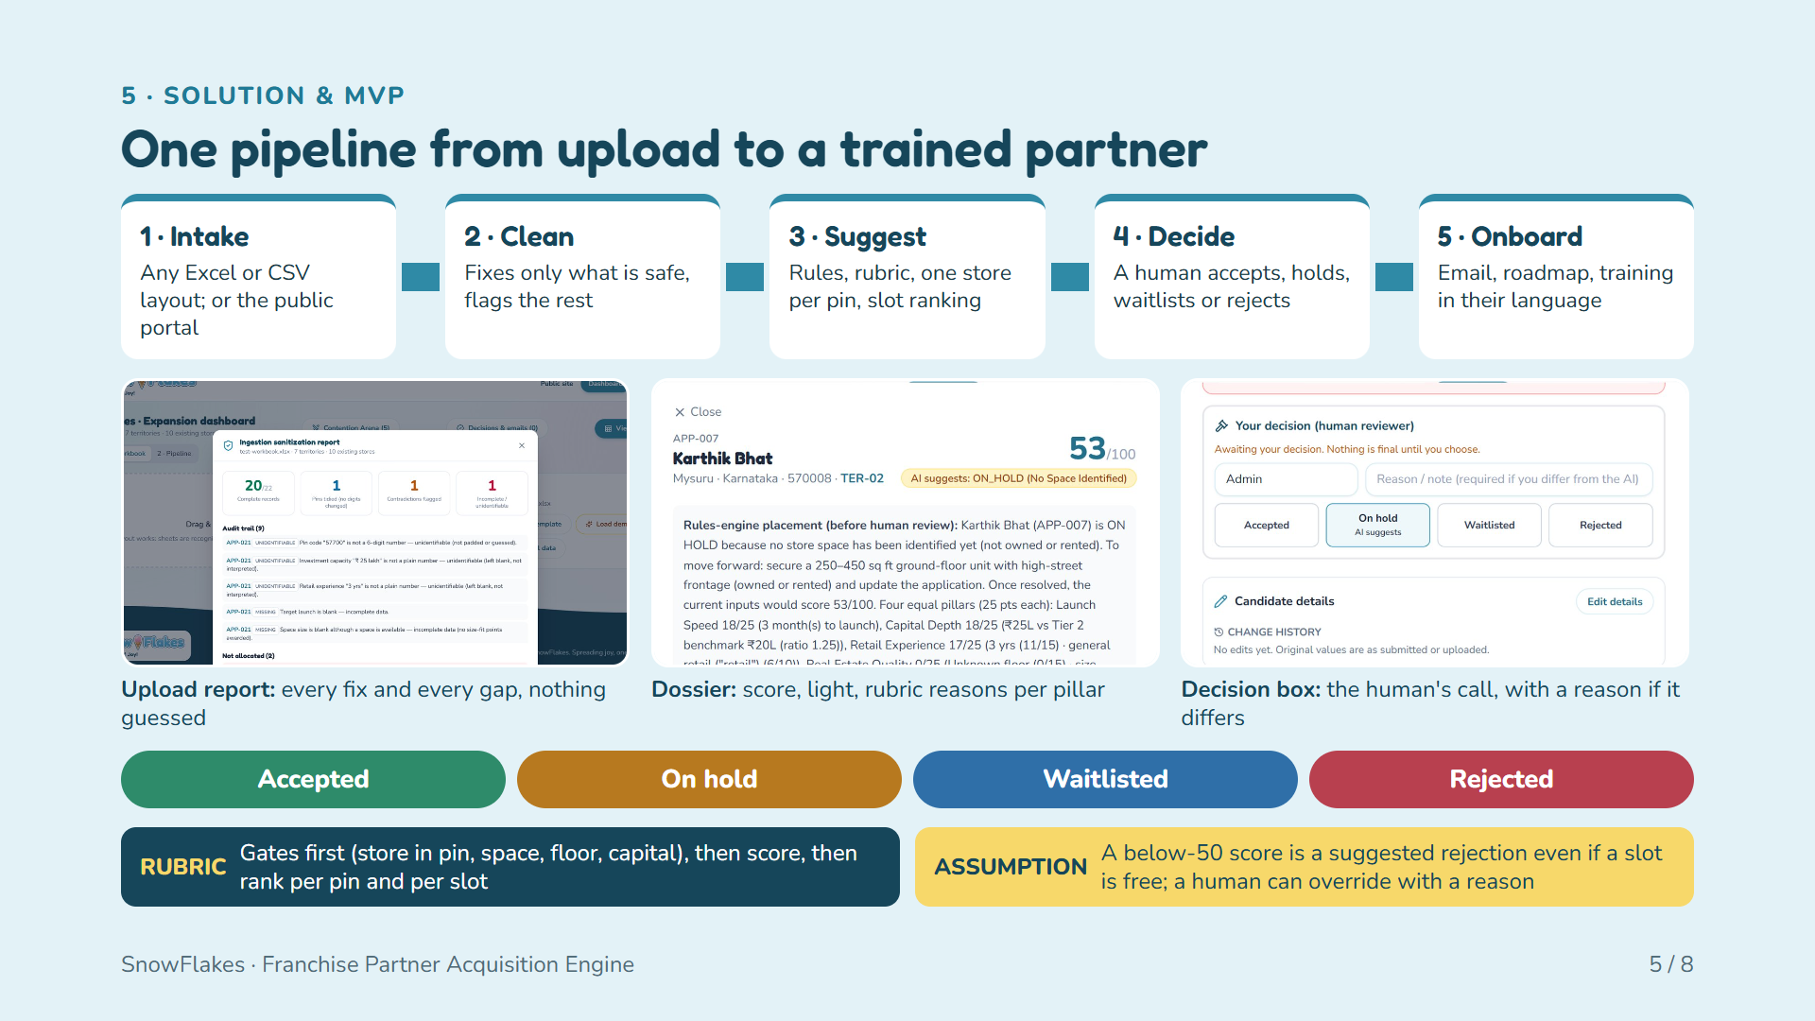
Notes:
Walk the pipeline left to right. Intake accepts any Excel or CSV layout because tables are recognised by their headings. Clean only does lossless fixes and reports everything else as incomplete. Suggest applies the rules and the rubric. Decide is the human step: the dossier shows the AI suggestion with reasons, and the decision box records the real outcome. Onboard sends an email and unlocks the partner's roadmap. The four outcomes are at the bottom.

Slide 6
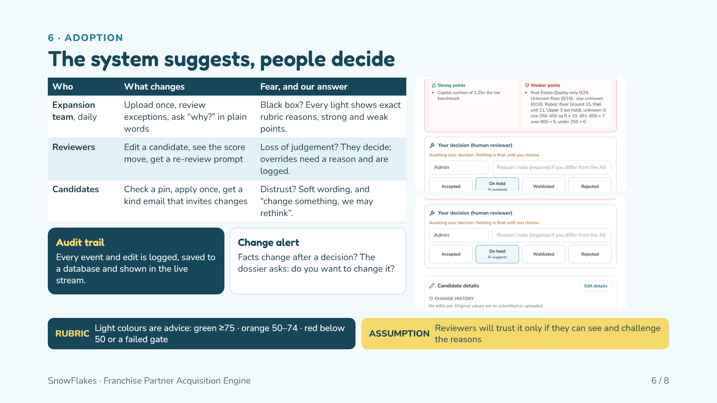
Notes:
Who uses it: the expansion team daily, reviewers for decisions, candidates through the public site. The main resistance is trust, so every light has exact rubric reasons, strong points and weaker points, which are the two screenshots on the right. The human decision box needs a reason when it differs from the AI. If a candidate's facts change after a decision, the dossier raises a banner asking whether to change the decision. Every event is written to an audit log.

Slide 7
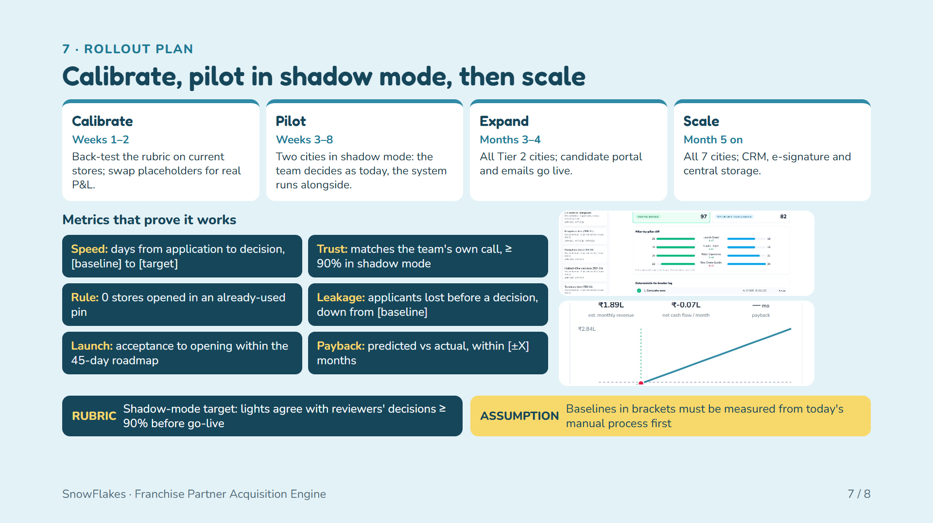
Notes:
Shadow mode means no risk: the team keeps deciding as today while the system runs next to it, and we compare its lights with their decisions. The screenshots show the contention arena, which explains rival applicants for one slot, and the payback model that will be calibrated with real P&amp;L. Baselines in square brackets must be measured before the pilot.

Slide 8
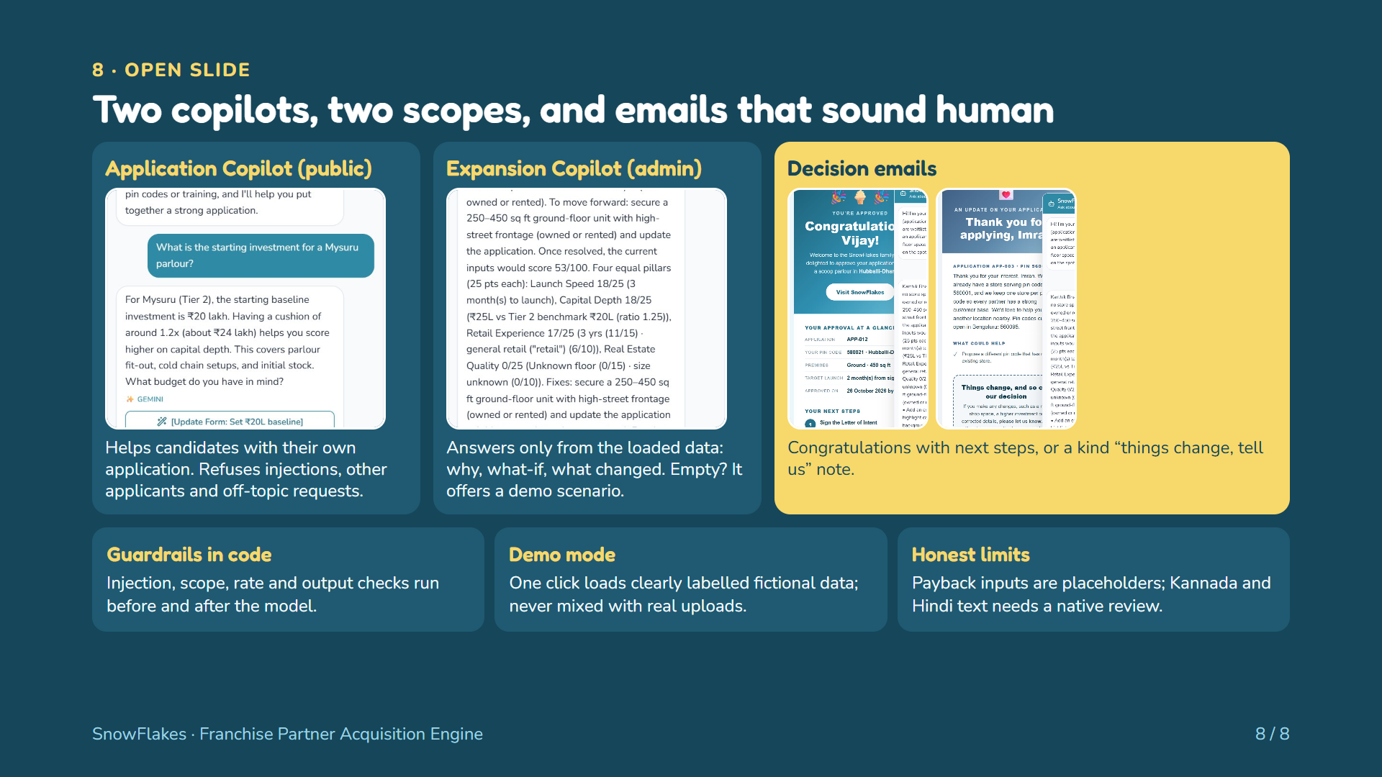
Notes:
The brownie points. Two separate copilots: the public Application Copilot only talks about the candidate's own application and the franchise process; the admin Expansion Copilot only works with the loaded data, can explain every change and offers a demo scenario when nothing is uploaded. Emails: approval, hold, waitlist and rejection each get a designed email, and the rejection invites changes so the team can rethink. Guardrails run in code. Be honest about limits.

