Slide 1


Chicago Crimes
Machine learning

Slide 2


Machine learning Beat
Divya Vishnumurthy
Ramesh Kalagnanam
Kevin Kao
Frances Doyle
Harshvardhan Suresh
Joe Strawinski

Slide 3
AGENDA
What are we doing
Chicago crime dataset
Machine learning workflow
Infrastructure walk through
Summary of outcomes
Crime Plots

Slide 4
SOLUTION statement
Solution statement goals:
Define scope (including Data Source)
Define target performance
Define context for usage
Define how solution will be created
Use the machine learning workflow to process and transform Chicago crime dataset to create a prediction model. This model must predict if a crime will result in an arrest with 70% or greater accuracy.
Solution statement:

Slide 5
Chicago CRIME DATASET
Year
Updated On
Latitude
Longitude
Location
Column definitions:
Block - partially redacted address
IUCR – Illinois Uniform Crime Reporting code
Primary Type – description of IUCR
Description – secondary description of IUCR
Beat – smallest police geographic area
FBI Code – FBI crime classification
Data is extracted from the Chicago Police Department's Citizen Law Enforcement Analysis and Reporting system
Reported crime between 2001 and present (less the most recent seven days)
As of 10/27/19, 6.9 million records
https://data.cityofchicago.org/Public-Safety/Crimes-2001-to-present/ijzp-q8t2/data
Database Features:
Self-Explanatory columns:
ID
Case Number
Date
Location Description
Arrest?
Domestic?
District
Ward
Community Area
X Coordinate
Y Coordinate

Slide 6
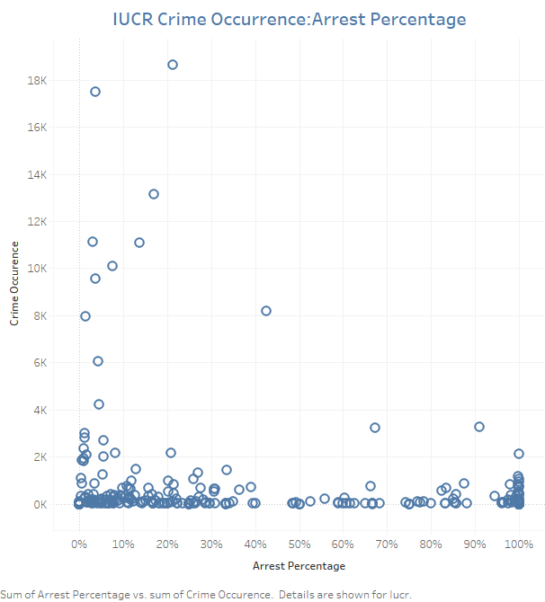
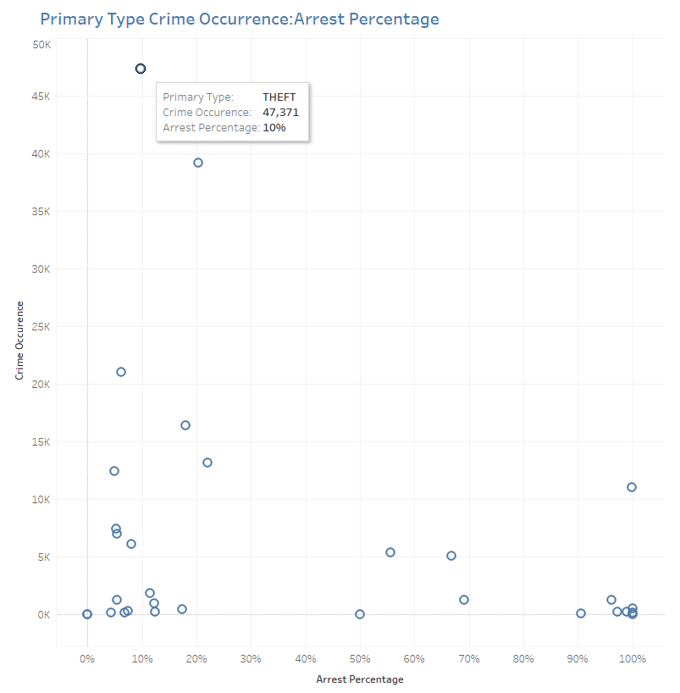
Chicago CRIME DATASET

Slide 7
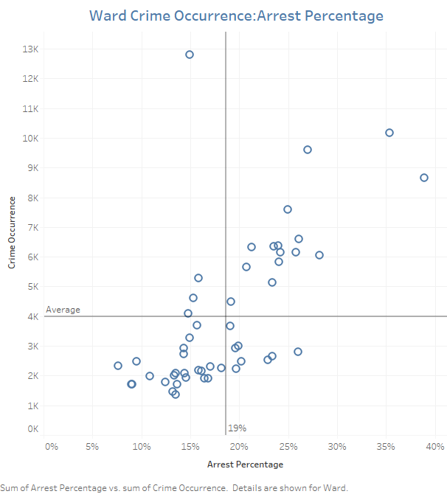
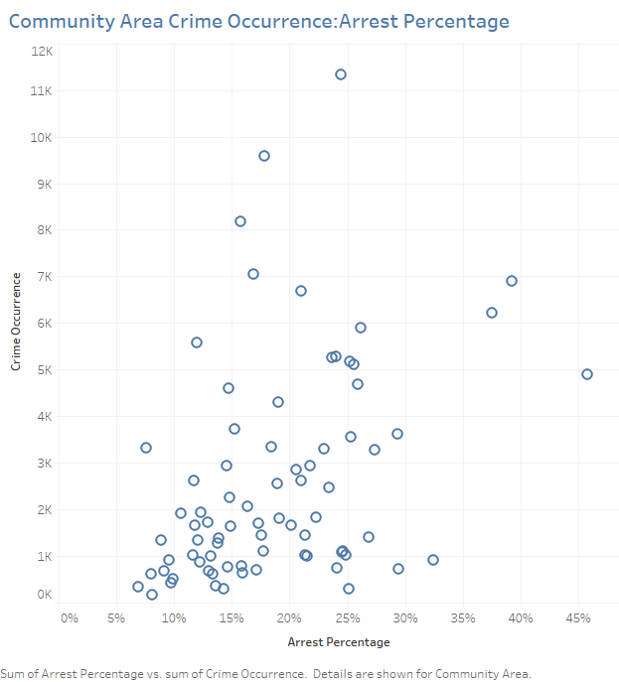
Chicago CRIME DATASET

Slide 8
Machine learning workflow
Asking the right question
Training the model
Testing the model
Preparing the data
Selecting an algorithm
Notes:
Learning Type – Supervised, Unsupervised
Result Type – Classification, Regression
Complexity of the algorithm
Basic Vs Enhancement

Slide 9

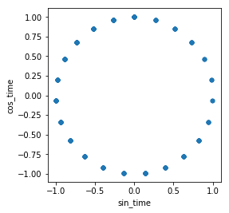
Machine learning workflow
Dropped null values
Convert categorical data into numeric values
Eliminated outliers
Dropped columns
Converted time to cyclical data
Preparing the data

Slide 10
Machine learning workflow
Asking the right question
Training the model
Testing the model
Preparing the data
Selecting an algorithm
Notes:
Learning Type – Supervised, Unsupervised
Result Type – Classification, Regression
Complexity of the algorithm
Basic Vs Enhancement

Slide 11
Machine learning workflow
Selecting an algorithm
Naïve Bayes
Random Forest
Decision Tree
Logistic Regression
Notes:
Learning Type – Supervised, Unsupervised
Result Type – Classification, Regression
Complexity of the algorithm
Basic Vs Enhancement

Slide 12
Machine learning workflow
Asking the right question
Training the model
Testing the model
Preparing the data
Selecting an algorithm

Slide 13
Naïve Bayes
Features: IUCR, Time of Occurrence, Location (modified Latitude/Longitude)
 | Predicted “No” | Predicted “Yes”
Actual “No” | TN = 1,272,029 | FP = 97,517 | 1,369,546
Actual “Yes” | FN = 494,196 | TP = 22,049 | 516,245
 | 1,766,225 | 119,566 | 1,885,791
Precision | Accuracy
When it predicts “Yes”, how often is it correct? TP/(TP + FP) = 22,049/119,566 = 18.4 percent | Overall, how often is the classifier correct? (TP + TN)/total = (22,049+1,272,029)/1,885,791= 68.6 percent
Evaluating the model with new dataset
Tested with 500 new records
371 out of 500 (“Predicted” True = Actual True)
Accuracy = 371/500 = 74.2 percent

Slide 14
RANDOM FOREST
Features: IUCR, Time of Occurrence, Location (modified Latitude/Longitude)
 | Predicted “No” | Predicted “Yes”
Actual “No” | TN = 1,279,397 | FP = 90,149 | 1,369,546
Actual “Yes” | FN = 183,435 | TP = 332,810 | 516,245
 | 1,462,832 | 422,959 | 1,885,791
Precision | Accuracy
When it predicts “Yes”, how often is it correct? TP/(TP + FP) = 332,810/422,959 = 78.7 percent | Overall, how often is the classifier correct? (TP + TN)/total = (332,810+1,279,397)/1,885,791= 85.5 percent
Evaluating the model with new dataset
Tested with 500 new records
425 out of 500 (“Predicted” True = Actual True)
Accuracy = 425/500 = 85 percent

Slide 15
LOGISTIC REGRESSION
Features: IUCR, Time of Occurrence, Location (modified Latitude/Longitude)
 | Predicted “No” | Predicted “Yes”
Actual “No” | TN = 1,006,257 | FP = 363,289 | 1,369,546
Actual “Yes” | FN = 206,925 | TP = 309,320 | 516,245
 | 1,213,182 | 672,609 | 1,885,791
Precision | Accuracy
When it predicts “Yes”, how often is it correct? TP/(TP + FP) = 309,320/672,609 = 45.9 percent | Overall, how often is the classifier correct? (TP + TN)/total = (309,320+1,006,257)/1,885,791= 69.7 percent
Evaluating the model with new dataset
Tested with 500 new records
332 out of 500 (“Predicted” True = Actual True)
Accuracy = 332/500 = 66.4 percent

Slide 16
LOGISTIC REGRESSION
Features: Crime type, Domestic crime(Y/N), District, Ward, Community Areas, Beat
 | Predicted “No” | Predicted “Yes”
Actual “No” | TN = 50,984 | FP = 1,305 | 52,289
Actual “Yes” | FN = 7,167 | TP = 5,949 | 13,116
 | 58,151 | 7,254 | 65,405
Precision | Accuracy
When it predicts “Yes”, how often is it correct? TP/(TP + FP) = 5,949/7,254 = 82 percent | Overall, how often is the classifier correct? (TP + TN)/total = (5,949+50,984)/65,405 = 87 percent
Evaluating the model with new dataset
Tested with 203,786 new records
176,662 out of 203,786 (“Predicted” True = Actual True)
Accuracy = 176,662/203,786 = 86.7 percent

Slide 17
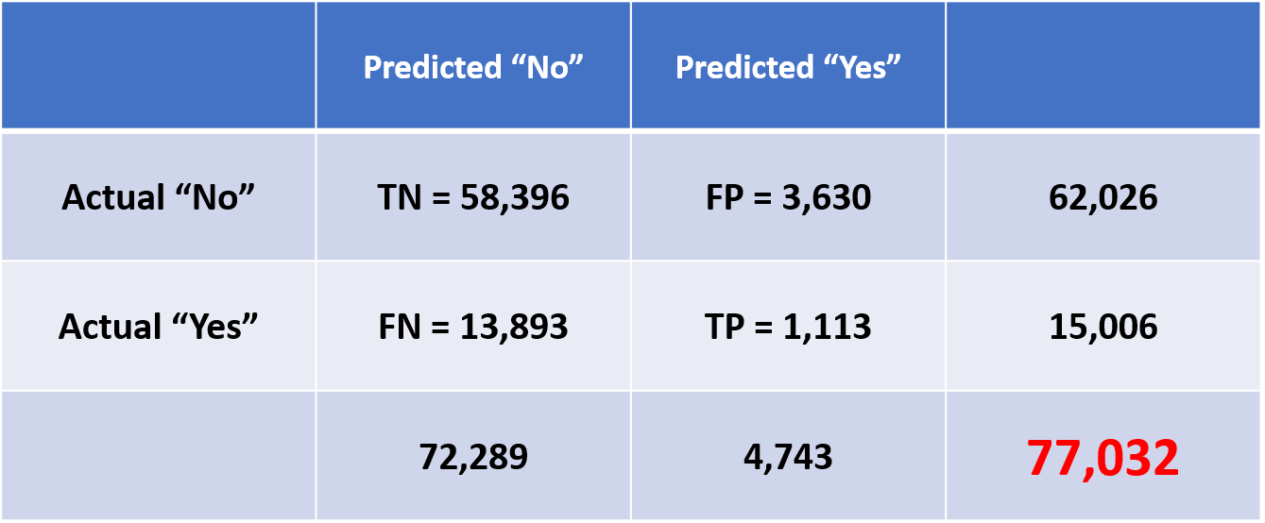
Naïve Bayes
Features: IUCR, Community Area, Police Beats, Hour, Month
Precision | Accuracy
When it predicts “Yes”, how often is it correct? TP/(TP + FP) = 1,113/4,743 = 23.5 percent | Overall, how often is the classifier correct? (TP + TN)/total = (1,113+58,396)/77,032= 77.3 percent
Evaluating the model with new dataset
Tested with 500 new records
371 out of 500 (“Predicted” True = Actual True)
Accuracy = 371/500 = 74.2 percent

Slide 18
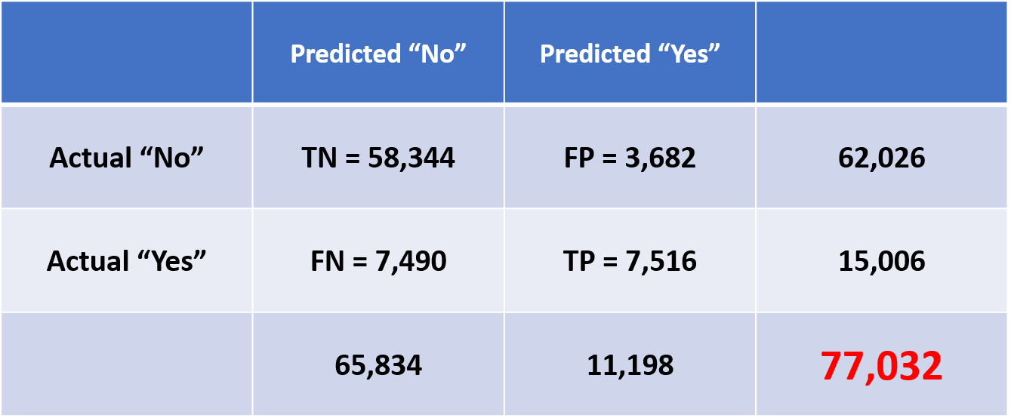
RANDOM FOREST
Features: IUCR , Community Area, Police Beats, Hour, Month
Precision | Accuracy
When it predicts “Yes”, how often is it correct? TP/(TP + FP) = 7,516/11,198 = 67.1 percent | Overall, how often is the classifier correct? (TP + TN)/total = (7,516+58,344)/77,032= 85.5 percent
Evaluating the model with new dataset
Tested with 500 Records
427 out of 500 (“Predicted” True = Actual True)
Accuracy = 427/500 = 85.4 percent

Slide 19
Efficiency Metrics of CHICAGO PD
The goal was to determine the efficiency of a police beat based on the crime type, police district and ward.
A beat is the smallest police geographic area with a dedicated police car. Three to five beats make up a police sector, and three sectors make up a police district.
Chicago police hold a monthly regular policing strategy meeting for the public to provide safety feedback based on the recent crime events.
The intent is to use these metrics to determine the most effective police district based on the crime type. Data will be used to re-assign resources to improve arrest rates.

Slide 20
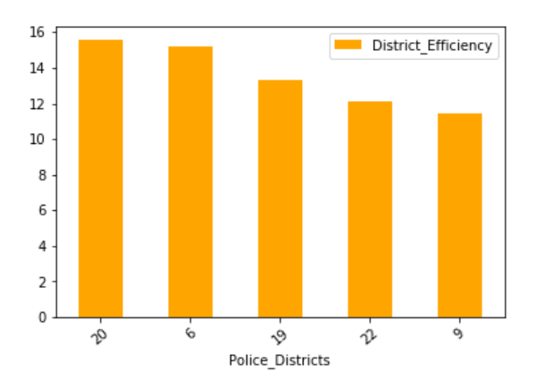
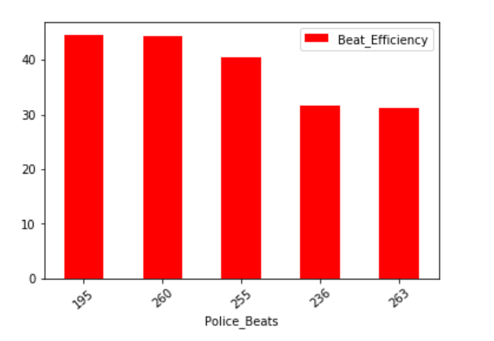
Efficiency Metrics of CHICAGO PD
With features- Crime type, Ward, Police District and Police Beat, the model works with an accuracy of 87%
Limitations in dataset:
The lag between event and arrest is unknown.
This missing data would help calculating efficiency better.

Slide 21

Algorithm with best outcomes
Random Forest 85%
Logistic Regression 87%
Naïve Bayes 74%
Decision Tree 87%

Slide 22
DEMO

Slide 23

Thank You

