Slide 1
VISUALISING STOCKS
BY-
DIVYA UDAY SINGH (RA2011003010829)
ANIMESH SINGH(ra2011003010829)

Slide 2
ABSTRACT
The project "Visualizing Projects" aims to create a comprehensive and user-friendly platform for visualizing project management data. The platform will allow project managers to track and monitor project progress, identify bottlenecks, and make data-driven decisions. The system will leverage modern data visualization techniques to represent data in intuitive and insightful ways, allowing project managers to quickly identify trends, patterns, and anomalies.
The project will be developed using modern web technologies and will be accessible from multiple devices. Ultimately, the project aims to help organizations optimize their project management processes and achieve greater success in their projects.

Slide 3
Introduction:
The project "Visualizing Stocks" aims to provide investors and traders with a comprehensive and intuitive platform for visualizing stock market data. The platform will leverage modern data visualization techniques to represent stock market data in a way that is easy to understand and analyze. The system will allow users to track stock prices, identify trends, and make data-driven investment decisions. The project will be developed using modern web technologies and will be accessible from multiple devices, making it easy for users to access and analyze stock market data on the go. The goal of this project is to help investors and traders make informed decisions about their investments and achieve greater success in the stock market. By providing a comprehensive and user-friendly platform for visualizing stock market data, this project will empower users to become more confident and effective in their investment strategies.

Slide 4
Motivation
The motivation for the project "Visualizing Stocks" stems from the growing demand for better tools and technologies for analyzing and visualizing stock market data. In today's fast-paced and highly competitive financial landscape, investors and traders need access to real-time and accurate stock market data to make informed investment decisions.
Traditionally, investors and traders have relied on static charts and graphs to analyze stock market data, which can be time-consuming and difficult to interpret. However, with the advent of modern data visualization techniques and technologies, it is now possible to create interactive and dynamic visualizations that provide users with a more intuitive and comprehensive view of the stock market.
Moreover, the rise of social media and other external data sources has created new challenges and opportunities for investors and traders

Slide 5
Literature Review
Data Visualization Techniques: There are several data visualization techniques that have been used in the finance industry to analyze and visualize stock market data. These include bar charts, line charts, scatter plots, heat maps, and candlestick charts. Research has shown that the choice of visualization technique can have a significant impact on the accuracy and effectiveness of stock market analysis.
Big Data Analytics: The volume of stock market data has increased significantly in recent years, with the rise of social media and other external data sources. This has created new challenges and opportunities for investors and traders, particularly in the area of big data analytics. Research has shown that big data analytics can be used to identify patterns and trends in stock market data that may not be visible using traditional analytical techniques.

Slide 6
Challenges and Limitations in the Existing System
The existing system for analyzing and visualizing stock market data faces several challenges and limitations that the project "Visualizing Stocks" aims to address. Some of these challenges and limitations include:
1. Complexity: The stock market is a complex and dynamic system, with multiple variables that can impact the value of stocks. Traditional data visualization techniques may not be able to capture the complexity of the stock market, leading to inaccurate and incomplete analysis.
2. Time-consuming: Analyzing and interpreting large volumes of stock market data can be time-consuming and labor-intensive. Traditional analytical techniques may require significant manual effort, which can lead to delays in decision-making.
3. Limited scope: Traditional data visualization techniques may have a limited scope, focusing on a single aspect of the stock market, such as price trends. This can lead to a narrow view of the market and may overlook important factors that can impact the value of stocks.

Slide 7
Objectives of the Project
To provide investors and traders with a powerful and user-friendly platform for visualizing and analyzing stock market data, enabling them to make more informed investment decisions.
To leverage modern data visualization techniques and advanced analytics capabilities to provide users with a comprehensive and real-time view of the stock market, enabling them to identify trends and patterns, compare the performance of different stocks, and generate reports and alerts to support their investment strategies.

Slide 8
Innovation Idea of the Project
Interactive and dynamic data visualization: The project will leverage interactive and dynamic data visualization techniques to provide users with a more intuitive and engaging way to analyze and explore stock market data. Users will be able to interact with the data in real-time, adjust the parameters of the visualizations, and generate customized reports to suit their specific needs and preferences.
Incorporation of external data sources: The project will incorporate external data sources, such as social media, news articles, and financial reports, to provide users with a more comprehensive and holistic view of the stock market. By analyzing these external data sources in conjunction with traditional stock market data, users will be able to identify trends and patterns that may not be visible using traditional analytical techniques.

Slide 9
Scope and Application of the Project:
Stock market analysis for investors and traders: The primary scope and application of the project is to provide a powerful and user-friendly platform for visualizing and analyzing stock market data, enabling investors and traders to make more informed investment decisions. The project will be particularly useful for those who want to analyze stock market data in real-time, compare the performance of different stocks, and identify trends and patterns that may not be visible using traditional analytical techniques.
Business intelligence for financial institutions: The project can also be applied to the field of business intelligence for financial institutions such as banks, hedge funds, and investment firms. By leveraging modern data visualization techniques and advanced analytics capabilities, financial institutions can gain insights into the stock market and make better investment decisions. The project can also be used for risk management and compliance reporting purposes, enabling financial institutions to comply with regulatory requirements and reduce their exposure to risk.

Slide 10
Architecture
Microservices architecture: The project will be developed using a microservices architecture, which will allow for the independent development, deployment, and scaling of individual services. Each microservice will perform a specific function, such as data ingestion, data processing, data storage, or data visualization. This approach will increase the flexibility and scalability of the system, making it easier to adapt to changing business needs.
Cloud-based infrastructure: The project will be deployed on a cloud-based infrastructure, such as Amazon Web Services (AWS) or Microsoft Azure. This approach will provide several benefits, including scalability, reliability, and cost-effectiveness. By leveraging cloud services, the project can easily scale up or down based on demand, ensuring that users can access the system quickly and efficiently. Additionally, cloud-based infrastructure can offer high availability and fault tolerance, reducing the risk of downtime or data loss.

Slide 11
Proposed Modules and their Algorithm Description:
Machine learning algorithms: The project will leverage machine learning algorithms to analyze and identify patterns in stock market data. These algorithms will be used to perform tasks such as anomaly detection, trend analysis, and sentiment analysis. For example, natural language processing algorithms can be used to analyze news articles and social media posts to determine the sentiment of investors and traders, which can then be used to predict market trends.
Data visualization algorithms: The project will also use advanced data visualization algorithms to present the stock market data in a visually compelling and intuitive way. These algorithms will enable users to explore the data in multiple dimensions, such as time series, geographical location, or stock performance. For example, clustering algorithms can be used to group stocks based on their performance or sector, while graph visualization algorithms can be used to show relationships between different stocks or market indices.

Slide 12
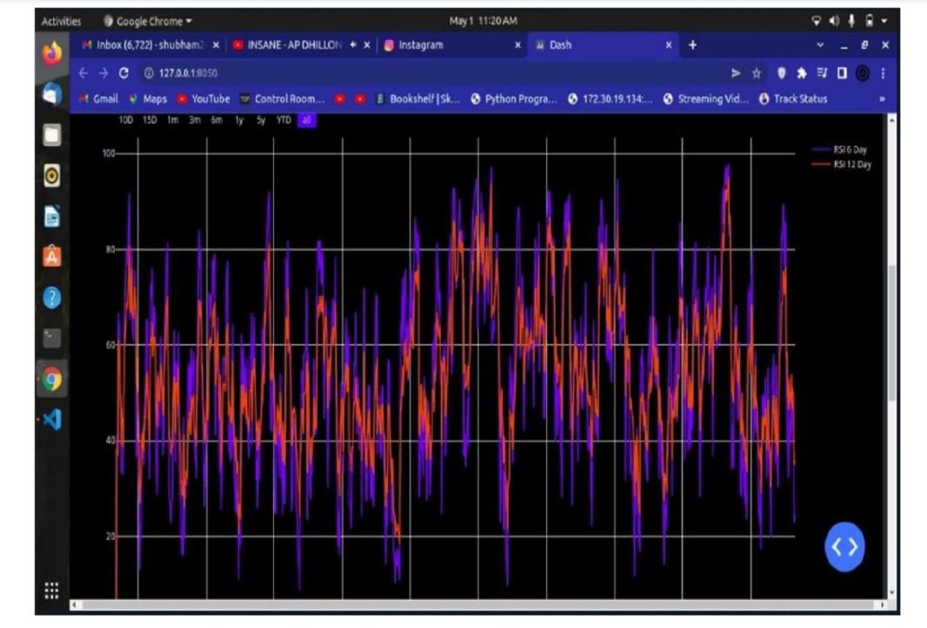
Output Screenshots

Slide 13
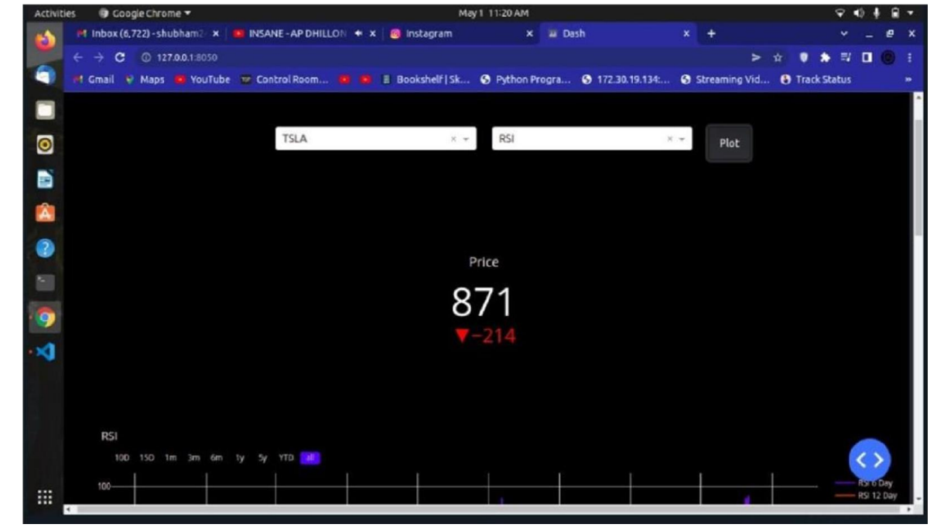

Slide 14
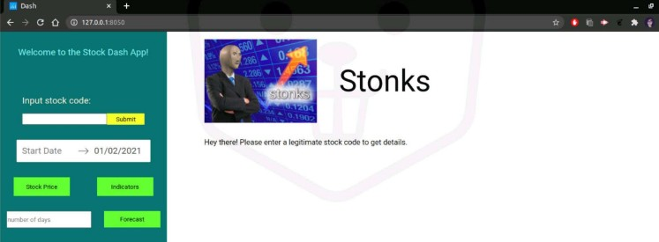

Slide 15
Results and Discussion:
The project is expected to provide users with a more comprehensive and real-time view of the stock market, enabling them to identify trends and patterns, compare the performance of different stocks, and generate reports and alerts to support their investment strategies. By providing users with more accurate and timely information, the project can help investors and traders make more informed investment decisions, resulting in better returns on their investments.

Slide 16
Conclusion
In conclusion, the project "Visualizing Stocks" aims to provide a powerful and user-friendly platform for analyzing and visualizing stock market data. By leveraging modern data visualization techniques and advanced analytics capabilities, the project can help investors and traders make more informed investment decisions, identify market trends and patterns, and automate some of the repetitive tasks associated with stock market analysis.
The microservices architecture and cloud-based infrastructure will make the system flexible, scalable, reliable, and cost-effective. Machine learning algorithms will be used to perform tasks such as anomaly detection, trend analysis, and sentiment analysis, while data visualization algorithms will enable users to explore the data in multiple dimensions.

