Slide 1

MUTUAL FUNDS PORTFOLIO AND PERFORMANCE ANALYSIS USING ML ALGORITHM
UNDER THE ESTEEMED GUIDANCE OF
DR. K. RAJAKUMAR
ASSOCIATE PROFESSOR
PRESENTED BY
Ruttala Divyavani (321107311062)
Mada Reena krupa (321107311020)

Slide 2
Abstract
Personal Portfolio Management: The system enables an individual to manage their mutual fund investments across multiple schemes.
NAV Prediction with Graphical Analysis: The application uses time series forecasting (e.g., ARIMA) to predict the Net Asset Value (NAV) of mutual fund schemes.
Interactive Dashboard: A web interface displays graphical data and investment actions, allowing users to interact with real-time data, view NAV charts, and execute transactions with ease.
Database-Driven System: It uses a backend database to manage user portfolios, transaction history, and scheme data, ensuring a structured and consistent investment record

Slide 3
Introduction
Purpose: The project aims to provide an intelligent platform for managing mutual fund investments by individual investors.
Functionality: It helps users monitor various mutual fund schemes, view NAV trends, and make informed decisions to buy, sell, or hold assets.
Predictive Insights: The system utilizes machine learning techniques (like ARIMA) to forecast future NAVs, enhancing decision-making accuracy.
User Interface: A dynamic web dashboard displays interactive graphs and portfolio details, supported by a structured backend database for transaction and fund data management.

Slide 4
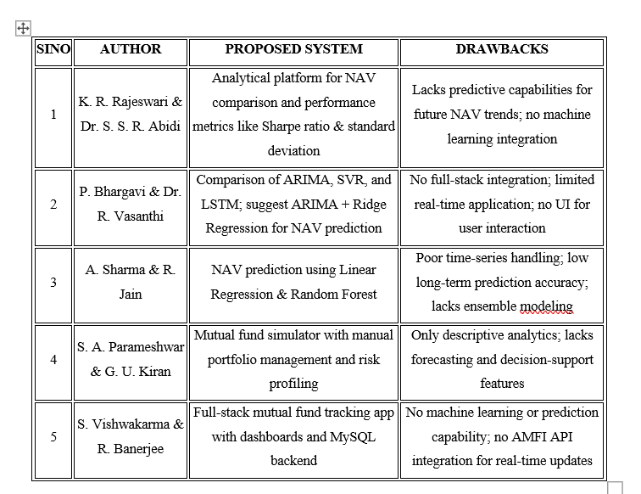
Literature review

Slide 5
Existing system
Limitations of current Approaches
No NAV Prediction:
Most platforms only show past NAVs without forecasting future trends, limiting informed decision-making.
Limited Portfolio Integration:
Users can’t track all investments in one place, especially if made through multiple platforms or offline.
No Manual Transaction Entry:
There’s no option to add custom or offline transactions, leading to an incomplete investment overview.
Lack of Visual Buy/Sell Tracking:
Existing tools don’t provide clear visuals for unit-wise buy/sell history, making it hard to analyze performance per transaction.

Slide 6
Proposed system
Advantages of Our Approaches
Smart Portfolio Management:
A web-based platform to manage mutual fund investments, track real-time NAVs, and perform buy/sell operations with complete transaction history.
Future NAV Prediction with ARIMA:
Uses ARIMA-based machine learning to forecast future NAVs, helping users make proactive and informed investment decisions.
Interactive Interface & Data Visualization:
Built with HTML, CSS, and JavaScript, the system offers intuitive graphs showing past and predicted NAV trends for better insight
Robust Backend & Secure Data Storage:
Python-powered backend and MySQL database ensure secure handling of user data, transactions, and dynamic portfolio calculations.

Slide 7
Problem statement
Managing mutual fund investments efficiently while making informed decisions based on future trends remains a challenge for many investors. There is a need for a user-friendly platform that not only helps track and manage mutual fund portfolios in real time but also provides intelligent predictions to support future investment planning. This project aims to develop a web-based Mutual Fund Portfolio Management System that simplifies fund tracking, transaction handling, and portfolio analysis, while integrating a machine learning-based NAV prediction feature using the ARIMA model to enhance decision-making for investors.

Slide 8
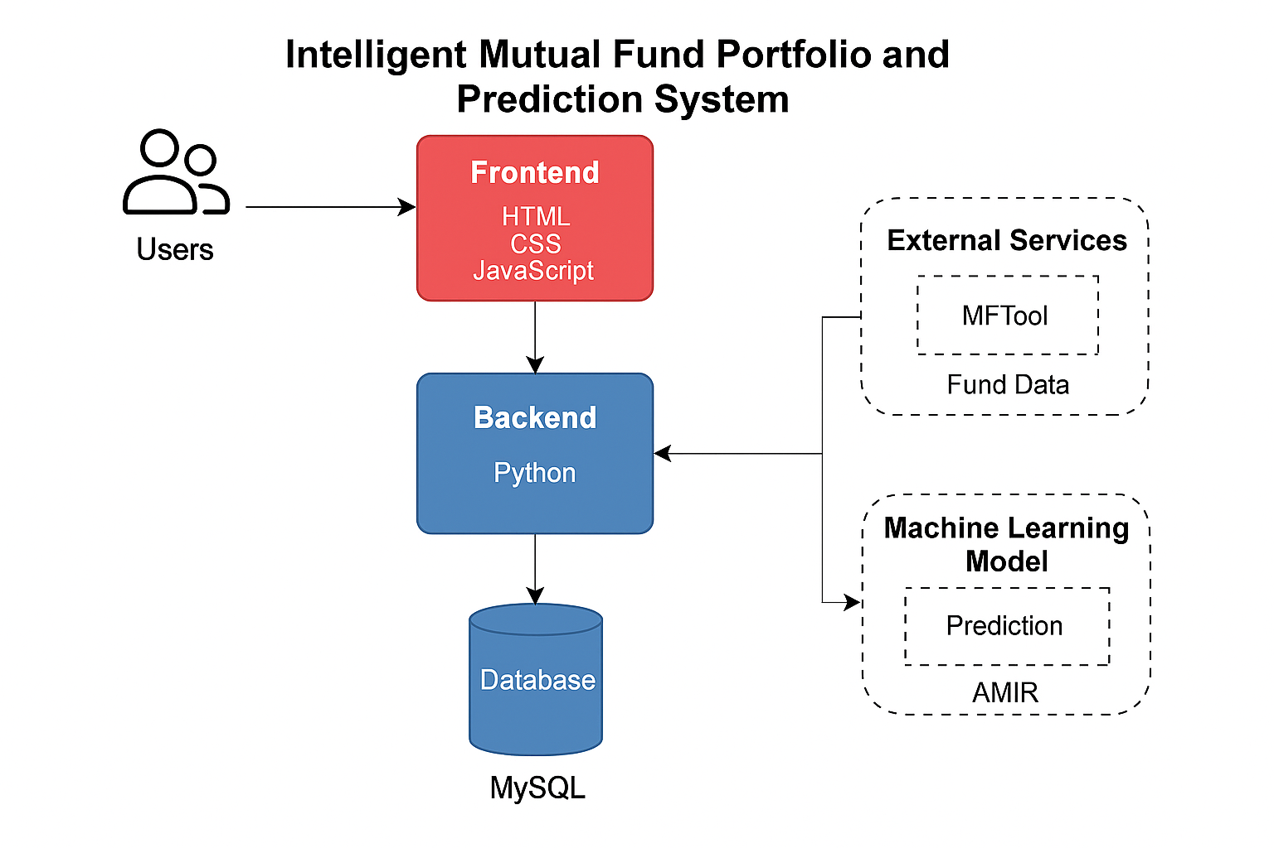
Architecture
General Architecture Workflow
User Interface (Frontend)Built with HTML, CSS, JavaScript: Allows users to interact with the system (add funds, view NAVs, make transactions)
Backend (Python + Flask):Handles business logic, data processing, and communicates with the ML model and database
Machine Learning Module (ARIMA + Ridge Regression):Predicts future NAVs using historical data
Database (MySQL):Stores user data, fund details, transactions, and NAV history

Slide 9
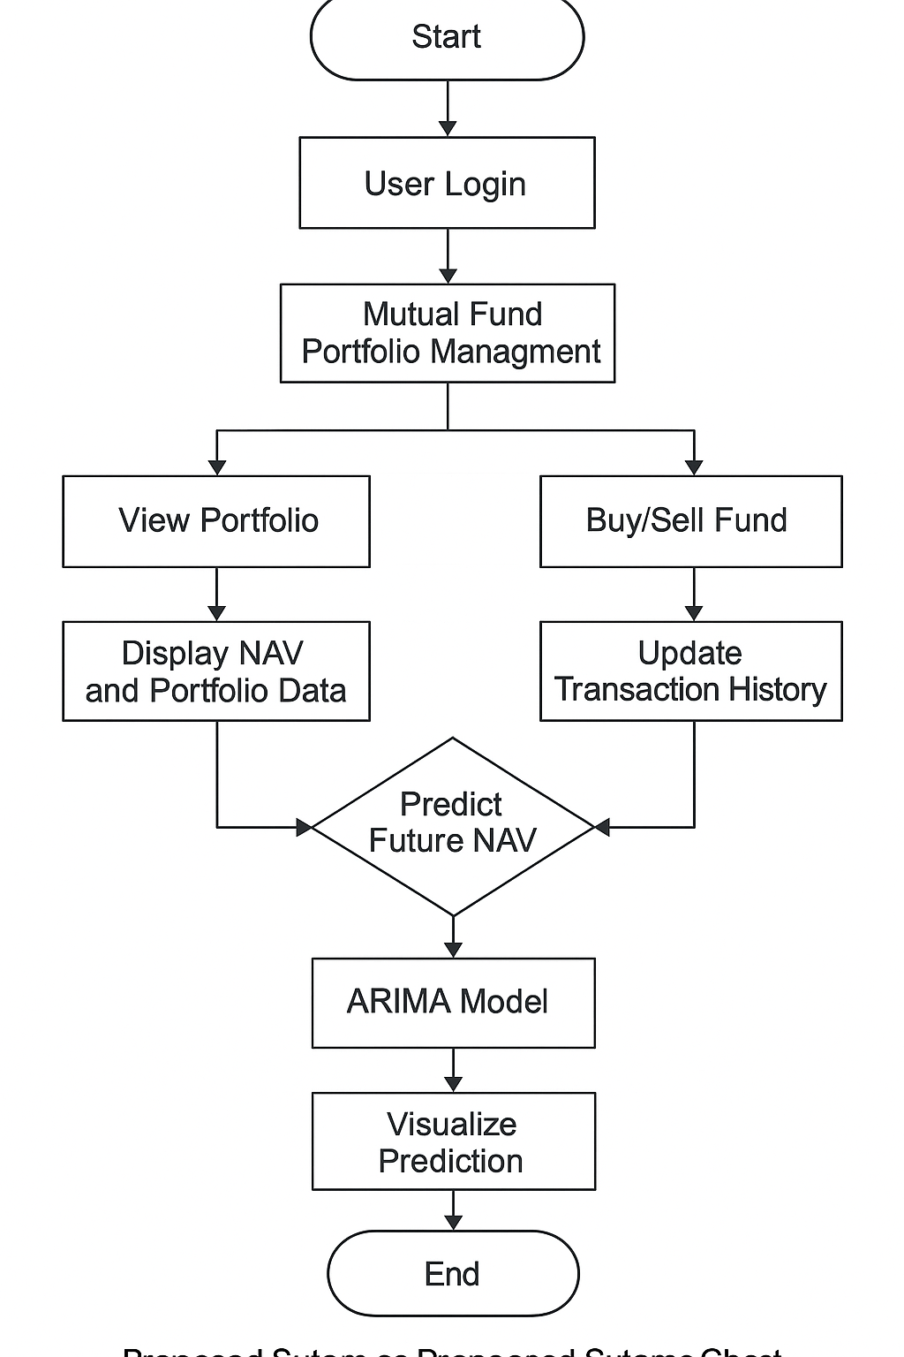
Workflow Workflow Diagram
Key Techniques
User Login & Action: User logs in and selects a mutual fund scheme.
Frontend Interaction: User performs actions like Buy/Sell, NAV prediction via a web interface (HTML/CSS/JS).
Backend Processing: Python Flask processes requests, handles logic, and communicates with the ML model or database.
Database Operations: MySQL stores/retrieves user details, transaction history, and NAV data.
ML Model Prediction: ARIMA model predicts future NAVs based on historical data.
Result Display: Predicted NAV and visual graphs are sent back to the frontend for user interpretation

Slide 10
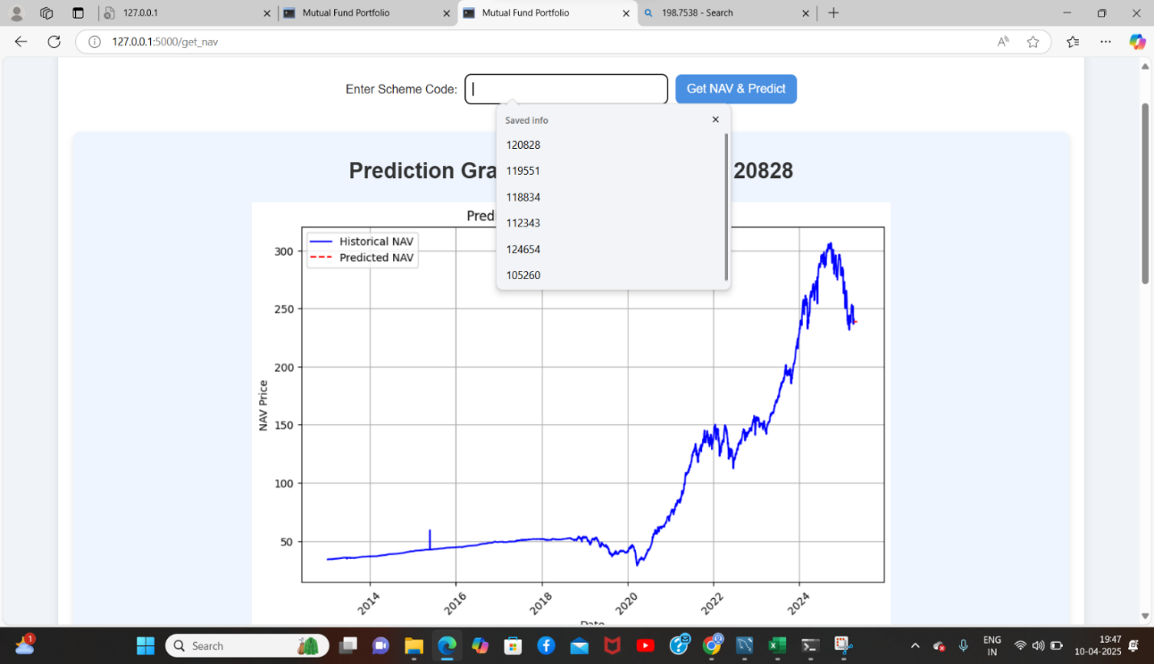
Enter scheme code

Slide 11
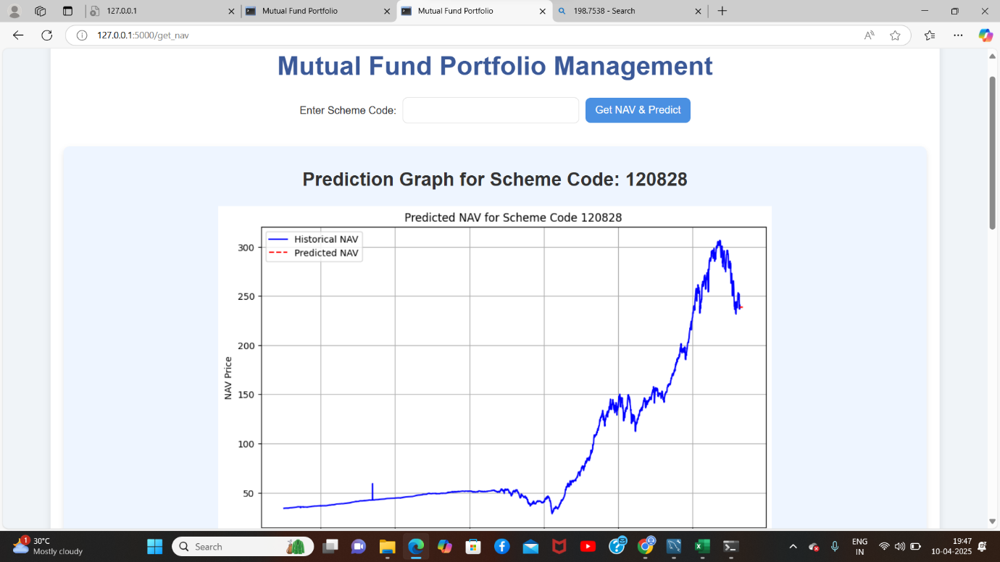
Prediction

Slide 12
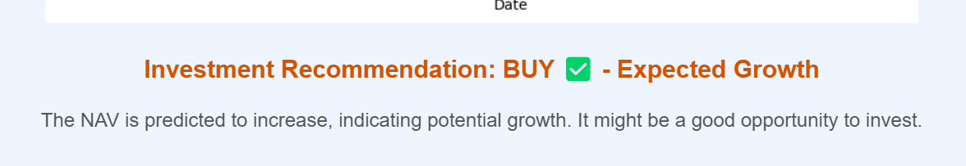

Slide 13
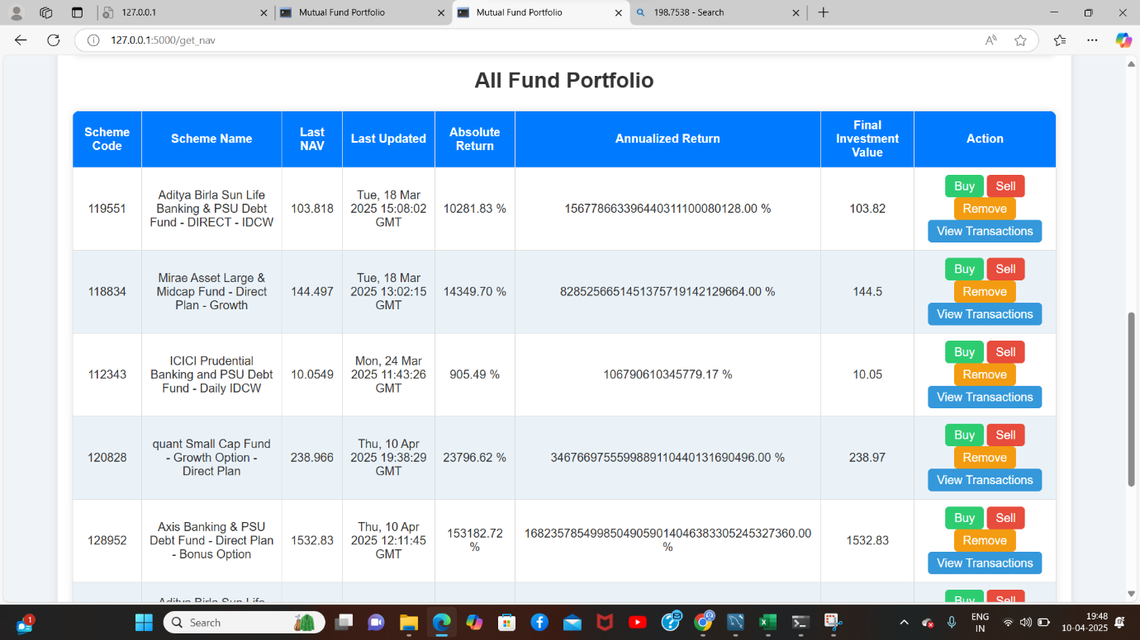

Slide 14
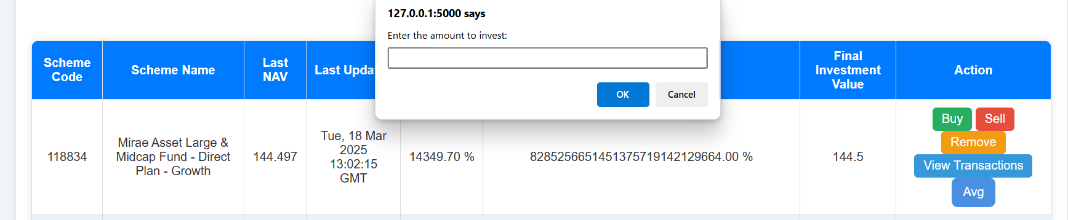
Buying fund

Slide 15
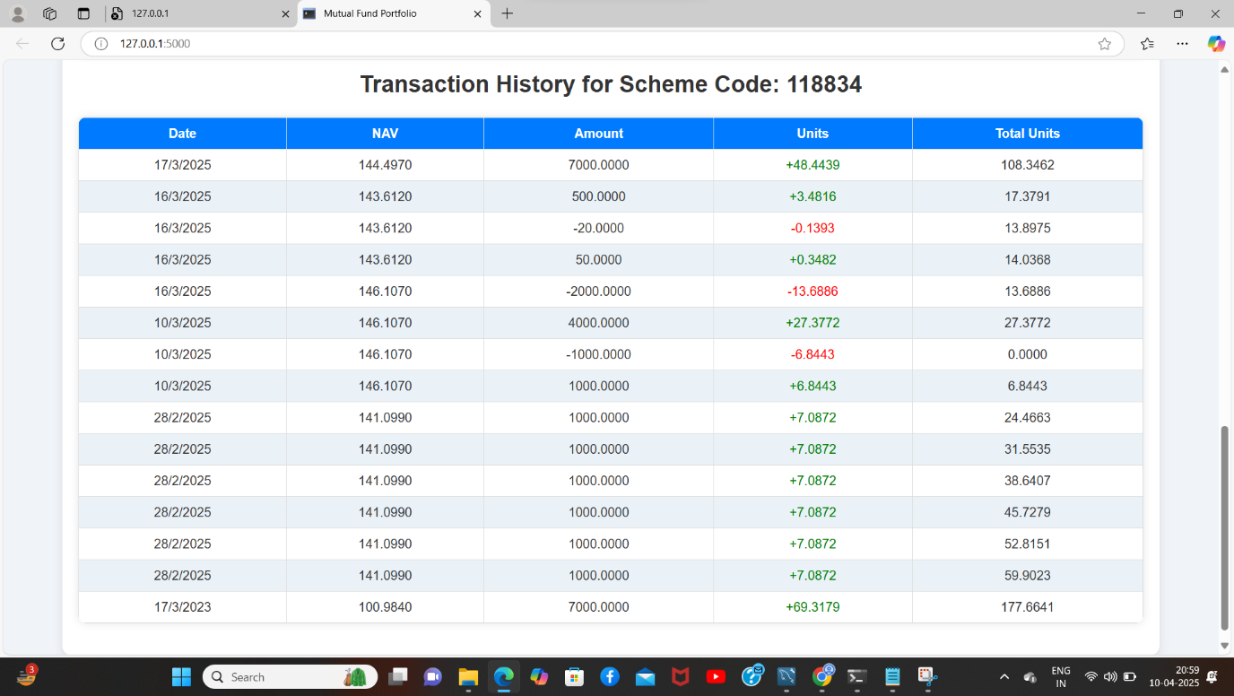
Viewing transaction history

Slide 16
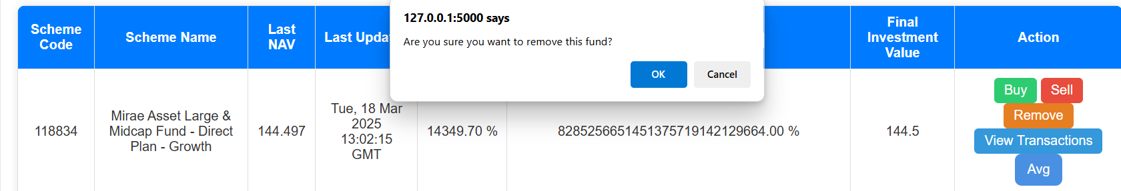
Removing fund

Slide 17
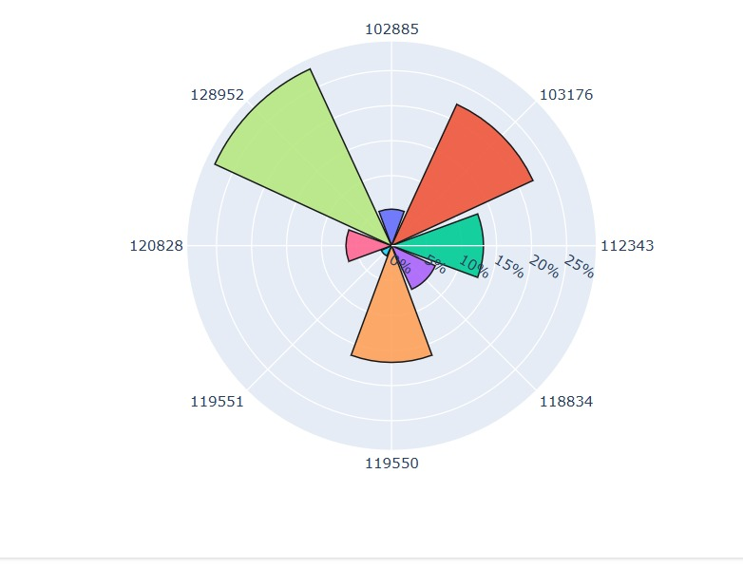
Average inverstment

Slide 18
RESULTS
Users can view, add, remove, buy, and sell mutual fund units with ease.
The ARIMA model successfully predicts future NAVs using historical data.
The system displays visual graphs for both past performance and forecasted trends.
Real-time NAV updates and transaction history are shown clearly in the dashboard
Transaction-based investment tracking improves transparency and financial insight

Slide 19
CONCLUSION
The system provides a centralized and intelligent platform for mutual fund portfolio management.
Integration of NAV prediction helps investors make data-driven and proactive decisions.
User-friendly design and clear visuals enhance usability and investment planning.
The combination of technology and finance delivers personalized and accurate insights.-

Slide 20
FUTURE SCOPE
Integrate additional ML models (e.g., LSTM, Prophet) for enhanced prediction accuracy.
Add SMS/email alerts for NAV thresholds or market movements.
Extend to support other asset types like stocks, ETFs, or SIP planning
Enable multi-user accounts with advisor-client modes for collaborative investment.
Incorporate APIs for direct fund transactions through AMFI or brokers.

Slide 21
Thank you

