Slide 1
2025
2025
CA Result Analysis May 2026 &
FAST CA CAMPUS
FAST CAREER CONSULTANTS P LTD.

Slide 2
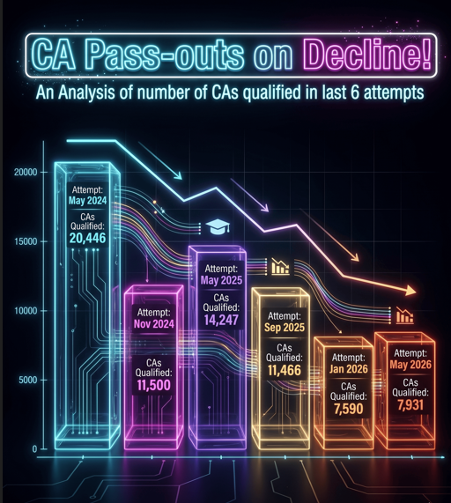
CA RESULTS May 2026
Significant Decline in CA Pass-Outs in May-Jan26

Slide 3
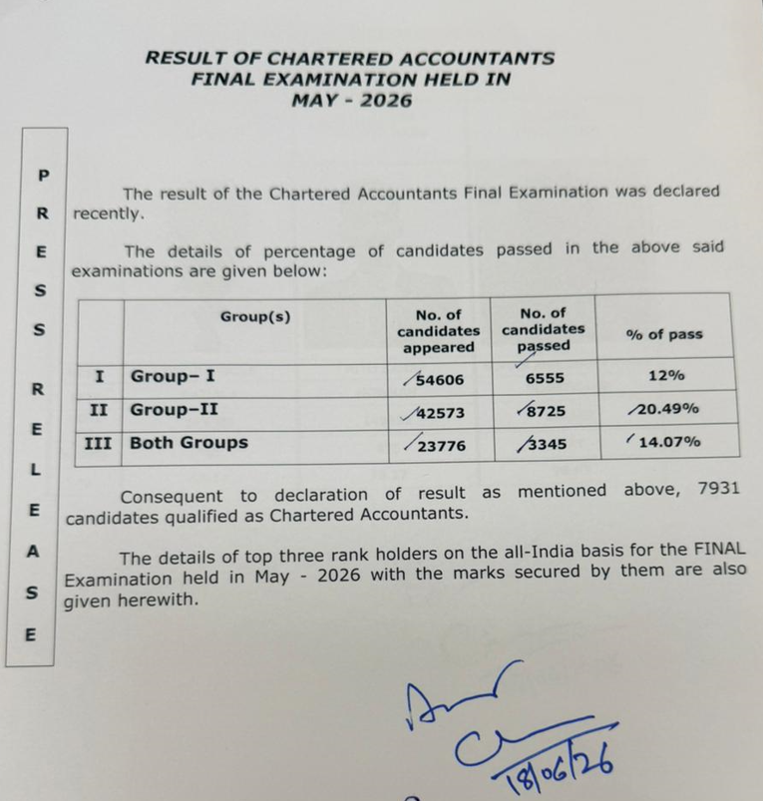

CA RESULTS May26
ICAI Press Release on Results
Announced on 18 June 2026

Slide 4
CA RESULTS May26
Decline in CA Pass-Outs continues 👇 … But There is Good News for Recruiters
Total Fresh CAs: 7,931
Similar to Jan26 exams which had 7590 pass-outs, but much lesser than historic pass-outs of 11466, 14247, 11,500 and 20446 in the previous 4 attempts
Lesser Drop-Outs Now!
High drop-out ratio was always the big worry with fresh CAs
Earlier — candidates could sit for the CA Final with up to 6 months of articleship still pending
Now (effective this result) — exams only after completing articleship & training
So every freshly qualified CA carries zero pending commitments
Immediately recruitable — ready to join from day one
Act fast. Recruit fast. Join FAST CA Campus!
Both Group Pass: 3,345 (14.07%)
Much better than previous attempt with only 2,446 (10.97%) both group pass-out %.

Slide 5
CA RESULTS May26
Both Group pass-out trend

Slide 6
CA RESULTS May26
Total CA pass-outs👇 trend

Slide 7
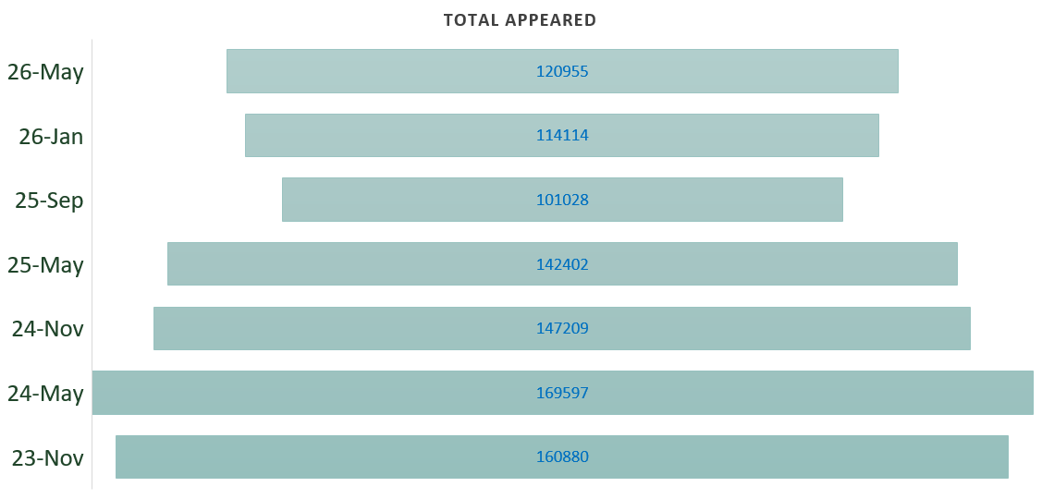
CA RESULTS May26
Total Candidates Appearing for Exams

Slide 8
Last two results gave only 7,500–8,000 CAs vs 11,500–15,000 earlier; ICAI shows more job openings than available CAs. Move early.
B. Exams now only post-articleship — this batch is ready
to join, no delays.
C. ICAI back to two exams a year; no fresh CAs till 2027.
Key Note

Slide 9
2025
2025
FAST CA CAMPUS
June 2026
FAST CAREER CONSULTANTS P LTD.

Slide 10
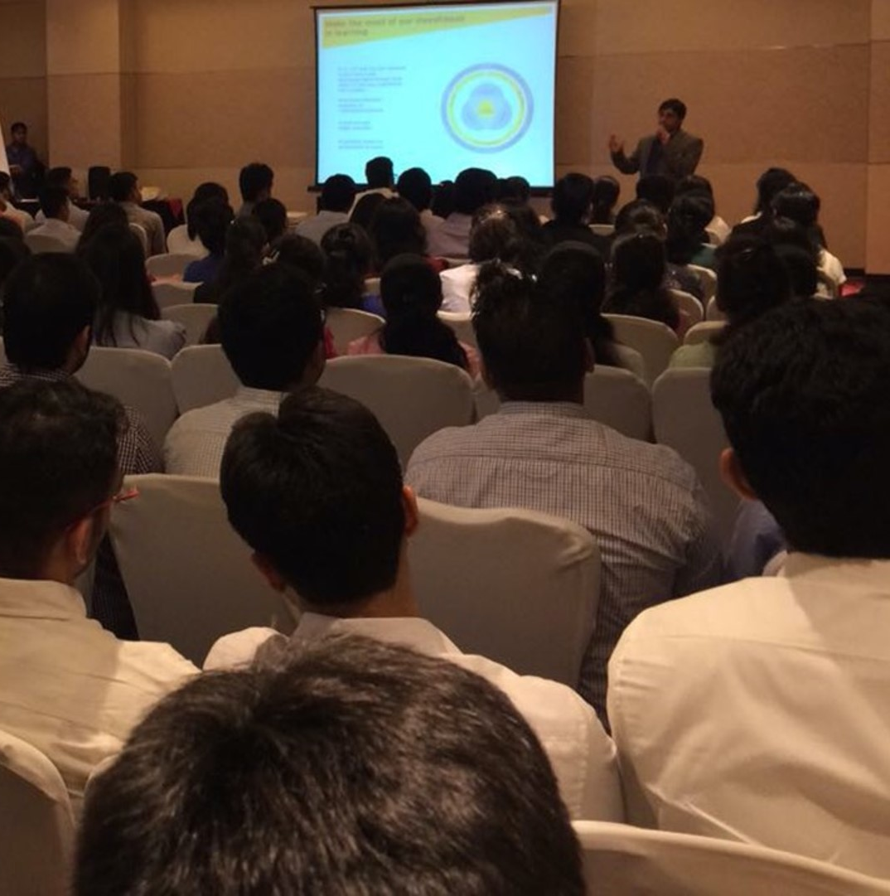
Invitation
FAST Careers
CA Campus
60+ corporates recruited freshly qualified CAs from FAST Careers.
4000+ CAs enroll for our Campus Recruitment drives every season.
Total Database of 160,000+ CAs

Slide 11

FAST CA VIRTUAL CAMPUS – June 2026
One Day | One Company | Daily Campus | First cum - First Serve
India’s First - Virtual CA Campus Drive - Starts 30 June
Conducted Online on Zoom / MS Teams
One Company
-
One
Date
Participated by All India CAs
Recruit First . Recruit with FAST Careers!
Slots on first cum first serve basis | No fixed or upfront costs | Platform – Zoom / MS Teams as per company choice

Slide 12


FAST CA CAMPUS – July 2026
One Day | One Venue | Tons of Participants | Multiple Recruiting Companies
Delhi
Mumbai
07 July 2026
10 July 2026
CAs expected to register
1500+
CAs expected to register
1500+
Slots on first cum first serve basis | No fixed or upfront costs | Organized at a premium hotel business centre

Slide 13
FAST CA CAMPUS
How it Works for Recruiting Companies!
Give us a Mail Confirmation to Participate by filling a prescribed form
&
Share the Job Description
We enlist you as a participating corporate on our portal www.fast-india.com
Candidates Apply Online on the Portal
&
are then screened by our HR Recruiters over a call
Resumes & XL List of Applicants meeting criteria specified is shared with the corporates
Companies Shortlist (unless want to meet all candidates) and Shortlisted applicants are called for the process on the Campus Day
FAST CA Campus are open for all CAs across India for participation and no fees is charged from candidates for participating or on joining the company

Slide 14

FAST CAREERS - CA CAMPUS
Features & Advantages
All India CAs
Date
Unlike other Campus, FAST Careers offers you to recruit from pool of 6000+ CA freshers from across locations
Virtual Campus - As per you choice
Physical Campus – See next slide
Rankers
Costs
All Top 50 AIRs
are expected to participate
No Fixed / No Up-front Fees. Only Variable Fee, customized to meet large or small CA requirements
Shortlist
Participating Companies will get candidate Profiles & all details in XL for pre-drive shortlisting
Physical & Virtual
Campus organized virtually as well as physically. Join any
www.fast-india.com
Candidates apply on our ERP based portal which attracts freshly qualified CAs more than that in any other job portal
Post Offer Follow-ups
Our model rewards us only on candidate joining the company, hence we have equal stakes involved to ensure conversions

Slide 15
2025
2025
FAST CA Campus
compared with
ICAI Campus?
FAST CAREER CONSULTANTS P LTD.

Slide 16

Comparative of CA Campus by ICAI & FAST Careers
ICAI CAMPUS
Physical Mode Only
Candidates divided across Campus. To access all candidates Recruiter to participate separately in various city campuses
Fixed Costs Model. Pay to participate, irrespective of candidate joining
All CAs access and participate
Company to do an excel shortlisting and manage candidates post offers
FAST Careers CA CAMPUS
Options to recruit in Physical mode or Virtual mode. Physical Campus currently only in Mumbai & Delhi
All candidates can apply to company of their wish with no city wise division made. Truly Recruiter gets chance to recruit from All India Pool in one go!
Charges - Pay only if candidate joins. No fixed charges. No venue charges. No upfront fees. No minimum commitments. No conditions attached.
All CAs can access, no fees from candidates, usually 40% to 50-60% of newly qualified CAs participate
FAST Careers provides excel database for shortlisting after initial on call screening. We also do post offer follow up for better conversions

Slide 17
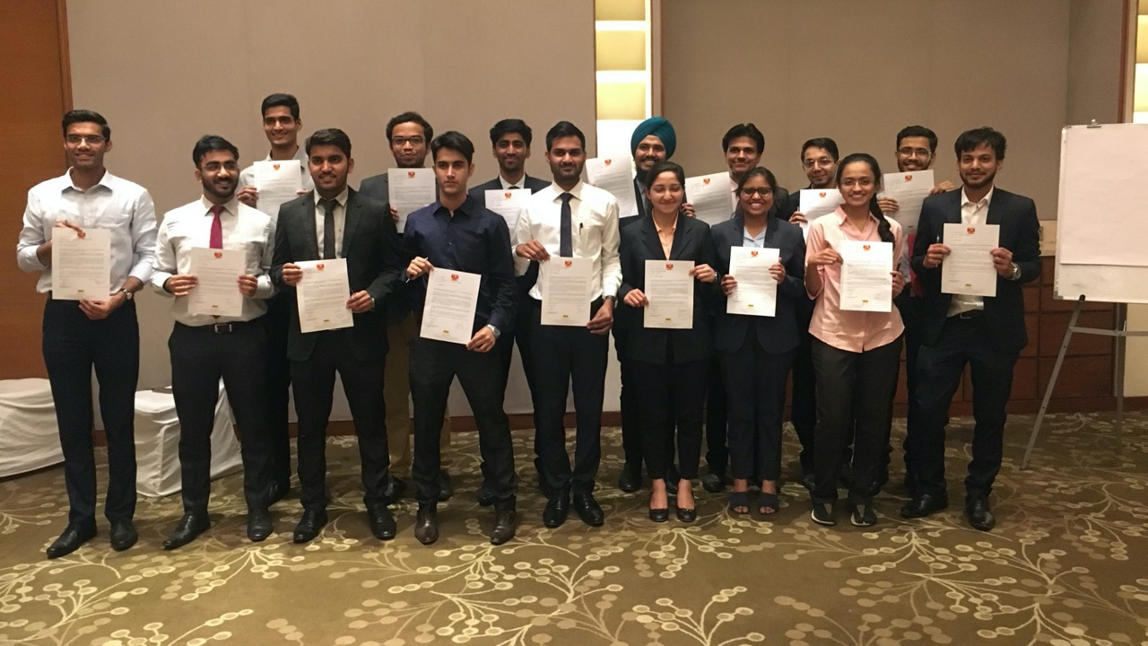
Looking to Recruit Only CA Rankers!
Contact us to know about
FAST All India CA Ranker Campus, 2026

Slide 18

Feel free to ask us
We will be gLAd to assist
Sarthak Ritesh
9826023534 9329882834
sarthak@fast-india.com ritesh@fast-india.com
Executed with Passion
Cost
Effective
Strategicaly
Advanced
Well
Planned
Honest
18

