Slide 1
LAB EVALUATION

Slide 2

PROJECT NAME
THE GAME OF CHANCE

Slide 3
TEAM MEMBERS
Divyayush Verma roll no:2210990299
Divyanoor Singh Saini roll no:2210990297
Gagandeep roll no:2210990312

Slide 4
WHAT IS GAME OF CHANCE?
It is a game which requires 2 players.(here the second player will be the computer)
You don’t need any skills to play this game.
The player who scores more runs wins the game.

Slide 5
BASIC IDEA OF THE GAME what information will we get from the code
Call for the toss-Odd or Even
Number for the toss-(any number)
If the number selected by player and computer is of same type(odd or even) as selected by the player, player wins the toss else the computer wins the toss.
Decision of either the player wants to bat or bowl first. Decision of the computer will be auto-generated randomly.
According to the decision, the player has to bat/bowl 6 balls.
If player and computer enter the same number, the batting side will be dismissed.
The one between the computer and the player to score more runs wins the game.

Slide 6
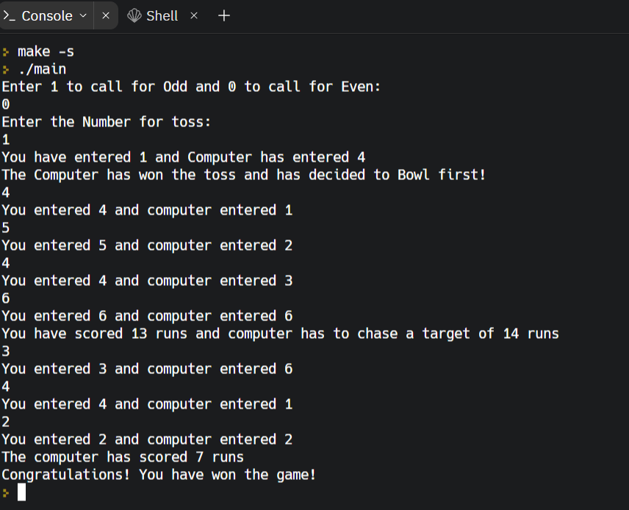
WORKING OF THE CODE:

