Slide 1
01
BEE MONITORING
Automated detection, tracking and desktop visualization
Final Project Presentation
Group 13 | 2 September 2026
VIDEO
DETECTION
TRACKING
INSIGHTS
Part 1: establish the pipeline • Part 2: expand data and improve robustness

Slide 2
P13: Building a Bee Monitoring Pipeline for Environmental Observation
Group Members:
Rohit Rathod(s09rrath)
Aniket Limbani(s17alimb)
Divyesh Kanani(s54dkana)
Prince Bambhroliya(s57pbamb)
Supervisor:
Lennart Reißner

Slide 3
Why automate bee monitoring?
02
The problem our system is designed to address
Long observations
Multiple classes
Continuous change
25 min
5 classes
time
A 25-minute video can contain thousands of frames. Manual inspection does not scale.
The dataset distinguishes five insect classes rather than treating every object as simply 'insect'.
Insects move, overlap and disappear. Monitoring therefore needs temporal information, not only single-frame detections.
Core question
How can raw video be converted into reliable, interpretable monitoring information?
Bee Monitoring • Group 13 • Final presentation • 2 September 2026

Slide 4
What the complete project delivers
03
A system, not only a trained detector
1 Detect
2 Track
3 Measure
4 Visualize
Locate + classify insects
Associate detections over time
Generate monitoring statistics
Present results in desktop UI
The final system should start with a video and finish with interpretable monitoring information.
Project status
Tracking and desktop visualization are the main focus now. Dataset creation is paused and planned for Part 2.
Bee Monitoring • Group 13 • Final presentation • 2 September 2026

Slide 5
System architecture
04
How the components connect
Video
→
Frame
processing
→
YOLO
Detection
→
Tracker
→
Statistics
→
Desktop
Visualization
Each stage produces information consumed by the next stage.
Input
Core AI
User output
Long-form video from the monitoring setup.
Object detection + temporal association.
Annotated video + statistics + desktop interface.
Bee Monitoring • Group 13 • Final presentation • 2 September 2026

Slide 6
Dataset at a glance
05
Current BuzzSetV2 preparation used for model development
Total images
8,492
8,492 images across the three splits.
Classes
5
bee • bumblebee • hoverfly • other_insect • moth
Annotations
14,961
10,930 train + 1,095 valid + 2,936 test
Image split: 63.6% train • 11.0% valid • 25.4% test
Bee Monitoring • Group 13 • Final presentation • 2 September 2026

Slide 7
Annotation distribution
06
Ground-truth instances available for evaluation
Train density
2.02
≈2.02 annotations / image
Validation density
1.17
≈1.17 annotations / image
Test density
1.36
≈1.36 annotations / image
Bee Monitoring • Group 13 • Final presentation • 2 September 2026

Slide 8
From COCO annotations to YOLO training data
07
A reproducible preparation step
Source
Conversion
Output
COCO JSON
images + bounding boxes + class IDs
→
Coordinate normalization
class-ID remapping
→
YOLO TXT
1 label per object
5,401 + 936 + 2,155
= 8,492 images converted
Bee Monitoring • Group 13 • Final presentation • 2 September 2026

Slide 9
Object detection model
08
YOLO11n experiment used in the current project work
Model
Parameters
Input size
Training
YOLO11x
5.6 M
640 × 640
50 epochs
Training configuration
• Tesla T4 GPU
• Batch size: 16
• Pretrained weights transferred: 448 / 499 items
• Optimizer: AdamW (auto-selected)
• Five detection classes
Bee Monitoring • Group 13 • Final presentation • 2 September 2026

Slide 10
Detection performance
09
Best checkpoint from the YOLO11n experiment
Best epoch
39
Precision
51.22%
Recall
30.67%
mAP50-95
19.78%
Bee Monitoring • Group 13 • Final presentation • 2 September 2026

Slide 11
Final epoch vs best checkpoint
10
Why we keep the best model, not simply the last one
Best checkpoint
Epoch 39 produced the strongest mAP50 and mAP50-95.
Recall remains low
≈31% means many ground-truth objects are still missed.
Implication
Detection improvement is important before relying on tracking statistics.
Bee Monitoring • Group 13 • Final presentation • 2 September 2026

Slide 12
How we evaluate a detector
11
Metrics used in the project
Precision
Recall
mAP@50
mAP@50–95
TP / (TP + FP)
TP / (TP + FN)
mAP50
mAP50-95
Of all predicted objects, how many are correct?
High precision → fewer false positives.
Of all real objects, how many did we find?
High recall → fewer missed objects.
Average precision using IoU ≥ 0.50 as the matching threshold.
Stricter summary averaged over IoU thresholds 0.50–0.95.
Why recall matters for monitoring
A missed insect can disappear from the downstream tracking stage. Improving recall therefore supports more complete tracking and statistics.
Bee Monitoring • Group 13 • Final presentation • 2 September 2026

Slide 13
Real-video inference
12
Testing the detector on an actual video stream
Input
Inference
Output
RIM_00006.mp4
YOLO detection applied frame-by-frame
Annotated video generated for inspection
Observed workflow
video → detection → annotated video → visual inspection
This connects benchmark metrics with real continuous footage.
Bee Monitoring • Group 13 • Final presentation • 2 September 2026

Slide 14
Tracking: the next major layer
13
Turning detections into persistent identities
ID 7
→
ID 7
→
ID 7
→
ID 7
t0
t1
t2
t3
Tracking output can support
Track duration
Unique IDs
Movement
Entry / exit
Bee Monitoring • Group 13 • Final presentation • 2 September 2026

Slide 15
Monitoring statistics
14
What becomes possible once tracking is stable
Count over time
Number of active tracks per interval.
Class distribution
Relative activity by insect class.
Track duration
How long tracked insects remain visible.
Later
Illustrative values — not measured project results.
Exportable tables / reports.
Bee Monitoring • Group 13 • Final presentation • 2 September 2026

Slide 16
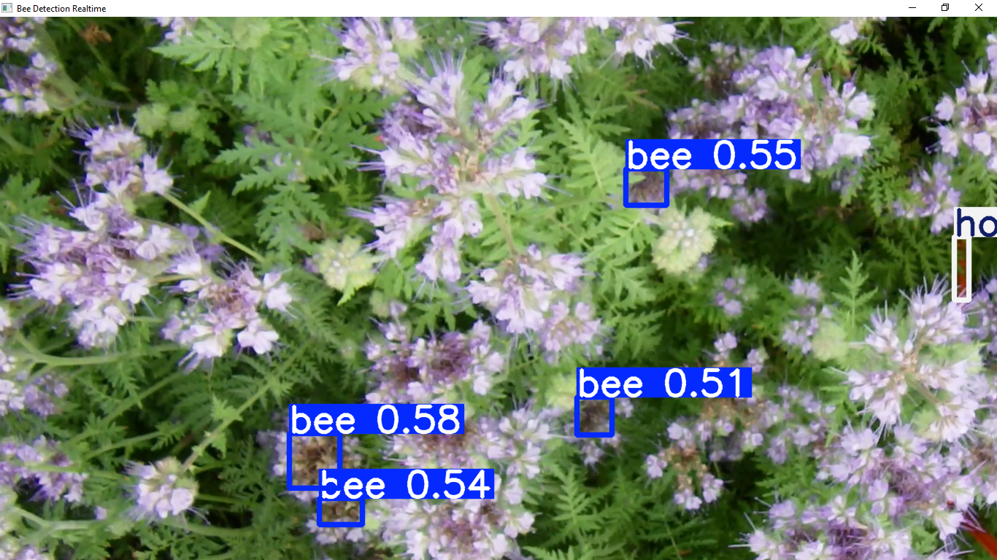
Desktop visualization
15
The final user-facing component
Active tracks
Bee count
bee 0.78
bee 0.78
—
—
bee 0.78
Activity graph
Live time-series panel
Class summary
Bee / bumblebee / hoverfly / other / moth
VIDEO + BOUNDING BOXES + TRACK IDs
Final numbers populate after tracking is finalized.
Bee Monitoring • Group 13 • Final presentation • 2 September 2026

Slide 17
Where we are now
16
Completed, active and deferred work
Work package
Status
Evidence / next output
Dataset preparation
Completed / paused
8,492 images; 14,961 annotations
COCO → YOLO conversion
Completed
5,401 / 936 / 2,155 converted
YOLO11n experiment
Completed
Best epoch 39; mAP50 0.3382
Real-video inference
Completed
Annotated output video generated
Tracking
In progress
Persistent IDs + track statistics
Desktop visualization
In progress
Video + statistics dashboard
Dataset expansion
Deferred
Planned for Part 2
Bee Monitoring • Group 13 • Final presentation • 2 September 2026

Slide 18
Current limitations
17
What the results tell us — and what they do not
Recall
mAP50
mAP50-95
30.67%
33.82%
19.78%
Many ground-truth objects are still missed.
Substantial room for detection improvement.
Stricter localization remains challenging.
• Small objects and motion blur are difficult cases.
• Occlusion can cause missed detections and unstable tracks.
• Tracking quality depends directly on detection quality.
• More diverse data and difficult examples are planned for Part 2.
Bee Monitoring • Group 13 • Final presentation • 2 September 2026

Slide 19
Part 2 roadmap
18
What we will improve after the current system is established
01
02
03
04
Expand dataset
More videos + difficult cases
Improve detector
Recall + localization
Strengthen tracking
Occlusion + ID stability
Refine analytics
Better monitoring statistics
Target outcome
A more robust end-to-end monitoring system that works reliably on long, real-world videos.
Bee Monitoring • Group 13 • Final presentation • 2 September 2026

Slide 20
Final demonstration
19
The most important slide: show the system working
Show
Detection boxes + class labels
INSERT FINAL TRACKING VIDEO HERE
Then show
Persistent track IDs
detections • IDs • movement • live statistics
Finish with
Statistics + desktop UI
Bee Monitoring • Group 13 • Final presentation • 2 September 2026

Slide 21
Conclusion
20
From raw video toward automated ecological monitoring
8,492 images → 5 classes → detection → tracking → statistics → visualization
Current evidence
A complete detection workflow and real-video inference are established.
Next milestone
Finish tracking + desktop visualization and integrate them into the final demo.
Thank you — Questions?
Bee Monitoring • Group 13 • Final presentation • 2 September 2026

