Slide 1
VEHICLE OWNER INFORMATION USING NUMBER PLATE
Shweta Melavane (2017220071)
Divyesh Marne(2017220070)

Slide 2
Contents:
Problem Statement
Objectives
Proposed Solution
Methodology
Results
References

Slide 3
Problem Statement:
It is hard to identify vehicle owner who brakes traffic rules & regulations and drives too fast.
Monitoring vehicles on the road is an ever present and persistent problem.
Breaking traffic rules by citizens to reach their required destination faster is increased.
Therefore, it is necessary to develop a Number Plate Detection system as one of the solutions to this problem.
Notes:
It is not always feasible to arrest and punish those people because the traffic police might not be able to read the vehicle plate number from the moving vehicle because of the speed of vehicle.

Slide 4
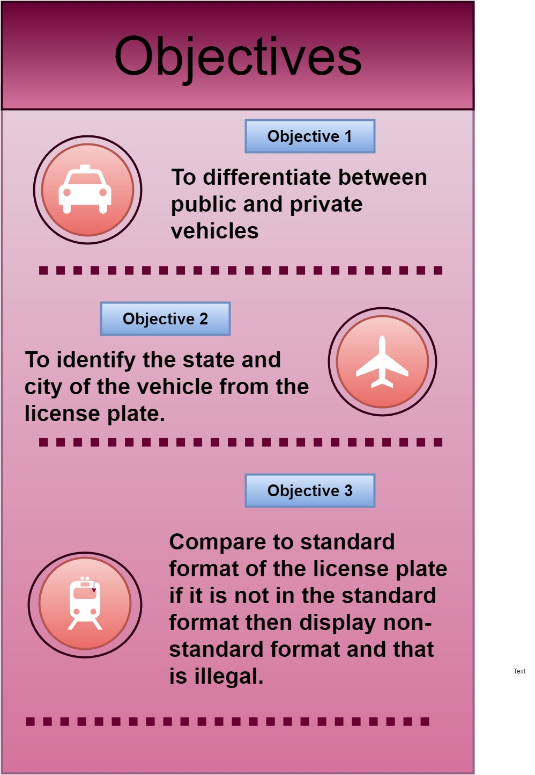
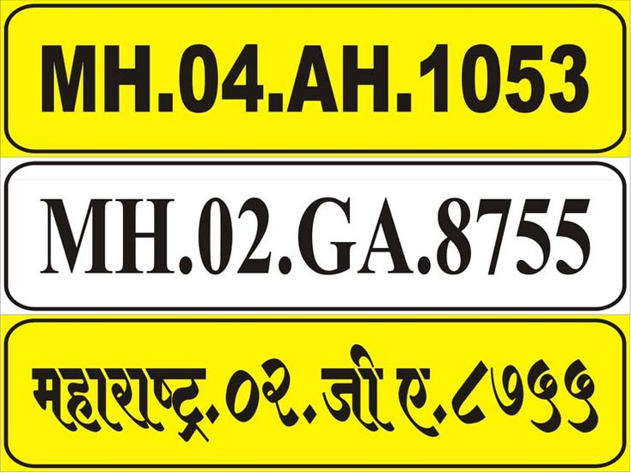
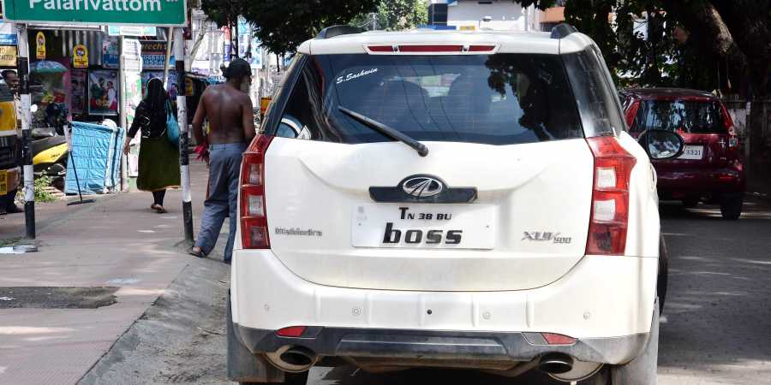

Slide 5
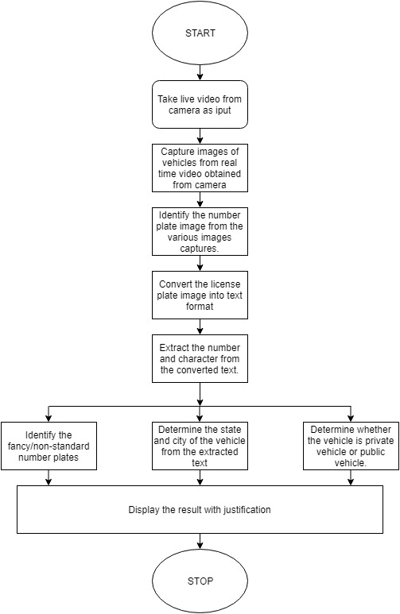
Proposed Solution:

Slide 7
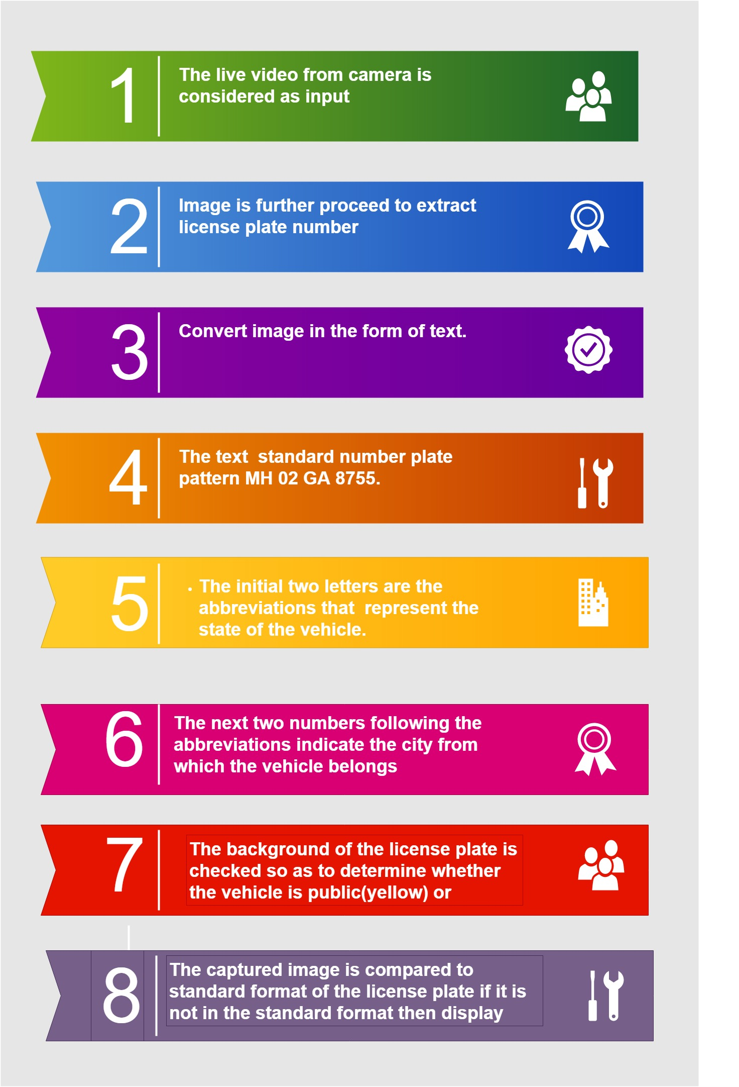
Methodology:

Slide 8
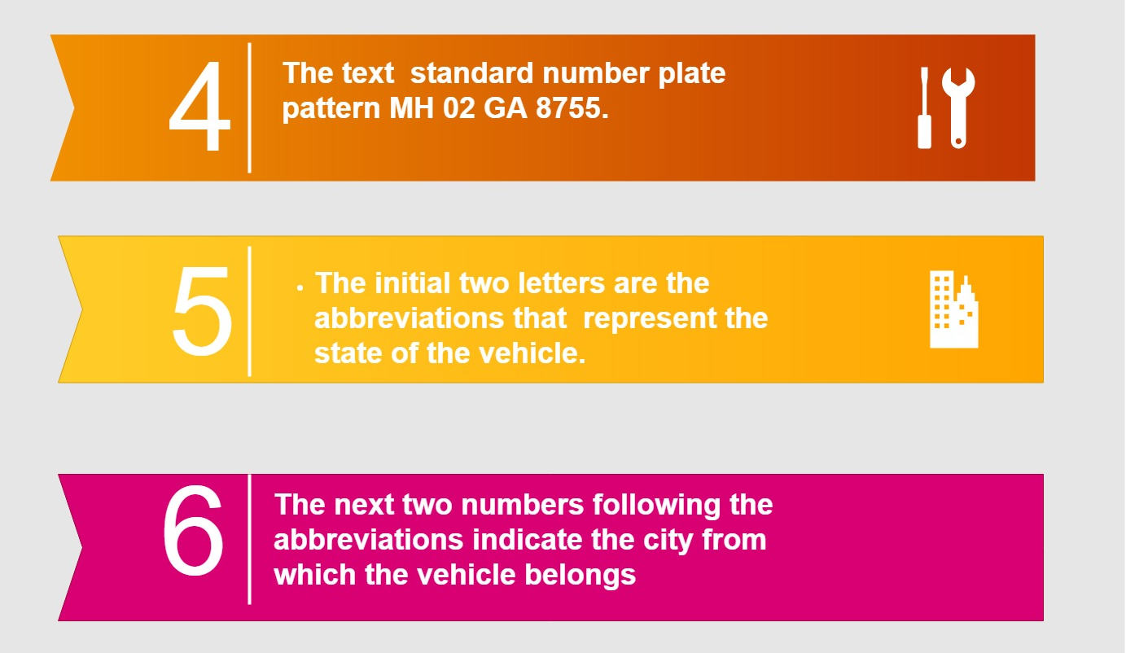

Slide 10
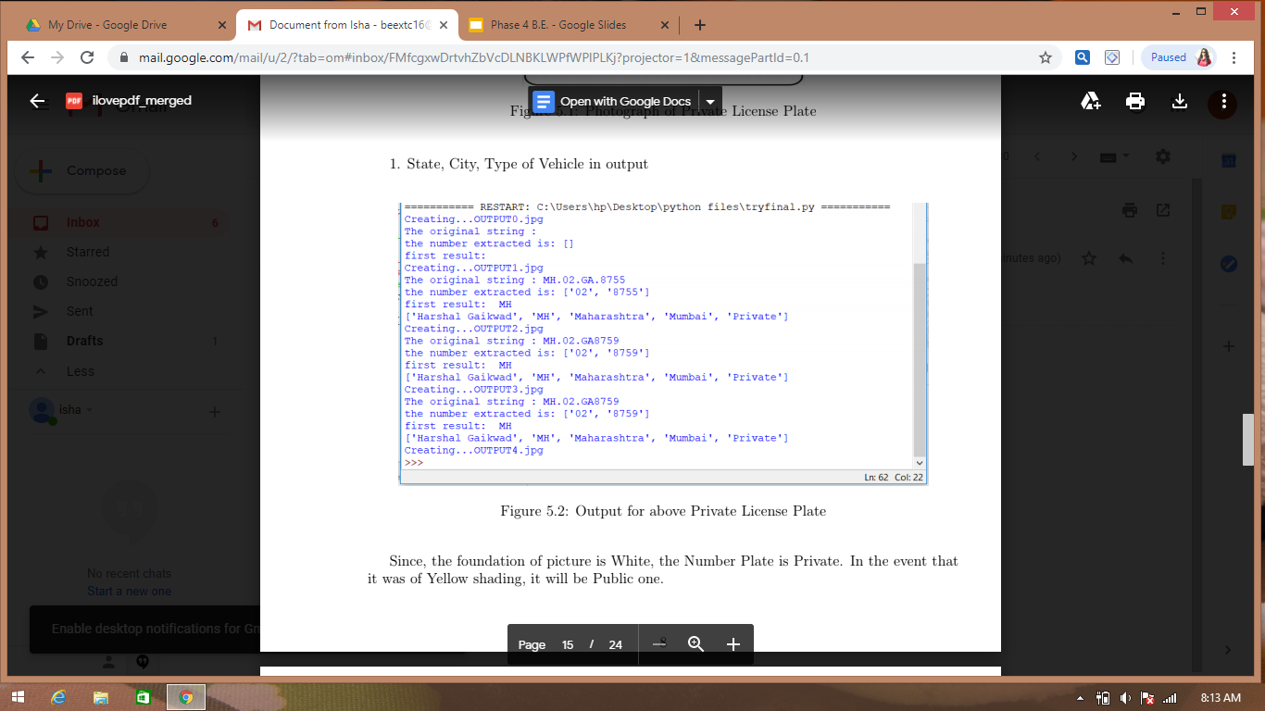
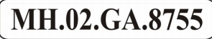
Results:
Fig 1: State, city and type of vehicle

Slide 11
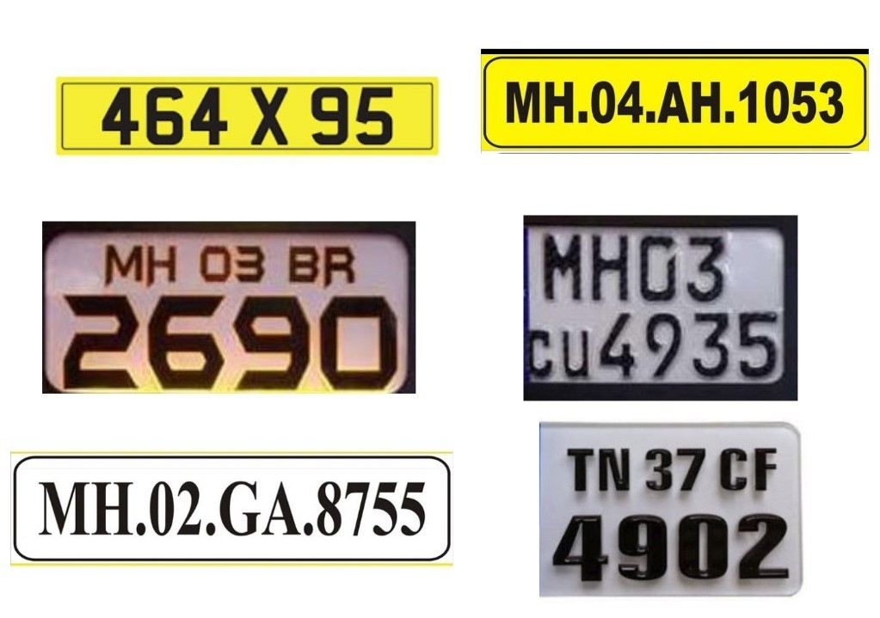
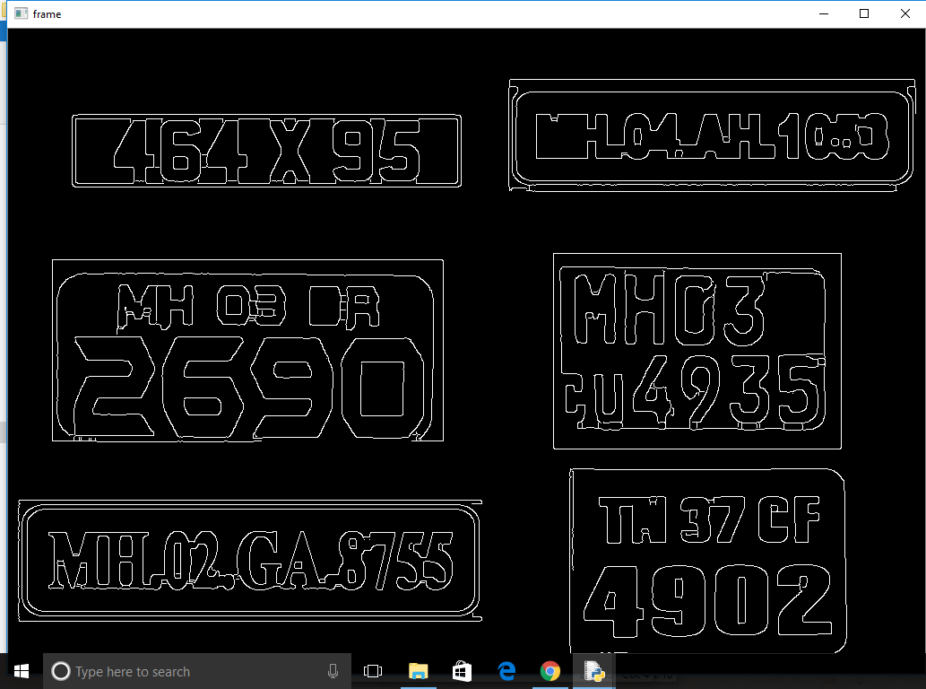
Fig 2: Edge Detection Output

Slide 12
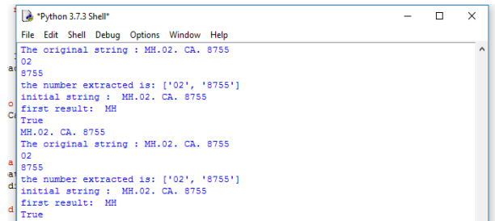
Fig 3: Detection of standard

Slide 13
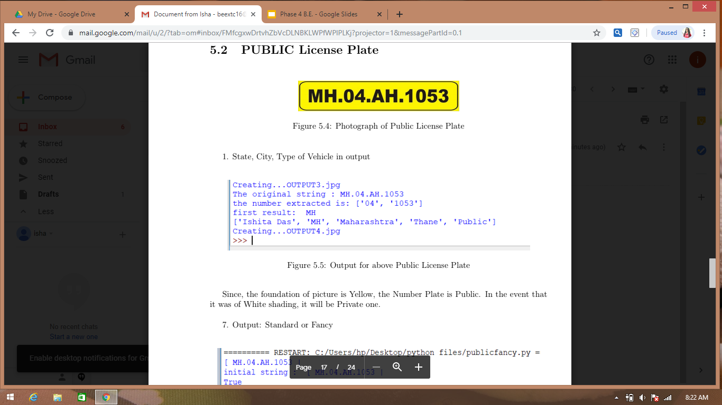
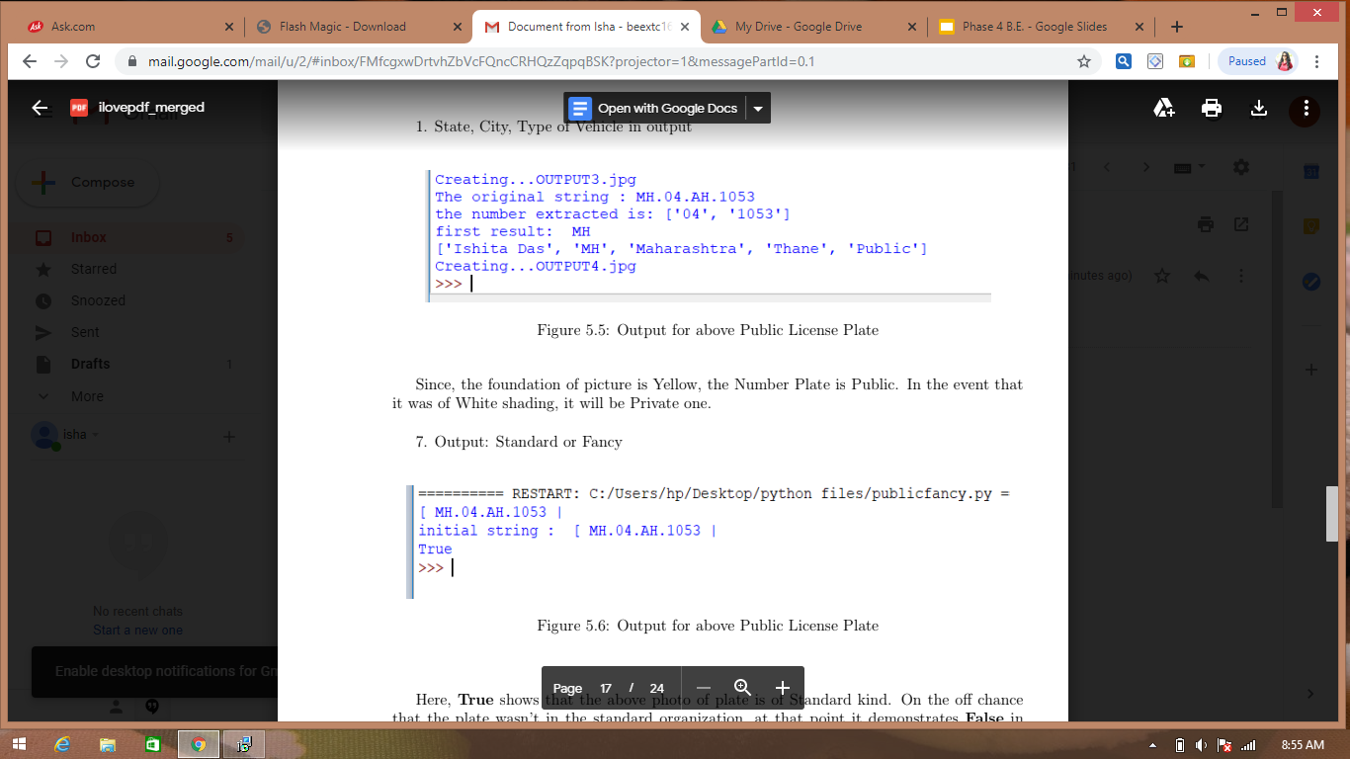
Fig 4: State,city and type of vehicle
Fig 5: Detection of standard

Slide 14
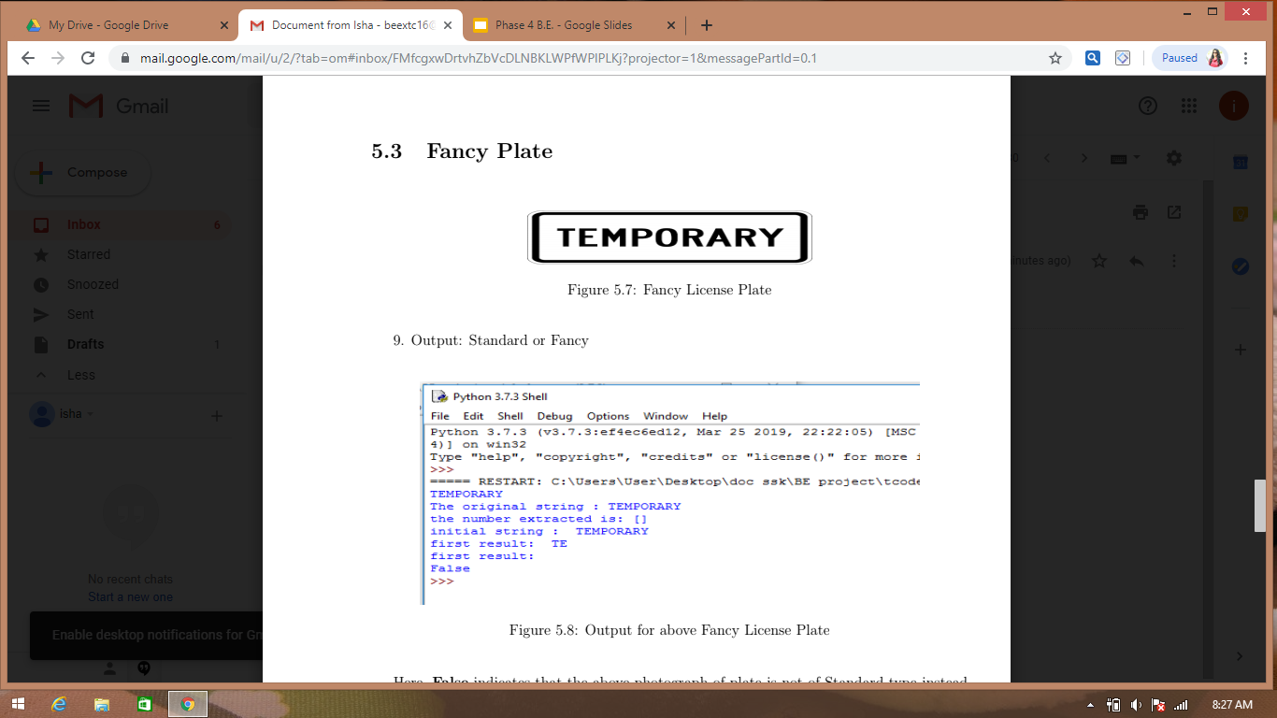
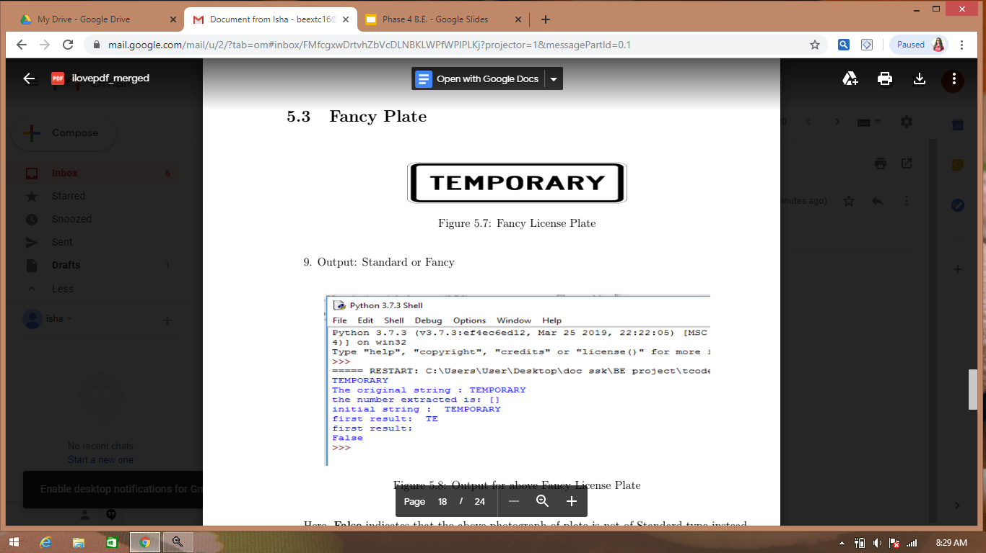
Fig 6: Output of whether standard or fancy plate

Slide 15

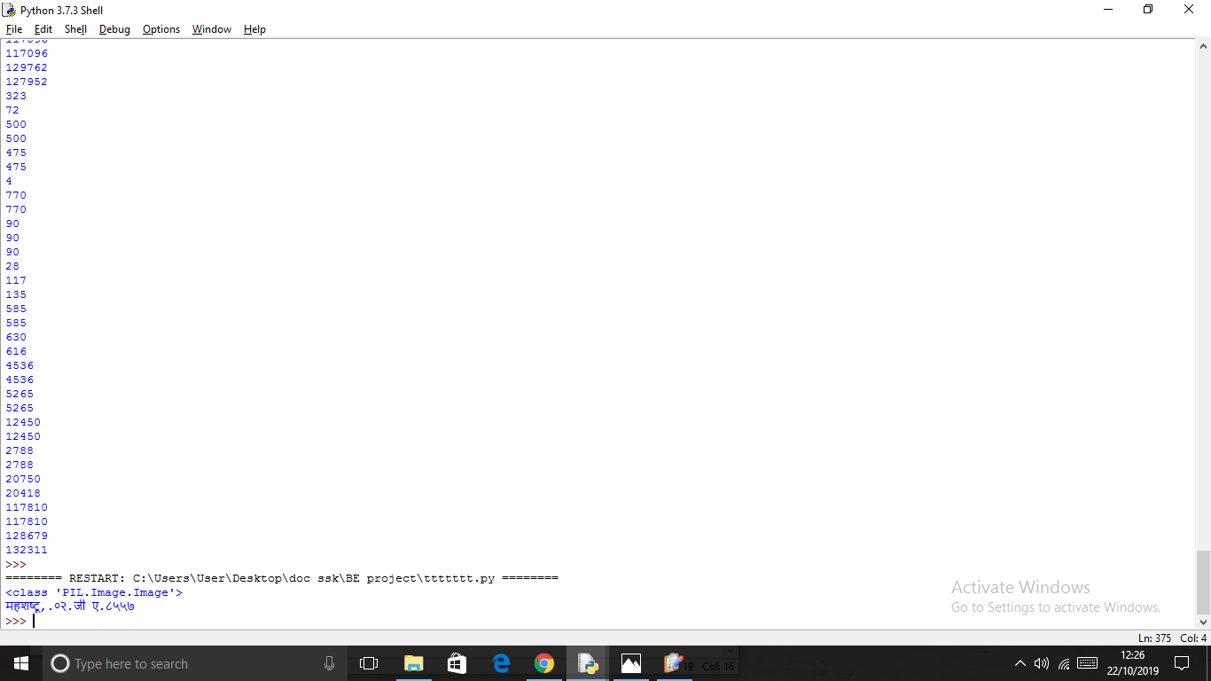
Fig 7: Marathi License plate output

Slide 16
References:
[1] Carlos A.B.Mello, “A Complete System for Vehicle License Plate Recognition”, Brazil,2009,https://docs.google.com/document/d/1L2eQx1y_ikFfnvBT8E72YmG_DUSeXSlgUpTjqnxZiMg/edit
[2] Mohamed A. Mohamed, “A Fast Algorithm for License Plate Detection”, Egypt, 2016,https://docs.google.com/document/d/11MfF3i-hzjQqLYP8AyzOithjpX106jz5lyVTDILw9UQ/edit
[3] Lisheng Jin,“License plate Recognition Algorithm for Passenger Cars in Chinese Residential Areas”China,2012,https://www.ncbi.nlm.nih.gov/pmc/articles/PMC3436033

