Slide 1
LANGUAGE TRANSLATOR
Shah Divyesh (17ITUOS127)
IT-100
Shah Harsh (17ITUOS113)
IT-101

Slide 2
LANGUAGE DESCRIPTION
Our language can be used to know the current time, date, day, month and year
To get output, user needs to write “What is the current _______”.
For example, if the user wants to know the current time, he needs to write “What is the current Time”.
The all possible inputs and their outputs are shown in following slides.

Slide 3
COMPILATION
The compilation steps are written below:
yacc –d myLanguage.y //Generate y.tab.h, y.tab.c
lex myLanguage.l //Generate lex.yy.c
cc y.tab.c lex.yy.c –o myLanguage
./myLanguage

Slide 4
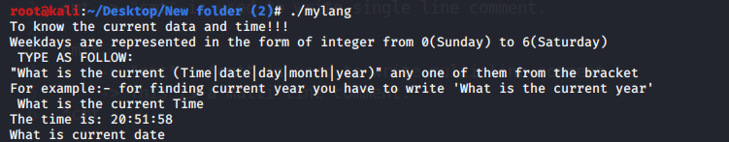
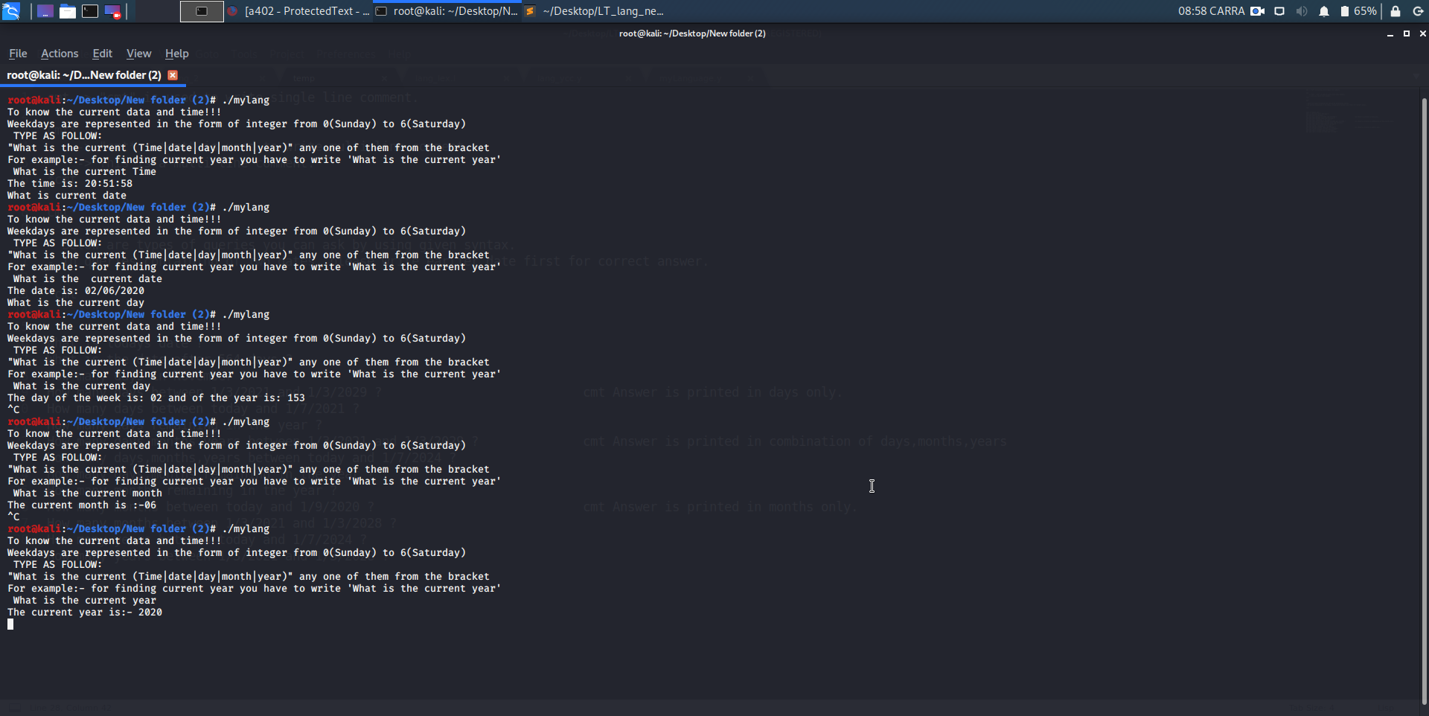
INPUT and OUTPUT

