Slide 1


SMART OFFICE WITH IOT
PREPARED BY:-
STUDENT 1 NAME: PATEL VRAJ SHAILESHKUMAR
ROLL NO: 35
ENROLLMENT NO: 21002170110127
BATCH: 1-B BRANCH: CE
STUDENT 2 NAME: GURJAR DIVYESH VIMALKUMAR
ROLL NO: 40
ENROLLMENT NO: 21002170110041
BATCH: 1-B BRANCH: CE
STUDENT 3 NAME: PATEL ARTH MUKESHBAHI
ROLL NO: 32
ENROLLMENT NO: 21002170110097
BATCH: 1-B BRANCH: CE
STUDENT 4 NAME: PANCHAL AYUSH NILESHKUMAR
ROLL NO: 34
ENROLLMENT NO: 21002170210053
BATCH: 1-B BRANCH: IT
STUDENT 5 NAME: KADAM RUSHIGANA MAHESHKUMAR
ROLL NO: 37
ENROLLMENT NO: 21002170210035
BATCH: 1-B BRANCH: IT

Slide 2
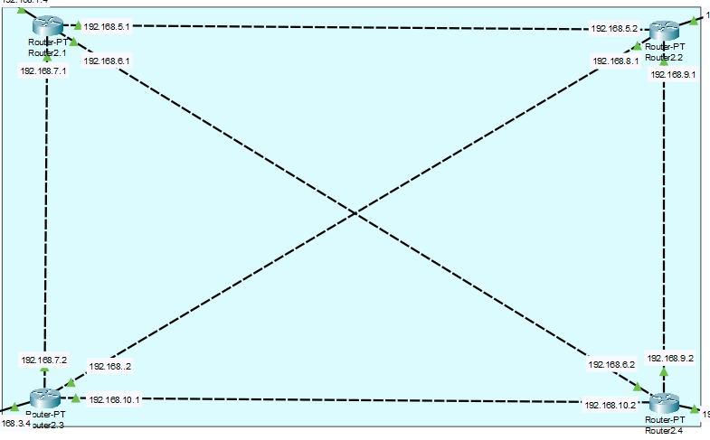
ABOUT PROJECT
IN THIS PROJECT WE HAVE USED MESH TOPOLOGY FOR CONNECTING ROUTERS.
WE HAVE USED LINK STATE ALGORITHM FOR COMMUNICATION OF ROUTERS.

Slide 3
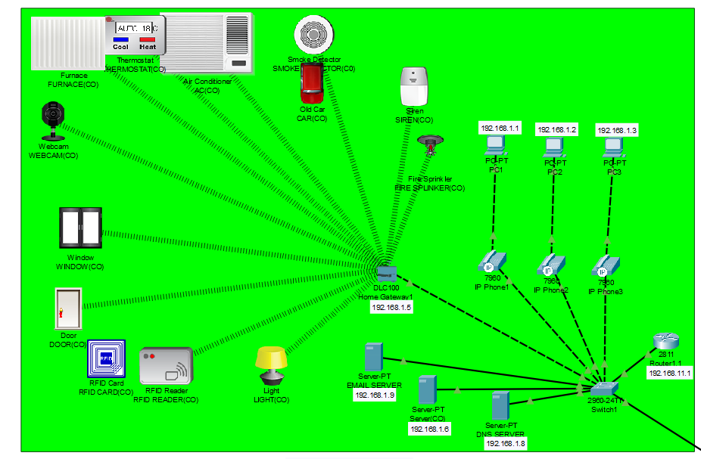
ABOUT PROJECT
THERE ARE FOUR OFFICE WHICH ARE CONNECTED WITH EACH OTHER.
HERE IS THE VIEW OF ONE OF THE OFFICE-CORPORATE OFFICE AHMEDABAD.
HERE WE HAVE CONNECTED IOT DEVICE AND HOME GATEWAY WITH WIRELESS CONNECTION.
THE IOT DEVICES ARE THEN REGISTERED TO THE SERVER OF RESPECTIVE OFFICES.

Slide 4
ABOUT PROJECT

Slide 5
ADVANTAGES
ACCESS OFFICE FROM ANY PLACE
GOOD FOR SAFETY AND SECURITY
SAVES TIME AND EFFORT
DISADVANTAGES
IF ANY SERVER OF OFFICE GOES DOWN THEN IT CANNOT BE ACCESSIBLE
COMPLEX SYSTEM FOR MAINTENANCE

Slide 6
THANK YOU….

