Slide 1





Solar Energy Prediction Using Weather Data

Slide 2

Learning Objectives
  Understand how weather factors influence solar power generation
  Learn how to preprocess and clean real-world energy data
  Train a machine learning model to predict solar energy output
  Apply AI/ML techniques to support green energy management
GOAL

Slide 3
Tools and Technology used
  Python – core programming language
  Pandas, NumPy – data preprocessing and analysis
  Scikit-Learn – machine learning model training
  Matplotlib – data visualization
  Jupyter Notebook – development environment

Slide 4
Methodology
  Data Collection: Simulated 6-month solar and weather dataset
  Data Preprocessing: Cleaned dates, removed noise, standardized values
  Feature Engineering: Added Month and DayOfYear features
  Model Training: Linear Regression for solar power prediction
  Model Evaluation: Checked accuracy using R² score and error metrics

Slide 5
Problem Statement:
  Solar energy generation varies daily due to changing weather conditions.
  Accurate prediction of solar output helps in better planning, energy storage, and efficient grid management.

Slide 6
Solution:
  Developed a machine learning model that predicts daily solar power generation (kWh) using weather parameters like temperature, cloud cover, and wind speed.
  This model can be integrated into smart energy systems or apps for real-time forecasting.

Slide 7
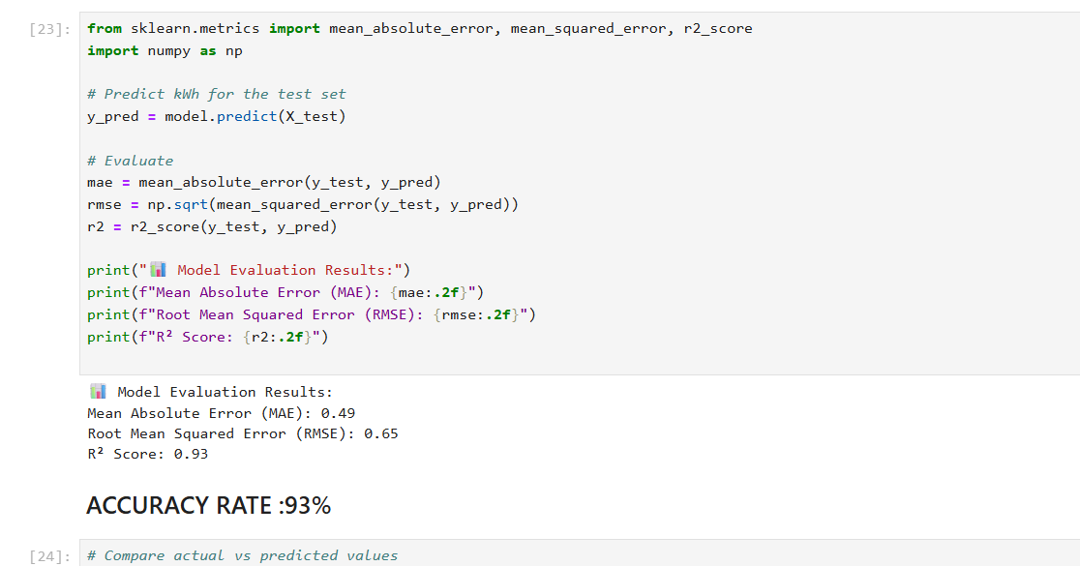
Screenshot of Output:
Model Accuracy (R²): 0.93 – The model predicts energy generation with high accuracy.

Slide 8
Conclusion:
  Successfully trained a model for solar power prediction using weather data
  Achieved 93% accuracy with consistent performance
  Demonstrated how AI/ML supports renewable energy optimization
  The approach is scalable for future real-time solar forecasting apps

