Slide 1
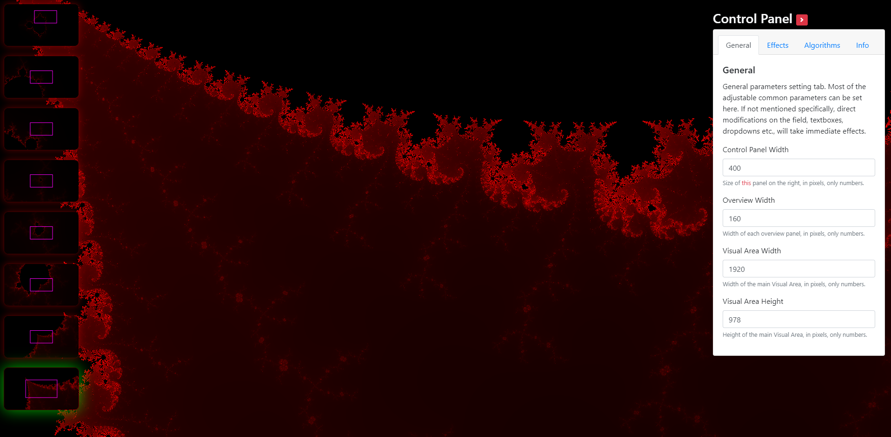
div#maps-container
div#visual-container
div#controls-container

Slide 2
index.js
naive-worker.js
work(magnif, x, y …)
postMessage({partialResults..})
postMessage({completeResults..})

Slide 3
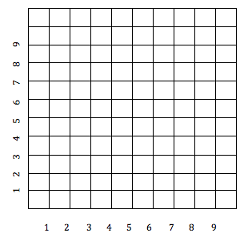
Pixels Grid
3
2
1
0
Math Axis
-1
1
2
3

Slide 4
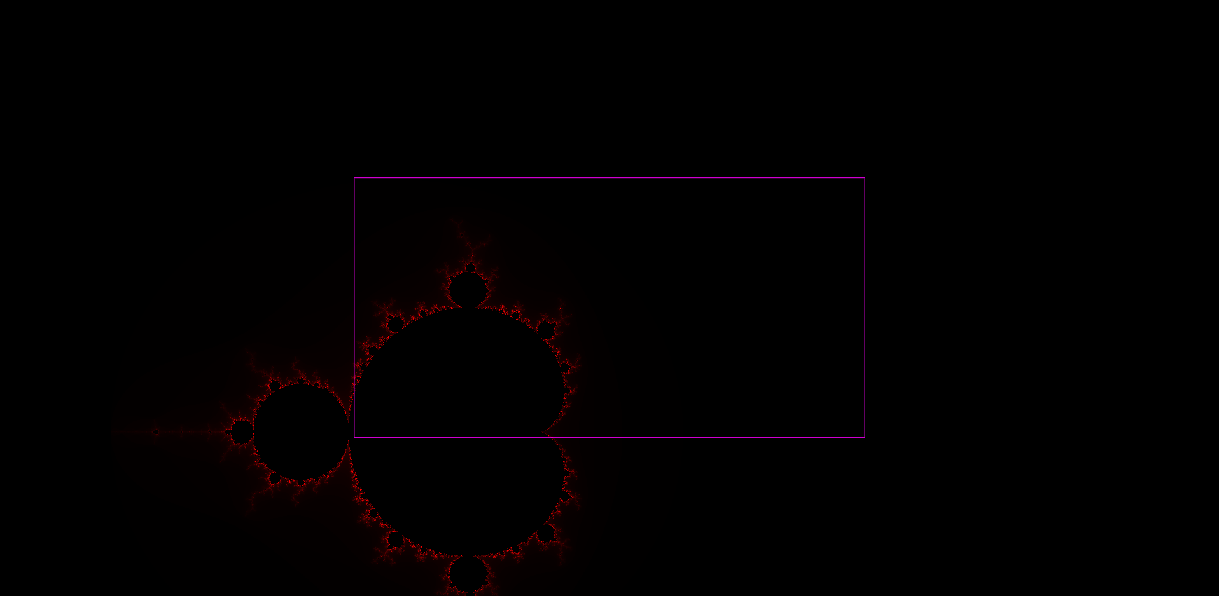

Slide 5
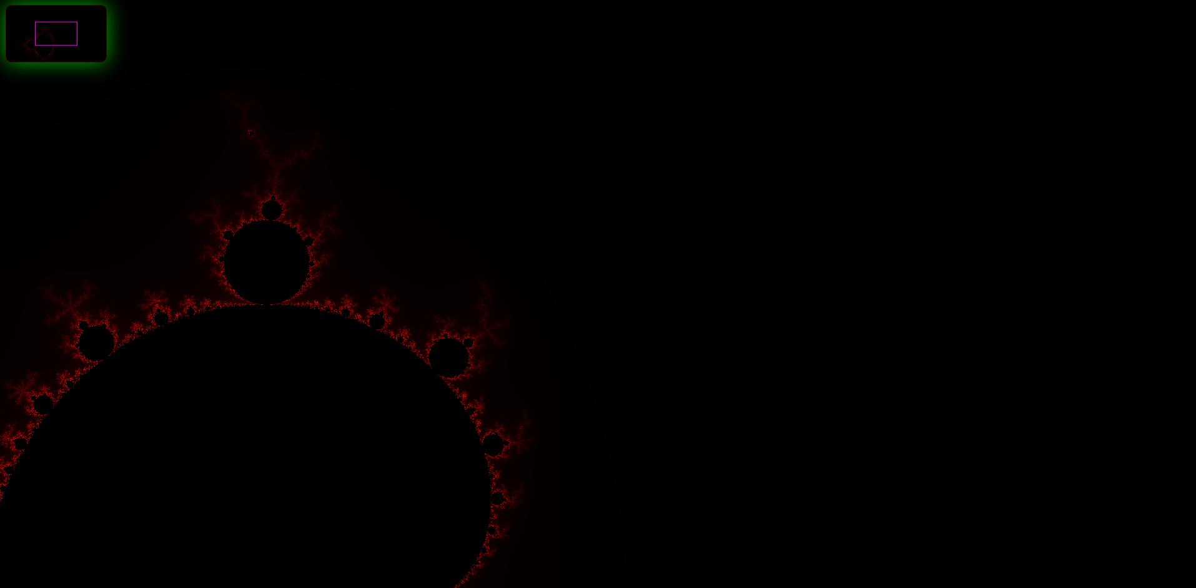

Slide 6
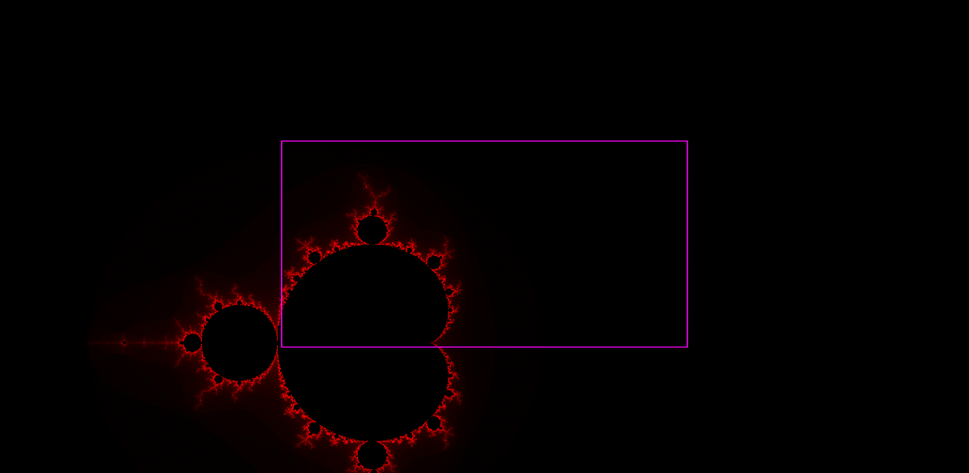

MiniMap Image
1920 x 1080
magnif 300
Shrunk Image
160 x 90
Visual Area Image
1920 x 1080
magnif 1000
A “Pair”

Slide 7
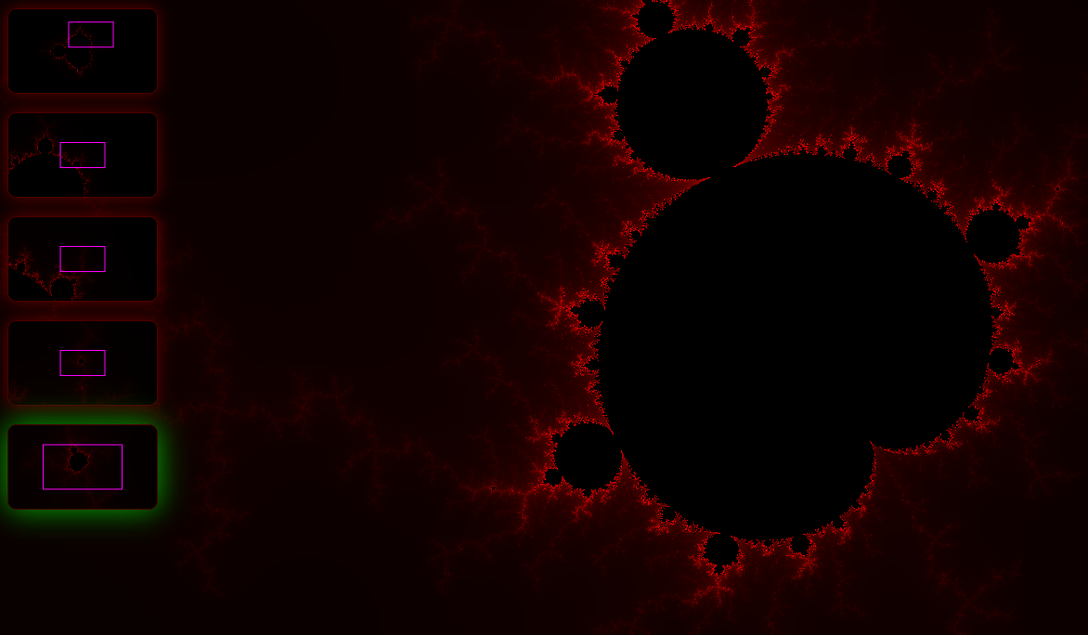
Flowing back coord. changes

Slide 9

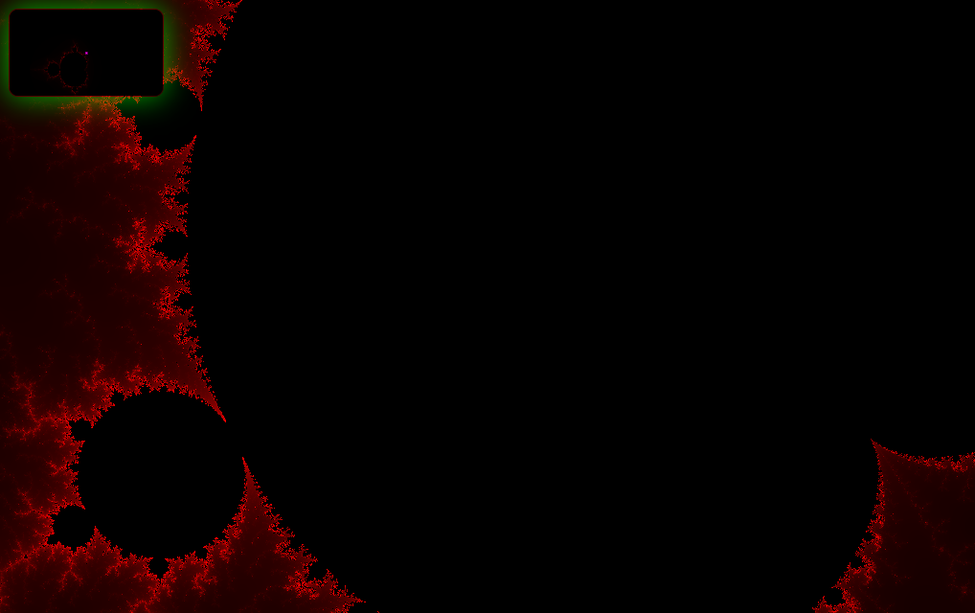

Slide 10
Contexts
Viewport of Preview
Contexts
Viewport of Preview
Any direction
Contexts

Slide 11
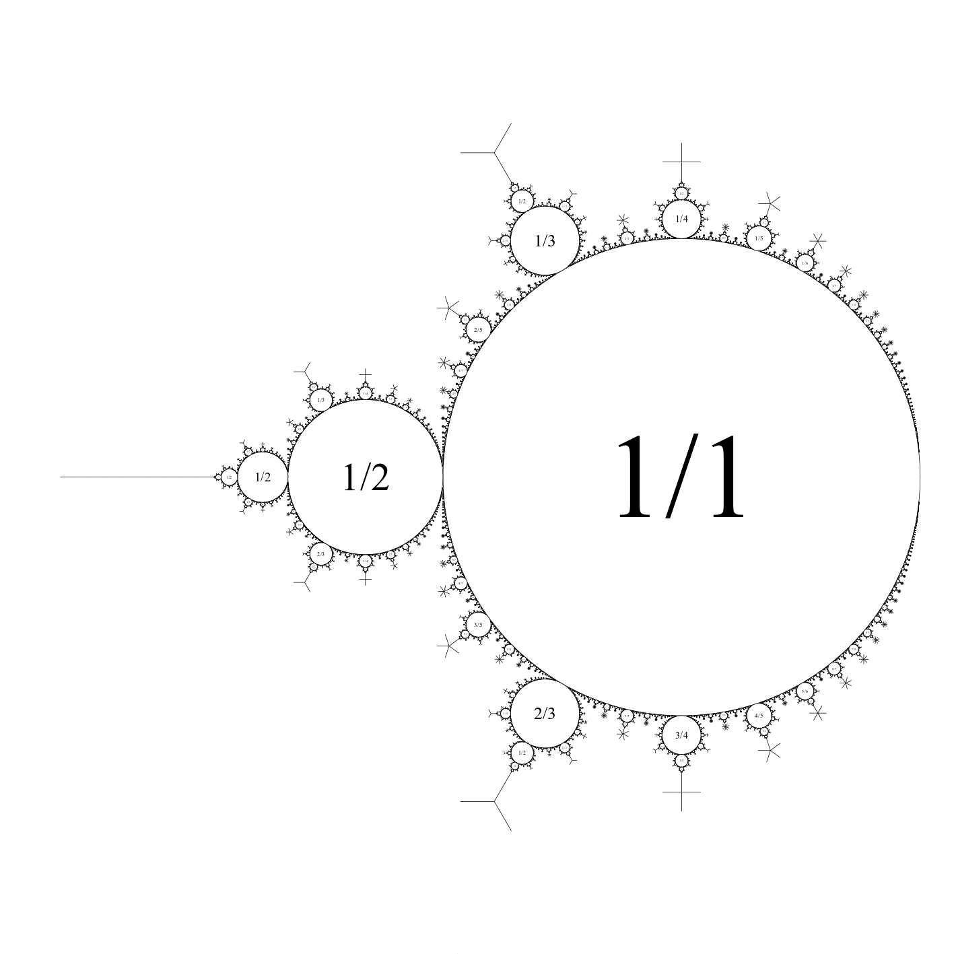
Waiting for requests to be resolved
Requests for dataset
Respond with dataset
Front End UI
Back End Resolver

Slide 12
Front End
Back End
request(params…)
response(part of response)(payloads..)
Response(complete response)(payloads..)

Slide 13
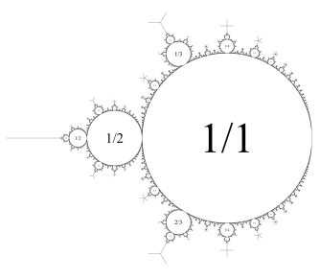
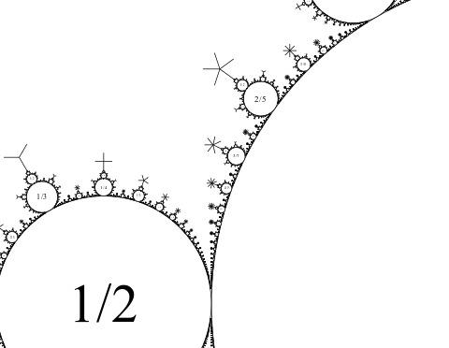
Focus + Context
Resolver
Front End

Slide 14
Focus + Context
Focus + Context
…
…
Focus + Context
manages
Resolver
(F+C)s Manager
“controls”
Front End

Slide 15
Focus + Context
Focus + Context
Control Panel
…
…
Focus + Context
Effects Manager

