Slide 1
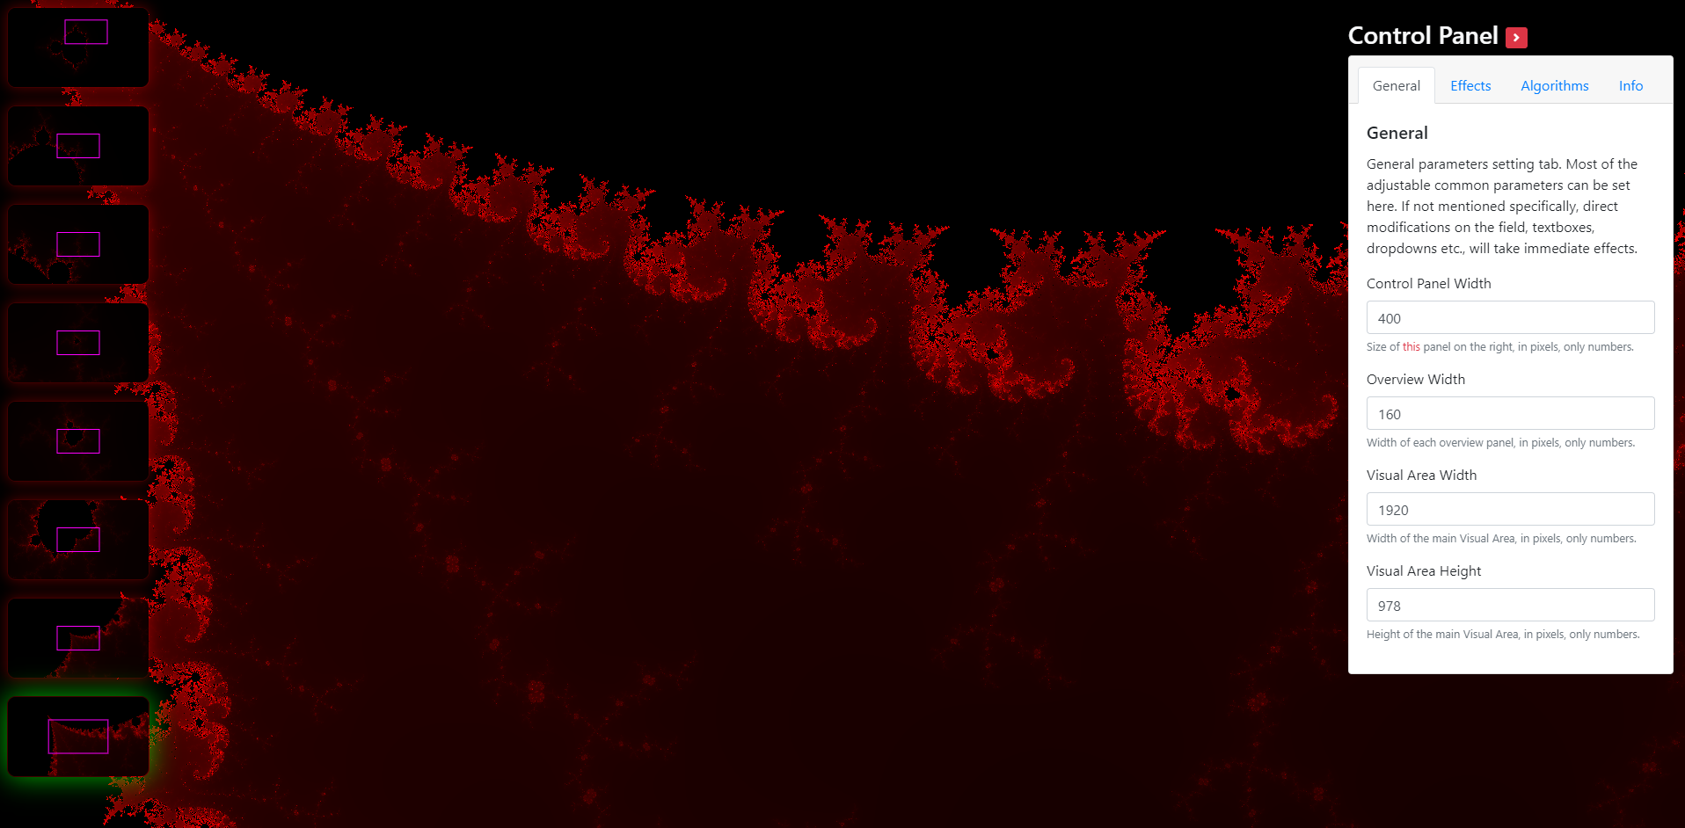
div#maps-container
div#visual-container
div#controls-container

Slide 2
index.js
naive-worker.js
work(magnif, x, y …)
postMessage({partialResults..})
postMessage({completeResults..})

Slide 3
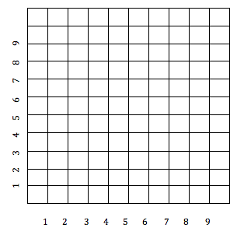
Pixels Grid
3
2
1
0
Math Axis
-1
1
2
3

Slide 4
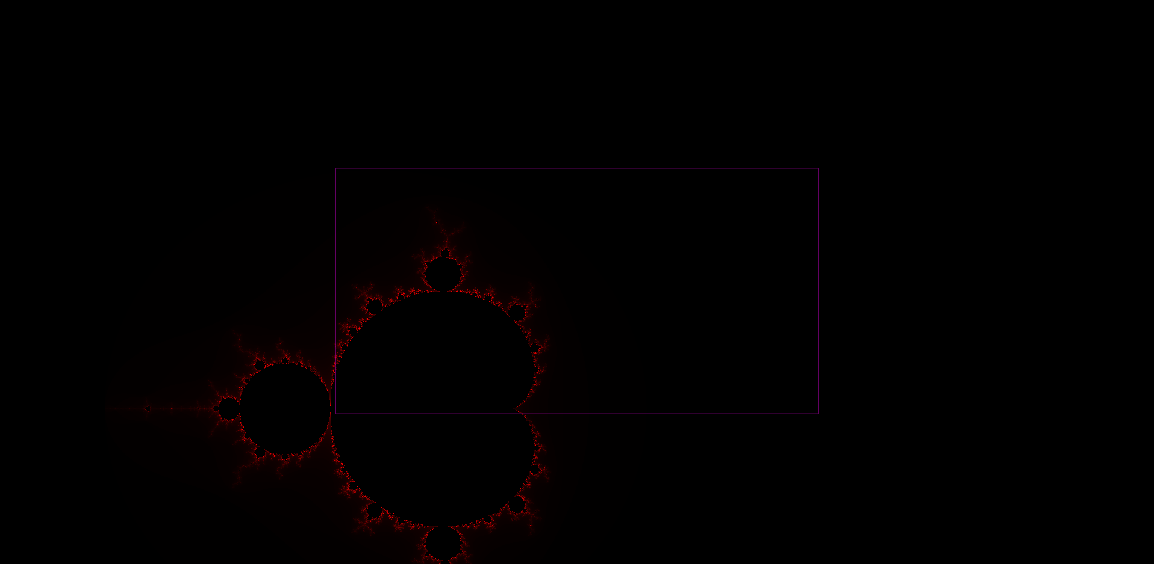

Slide 5
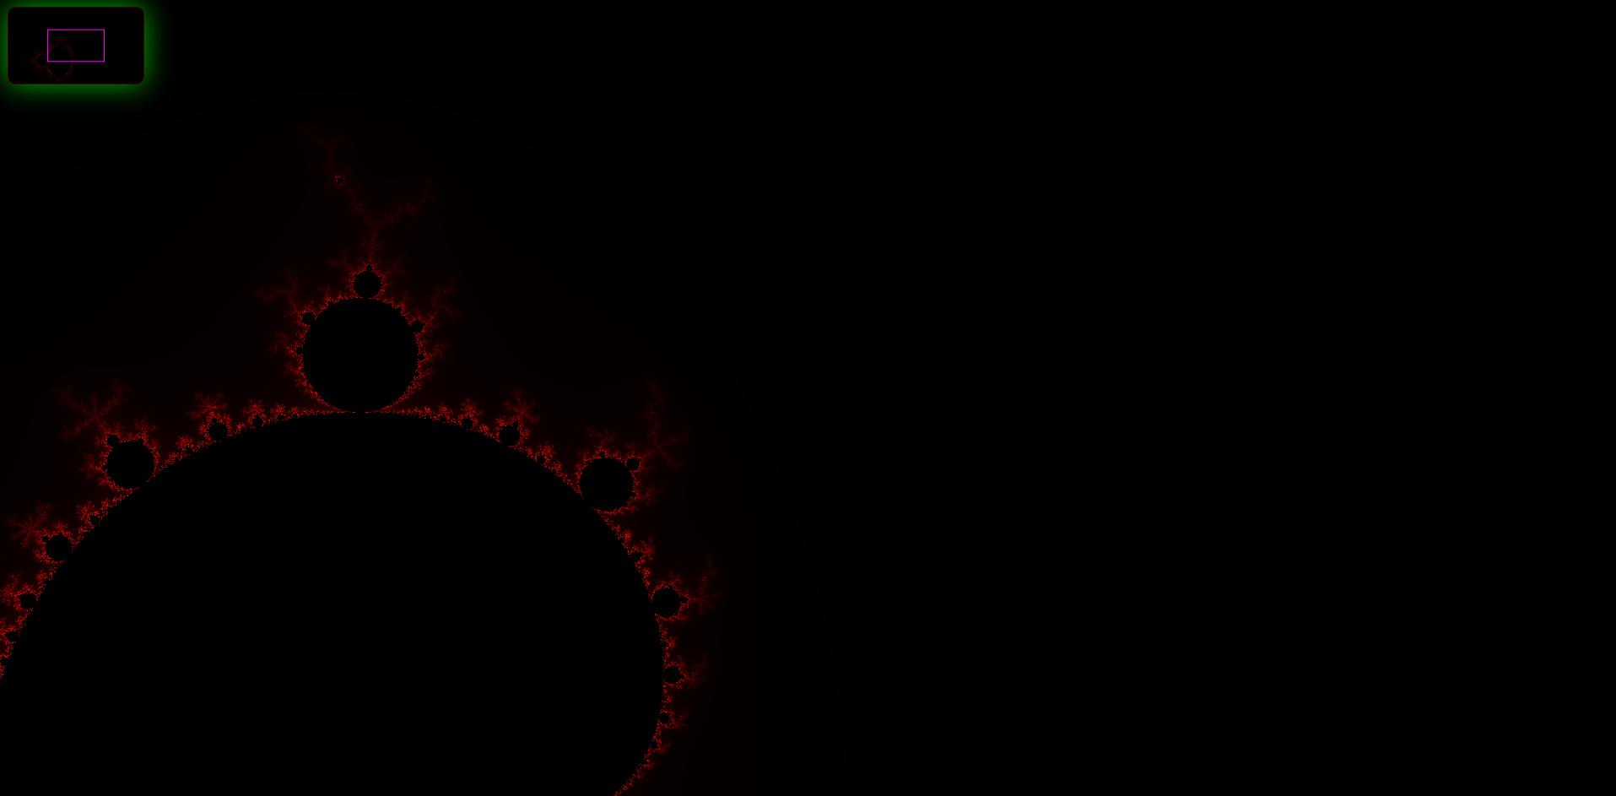

Slide 6
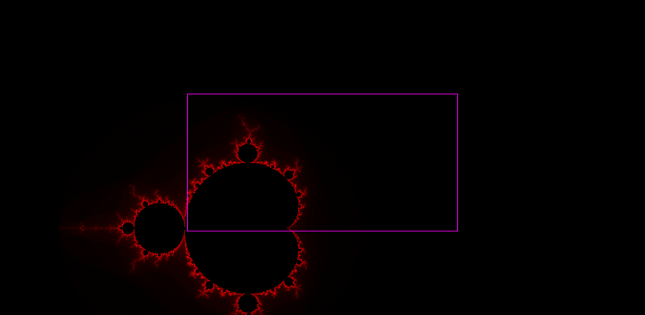

MiniMap Image
1920 x 1080
magnif 300
Shrunk Image
160 x 90
Visual Area Image
1920 x 1080
magnif 1000
A “Pair”

Slide 7
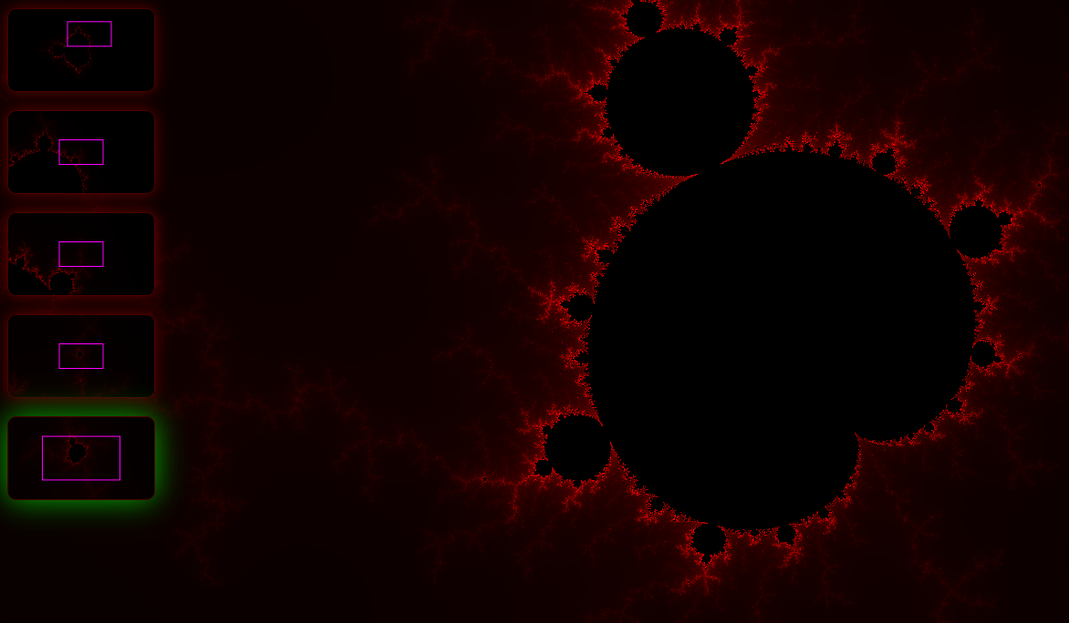
Flowing back coord. changes

Slide 9

