Slide 1
EEG/MEG:
Experimental Design
&
Preprocessing
Methods for Dummies
28 January 2009
Matthias Gruber
Nick Abreu

Slide 2
Outline - Design
Why EEG/MEG?
What is an ERP/ERF?
Interpretation/ Inferences from ERP/ ERFs
  Based on prior knowledge (components)
  Based on no prior knowledge
Electrode montage
General guidelines for a good design

Slide 3
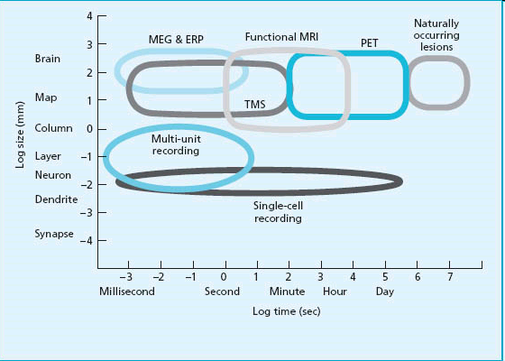
Why EEG/MEG?
High temporal resolution
EEG: comparably cheap
EEG/MEG or fMRI?
  What is your hypothesis?
  What method is the best to answer your question?

Slide 4

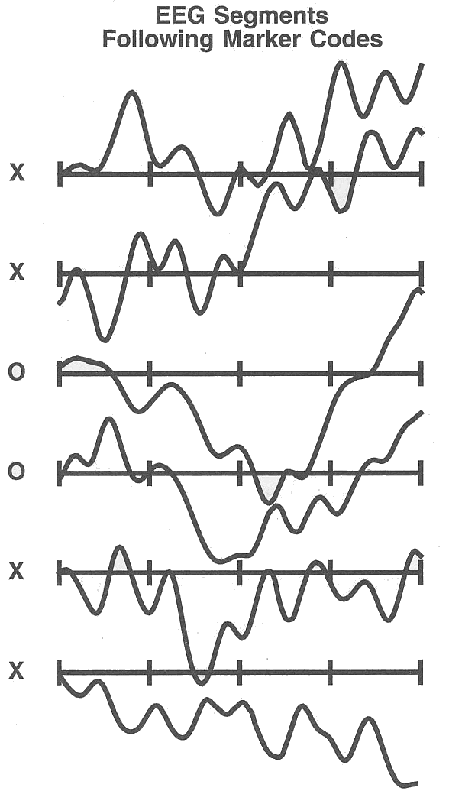
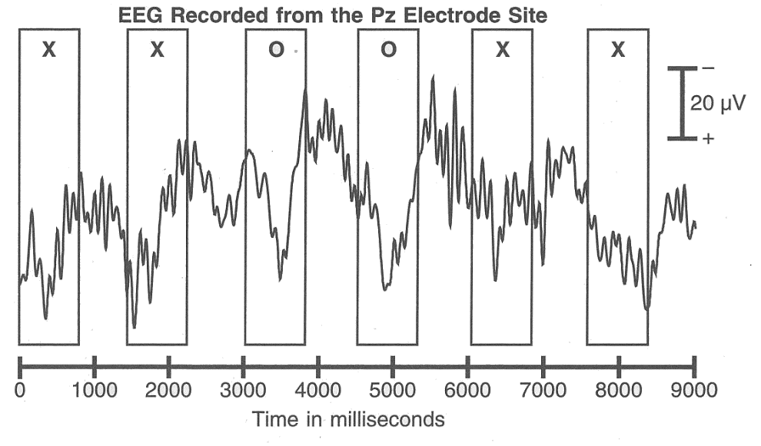
What is an ERP/ ERF?
  ERP/ ERF: Event-related Potential/ Field
  Definition: the average (across trials/ subjects) potential/field at the scalp relative to some specific event in time
Stimulus/Event
Onset

Slide 5
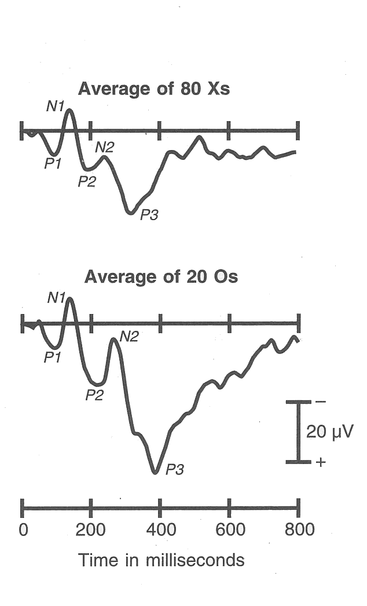
What is an ERP/ ERF?
Averaging

Slide 6
What is an ERP/ ERF?
ERPs are signal-averaged epochs of EEG that are time-locked to the onset of stimulus
Non-time-locked activity (noise) is lost to averaging

Slide 7
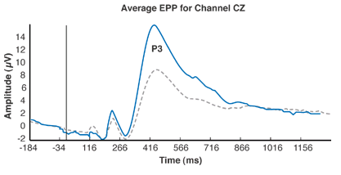
How to interpret an ERP/ ERF waveform?
  ERP/ERF waveforms are often interpreted in terms of their constituent components
Component (def) - Scalp-recorded electrical activity that is generated by a given patch of cortex engaged in a specific computational operation
+
sensor
+
-
+
-
-

Slide 8
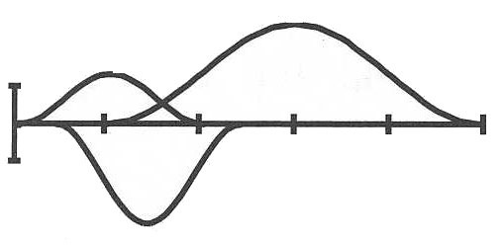
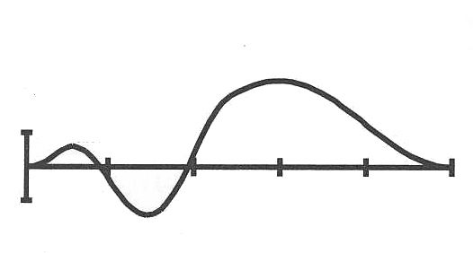
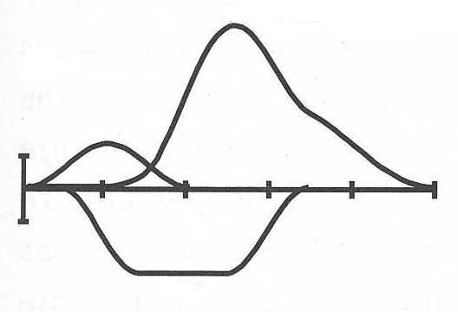
Components
Latent Components
Observed Waveform
OR
OR
many others…
Any given electrode/sensor records a series of temporally overlapping latent components
A given waveform could have arisen from many combinations of latent components

Slide 9
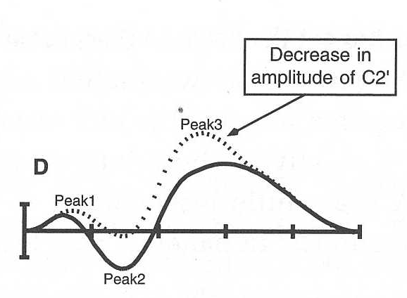
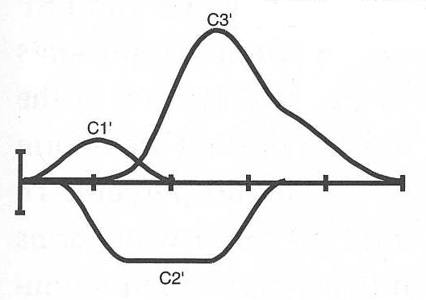
Components
Latent Components
Observed Waveform
The morphology of a component is not necessarily obvious from the observed waveform when components overlap

Slide 10
What to do?
How can one make valid inferences about latent components from observed waveforms?
Experimental design!

Slide 11
Design strategies
Focus on one specific component:
Design experiment to stop other components from varying, especially temporally overlapping components
Focus on components that are well-known:
well-studied experimental manipulations
Focus on large components:
less sensitive to variations in others
Focus on easily isolated components
Test hypotheses that are component-independent
Luck, S. J. (2005). Ten simple rules for designing ERP experiments, p. 17-33, Event-Related Potentials: A Methods Handbook. MIT

Slide 12
no prior knowledge = component-independent
Inferences not based on prior knowledge
Define your ERP effect in four ways:
Polarity
Timing
Amplitude
Scalp distribution

Slide 13
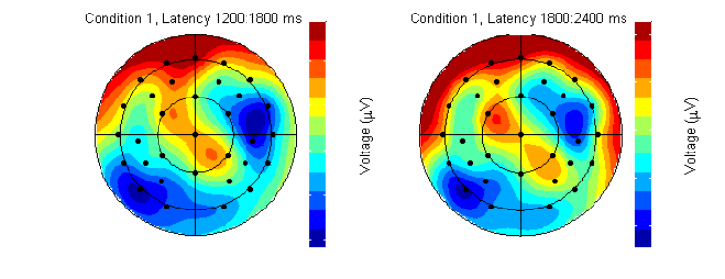
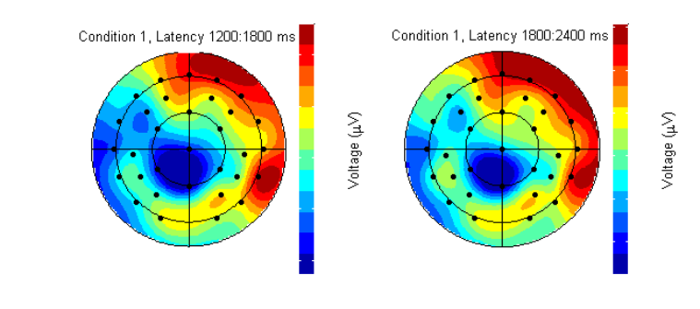
Inferences not based on prior knowledge
Polarity
Timing
Amplitude
Scalp distribution
Condition 1 Condition 2
Fpz
Fpz
Recognized
Word
2s
Word
2s
Forgotten
+ max
+
+ max
5µV
- max
- max

Slide 14
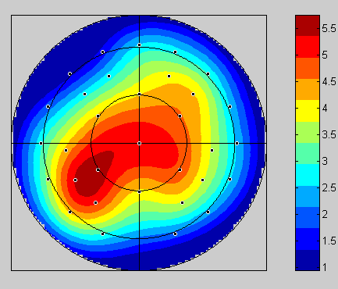
Electrode Montage
    What is my hypothesis? Where do I expect differences?
Analysis of ERP effect (ANOVA design):
Response (2) x Site (18)
Response (2) x Anterior-Posterior (3) x Hemisphere (2)
x Inferior-Superior (3)
Place Hits - CR
Memory test phase:
Recollected – Correct Rejections
400-600

Slide 15
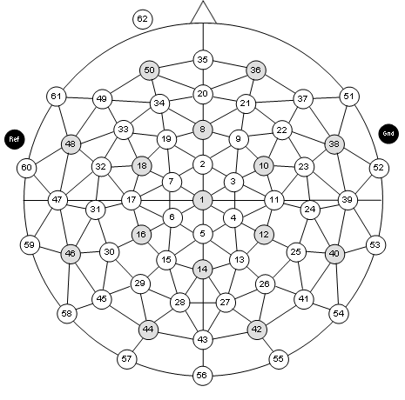
Analysis of ERP effect (ANOVA design):
Response (2) x Sites (18)
Response (2) x Anterior-Posterior (3) x Hemisphere (2) x Inferior-Superior (3)
Anterior-Posterior (3) Hemisphere (2) Inferior-Superior (3)
Frontal
Central
Parietal
Inferior
Left
Right
Medial
Superior

Slide 16
… developing a good design
Specific EEG/ MEG issues:
  Amplifier setting
  small epochs
General issues:
  trial numbers
  behavioural confounds
  Only few conditions

Slide 17
EEG/MEG:
Experimental Design
&
Preprocessing
Methods for Dummies
28 January 2009
Matthias Gruber
Nick Abreu

Slide 18
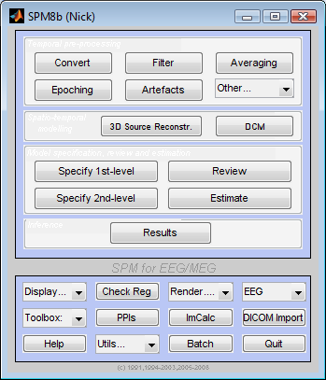
M/EEG Preprocessing in SPM8

Slide 19
Overview
Goal: Raw data to signal-averaged ERPs or ERFs
How:
  Data conversion
  Montage mapping
  Specify location of sensors
  Epoching
  Downsampling
  Filter
  Artefact Removal
  Signal Averaging
  Rereferencing
Notes:
Overview of talk: Review of M/EEG signal, Preprocessing, Study Design

Slide 20
SPM5 -> SPM8
Better conversion of data from native format to flexible matlab format
New M/EEG data format
Interface with user – GUI or two different scripting methods suitable for automating multi-subject data analysis
Convert SPM data to FieldTrip or EEGLAB and back
Source Reconstruction and Effective Connectivity (see next week’s talk)
Notes:
Introduction –

Slide 21
Data conversion
*.mat
*.bdf
*.dat
Native machine-dependent format → a Matlab-based, common SPM format
Can also convert SPM5 data to SPM8 format by selecting the appropriate .mat file

Slide 22
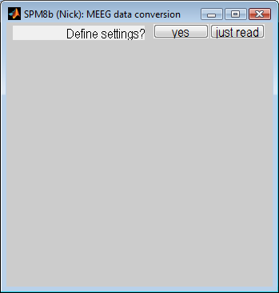
Data conversion
“Just read” – Easy, no questions asked
“Yes, define settings”
  “Continuous v. trials” – Is machine-dependent data already divided into trials?
    Follow-up q’s (see SPM8 manual)
  “Which channels should be converted?”

Slide 23
Montage mapping
Refine the number and types of channels used for further processing
User-defined
  Script (see SPM8 manual) or GUI

Slide 24
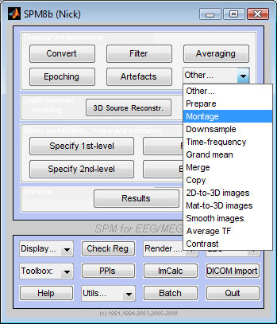
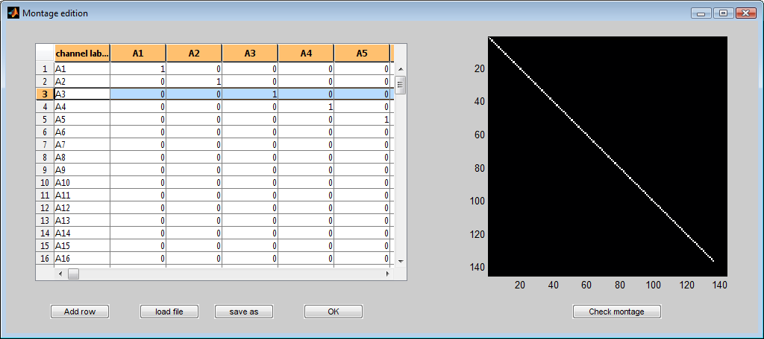
Montage mapping
Review channel mapping
Set up difference potentials (vEOG, hEOG) [1 -1]
Rename channel labels
Delete any unwanted channels (delete rows)

Slide 25
Prepare
(Specify location of sensors)
SPM can recognize common EEG setups (extended 1020, Biosemi, EGI) based on channel labels and assigns 'EEG' channel type and default electrode locations
But sometimes the user needs to specify additional info

Slide 26
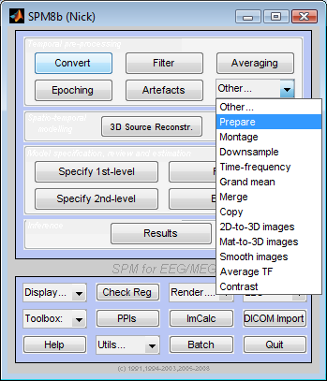
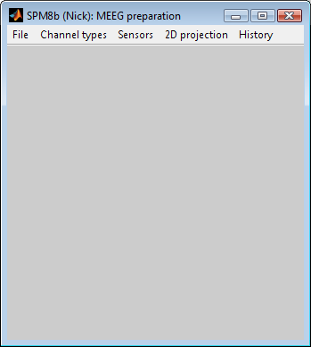
Prepare in SPM
Review preprocessing steps (scripting)
Change/review 2D display of electrode locations
1) Load recently converted file
2) Change/review channel assignments (EEG v. EOG)
3) Set sensor positions:
-Assign defaults
-From .mat file
-From user-written locations file

Slide 27
Epoching
Specify ‘epoch’ time window
  Directly associated with triggers?
    Specify [prestimulus time, poststimulus time]
  Offset/unrelated to triggers?
    Specify N x 2* matrix – each row contains start and end of a trial (in samples)
Automatic baseline-correction
  The mean of the pre-stimulus time is subtracted from the whole trial.
Set category labels
Review individual trials by hand

Slide 28
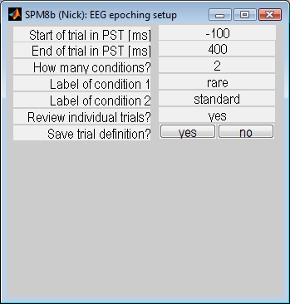
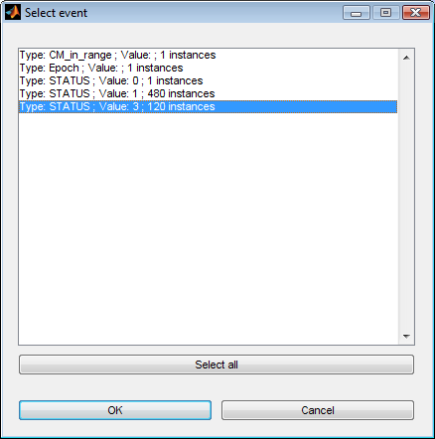
Epoching in SPM
See if all trials are there
For multisubject/batch epoching in future

Slide 29
Issues in Epoching
Segment length:
At least 100 ms should precede the event onset (for baseline correction).
The time - frequency analysis can distort the signal at both ends of the segment. Have padding (see SPM8 manual). The affected segment length depends on the frequency in an inverse manner (length ms ~ 2000/freq Hz)
The segment should not be too long nevertheless, the longer it is the
bigger the chance to include an artefact!
(Tomalski & Kadosh 2008, MfD)

Slide 30
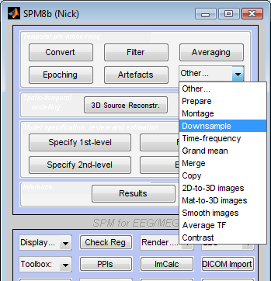
Downsampling
Convert large dataset into smaller files
  Useful when dealing with many subjects’ data
512 Hz (large file)→ 200 Hz (takes up less than 50% amount of space as original file)
Set new sampling rate
(must be smaller than initial value)

Slide 31
Filtering
Why filter?
  EEG consists of a signal plus noise
  Some of the noise is sufficiently different in frequency content from the signal that it can be suppressed simply by attenuating different frequencies, thus making the signal more visible
    Non-neural physiological activity (skin/sweat potentials)
    Noise from electrical outlets

Slide 32
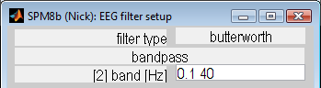
Filtering
SPM8 invokes Butterworth filter
  Bandpass filter: e.g., 0.1 – 40 Hz
Caution
  Any filter distorts at least some part of the signal
  Gamma band activity occupies higher frequencies compared to standard ERPs

Slide 33
Artefact Removal
Problem: Some trials contain BOTH signal of interest & a large amount of signal from other sources
What causes artefacts?
  Eye movement
  Eye blinks
  Head movement
    Talking, itching, etc.
  Sweating
  Swelling
  ‘Boredom’ alpha waves

Slide 34
Artefact Removal
Avoid having artefacts in the first place
  Blinking
    Avoid contact lenses
    Build ‘blink breaks’ into your paradigm
    If subject is blinking too much – tell them
  EMG
    Ask subjects to relax, shift position, open mouth slightly
  Alpha waves
    Ask subject to get a decent night’s sleep beforehand
    Have more runs of shorter length – talk to subject in between
    Vary ISI – alpha waves can become entrained to stimulus

Slide 35
Artefact Removal
Hand-picked
Use of a more sophisticated Matlab algorithm
Automatic SPM functions
  Thresholding
    2 passes (1st – bad channels, 2nd – bad trials)
    Note: no change to data, just tagged to be rejected
  Robust averaging
    Estimates weights (0-1) indicating how artefactual a trial is

Slide 36
Signal Averaging
S/N ratio increases as a function of the square root of the number of trials.
As a general rule, it’s always better to try to decrease sources of noise than to increase the number of trials.

Slide 37
Rereferencing
Set appropriate reference (true, unbiased zero value)
  Use of a single electrode, in theory free from any neuronal activity of interest
    e.g., mastoid, vertex
  Use of average across multiple electrodes, less susceptible to bias due to electrode location
    “virtual electrode”

Slide 38
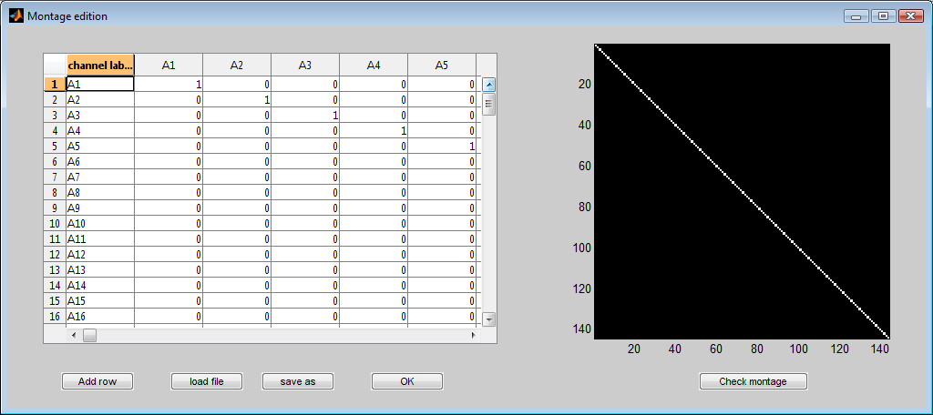
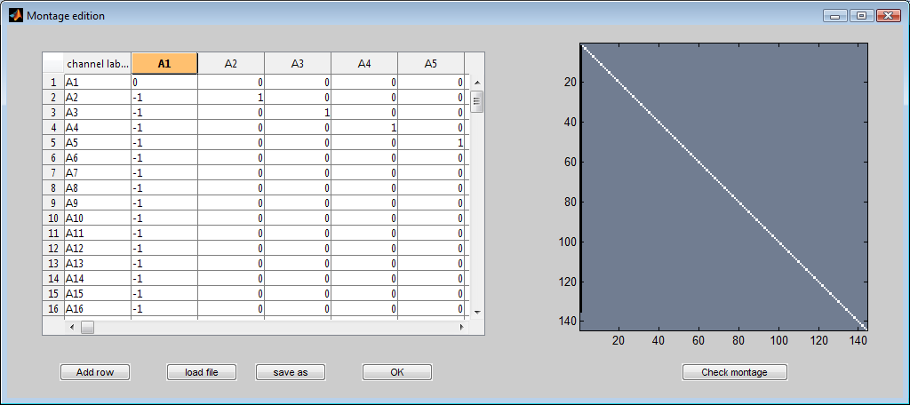
Rerefencing in SPM
Familiar function – ‘Montage’
Reference to A1 electrode

Slide 39
Rereferencing in SPM
Rereference to average electrode
  N = number of EEG channels
  Diagonals of matrix = (N-1)/N
  All other values in matrix = -1/N

Slide 40
References
S. J. Kiebel: 10 November 2005. ppt-slides on ERP analysis at http://www.fil.ion.ucl.ac.uk/spm/course/spm5_tutorials/SPM5Tutorials.htm
J. Brooks and M. Joao: 13 February 2008. ppt-slides on EEG & MEG Experimental Design at http://www.fil.ion.ucl.ac.uk/~jchumb/MfDweb.htm
G. Galli: ppt-slides on methodological issues about ERP analyses. Presented at the CEUK Workshop 2008 in Stirling.
Todd, C. Handy (ed.). 2005. Event-Related Potentials: A Methods Handbook. MIT
Luck, S. J. (2005). An Introduction to the Event-Related Potential Technique. MIT Press.

Slide 41
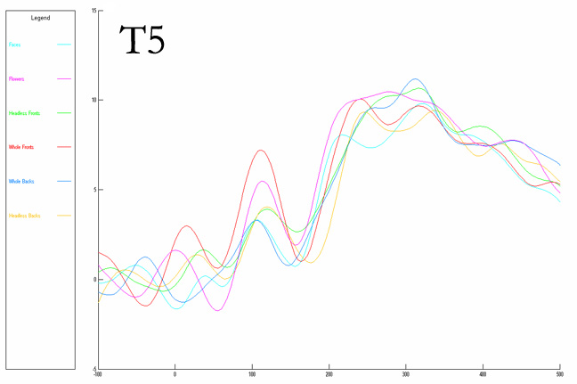
Thank you!

