Slide 1
INHERITANCE

Slide 2
Topics
Inheritance Basics
Member Access and Inheritance
A Superclass variable Can Reference a Subclass Object
Using Super to call Superclass Constructors
A Second use for Super
Creating a Multilevel Hierarchy
When Constructors are Called
Method Overriding
Dynamic Method Dispatch
Final keyword
Object class

Slide 3
Inheritance Basics
It is an important part of OOPs (Object Oriented programming system).
Inheritance in Java is a mechanism in which one object acquires all the properties and behaviors of a parent object.
Inheritance represents the IS-A relationship which is also known as a parent-child relationship.
Why use inheritance in java
1. For Method Overriding
2. For Code Reusability.

Slide 4
Terms used in Inheritance:
Class:
Sub Class/Child Class
Super Class/Parent Class
Reusability
The syntax of Java Inheritance:
class Subclass-name extends Superclass-name
{
//methods and fields
}
Example: SimpleInheritance.java

Slide 5
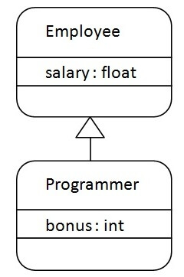

Slide 6
Example Program:
class Employee{
float salary=40000;
}
class Programmer extends Employee{
int bonus=10000;
public static void main(String args[]){
Programmer p=new Programmer();
System.out.println("Programmer salary is:"+p.salary);
System.out.println("Bonus of Programmer is:"+p.bonus);
}
}

Slide 7
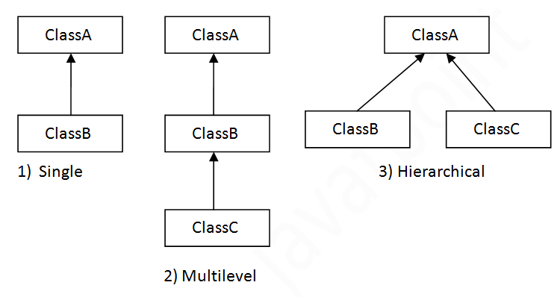
Types of Inheritance
Types of inheritance in java

Slide 8
Why multiple inheritance is not supported in java?
To reduce the complexity and simplify the language, multiple inheritance is not supported in java.
Consider a scenario where A, B, and C are three classes. The C class inherits A and B classes. If A and B classes have the same method and you call it from child class object, there will be ambiguity to call the method of A or B class.
Since compile-time errors are better than runtime errors, Java renders compile-time error if you inherit 2 classes. So whether you have same method or different, there will be compile time error.

Slide 9
Example:
class A{
void msg(){System.out.println("Hello");}
}
class B{
void msg(){System.out.println("Welcome");}
}
class C extends A,B{//suppose if it were
public static void main(String args[]){
C obj=new C();
obj.msg();//Now which msg() method would be invoked?
}
}

Slide 10
Member Access and Inheritance
Subclass includes all of the members of its superclass,except private members.
We can access these variables by using the methods of its own class
class A {
private int j;
int getj() {
return j; } Example:Access1.java
}
class B extends A {
int i=j; //error
int i=getj(); }

Slide 11
A Superclass variable can reference a subclass object
A reference variable of a superclass can be assigned a reference to any subclass derived from that superclass only
BoxWeight bw=new BoxWeight();
Box b=new Box();
B=bw;
Example:RefDemo.java
Boxweightobject
Box Object

Slide 12
Using super
Whenever a subclass needs to refer to its immediate superclass, it can do so by use of the keyword super.
Super has 2 general forms
1. It calls the superclass constructor.
2. It is used to access a “member” of the superclass that has been hidden by a member of a subclass.
Here,member can be either a method or an instance variable.

Slide 13
Using super to call super class constructor
A subclass can call a constructor method defined by its superclass by use of the following form of super.
super(parameter-list);
super() must always be the first statement executed inside a subclass constructor.
Example: DemoSuper.java

Slide 14
class BoxWeight extends Box {
double weight;
BoxWeight(double d,double h,double b,double m)
{
super(d,h,b);
weight=m;
}
}
A second Use for Super:
Example:super2.java

Slide 15
Creating a Multilevel Hierarchy
class Animal{
void eat(){System.out.println("eating...");}
}
class Dog extends Animal{
void bark(){System.out.println("barking...");}
}
class BabyDog extends Dog{
void weep(){System.out.println("weeping...");}
}
class TestInheritance2{
public static void main(String args[]){
BabyDog d=new BabyDog();
d.weep();
d.bark();
d.eat();
}}

Slide 16
When Constructors are called
Constructors are called in oreder of derivation from superclass to subclass.
Further since super() must be the first statement executed in a subclass constructor,this order is same whether or not super() is used.
If super() is not used then the default or parameterless constructor of each superclass will be executed
Example : CallingCons.java

Slide 17
Method Overriding
In a class Hierarchy when a method in a subclass has the same name and type signatures as a method in its superclass,then the method in the subclass is said to be override the method in the superclass.
When a override method is called from within a subclass it will always refer to the version of that method defined by the subclass.
The version of the method defined by the superclass will be hidden.
Example:Override.java

Slide 18
Method overriding occurs only when the names and type signatures are identical.If they are not ,then 2 methods are simply overloaded.
Ex: Ovveride1.java
class A {
void show(){
System.out.println(“I and j are”+i+” ”+j);
}
class B extends A {
void show(String msg) {
System.out.println(msg + k);
}
}

Slide 19
Dynamic Method Dispatch
Dynamic Method Dispatch is the mechanism by which a call to an overridden method is resolved at runtime,rather than complie time
Superclass reference variable can refer to a subclass object.
Java uses this fact to resolve calls to overriden method at runtime.
When an overidden method is called through a superclass reference java determines which version of that method to execute based upon the type of object being referred at the time the call occurs
Example: Dispatch.java

Slide 20
Using final with Inheritance
The keyword final has 3 uses:
1. To create a constant
2. To prevent Overriding
3. To prevent Inheritance

Slide 21
To prevent Overriding:
Methods declared as final cant be overriden
Ex:
class A {
final void meth() {
System.out.println(“This is final method”);
}
}
class B extends A {
void meth() { //Error! Cant override.
System.out.println(“Illegal”);
}
}

Slide 22
final to prevent Inheritance
It is used to prevent a class from being inherited,to do this preceed the class declaration with final.
final class A {
//…
}
class B extends A { // Error can’t subclass A
//…
}

Slide 23
The Object class
Object is a special class defined by java.
All other classes are subclasses of Object,that is Object is a superclass of all other classes.
A reference variable of type Object can refer to any other class.
Object defines some methods,they are available in every object

Slide 24
Method Purpose
Object clone() creates a new object that is the same as the object being cloned
Boolean equals(Object object) Determine whether one object is equal to another
void finalize() called before an unused object is recycled
class getClass() Obtains the class of an object at runtime
int hashCode Return the hashcode associated with the invoking object.
void notify() Resumes execution of a thread waiting on the invoking object
Void notifyAll() Resumes execution of all threads waiting on the invoking object

Slide 25
Method Purpose
String toString() Returns the String that describes the object
void wait() waits on another thread of execution
void wait(long milliseconds)
void wait(long milliseconds,int nanoseconds)

