Slide 1
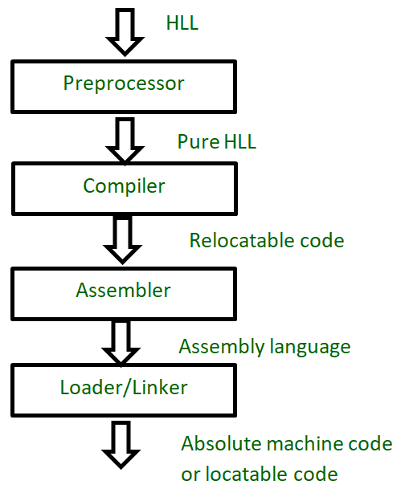
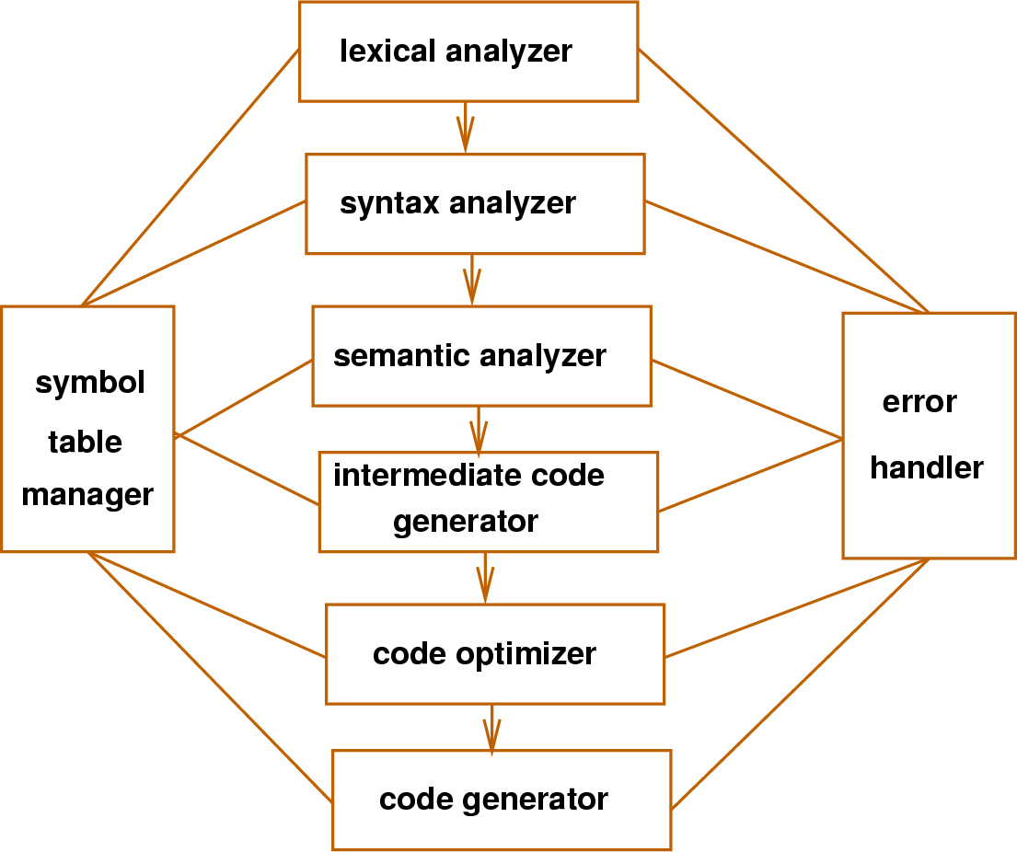
Lex & YACC
Complier :
Source Code

Slide 2
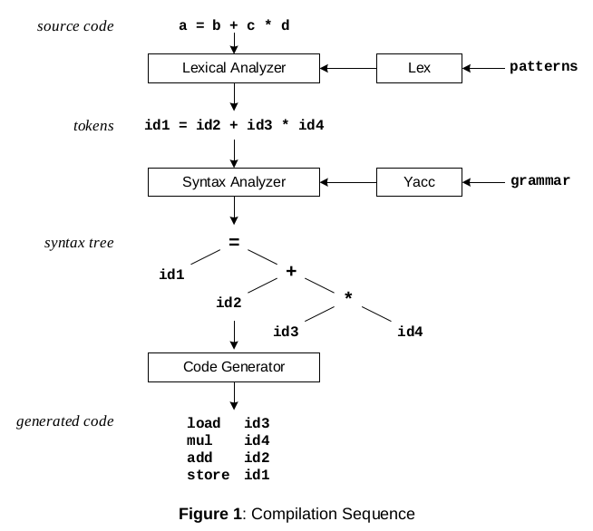

Slide 3
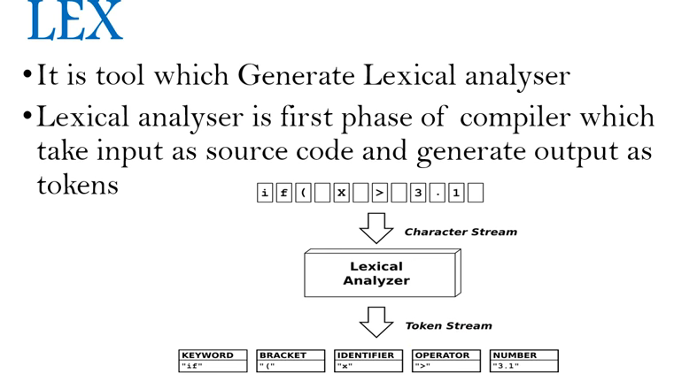

Slide 4
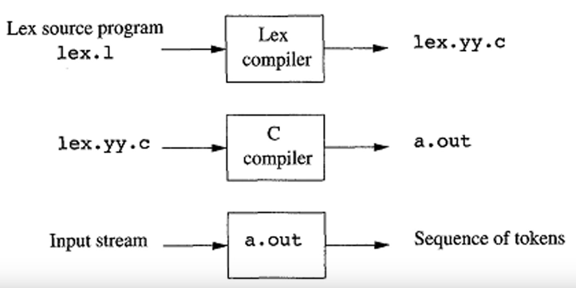
Lex: Lex will read your patterns and generate C code(lex.yy.c) for a lexical analyzer or scanner. The lexical analyzer matches strings in the input, based on your patterns, and converts the strings to tokens.
* Lex is called scanner generator
*Input: Set of Regular Expression(Pattern) and assocuiate action
*Output: lex.yy.c

Slide 5
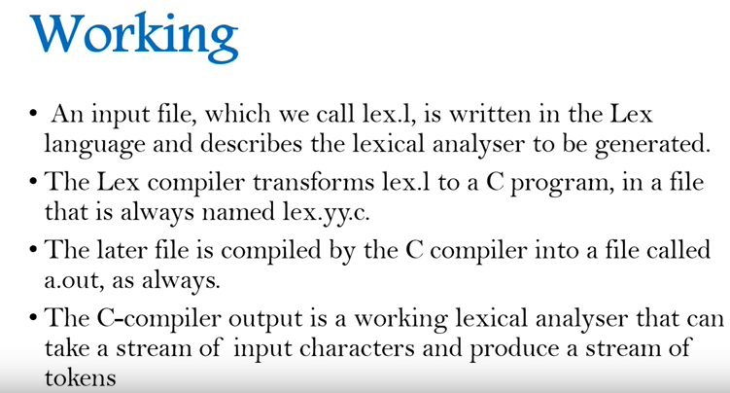

Slide 6
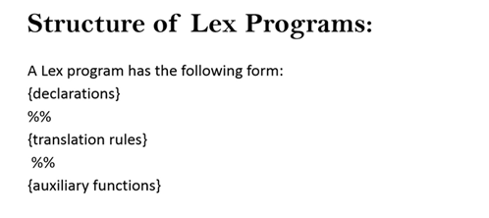
{ Decalre variables and c program code that
we want to copy Into final program
Use %{--------- %}
}
{ Pattern {Action} }
{ Any legal c code lex copies it to the c file after
The end of lex generated code}

Slide 7
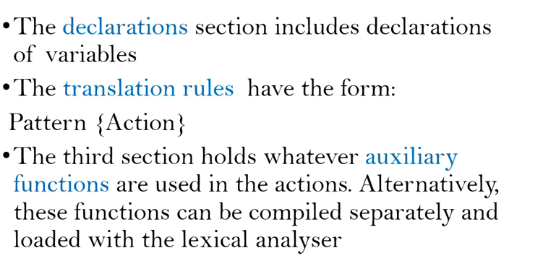

Slide 8
Pattern | Mathes
. | matches any character except newline character
\. | matches the . character
\n | matches the newline character
\t | matches the tab character
\\ | matches the \ character
[ \t] | matches either a space or tab character
[^a-d] | matches any character other than a,b,c and d
a | matches a
abc | matches abc
[abc] | matches a, b or c
[a-f] | matches a, b, c, d, e, or f
[0-9] | matches any digit
X+ | mathces one or more of X
X* | mathces zero or more of X

Slide 9
Pattern | Mathes
[0-9]+ | matches any integer
(...) | grouping an expression into a single unit
| | alternation (or)
(a|b|c)* | is equivalent to [a-c]*
X? | X is optional (0 or 1 occurrence)
[A-Za-z] | matches any alphabetical character

Slide 10
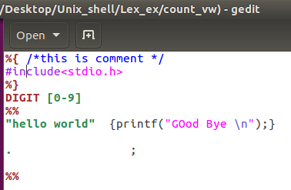
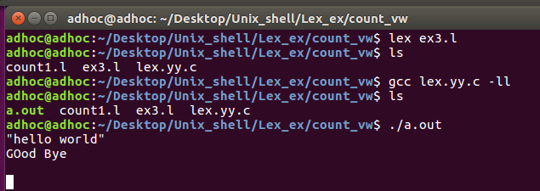
Lex First Program

Slide 11
How to compile/run lex program
$ lex filename.l [It will create lex.yy.c file]
$ gcc lex.yy.c -ll [compile the scanner & main from the lex library(-ll) and create a.out file ]
$./a.out
Hell World
show output as----
Good Bye

Slide 12
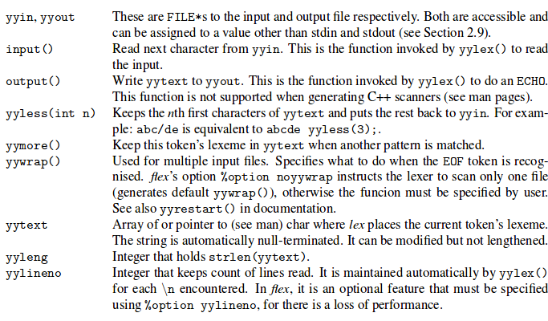
Variables and functions used in lex
The routine yylex() provides information by way of global variables and the value it returns, but also by way of macros, functions, and options.

Slide 13
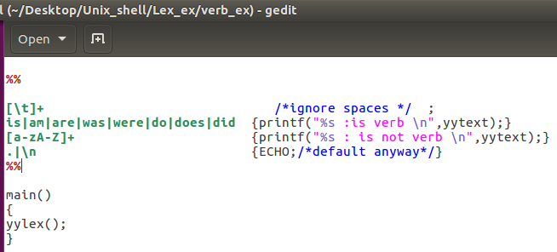
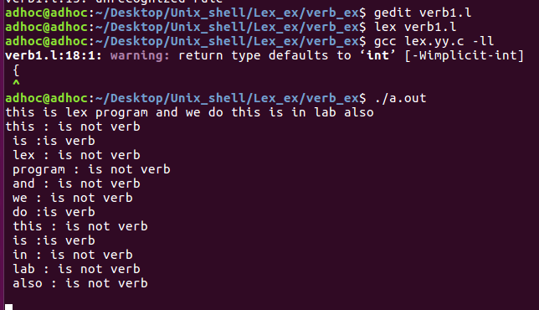
Lex program to recognize Verb

Slide 14
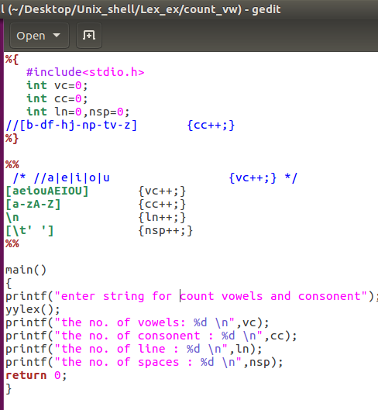
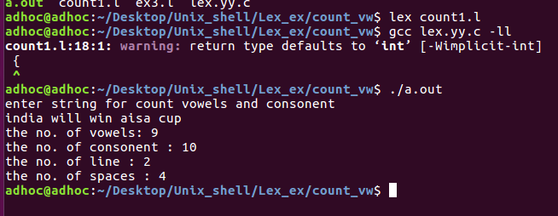
To count no. Of Vowels & Consonent

Slide 15
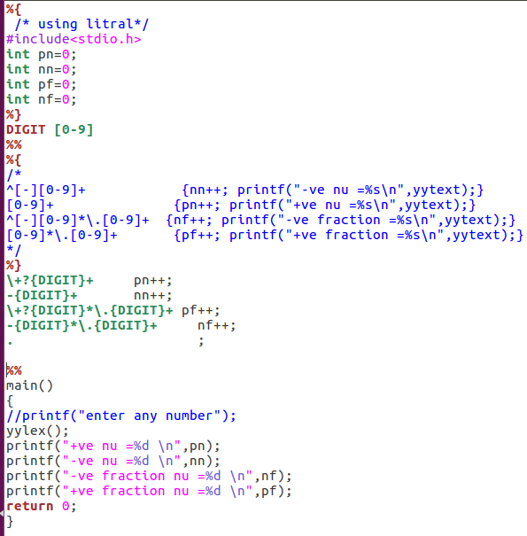
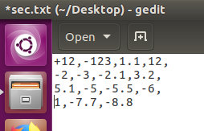
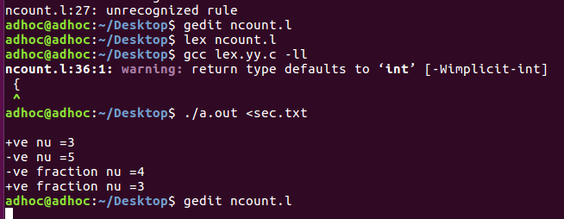
Use Litral /create your variable

Slide 16
Print the letter of string one by one
%{ #include<stdio.h>
char ch, i,j;
}
%%
[a-z]* { for(i=‘d’;i>=‘a’;i--)
{for(j=‘a’;j<=i;j++)
{printf(“%c”,j);
}
printf(“\n”);
}
}
%%
Int main()
{
yylex();
return0;
}
Output: $ lex p7.l
$ gcc lex.yy.c –lfl
$./a.out
abcd
a b c d
a b c
a b
a

Slide 17
Distinguish between keyword
%{
enum{ INTEGER, FLOAT, IDENTIFIER, OPERATOR, COMMENT};
%}
DIGIT [0-9]
letter [a-zA-Z]
%%
“ “| “\t” ; /* [‘ ‘ \t] ; */
{DIGIT }+ { return INTEGER;}
{DIGIT }+\.{DIGIT }+ { return FLOAT;}
‘+’|
‘-’|
‘*’|
‘/’ {return OPERATOR;}
{letter}({letter}\{digit})* { return IDENTIFIER;}
“/*” {return COMMENT;}
%%
Int main()
{
Int result, running=1;
while(running)
{ result=yylex()
switch(result)
{
case INTEGER: printf(“ integer”); break;
---
}
}
Return 0;
}
Output:
$./a.out
My
Identifier
Cin
Identifier
23
Integer
45.67
float

Slide 18
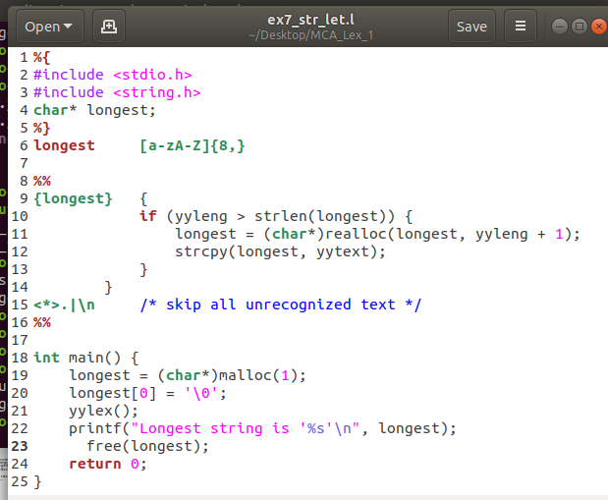
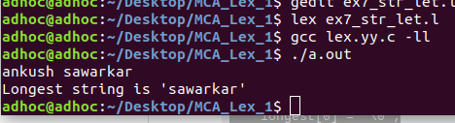
Lonest word of string

Slide 19
Question on Lex
To count no of vowels and consonants.
To count the length of string
To count the type of numbers-- +integer, -ve integer, +ve fraction, -ve fraction
To count the no of words, character, and lines.
To find if a character apart from alphabets occurs in a string.
To identify set of strings having 3 to 5 alphabets.
To count number of small letter, capital letter, special symbol in string.
Note: You have to practice various question of Lex in LAB

