Slide 1
Floyd - Warshall Algorithm
Divyanshu Shrivastava – 187909
MCA – 2nd YEAR

Slide 2
Agenda
Introduction
How Floyd-Warshall Algorithm Works?
Recurrence relation
Recursive approach
Top down dynamic Programming(memorization)
Bottom-up Dynamic programming
Implementation

Slide 3
Introduction
Floyd-Warshall Algorithm is an algorithm for finding the shortest path between all the pairs of vertices in a weighted graph. This algorithm works for both the directed and undirected weighted graphs. But, it does not work for the graphs with negative cycles (where the sum of the edges in a cycle is negative).
Floyd - Warshall algorithm is also called as
Floyd's algorithm
Roy-Floyd algorithm
Roy-Warshall algorithm
WFI algorithm.
A weighted graph is a graph in which each edge has a numerical value associated with it.
This algorithm follows the dynamic programming approach to find the shortest paths.

Slide 4
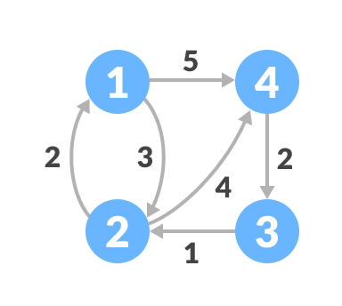
How Floyd-Warshall Algorithm Works?
Let the given graph be:

Slide 5
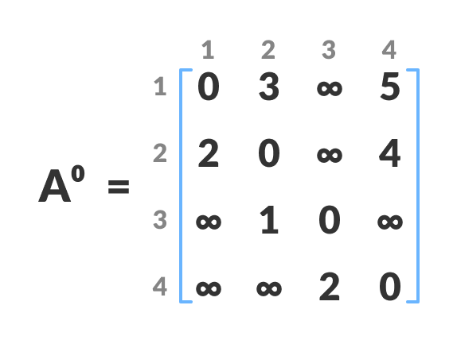
Step 1
Create a matrix A⁰ of dimension n*n where n is the number of vertices. The row and the column are indexed as i and j respectively. i and j are the vertices of the graph. Each cell A[i][j] is filled with the distance from the i^{th} vertex to the j^{th} vertex. If there is no path from i^{th h} vertex to j^{th} vertex, the cell is left as infinity.

Slide 6
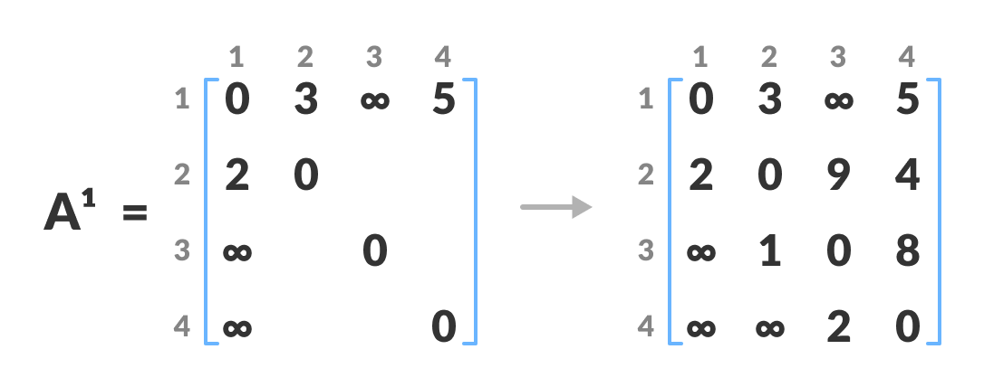
Step 2
Now create a matrix A¹ using matrix A⁰ . The elements in the first column and the first row are left as they are. The remaining cells are filled in the following way.
Let k be the intermediate vertex in the shortest path from source to destination. In this step, k is the first vertex. A[i][j] is filled with
(A[i][k] + A[k][j]) if (A[i][j] > A[i][k] + A[k][j]).
That is, if the direct distance from the source to the destination is greater than the path through the vertex k, then the cell is filled with A[i][k] + A[k][j].
In this step, k is vertex 1. We calculate the distance from source vertex to destination vertex through this vertex k.

Slide 7
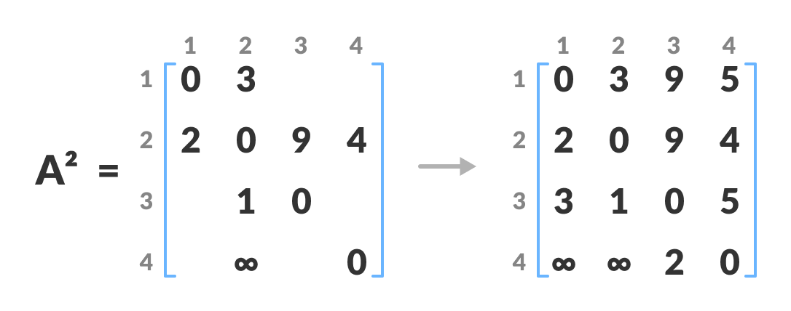
Step 3
In a similar way, A² is created using matrix A³ . The elements in the second column and the second row are left as they are.
In this step, k is vertex (i.e. vertex 2). The remaining steps are same as step 2.

Slide 8
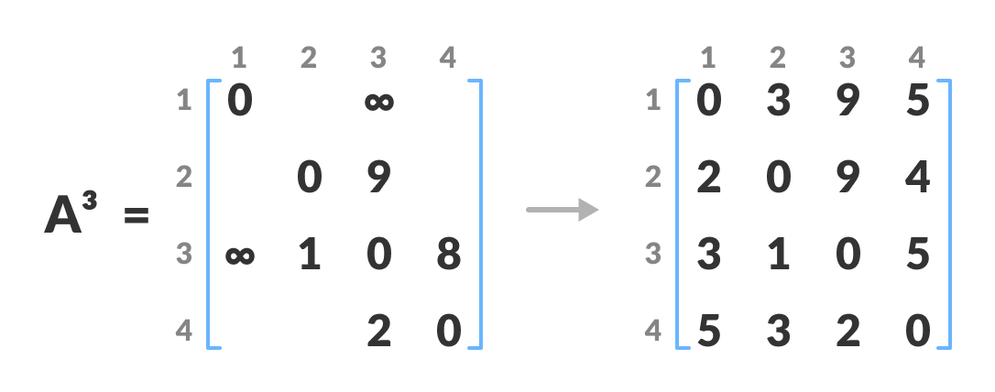
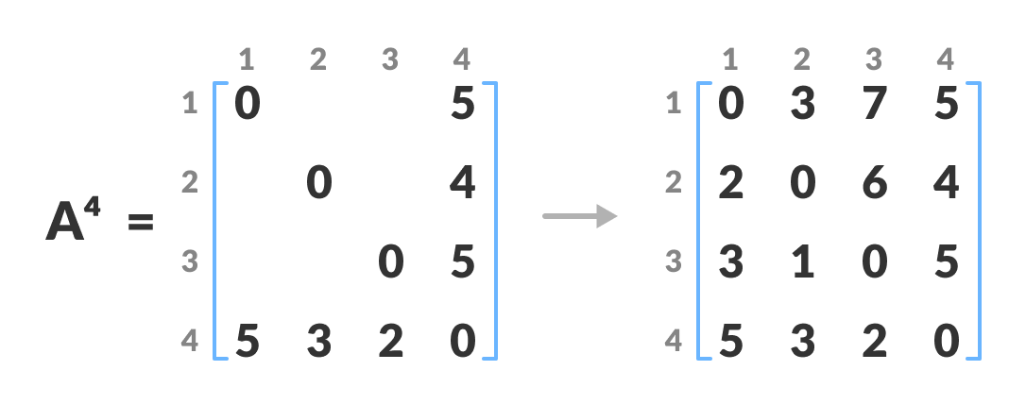
Step 4
In a similar way, A³ and A⁴ is also created. A4 gives the shortest path between each pair of vertices.

Slide 9

Recurrence Relation
Assume we are trying to find a shortest path from u to v using a set of k vertices {w₁, ..., w_{k}}. Then either
w_{k} is an intermediate vertex of a shortest path from u to v and we can break the problem down into the shortest path from u to w_{k} and w_{k} to v
OR w_{k} is not an intermediate vertex and we can just consider the shortest path involving {w₁, ..., w_{k−1}} Recursive Relation: Let $d_{ij}^{(k)}$ be the shortest path from v_{i} to v_{j} using only vertices {v₁, ..., v_{k}}. Then:
$$d_{ij}^{(k)}= \left\{\begin{aligned}w\left(v_{i},v_{j}\right) if k=0 \\ min(d_{ij}^{\left(k−1\right)},d_{ik}^{\left(k−1\right)}+d_{kj}^{\left(k−1\right)} if k>0\end{aligned}\right.$$

Slide 10
recursive Approach
function floydwarshall(w, n) begin
var D = 2D array (n * n)
for i = 1 to n begin
for j = 1 to n begin
D[i, j] = fwr(w, n, i, j)
end
end
return D
end
function fwr(w, k, i, j) begin
if k = 0 then return w[i, j]
else begin
var c1 = fwr(w, k-1, i, j)
var c2 = fwr(w, k-1, i, k) + fwr(w, k-1, k, j)
return min(c1, c2)
end
end
Time Complexity O(n⋅nm) = O(n²m), may be as bad as n⁴ if m=n²

Slide 11
TOP-DOWN Approach
function floydwarshall(w, n) begin
var D = 2D array (n * n)
for i = 1 to n begin
for j = 1 to n begin
D[i, j] = fwr(w, n, i, j)
end
end
return D
end
var m = 3D array (n*n*n) initialized to infinity
function fwr(w, k, i, j) begin
if m[k, i, j] = infinity then begin
if k = 0 then m[k, i, j] = w[i, j]
else begin
var c1 = fwr(w, k-1, i, j)
var c2 = fwr(w, k-1, i, k) + fwr(w, k-1, k, j)
m[k, i, j] = min(c1, c2)
end
end
return m[k, i, j]
end
Time Complexity O(n³)

Slide 12
BOTTOM-UP Approach
function floydwarshall(w, n) begin
var D = 3D array (n*n*n) initialized to infinity
for i = 1 to n begin
for j = 1 to n begin
D[0, i, j] = w[i, j]
end
end
for k = 1 to n begin
for i = 1 to n begin
for j = 1 to n begin
var c1 = D[k-1, i, j]
var c2 = D[k-1, i, k] + D[k-1, k, j]
D[k, i, j] = min(c1, c2)
end
end
end
return D[n]
end
Time Complexity O(n³)

Slide 13
Implementation - 1
# Python Program for Floyd Warshall Algorithm
# Number of vertices in the graph
V = 4
# Define infinity as the large enough value. This value will be
# used for vertices not connected to each other
INF = 99999
# Solves all pair shortest path via Floyd Warshall Algorithm
def floydWarshall(graph):
""" dist[][] will be the output matrix that will finally
have the shortest distances between every pair of vertices """
""" initializing the solution matrix same as input graph matrix
OR we can say that the initial values of shortest distances
are based on shortest paths considering no
intermediate vertices """
dist = map(lambda i : map(lambda j : j , i) , graph)
""" Add all vertices one by one to the set of intermediate
vertices.
---> Before start of an iteration, we have shortest distances
between all pairs of vertices such that the shortest
distances consider only the vertices in the set
{0, 1, 2, .. k-1} as intermediate vertices.
----> After the end of a iteration, vertex no. k is
added to the set of intermediate vertices and the
set becomes {0, 1, 2, .. k}
"""

Slide 14
Implementation - 2
for k in range(V):
# pick all vertices as source one by one
for i in range(V):
# Pick all vertices as destination for the
# above picked source
for j in range(V):
# If vertex k is on the shortest path from
# i to j, then update the value of dist[i][j]
dist[i][j] = min(dist[i][j] ,
dist[i][k]+ dist[k][j])
printSolution(dist)
# A utility function to print the solution
def printSolution(dist):
print "Following matrix shows the shortest distances\
between every pair of vertices"
for i in range(V):
for j in range(V):
if(dist[i][j] == INF):
print "%7s" %("INF"),
else:
print "%7d\t" %(dist[i][j]),
if j == V-1:
print ""
# Driver program to test the above program
graph = [[0,5,INF,10],
[INF,0,3,INF],
[INF, INF, 0, 1],
[INF, INF, INF, 0]
]
# Print the solution
floydWarshall(graph);

Slide 15
Thankyou
Divyanshu Shrivastava
Mca 2nd Year
Roll No. – 187909
Reg. No. – MC18111

