Slide 1
ROBOTIC PROCESS AUTOMATION
Divyanshu Shrivastava – 187909
MCA – 2nd YEAR

Slide 2
Agenda
What do we mean by Robotics process automation
RPA REQUIREMENT SCENARIO
Where do we require RPA
Benefits of USING RPA
What to AUTOMATE
How to automate
LIVE EXAMPLE

Slide 3
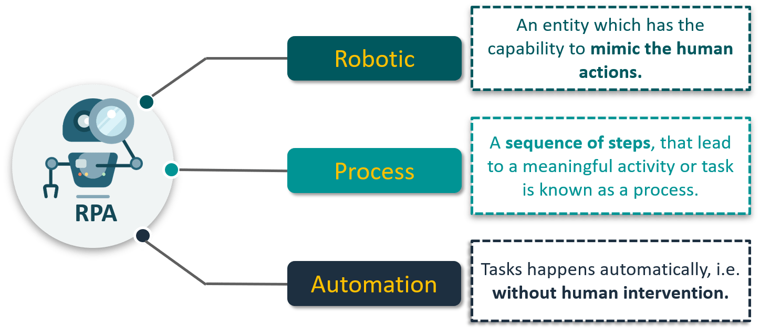

Slide 4

WHY RPA?
CREDIT CARD FRAUD DETECTION
Points which are checked?
Last Location of Access
Usual Amount of Transaction
Number of times wrong PIN entered

Slide 5

WHY RPA?
CREDIT CARD FRAUD DETECTION

Slide 6

WHY RPA?
CREDIT CARD FRAUD DETECTION
Anomalies
Workforce
Automated System

Slide 7
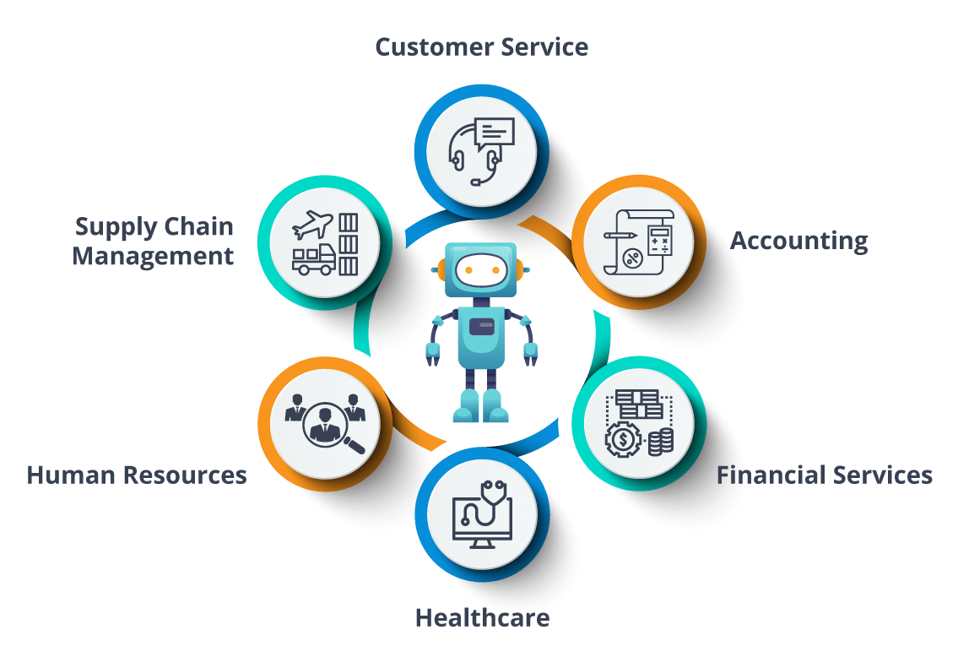
WHY Robotic Process Automation ?

Slide 8
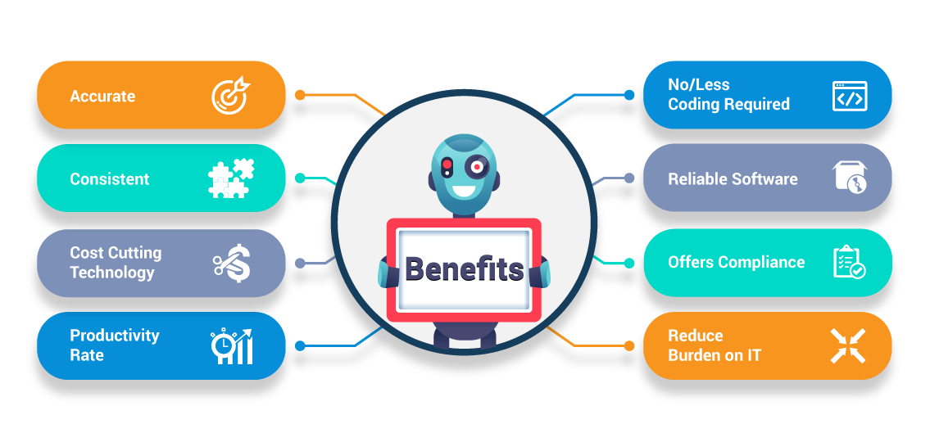
Benefits of Robotic Process Automation

Slide 9



What to Automate?
RPA Amenability
BOT Requirements
Process Optimization

Slide 10
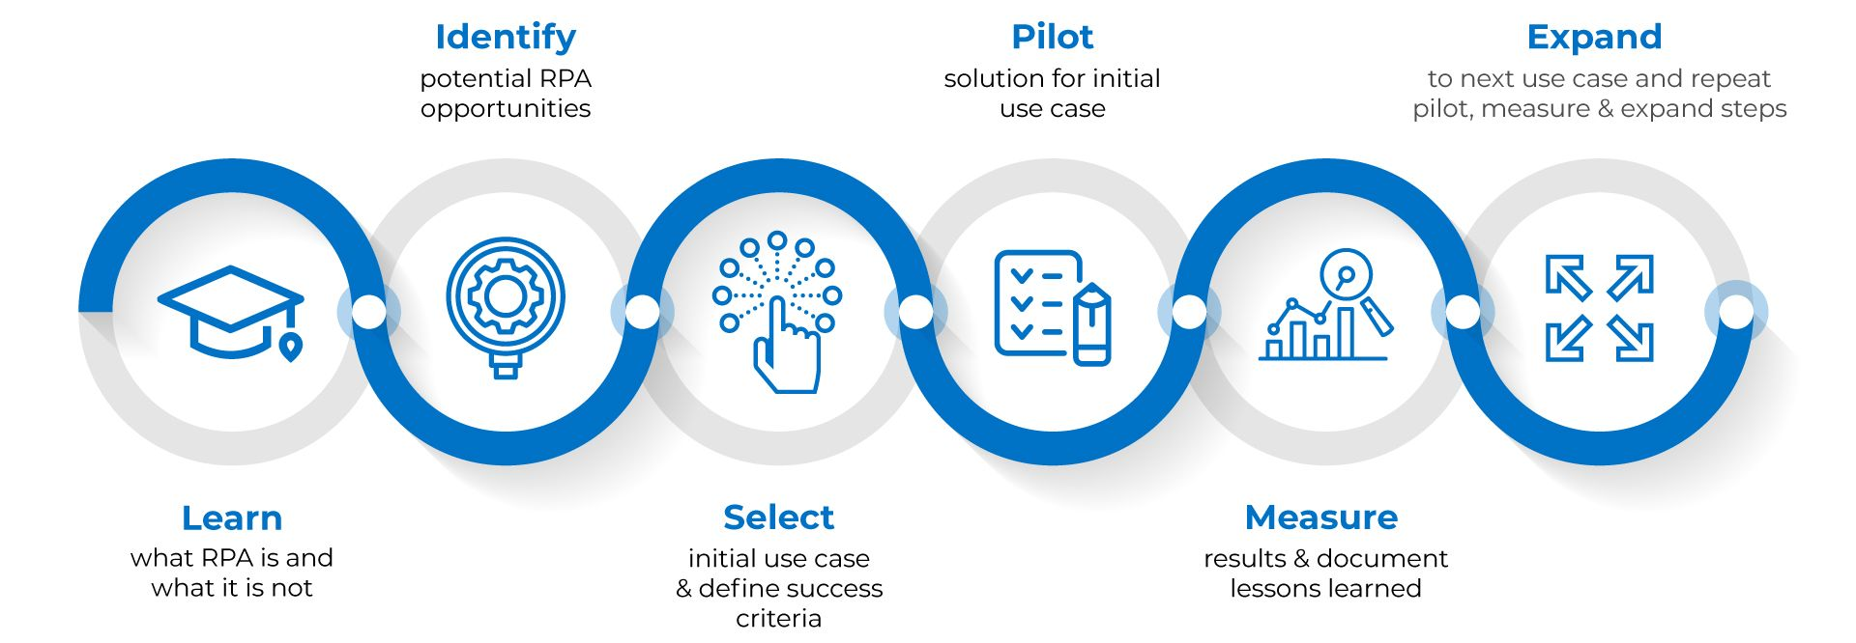
HOW to Automate?

Slide 11
Let US SEE A Live Example

Slide 12
THANKYOU

