Slide 1
Gen AI Based Email classification and OCR
by Binary Brains Team
(Divya & Yamini)

Slide 2
Introduction
This system automates service ticket creation by extracting text from emails and attachments, analyzing content using AI, and generating tickets based on confidence scores.

Slide 3
Email Processing Layer
- Extract email body text
- Extract attachments (PDF, DOC, etc.) using PyMuPDF, pdfminer.six, or python-docx

Slide 4
Text Aggregation & Preprocessing
- Combine extracted text
- Clean and normalize data

Slide 5
AI Model Processing Layer
- Pass combined text to a pre-trained BERT model (or other LLM)
- Perform intent classification & extract relevant entities
- Compute confidence score

Slide 6
Service Ticket Creation
- If confidence score is high: auto-create ticket
- If confidence score is low: send for manual review

Slide 7
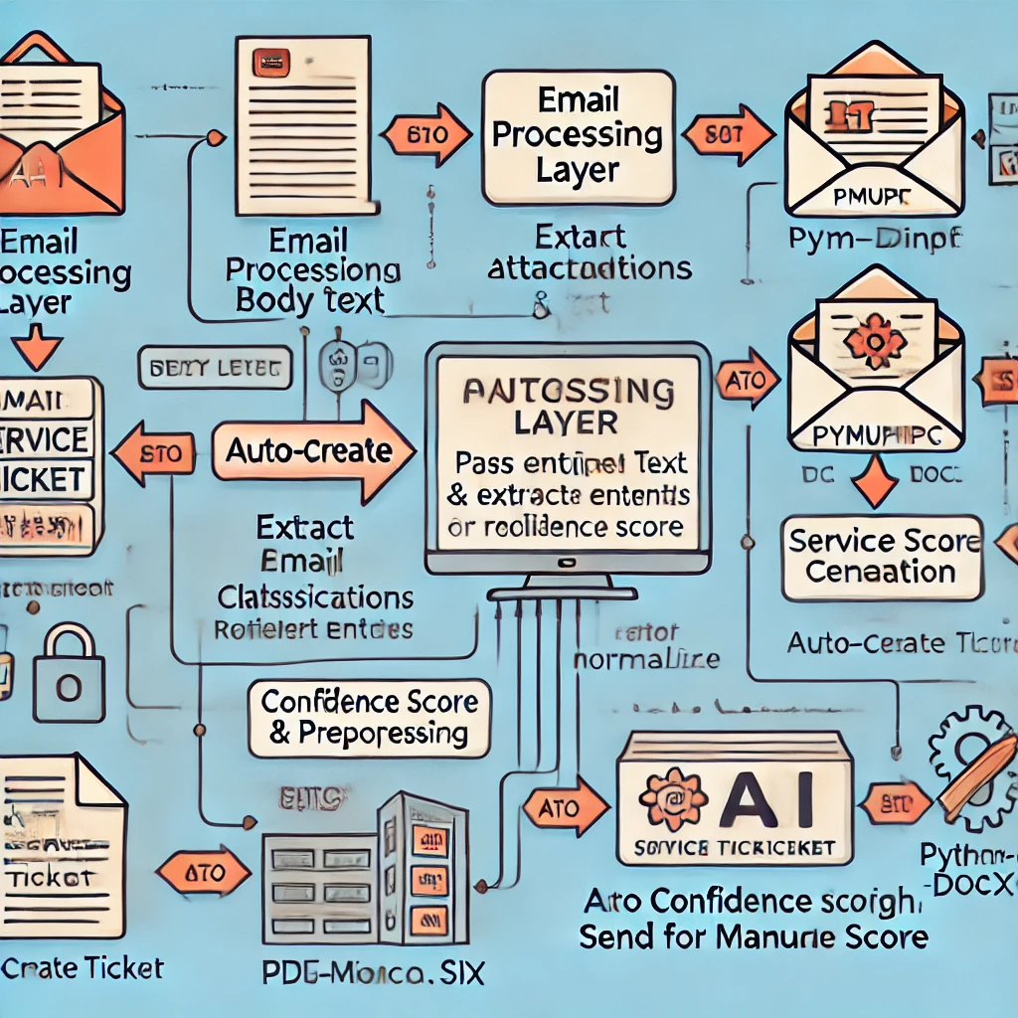
Architectural Flow Diagram

