Slide 1
Hadoop KT
- Diwakar Sharma

Slide 2
What is Big Data?
Do you know ?
In a minute there are around 4 millions searches on google
In a minute, around million orders are placed on Amazon and Alibaba
Around 100 K hours of video streaming occurs on YouTube
Millions of share on Facebook
All this data is usually in size of petabytes ( 1PB = ~1000TeraBytes)
So all these above scenarios are basically the reason why entire world is leaning towards heavy usage of data (what we know as Big Data)

Slide 3
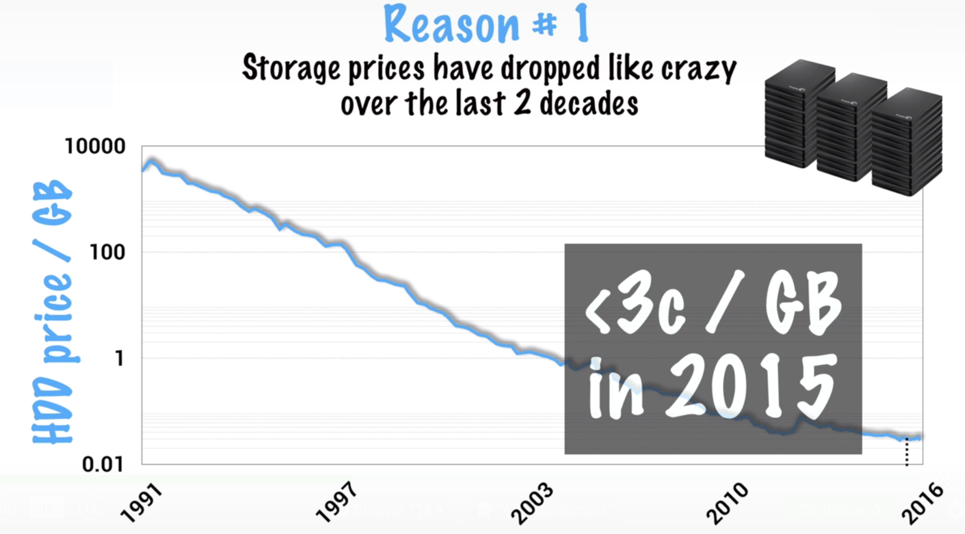
What is the need for all this data?
Big organizations can afford it
Why – Because they have resources and price of storage is decreased in last 20 years

Slide 4
Continued…
Big companies can monetize on these data :-
Ads
Revenue Services
Personalized Search
Recommendations
Can built better products (maps, voice assistants like Siri etc.)

Slide 5
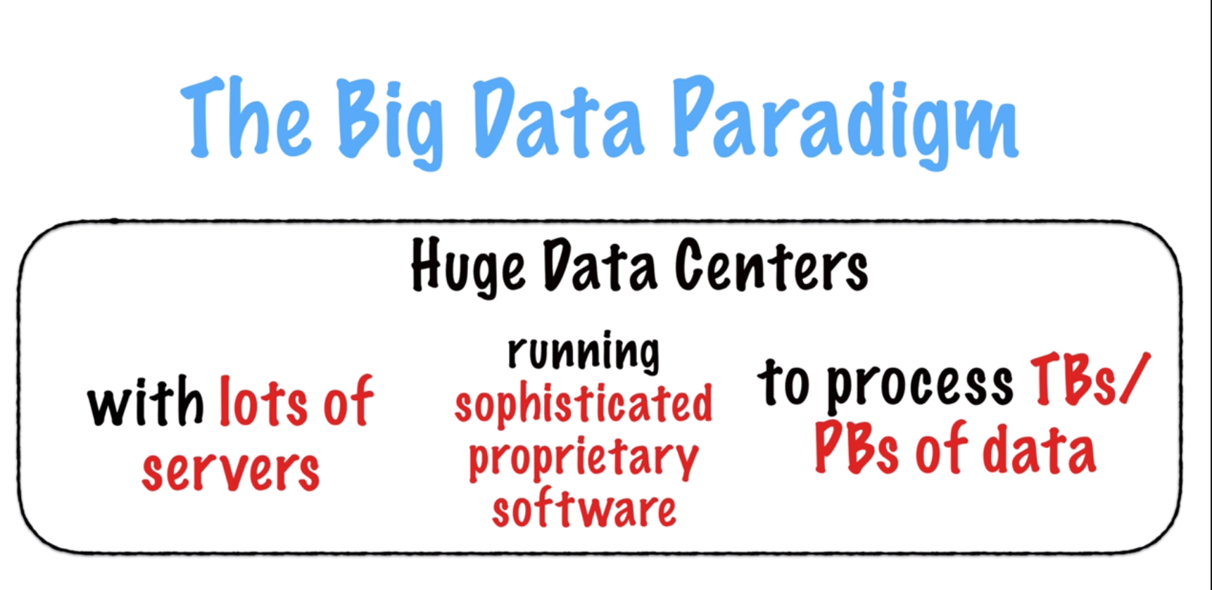
How they do it?
Have huge data centers
These data centers have large number of servers
They have their own software to analyze this huge data

Slide 6
Why do we care?
Yes, we do not have big loads of data like Facebook, Twitter etc.
But we still have data in TB/PB order
So, we should harness this technology to scale down and scale up based on demand
Classic example – Amazon Web Services
Example of Flipkart – Started with excel sheets to analyze data but with scaling they moved to in memory solutions like HANA and now with such a huge data load they are using Big data technologies

Slide 7
Why do we care?
Serial vs Distributed computing
Usually disks have a limitation ( transfer speed, latency, how much storage available)
But When we distribute the computing what happens:-
Divide big chunk of data in small loads. ( 100 TB/10 machines reduce read time)
Disk size – No problem now
Also, disks have now less data it can be processed with less efficiency processors as well

Slide 8
Hadoop
Distributed computing framework
Developed in Java (Apache Software Foundation)
Hadoop has
a file system which manages data storage
A framework to process this data ( which is done across multiple machines)
File system is called HDFS and framework is called as MapReduce

Slide 9
Continued…
Current version was released in 2013 known as Hadoop 2.0
MapReduce is broken in two parts
MapReduce – define what data processing task
Yarn – framework which runs this data processing task
Do not forget HDFS (the actual storage)

Slide 10
HDFS
Hadoop Distributed File System
It is installed on a group of machines which we know as Cluster
One of these machines or nodes is main called as name Node
This name node contains – directory structure and metadata for all files across entire cluster
Rest other nodes are called as data nodes which actually contains data to be processed upon
Whenever we encounter big data it is broken down in blocks of 128MB (standard size)
Why 128 MB ?

Slide 11
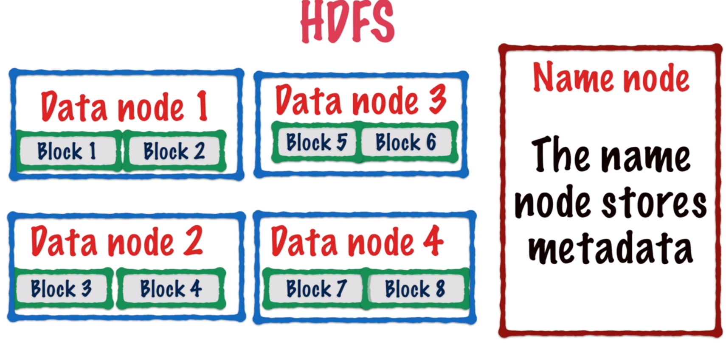
Continued…
These blocks are stored across different data nodes and this distribution is random
Which many any node can contain any block and name node contains block location for different file or data in general:-
So the files are read (1. Metadata in namenode 2. blocks in datanodes)

Slide 12
Question ?
What if some block gets corrupted ?
What if entire data node crashes?
Hint – Replication factor….

Slide 13
MapReduce
We have already stored file in HDFS
(Framework takes care of replication factor)
Objective – Find the frequency of word in a text file
Option 1 → reconstruct the entire file in one node and process it to find the frequency of word ( serial programming as we have done in Java count, shell scripting)

Slide 14
Continued….
Option 2 → Feed the file to Hadoop framework where it is splitted in blocks. Each block contains some words.
Count the frequency of words in Blocks ( 12,3------n)
We can get n results based on number of blocks
What to do now?
Take all these n results and feed to one process ( summation, division etc)
This is the idea behind MR ( parallelization)

Slide 15
Continued…
2 phases
Map → Process each block in the node it is stored in
Reduce → Take all the results to a single node and do some process (combine)
Not to worry about what if some block gets corrupted and what if node is down etc since MR framework takes care of it and Hadoop admin checks the health which doing manual check process

Slide 16
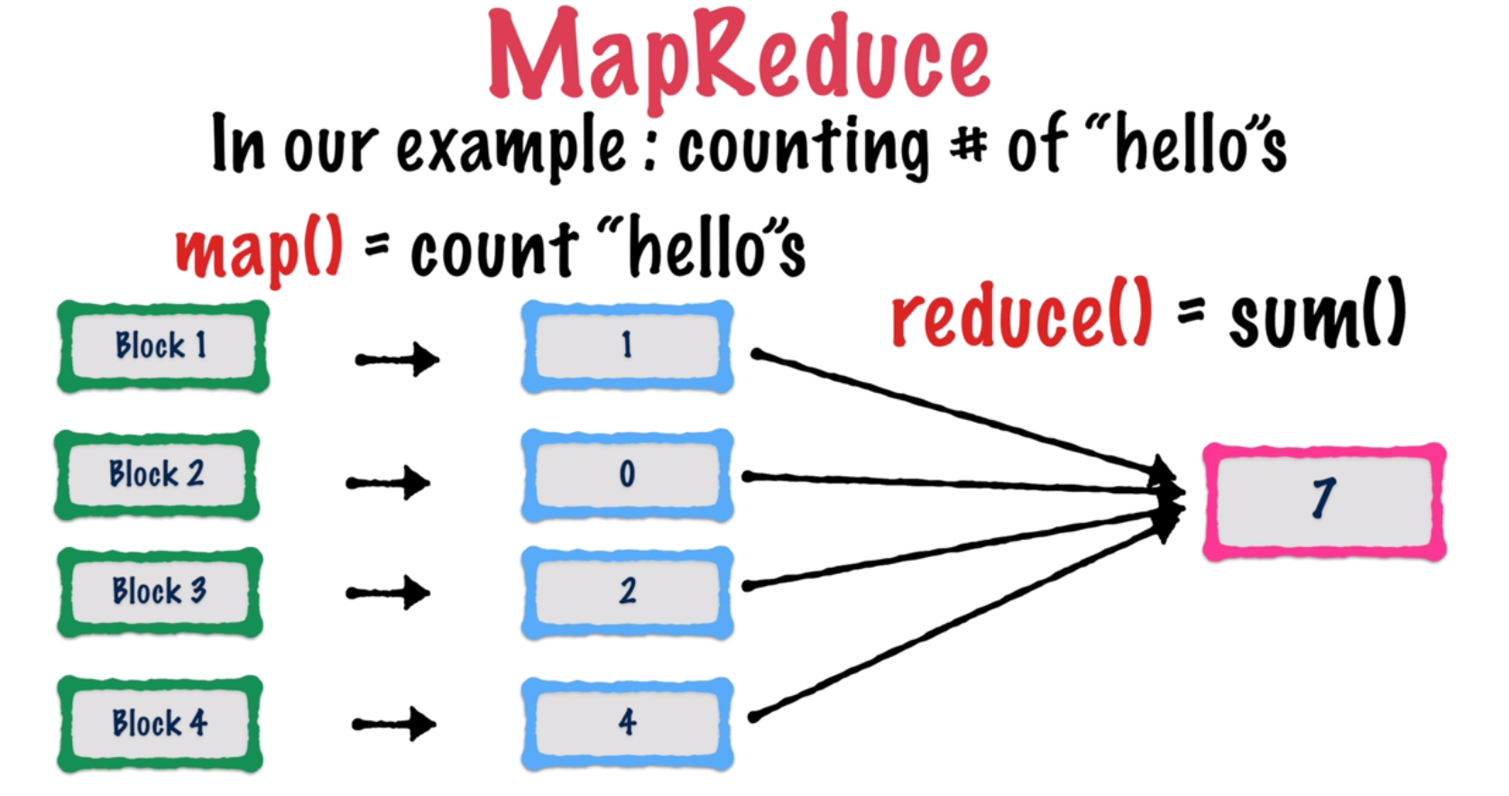
Continued…

Slide 17
YARN
Yet Another Resource Negotiator
Introduced in Hadoop 2.0
Why – to handle the management of resources on cluster
Co-ordinated all different MR tasks on cluster
Also monitors for failures and assigns new resources
We’ll discuss later if time permits ( not required as a developer)

Slide 18
Summary of Hadoop
1. MapReduce – Developer writes map and reduce tasks using MR api
2. YARN – Assigns jobs to cluster
3. HDFS – Stores final result once job is completed.

Slide 19
Hadoop Shell Basics
Print the Hadoop version – hadoop version
List the contents of root dir in HDFS – hadoop fs –ls /
Report the amount of space used and available : Hadoop fs –df hdfs:/
Run a DFS filesystem checking utility: Hadoop fsck - /
Run a cluster balancing utility : Hadoop balancer
Create a dir: Hadoop fs –mkdir ~/dirname
List content in new dir : Hadoop fs –ls ~/dirname
Add textfile to this dir: Hadoop fs –put origindir/file.txt /destdir

Slide 20
See how much space this dir occupies: hadoop fs –du –s –h dirname
Delete a file abc.txt from this dir : Hadoop fs -rm dirname/abc.txt
Wild card deletion : Hadoop fs –rm –r dirname/*
Empty Trash: Hadoop fs –expunge
copyfromLocal: Hadoop fs –copyFromLocal localdir/filename destdir/
Copy inside hdfs: Hadoop fs –cp dir1/file1 dir2
Also –get can be used in place of –copyToLocal similarly –put for –copyFromLocal
Default file permissions in HDFS are 666

Slide 21
Copy from one node in cluster to another
hadoop fs -distcp hdfs://namenodeA/apache_hadoop hdfs://namenodeB/Hadoop
-overwrite option to overwrite existing files
-update to syncronize dir
List all Hadoop shell commands: Hadoop fs
Help : Hadoop fs -help

