Slide 1



Slide 2

What is Hive ?
What Hive is Not
Hive Architecture
Hive QL
Tables
Joins

Slide 3
What is Hive :
The Apache Hive data warehouse software facilitates querying and managing large datasets residing in distributed storage. Built on top of Apache Hadoop, it provides
Tools to enable easy data extract/transform/load (ETL)
A mechanism to impose structure on a variety of data formats
Access to files stored either directly in Apache HDFS or in other data storage systems such as Apache Hbase
Query execution via Map Reduce
Provides SQL like query language –HIVE QL. Allows to plug in custom mappers/reducers in queries and also allows UDFs
Hive is designed to enable easy data summarization, ad-hoc querying
and analysis of large volumes of data

Slide 4
What Hive is Not ?
Latency for Hive queries is generally very high (minutes) even when data sets involved are very small (say a few hundred megabytes). As a result it cannot be compared with systems such as RDBMS.
Hive is not designed for online transaction processing and does not offer real-time queries and row level updates. It is best used for batch jobs over large sets of immutable data (like web logs). Table update is achieved by transforming data into new table.
Hive schema is not a ‘schema on write’. Does not verify the data when it is loaded. It is a ‘schema on read’ which verifies data on SQL query.
Unlike RDBMS table, More than one schema can be applied to same data
Hive doesn’t define clear semantics for concurrent access to tables, which means applications need to build their own application-level concurrency or locking mechanism. The Hive team is actively working on improvements in all these areas.

Slide 5
Hive is used for:-
Log Processing
Text Mining
Document Indexing
Customer-facing business intelligence (Google analytics)
Predictive Modeling
Hypothesis Testing

Slide 6
Hive Architecture :
Metastore : Stores system catalog
Driver : manages life cycle of HiveQLquery as it moves thru’ HIVE; also manages session handle and session statistics
Query compiler: Compiles HiveQLinto a directed acyclic graph of map/reduce tasks
Execution engines: The component executes the tasks in proper dependency order; interacts with Hadoop
Hive Server : provides Thrift interface and JDBC/ODBC for integrating other applications.
Client components: CLI, web interface, jdbc/odbcinteface
Extensibility interface include SerDe, User Defined Functions and User Defined Aggregate Function.

Slide 7
Hive Data Organized as
Databases –Namespace that separates tables
Tables -Homogeneous units of data with same schema
Partitions -A way of dividing a table into coarse-grained Parts based on the value of a partition column, such as date.
Buckets -Tables or partitions may further be subdivided into buckets, to give extra structure to the data that may be used for more efficient queries.

Slide 8
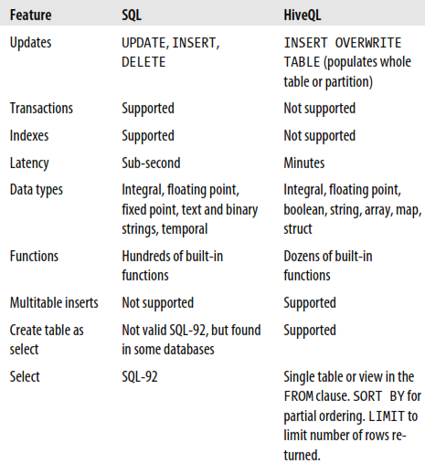
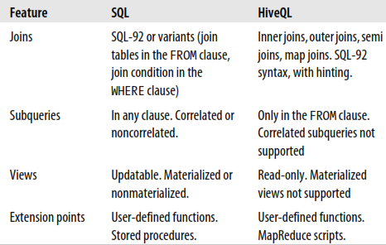
Difference B/W HIVE and SQL

Slide 9
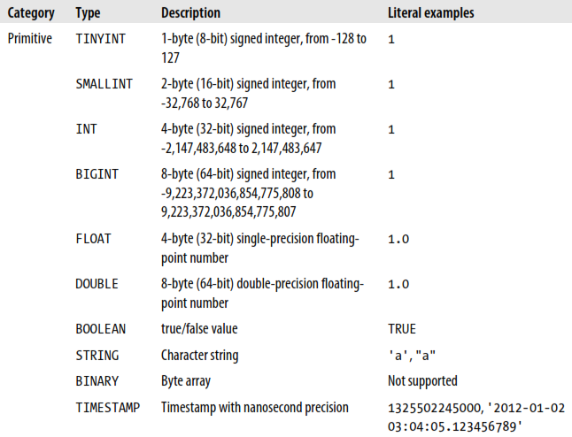
Data Types:
1. Primitive Data Type 2. Complex Data Type

Slide 10
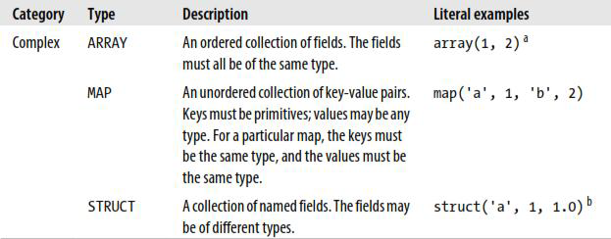
Complex Data Types

Slide 11
Data Storage Hive and HDFS
LOADING DATA FROM LOCAL FILE TO HDFS
LOADING DATA FROM HDFS TO LOCAL
LOADING DATA FROM LOCAL FILE TO HIVE TABLE
LOADING DATA FROM HDFS FILE TO HIVE TABLE
LOADING DATA FROM Hive TABLE TO Hive TABLE

Slide 12
Data Storage
Warehouse directory in HDFS
–e.g., /user/hive/warehouse
• Tables stored in subdirectories of
warehouse
–Partitions, buckets form subdirectories of
tables
• Actual data stored in flat files
–Control char-delimited text, or Sequence Files
–With custom SerDe, can use arbitrary format

Slide 13
Generally in the Hadoop Data Work Flow going on 3 modes i.e
1. Local Mode
2. Standalone Mode ( Pseudo Mode) : ( fs )
3. Pseudo-Distributed Mode ( dfs )
Local Mode:
Standalone Mode: In standalone mode everything (namenode, datanode, tasktracker,
jobtracker) is running in one JVM on one machine
Pseudo-Distributed Mode: In pseudo-distributed mode, everything is running each in it's own JVM, but still on one machine. In terms of the client interface there shouldn't be any difference
Example: $hadoop <fs/dfs> -<hdfs commands>
Ex: $hadoop dfs -ls fs: file System
dfs: distributed file system

Slide 14
Hive console: hive shell is called hive console
$ hive >
$hive > show tables;
To Display all files and Directores of Hadoop:
$hadoop fs -ls;
$hadoop fs -mkdir <dirname>
$hadoop fs -ls <dirname>
$hadoop fs -cat <dirname/filename>

Slide 15
Types of tables
Inner or Manage Table (by default)
External Table
Partitioned
Non partitioned
Partitioned
Non partitioned

Slide 16
Managed Tables and External Tables
When you create a table in Hive, by default Hive will manage the data, which means that Hive moves the data into its warehouse directory.
Alternatively, you may create an external table, which tells Hive to refer to the data that is at an existing location outside the warehouse directory.
The difference between the two types of table is seen in the LOAD and DROP Semantics.
 | Managed Table | External Table
Create / Load | Data will be Warehouse directory | Data will be at external location. Does not even check whether external location exists.
Drop | Metadata and Data is deleted | Metadata is deleted and data is untouched.

Slide 17
CREATE TABLE managed_table(dummy STRING);
LOAD DATA INPATH '/user/tom/data.txt' INTO table managed_table;
CREATE EXTERNAL TABLE external_table2(dummy STRING)
LOCATION '/user/mydir/external_table2’;
LOAD DATA INPATH '/user/tom/data.txt' INTO TABLE external_table2;
Which one to use?
As a rule of thumb, if you are doing all your processing with Hive, then use managed tables, but if you wish to use Hive and other tools on the same dataset, then use external tables. A common pattern is to use an external table to access an initial dataset stored in HDFS (created by another process), then use a Hive transform to move the data into a managed Hive table. This works the other way around, too—an external table (not necessarily on HDFS) can be used to export data from Hive for other applications to use.
Another reason for using external tables is when you wish to associate multiple schemas with the same dataset.

Slide 18
Partitions
Partition : means to categorize the data in a table.
Whenever we request a piece of data we use Partitions by default it is a Non-Partitioned Table.
Types: 1. Partitioned
2. Non – Partitioned (by Default)
EX: Non-Partitioned:
Syntax: create table <table name>(col1 data type,col2 data type, …………) row format delimited
fields terminated by ‘,’
Loading: load data local inpath ‘<local file name>’ into table <table name>;
EX: Partitioned:
SYS: hive> create table <TN>(…….) partitioned by(…….) row format ………;
Syntax EX: hive> create table sales_day(prid int,prname string,quantity int,price double,branch string) partitioned by (day int,month int,year int) row format delimited fields terminated by ',';

Slide 19
hive> load data local inpath 'sales' into table sales_day partition(day=12,month=2,year=2013);
Hive> load data local inpath ‘sales2’ into table sales_day partition(day=13,month=2,year=2013);
Hive> select * from sales_day;
Note :
In hive Partitioned are logical in RDBMS the partitions are Physical;
We use the technique of partitions to manage incremental loads;
Distinct: to eliminates duplicate vales in list of a column.
Ex1: hive> select distinct(dloc) from dept;
Ex2: hive>select count(distinct(dloc)) from dept;

Slide 20
Hive Built in Functions :
Floor () : floor(7.6)/floor(7.1) = 7
Round() : round(7.1) = 7
Ceil() : ceil(7.1)=8
Sqrt() : Square root
Cbrt() : cubic root
Pow() : Power value
ex: pow(n,2) = n^2
7. Concat() : Concatenating string
Ex : concat(firstname , last name) : ram kumar
concat(firatname,’-’,lastname) : ram-kumar
concat(‘-’,firstname.lastname,middlename); : ram-kumar-mani

Slide 21
JOINS
A. Inner Join B. Outer Join
1. Left Outer Join
2. Right Outer Join
3. Full Outer Join

Slide 22
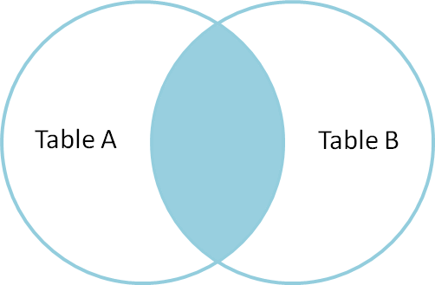
INNER JOIN :
hive> SELECT * FROM sales;
NAME ID
Joe 2
Hank 4
Ali 0
Eve 3
Hank 2
hive> SELECT * FROM things;
ID NAME
2 Tie
4 Coat
3 Hat
1 Scarf
We can perform an inner join on the two tables as follows:
hive> SELECT sales.*, things.*
> FROM sales JOIN things ON (sales.id = things.id);
Joe 2 2 Tie
Hank 2 2 Tie
Eve 3 3 Hat
Hank 4 4 Coat
Select e.id, d.id,d.name from sales e join things d on(e.id=d.id);

Slide 23
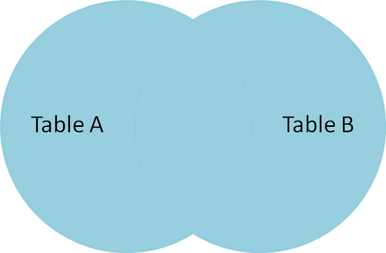
OUTER JOIN
Full Outer Join
hive> SELECT sales.*, things.* FROM sales FULL OUTER JOIN things ON (sales.id = things.id);
Ali 0 NULL
NULL 1 Scarf
Joe 2 2 Tie
Hank 2 2 Tie
Eve 3 3 Hat
Hank 4 4 Coat

Slide 24
Left Outer Join
hive> SELECT sales.*, things.*
FROM sales LEFT OUTER JOIN things ON (sales.id = things.id);
Ali 0 NULL
Joe 2 2 Tie
Hank 2 2 Tie
Eve 3 3 Hat
Hank 4 4 Coat
Right Outer Join:
hive> SELECT sales.*, things.*> FROM sales RIGHT OUTER JOIN things ON (sales.id = things.id);
NULL 1 Scarf
Joe 2 2 Tie
Hank 2 2 Tie
Eve 3 3 Hat
Hank 4 4 Coat

