Slide 1
Hadoop KT- Day2
- Diwakar Sharma

Slide 2
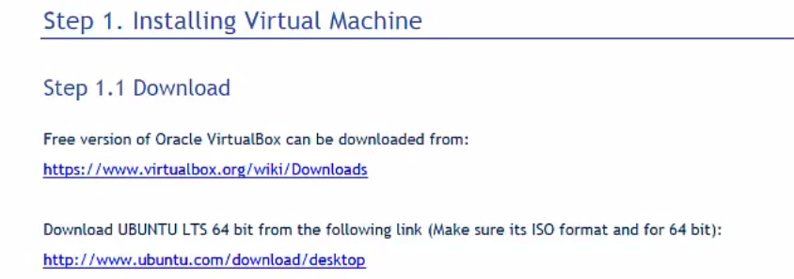
Hadoop Setup
1. Install virtual machine

Slide 3
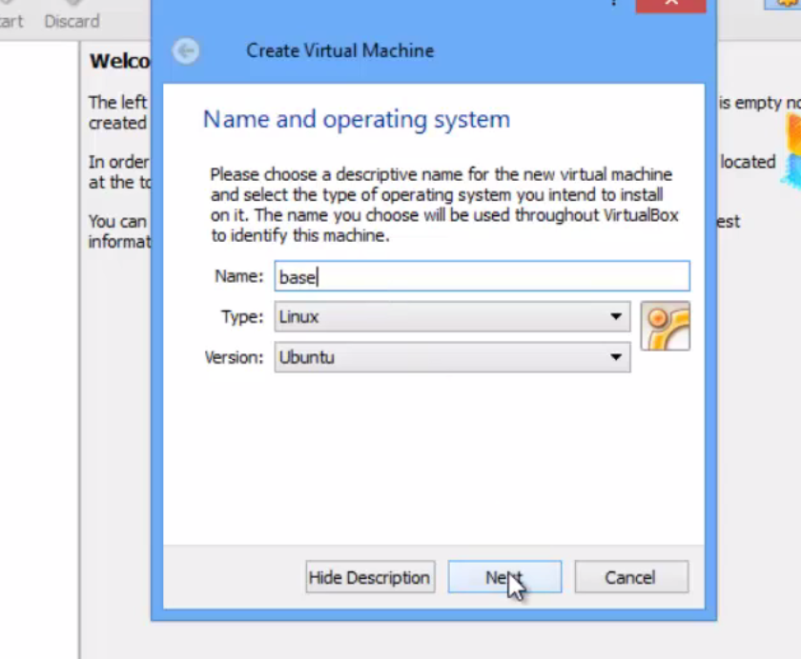
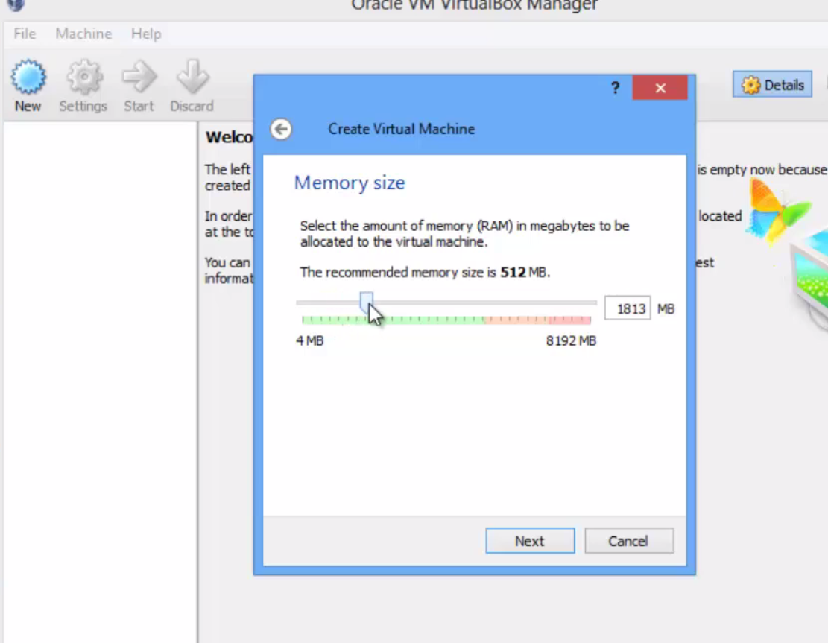
Choose Ram at least 2GB (4GB advised)

Slide 4
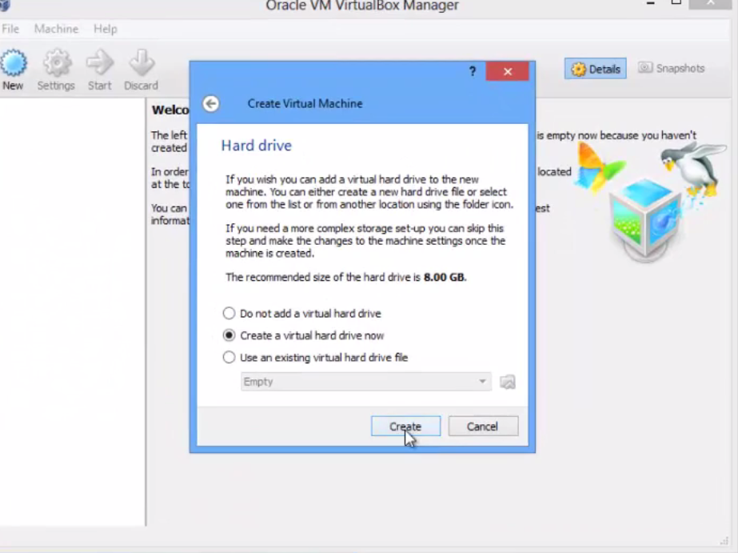
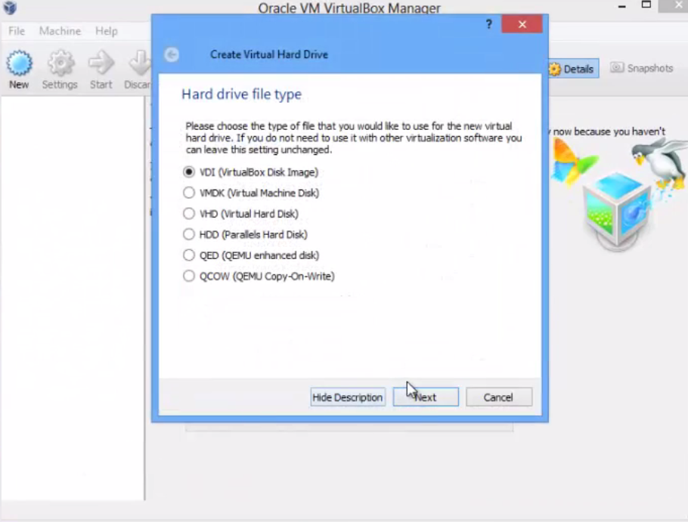

Slide 5
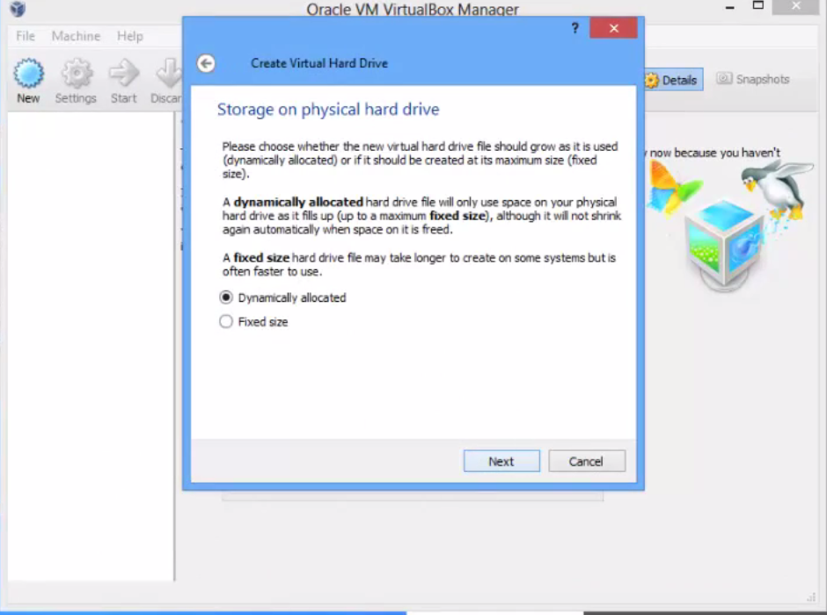
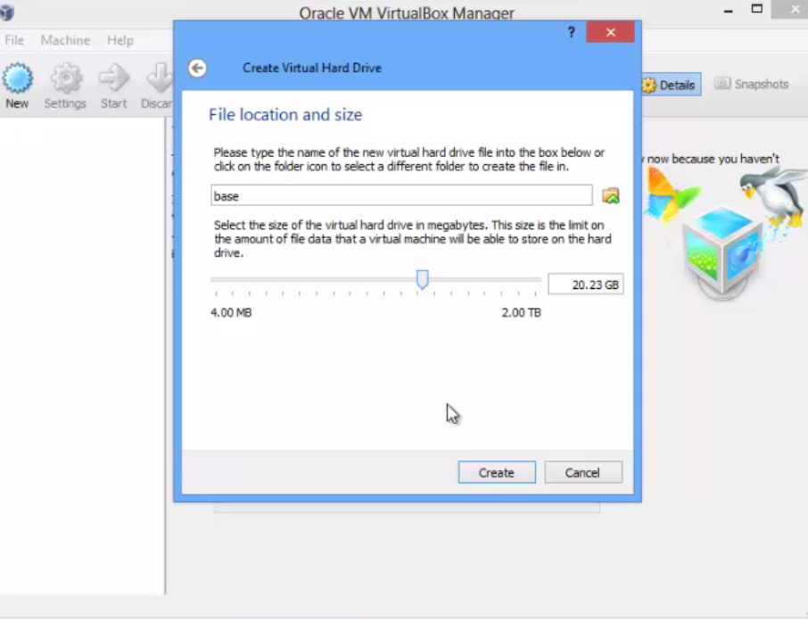

Slide 6
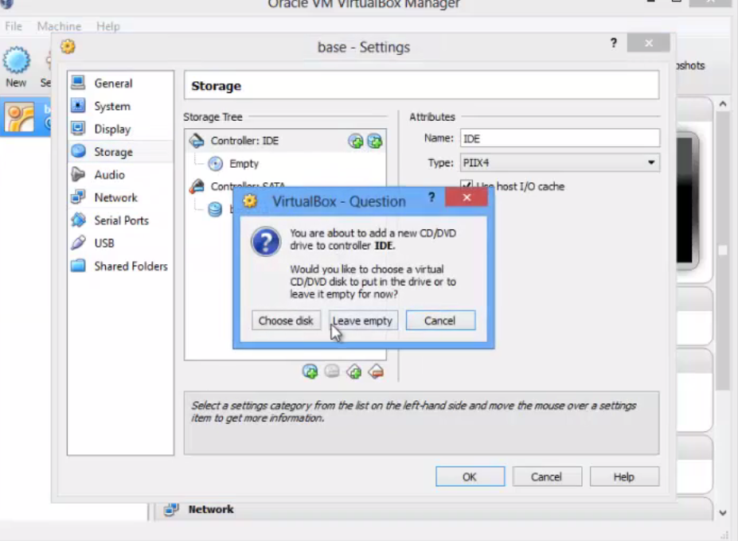
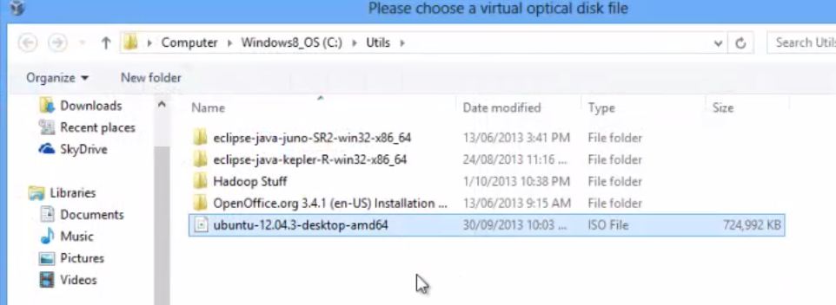
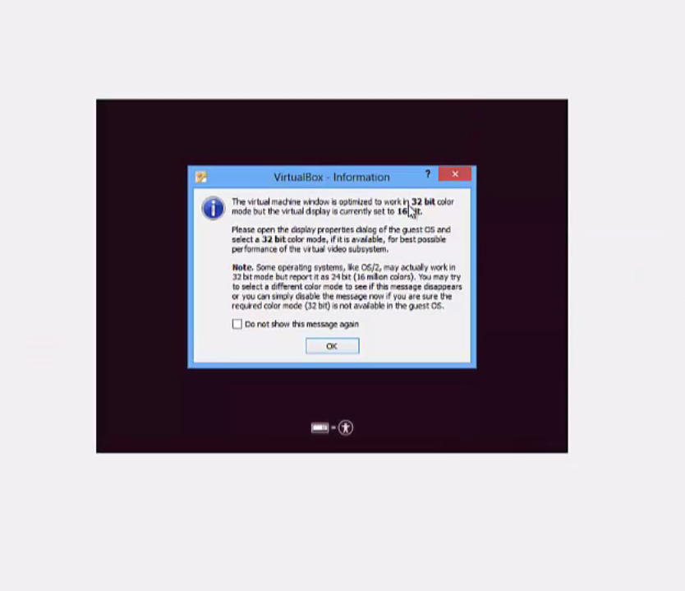

Slide 7
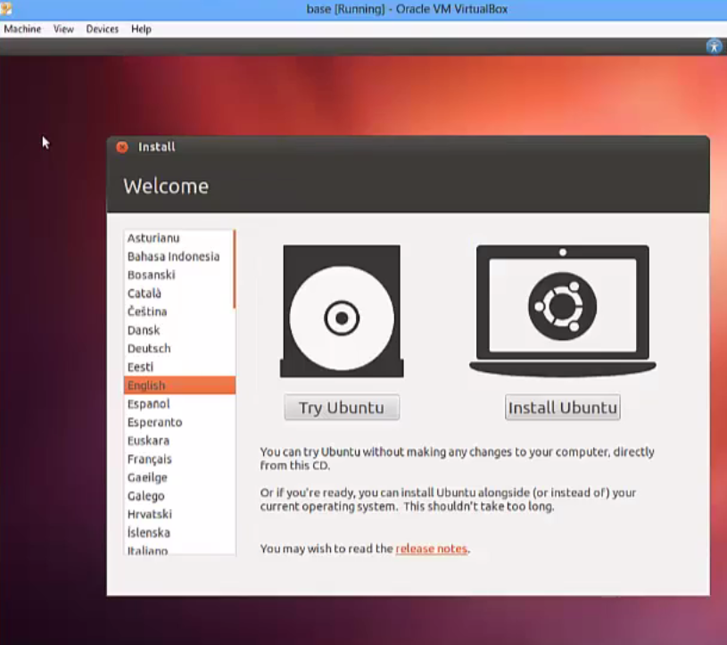
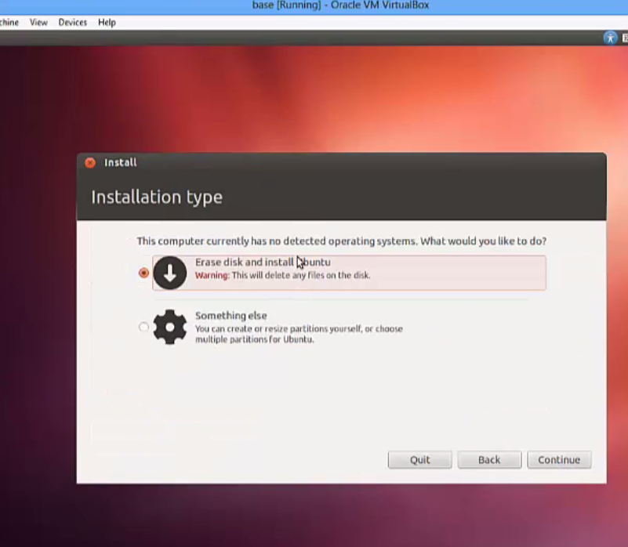

Slide 8
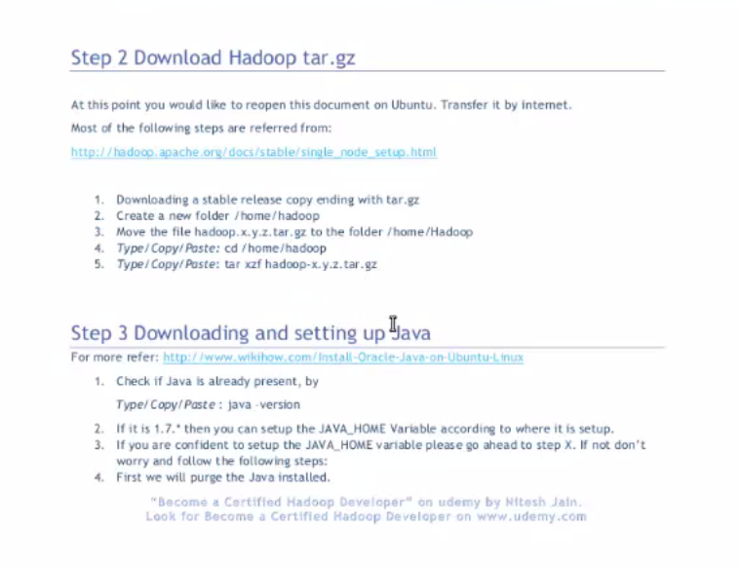
After Ubuntu Install

Slide 9
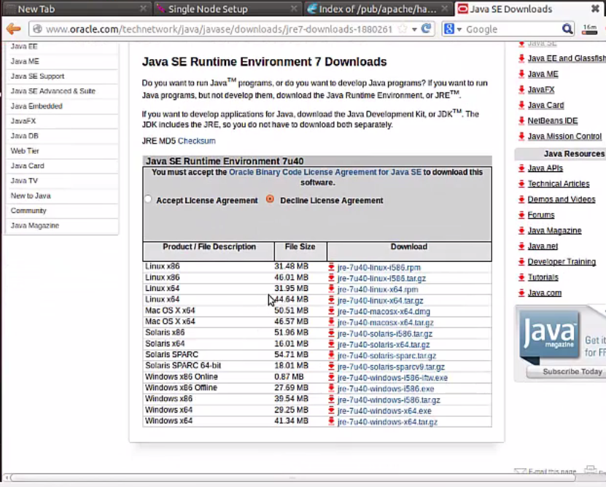

Slide 10
https://media.readthedocs.org/pdf/doctuts/latest/doctuts.pdf
https://rstudio-pubs-static.s3.amazonaws.com/78508_abe89197267240dfb6f4facb361a20ed.html

