Slide 1

Coffee Shop Sales Analysis
Data-Driven Insights for Better Decision-Making

Slide 2
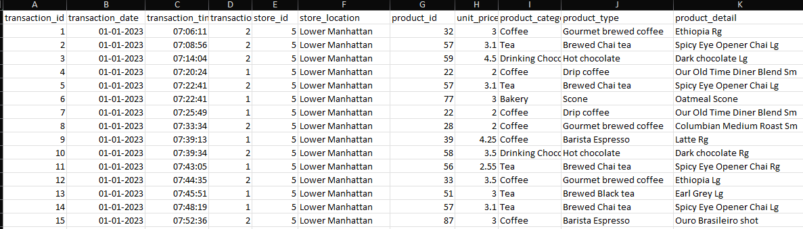
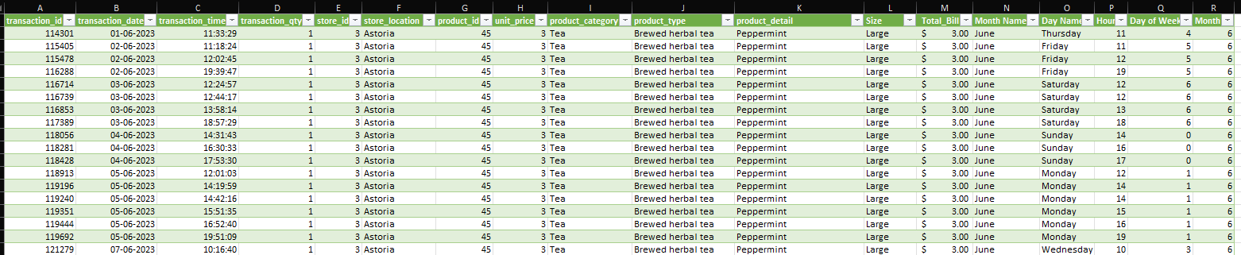
Raw Data
Transformed Data

Slide 3
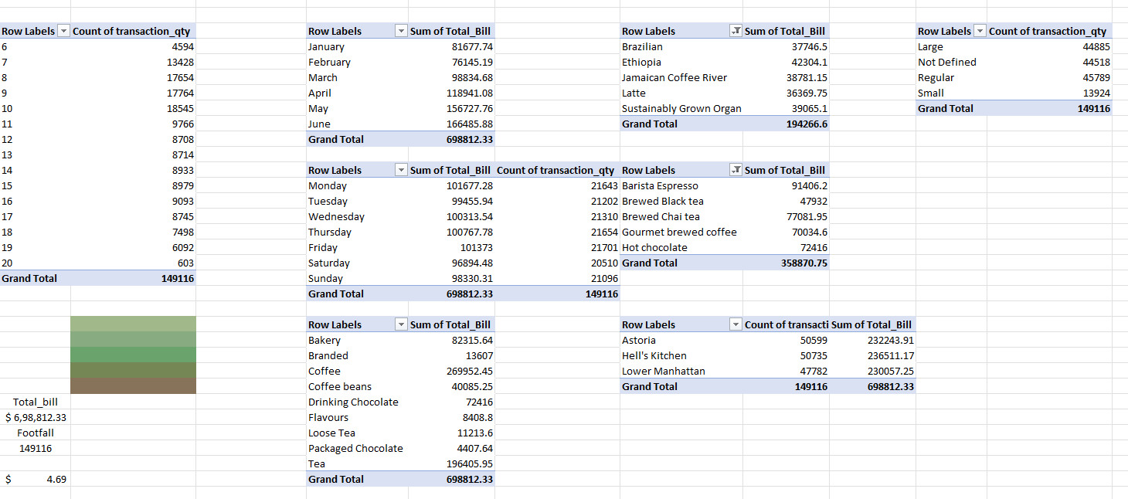
Pivot Table

Slide 4
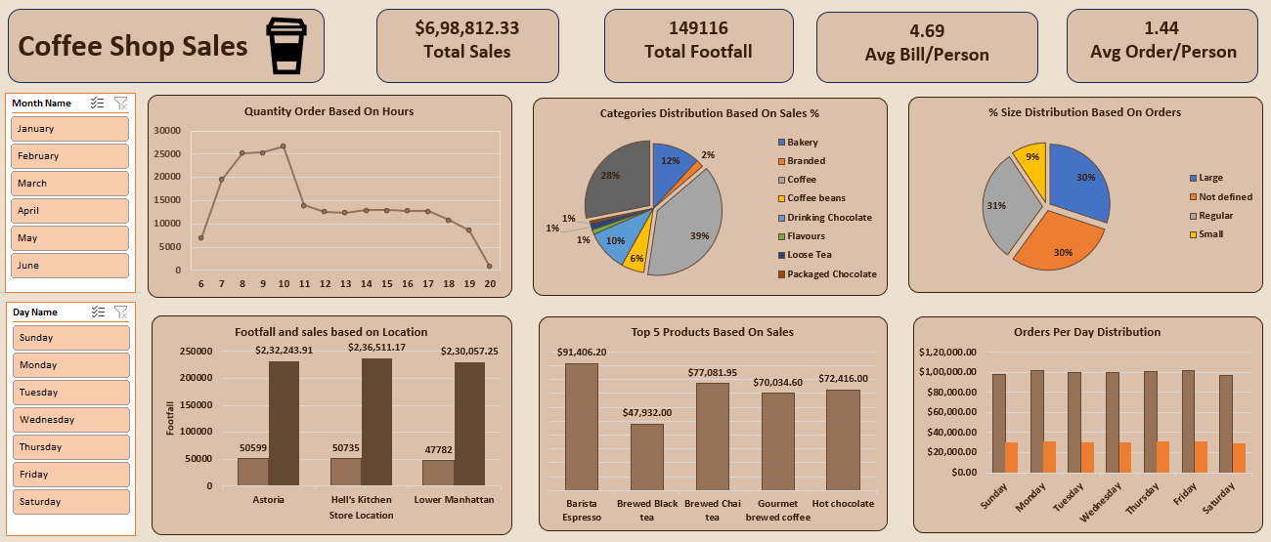
DASHBOARD

Slide 5
Key Metrics
1. Total Sales: $698,812.33
2. Total Footfall: 149,116 customers
3. Average Bill Per Person: $4.69
4. Average Order Per Person: 1.44

Slide 6
Sales Insights
1. Peak Order Hours: 8 AM to 10 AM – Mornings are crucial!
2. Top Categories by Sales:
- Coffee: 39%
- Bakery: 28%
- Coffee Beans: 12%
3. Sales by Location:
- Hell’s Kitchen: $236,511.17
- Astoria: $232,243.91
- Lower Manhattan: $230,057.25

Slide 7
Product and Order Insights
1. Top 5 Products by Sales:
- Barista Espresso: $91,406.20
- Brewed Black Tea: $77,081.95
- Brewed Chai Tea: $70,034.60
2. Orders Per Day Distribution:
- Highest on Fridays and Wednesdays – Time to plan those special deals!

