Slide 1


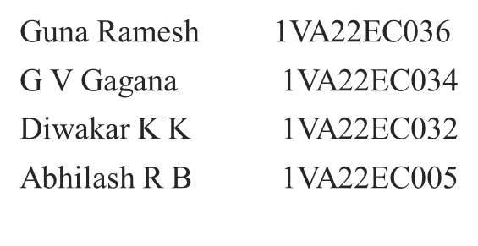

SAI VIDYA INSTITUTE OF TECHNOLOGY
DEPARTMENT OF
ELECTRONICS AND COMMUNICATION ENGINEERING
PHASE II MAJOR PROJECT (BEC786)
DESIGN AND IMPLEMENTATION OF CIRCULAR MICROSTRIP PATCH ANTENNA
A
Department of ECE
Sai Vidya Institute of Technology
MAJOR PROJECT PHASE II (BEC786)

Slide 2
ACKNOWLEDGEMENT
I would like to express my heartfelt gratitude to everyone who has contributed for commencement of Major Project Phase II [BEC786].
We would like to thank the Management and Prof. M R Holla, Director, Dr. A M Padma Reddy, Additional Director, Sai Vidya Institute of Technology for providing facilities and supporting us.
We wish to express our sincere gratitude to Dr. Y JAYASIMHA, Dean Academics and Professor, Department of ECE, Our beloved Principal Dr. Manjunath T N, Sai Vidya Institute of Technology, for providing us required facilities to carry out project Work.
We are thankful to Dr. VENKATESHA M, Professor and HOD, Department of Electronics and Communication Engineering, Sai Vidya Institute of Technology, for his valuable suggestions and support.
We extend deepest thanks to our project guide, Prof. Darshan R V, Assistant Professor for their invaluable guidance, constructive feedback, and constant encouragement throughout the completion of Major Project Phase II [BEC786].
DESIGN AND IMPLEMENTATION OF CIRCULAR MICROSTRIP PATCH ANTENNA

Slide 3
ABSTRACT
Wireless communication appears in almost every electronic device today, in cluding Wi-Fi routers, Bluetooth gadgets, smart home systems, and IoT devices. All these systems require an antenna to send and receive signals. In this project, a circular microstrip patch antenna is designed for the 2.45 GHz frequency, which is commonly used for Wi-Fi, Bluetooth, and other short-range wireless applications. The antenna uses an FR4 substrate, which is low-cost and easy to make in college labs. The design started with calculations using standard formulas. Then, it was modeled and simulated using ANSYS HFSS, a software tool for studying antenna behavior. The simulation results reveal important performance parameters such as return loss (S11), VSWR, radiation pattern, and gain. The antenna resonates at 2.45 GHz with good matching and acceptable radiation performance. This project aids in understanding how to design, analyze, and optimize antennas using simulation tools. The results indicate that the circular microstrip patch antenna is suitable for simple wireless applications and can be improved in the future by increasing bandwidth, boosting gain, or enabling operation at multiple frequencies.
Keywords: Microstrip Patch Antenna, Circular Patch, 5G, IoT, Substrate, radition pattern,VSWR
DESIGN AND IMPLEMENTATION OF CIRCULAR MICROSTRIP PATCH ANTENNA
Circularly Polarized Multi-Band Microstrip Patch Antenna for 5G and IoT
MAJOR PROJECT PHASE 1 (BEC685)

Slide 4
PROJECT AGENDA
Introduction
Literature Survey
Research Gap
Problem Statement
Objectives
Tools required
Results
Conclusions
Bibliography
DESIGN AND IMPLEMENTATION OF CIRCULAR MICROSTRIP PATCH ANTENNA
MAJOR PROJECT PHASE 1 (BEC685)
Circularly Polarized Multi-Band Microstrip Patch Antenna for 5G and IoT

Slide 5
INTRODUCTION
This project focuses on the design and analysis of a circular microstrip patch antenna (CMPA) operating at 2.45 GHz within the ISM band, widely used for Wi-Fi, Bluetooth, ZigBee, and IoT applications. CMPAs are favored due to their rotational symmetry, compact size, stable radiation characteristics, and ability to support circular polarization, which reduces multipath interference and polarization mismatch.
The antenna is designed on an FR4 substrate for cost-effectiveness and ease of fabrication. Key performance parameters such as return loss (S₁₁), Voltage Standing Wave Ratio (VSWR), bandwidth, gain, radiation efficiency, are analyzed using ANSYS HFSS. This study provides insights into antenna design, electromagnetic theory, and practical implementation, which are essential for modern wireless communication systems and IoT devices.
MAJOR PROJECT PHASE 1 (BEC685)
Circularly Polarized Multi-Band Microstrip Patch Antenna for 5G and IoT
DESIGN AND IMPLEMENTATION OF CIRCULAR MICROSTRIP PATCH ANTENNA

Slide 6
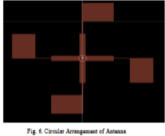
LITERATURE SURVEY
Paper Details | Proposed Work | Methodology | Research Gap
Title of paper: Design and Simulation of Microstrip Patch Antenna Using Circular Structure Author Names: Kalamani C., Dhanasekar J., Abiramasundari S., and Ishwarya Niranjana M. Year of Publication: 2023 | the proposed work involves designing and simulating a circular microstrip patch antenna using ADS software, operating at multiple frequency bands (4.5, 5.7, and 7.6 GHz). It aims to enhance gain, directivity, and return loss by inserting a λ/4 transmission line. The antenna operates at 5.8 GHz, suitable for WLAN and RFID applications. | The methodology involves designing the microstrip patch antenna with optimized dimensions using ADS software. A λ/4 transmission line is inserted to enhance gain and directivity. The antenna is structured in a circular arrangement to improve radiation performance. Simulations evaluate parameters like return loss, gain, and directivity across multiple frequency bands | The study lacks exploration of multi-band performance optimization through novel structural modifications and substrate materials. Further investigation into broadening bandwidth and gain for various configurations remains needed
DESIGN AND IMPLEMENTATION OF CIRCULAR MICROSTRIP PATCH ANTENNA
MAJOR PROJECT PHASE 1 (BEC685)
Circularly Polarized Multi-Band Microstrip Patch Antenna for 5G and IoT

Slide 7
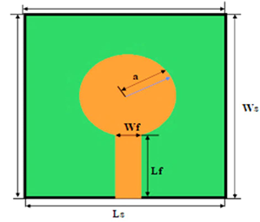
LITERATURE SURVEY
Paper Details | Proposed Work | Methodology | Research Gap
Title of paper:Design and Implementation of Microstrip Circular Patch Antenna for 5G Applications. Author Names:John Colaco and Rajesh Lohani Year of Publication: 2020 | The paper focuses on the design and implementation of a microstrip circular patch antenna for 5G applications, operating at a resonant frequency of 28.5 GHz. Utilizing FEKO software for simulation. | The methodology for designing the microstrip circular patch antenna for 5G applications involves defining parameters using Rogers RT/Duroid 5880 substrate. The antenna geometry is established, followed by simulation with FEKO software. Key performance metrics, including return loss, gain, bandwidth, and radiation efficiency, are analyzed. | Need for improved bandwidth and gain compared to existing designs. Challenges related to dielectric losses and antenna size suggest that exploring alternative materials
DESIGN AND IMPLEMENTATION OF CIRCULAR MICROSTRIP PATCH ANTENNA
Circularly Polarized Multi-Band Microstrip Patch Antenna for 5G and IoT
MAJOR PROJECT PHASE 1 (BEC685)

Slide 8
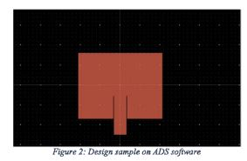
LITERATURE SURVEY
Paper Details | Proposed Work | Methodology | Research Gap
Title of paper:Microstrip Patch Antenna Design and Analysis withVarying Substrates For 5G. Author Names: Rameshwar A. Year of Publication: 2020 | This work designs and analyzes microstrip patch antennas at 28 GHz and 39 GHz using different substrates to identify the most efficient material for 5G applications. | The antenna was designed using an inset-fed rectangular patch, tested at 28 GHz and 39 GHz, and analyzed with different substrates (Rogers 5880, FR4, Teflon) using ADS and MATLAB to evaluate performance. | There is limited research comparing different substrates for microstrip patch antennas at 5G mm-wave frequencies to optimize performance.
DESIGN AND IMPLEMENTATION OF CIRCULAR MICROSTRIP PATCH ANTENNA

Slide 9
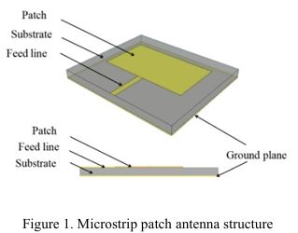
LITERATURE SURVEY
Paper Detail | Proposed work | Methodology | Research Gap
Title of paper: Design and simulation of rectangular microstrip patch antenna with 5Gmm-wave Coaxial Line Back-feed and Microstrip Line side-feeds Author names: Hongxin,Chenwei Wu Year of Publication: 2020. | A self-decoupling circularly polarized MIMO antenna is proposed, using polarization mismatch and a null-field feed position to achieve high isolation without additional decoupling structures. | Two square microstrip patch antennas were designed with L-shaped feeds and corner cuts to achieve circular polarization . Polarization mismatch and null-field placement enabled self-decoupling, ensuring high isolation without extra structures. | There is a lack of compact, self-decoupling circularly polarized MIMO antenna designs that avoid using extra isolation structures.
DESIGN AND IMPLEMENTATION OF CIRCULAR MICROSTRIP PATCH ANTENNA

Slide 10
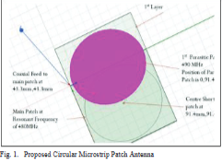
LITERATURE SURVEY
Paper Details | Proposed Work | Methodology | Research Gap
Title of paper:Design of Compact Circular Microstrip Patch Antenna using Parasitic Patch Author Names:Richa Sharma, N.S. Raghava, and Asok De. Year of Publication: 2020 | The proposed work designs a compact circular microstrip patch antenna using parasitic patches, substrate optimization, and a central shorting pin to achieve up to 60% size reduction while maintaining UHF band performance. | The methodology involves designing the circular microstrip patch antenna with parasitic layers, optimizing the feed point, shorting pin location, and substrate height using simulation tools like HFSS to achieve size reduction and desired resonant frequencies. | The gap lies in the limited integrated analysis of parasitic patches, shorting pins, and substrate effects on size and performance optimization of compact circular microstrip antennas in the UHF band
DESIGN AND IMPLEMENTATION OF CIRCULAR MICROSTRIP PATCH ANTENNA

Slide 11
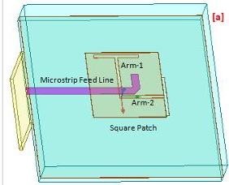
LITERATURE SURVEY
Paper Detail | Proposed work | Methodology | Research Gap
Title of paper: Circularly polarized wideband Aperture Antenna for Wireless Communication. Author Names: Rajeev Verma, Srikant Satya Sai, and Dr. Ajay Kumar Sharma. Year of Publication: 2023. | The proposed work designs a wideband, circularly polarized aperture antenna using layered substrates and orthogonal slot arms, optimized via HFSS for high-frequency wireless applications | The design employs an aperture-coupled microstrip patch antenna with optimized dimensions in HFSS to achieve broadband circular polarization (RHCP). | The research gap is the lack of compact, wideband circularly polarized antennas with enhanced axial ratio and stable gain at millimeter-wave frequencies, suitable for advanced wireless applications
DESIGN AND IMPLEMENTATION OF CIRCULAR MICROSTRIP PATCH ANTENNA
Circularly Polarized Multi-Band Microstrip Patch Antenna for 5G and IoT
Circularly Polarized Multi-Band Microstrip Patch Antenna for 5G and IoT
Circularly Polarized Multi-Band Microstrip Patch Antenna for 5G and IoT

Slide 12
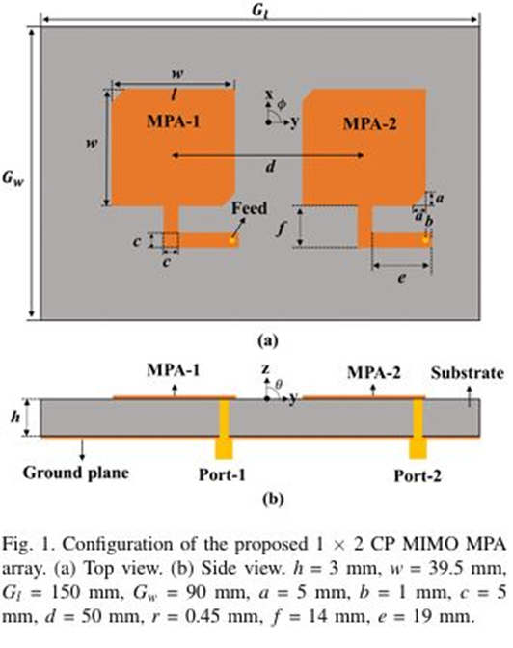
LITERATURE SURVEY
Paper Detail | Proposed Work | Methodology | Research Gap
Title of paper:A Self-Decoupling circularly polarized MIMO microstrip patch Antenna Array. Author Name:shuai Gao,wan Jun Yang, Xin dai and Dong Tang Year of Publication: 2024 | The proposed work is a compact MIMO antenna design that uses smart feeding and polarization tricks to reduce interference between two antennas—achieving high isolation (47 dB) without needing extra components. It's ideal for space-saving applications like 5G and GPS. | The L-shaped feeding lines generate CP in the active antenna and LP in the passive, reducing mutual coupling naturally. This self-decoupling design achieves high port isolation (>47 dB) without extra components, verified by simulations | This work addresses the lack of compact, self-decoupling circularly polarized MIMO antennas by achieving high isolation without extra components.
Circularly Polarized Multi-Band Microstrip Patch Antenna for 5G and IoT
DESIGN AND IMPLEMENTATION OF CIRCULAR MICROSTRIP PATCH ANTENNA

Slide 13
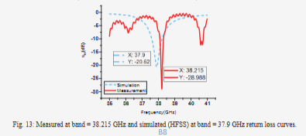
LITERATURE SURVEY
Paper Details | Proposed Work | Methodology | Research Gap
Title of paper:A 38 GHZ MODIFIED CIRCULAR MICROSTRIP PATCH ANTENNA FOR 5G MOBILE SYSTEMS Author Names:Esraa I. Hassan, Radwa I. Hamad, and Mohamed I. Omar. Year of Publication: 2021 | The proposed antenna is a compact, modified circular microstrip patch for 38 GHz 5G applications, with enhanced gain and bandwidth achieved using a defected ground structure. It offers high performance and ease of fabrication | The methodology involves iterative design, simulation, and fabrication of a modified circular microstrip patch antenna with a defected ground structure to optimize performance at 38 GHz for 5G applications. . | The paper proposes a compact, modified circular microstrip patch antenna for 5G at 38 GHz. It features a defected ground structure (DGS) to enhance bandwidth and gain.
DESIGN AND IMPLEMENTATION OF CIRCULAR MICROSTRIP PATCH ANTENNA

Slide 14
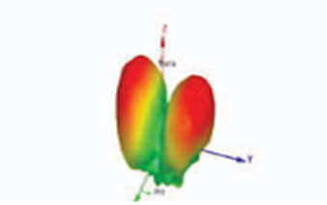
LITERATURE SURVEY
Paper Details | Proposed Work | Methodology | Research Gap
Title of paper: Design and Implementation of Circular Microstrip Patch Array Antenna for 5G Communication using Rogers RT 5880 Author Names: Pasupuleti Swarnalatha, Vivek Rajpoot, R.V.V.Krishna Year of Publication: 2022. | The proposed work involves designing a circular microstrip patch antenna (CMPA) for 5G applications, operating at 28 GHz using Rogers RT5880 substrate. The antenna features a compact size with a diameter of 2.02 mm and aims for low return loss and high gain, achieving S11 values of -16.2 dB for a single antenna and -21.6 dB for a four-element array. | Defining design parameters for a 28 GHz operation, selecting Rogers RT5880 as the substrate, and modeling the antenna using HFSS software. Simulations are conducted to evaluate performance metrics such as return loss and gain for single and array configurations. The design is then optimized based on simulation results and existing literature. | Need for hybrid designs and improved bandwidth. It lacks attention to multi-directional performance in urban environments and IoT optimization.
MAJOR PROJECT PHASE 1 (BEC685)
Circularly Polarized Multi-Band Microstrip Patch Antenna for 5G and IoT
DESIGN AND IMPLEMENTATION OF CIRCULAR MICROSTRIP PATCH ANTENNA

Slide 15
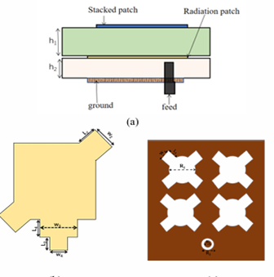
LITERATURE SURVEY
Paper Details | Proposed Work | Methodology | Research Gap
Title of paper: A circularly polarized microstrip phased array antenna for 5G communication Author Names: Liang-Yong Yi, An-Zi Wang, Li Zhang, Shi Fang, Cai-Tao Hui Year of Publication: 2023 | The proposed method in this study involves the design of a single-fed stacked microstrip antenna unit aimed at enhancing the performance of phased arrays for 5G communication. | The design of the circularly polarized microstrip phased array antenna features a stacked square patch configuration with perturbation stubs for enhanced polarization. A 5x5 array is simulated at 3.4-3.7GHz, focusing on optimal reflection coefficients and axial ratios. Simulation results confirm the design's effectiveness for 5G communication applications. | Need for wider beam scanning capabilities without compromising on gain and circular polarization performance Size and Profile Concerns .
MAJOR PROJECT PHASE 1 (BEC685)
DESIGN AND IMPLEMENTATION OF CIRCULAR MICROSTRIP PATCH ANTENNA
Circularly Polarized Multi-Band Microstrip Patch Antenna for 5G and IoT

Slide 16
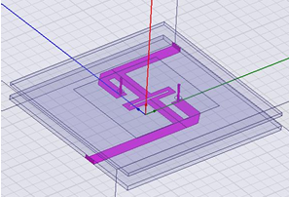
LITERATURE SURVEY
Paper Details | Proposed Work | Methodology | Research Gap
Title of paper: Broadband Circularly Polarized Antenna Design and Simulation for 5G loTApplication Author Names: Lili Wan,Shenghai Chen,Ni Zhou Year of Publication: 2021 | The proposed work involves the design and optimization of a broadband circularly polarized antenna with a resonant frequency of 2.45 GHz, utilizing a square-shaped radiator and dual-coaxial probe feeding. | The methodology includes designing a square patch antenna on an FR4 substrate (80 x 80 x 8.5 mm³) and simulating it using HFSS software to assess performance metrics. Adjustments are made to the feeding mechanism and geometry to optimize impedance and axial ratio bandwidths. This process ensures effective circular polarization. The final design targets applications in 5G IoT. | Struggle to achieve both broad impedance and axial ratio bandwidths while maintaining high performance.
DESIGN AND IMPLEMENTATION OF CIRCULAR MICROSTRIP PATCH ANTENNA
Circularly Polarized Multi-Band Microstrip Patch Antenna for 5G and IoT

Slide 17
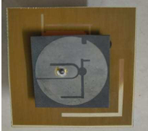
LITERATURE SURVEY
Paper Details | Proposed Work | Methodology | Research Gap
Title of paper: DGS-Based Circularly Polarized Patch Antenna with enhanced Bandwidth for 5G Application Author Names: Syam Sai G, Sesha Sai Harshitha K, Praneeth Kumar P, Damodhar Reddy P and Mekaladevi V Year of Publication: 2024 | This work introduces a microstrip patch antenna for5G applications that is circularly polarized, has slots, and a faultyground structure. The designed antenna is printed on Rogers 5880substrate with overall size of 60 mm × 60 mm × 5.8 mm. | The methodology involves designing a microstrip circularly polarized antenna on a Rogers 5880 substrate with etched slots to achieve circular polarization. It includes simulations to evaluate impedance bandwidth and axial ratio bandwidth, optimizing design parameters for effective performance within the 5G. | Low gain, reduced radiation efficiency, and complex structures leading to difficulties in manufacturing and alignment.
DESIGN AND IMPLEMENTATION OF CIRCULAR MICROSTRIP PATCH ANTENNA
MAJOR POJECT PHASE 1 (BEC685)
Circularly Polarized Multi-Band Microstrip Patch Antenna for 5G and IoT

Slide 18
RESEARCH GAP
Only limited literature addresses a simple single-band circular patch antenna specifically tuned for 2.45 GHz ISM applications while using FR4, despite its cost advantage and availability in academic environments. Furthermore, many existing works do not provide optimization strategies to overcome FR4-related drawbacks such as high dielectric loss, reduced gain, and narrow bandwidth. There is also a lack of studies that adopt an HFSS-based simulation workflow focused on improving impedance matching, return loss, and radiation characteristics for a compact circular geometry suitable for student-level fabrication and low-cost wireless systems. This gap indicates the need for a design approach that is both practically implementable and performance-optimized, which this project aims to fulfill.
MAJOR PROJECT PHASE 1 (BEC685)
DESIGN AND IMPLEMENTATION OF CIRCULAR MICROSTRIP PATCH ANTENNA
Circularly Polarized Multi-Band Microstrip Patch Antenna for 5G and IoT

Slide 19
PROBLEM STATEMENT
Achieving proper impedance matching, acceptable return loss, and stable radiation characteristics remains a significant challenge when designing low-cost antenna solutions for wireless systems operating at 2.45 GHz. The use of FR4 as a substrate further contributes to performance limitations due to dielectric losses and bandwidth reduction. Therefore, this project focuses on addressing these constraints by designing and simulating a circular microstrip patch antenna using ANSYS HFSS to obtain improved impedance matching and reliable radiation performance suitable for practical wireless communication applications.
MAJOR PROJECT PHASE 1 (BEC685)
DESIGN AND IMPLEMENTATION OF CIRCULAR MICROSTRIP PATCH ANTENNA
Circularly Polarized Multi-Band Microstrip Patch Antenna for 5G and IoT

Slide 20
RESEARCH OBJECTIVES
Objective 1 Designing and simulating circular microstrip patch antenna.
Objective 2
To simulate the antenna in HFSS and evaluate its S11, VSWR, radiation pattern, and gain for stable wireless performance.
Objective 3 Enhance antenna performance with slots and feeding methods.
MAJOR PROJECT PHASE 1 (BEC685)
DESIGN AND IMPLEMENTATION OF CIRCULAR MICROSTRIP PATCH ANTENNA
Circularly Polarized Multi-Band Microstrip Patch Antenna for 5G and IoT

Slide 21
TOOLS REQUIRED
These are the software tools been used
HFSS – For design & simulation.
Latex –for report
These are the hardware tools to be used
FR4 Substrate Board (εr = 4.4, h = 3.6 mm) – Base for antenna
Copper-Clad PCB Sheet – For patch and ground plane
Fabrication Tools
MAJOR PROJECT PHASE 1 (BEC685)
DESIGN AND IMPLEMENTATION OF CIRCULAR MICROSTRIP PATCH ANTENNA
Circularly Polarized Multi-Band Microstrip Patch Antenna for 5G and IoT

Slide 22
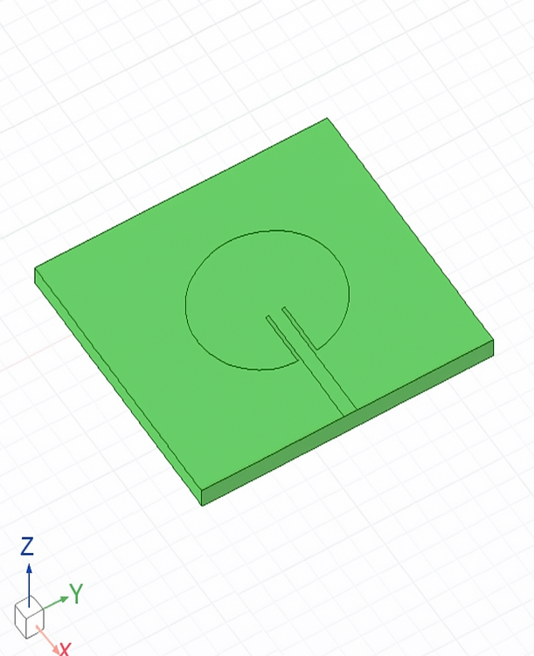
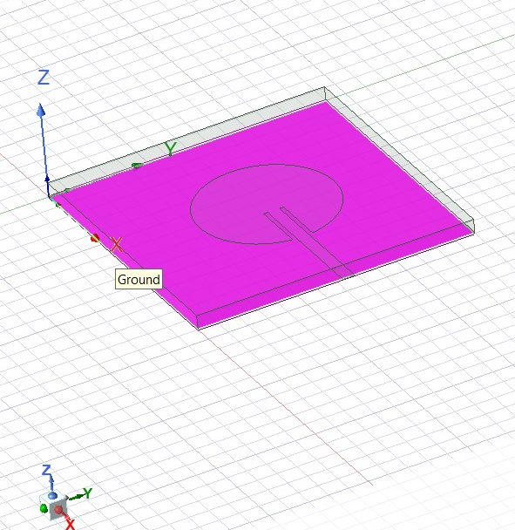
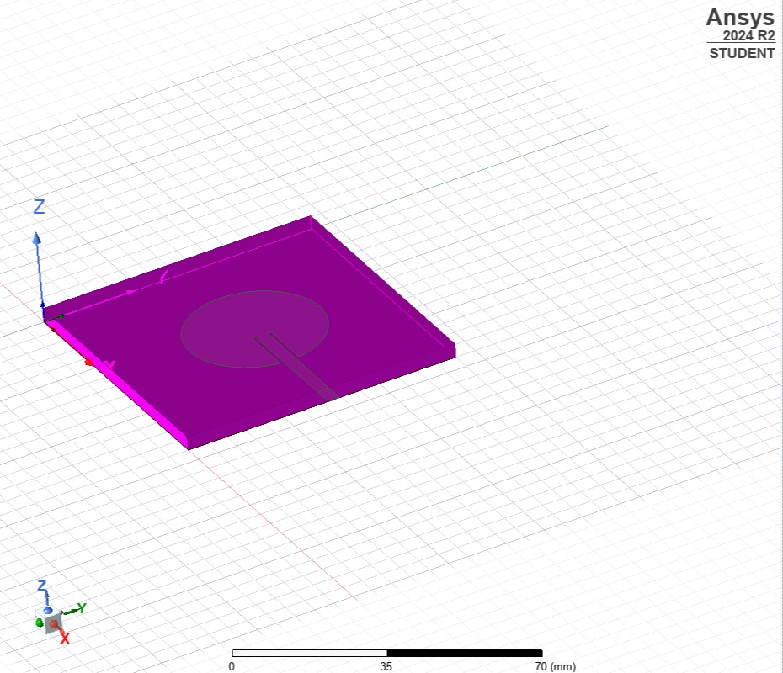
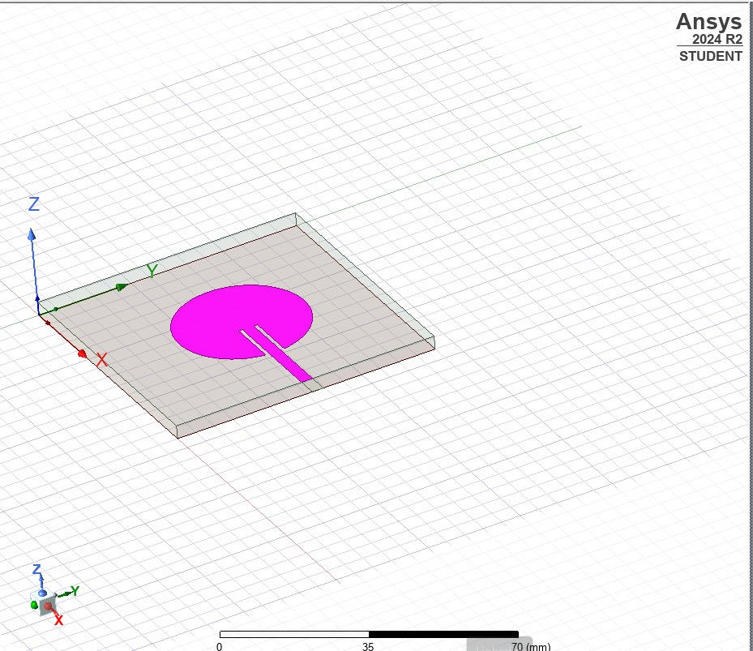
HFSS Project Setup & Basic Modeling
Fig: Circular Patch On Substrate
Circularly Polarized Multi-Band Microstrip Patch Antenna for 5G and IoT
DESIGN AND IMPLEMENTATION OF CIRCULAR MICROSTRIP PATCH ANTENNA

Slide 23
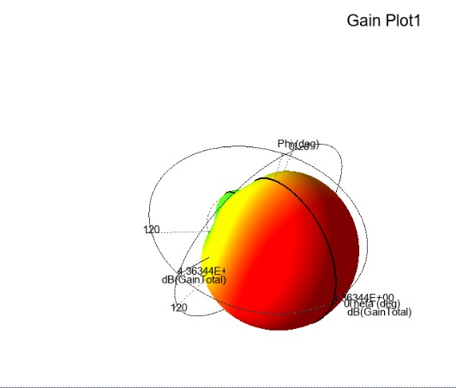
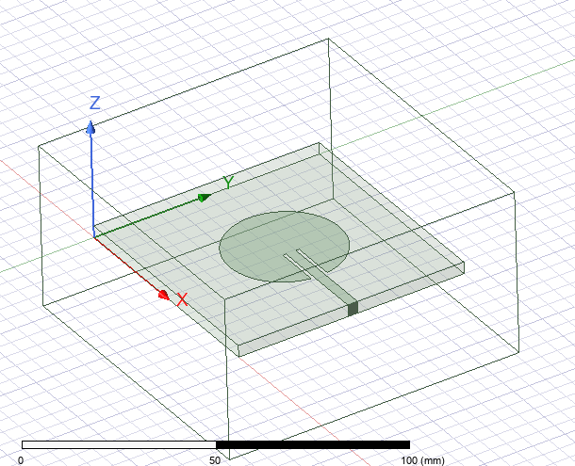
Results
Figure : circular microstrip patch antenna
Figure :3D total gain radition pattern of circular microstrip antenna at
2.45GHz showing the maximum gain of approximately 4.36dB
DESIGN AND IMPLEMENTATION OF CIRCULAR MICROSTRIP PATCH ANTENNA

Slide 24
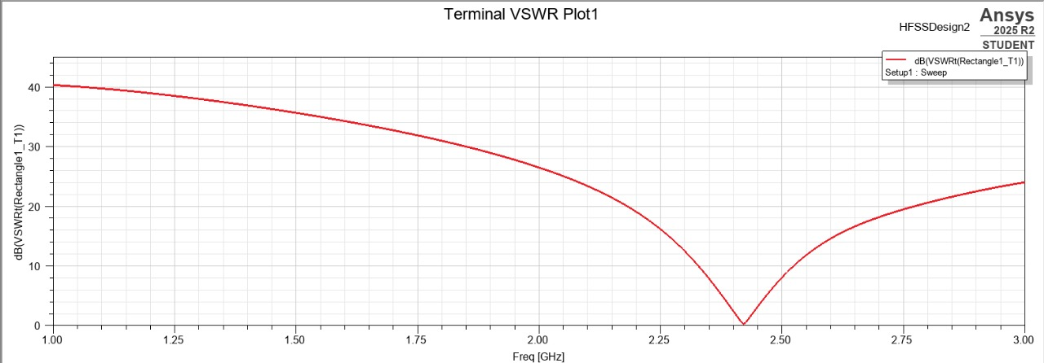
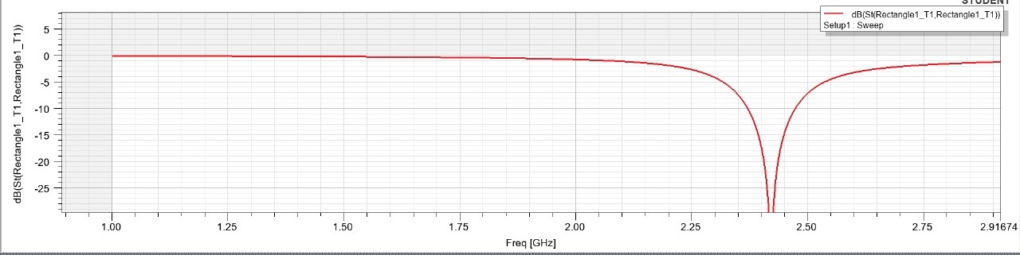
Figure 5.25: S11 (return loss) Vs frequency plot

Slide 25
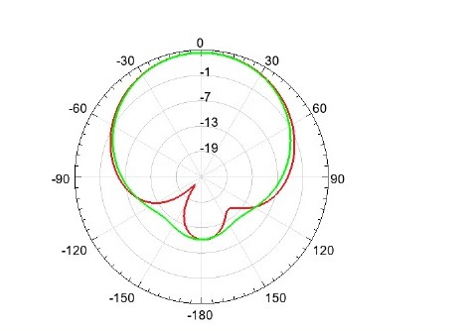
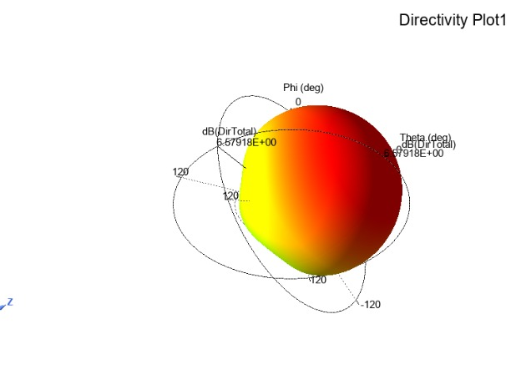
Figure:3D directivity plot of circular microstrip antenna at 2.45GHz ,illustrating a peak directivity of about 6.58dB
Figure :2D polar plot of total gain
DESIGN AND IMPLEMENTATION OF CIRCULAR MICROSTRIP PATCH ANTENNA

Slide 26
CONCLUSIONS
Following the theoretical calculations, the antenna was modeled and simulated in ANSYS HFSS, which provided a visual and numerical verification of the design. The simulation setup included defining the circular patch geometry, coaxial probe feed, and appropriate radiation boundaries to mimic free space conditions. Adaptive meshing was applied to improve the accuracy of the results. The S-parameter analysis demonstrated a resonant frequency at 2.45 GHz, with a return loss (S11) of less than-20 dB, indicating excellent impedance matching. The VSWR was observed to be approximately 1.2, confirming low reflection and high efficiency of the antenna. The simulated radiation patterns revealed the expected omnidirectional characteristics in the horizontal plane, which is characteristic of circular patch antennas. The gain was observed to be in the range of 3–5 dBi, which is typical for FR4-based microstrip antennas. The bandwidth, measured from the S11 curve, closely matched the theoretical estimate, demonstrating that the analytical design equations provide accurate predictions for antenna performance. The comparison of Design and implementation of Circular Microstrip patch Antenna and simulation results validates the design methodology, confirming that the chosen parameters successfully meet the design objectives
MAJOR PROJECT PHASE 1 (BEC685)
Circularly Polarized Multi-Band Microstrip Patch Antenna for 5G and IoT
DESIGN AND IMPLEMENTATION OF CIRCULAR MICROSTRIP PATCH ANTENNA

Slide 27
BIBLIOGRAPHY
Rashmi N ,Vaidyanathan K , Raghavendra DS ,Akanksha A, "Design and Implementation of Multiband Microstrip Patch Antenna for 5G-IOT Communication System,"
John Colaco and Rajesh Lohani ., "Design and Implementation of Microstrip Circular Patch Antenna for 5G Applications.
Pasupuleti Swarnalatha, VivekRajpoot, R.V.V.Krishna“Design and Implementation of Circular Microstrip Patch Array Antenna for 5G Communication using Rogers RT 5880”
Liang-Yong Yi, An-Zi Wang, Li Zhang, Shi Fang, Cai-Tao Hui “A circularly polarized microstrip phased array antenna for 5G communication”
Lili Wan,Shenghai Chen,Ni Zhou” Broadband Circularly Polarized Antenna Design and Simulation for 5G loTApplication”.
Syam Sai G, Sesha Sai Harshitha K, Praneeth Kumar P, Damodhar Reddy P and Mekaladevi V” DGS-Based Circularly Polarized Patch Antenna with enhanced Bandwidth for 5G Application”
Rameshwar A.’’Microstrip Patch Antenna Design and Analysis withVarying Substrates For 5G.”
Hongxin,Chenwei Wu, : ‘’Design and simulation of rectangular microstrip patch antenna with 5Gmm-wave Coaxial Line Back-feed and Microstrip Line side-feeds”.
Rajeev Verma, Srikant Satya Sai, and Dr. Ajay Kumar Sharma, “Circularly polarized wideband Aperture Antenna for Wireless Communication”.
shuai Gao,wan Jun Yang, Xin dai and Dong Tang “A Self-Decoupling circularly polarized MIMO microstrip patch Antenna Array.”
MAJOR PROJECT PHASE 1 (BEC685)
DESIGN AND IMPLEMENTATION OF CIRCULAR MICROSTRIP PATCH ANTENNA
Circularly Polarized Multi-Band Microstrip Patch Antenna for 5G and IoT

Slide 28
THANK YOU !
MAJOR PROJECT PHASE 1 (BEC685)
Circularly Polarized Multi-Band Microstrip Patch Antenna for 5G and IoT

